Slide 1
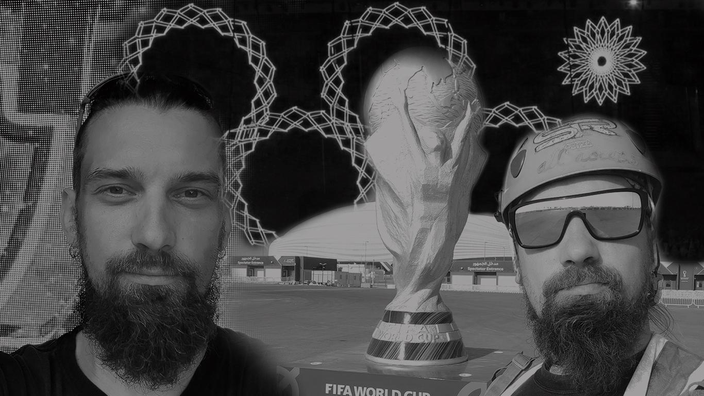
Lazarev Aleksey
Technical manager
Overlay Manager
Site manager
Team leader
Professional Portfolio

Slide 2
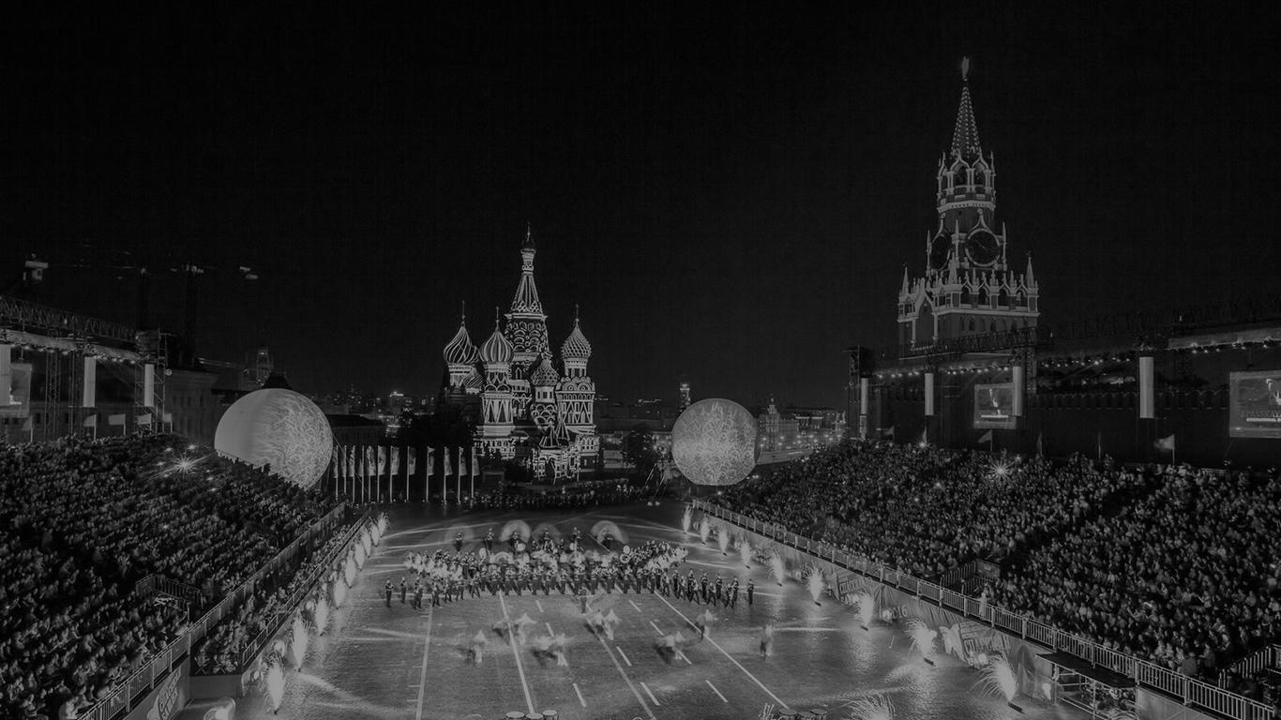
Contacts
Lazarev Alexey
September 30, 1987
Moscow, Russia
+79035560626
Email Alexlaza1@gmail.com
Facebook https://clck.ru/34pxFT
LinkedIn https://clck.ru/34pxH2
Driver's License Category: "B" since 2007
Married, one child

Slide 3
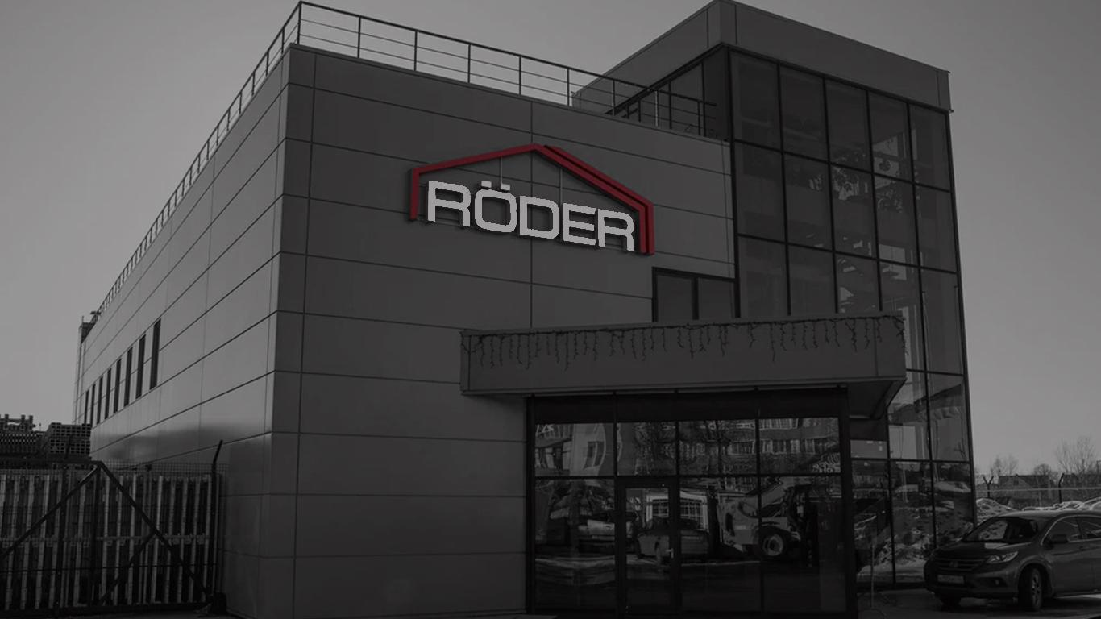


Röder
Russia Moscow, Qatar Doha
June 2023 - Present
Technical Manager
Preparation of personnel and equipment lists, client communication on-site, supervision of construction installation and dismantling. Ensuring uninterrupted supply of materials for the "Russia 21st century" exhibition and Doha Expo 2023.

Slide 4
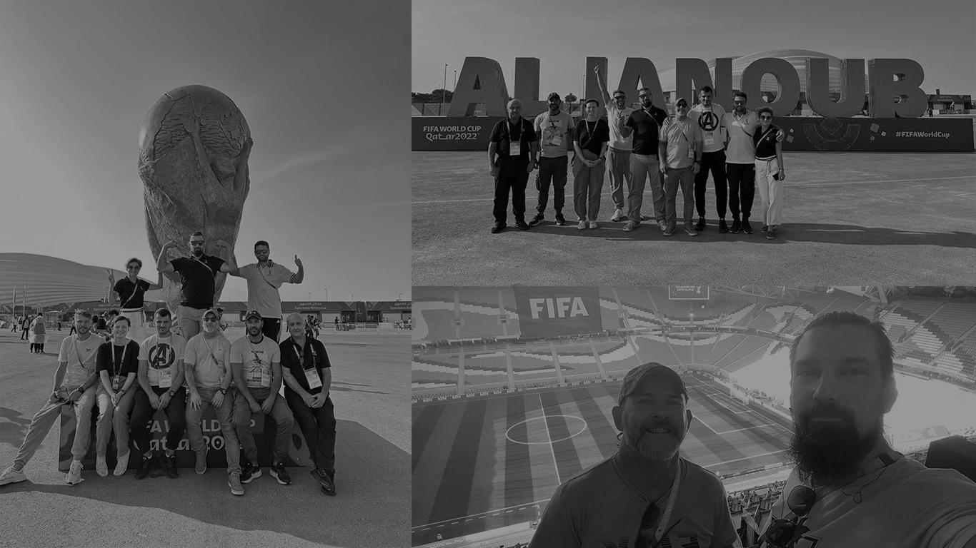


United for Manpower Solutions
Octobre 2021 - January 31, 2023
Organizing and supervising the work of an international team of 27 people. Planning and preparation of accompanying documentation for the 2022 FIFA World Cup and 2021 FIFA Arab Cup. Establishing working relationships with personnel from various countries. Organizing the supply of materials and tools for uninterrupted work at Al Janoub Stadium in Qatar.

Slide 5
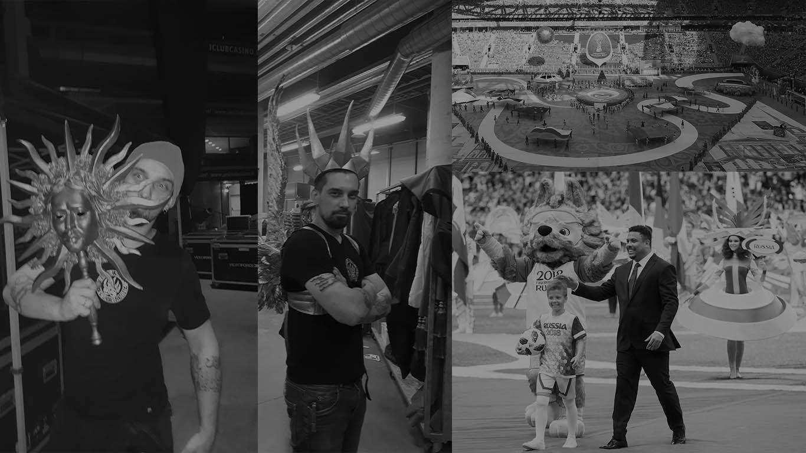


StageHand Production
April 2016 - September 2019
General Director
Organizing and conducting shows, concerts, and events, including the 2017 FIFA Confederations Cup and the 2018 FIFA World Cup. Assisting in the preparation of opening and closing ceremonies, approving set designs, organizing installation and dismantling, and personnel selection for installation work and stage production. Company management, participation in tenders, preparation of estimates.

Slide 6





Cirque Du Soleil 45 Degrees
December 2010 - January 2016
Staging Automation Technician, Freelancer, Foreman Staff selection and assistance in installation and dismantling work, handling props, servicing automated mechanisms. Crew Boos,Installation of structures, maintenance of cleanliness, correction of breakdowns, restoration of props.

Slide 7
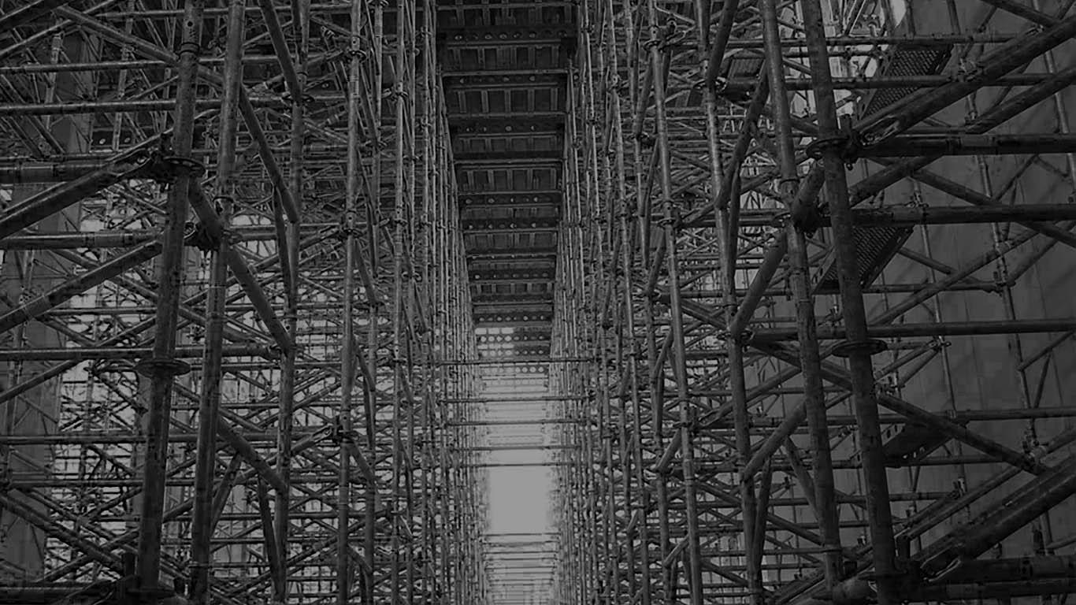



MF Group
April 2015 - December 2015
Worked as a freelancer since 2006,Regional Supervisor 2015
Conducting installation and dismantling work in the Krasnodar Krai region, equipment logistics, transportation of installation teams, arranging accommodation and meals, renting transportation and additional equipment from subcontractors, creating schedules and estimates.

Slide 8
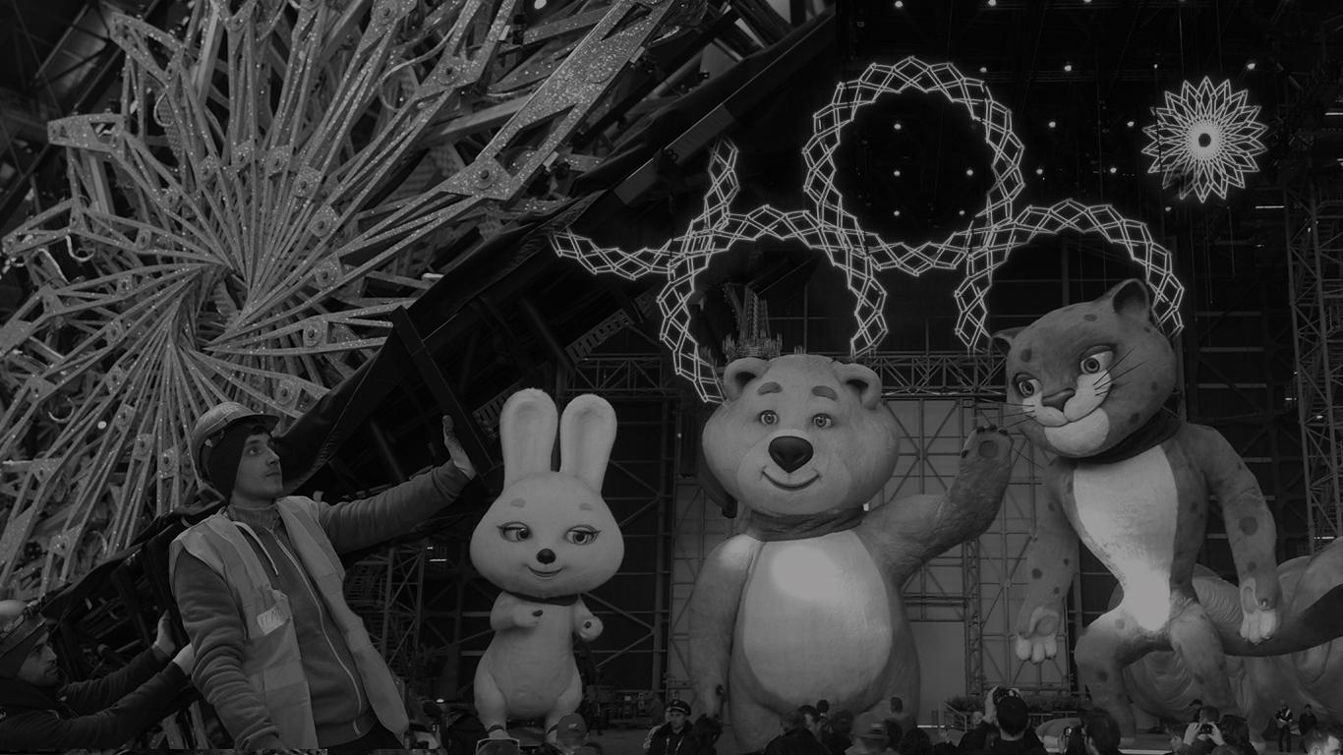

Vivat Group
September 2013 - April 2014
Senior Manager
Participation in tenders, recruitment of English-speaking professionals, organizing transportation for 500 installation workers, contract preparation and signing, monitoring attendance and task completion. Ensuring the uninterrupted work of installers and participants of the opening and closing ceremonies of the Olympic and Paralympic Games in Sochi 2014.

Slide 9
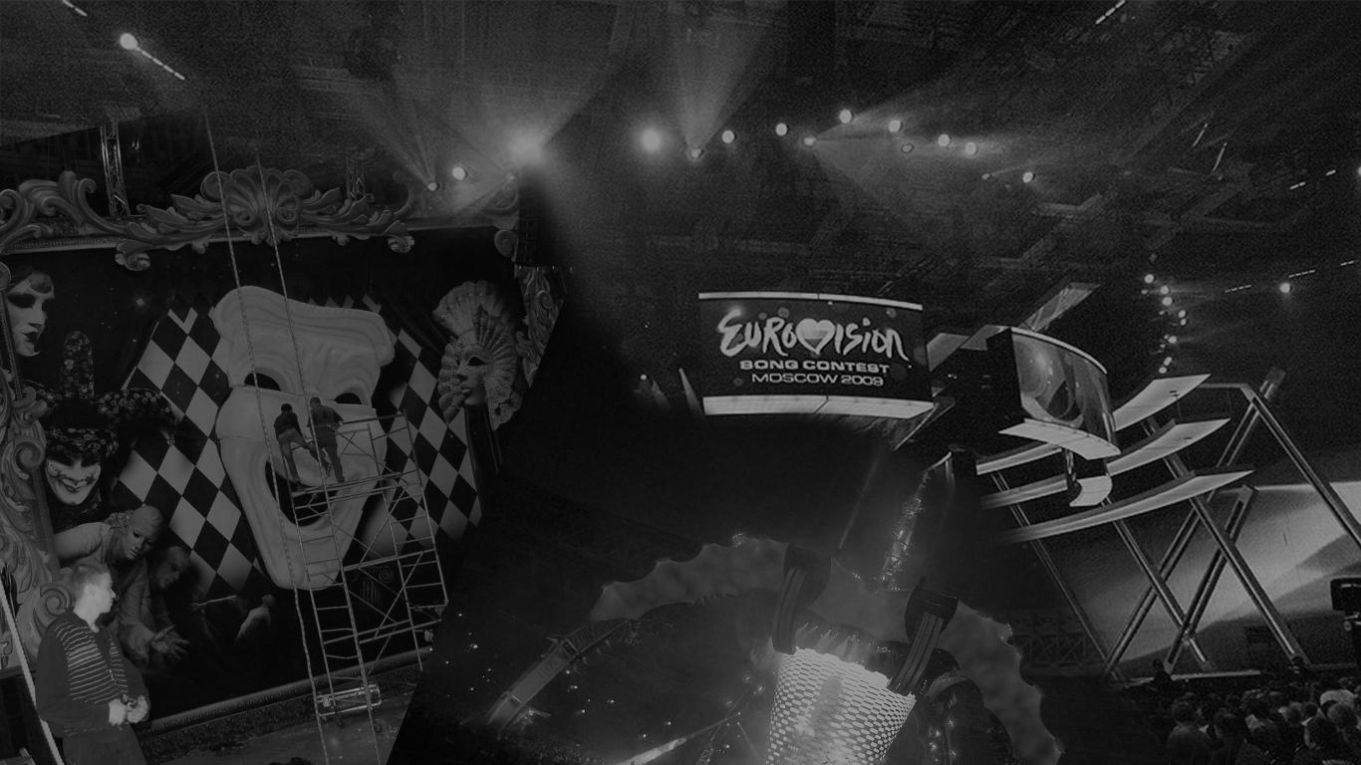


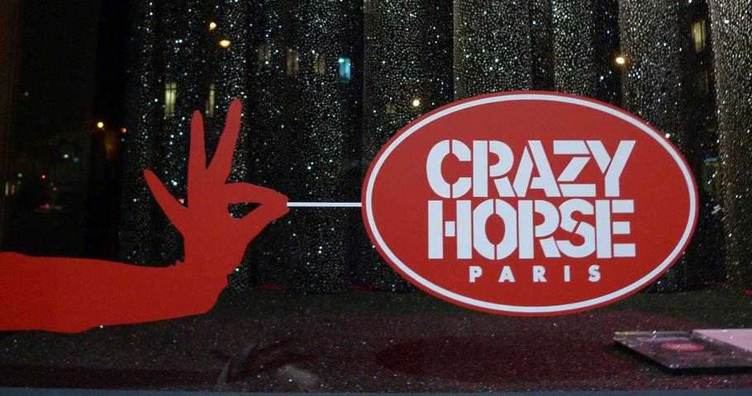


Abd Entertainment
Cometa Production
Spin Music Service
October 2007 - April 2013
Monitoring the execution of all installation work and permits, staff selection for the 2009 Eurovision Song Contest, negotiating technical conditions with European contractors, monitoring the installation of events for companies such as "Cartier" and "Dior," working on set design and installation for TV shows and presidential inaugurations, organizing a team for technical work at Moscow's largest concert venue, the Olympic Stadium, for various artists.

Slide 10
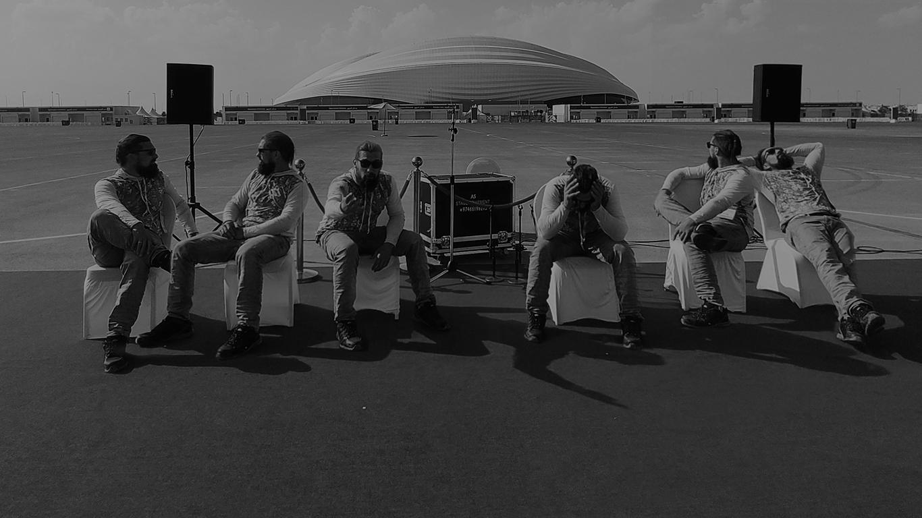
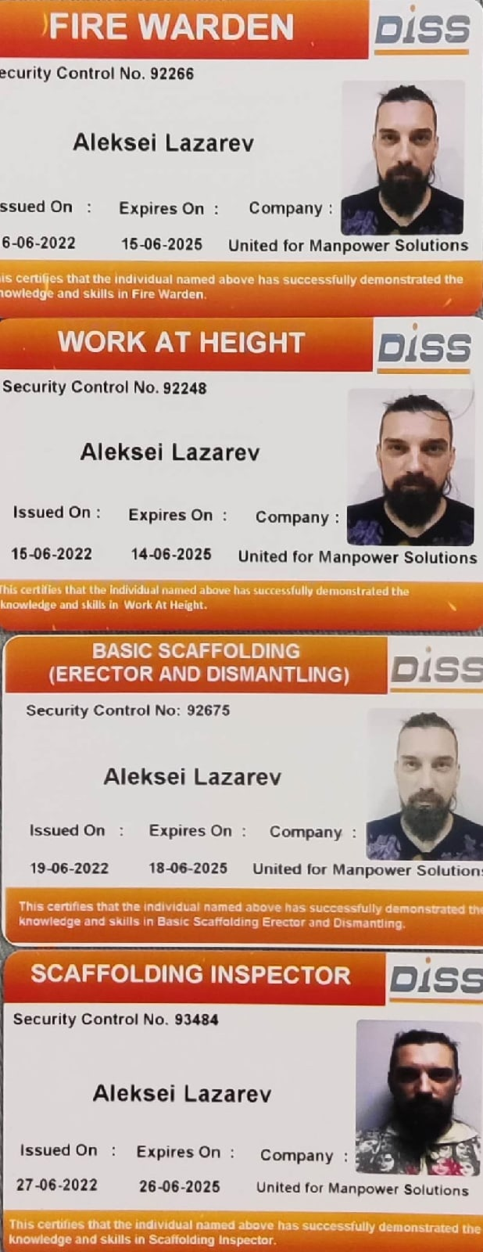
INTERPERSONAL
AND
TEAM SKILLS
Easily unite people from different countries
Honest, friendly, excellent communication skills
Project management experience, including planning and preparation of supporting documentation
Experience operating loading equipment, extensive experience as a high-altitude installer.
Completed courses in fire safety, labor protection, and first aid.
Regularly use Microsoft Office, Outlook, Adobe, MacOs Keynote.
Business correspondence, letter and note writing, content editing.

Slide 11
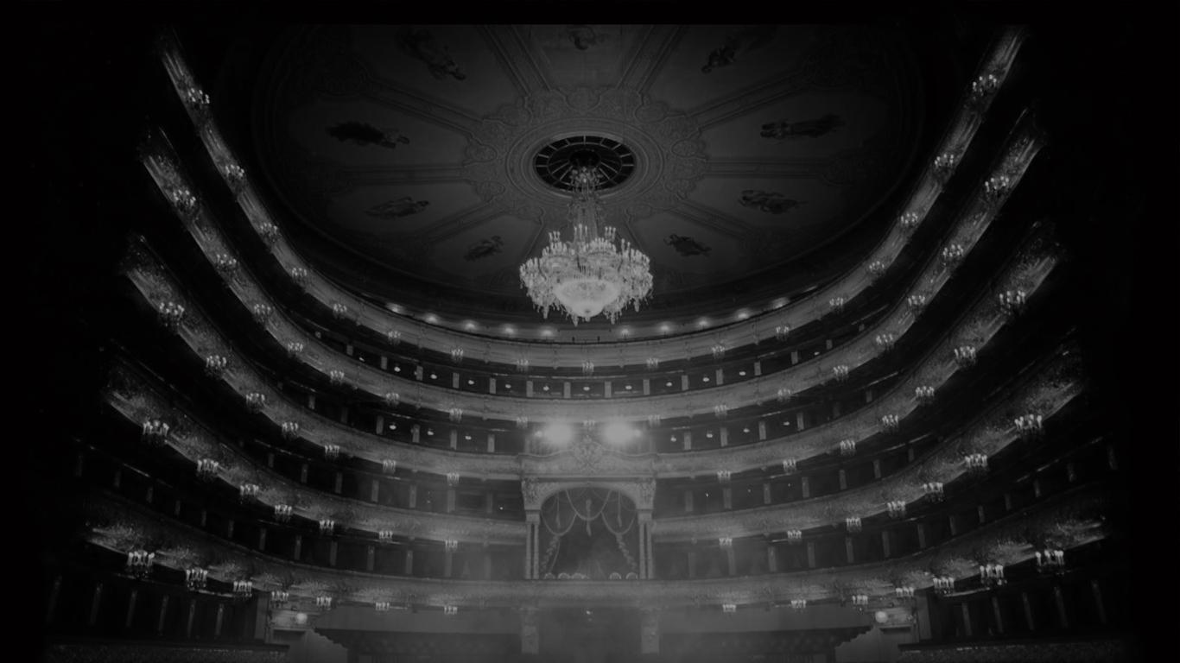
Thanks for your attention
Email: Alexlaza1@gmail.com
Facebook: https://clck.ru/34pxFT LinkedIn: https://clck.ru/34pxH2

