Slide 1
PARALLEL THINKING:
THE SIEVE OF ERATOSTHENES
Assigned By :- Prof. Bhaskar Chaudhary

Slide 2
Problem Statement :-
Find the maximum prime number and number of primes between 1 to N.

Slide 3
Significance of
Large Prime Number
Why large Prime numbers are very useful?
Many Public-key cryptography algorithm such as RSA, Diffie Hellman are based on large prime numbers.
Security of encryption is based on how much prime number is large. More large prime number can turn into more possible results and hard to crack it. E.g.,
5-digit prime number
40-bit encryption
1.1 trillion possible results
7-digit prime number
56-bit encryption
72 quadrillion possible results.
16-digit prime number
128-bit
encryption
340,282,366,920,938,463,463,374,607,431,768,211,456
possible results

Slide 4
Sieve of Eratosthenes (serial)
A classical and efficient method of finding prime numbers is sieve of Eratosthenes.
Input :- Integer N denotes range.
Output :- Maximum Prime number between 1 to N and number of primes between 1 to N.
Pseudo-code for sieve of Eratosthenes’s serial implementation :-
Create a boolean array of consecutive integers from 2 to n.
Initially, let k equal to 2, which is the first prime number.
Starting from k², count up in increments of k and mark each of this number with value false. These numbers will be k(k+1),k(k+2),k(k+3),etc…
Find the first number greater than k in list that is true and this number should be less than √N . If no such number exists, stop. Otherwise, let k now equal this number (which is the next prime), and repeat from step 3.

Slide 5
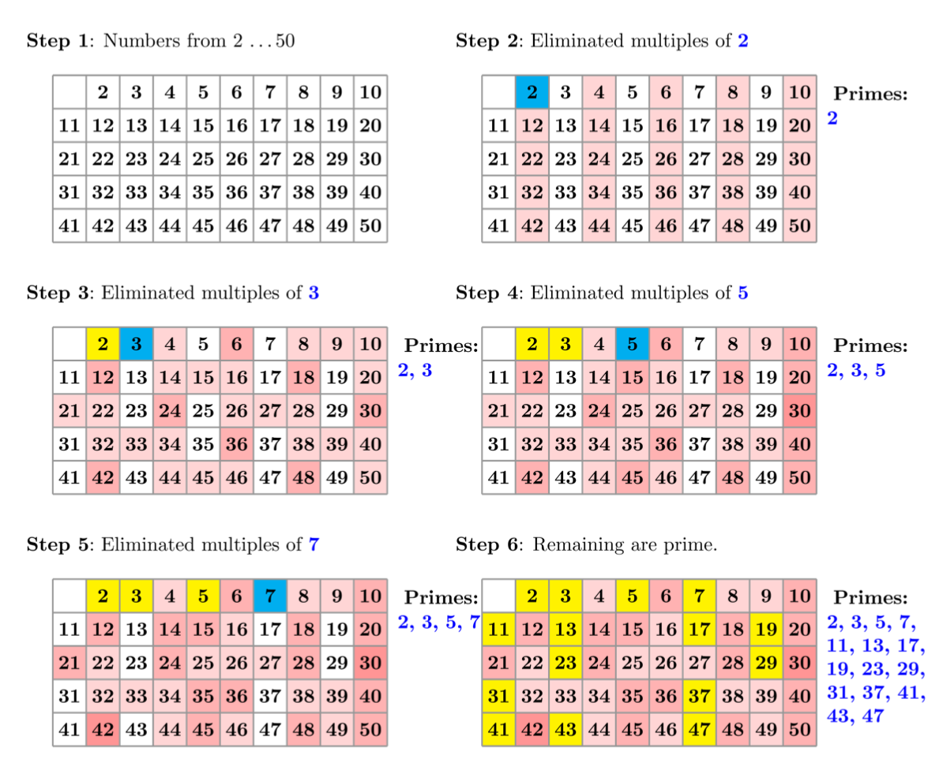
Fig-1: Steps for the calculation of prime numbers using the Sieve of Eratosthenes algorithm

Slide 6
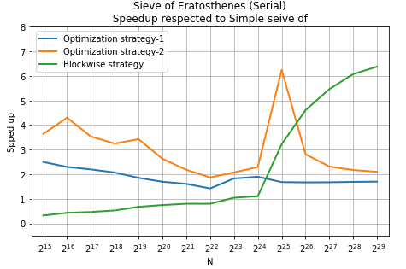
This serial Implementation takes O(n) memory and O(n*ln(ln(n))) computation time. So for N > 10⁹ ,it requires more memory and time.
All even numbers are prime numbers except 2. So, If we consider that and take only odd numbers then we only need half of the memory half of the execution time.
So, we managed to get speedup of nearly 2 using only this optimization.
The unusual behaviour at 2²⁵ for optimization strategy-2 is because of L3 cache misses.
Fig-2 : Comparison between optimization strategies and base algorithm.

Slide 7
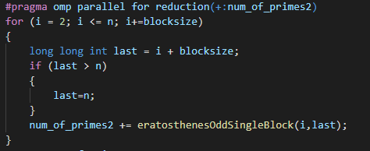
Sieve of Eratosthenes (parallel)
If we directly try to parallel the sieve of Eratosthenes, it’s not possible due to redundancy between two processor.
For parallelization, we divide the range into continuous blocks.
Now, If we assign whole block to any of the processor than we can efficiently use the memory so it results in less memory consumption and faster computation.
Fig-3: Code of dividing the range into continuous blocks.

Slide 8
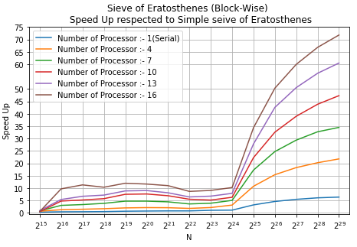

Parallel block-wise Implementation takes only O(B) memory.
Time Complexity :-
After N>2²⁴ , we can get significant amount of speedup ( with respect to the base algorithm). Because in base algorithm there is more L3 cache misses than the block-wise implementation.
For N=2²⁹ and p=16, we get maximum speedup of around 75.
Fig-4: Speedup vs N

Slide 9
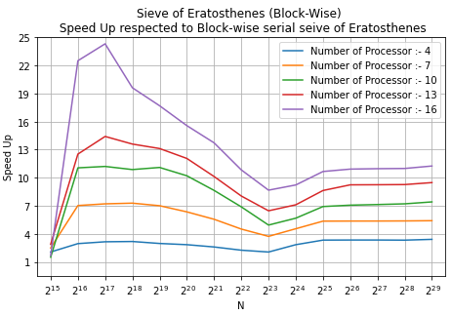
Theoretical maximum speedup is p.
We achieved speedup nearly equal to p for larger N.
Some unusual behaviour seen nearly around N=2¹⁷ because of L2 cache misses.
For large N, we nearly get constant speedup. i.e. ( p=16, speedup=11).
Fig-5 : Comparison between optimization strategies and base algorithm.

Slide 10
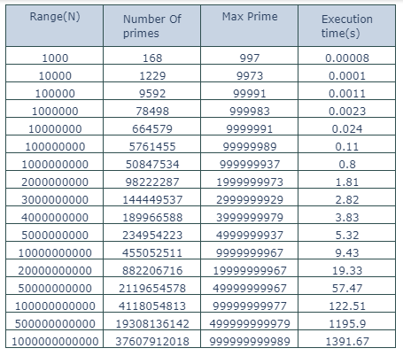
Useful Results

Slide 11
Conclusion
We were successfully able to parallelize the sieve of Eratosthenes Algorithm.
The speedup of 11 was achieved for for 16 cores with respect to blockwise serial implementation and speedup of 75 was achieved for 16 cores with respect to simple serial implementation.
Our main objective was just to parallelize the algorithm but after modifying the algorithm , significant speedup, efficiency and execution time was observed.

