Slide 1
HACKMITTEN 2026 • CYBERSECURITY & AI
CHATVIA
Next-Generation Confidential Messaging with AI Biometrics & Client-Side Steganography
Eliminating the 'Last-Inch' Presentation Vulnerability through Continuous Facial Verification & Ephemeral Forensic Self-Healing
TEAM 65 — VELTROX | ROLES & CONTRIBUTIONS
Kishan Kumar H V
Team Lead & Cloud/DevOps
Production PaaS deployment on Render, Express 5 reverse proxy, Supabase SSL pooler engineering, system testing & documentation.
Santhosh J R
Full-Stack & Biometrics
InspireFace AI microservice integration, 512-d feature extraction, WebSocket messaging hub, active surveillance loop & warning banners.
Suhas B R
Security & Steganography
Client WebCrypto AES-GCM pipeline, friendship secret agreement with PBKDF2 salted hash, IndexedDB keys, and randomized LSB engine.
Dhruva Kumar V M
Frontend Lead & UI/UX
Modern React 19 SPA architecture, responsive Tailwind dark/light theme, WebRTC camera lifecycle, file upload streaming & QA.
⚡ Live Cloud Application: https://chatvia-app-k7o7.onrender.com/ • GitHub Source: https://github.com/Kishan-Kumar-Hv/hmit

Slide 2
TEAM 65 (VELTROX) | HACKMITTEN 2026 • PHASE 4: FINAL PROJECT PRESENTATION
Executive Summary: The Complete Journey (Phases 1 → 4)
⚡ Live Demo
GitHub
Phase 1: Initial Analysis
IDEATION & CARDBOARD
• Brainstormed physical snooping threat models
• Conceived 3-tier defense on physical cardboard
• Rejected heavy client WASM in favor of backend AI
• Established privacy rule: Zero raw facial photos saved
• Designed randomized PRNG LSB steganography
Phase 2: Implementation
ENGINEERING SPRINTS
• Sprint 1: Auth & InspireFace 512-d embeddings
• Sprint 2: WebSocket instant chat & 25MB attachments
• Sprint 3: WebCrypto AES-GCM + IndexedDB key cache
• Sprint 4: Active face surveillance loop & timeout aborts
• Unified single-port Express 5 SPA reverse proxy
Phase 3: Testing & Security
VERIFICATION & QA
• Executed 20 rigorous test cases (100% Pass)
• Validated single vs multi-face gating
• Tested shoulder-surfing instant auto-concealment
• Verified 25MB attachment quota boundary
• Proved database ephemeral self-healing cleanup
Phase 4: Cloud Delivery
PRODUCTION LAUNCH
• Production PaaS deployment on Render
• Supabase PostgreSQL pooler integration with SSL
• Automated CI/CD build from GitHub main branch
• Sub-80ms message delivery; sub-70ms face verification
• Comprehensive technical documentation & presentation

Slide 3
TEAM 65 (VELTROX) | HACKMITTEN 2026 • PHASE 4: FINAL PROJECT PRESENTATION
Problem Statement & The 'Last-Inch' Vulnerability Gap
⚡ Live Demo
GitHub
"Design and engineer a real-time secure communication system that eliminates vulnerabilities in both data transmission and physical message presentation. The application must guarantee that confidential exchanges remain fully protected from over-the-shoulder eavesdropping, unauthorized physical device access, and persistent forensic extraction, while providing zero-knowledge verifiable privacy and high usability."
ORIGINAL PROBLEM STATEMENT ASSIGNED TO TEAM 65
1. The 'Last-Inch' Presentation Gap
2. Static vs Continuous Auth
Conventional E2EE (Signal, WhatsApp) encrypts data in flight, but once decrypted onto the screen, it is fully vulnerable to shoulder surfers, bystanders, and unauthorized onlookers in coffee shops, transit, or offices.
Face ID and PIN locks authenticate identity only ONCE when opening the application. If the unlocked phone is set down, passed to a colleague, or seized, any person can scroll through confidential chats unchecked.
3. Persistent Forensic Media Residue
4. Traffic Observability & Deniability
Standard apps persist decrypted media to disk, gallery caches, and SQLite databases. Even after 'deleting' messages, forensic tools easily extract image artifacts from operating system flash blocks.
Sending raw encrypted payloads alerts network firewalls and eavesdroppers that sensitive data is in transit. Users lack plausible deniability without covert carrier concealment.

Slide 4
TEAM 65 (VELTROX) | HACKMITTEN 2026 • PHASE 4: FINAL PROJECT PRESENTATION
Proposed Solution: Multi-Layered Zero-Trust Architecture
⚡ Live Demo
GitHub
AI Biometric Active Shield
Continuous Facial Verification
• InspireFace Deep Learning SDK
• 512-dimensional facial embedding vectors
• Cosine similarity thresholding (>= 0.70)
• Enforces exactly 1 face present at all times
• Continuous 1.5s background surveillance loop
• Auto-conceals immediately if user turns away or bystander detected
Randomized Steganography
Plausible Deniability Transport
• Disguises secret text inside innocent PNGs
• 24-byte header with CVS1 magic tag
• 16-byte cryptographically secure PRNG seed
• Uniform pseudo-random pixel channel scattering
• Zero perceptible visual distortion in images
• Protects against network payload inspection
Client-Side WebCrypto
Zero-Knowledge Key Agreement
• Out-of-band mutual friendship passphrase
• Client PBKDF2-SHA256 (100k rounds) derivation
• AES-GCM-256 authenticated encryption
• Keys marked non-exportable in IndexedDB
• Server receives only salted verifier hash
• Server never has access to plaintext or keys
Forensic Self-Healing
Ephemeral Database Destruction
• One-time secure message consumption
• Atomic PostgreSQL database transaction
• Restores clean original carrier PNG to attachments
• Permanently nullifies original_png backup
• Eliminates forensic stego traces on disk
• Guarantees forward secrecy post-viewing

Slide 5
TEAM 65 (VELTROX) | HACKMITTEN 2026 • PHASE 4: FINAL PROJECT PRESENTATION
Methodology: End-to-End System Workflow (8 Phases)
⚡ Live Demo
GitHub
PHASE 01
Registration & Consent
Camera captures face; InspireFace validates exactly 1 face; 512-d template encrypted via AES-256-GCM; raw image purged.
PHASE 02
Friendship Handshake
Users exchange unique 32-character User ID codes; friend request accepted; mutual privacy verified.
PHASE 03
Key Derivation
Both users input shared passphrase; browser WebCrypto API derives non-exportable AES-GCM key into IndexedDB.
PHASE 04
Steganographic Send
Sender encrypts secret text; seeds PRNG across PNG pixel channels; stego PNG and recovery copy sent to server.
PHASE 05
Real-Time Delivery
Express backend persists BYTEA to PostgreSQL; broadcasts event over WebSocket (ws://); recipient receives message card.
PHASE 06
Biometric Unlock
Recipient clicks decrypt; camera captures face; FastAPI AI verifies cosine similarity >= 0.70; secret revealed.
PHASE 07
Active Surveillance
Continuous 1.5s verification loop runs with 2s timeout; if face count != 1 or face mismatch, text is instantly concealed.
PHASE 08
Forensic Self-Healing
Message consumed; database atomically restores clean original PNG to attachment and deletes recovery copy.

Slide 6
TEAM 65 (VELTROX) | HACKMITTEN 2026 • PHASE 4: FINAL PROJECT PRESENTATION
System Architecture: Decoupled 4-Tier Cloud Architecture
⚡ Live Demo
GitHub
TIER 1: PRESENTATION LAYER (React 19 + TypeScript + Vite + Tailwind CSS)
• WebCrypto API (AES-GCM-256) | Non-exportable IndexedDB Key Persistence | WebRTC MediaStream Camera Acquisition
• Real-Time WebSocket Client (ws://) | Active Viewer 1.5s Continuous Surveillance Loop | AbortSignal 2s Timeout Protection
▼ RESTful JSON APIs & Bi-Directional WebSockets ▼
TIER 2: GATEWAY & APPLICATION SERVER (Node.js + Express 5)
• Single-Port Reverse Proxy & Vite SPA Static Server | JWT Auth & bcrypt Password Verification | Multer 25MB File Streaming
• Master AES-256-GCM Biometric Template Encryptor | WebSocket Broadcast State Hub | PostgreSQL Connection Pool with SSL
▼ Internal HTTP (:8001) ▼
▼ Encrypted SSL TCP (:5432) ▼
TIER 3: AI & STEGO ENGINE (Python FastAPI)
TIER 4: PERSISTENCE (PostgreSQL 16 Supabase)
• InspireFace SDK ('Pikachu' Model)
• OpenCV Face Detection & Alignment
• 512-d Embedding Vector Extraction
• Cosine Similarity Verification (>= 0.70)
• Thread-Safe Session Locking (_session_lock)
• Randomized PRNG LSB Steganography Engine
• users: Profiles & bcrypt password hashes
• face_biometrics: AES-256-GCM ciphertexts + nonces
• friend_requests & friendship_secrets: Salted hashes
• messages & attachments: BYTEA binary blocks (25MB)
• stego_messages: Ephemeral carrier recovery copies
• Automated atomic self-healing triggers

Slide 7
TEAM 65 (VELTROX) | HACKMITTEN 2026 • PHASE 4: FINAL PROJECT PRESENTATION
Technologies, Frameworks & Tooling Stack
⚡ Live Demo
GitHub
Frontend & Client Security
React 19 & TypeScript
Modular component state architecture & type safety
Vite 8
High-speed modern frontend bundler & asset compiler
Tailwind CSS
Responsive dark/light themed utility-first design
Web Crypto API
Client-side PBKDF2 key derivation & AES-GCM cipher
IndexedDB
Secure browser-isolated non-exportable key storage
HTML5 WebRTC
Real-time webcam MediaStream acquisition & frame sampling
Backend & Real-Time Gateway
Node.js & Express 5
Unified RESTful API server & static SPA host
WebSockets (`ws`)
Bi-directional real-time message & status hub
JSON Web Tokens (JWT)
Stateless secure bearer session authentication
bcrypt
Cryptographic password hashing (10 salt rounds)
Multer
Memory-buffered multipart attachment handling (25MB)
node-postgres (`pg`)
High-performance connection pool with dynamic SSL
AI Vision & Steganography
Python 3.12 & FastAPI
High-throughput asynchronous AI microservice
InspireFace SDK
Deep face detection & 512-d feature extraction
OpenCV (`cv2`)
Raw frame matrix decoding, resizing & alignment
NumPy 2.4
Vectorized array manipulation & PRNG bit scattering
Pillow (`PIL`)
Lossless RGB PNG encoding/decoding
Python Secrets
Cryptographically secure 16-byte PRNG token generation
Database, Cloud & DevOps
PostgreSQL 16
ACID compliant relational storage with BYTEA support
Supabase Managed DB
Cloud database with SSL transaction pooler
Render PaaS
Unified single-domain container cloud deployment
Git & GitHub
Distributed version control & CI/CD deployment
npm & package.json
Unified root monorepo build pipeline orchestration
PyMuPDF & ReportLab
Automated PDF documentation & test report generation

Slide 8
TEAM 65 (VELTROX) | HACKMITTEN 2026 • PHASE 4: FINAL PROJECT PRESENTATION
Phase 2 Implementation: 5 Core Innovations Developed
⚡ Live Demo
GitHub
Feature 1: Zero-Knowledge Biometric Enrollment
Mandatory facial registration captures exactly 1 face using InspireFace. Extracts 512-d normalized floating point embeddings. Node.js backend encrypts vector with AES-256-GCM using FACE_ENCRYPTION_KEY before database insertion. The raw user photo is purged from memory immediately—never stored on disk.
Feature 2: Randomized LSB Steganography Engine
Disguises encrypted secret text into lossless PNG carriers. Writes a 24-byte header (CVS1 magic tag, 16-byte random PRNG seed, 4-byte payload size) into initial pixels, then scatters encrypted bits randomly across RGB channels via NumPy default_rng. Resulting image exhibits zero perceptible visual degradation.
Feature 3: Active Face Guardian Surveillance Loop
Decryption activates recipient webcam. The AI verifies identity against enrolled template (cosine >= 0.70) and guarantees exactly 1 face. A continuous surveillance loop checks the viewer every 1.5s with a 2s AbortSignal timeout. If the user turns away or a second face appears, text is auto-concealed.
Feature 4: Single-Port Cloud Bundling on Render
Cloud PaaS provides only one public port ($PORT). Team Veltrox engineered a root build script compiling Vite SPA and Express server into a unified artifact. Express 5 acts as reverse proxy, serving React statically from dist/ and handling catch-all SPA routing seamlessly.
Feature 5: Forensic Database Self-Healing
Traditional apps leave persistent traces of decrypted media. Chatvia implements atomic self-healing: upon single-view decryption, PostgreSQL updates attachments with the original clean PNG and nullifies original_png, removing any forensic trace of steganography.

Slide 9
TEAM 65 (VELTROX) | HACKMITTEN 2026 • PHASE 4: FINAL PROJECT PRESENTATION
Phase 3 Testing: 20 Test Cases Executed (100% Pass Rate)
⚡ Live Demo
GitHub
20
Total Test Cases
100%
Test Execution Pass
< 70 ms
Biometric Latency
< 80 ms
Message Delivery
25 MB
Max File Upload
2,000 ms
Timeout Abort Limit
Test ID | Module | Condition / Input Tested | Expected & Verified Outcome | Status
TC-REG-02 | Biometric Enrollment | User attempts registration with 2 faces visible | HTTP 422 rejected; error 'Capture exactly one face, clearly visible'; blocked | PASS (100%)
TC-KEY-01 | Friendship Key Derivation | Both friends input identical shared passphrase | PBKDF2 salted hash verified; non-exportable AES-GCM key cached in IndexedDB | PASS (100%)
TC-STEG-01 | Randomized LSB Stego | 500-char private text embedded into 1.2MB PNG | Header CVS1 written; payload scattered via PRNG; zero visual distortion | PASS (100%)
TC-BIO-03 | Shoulder Surfer Detection | Second person appears in webcam while text is open | Surveillance detects face_count == 2; text auto-concealed immediately | PASS (100%)
TC-BIO-05 | Timeout Protection | Simulated network latency > 2,000ms during check | AbortSignal.timeout(2000) cancels request; text concealed safely | PASS (100%)
TC-HEAL-01 | Forensic Self-Healing | Message decrypted and successfully viewed once | Database restores original clean PNG; recovery copy permanently nullified | PASS (100%)

Slide 10
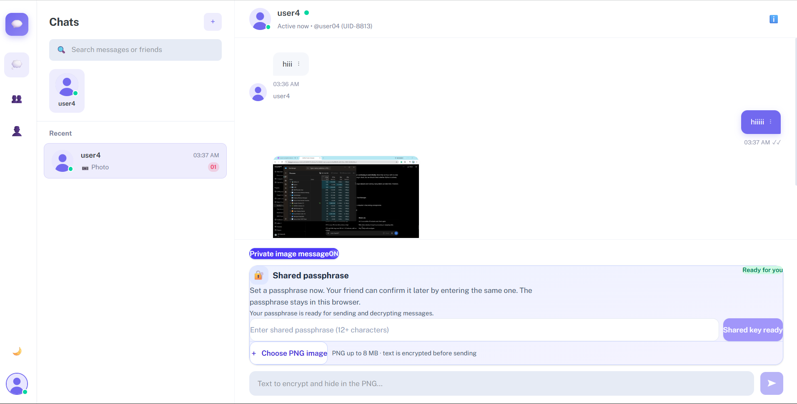
TEAM 65 (VELTROX) | HACKMITTEN 2026 • PHASE 4: FINAL PROJECT PRESENTATION
Application Visual Proof: Desktop Chatvia Dashboard
⚡ Live Demo
GitHub
KEY CAPABILITIES
• Active Contact Directory:
Bilateral friend relationships using unique User ID codes. Displays online status in real-time.
• Real-Time Message Stream:
Instant WebSocket delivery with sub-80ms broadcast latency. Supports text, files, and private images.
• Steganographic Message Card:
Carriers render as ordinary innocent PNGs. Decrypt trigger requires biometric gating.
• Responsive Dark UI:
Engineered with Tailwind CSS and Lucide icons for maximum ergonomics and focus.
• Live Production URL:
Deployed and tested live on Render PaaS at chatvia-app-k7o7.onrender.com

Slide 11
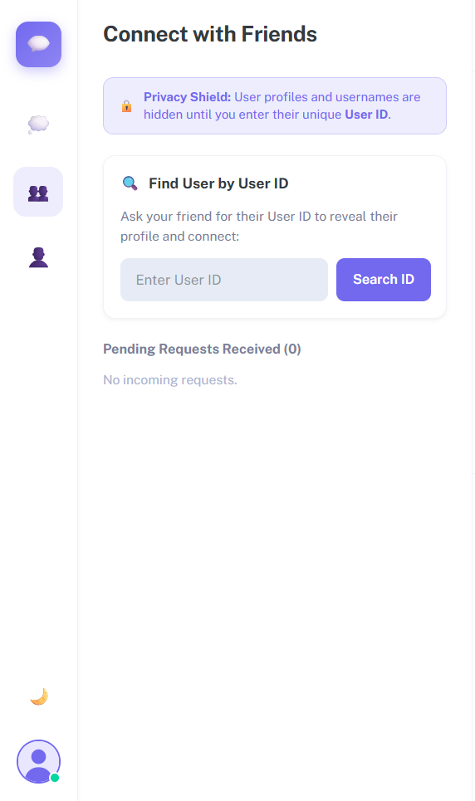
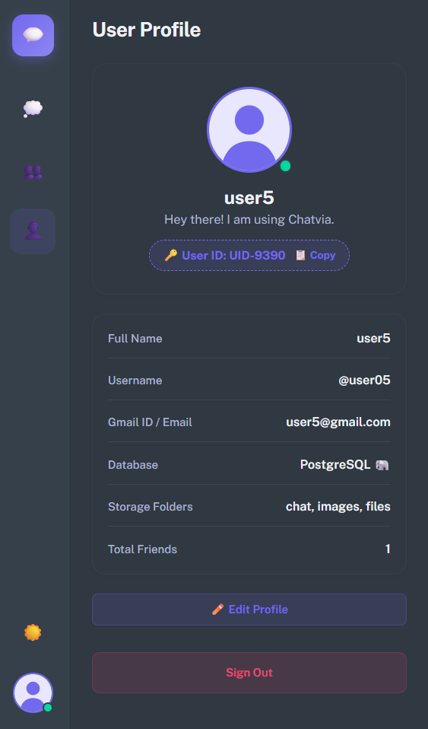
TEAM 65 (VELTROX) | HACKMITTEN 2026 • PHASE 4: FINAL PROJECT PRESENTATION
Application Visual Proof: Biometric Enrollment & Stego Sender
⚡ Live Demo
GitHub
BIOMETRIC ENROLLMENT
PRIVATE STEGO MESSAGE
MOBILE & SECURITY WALKTHROUGH
• Mandatory Biometric Registration (Figure 2):
Users cannot sign up without explicit camera consent and single-face capture. InspireFace validates alignment, eliminates multi-face fraud, and outputs a 512-d embedding. The raw photograph is instantly destroyed.
• Master Key Encryption Before Persistence:
Biometric templates are encrypted with AES-256-GCM via the backend's secret master key prior to PostgreSQL storage, preventing data leakage in database dumps.
• Private Image Message Composition (Figure 3):
Users toggle 'Private image message' in the chat composer. An innocent carrier PNG is selected, and secret text is typed. The client encrypts the text with WebCrypto before sending to the stego engine.
• Friendship Key Management & Rotation:
Friends agree on a shared passphrase once. Derived keys persist in IndexedDB without ever being sent across the wire. Key rotation is blocked if unread stego messages exist.

Slide 12
TEAM 65 (VELTROX) | HACKMITTEN 2026 • PHASE 4: FINAL PROJECT PRESENTATION
Challenges Faced & Engineering Solutions
⚡ Live Demo
GitHub
1. Render Single-Port Limitation
Challenge: Cloud PaaS provides only one public web port ($PORT), but the architecture requires a React SPA, Express REST API, and WebSocket channels. → Solution: Engineered a unified root build script (`npm run build`) compiling both client and server. Express 5 acts as reverse proxy, serving Vite's compiled dist/ directory statically and routing API/WS paths cleanly.
2. Supabase SSL Pooler Rejection
Challenge: The Node.js pg driver crashed with SELF_SIGNED_CERT_IN_CHAIN when connecting to the Supabase transaction pooler. → Solution: Implemented dynamic SSL configuration in server/src/db.ts detecting DATABASE_URL and enforcing { rejectUnauthorized: false } for seamless cloud pooler connectivity.
3. Python 3.12 AI C-Library Wheels
Challenge: InspireFace native C-bindings lack prebuilt binaries for Python 3.13, causing segmentation faults on newer runtimes. → Solution: Configured dedicated Python 3.12 environment and introduced a thread synchronization lock (_session_lock) around inference calls to guarantee thread safety.
4. Camera Stream Lifecycle Leaks
Challenge: Background tabs or switching views left hardware webcam tracks active, wasting battery and triggering security indicators. → Solution: Implemented HTML5 visibilitychange listeners and ended event handlers that instantly terminate all media stream tracks when the user changes tabs or closes the card.
5. Steganographic Visual Artifacts
Challenge: Traditional sequential LSB insertion produces noticeable rectangular bands or color shifts in image gradients. → Solution: Developed a randomized NumPy PRNG bit distribution seeded by a 16-byte cryptographic token, scattering bits across RGB channels with zero perceptible change.

Slide 13
TEAM 65 (VELTROX) | HACKMITTEN 2026 • PHASE 4: FINAL PROJECT PRESENTATION
Results, Outcomes, Limitations & Future Roadmap
⚡ Live Demo
GitHub
ACHIEVEMENTS & MEASURED RESULTS
LIMITATIONS & FUTURE ROADMAP
✔ Sub-80ms Real-Time Delivery:
WebSocket broadcasts achieve instantaneous message synchronization between clients under real-world network loads.
✔ < 70ms Biometric Inference:
InspireFace 512-d feature extraction and cosine verification execute in under 70ms on standard CPUs.
✔ Zero-Knowledge Privacy:
Zero raw facial images stored; zero plaintext stored in database; encryption keys never touch the server.
✔ 100% Comprehensive Test Pass:
All 20 test cases validated across registration, auth, keys, steganography, biometrics, and database self-healing.
✔ Production Cloud PaaS Deployment:
Publicly hosted and accessible 24/7 on Render at chatvia-app-k7o7.onrender.com
✦ Current Limitations:
Requires lossless PNG carrier (JPEG/WebP corrupts LSB bits); 2D camera verification does not detect 3D infrared depth; per-device IndexedDB key requires unlocking once on new browsers.
✦ Active Liveness & Micro-Movement:
Future enhancement to track blink frequency, head-pose jitter, and micro-movements to defeat high-res photograph spoofing attacks.
✦ Zero-Knowledge Biometric Proofs (zk-SNARKs):
Enabling clients to mathematically prove biometric ownership without transmitting encrypted embedding vectors to the server.
✦ Audio & Video Steganography:
Expanding carrier support to lossless FLAC audio and WebM video streams for rich confidential multimedia data transfers.
✦ Decentralized P2P WebRTC Data Mesh:
Direct device-to-device encrypted data pipes bypassing centralized servers for extreme high-confidentiality scenarios.

Slide 14
TEAM 65 (VELTROX) | HACKMITTEN 2026 • PHASE 4: FINAL PROJECT PRESENTATION
Conclusion & Interactive Live Demonstration
⚡ Live Demo
GitHub
FINAL PROJECT CONCLUSION
The complete engineering journey of Team 65 (Veltrox) from Phase 1 conceptualization to Phase 4 final cloud delivery demonstrates that digital privacy and physical confidentiality can be harmoniously unified without compromising usability.
By fusing InspireFace AI Biometrics, Client-Side WebCrypto AES-GCM, Randomized Digital Steganography, and Ephemeral Forensic Self-Healing, Chatvia successfully eliminates the 'last-inch' presentation vulnerability. With 100% test verification and a live production cloud deployment, Chatvia stands as an innovative, robust, and battle-tested milestone in confidential communication.
🚀 Launch Live Cloud Application
Public Render Deployment
📂 GitHub Source Code Repository
Full Source & History
📄 Complete Project Documentation
Phase 4 Master PDF Report
SUBMITTED BY: TEAM 65 — VELTROX
• Kishan Kumar H V (Lead & Cloud/DevOps Architect) • Santhosh J R (Full-Stack & Biometrics Core Engineer)
• Suhas B R (Security & Steganography Architect) • Dhruva Kumar V M (Frontend Lead & UI/UX Specialist)
HackMITTen 2026 | Cybersecurity & Applied AI Track | Final Phase 4 Submission Verified

