Slide 1
Principles of Distributed Database Systems
M. Tamer Özsu
Patrick Valduriez

Slide 2
Outline
Distributed Query Processing
Overview
Query Modification
Query Decomposition
Data Localization
Query Translation
Distributed Cost Model
Distributed Query Optimization
Join Ordering
Dynamic Approach
Static Approach
Hybrid Approach
Adaptive Query Processing

Slide 3
Global Query Optimization
Input: Global query
Find the best global schedule
Minimize a cost function
Distributed join processing
Bushy vs. linear trees
Which relation to ship where?
Ship-whole vs ship-as-needed
Decide on the use of semijoins
Semijoin saves on communication at the expense of more local processing
Join methods
Nested loop, merge join or hash join

Slide 4
Components of Query Optimization
Search space
The set of equivalent algebra expressions (query trees)
Search Strategy
Explores the search space and selects the best plan, using the cost model
Exhaustive search, heuristic algorithms
Cost model
I/O cost + CPU cost + communication cost
These might have different weights in different distributed environments (LAN vs WAN)
Can also maximize throughput
Notes:
This page is talking about general things.

Slide 5
Query Optimization Process
Input Query
Search Space
Generation
Transformation
Rules
Equivalent QEP
Search
Strategy
Cost Model
Best QEP
Notes:
Main things for query optimization are Search space and search strategy
QEP – Query Execution Plan
Exectution plan represented by tree – We can have many trees.

Slide 6
Search Space
Linear Join Tree
Bushy Join Tree
⋈
⋈
⋈
R₄
⋈
R₃
⋈
⋈
R₁
R₂
R₁
R₂
R₃
R₄
Notes:
4 Fragments, 3 Join, different joins are possible.

Slide 7
Search Strategy
How to “move” in the search space
Deterministic
Start from base relations and build plans by adding one relation at each step
Dynamic programming
Greedy
Randomized
Search for optimalities around a particular starting point
Better when > 10 relations
Iterative improvement
Notes:
Deterministic is more preferable because we can apply all algorithms.
Dynamic programming – Similar tasks (Frequent tasks)

Slide 8
Search Strategies
Deterministic
⋈
⋈
⋈
R₄
⋈
⋈
R₃
⋈
R₃
R₁
R₂
R₁
R₂
R₁
R₂
Randomized
⋈
⋈
⋈
R₃
⋈
R₂
R₁
R₂
R₁
R₃
Notes:
Save the result, and use it later

Slide 9
Optimization Granularity
Single query at a time
Cannot use common intermediate results
Multiple queries at a time
Efficient if many similar queries
Decision space is much larger

Slide 10
Optimization Timing
Static
Compilation ➔ optimize prior to the execution
Difficult to estimate the size of the intermediate results
Can amortize (divide) over many executions
Dynamic
Run time optimization
Exact information on the intermediate relation sizes
Have to re-optimize for multiple executions
Hybrid
Compile using a static algorithm
If the error in estimate sizes > threshold, re-optimize at run time
Notes:
Static => We don’t do any compilation. This is considered before compilation.
Dynamic => Compile and a part of it runs. Complie – get intermediate result and change on it.

Slide 11
Query Optimization Issues – Optimization Timing
Static
Static query optimization is done at query compilation time.
This timing is appropriate for use with the exhaustive search method.
Since the sizes of the intermediate relations of a strategy are not known until run time, they must be estimated using database statistics.
Errors in these estimates can lead to the choice of suboptimal strategies.
Notes:
Exhaustive search method => Each way is considered which takes time.

Slide 12
Query Optimization Issues – Optimization Timing
Dynamic
Dynamic query optimization proceeds at query execution time.
At any point of execution, the choice of the best next operator can be based on accurate knowledge of the results of the operators executed previously.
The main advantage is that the sizes of intermediate relations are available to the query processor, thereby minimizing the probability of a bad choice.
The main shortcoming is that query optimization, an expensive task, must be repeated for each execution of the query.
Therefore, this approach is best for ad-hoc queries.
Notes:
shortcoming =means=> disadvantage
ad-hoc queries =means=> not frequently running.

Slide 13
Query Optimization Issues – Optimization Timing
Hybrid
Hybrid query optimization attempts to provide the advantages of static query optimization while avoiding the issues generated by inaccurate estimates.
The approach is basically static, but dynamic query optimization may take place at run time when a high difference between predicted sizes and actual size of intermediate relations is detected.

Slide 14
Optimization Decision Sites
Centralized
Single site determines the “best” schedule
Simple
Need knowledge about the entire distributed database
Distributed
Cooperation among sites to determine the schedule
Need only local information
Cost of cooperation
Hybrid
One site determines the global schedule
Each site optimizes the local subqueries
Notes:
When we run one query then we involve multiple sites – how can we do it?
Who is going to define which one to use? – Centralized or Distributed or Hybrid

Slide 15
Query Optimization Issues – Decision Sites
A single site or several sites may participate in the selection of the strategy to be applied for answering the query.
Most systems use the centralized decision approach, in which a single site generates the strategy.
The centralized approach is simpler but requires knowledge of the entire distributed database, while the distributed approach requires only local information.
The decision process could be distributed among various sites participating in the elaboration of the best strategy.
Hybrid approaches where one site makes the major decisions and other sites can make local decisions are also frequent.
Notes:
Centralized is easy but it needs information from all the sites.

Slide 16
Outline
Distributed Query Processing
Overview
Query Modification
Query Decomposition
Data Localization
Query Translation
Distributed Cost Model
Distributed Query Optimization
Join Ordering
Dynamic Approach
Static Approach
Hybrid Approach
Adaptive Query Processing

Slide 17
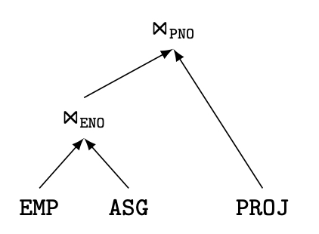
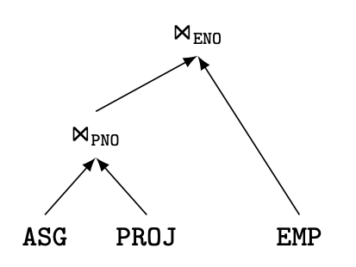
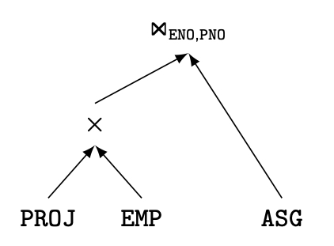
Join Trees
Characterize the search space for optimization
For N relations, there are O(N!) equivalent join trees that can be obtained by applying commutativity and associativity rules
SELECT ENAME,RESP
FROM EMP
NATURAL JOIN ASG
NATURAL JOIN PROJ
Notes:
X => This is not the Cartesian product – it is a join.

Slide 18
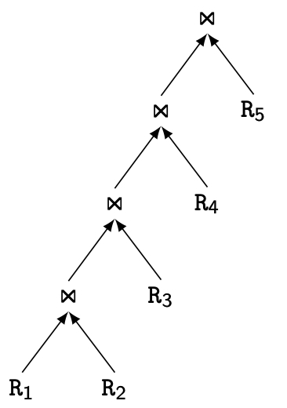
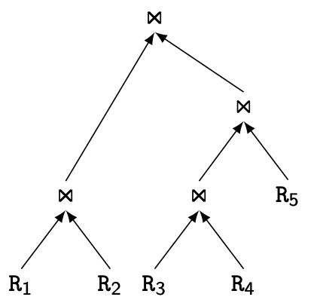
Join Trees
Two major shapes
Linear versus bushy trees
Linear Join Tree
Bushy Join Tree
Notes:
- Different space

Slide 19
Join Ordering
Ordering joins is an important aspect of centralized query optimization.
Join ordering in a distributed context is even more important since joins between fragments may increase the communication time.

Slide 20
Join Ordering
Consider two relations only
if size(R) < size(S)
Site 1
R
S
Site 2
if size(R) > size(S)
The obvious choice of the relation to transfer is to send the smaller relation to the site of the larger one, which gives rise to two possibilities, as shown above.
To make this choice we need to evaluate the sizes of R and S.
Notes:
We have 2 joins – then which one first? That is ordering.
This is distributed. It's different from centralized. (In distributed they are in different sites)
Copy the samller size table to another site.

Slide 21
Join Ordering
Consider two relations only
if size(R) < size(S)
Site 1
R
S
Site 2
if size(R) > size(S)
As in the case of a single join, the objective of the join-ordering algorithm is to transmit smaller operands.
Thus, estimating the size of relations and/or join results is mandatory, but also difficult.
Multiple relations are more difficult because of too many alternatives.
Compute the cost of all alternatives and select the best one.
Necessary to compute the size of intermediate relations which is difficult.
Use heuristics

Slide 22
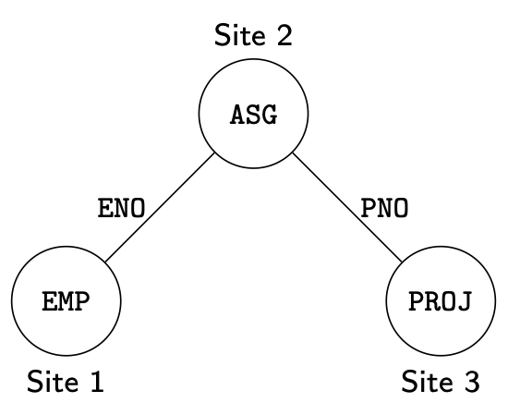
Join Ordering – Example
Consider
PROJ ⋈_{PNO} ASG ⋈_{ENO} EMP

Slide 23
Join Ordering – Example
Execution alternatives:
1. EMP→ Site 2 2. ASG → Site 1
Site 2 computes ASG'=EMP ⋈ ASG Site 1 computes ASG'=EMP ⋈ ASG
ASG'→ Site 3 ASG' → Site 3
Site 3 computes ASG' ⋈ PROJ Site 3 computes ASG’ ⋈ PROJ
3. ASG → Site 3 4. PROJ → Site 2
Site 3 computes ASG'=ASG ⋈ PROJ Site 2 computes ASG'=PROJ ⋈ ASG
ASG' → Site 1 ASG' → Site 1
Site 1 computes ASG' ▷◁ EMP Site 1 computes ASG' ⋈ EMP
5. EMP → Site 2
PROJ → Site 2
Site 2 computes EMP ⋈ PROJ ⋈ ASG
ASG
ENO
Site 2
PNO
EMP
PROJ
Site 1
Site 3
Notes:
Number 5 can be done in parallel.
If response time is important then number 5 can be good.

Slide 24
Join Ordering – Example
To select one of these, the following sizes must be known or predicted:
size(EMP), size(ASG), size(PROJ),
size(EMP ⋈ ASG), and size(ASG ⋈ PROJ)
Furthermore, if the response time is considered, the optimization must consider that transfers can be done in parallel with strategy 5.
An alternative is to use heuristics that consider only the sizes of the operand relations by assuming, for example, that the cardinality of the resulting join is the product of operand cardinalities.
In this case, relations are ordered by increasing sizes and the order of execution is given by this ordering and the join graph.
For instance, the order (EMP, ASG, PROJ) could use strategy 1, while the order (PROJ, ASG, EMP) could use strategy 4.
Notes:
EMP, ASG, PROJ -> EMP is smallest and PROJ is large => Use Strategy 1

Slide 25
Semijoin based Algorithms
Semijoin operation can be used to decrease the total time of join queries
Consider the join of two relations:
R[A] (located at site 1)
S[A] (located at site 2)
Alternatives:
Do the join R ⋈_{A}S
Perform one of the semijoin equivalents
R ⋈_{A}S ⇔ (R ⋉_{A}S) ⋈_{A}S
⇔ R ⋈_{A} (S ⋉_{A} R)
⇔ (R ⋉_{A} S) ⋈_{A} (S ⋉_{A} R)
R
A | B | C
1 | 1 | 2
2 | 1 | 2
3 | 2 | 2
6 | 2 | 3
7 | 3 | 3
S
A | D | E
1 | 3 | 6
2 | 3 | 6
5 | 5 | 7
8 | 1 | 3
Notes:
Important of EXAM
If we don't use semi-join, then send a smaller table to another site.
R Semijoin A result = tuple 1,2

Slide 26
Semijoin based Algorithms
R ⋈_{A}S
Do the join R ⋈_{A}S
Perform one of the semijoin equivalents
R ⋈_{A}S ⇔ (R ⋉_{A}S) ⋈_{A}S
⇔ R ⋈_{A} (S ⋉_{A} R)
⇔ (R ⋉_{A} S) ⋈_{A} (S ⋉_{A} R)
A | B | C | D | E
1 | 1 | 2 | 3 | 6
2 | 1 | 2 | 3 | 6
R ⋉_{A}S
A | B | C
1 | 1 | 2
2 | 1 | 2
R
S
A | B | C
1 | 1 | 2
2 | 1 | 2
3 | 2 | 2
6 | 2 | 3
7 | 3 | 3
S ⋉_{A} R
A | D | E
1 | 3 | 6
2 | 3 | 6
5 | 5 | 7
8 | 1 | 3
A | D | E
1 | 3 | 6
2 | 3 | 6
Notes:
These 3 in point 2 are equivalent.

Slide 27
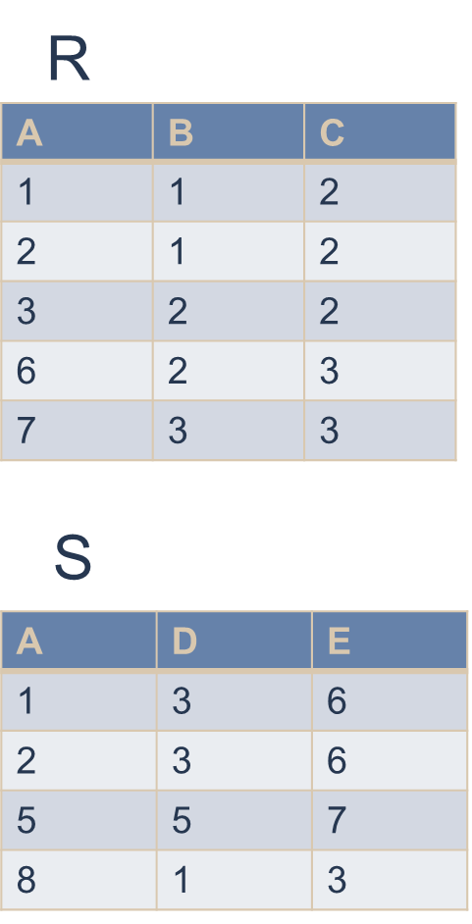
Semijoin based Algorithms
Perform the join ( R ⋈_{A}S ) assuming that size(R) > size(S).
send S to Site 1
Site 1 computes R ⋈_{A} S
Consider semijoin (R ⋉_{A}S) ⋈_{A}S
S' = Π_{A}(S)
S' → Site 1
Site 1 computes R' = R ⋉_{A}S'
R'→ Site 2
Site 2 computes R' ⋈_{A}S
Semijoin is better if size(Π_{A}(S)) + size(R ⋉_{A}S’)) < size(S)
S
Site 2
A
Site 1
R
Notes:
S' = Π_{A}(S) => Project attribute A from S
Most time taking process is coping the fragment from one site to other.
VERY IMPORTANT OF FINAL EXAM - 100%

Slide 28
Join versus Semijoin
Compared with the join, the semijoin induces more operations but possibly on smaller operands.
If the join attribute length is much smaller than the length of an entire tuple, then the semijoin approach can result in significant savings in communication time.
Using semijoins may well increase the local processing time, since one of the two joined relations must be accessed twice.
Using semijoins might not be a good idea if the communication time is not the dominant factor, as is the case with local area networks

Slide 29
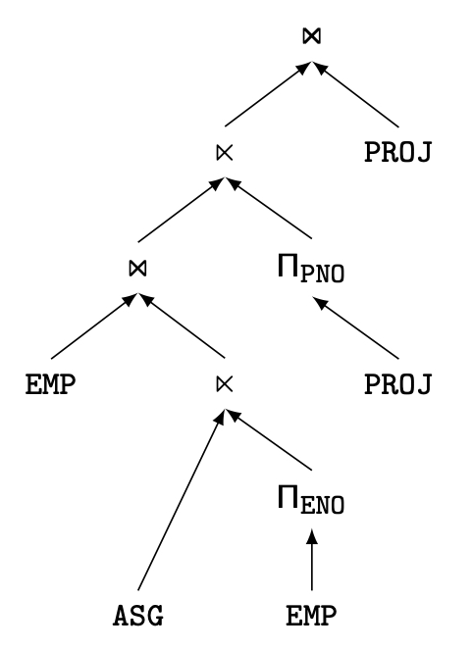
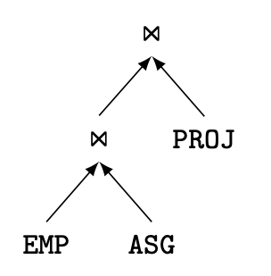
Join versus Semijoin-based Ordering
Semijoin-based induces more operators, but possibly on smaller operands
Notes:
Left side is semijoin – looks complex but it takes less time because less amount of data is getting transferred.

Slide 30
Full Reducer
Optimal semijoin program that reduces each relation more than others
How to find the full reducer?
Enumeration of all possible semijoin programs and select the one that has best size reduction
Problem
For cyclic queries, no full reducers can be found
For tree queries, full reducers exist but the number of candidate semijoin programs is exponential in the number of relations
Notes:
Enumeration – Consider all different cases and estimate the size and transfer of each to find the best one.

Slide 31
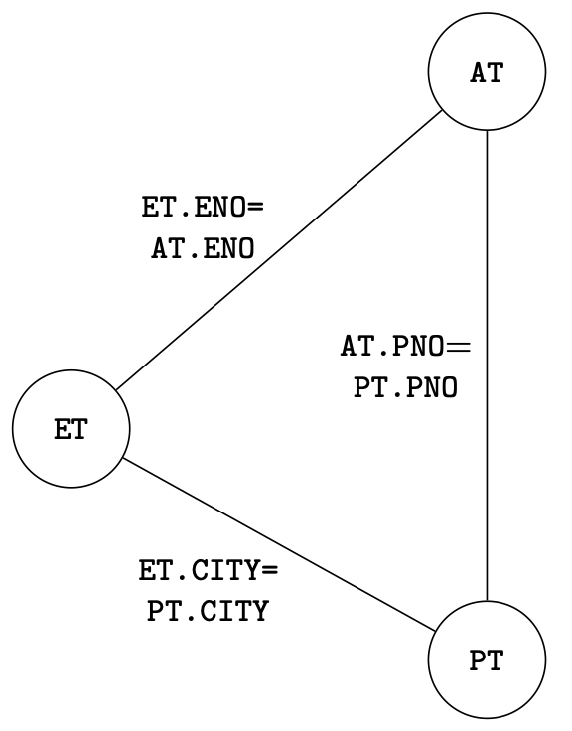
Full Reducer – Example
Consider
ET (ENO, ENAME, TITLE, CITY)
AT (ENO, PNO, RESP, DUR, CITY)
PT (PNO, PNAME, BUDGET, CITY)
And the cyclic query
SELECT ENAME, PNAME
FROM ET NATURAL JOIN AT
NATURAL JOIN PT
NATURAL JOIN ET
Notes:
This is a graph.
We have 3 joins.

Slide 32
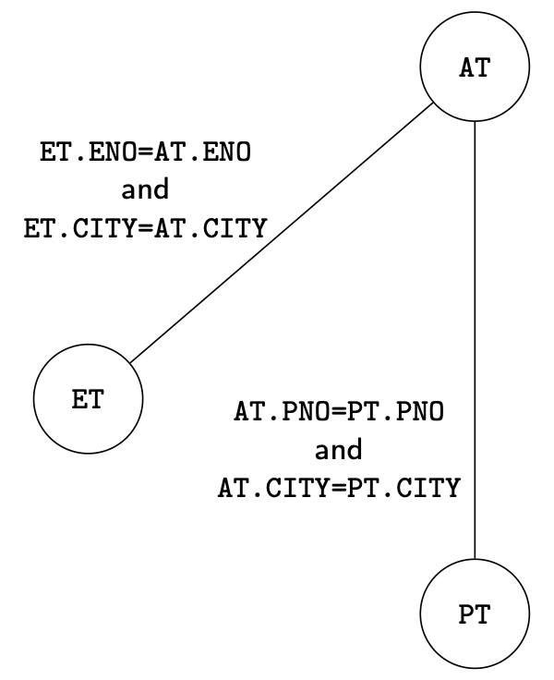
Full Reducer – example
Solution: transform the cyclic query into a tree
Remove one arc of the cyclic graph
Add appropriate predicates to other arcs such that the removed predicate is preserved by transitivity
Notes:
Parent and child is fixed in tree.
Tree we can have many options and computation is possible, where as in graph even computation is not possible.
Here we have 2 join and 3rd join is replaced by selection.

Slide 33
Outline
Distributed Query Processing
Overview
Query Modification
Query Decomposition
Data Localization
Query Translation
Distributed Cost Model
Distributed Query Optimization
Join Ordering
Dynamic Approach
Static Approach
Hybrid Approach
Adaptive Query Processing

Slide 34
Distributed Query Optimization
Distributed Dynamic approach
Distributed INGRES
No static cost estimation, only runtime cost information
Distributed Static approach
System R*
Static cost model
Hybrid approach
2-step
But, we need to see Centralized Query Optimization first
Notes:
These approaches are not only for distributed but also for centralized.

Slide 35
Centralized Query Optimization
The main query optimization techniques for centralized systems is a prerequisite to understand distributed query optimization with three reasons.
First, a distributed query is translated into local queries, each of which is processed in a centralized way.
Second, distributed query optimization techniques are often extensions of the techniques for centralized systems.
Finally, centralized query optimization is a simpler problem; the minimization of communication costs makes distributed query optimization more complex.
Notes:
Centralized is using dynamic and static.
Why do we need to understand this first, the above 3 reasons explains it.

Slide 36
Centralized Query Optimization
Dynamic (Ingres project at University of California, Berkeley)
Interpretive
Static (System R project at IBM)
Exhaustive search
Hybrid (Volcano project at Oregon Graduate Institute)
Choose node within plan
Notes:
3 approaches
Static: Many tree – estimte the cost – choice the best

Slide 37
Dynamic Algorithm
Decompose each multi-variable query into a sequence of mono-variable queries with a common variable
Process each by a one variable query processor
Choose an initial execution plan (heuristics)
Order the rest by considering intermediate relation sizes
No need for a cost model, so No statistical information is maintained.

Slide 38
Heuristic Optimization
Cost-based optimization is expensive, even with dynamic programming.
Systems may use heuristics to reduce the number of choices that must be made in a cost-based fashion.
Heuristic optimization transforms the query-tree by using a set of rules that typically (but not in all cases) improve execution performance:
Perform selection early (reduces the number of tuples)
Perform projection early (reduces the number of attributes)
Perform most restrictive selection and join operations (i.e. with smallest result size) before other similar operations.
Some systems use only heuristics, others combine heuristics with partial cost-based optimization.
Notes:
Line 1: Cost based optimization: many tree – calculate cost – find the best one.
Some part is repeated – common (Calculate once and store it – dynamic programming)
Heuristic – Don’t consider all cases – assume some cases and reduce it.
The last point denotes 4 heuristic cases approach.

Slide 39
Dynamic Algorithm–Decomposition
Replace an n variable query q by a series of queries
q₁→q₂ → … → q_{n}
where q_{i} uses the result of q_{i-1}.
Detachment
Query q decomposed into q' → q" where q' and q" have a common variable which is the result of q'
Tuple substitution
Replace the value of each tuple with actual values and simplify the query
q(V₁, V₂, ... V_{n}) → (q' (t₁, V₂, V₂, ... , V_{n}), t₁∈R)
Notes:
Multi dynamic quey is considered as mono optimizeed query (decomposed).

Slide 40
Detachment
q: SELECT V₁.A₁,V₂.A₂,V₃.A₃, …,V_{n}.A_{n}
FROM R₁ V₁, …,R_{n} V_{n}
WHERE P₁(V₁.A₁’)AND P₂(V₁.A₁,V₂.A₂,…, V_{n}.A_{n})
⇓
q': SELECT V₁.A₁ INTO R₁'
FROM R₁ V₁
WHERE P₁(V₁.A₁)
q": SELECT V₂.A₂, …,V_{n}.A_{n}
FROM R₁' V₁, R₂ V₂, …,R_{n} V_{n}
WHERE P₂(V₁.A₁, V₂.A₂, …,V_{n}.A_{n})
Notes:
Variables
q’ :
q” = q - q’
We can continue
Slide – 37
Multi to mono

Slide 41
Detachment Example
Names of employees working on CAD/CAM project
q₁: SELECT EMP.ENAME
FROM EMP, ASG, PROJ
WHERE EMP.ENO=ASG.ENO AND ASG.PNO=PROJ.PNO AND PROJ.PNAME="CAD/CAM"
⇓
q₁₁: SELECT PROJ.PNO INTO JVAR
FROM PROJ
WHERE PROJ.PNAME="CAD/CAM"
q': SELECT EMP.ENAME
FROM EMP,ASG,JVAR
WHERE EMP.ENO=ASG.ENO
AND ASG.PNO=JVAR.PNO
Notes:
q1: 3 tables, 2 join, 1 select
q11: selection, we save intermediate result into JVAR
q’: 2 joins
q1 = q11 + q’ or (q11 = q1-q’)
IMPORTANT FOR EXAM

Slide 42
Detachment Example (cont’d)
q': SELECT EMP.ENAME
FROM EMP,ASG,JVAR
WHERE EMP.ENO=ASG.ENO
AND ASG.PNO=JVAR.PNO
⇓
q₁₂: SELECT ASG.ENO INTO GVAR
FROM ASG,JVAR
WHERE ASG.PNO=JVAR.PNO
q₁₃: SELECT EMP.ENAME
FROM EMP,GVAR
WHERE EMP.ENO=GVAR.ENO
Notes:
Apply the decomposition again
q12: 1 join of q’
Q13: next join

Slide 43
Detachment Example (cont’d)
q₁₁: SELECT PROJ.PNO INTO JVAR
FROM PROJ
WHERE PROJ.PNAME="CAD/CAM“
q₁₂: SELECT ASG.ENO INTO GVAR
FROM ASG,JVAR
WHERE ASG.PNO=JVAR.PNO
q₁₃: SELECT EMP.ENAME
FROM EMP,GVAR
WHERE EMP.ENO=GVAR.ENO
Thus query q1 has been reduced to the subsequent queries q₁₁ → q₁₂ → q₁₃.
Query q₁₁ is mono-relation and can be executed. However, q₁₂ and q₁₃ are not mono-relation and cannot be reduced by detachment.
Notes:
Our goal is to get a mono variable query – 1 table
q11 is a mono variable– q12 and q13 are not mono variable query.

Slide 44
Detachment Example (cont’d)
Multi-relation queries, which cannot be further detached (e.g., q₁₂ and q₁₃), are irreducible.
Irreducible queries are converted into mono-relation queries by tuple substitution.
Given an n-relation query q, the tuples of one relation are substituted by their values, thereby producing a set of (n−1)-relation queries.
Notes:
We cannot detach q12 and q13, so there are different ways.
Choice one relation if we have
Substitution means consider one tuple by ony tuple – select one by one

Slide 45
Tuple Substitution
First, one relation in q is chosen for tuple substitution. Let R₁ be that relation.
Then for each tuple t_{1i} in R₁, the attributes in q are replaced by their actual values, thereby generating a query q’ with n− 1 relations.
Therefore, the total number of queries in q’ produced by tuple substitution is card(R1).
Notes:
Choice R1 for substitution.
If we have 1000’s of tuples then this approach is not very practical.

Slide 46
Tuple Substitution
q₁₁ is a mono-variable query
q₁₂ and q₁₃ are subject to tuple substitution
Assume GVAR has two tuples only: 〈E1〉 and 〈E2〉
Then q₁₃ becomes
q₁₃₁: SELECT EMP.ENAME
FROM EMP
WHERE EMP.ENO="E1"
q₁₃₂: SELECT EMP.ENAME
FROM EMP
WHERE EMP.ENO="E2"
q₁₃: SELECT EMP.ENAME
FROM EMP,GVAR
WHERE EMP.ENO=GVAR.ENO
Notes:
Q11 is mono variable – q12 and q13 are not mono variable
GVAR – from slide 43
Join replaced by selections
Q13 – using 2 tables where as q131 and q132 are using 1 table - so it got reduced
These approaches are centralized – Detachment and tuple substitution

Slide 47
Distributed Dynamic Approach
Execute all monorelation queries (e.g., selection, projection)
Reduce the multi-relation query (MRQ) to produce irreducible subqueries q₁→ q₂ → … → q_{n} such that there is only one relation between q_{i} and q_{i+1}
Choose q_{i} involving the smallest fragments to execute (call MRQ')
Find the best execution strategy for MRQ'
Determine processing site
Determine fragments to move
Repeat 3 and 4
Notes:
How can we apply the techniques to distributed envirornment.

Slide 48
Distributed Dynamic Algorithm
Example. Assume that relations EMP, ASG, and PROJ of the query are stored as follows, where relation EMP is fragmented.
Site 1: EMP₁ and ASG
Site 2: EMP₂ and PROJ
There are several possible strategies, including the following:
Execute the entire query (EMP ⋈ ASG ⋈ PROJ) by moving EMP₁ and ASG to site 2.
Execute (EMP ⋈ ASG) ⋈ PROJ by moving (EMP₁ ⋈ ASG) and ASG to site 2, and so on.
The choice between the possible strategies requires an estimate of the size of the intermediate results.
Notes:
Query – join 3 tables
Possible different ways – 2 ways mentioned above in point 2.

Slide 49
Centralized Query Optimization
Dynamic (Ingres project at UCB)
Interpretive
Static (System R project at IBM)
Exhaustive search
Hybrid (Volcano project at OGI)
Choose node within plan

Slide 50
Static Approach
Cost function includes local processing as well as transmission
Considers only joins
“Exhaustive” search
Compilation
Notes:
In this, we need to consider cost function.

Slide 51
Static Algorithm
With static query optimization, there is a clear separation between the generation of the QEP at compile-time and its execution by the DBMS execution engine.
Thus, an accurate cost model is key to predict the costs of candidate QEPs.
The input to the optimizer is a relational algebra tree resulting from the decomposition of an SQL query.
The output is a QEP that implements the “optimal” relational algebra tree.
Notes:
Find all QEPs (Query Execution Plan) – estimate the cost of each plan an d find the best one.
We have SQL query -> We need to have a tree -> Each tree we need to estimate the cost (how long does it take – time).

Slide 52
Static Algorithm
The optimizer assigns a cost (in terms of time) to every candidate tree and retains the one with the smallest cost.
The candidate trees are obtained by a permutation of the join orders of the n relations of the query using the commutativity and associativity rules.
To limit the overhead of optimization, the number of alternative trees is reduced using dynamic programming.
The set of alternative strategies is constructed dynamically so that, when two joins are equivalent by commutativity, only the cheapest one is kept.
Notes:
If we have many joins then multiple orders are possible.
We can use dynamic approach – calculate once and store it for later.

Slide 53
Static Algorithm
The optimization algorithm consists of two major steps.
First, the best access method to each individual relation based on a select predicate is predicted.
Second, for each relation R, the best join ordering is estimated, where R is first accessed using its best single-relation access method. The cheapest ordering becomes the basis for the best execution plan.
Execute joins
Determine the possible ordering of joins
Determine the cost of each ordering
Choose the join ordering with minimal cost
Notes:
Point 2: It means Heuristic (slide 38) – Discard the tree which has union first – we need selection first.
After that if we have multiple joins consider the minimum cost ordering join.

Slide 54
Static Algorithm – Example
Names of employees working on CAD/CAM project
q₁: SELECT EMP.ENAME
FROM EMP, ASG, PROJ
WHERE EMP.ENO=ASG.ENO AND ASG.PNO=PROJ.PNO AND PROJ.PNAME="CAD/CAM"
EMP.ENO=ASG.ENO
ASG
ASG.PNO=PROJ.PNO
ENO
PNO
EMP
PROJ
Notes:
The diagram is called a join graph
To join 2 tables we need to copy those tables to memory.
If we have memory to hold the tables then no problem. But if you don’t have enough space then how do we do the comparison (of common attributes to join).
Then we divide the table in to vertical fragments (tuples are divided – first 10 tuples – one fragment, next 10 another fragment)
ASG – A1,A2, A3, …, EMP – E1, E2, E3,…. (A1 compare with E1, A2 with E2, ..) and many other comparisons. If the results are the same but, OMG it will take so much time.

Slide 55
Block Nested-Loop Join
Variant of nested-loop join in which every block of inner relation is paired with every block of outer relation.
for each block B_{r} of r do begin for each block B_{s} of s do begin for each tuple t_{r} in B_{r} do begin for each tuple t_{s} in B_{s} do begin Check if (t_{r},t_{s}) satisfy the join condition if they do, add t_{r} • t_{s} to the result. end end end end
Notes:
Compare each tuple with all other tuples from other tables.
Another option is to change the table ordering. – Swap R and S.
Outer R, inner S
One block from outer R we need to reach all the inner block from S

Slide 56
Block Nested-Loop Join (Cont.)
Worst case estimate: b_{r} ∗ b_{s} + b_{r} block transfers + 2 * b_{r} seeks
Each block in the inner relation s is read once for each block in the outer relation
Best case: b_{s} + b_{r} block transfers + 2 seeks.
If the smaller relation fits entirely in memory, use that as the inner relation.
Examples use the following information
Number of records of student: 5,000
Number of blocks of student: 100
Number of records of takes: 10,000
Number of blocks of takes: 400
Notes:
One tuple is one block
ASG – 10 tuples (block)
EMP – 10 tuples (block)
Best case – We have the memory to store both tables in the memory.

Slide 57
Block Nested-Loop Join (Cont.)
In the worst case, if there is enough memory only to hold one block of each relation, the estimated cost is
b_{r} ∗ b_{s} + b_{r} block transfers,
2 * b_{r} seeks,
Assuming worst case memory availability cost estimate is
with student as outer relation:
100 ∗ 400 + 100 = 40,100 block transfers,
2 * 100 = 200 seeks
with takes as the outer relation
400 ∗ 100 + 400 = 40,400 block transfers
2 * 400 = 800 seeks
Notes:
The last 2 points are really important – which table to take as inner and which to take as outer?
Cost-dominant data is how much data to reach (transfer/read from disk and memory)
For different outer and inner table combination we get different cost (time)

Slide 58
Indexed Nested-Loop Join
Index lookups can replace file scans if
join is an equi-join or natural join and
an index is available on the inner relation’s join attribute
For each tuple t_{r} in the outer relation r, use the index to look up tuples in s that satisfy the join condition with tuple t_{r}.
Worst case: buffer has space for only one block of r, and one block of index for each tuple in r, we perform an index lookup on s.
Cost of the join: b_{r} + n_{r} ∗ c block transfers and seeks
Where c is the cost of traversing index and fetching all matching s tuples for one tuple of r
c can be estimated as cost of a single selection on s using the join condition. (i.e., height +1)
If indices are available on join attributes of both r and s, use the relation with fewer tuples as the outer relation.
Notes:
While doing join we also use index.
If we don’t have an index we need to compare all possible pairs, but if we have index we don’t need to take all combinations.
Formula for cost function: b_{r} + n_{r} ∗ c (There is no bs – size of s doesn't matter only one table size matters)

Slide 59
Example of Indexed Nested-Loop Join Costs
Compute student takes, with student as the outer relation.
Let takes have a primary B⁺-tree index on the attribute ID, which contains 20 entries in each index node.
Since takes has 10,000 tuples, the height of the tree is 4, and one more access is needed to find the actual data.
If there are K search-key values in the file, the height of the tree is no more than ⎡log_{⎡n/2⎤}(K)⎤ = ⎡log_{⎡20/2⎤}(10,000)⎤ = 4
Cost of indexed nested loops join (b_{r} + n_{r} ∗ c)
100 + 5000 * 5 = 25,100 block transfers and seeks.

Slide 60
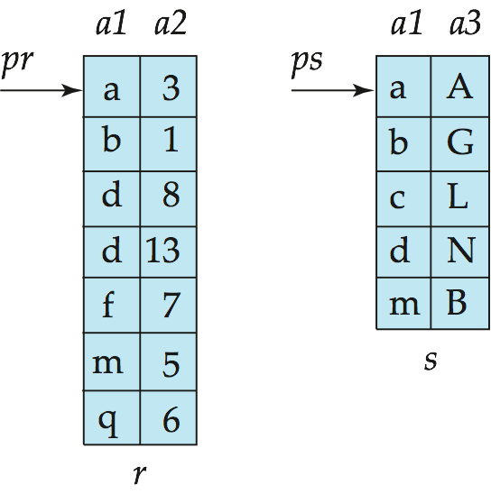
Merge-Join
Sort both relations on their join attribute (if not already sorted on the join attributes).
Merge the sorted relations to join them
Join step is similar to the merge stage of the merge-sort algorithm.
Main difference is handling of duplicate values in join attribute — every pair with same value on join attribute must be matched
Detailed algorithm in book
Notes:
One more popular join method.

Slide 61
Merge-Join (Cont.)
Can be used only for equi-joins and natural joins
Each block needs to be read only once (assuming all tuples for any given value of the join attributes fit in memory
Thus the cost of merge join is:
b_{r} + b_{s} block transfers + ⎡b_{r} / b_{b}⎤ + ⎡b_{s} / b_{b}⎤ seeks
+ the cost of sorting if relations are unsorted.
Buffer size: b_{b} blocks for each relation.

Slide 62
Static Algorithm – Example
Names of employees working on CAD/CAM project
q₁: SELECT EMP.ENAME
FROM EMP, ASG, PROJ
WHERE EMP.ENO=ASG.ENO AND ASG.PNO=PROJ.PNO AND PROJ.PNAME="CAD/CAM"
Assume
EMP has an index on ENO,
ASG has an index on PNO,
PROJ has an index on PNO and an index on PNAME
Notes:
Based on the primary key we can have an index – sometimes we don’t need to have primary key as index.

Slide 63
Example (cont’d)
Choose the best access paths to each relation
EMP has an index on ENO,
ASG has an index on PNO,
PROJ has an index on PNO and an index on PNAME
Determine the best join ordering
EMP ▷◁ ASG ▷◁ PROJ
ASG ▷◁ EMP ▷◁ PROJ
ASG ▷◁ PROJ ▷◁ EMP
PROJ ▷◁ ASG ▷◁ EMP
EMP ▷◁ PROJ ▷◁ ASG
PRO ▷◁ EMP ▷◁ ASG
Select the best ordering based on the join costs
Notes:
3 tables, 2 join – we can have 6 possible ways to join [The result are all same, but cost is different – how long does it takes]

Slide 64
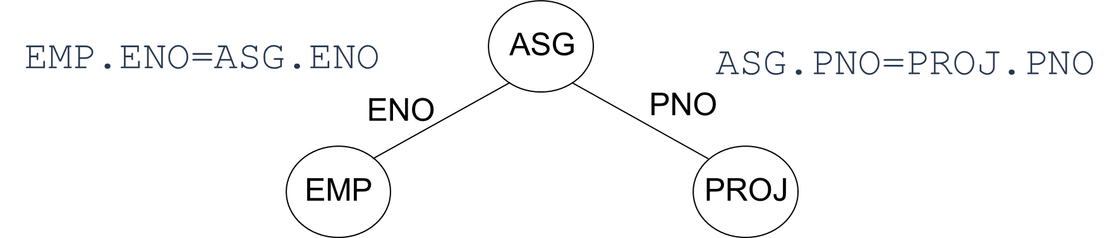
Example (cont’d)
Determine the best join ordering
(EMP ▷◁ ASG) ▷◁ PROJ
(ASG ▷◁ EMP) ▷◁ PROJ
(ASG ▷◁ PROJ) ▷◁ EMP
(PROJ ▷◁ ASG) ▷◁ EMP
(EMP ▷◁ PROJ) ▷◁ ASG (x)
(PROJ ▷◁ EMP) ▷◁ ASG (x)
Select the best ordering based on the join costs
Notes:
We don’t need to join EMP and PROJ so last 2 are eliminated.

Slide 65
Static Algorithm
(EMP ▷◁ ASG) ▷◁ PROJ (x)
(ASG ▷◁ EMP) ▷◁ PROJ (x)
(ASG ▷◁ PROJ) ▷◁ EMP
(PROJ ▷◁ ASG) ▷◁ EMP
EMP has an index on ENO,
ASG has an index on PNO,
PROJ has an index on PNO and an index on PNAME
((PROJ ⋈ ASG) ⋈ EMP) is selected. Why?
The number of tuples of PROJ is smaller than that of ASG typically
( b_{r} + n_{r} ∗ c block transfers and seeks for indexed nested loop join)
The number of tuples of PROJ is smaller than that of ASG or EMP typically
Notes:
What else we can eliminate
The number of tuples in PROJ is less than that of EMP and ASG – Slide 7 from the previous PPT
We have an index so we can tell which table is larger and which is smaller – [Slide 58]
Last point - br - number of blocked in r, nr – number of tuples in r
[r join s -> br + nr * c], [s join r -> bs + ns *c]
IMPORTANT MATERIAL FOR EXAM

Slide 66
Distributed Static Approach
This algorithm performs an exhaustive search of all alternative strategies in order to choose the one with the least cost.
Although predicting and enumerating these strategies may be costly, the overhead of exhaustive search is rapidly amortized if the query is executed frequently.
Query compilation is a distributed task, coordinated by a master site, where the query is initiated.
Notes:
2nd point – we know it takes longer time – consider all combination
3rd point – is an additional one - ASG, PRoJ, EMP – which site will do what?

Slide 67
Distributed Static Approach
The optimizer of the master site makes all intersite decisions, such as the selection of the execution sites and the fragments as well as the method for transferring data.
The other sites that have relations involved in the query, make the remaining local decisions (such as the ordering of joins at a site) and generate local access plans for the query.
The objective function of the optimizer is the general total time function, including local processing and communications costs.

Slide 68
Distributed Static Approach
The input to the algorithm of the static approach is a localized query expressed as a relational algebra tree (the query tree), the location of relations, and their statistics.
As in the centralized case, the optimizer must select the join ordering, the join algorithm (block nested-loop or merge-join), and the access path for each fragment (e.g., primary index, sequential scan, etc.).
These decisions are based on statistics and formulas used to estimate the size of intermediate results and access path information.

Slide 69
Distributed Static Approach
In addition, the optimizer must select the sites of join results and the method of transferring data between sites.
To join two relations, there are three candidate sites: the site of the first relation, the site of the second relation, or a third site (e.g., the site that needs results of the join for other operations).
Notes:
Which site is doing which operation?

Slide 70
Distributed Static Approach – Performing Joins
Ship whole
Fetch as needed
Notes:
Ship whole – The whole table, or fragment is transferred.
Fetch as needed – Only part of table or fragments are transferred.

Slide 71
Distributed Static Approach – Performing Joins
Two methods are supported for intersite data transfers.
Ship whole: The entire relation is shipped to the join site and stored in a temporary relation before being joined.
Larger data transfer
Smaller number of messages
Better if relations are small

Slide 72
Distributed Static Approach – Performing Joins
Two methods are supported for intersite data transfers.
Fetch as needed : The external relation is sequentially scanned, and for each tuple the join value is sent to the site of the internal relation, which selects the internal tuples matching the value and sends the selected tuples to the site of the external relation.
This method is equivalent to the semijoin of the internal relation with each external tuple
Smaller data transfer
Larger number of messages
Number of messages = O(cardinality of external relation)
Data transfer per message is minimal
Better if relations are large and the selectivity is good (only a few matching tuples).
Notes:
It depends on the query, sometimes only necessary information is transferred.

Slide 73
Distributed Static Approach – Performing Joins
Given the join of an external (outer) relation R with an internal (inner) relation S on attribute A, There are five join strategies.
In what follows we describe each strategy in detail and provide a simplified cost formula for each,
where LT denotes local processing time (I/O + CPU time) and
CT denotes communication time.
For simplicity, we ignore the cost of producing the result.
For convenience, we denote by s the average number of tuples of S that match one tuple of R:
Notes:
I/O + CPU time: Read from memory to disk and operation in disk

Slide 74
Distributed Static Approach – Performing Joins
Move outer relation (R) tuples to the site of the inner relation (S)
Retrieve outer tuples
Send them to the inner relation site
Join them as they arrive
LT = Local Processing Time (I/O time + CPU time)
CT = Communication Time
Total Cost = LT (retrieving card(R) tuples from R)
+ CT (size (R))
+ LT (retrieve card(S) tuples from S) * card(R)
Notes:
We have 5 possible ways, this is the 1st method.
Bottom/Basic understanding -> Send S to site 1 -> Read table from disk of site 2 to memory of site 2 -> then send to memory from site 2 memory to site 1 memory and then store it in disk of site 1.
a) retrieve - from disk to memory
b) send – memory to memory
c) join
To compare we need it in memory so, no need to store
retrieve card(S) tuples from S: It means to join we need S which it stored in disk in site 2

Slide 75
Distributed Static Approach – Performing Joins
Move inner relation (S) to the site of outer relation (R)
Cannot join as they arrive; they need to be stored
Total Cost = LT (retrieving card(S) tuples from S)
+ CT (size (S))
+ LT (store card(S) tuples into T)
+ LT (retrieving card(R) tuples from R)
+ LT (retrieve card(S) tuples from T) * card(R)
Notes:
Opposite direction.
Instead of R we are reading S
Instead of directly joining as soon as it arrives(case 1 – slide 74), in this case we are storing it first, then retrieving and then joining.
Why do we need additional 2 operations? – Why are we storing? - because here inner are outer are changed [Inner table is copied to the outer side in this case]. But previous case the ineer and outer are not changed and outer is copied to inner
R is outer and S is inner
We might think that is not fast, but CT is retundant. If S is small then this could be better.

Slide 76
Distributed Static Approach – Performing Joins
Move both inner and outer relations to another site
Total Cost = LT (retrieving card(S) tuples from S)
+ CT (size (S))
+ LT (store card(S) tuples into T)
+ LT (retrieving card(R) tuples from R)
+ CT (size (R))
+ LT (retrieve card(S) tuples from T) * card(R)
Notes:
From site-1 to site-3 and site-2 to site-3 and then join in site-3
S – inner
R - outer

Slide 77
Distributed Static Approach – Performing Joins
Fetch inner tuples as needed
For each tuple in R, the join attribute (A) value is sent to the site of S.
s tuples of S which match that value are retrieved and sent to the site of R to be joined as they arrive
Total Cost = LT(retrieve card(R) tuples from R)
+ CT(length(A)) * card(R)
+ LT(retrieve card(S) tuples from S) * card(R)
+ CT( s * length(S))
+ LT (store s * length(S) into T)
+ LT (retrieving card(R) tuples from R)
+ LT (retrieve s * length(S) from T) * card(R)
Notes:
It’s similar to semi-join
Slide 27 – In slide 27 we start with S – because we assume S is smaller.
But here we do opposite way, we start from R – R can also be smaller.
2 copies (CT), you can see from slide 27 also 2 copies.

Slide 78
Distributed Static Approach – Performing Joins
Fetch outer tuples as needed
For each tuple in S, the join attribute (A) value is sent to the site of R.
r tuples of R which match that value are retrieved and sent to the site of S to be joined as they arrive
Total Cost = LT(retrieve card(S) tuples from S)
+ CT(length(A)) * card(S)
+ LT(retrieve card(R) tuples from R) * card(S)
+ CT( r * length(R))
+ LT (retrieving card(S) tuples from S) * card(R)

Slide 79
Centralized Query Optimization
Dynamic (Ingres project at UCB)
Interpretive
Static (System R project at IBM)
Exhaustive search
Hybrid (Volcano project at OGI)
Choose node within plan

Slide 80
Hybrid optimization
In general, static optimization is more efficient than dynamic optimization
Adopted by all commercial DBMS
But even with a sophisticated cost model (with histograms), accurate cost prediction is difficult
Example
Consider a parametric query with predicate
WHERE R.A = $a /* $a is a parameter
The only possible assumption at compile time is uniform distribution of values
Solution: Hybrid optimization
Choose-plan done at runtime, based on the actual parameter binding

Slide 81
Hybrid optimization
Hybrid query optimization attempts to provide the advantages of static query optimization while avoiding the issues generated by inaccurate estimates.
The approach is basically static, but further optimization decisions may take place at run time by adding a conditional runtime reoptimization phase
Thus, plans that have become infeasible or suboptimal are reoptimized.
However, detecting suboptimal plans is hard and this approach tends to perform much more reoptimization than necessary.

Slide 82
Hybrid optimization
A more general solution is to produce dynamic QEPs, which include carefully selected optimization decisions to be made at runtime using “choose-plan” operators.
The choose-plan operator links two or more equivalent subplans of a QEP that are incomparable at compile-time
The execution of a choose-plan operator yields the comparison of the subplans based on actual costs and the selection of the best one.
Choose-plan nodes can be inserted anywhere in a QEP.

Slide 83
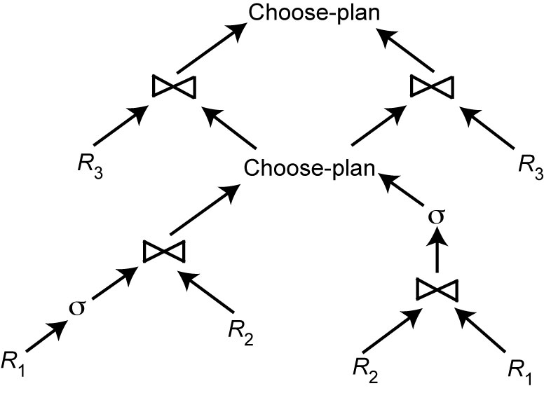
Hybrid Optimization Example
The bottom choose-plan operator compares the cost of two alternative subplans for joining R₁ and R₂, the left subplan being better than the right one
As stated above, since there is a runtime binding of the parameter $a, the accurate selectivity of σ_{A<=$a} (R₁) cannot be estimated until runtime.
σ_{A<=$a} (R₁) ▷◁ R₂ ▷◁ R₃
$a=A
$a=A

Slide 84
Hybrid Optimization Example
The top choose-plan operator compares the cost of two alternative subplans for joining the result of the bottom choose-plan operation with R₃.
Depending on the estimated size of the join of R₁ and R₂, which indirectly depends on the selectivity of the selection on R₁, it may be better to use R₃ as external or internal relation.
σ_{A<=$a} (R₁) ▷◁ R₂ ▷◁ R₃
$a=A
$a=A

Slide 85
Distributed Hybrid optimization
The static and dynamic distributed optimization approaches have some advantages and disadvantages as in centralized systems
However, the problems of accurate cost estimation and comparison of QEPs at compile-time are much more severe in distributed systems.
In addition to unknown bindings of parameter values in embedded queries, sites may become unavailable or overloaded at runtime.
In addition, relations (or relation fragments) may be replicated at several sites.

Slide 86
Distributed Hybrid optimization
The hybrid query optimization technique using dynamic QEPs is general enough to incorporate site and other decisions.
However, the search space of alternative subplans linked by choose-plan operators becomes much larger and may result in heavy static plans and much higher startup time.
Therefore, several hybrid techniques have been proposed to optimize queries in distributed systems
They essentially rely on the following two-step approach:

Slide 87
2-Step Optimization
At compile time, generate a static plan that specifies the ordering of operations and the access methods, without considering where relations are stored.
At startup time, generate an execution plan by
carrying out site and copy selection, and
allocating the operations to the sites.

Slide 88
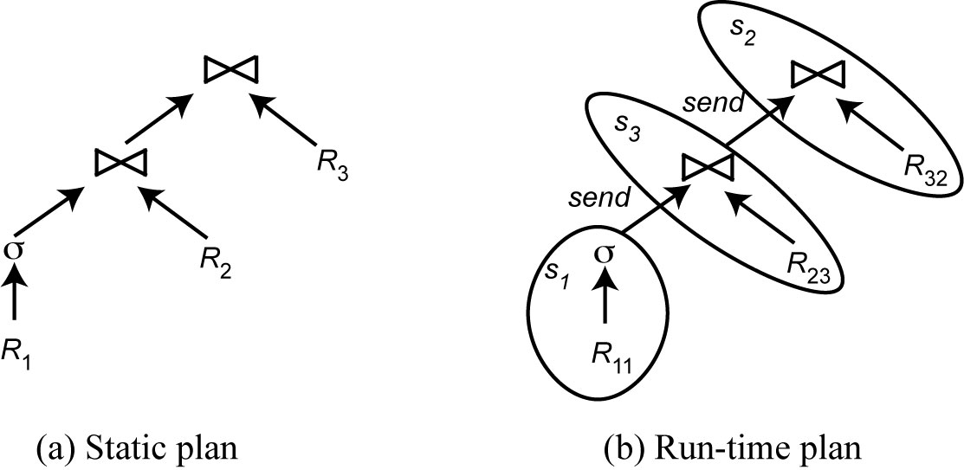
2-Step Optimization
σ (R₁) ▷◁ R₂ ▷◁ R₃
The static plan shows the relational operation ordering as produced by a centralized query optimizer.
The run-time plan extends the static plan with site, copy selection and communication between sites.
For instance, the first selection is allocated at site S₁ on copy R₁₁ of relation R₁ and sends its result to site S₃ to be joined with R₂₃

Slide 89
2-Step Optimization
The first step can be done by a centralized query optimizer. It may also include choose-plan operators so that runtime bindings can be used to make accurate cost estimations.
The second step carries out site and copy selection, possibly in addition to choose-plan operator execution. Furthermore, it can optimize the load balancing of the system.

Slide 90
2-Step – Problem Definition
Given
A set of sites S = {s₁, s₂, …, s_{n}},
A query Q ={q₁, q₂, q₃, q_{4, …,} q_{m}} such that each subquery q_{i} is the processing unit that accesses one relation and communicates with its neighboring queries
For each q_{i} in Q, a feasible allocation set of sites S_{q}={s₁, s₂, …,s_{k}} where each site stores a copy of the relation in q_{i}
Each site s_{i} has a load, denoted by load(s_{i}), which reflects the number of queries currently submitted.
The objective is to find an optimal allocation of Q to S such that
the unbalanced load of S is minimized
The total communication cost is minimized

Slide 91
2-Step Algorithm
For each q in Q compute load (S_{q})
While Q not empty do
Select subquery a with least allocation flexibility
Select best site b for a (with least load and best benefit)
Remove a from Q and recompute loads if needed

Slide 92
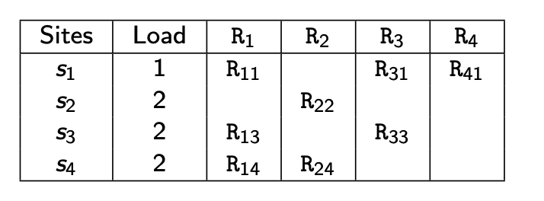
2-Step Algorithm Example
Consider the following query:
Let Q = {q₁, q₂, q₃, q₄}
where q₁ is associated with R₁,
q₂ is associated with R₂ joined with the result of q₁,
q₃ is associated with R₃ joined with the result of q₂, and
q₄ is associated with R₄ joined with the result of q₃.
σ (R₁) ▷◁ R₂ ▷◁ R₃ ▷◁ R₄

Slide 93
2-Step Algorithm Example
Consider the following query:
It performs 4 iterations
Iteration 1:
select q₁ with the least allocation flexibility, allocate to s₁,
set load(s₁) = 2
σ (R₁) ▷◁ R₂ ▷◁ R₃ ▷◁ R₄
New Load
2(q₁)
2
2
2

Slide 94
2-Step Algorithm Example
Consider the following query:
It performs 4 iterations
Iteration 2: the next subquery to be selected is q₂.
select q₂, allocate to s₂ (it could be allocated to s₄ which has the same load as s₂,
set load(s₂) = 3 or set load(s₄) = 3
σ (R₁) ▷◁ R₂ ▷◁ R₃ ▷◁ R₄
New Load
New Load
2(q₁)
2(q₁)
3(q₂)
2
2
2
2
3(q₂)

Slide 95
2-Step Algorithm Example
Consider the following query:
It performs 4 iterations
Iteration 3:
select q₃, allocate to s₁, set load(s₁) = 3 or allocate to s₃,
set load(s₃) = 3
σ (R₁) ▷◁ R₂ ▷◁ R₃ ▷◁ R₄
New Load
New Load
3(q₁, q₃),
2(q₁)
3(q₂)
2
2
2
3(q₃)
3(q₂)

Slide 96
2-Step Algorithm Example
σ (R₁) ▷◁ R₂ ▷◁ R₃ ▷◁ R₄
Consider the following query:
It performs 4 iterations
Iteration 4:
select q₄, allocate to s₁
set load(s₁) = 4 or set load(s₁) = 3
Which one is better? (need to consider load-balancing)
New Load
New Load
4(q₁, q₃, q₄)
3(q₁, q₄)
3(q₂)
2
2
2
3(q₃)
3(q₂)

Slide 97
Adaptive Query Processing - Motivations
Assumptions underlying query optimization
The optimizer has sufficient knowledge about runtime Cost information
Runtime conditions remain stable during query execution
Appropriate for systems with small data sources in a controlled environment
Inappropriate for changing environments with large numbers of data sources and unpredictable runtime conditions

Slide 98
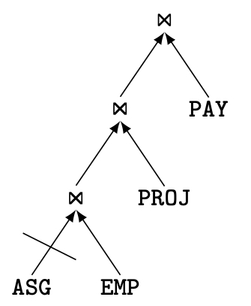
Example: QEP with Blocked Operator
Assume ASG, EMP, PROJ and PAY each at a different site
If ASG site is down, the entire pipeline is blocked
However, with some reorganization, the join of EMP and PAY could be done while waiting for ASG

Slide 99
Adaptive Query Processing – Definition
Adaptive query processing is a form of dynamic query processing, with
a feedback loop between the execution environment and the query optimizer in order to react to unforeseen variations of runtime conditions.
A query processing system is defined as adaptive if it receives information from the execution environment and determines its behavior according to that information in an iterative manner.
a general adaptive query processing process
Eddy approach that provides adaptive query processing

Slide 100
Adaptive Query Processing – Definition
Adaptive query processing adds to the traditional query processing process the following activities: monitoring, assessing, and reacting.
Monitoring involves measuring some environment parameters within a time window, and reporting them to the assessment component.
It analyzes the reports and considers thresholds for an adaptive reaction plan.
Finally, the reaction plan is communicated to the reaction component that applies the reactions to query execution.

Slide 101
Adaptive Components
Monitoring parameters (collected by sensors in QEP)
Memory size
Data arrival rates
Actual statistics
Operator execution cost
Network throughput
Adaptive reactions
Change schedule
Replace an operator by an equivalent one
Modify the behavior of an operator
Data repartitioning

Slide 102
Eddy Approach
Eddy is a general framework for adaptive query processing over distributed relations.
Multiple valid operator trees can be derived from G (Join graph) that obey the constraints in C by exploring the search space with different predicate orders.
There is no need to find an optimal QEP during query compilation.
The process of QEP compilation is completed by adding the eddy operator which is an n-ary operator placed between the relations in D and query predicates in P.

Slide 103
Eddy Approach
Query compilation: produces a tuple ⟨D, P, C, Eddy⟩
D: set of data sources (e.g. relations)
P: set of predicates (operations)
C: ordering constraints to be followed at runtime
Eddy: n-ary operator between D and P
Query execution: operator ordering on a tuple basis using Eddy
based on cost and selectivity
Change of join ordering during execution

Slide 104
QEP with Eddy
Q = {σ_{P} (R) ⋈ S ⋈ T)
Assume that
the only access method to relation T is through an index on join attribute T.A,
the second join can only be an index join over T.A.
Assume also that σ_{P} is an expensive predicate (e.g., a predicate over the results of running a program over values of R.B).
D= {R, S, T}
P = {σ_{P} (R), R ⋈₁ S, S ⋈₂ T)
C = {S < T} where < imposes S tuples to probe T tuples using an index on join attribute T.A

Slide 105
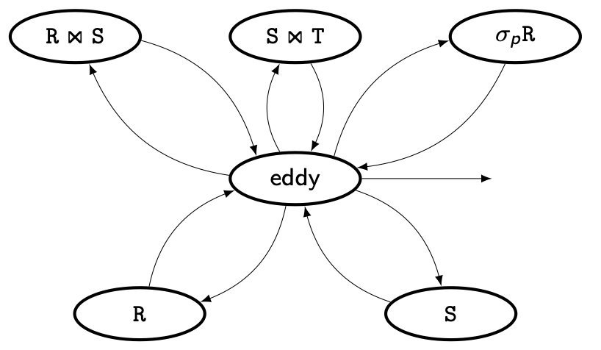
QEP with Eddy
It shows a QEP produced by the compilation of query Q with eddy.
An ellipse corresponds to a physical operator (i.e., either eddy operator or an algorithm implementing a predicate p ∈ P).
As usual, the bottom of the plan presents the source relations.
In the absence of a scan access method, the access to relation T is wrapped by the join S and T, thus does not appear as a source relation.
The arrows specify pipeline dataflow following a producer–consumer relationship.
Finally, an arrow departing from the eddy models the production of output tuples.

Slide 106
QEP with Eddy
Eddy provides fine-grained adaptiveness by deciding how to access tuples through predicates according to a scheduling policy.
During query execution, tuples in source relations are retrieved and staged into an input buffer managed by the eddy operator.
Eddy responds to relation unavailability by simply reading from another relation and staging tuples in the buffer pool.
The flexibility of choosing the currently available source relation is obtained by relaxing the fixed order of predicates in a QEP.
In eddy, there is no fixed QEP and each tuple follows its own path through predicates according to the constraints in the plan and its own history of predicate evaluation.

