Slide 1
Principles of Distributed Database Systems
M. Tamer Özsu
Patrick Valduriez

Slide 2
Outline
Distributed Transaction Processing
Distributed Concurrency Control
Distributed Reliability

Slide 3
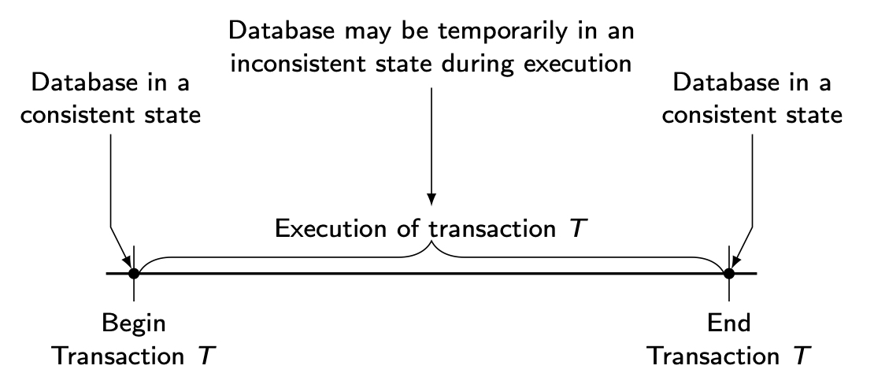
Transaction
A transaction is a collection of actions that make consistent transformations of system states while preserving system consistency.
concurrency transparency
failure transparency
Notes:
Query and transaction are basically the same.
Consistency means DB is correct (Does not violate any rule).

Slide 4
Transaction Characterization
Begin_transaction
…
Read
Read
…
Write
Read
…
Commit
Read set (RS)
The set of data items that are read by a transaction
Write set (WS)
The set of data items whose values are changed by this transaction
Base set (BS)
RS and WS
Notes:
Read means copying data from disk to memory.
Write means copying data from memory to disk.

Slide 5
Principles of Transactions
ATOMICITY
all or nothing
CONSISTENCY
no violation of integrity constraints
ISOLATION
concurrent changes invisible ⇒ serializable
DURABILITY
committed updates persist
Notes:
Isolation: Concurrent execution is allowed – if we don’t allow then the transaction will take a long time.
Durability: Changes made permanent by copying to disk.

Slide 6
Transactions Provide…
Atomic and reliable execution in the presence of failures
Correct and fast execution in the presence of multiple user accesses
Correct management of replicas (if they support it)
Notes:
Atomic and reliable means atomicity and durability
Correct and fast means Consistency and Isolation

Slide 7
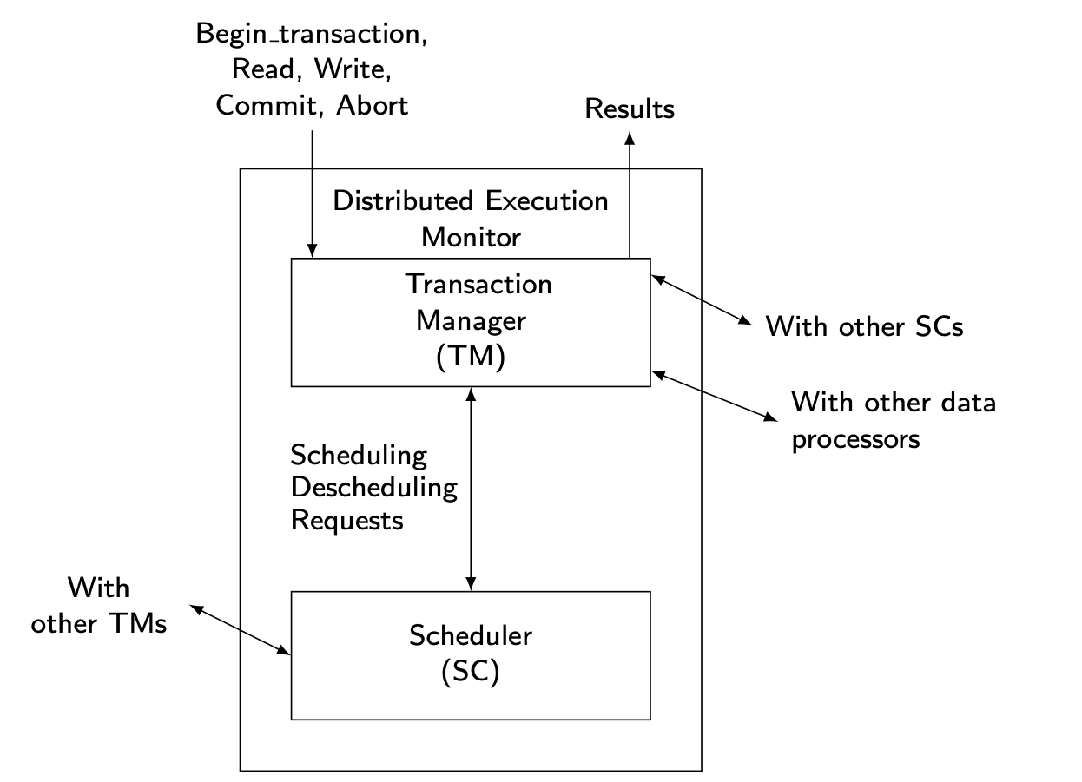
Distributed TM Architecture
Notes:
I don’t want you to memorize these but just understand.

Slide 8
Outline
Distributed Transaction Processing
Distributed Concurrency Control
Distributed Reliability

Slide 9
Concurrency Control
The problem of synchronizing concurrent transactions such that the consistency of the database is maintained while, at the same time, maximum degree of concurrency is achieved.
Enforce isolation property
Anomalies:
Lost updates
The effects of some transactions are not reflected on the database.
Inconsistent retrievals
A transaction, if it reads the same data item more than once, should always read the same value.

Slide 10
Conflict Operations
Two actions are said to be in conflict (conflicting pair) if:
The actions belong to different transactions.
At least one of the actions is a write operation.
The actions access the same object (read or write).
The following set of actions is conflicting:
R1(X), W2(X), W3(X) (3 conflicting pairs)
While the following sets of actions are not:
R1(X), R2(X), R3(X)
R1(X), W2(Y), R3(X)
Notes:
This is the basic idea of how to control.
Control by restriction.
Control read and write in the database.
Can read or not, can write or not?
Rules to control.
R1(X) – Transaction 1 needs to read data item X.

Slide 11
Example of Conflict Equivalence
conflict
S₁: r₁(x) r₂(x) w₂(x) r₁(y) w₁(y)
S₂: r₁(x) r₂(x) r₁(y) w₂(x) w₁(y)
S₃: r₁(x) r₁(y) r₂(x) w₂(x) w₁(y)
S₄: r₁(x) r₁(y) r₂(x) w₁(y) w₂(x)
S₅: r₁(x) r₁(y) w₁(y) r₂(x) w₂(x)
schedules have the same set of conflicting operations.
conflicting operations
ordered in same way
S₁ is equivalent to S₅
S₅ is the serial schedule T₁, T₂
S₁ is serializable
S₁ is not equivalent to the serial schedule T₂, T₁
Notes:
Conflict equivalent:
The result is all the same because the conflicting operations are all the same.
S5 is called serial (one transaction start and end then another transaction start and end) [111222]
Serializable means the result is the same as the serial
EXAM - 100%

Slide 12
Serializable Schedules
A schedule is said to be serializable when the schedule is conflict-equivalent to one or more serial schedules.
initial state final state
x=1, y=3 r₂(x) w₂(y) r₁(x) w₁(x) x=5, y=1
T₂ T₁
x=1, y=3 r₁(x) r₂(x) w₂(y) w₁(x) x=5, y=1
x=1, y=3 r2(x) r1(x) w2(y) w1(x) x=5, y=1
x=1, y=3 r2(x) r1(x) w1(x) w2(y) x=5, y=1
x=1, y=3 r1(x) r2(x) w1(x) w2(y) x=5, y=1
T₁: begin transaction
read (x, X);
X = X+4;
write (x, X);
commit;
T₂: begin transaction
read (x,Y);
write (y,Y);
commit;
Notes:
r2(x) and w1(x) are conflicting
So that order should be same in all

Slide 13
Serialization Graph of a Schedule, S
Nodes represent transactions
There is a directed edge from node T_{i} to node T_{j} if T_{i} has an operation p_{i,k} that conflicts with an operation p_{j,r} of T_{j} and p_{i,k} precedes p_{j,r} in S
Theorem - A schedule is serializable if and only if its serialization graph has no cycles

Slide 14
Example of Serialization Graph
Conflict (*)
S: … p_{1,i}, …, p_{2,j}, ...
T₂
T₄
S is serializable in order
T₁ T₂ T₃ T₄ T₅ T₆ T₇
*
T₁
T₅
T₆
T₇
T₃
S is not serializable due
to cycle T₂ T₆ T₇ T₂
T₂
T₄
T₁
T₅
T₆
T₇
T₃
Notes:
If there is CYCLE then it is NOT serializable.

Slide 15
Serializability in Distributed DBMS
Two histories have to be considered:
local histories
global history
For global transactions (i.e., global history) to be serializable, two conditions are necessary:
Each local history should be serializable → local serializability
Two conflicting operations should be in the same relative order in all of the local histories where they appear together → global serializability
Notes:
In centralized we only need local, but for distributed we need both local and global.

Slide 16
Global Non-serializability
T₁: Read(x) T₂: Read(x)
x ←x-100 Read(y)
Write(x) Commit
Read(y)
y ←y+100
Write(y)
Commit
x stored at Site 1, y stored at Site 2
LH₁, LH₂ are individually serializable (in fact serial), and the two transactions are globally serializable.
LH₁={R₁(x), W₁(x), R₂(x)}
LH₂={R₁(y), W₁(y), R₂(y)}
Notes:
LH – Local history (Local schedule)
LH1 – w1(x) and r2(x) are conflicting
LH2 – w1(y) and r2(y) are conflicting

Slide 17
Global Non-serializability
T₁: Read(x) T₂: Read(x)
x ←x-100 Read(y)
Write(x) Commit
Read(y)
y ←y+100
Write(y)
Commit
x stored at Site 1, y stored at Site 2
LH₁, LH₂ are individually serializable (in fact serial), but the two transactions are not globally serializable.
LH₁={R₁(x),W₁(x), R₂(x)}
LH₂={R₂(y), R₁(y),W₁(y)}
Notes:
LH2 – r2(y) and w1(y) is conflicting
Conflict is LH1 and LH2 is OK but if we combine then its NOT OK

Slide 18
Concurrency Control Algorithms
Pessimistic Algorithms
Locking-based Algorithms
Centralized (primary site) 2PL (Two-Phase Locking)
Distributed 2PL
Timestamp-based Algorithms
Basic TO (Timestamp Ordering)
Conservative TO
Multiversion Concurrency Control
Optimistic Algorithms
Notes:
Why do we have so many algorithms – Because we have correctness and performance [We need to balance both]

Slide 19
Locking-Based Algorithms
Transactions indicate their intentions by requesting locks from the scheduler (called lock manager).
Locks are either read lock (rl) [also called shared lock] or write lock (wl) [also called exclusive lock]
Read locks and write locks conflict (because Read and Write operations are incompatible
rl wl
rl yes no
wl no no
Locking works nicely to allow concurrent processing of transactions.
Notes:
For this algorithm performance gets sacrificed.

Slide 20
Two-Phase Locking (2PL)
Transaction does not release a lock until it has all the locks it will ever require.
Transaction has a locking phase followed by an unlocking phase
Guarantees serializability when locking is done in this way
T′s first unlock
Number
of locks
held by T
T commits
time
Notes:
Lock, unlock, lock, unlock is not possible.

Slide 21
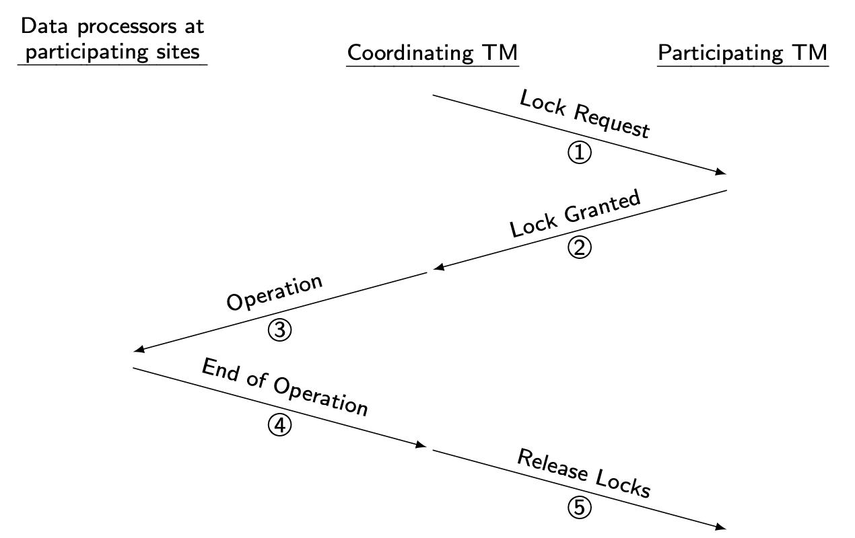
Centralized 2PL (C2PL)
There is only one Coordinating TM, the lock manager at the central site, and the data processors (DP) at the other participating sites.
The participating sites are those that store the data items on which the operation is to be carried out.
Lock requests are issued to Coordinating TM.
Notes:
Lock, lock, lock then unlock, unlock, unlock - this is the idea
Lock, unlock, lock, unlock is not allowed

Slide 22
Distributed 2PL (D2PL)
Lock managers are placed at each site. Each scheduler handles lock requests for data at that site. The distributed 2PL is similar to the C2PL, with two major modifications.
The messages that are sent to the central site lock manager in C2PL are sent to the lock managers at all participating sites in D2PL.
The second difference is that the operations are not passed to the data processors by the coordinating transaction manager, but by the participating lock managers.
This means that the coordinating transaction manager does not wait for a “lock request granted” message.

Slide 23
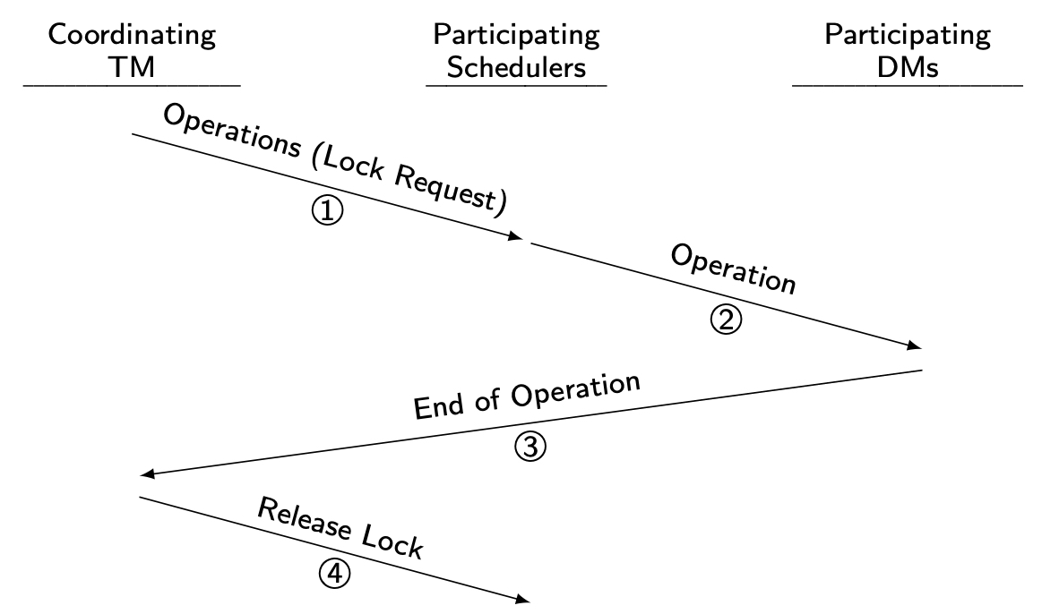
Distributed 2PL Execution

Slide 24
Deadlock
A transaction is deadlocked if it is blocked and will remain blocked until there is intervention.
Locking-based CC algorithms may cause deadlocks.
TO-based algorithms that involve waiting may cause deadlocks.
Wait-for graph
If transaction T_{i} waits for another transaction T_{j} to release a lock on an entity, then T_{i} → T_{j} in WFG.
T_{i}
T_{j}
Notes:
Wait forever.
If wait for graph has a cycle then deadlock is present, then we need to cut.

Slide 25
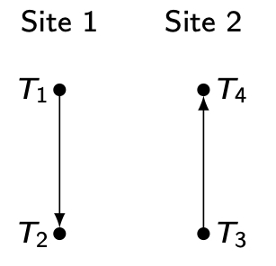
Local versus Global WFG
T₁ and T₂ run at site 1, T₃ and T₄ run at site 2.
T₃ waits for a lock held by T₄ which waits for a lock held by T₁ which waits for a lock held by T₂ which, in turn, waits for a lock held by T₃.
Local WFG
Global WFG

Slide 26
Deadlock Detection
Transactions are allowed to wait freely.
Wait-for graphs and cycles.
Topologies for deadlock detection algorithms
Centralized
Hierarchical
Distributed

Slide 27
Centralized Deadlock Detection
One site is designated as the deadlock detector for the system.
Each scheduler periodically sends its local WFG to the central site which merges them to a global WFG to determine cycles.
How often to transmit?
Too often ⇒ higher communication cost but lower delays due to undetected deadlocks
Too late ⇒ higher delays due to deadlocks, but lower communication cost
Would be a reasonable choice if the concurrency control algorithm is also centralized.
Proposed for Distributed INGRES
Notes:
One site doing all the detection.

Slide 28
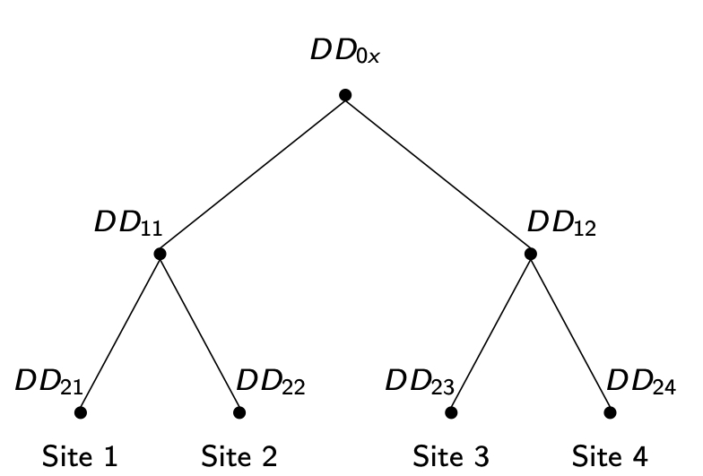
Hierarchical Deadlock Detection
An alternative to centralized deadlock detection is the building of a hierarchy of deadlock detectors (see Fig. below).
Deadlocks that are local to a single site would be detected at that site using the LWFG.
Each site also sends its LWFG to the deadlock detector at the next level.
For example, a deadlock at site 1 would be detected by the local deadlock detector (DD) at site 1 (denoted DD₂₁, 2 for level 2, 1 for site 1).
If, however, the deadlock involves sites 1 and 2, then DD₁₁ detects it.
Finally, if the deadlock involves sites 1 and 4, DD_{0x} detects it, where x is one of 1, 2, 3, or 4.
Notes:
DD – Deadlock Detector
DD12 – level 1 and site 2

Slide 29
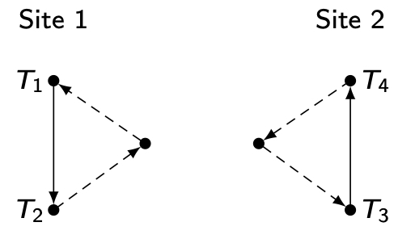
Distributed Deadlock Detection
There are local deadlock detectors at each site that communicate their LWFGs with one another. The LWFG at each site is formed and is modified as follows:
Since each site receives the potential deadlock cycles from other sites, these edges are added to the LWFGs.
The edges in the LWFG show that local transactions are waiting for transactions at other sites.

Slide 30
Distributed Deadlock Detection
If there is a cycle that does not include the external edges, there is a local deadlock that can be handled locally.
If, on the other hand, there is a cycle involving these external edges, there is a potential distributed deadlock and this cycle information has to be communicated to other deadlock detectors.
In the case of Example, the possibility of such a distributed deadlock is detected by both sites.
Notes:
Dotted line is external and line is local

Slide 31
Concurrency Control Algorithms
Pessimistic Algorithms
Locking-based Algorithms
Centralized (primary site) 2PL (Two-Phase Locking)
Distributed 2PL
Timestamp-based Algorithms
Basic TO (Timestamp Ordering)
Conservative TO
Multiversion Concurrency Control
Optimistic Algorithms

Slide 32
Timestamp Ordering
Transaction (T_{i}) is assigned a globally unique timestamp (using system clock) ts(T_{i}).
Transaction manager attaches the timestamp to all operations issued by the transaction.
Each data item is assigned a write timestamp (wts) and a read timestamp (rts):
rts(x) = largest timestamp of any read on x
wts(x) = largest timestamp of any write on x
Conflicting operations are resolved by timestamp order.
Notes:
Timestamp: Clock values are generated in the system.
When the transaction starts then clock cycle starts
Inside that, each data items are assigned to read the timestamp and write the timestamp

Slide 33
Basic Timestamp Ordering
Two conflicting operations O_{ij} of T_{i} and O_{kl} of T_{k} →
O_{ij} executed before O_{kl} iff ts(T_{i}) < ts(T_{k}).
T_{i} is called older transaction
T_{k} is called younger transaction
for R_{i}(x) for W_{i}(x)
if ts(T_{i}) < wts(x) if ts(T_{i}) < rts(x) or ts(T_{i}) < wts(x)
then reject R_{i}(x) then reject W_{i}(x)
else accept R_{i}(x) else accept W_{i}(x)
rts(x) ← ts(T_{i}) wts(x) ← ts(T_{i})
Notes:
System clock value is always increasing.
Ts(Ti) < ts(Tk) means Ti started before Tk
Reject then do again [restart – get new clock values]

Slide 34
Conservative Timestamp Ordering
Basic timestamp ordering tries to execute an operation as soon as it is accepted
progressive
too many restarts since there is no delaying
Conservative timestamping delays each operation until no operation with a smaller timestamp can arrive at that scheduler.
If this condition can be guaranteed, the scheduler will never reject an operation.
However, this delay introduces the possibility of deadlocks.

Slide 35
Concurrency Control Algorithms
Pessimistic Algorithms
Locking-based Algorithms
Centralized (primary site) 2PL (Two-Phase Locking)
Distributed 2PL
Timestamp-based Algorithms
Basic TO (Timestamp Ordering)
Conservative TO
Multiversion Concurrency Control
Optimistic Algorithms

Slide 36
Multiversion Concurrency Control (MVCC)
Do not modify the values in the database, create new values.
Implemented in a number of systems: IBM DB2, Oracle, SQL Server, SAP HANA, BerkeleyDB, PostgreSQL
MVCC techniques typically use timestamps to maintain transaction isolation
Each version of a data item that is created is labeled with the timestamp of the transaction that creates it.
The idea is that each read operation accesses the version of the data item that is appropriate for its timestamp, thus reducing transaction aborts and restarts.
Notes:
The basic idea is not to modify but instead create new values.

Slide 37
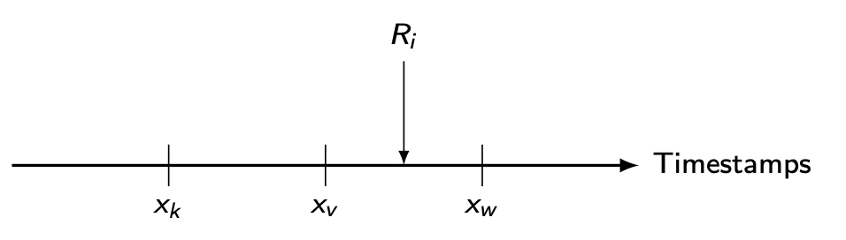
MVCC Reads
A R_{i}(x) is translated into a read on one version of x.
Find a version of x (say x_{v}) such that ts(x_{v}) is the largest timestamp less than ts(T_{i}).
Notes:
Ri is reading xv, the largest among the smallest.

Slide 38
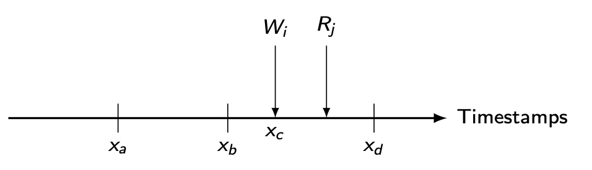
MVCC Writes
A W_{i}(x) is translated into W_{i}(x_{w}) so that ts(x_{w}) = ts(T_{i})
accepted if and only if no other transaction with a timestamp greater than ts(T_{i}) has read the value of a version of x (say, x_{r}), in other words, accepted if ts(x_{r}) < ts(x_{w})
Rejected If the scheduler has already processed any R_{j}(x_{r}) such that ts(x_{w}) < ts(x_{r})
If W_{i}(x) is accepted, it would create a version (x_{c}) that R_{j} should have read, but did not since the version was not available when R_{j} was executed
x_{r}
Notes:
If a younger transaction read, if we write then it’s a problem.

Slide 39
Concurrency Control Algorithms
Pessimistic Algorithms
Locking-based Algorithms
Centralized (primary site) 2PL (Two-Phase Locking)
Distributed 2PL
Timestamp-based Algorithms
Basic TO (Timestamp Ordering)
Conservative TO
Multiversion Concurrency Control
Optimistic Algorithms

Slide 40
Optimistic Concurrency Control Algorithms
Pessimistic execution
Validate
Read
Compute
Write
Optimistic execution
Read
Compute
Validate
Write
Notes:
Pessimistic is asking or checking something, but optimistic is not asking, any transaction can read or write.
Checking is later optimistic, it checks later after the transaction.

Slide 41
Optimistic Concurrency Control Algorithms
Transaction execution model: divide into subtransactions each of which execute at a site
T_{ks}: transaction T_{k} that executes at site s
Transactions run independently at each site until they reach the end of their read phases
All subtransactions are assigned a timestamp at the end of their read phase
Validation test is performed during validation phase. If one fails, all rejected.
Notes:
If one fail then all reject.

Slide 42
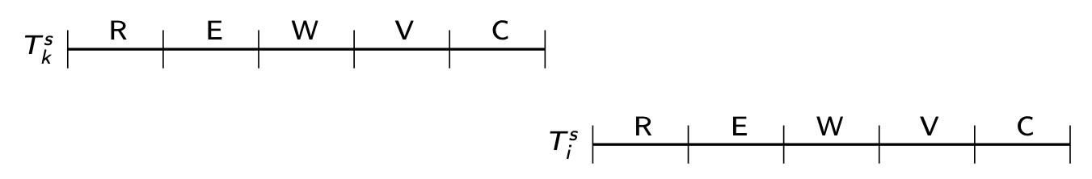
Optimistic CC Validation Test
If all transactions T_{ks} where ts(T_{ks}) < ts(T_{is}) have completed their write phase before T_{is} has started its read phase, then validation succeeds
Transaction executions in serial order
Notes:
Read, execution, write, validate, commit
k: transaction number,
s: site number
Tks Is older because it started first, and Tis is younger because it started after Tks

Slide 43
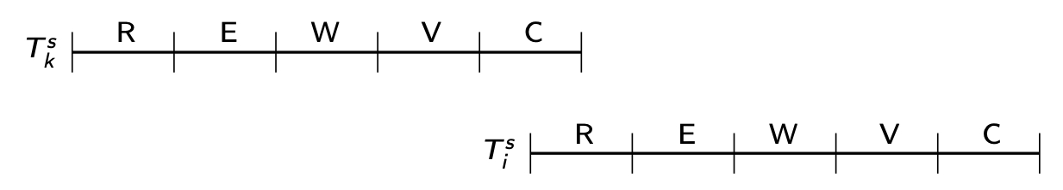
Optimistic CC Validation Test
If there is any transaction T_{ks} such that ts(T_{ks})<ts(T_{is}) and which completes its write phase while T_{is} is in its read phase, then validation succeeds if WS(T_{ks}) ∩ RS(T_{is}) = Ø
Read and write phases overlap, but T_{is} does not read data items written by T_{ks}
Notes:
WS – Write Set
RS – Read Set
WS(T_{ks}) ∩ RS(T_{is}) = Ø : means no intersection

Slide 44
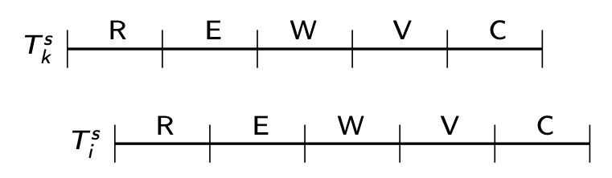
Optimistic CC Validation Test
If there is any transaction T_{ks} such that ts(T_{ks})< ts(T_{is}) and which completes its read phase before T_{is} completes its read phase, then validation succeeds if
WS(T_{ks}) ∩ RS(T_{is}) = Ø and WS(T_{ks}) ∩ WS(T_{is}) = Ø
They overlap, but don't access any common data items.

Slide 45
Outline
Distributed Transaction Processing
Distributed Concurrency Control
Distributed Reliability

Slide 46
Reliability
Problem:
How to maintain
atomicity
durability
properties of transactions
Ch.10/46

Slide 47
Types of Failures
Transaction failures
Transaction aborts (unilaterally or due to deadlock)
System (site) failures
Failure of processor, main memory, power supply, …
Main memory contents are lost, but secondary storage contents are safe
Partial vs. total failure
Media failures
Failure of secondary storage devices → stored data is lost
Head crash/controller failure
Communication failures
Lost/undeliverable messages
Network partitioning
Notes:
Transaction failure means deadlock or so on

Slide 48
Distributed Reliability Protocols
Distributed reliability protocols aim to maintain the atomicity and durability of distributed transactions.
Commit protocols
How to execute commit command for distributed transactions.
Issue: how to ensure atomicity and durability?
Termination protocols
If a failure occurs, how can the remaining operational sites deal with it?
Non-blocking: the occurrence of failures should not force the sites to wait until the failure is repaired to terminate the transaction.
Recovery protocols
When a failure occurs, how do the sites where the failure occurred deal with it?
Independent: a failed site can determine the outcome of a transaction without having to obtain remote information.
Independent recovery ⇒ non-blocking termination
Notes:
Even in case of failure how to maintain atomicity and durability.
Commit – transaction is complete and stores the updates in the disk.

Slide 49
Two-Phase Commit (2PC)
It is a very simple and elegant protocol that ensures the atomic commitment of distributed transactions.
Coordinator :The process at the site where the transaction originates and which controls the execution
Participant :The process at the other sites that participate in executing the transaction
Phase 1 : The coordinator gets the participants ready to write the results into the database
Phase 2 : Everybody writes the results into the database
Global Commit Rule:
The coordinator aborts a transaction if and only if at least one participant votes to abort it.
The coordinator commits a transaction if and only if all of the participants vote to commit it.
Notes:
The starting site is the coordinator and the other sites are participants.
Mostly starting site ends the transaction.
First, the coordinator sends a signal – I am starting this, then “Everything is ok” is sent. If all participant says “ok” then commit or else abort.

Slide 50
State Transitions in 2PC
Coordinator
Participant
COMMIT
Notes:
This is a simplified version of side 51.

Slide 51
2PC Protocol Actions
Notes:
This is in detail
We have 1 coordinator and multiple participants

Slide 52
Centralized 2PC

Slide 53
Linear 2PC
V-C: Vote-Commit, V-A: Vote-Abort, G-C: Global-commit, G-A: Global-abort
Notes:
One signal to one
Prepare: means initiate

Slide 54
Distributed 2PC
The coordinator sends the prepare message to all participants.
Each participant then sends its decision to all the other participants (and to the coordinator) by means of either a “vote-commit” or a “vote-abort” message.

Slide 55
Distributed 2PC
Each participant waits for messages from all the other participants and makes its termination decision according to the global-commit rule.
Obviously, there is no need for the second phase of the protocol, since each participant has independently reached that decision at the end of the first phase.

Slide 56
Dealing with Site Failures
Our aim is to develop nonblocking termination and independent recovery protocols.
Termination Protocol for 2PC
It serves the timeouts for both the coordinator and the participant processes.
A timeout occurs at a destination site when it cannot get an expected message from a source site within the expected time period.
In this section, we consider that this is due to the failure of the source site.
Recovery Protocol for 2PC
It serves the failures for both the coordinator and the participant processes.
3PC Protocol

Slide 57
Site Failures - 2PC Termination
Timeout in WAIT
Coordinator is waiting for the local decisions of the participants.
Cannot unilaterally commit since the global-commit rule has not been satisfied.
Can unilaterally abort
Timeout in ABORT or COMMIT
Not certain that the commit or abort procedures have been completed by the participant sites.
Thus the coordinator repeatedly sends the “global-commit” or “global-abort” commands to the sites that have not yet responded, and waits for their acknowledgement.
Notes:
There are 2 waits when we consider for coordinator.

Slide 58
Site Failures - 2PC Termination
Timeout in INITIAL
Participant is waiting for a “prepare” message.
Coordinator must have failed in INITIAL state
Unilaterally abort
Timeout in READY
Participant has voted to commit the transaction but does not know the global decision of the coordinator.
The participant cannot unilaterally reach a decision.
Stay blocked until it can learn from someone (either the coordinator or some other participant) the ultimate fate of the transaction

Slide 59
Site Failures - 2PC Recovery
Failure in INITIAL
Start the commit process upon recovery
Failure in WAIT
Restart the commit process upon recovery
Failure in ABORT or COMMIT
Nothing special if all the acks have been received
Otherwise the termination protocol is involved

Slide 60
Site Failures - 2PC Recovery
Failure in INITIAL
Unilaterally abort upon recovery
Failure in READY
The coordinator has been informed about the local decision
Treat as timeout in READY state and invoke the termination protocol
Failure in ABORT or COMMIT
These states represent the termination conditions, so, upon recovery, the participant does not need to take any special action.

Slide 61
2PC Recovery Protocols – Additional Cases
A site failure may occur after the coordinator or a participant has written a log record but before it can send a message
Coordinator site fails after writing “begin_commit” log and before sending “prepare” command
treat it as a failure in WAIT state; send “prepare” command upon recovery

Slide 62
2PC Recovery Protocols – Additional Cases
A site failure may occur after the coordinator or a participant has written a log record but before it can send a message
Participant site fails after writing “ready” record in log but before “vote-commit” is sent
treat it as failure in READY state
alternatively, can send “vote-commit” upon recovery

Slide 63
2PC Recovery Protocols – Additional Cases
A site failure may occur after the coordinator or a participant has written a log record but before it can send a message
Participant site fails after writing “abort” record in log but before “vote-abort” is sent
no need to do anything upon recovery

Slide 64
2PC Recovery Protocols – Additional Case
Coordinator site fails after logging its final decision record but before sending its decision to the participants
coordinator treats it as a failure in COMMIT or ABORT state
participants treat it as timeout in the READY state

Slide 65
2PC Recovery Protocols – Additional Case
Participant site fails after writing “abort” or “commit” record in log but before acknowledgement is sent
participant treats it as failure in COMMIT or ABORT state
coordinator will handle it by timeout in COMMIT or ABORT state

Slide 66
Problem With 2PC
Blocking
Ready implies that the participant waits for the coordinator
If coordinator fails, site is blocked until recovery
Blocking reduces availability
Independent recovery is not possible
However, it is known that:
Independent recovery protocols exist only for single site failures;
no independent recovery protocol exists which is resilient to multiple-site failures.
So we search for these protocols – 3PC

Slide 67
Three-Phase Commit
3PC is non-blocking.
A commit protocols is non-blocking iff
it is synchronous (occurring) within one state transition, and
its state transition diagram contains
no state which is “adjacent” to both a commit and an abort state, and
no non-committable state which is “adjacent” to a commit state
Adjacent: possible to go from one state to another with a single state transition
Committable: all sites have voted to commit a transaction
e.g.: COMMIT state

Slide 68
State Transitions in 3PC
add another state between the WAIT (and READY) and COMMIT states which serves as a buffer state where the process is ready to commit (if that is the final decision) but has not yet committed.
Coordinator
Participant
Notes:
Abort and commit are not adjacent (Not side by side)
We added pre-commit to satisfy the rules in slide 67.

Slide 69
2PC Protocol Actions
Notes:
At least understand what’s going on.

Slide 70
3PC Protocol Actions
Notes:
No need this but at least you need to know 2PC

Slide 71
Network Partitioning
Simple partitioning
Only two partitions
Multiple partitioning
More than two partitions
Formal bounds:
There exists no non-blocking protocol that is resilient to a network partition if messages are lost when partition occurs.
There exist non-blocking protocols which are resilient to a single network partition if all undeliverable messages are returned to sender.
There exists no non-blocking protocol which is resilient to a multiple partition.

Slide 72
Independent Recovery Protocols for Network Partitioning
No general solution possible
allow one group to terminate while the other is blocked
improve availability
How to determine which group to proceed?
The group with a majority
How does a group know if it has majority?
Centralized
Whichever partitions contains the central site should terminate the transaction
Voting-based (quorum)
Notes:
If the network is blocked then we cannot decide whether to commit or abort.
There are 3 groups, between groups they can communicate, but one group to another group cannot communicate (Partitioned).

Slide 73
Quorum Protocols
The network partitioning problem is handled by the commit protocol.
Every site is assigned a vote V_{i}.
Total number of votes in the system V
Abort quorum V_{a}, commit quorum V_{c}
V_{a} + V_{c} > V where 0 ≤ V_{a} , V_{c} ≤ V
Before a transaction commits, it must obtain a commit quorum V_{c}
Before a transaction aborts, it must obtain an abort quorum V_{a}
The first rule ensures that a transaction cannot be committed and aborted at the same time.
The next two rules indicate the votes that a transaction has to obtain before it can terminate one way or the other.
Notes:
How to control the Quorums.
A transaction cannot commit and abort at the same time.

Slide 74
Paxos Consensus Protocol
2PC has blocking, and to overcome it, we have 3PC which is expensive and not resilient to network partitioning
General problem: how to reach an agreement (consensus) among TMs about the fate of a transaction
General idea: If a majority reaches a decision, the global decision is reached (like voting)
Paxos is a family of protocols for solving consensus in a network of unreliable or fallible processors.
Consensus is the process of agreeing on one result among a group of participants.
Notes:
3PC is more expensive than 2PC
If there is no network partitioning in 3PC then it's not working well.
We need to decide what to do with the transaction (commit or abort).

Slide 75
Paxos
Roles:
Proposer: recommends a decision
Acceptor: decides whether to accept the proposed decision
Learner: discovers the agreed-upon decision by asking or it is pushed
Naïve Paxos: one proposer
Operates like a 2PC
In the first round, the proposer suggests a value for the variable and acceptors send their responses (accept/not accept).
If the proposer gets accepts from a majority of the acceptors, then it determines that particular value to be the value of the variable and notifies the acceptors who now record that value the final one.
A learner can, at any point, ask an acceptor what the value of the variable is and learn the latest value.

Slide 76
Paxos & Complications
Multiple proposers can put forward a value for the same variable. Therefore, an acceptor needs to pick one of the proposed values.
using a ballot number so that acceptors can differentiate different proposals
Given multiple proposals, it is possible to get split votes on multiple proposals with no proposed value receiving a majority.
running multiple consensus rounds—if no proposal achieves a majority, then another round is run and this is repeated until one value achieves majority
Notes:
For transactions with multiple participants we need multiple proposers.

Slide 77
Paxos & Complications
It is possible that some of the acceptors fail after they accept a value. If the remaining acceptors who accepted that value do not constitute a majority, this causes a problem.
this could be treated as the second issue and a new round can be started.
However, the complication is that some learners may have learned the accepted value from acceptors in the previous round, and if a different value is chosen in the new round we have inconsistency.
Paxos deals with this again by using ballot numbers.

Slide 78
Basic Paxos with Failures
Some acceptors fail but there is quorum
Not a problem
Enough acceptors fail to eliminate quorum
Run a new ballot
Proposer/leader fails
Choose a new leader and start a new ballot
Notes:
Acceptors are accepting, but after that, something is happening.

Slide 79
Assignment #3

