Slide 1


Problem Statement
Smart Panic SOS Button with Live Location & Voice Feed
An IoT-based Emergency Safety System

Slide 2


The Critical Need for Instant Emergency Response
In critical moments, every second counts. Traditional emergency responses face significant challenges that delay help when it's needed most, highlighting the urgent need for smarter solutions.
Rising Emergency Incidents
Communication Delays
One-Touch Solution
Growing need for instant, reliable emergency response systems in urban and remote areas
Manual calling or messaging takes precious time during panic situations when coordination is impaired
A wearable safety device that activates with a single press, sharing location and audio instantly

Slide 3


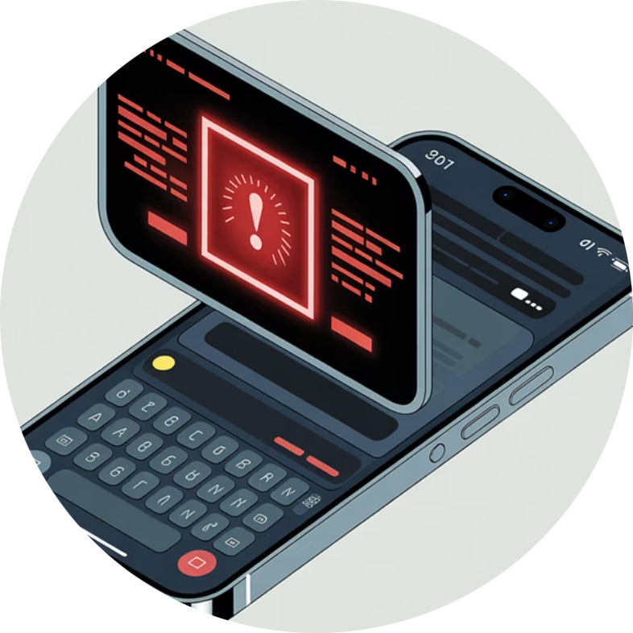
CORE STRATEGY
KEY CAPABILITIES
Project Objectives & Core Capabilities
Real-Time Location Sharing
Voice Capture System
Instant Alert Delivery
Instant GPS coordinates transmitted to emergency contacts with Google Maps integration for precise positioning
10-15 second audio recording of surroundings provides situational awareness to first responders
Automated SMS and data transmission ensures emergency contacts receive alerts within seconds

Slide 4

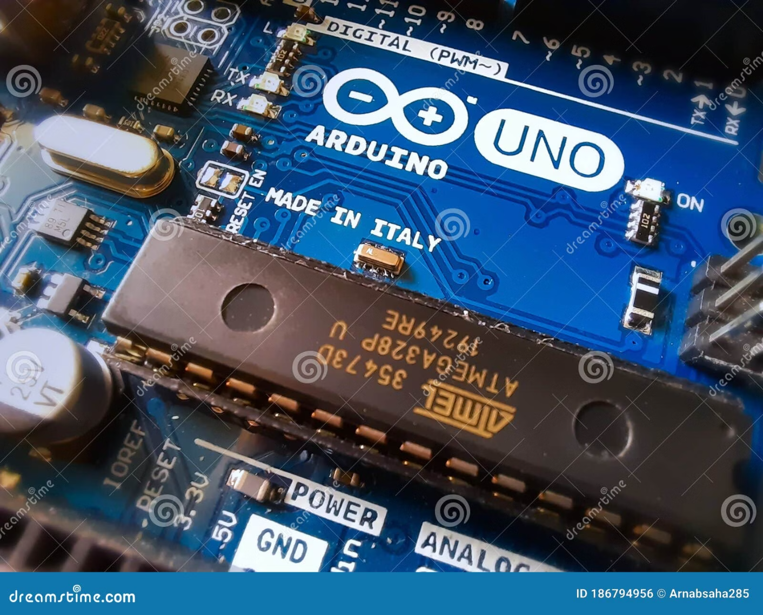
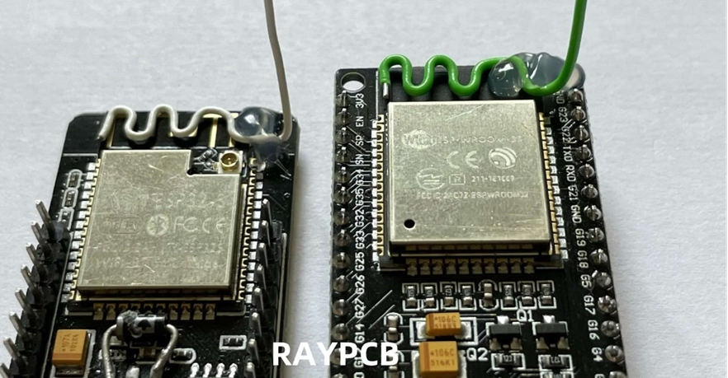
Selecting the Best Controller Board
The controller board serves as the brain of the SOS device, managing button input detection, GPS data processing, audio capture, and wireless communication. Choosing the right microcontroller is critical for system reliability and performance.
ESP32 Board
Advanced dual-core processor with built-in wireless connectivity
Arduino Board
Popular beginner-friendly platform with extensive community support

Slide 5
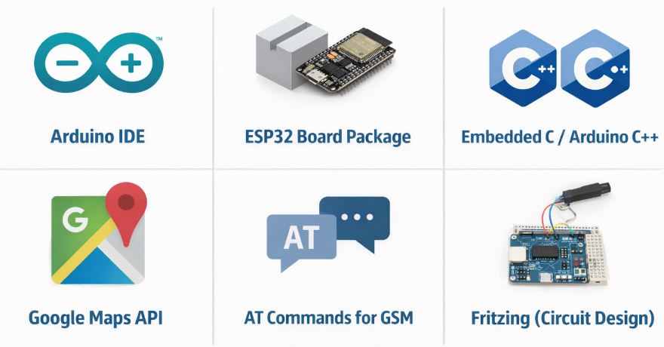
Required Software Tools
Arduino IDE
ESP32 Board Package
Embedded C / Arduino C++
Google Maps API (for location link)
AT Commands for GSM
Fritzing (for circuit diagram)

Slide 6
General Hardware Requirements
GPS Module
SOS Push Button
NEO-6M / NEO-7M: Captures real-time latitude and longitude coordinates with high accuracy for precise location sharing
Physical panic trigger with 5-second press-and-hold activation to prevent accidental alerts while ensuring quick access
Microphone Module
GSM Module
I2S Microphone (MAX9814) : Captures high-quality ambient audio for 10-15 seconds, providing critical situational context
SIM800L / E9G: Transmits SMS alerts, initiates calls, and sends data packets over cellular networks
Power System
Feedback Indicators
Rechargeable Li-ion battery with charging module and voltage regulation for portable, reliable operation
Buzzer and LED provide immediate user confirmation of system activation and status updates

Slide 7
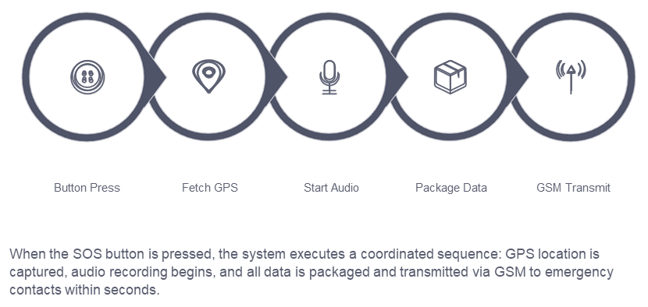
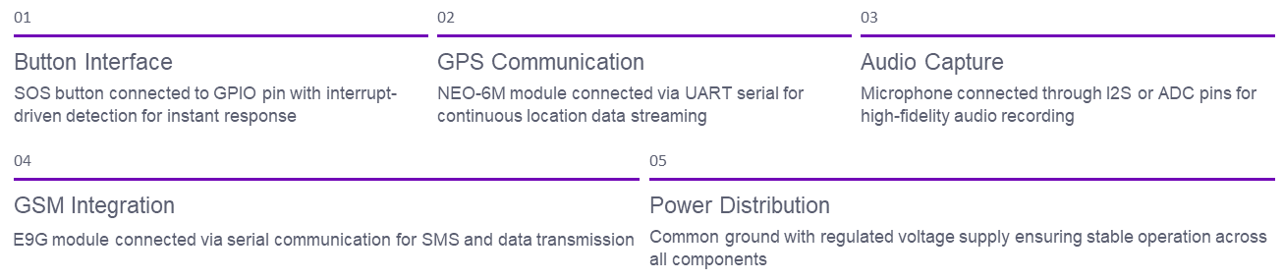
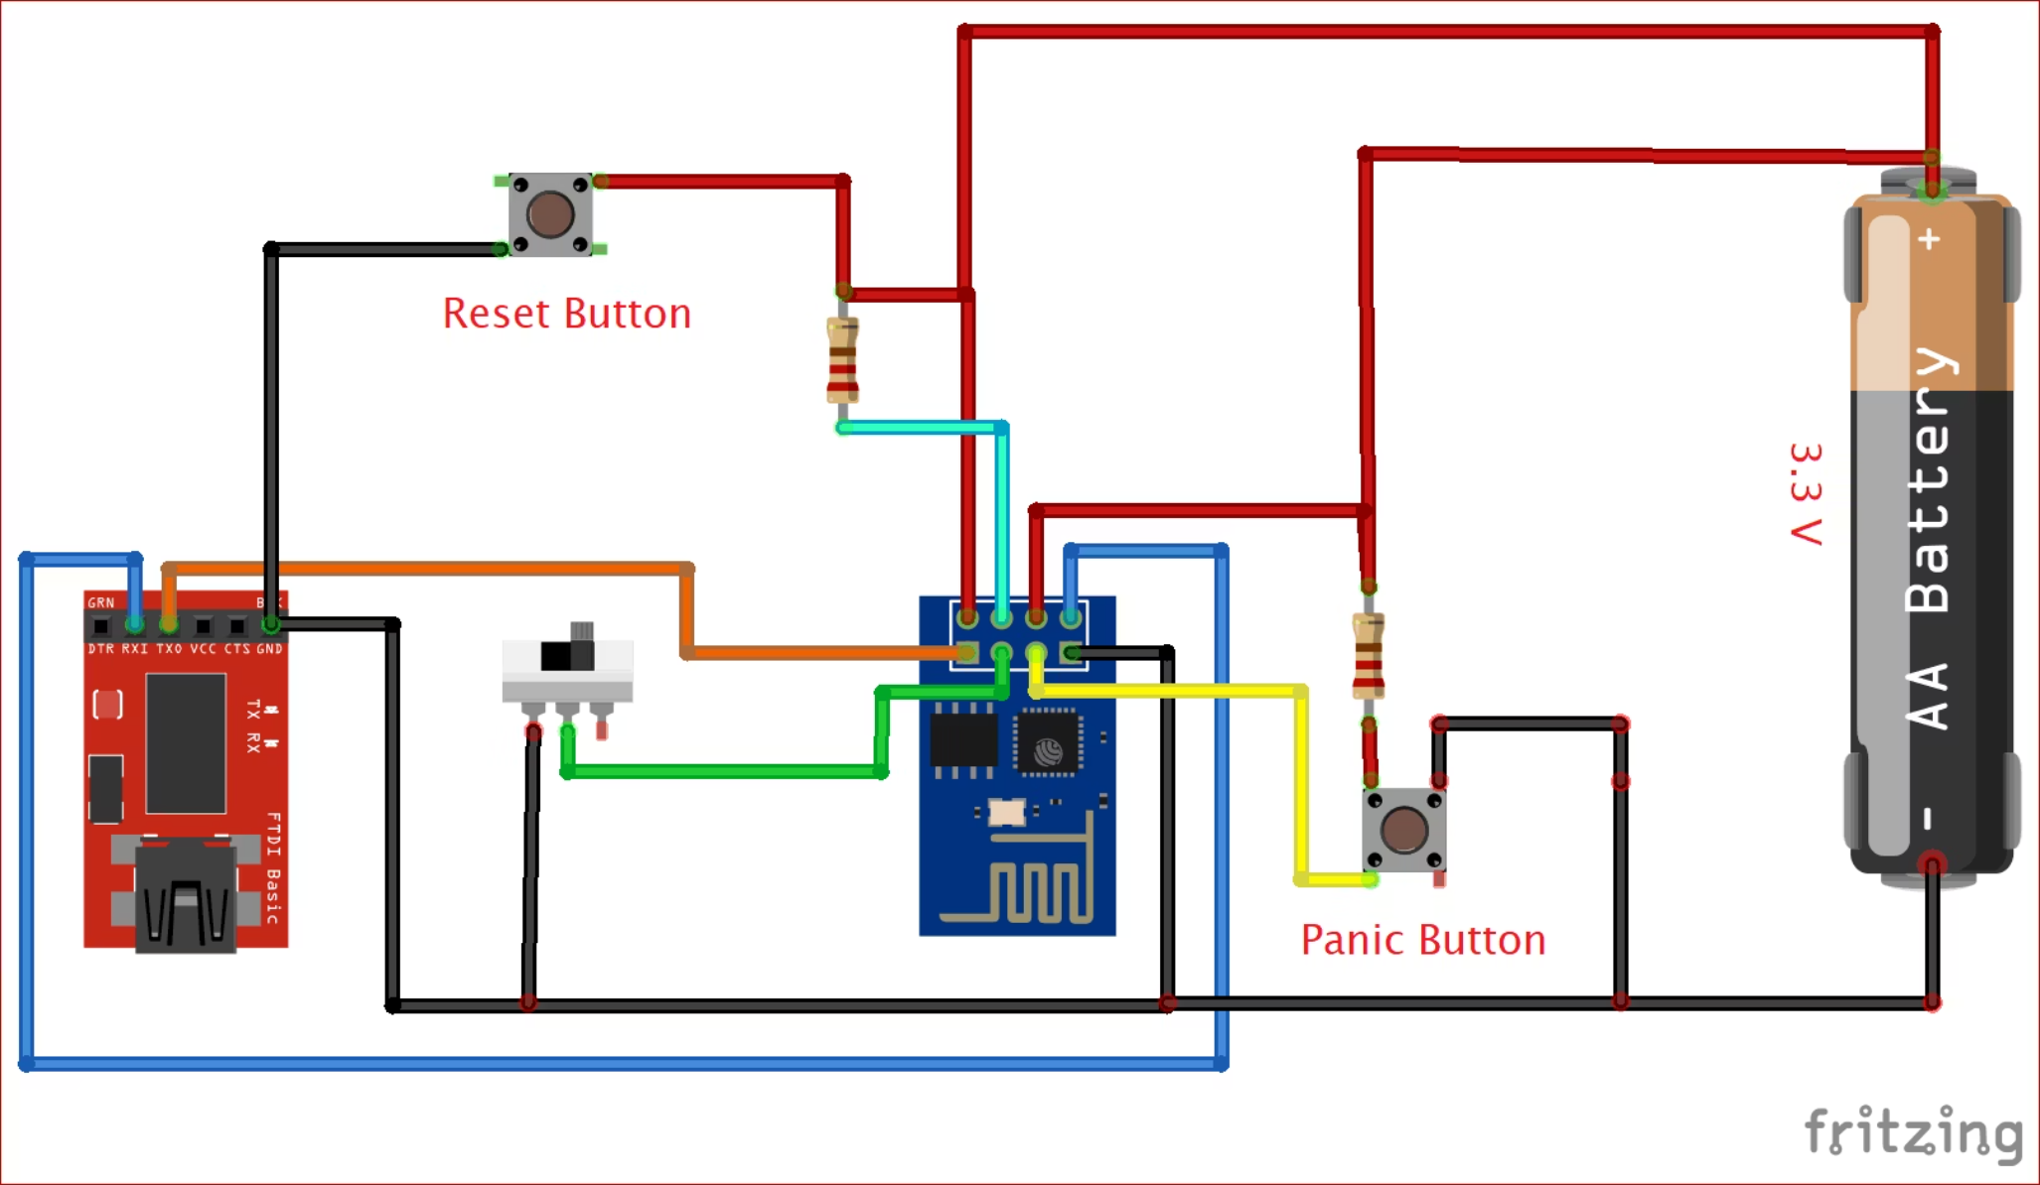
SYSTEM ARCHITECTURE
Circuit Design & Communication Flow
Data Flow Sequence
Hardware Connections
The ESP32 serves as the central hub, coordinating all peripheral modules through various communication protocols.

