Slide 1
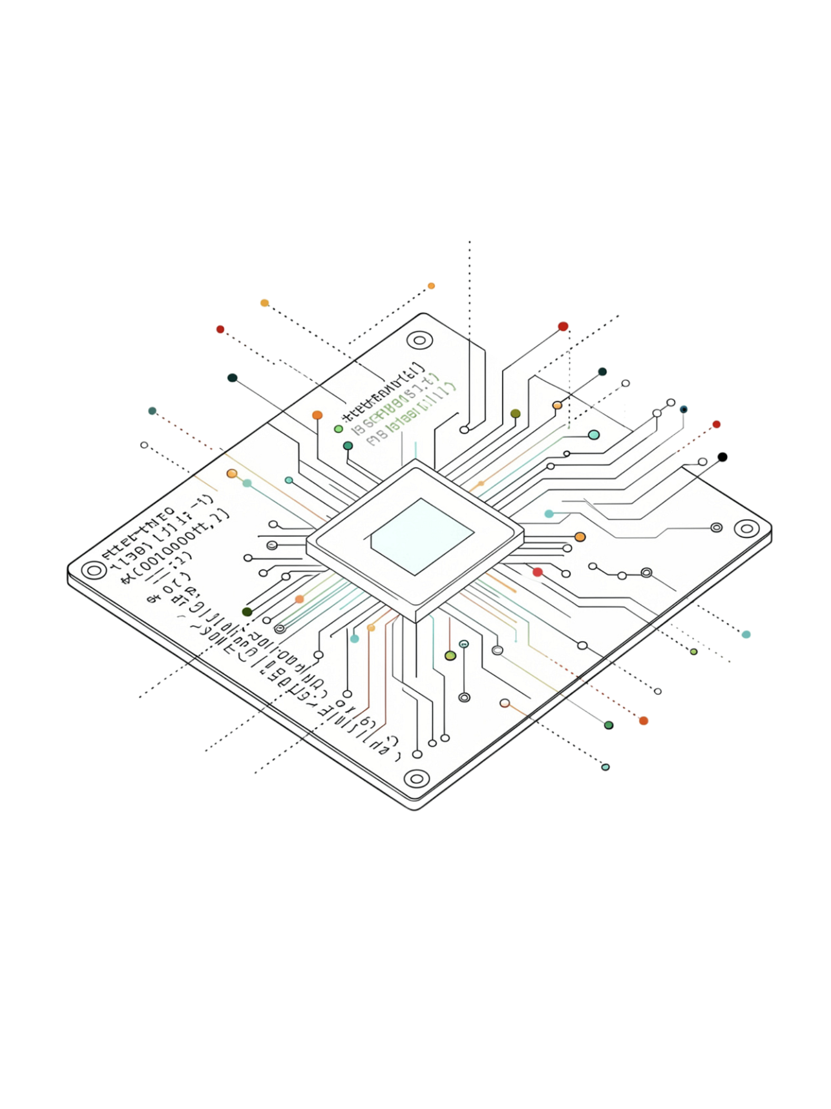
AGENTIC CODE INTELLIGENCE
Semantic Retrieval of Relevant Code from Large Code Libraries
SAMSUNG PRISM 2026

Slide 2

From Natural Language to the Right Code
Challenge
Example Query
Constraints
Given a natural-language query, retrieve relevant code from 8,765 snippets without exhaustive LLM ranking.
Snippets may be long; semantic relevance required; brute-force LLM ranking is computationally inefficient.
"How is the input preprocessed before going to the main function?"

Slide 3
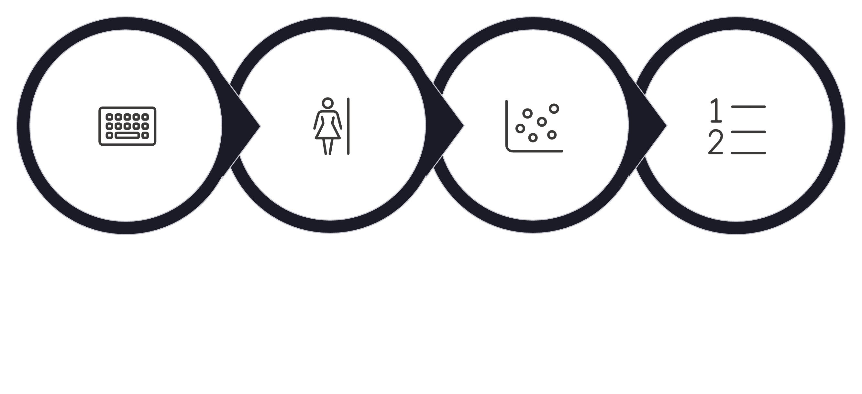
CPU-Efficient Semantic Code Retrieval
MiniLM Encoder
Cosine Similarity
Query Input
Ranked Top-K
CPU-Compatible
Cached Embeddings
Deterministic Ranking
No GPU dependency — fully runnable on standard hardware.
8,765 snippets pre-embedded and indexed at startup.
Cosine similarity ensures reproducible, stable retrieval order.

Slide 4
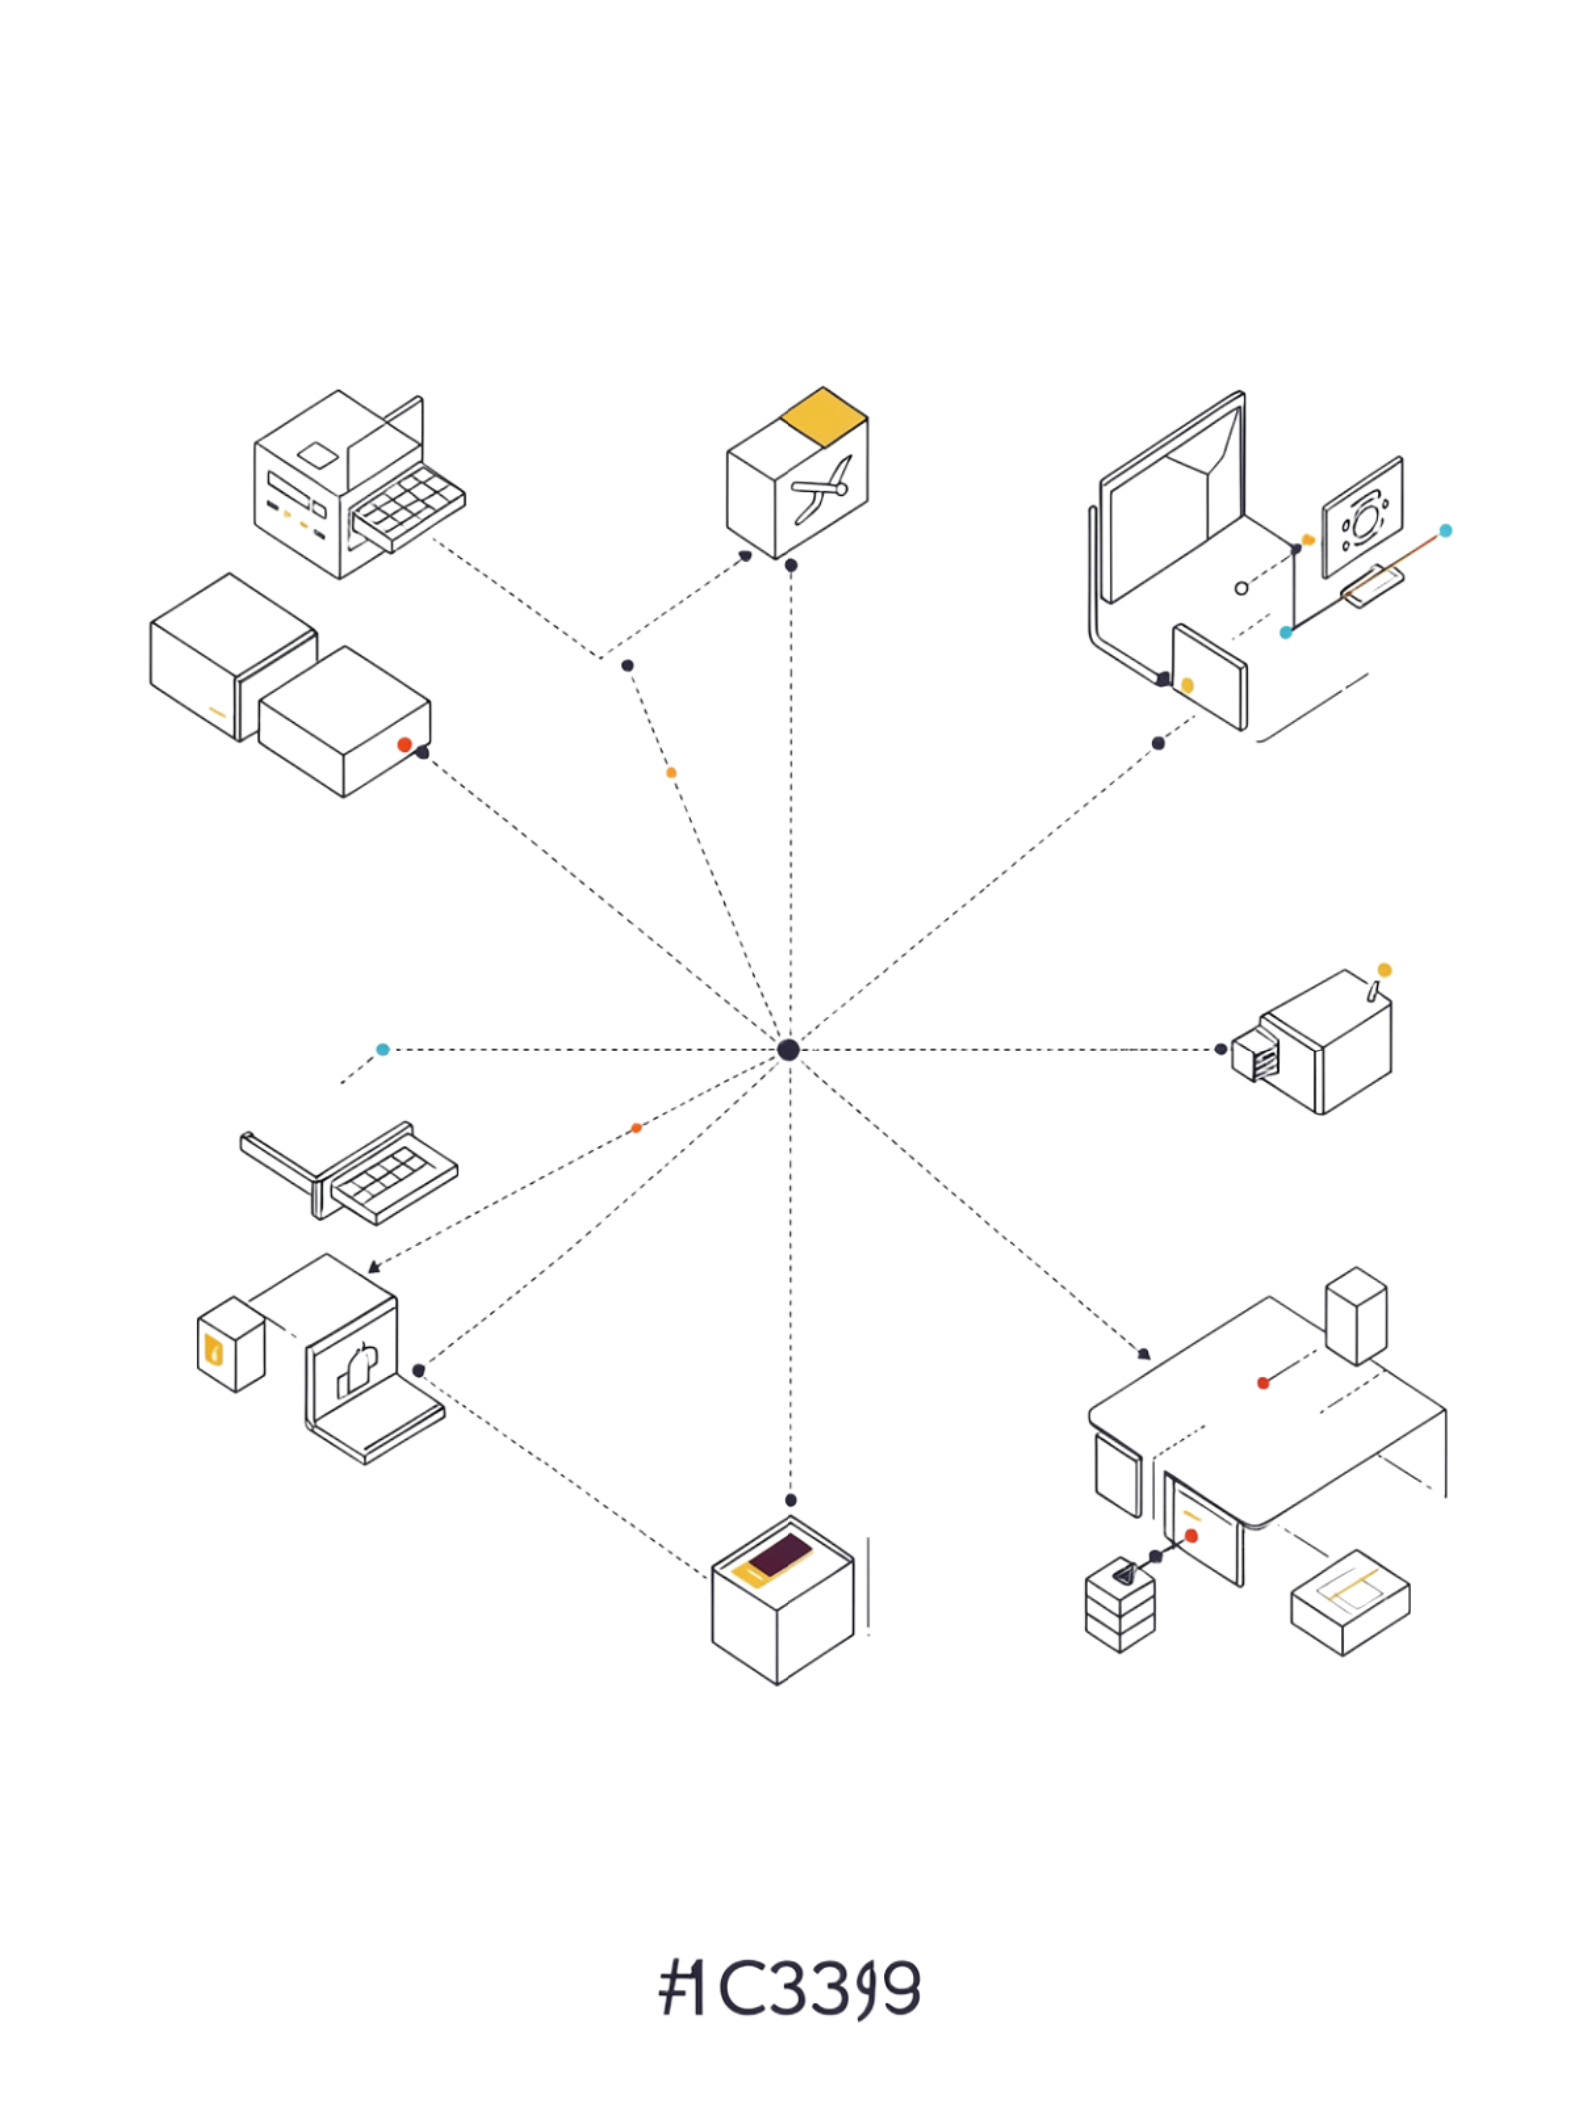
Making Code Searchable by Meaning
Representation Pipeline
Candidate Improvement
Code snippet → Text representation → MiniLM embedding → Vector space
Prefix "python code:" prepended to each snippet — provides explicit language context to the encoder without changing model weights or architecture.
Official Baseline
Title concatenated with raw code text, passed directly to the encoder.
Key Finding
This minimal prefix improves both NDCG@10 and MRR@10 over the official baseline with zero additional compute cost.

Slide 5
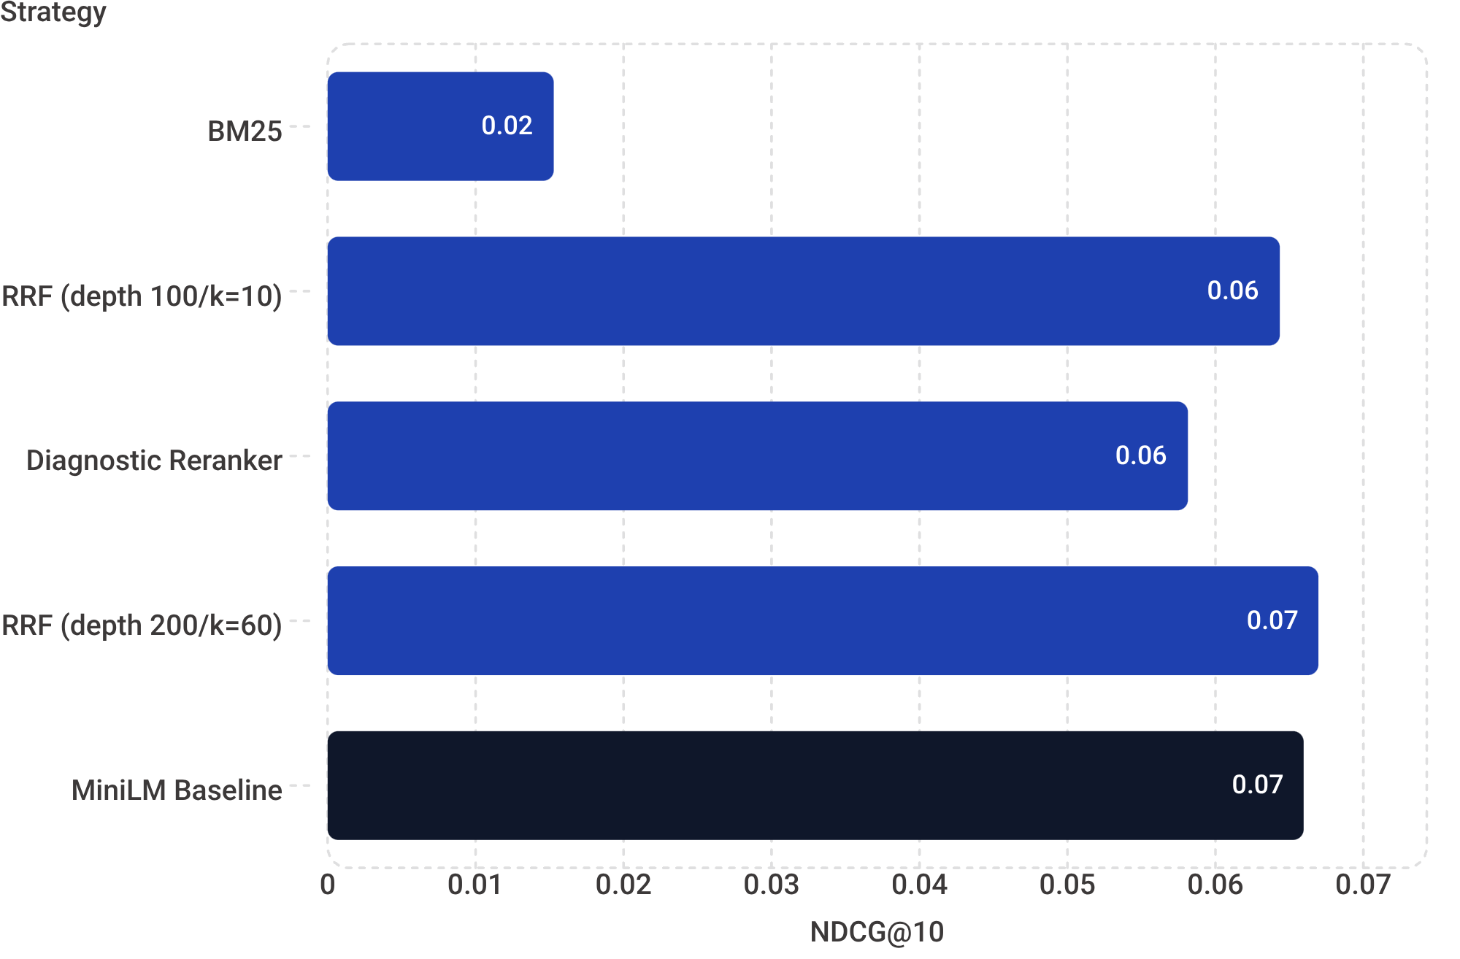

We Tested Multiple Retrieval Strategies
Strategy Comparison — NDCG@10
Five distinct retrieval strategies were evaluated on the AppsRetrieval test set.
MiniLM baseline: MRR@10 0.05581
BM25: MRR@10 0.01293 — sparse retrieval underperforms on code semantics
RRF (200/60): MRR@10 0.05499
RRF (100/10): MRR@10 0.05663
Diagnostic reranker: MRR@10 0.04774
Dense embedding consistently outperforms sparse BM25 for semantic code retrieval.

Slide 6
A Small Representation Change Improved Both Metrics
+4.9%
+4.2%
NDCG@10 Gain
MRR@10 Gain
0.06596 → 0.06922 with "python code:" prefix
0.05581 → 0.05814 with "python code:" prefix
Methodological Note
Representation | NDCG@10 | MRR@10
Official MiniLM baseline | 0.06596 | 0.05581
python code: prefix ✓ Selected | 0.06922 | 0.05814
[LANGUAGE] + [CODE] sections | 0.06917 | 0.05770
These are exploratory test-set measurements. AppsRetrieval provides no train/dev relevance split, so results reflect test-set performance only and should not be interpreted as generalization estimates.

Slide 7
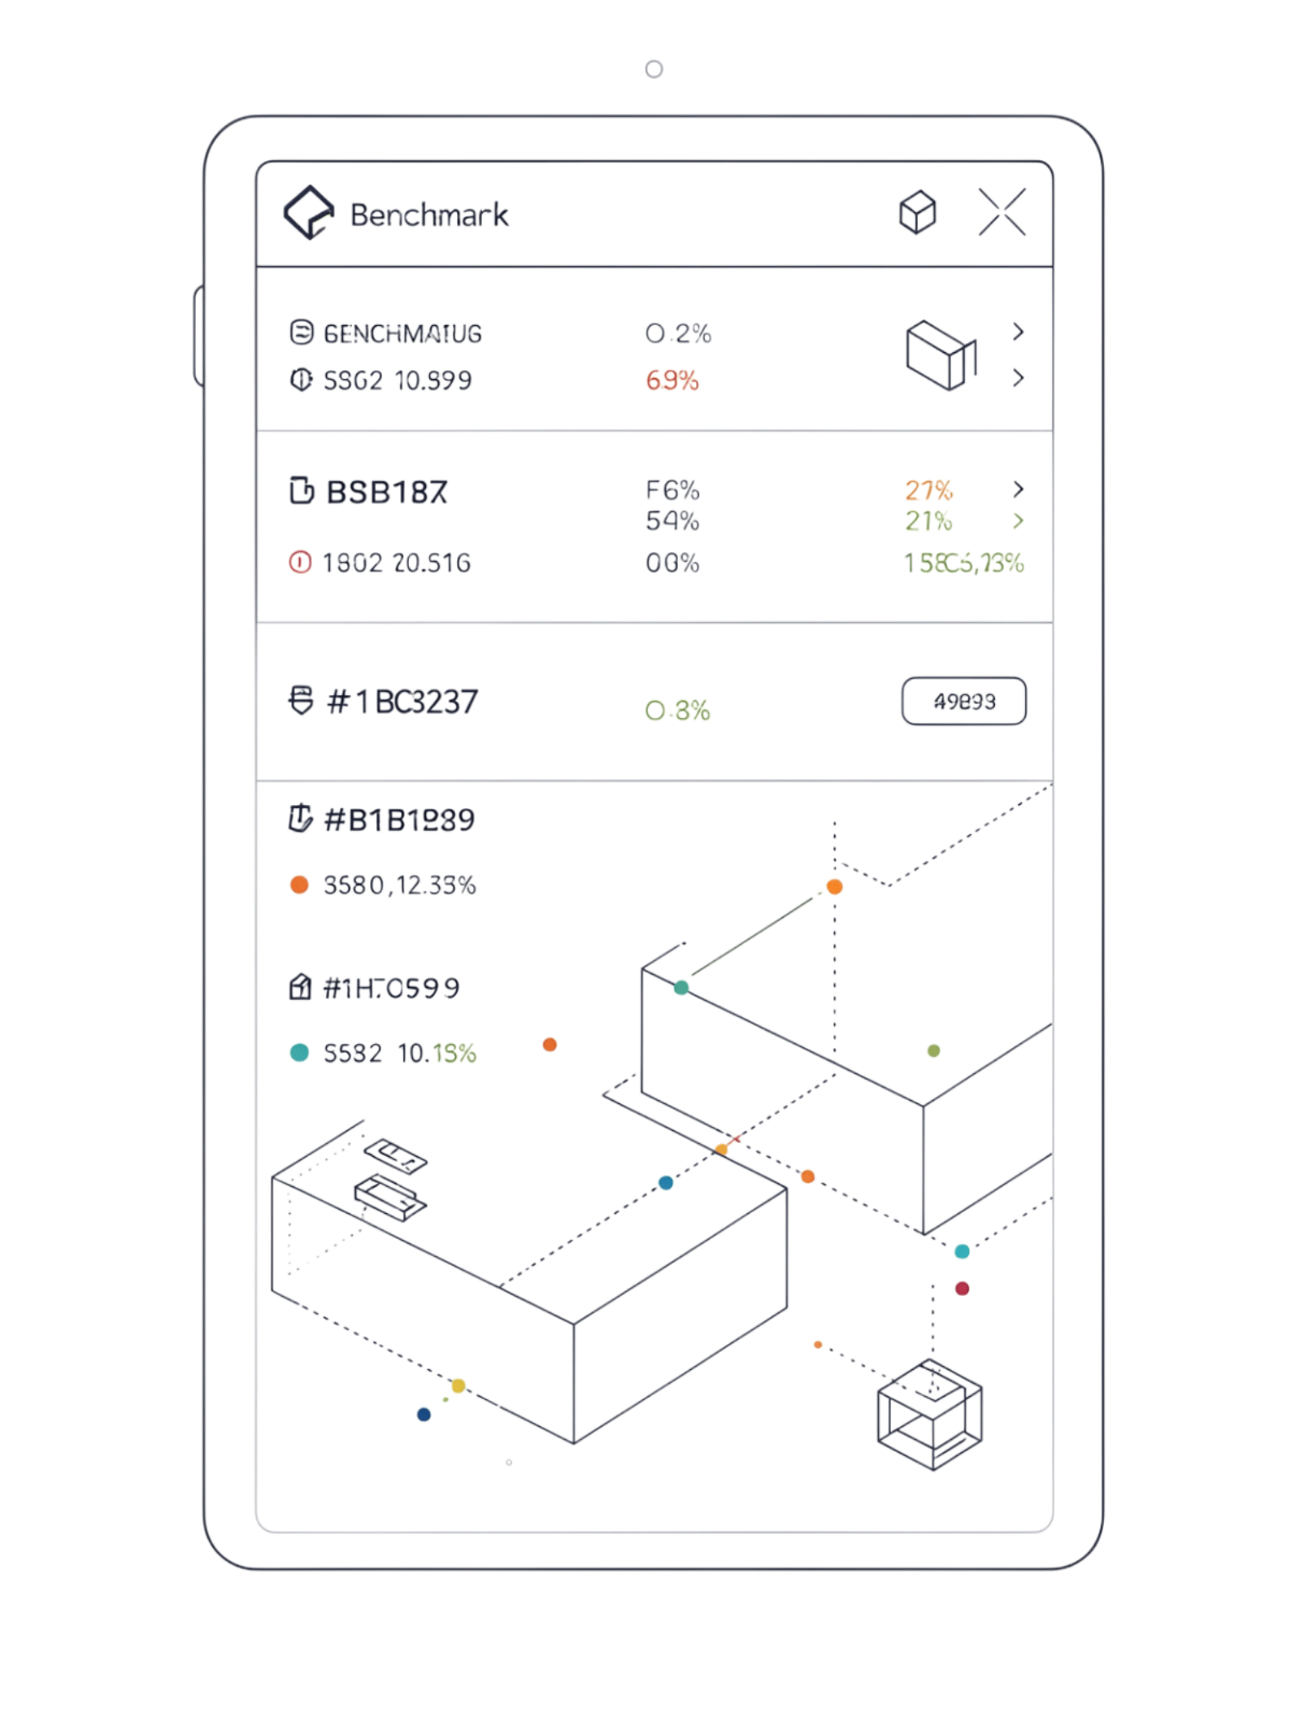
MTEB AppsRetrieval Evaluation
Corpus
8,765 Python code snippets
Queries
3,765 natural-language programming questions
Final NDCG@10
0.06922
Final MRR@10
0.05814
Execution Profile
Submission Artifact
CPU-only · ~260s MTEB task time · ~1.46 GB peak memory
Model: sentence-transformers/all-MiniLM-L6-v2
Revision: 1110a243fdf4706b3f48f1d95db1a4f5529b4d41
Ranked top-10 document IDs for all 3,765 queries:
artifacts/submission/
apps_retrieval_test_top10.json

Slide 8
Live Semantic Code Retrieval
Demo Query Categories
$ python retrieve.py \
--query "Use breadth-first search to find
shortest path distances in an
unweighted graph"
Searching 8,765 snippets...
Rank 1 | Score: 0.7831
def bfs_shortest_path(graph, start):
distances = {start: 0}
queue = deque([start])
while queue:
node = queue.popleft()
...
Rank 2 | Score: 0.7214
def shortest_path_unweighted(adj, src):
...
Retrieval time: 0.38s (CPU)
Graph Algorithms
Input Preprocessing
BFS / DFS shortest path traversal
Query how data is structured before main functions
Data Structures
Stack, queue, and tree operations
Output: top-K results with code preview and similarity score per query.

Slide 9
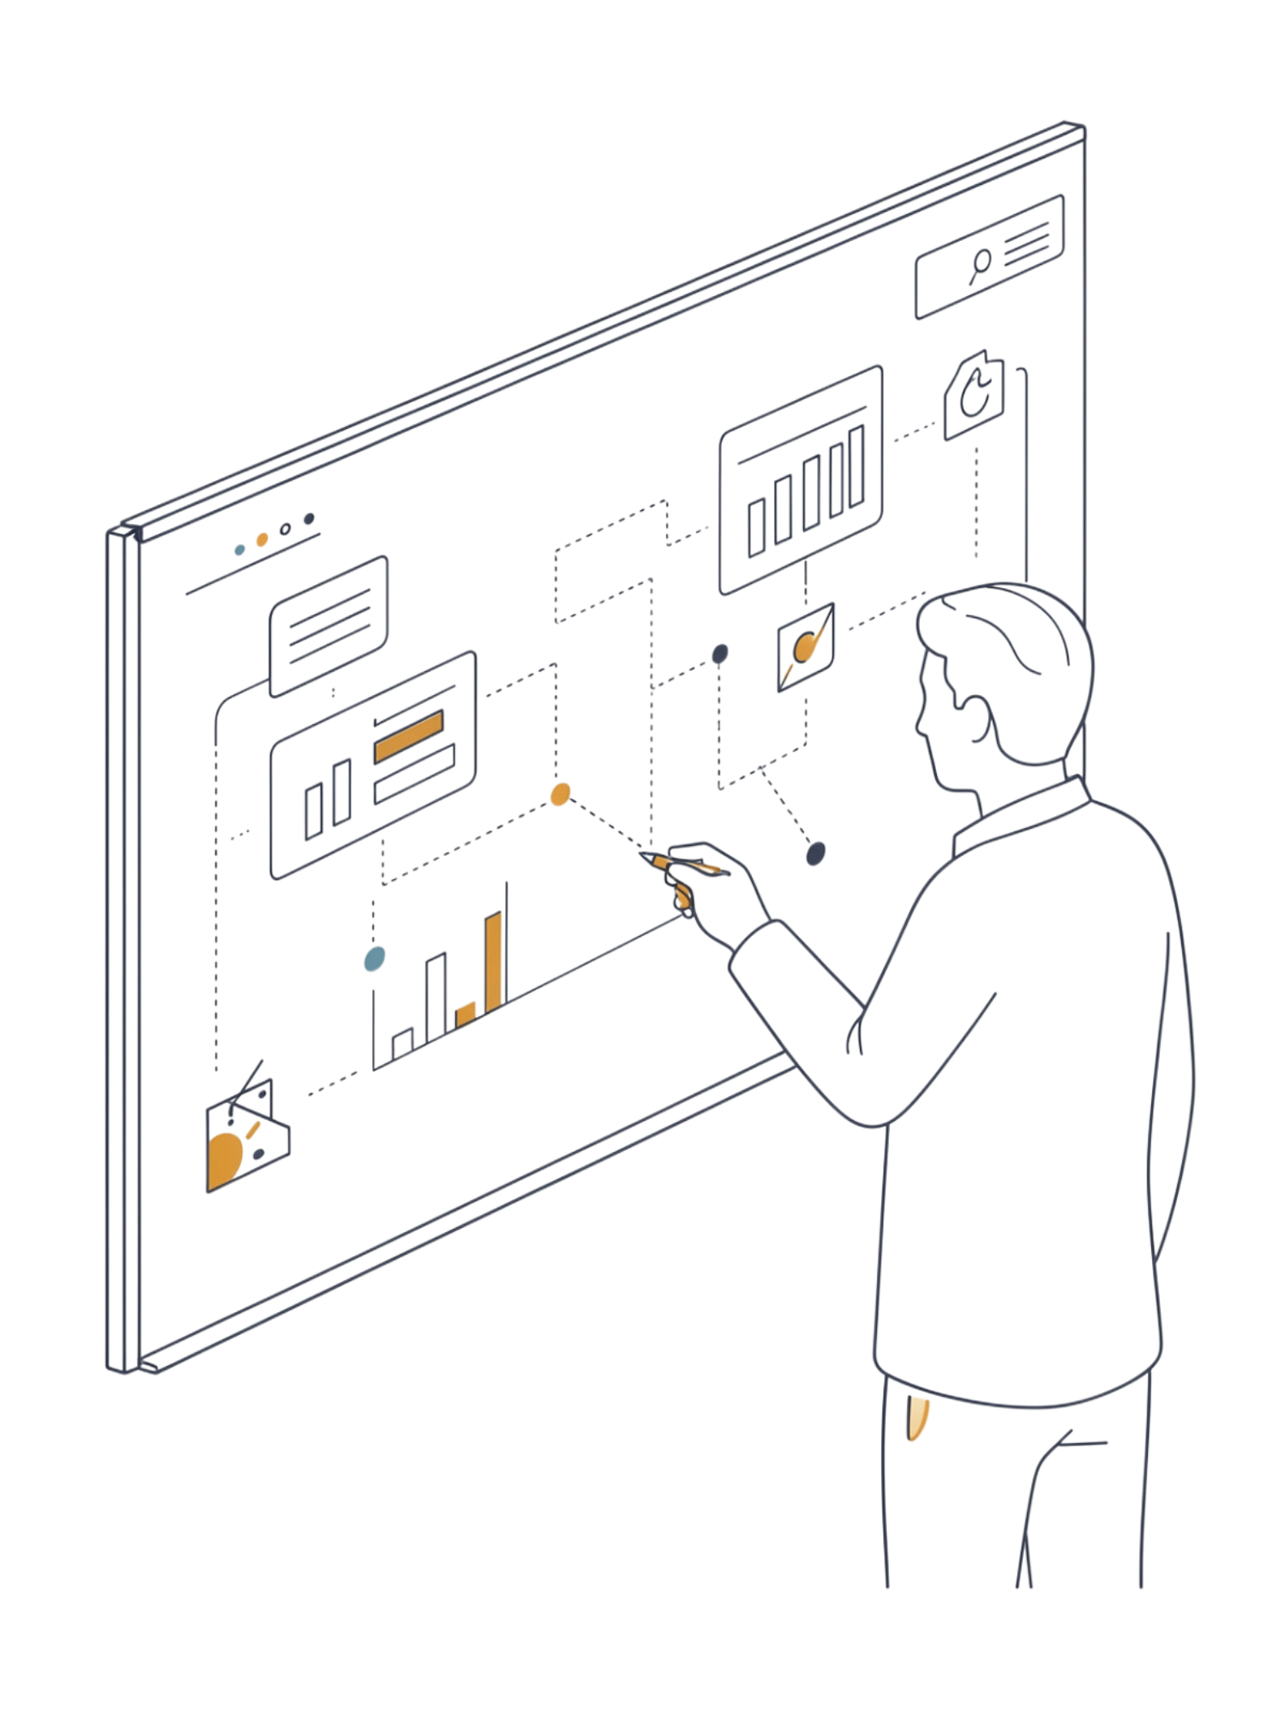

Key Takeaways
1
Semantic retrieval without LLM ranking
Natural-language queries retrieve relevant code via dense embeddings — no large model inference at query time.
2
CPU-friendly and scalable
Embedding pipeline handles 8,765 snippets at ~1.46 GB peak memory; no GPU required.
3
Representation matters
Five retrieval strategies and multiple text representations were rigorously compared on the MTEB AppsRetrieval benchmark.
4
Reproducible predictions
Deterministic pipeline produces stable MTEB AppsRetrieval submissions via apps_retrieval_test_top10.json.
Future work: Version-aware retrieval · multi-pass retrieval · stronger code-aware representations · learned reranking with labeled data

