Slide 1


Slide 2

Mini Project (01CE0609)
Semester 6
Review 1 07/03/2026
India District-Wise Weather & Air-Quality Monitoring Dashboard (EnviroWatch)
Team ID: T_024
Team Member 1: Rajnishkumar Sinh (92410103096) (6EC5-B)
Team Member 2: Kishan Vachhani (92410103097) (6EC5-B)
Guided By
Internal Guide
Prof. Viraj Daxini
Department of Computer Engineering, Faculty of Engineering & Technology

Slide 3
Abstract
Build a dashboard using C# .NET, MS SQL, JavaScript/jQuery and charting libraries. Pull current weather from OpenWeatherMap (free tier) and AQI from IQAir / AirVisual or OpenWeather’s AQI endpoint (free for development within limits). Store periodic snapshots in MS SQL for 7/30-day trend charts, allow users to subscribe (via social login) to district alerts, and export reports. This helps communities track pollution trends and prepare alerts.

Slide 4
Outline
Introduction
Problem Statement
Objective
Literature review
Existing System & Limitations
Tools & Technologies
Project Structure
Features
How Project works
Database Design
Challenges Faced
Future Scope
Conclusion
Reference

Slide 5

Introduction
▸ Air pollution is one of India's most pressing environmental crises — over 1.67 million deaths per year (Lancet, 2019)
▸ India has 21 of the world's 30 most polluted cities (IQAir 2023 World Air Quality Report)
▸ Most citizens lack access to real-time, localized air quality data for their district
▸ Existing solutions focus on metro cities — rural and semi-urban areas remain uncovered
▸ EnviroWatch bridges this gap by providing a comprehensive monitoring dashboard covering all 780+ Indian districts
▸ The platform combines weather + AQI data with health recommendations, empowering communities to make informed decisions

Slide 6
Problem Statement
📊 Data Fragmentation
🏘 Limited District Coverage
Weather and AQI data exist on separate platforms — OpenWeatherMap, CPCB, SAFAR — making correlating environmental data difficult for ordinary citizens
Existing AQI dashboards (like AQICN, IQAir) provide data for major metros only; 95% of Indian districts lack accessible real-time AQI monitoring
📉 No Historical Trend Analysis
⚠ No Proactive Alert System
Citizens cannot easily track pollution patterns over 7/30-day windows to identify seasonal spikes or long-term deterioration in their area
No free, open platform allows users to set personalized AQI threshold alerts for their specific district

Slide 7
Objectives
01 Build a real-time AQI & Weather monitoring dashboard for 780+ Indian districts
02 Integrate OpenWeatherMap APIs (Weather + Air Pollution) for live and historical data
03 Calculate Indian NAQI (National Air Quality Index) using CPCB breakpoint standards
04 Store periodic data snapshots in MS SQL Server for 7/30-day trend analysis
05 Provide health recommendations based on combined AQI + Weather conditions
06 Enable district-level alert subscriptions with configurable AQI thresholds
07 Support report export in PDF and CSV formats for offline analysis
08 Visualize data through interactive maps (Leaflet.js) and multi-chart analytics (Chart.js)

Slide 8
Literature Review
CPCB NAQI Standards
AQICN.org / IQAir
India's Central Pollution Control Board defines AQI breakpoint tables for PM2.5, PM10, O3, NO2, SO2, CO — adopted in EnviroWatch for accurate Indian AQI calculation
Popular AQI platforms but limited to monitoring stations in metro cities; no district-level granularity or combined weather analysis
OpenWeatherMap APIs
ASP.NET MVC + EF Core
Provides free-tier access to current weather, air pollution data, and historical air pollution API — chosen for its comprehensive coverage and developer-friendly access
Microsoft's robust framework for building scalable web applications with the repository pattern, dependency injection, and code-first database migrations

Slide 9
Existing System & Limitations
Platform | Coverage | Real-Time AQI? | Historical Trends? | Health Recs? | Export? | Key Limitation
AQICN.org | Global (stations) | ✘ | ✘ | ✘ | ✘ | Metro stations only; no Indian district-level data; no historical trends or health recs
IQAir | Global (cities) | ✔ | ~ | ✘ | ✘ | Limited to major cities; paid API for historical data; no district granularity for India
CPCB Dashboard | India (stations) | ✔ | ~ | ✘ | ✘ | Only CPCB monitoring stations (~400); no weather integration; clunky legacy UI
SAFAR | India (8 cities) | ✔ | ✔ | ~ | ✘ | Covers only 8 metro cities; no district-level monitoring; no export or alert subscriptions
EnviroWatch ✔ | India (780+ districts) | ✔ | ✔ | ✔ | ✔ | Full district coverage + weather + NAQI + health recs + export + alerts in one platform
Engineering Gap Solved:
No existing free platform combines real-time weather + Indian NAQI (CPCB breakpoints) + historical trends + health recommendations + PDF/CSV export for all 780+ Indian districts. EnviroWatch also solves the OpenWeatherMap rate-limit challenge by using batched background snapshots (50 districts/batch, 500ms delay) and on-demand API calls with lazy-loading on marker click.

Slide 10
Tools & Technologies
Backend
Backend
Database
Database
Frontend
Frontend
APIs & Tools
APIs & Tools
Auth & PWA
Auth & PWA
C# .NET 8 MVC
C# .NET 8 MVC
MS SQL Server
MS SQL Server
JavaScript / jQuery
JavaScript / jQuery
OpenWeatherMap
Weather API
OpenWeatherMap Weather API
Google OAuth 2.0
Google OAuth 2.0
Core application framework
Core application framework
Primary relational database
Primary relational database
DOM manipulation & AJAX
DOM manipulation & AJAX
Real-time weather data
Social login authentication
Social login authentication
Real-time weather data
Entity Framework Core
Entity Framework
Core
Code-First Migrations
Code-First Migrations
Leaflet.js
Leaflet.js
OpenWeather Air
Pollution API
OpenWeather Air Pollution API
Service Worker + Manifest
Service Worker + Manifest
ORM for database operations
Schema management via EF Core
Schema management via EF Core
Interactive map with markers
Interactive map with markers
Current + historical AQI
PWA installability
ORM for database operations
Current + historical AQI
PWA installability
Hosted Background Service
Hosted Background
Service
JSON Seeder
(780+ districts)
JSON Seeder (780+ districts)
Chart.js
Chart.js
QuestPDF
QuestPDF
Cookie Authentication
Cookie Authentication
Periodic data snapshot scheduling
Bulk district data loading
Line, bar, doughnut charts
Line, bar, doughnut charts
Server-side PDF report generation
Server-side PDF report generation
Session management
Session management
Periodic data snapshot scheduling
Bulk district data loading

Slide 11
Project Structure
EnviroWatch/
├─ Controllers/
│ ├─ HomeController.cs
│ ├─ AnalysisController.cs
│ ├─ ExportController.cs
│ ├─ SubscriptionsController.cs
│ └─ AccountController.cs
├─ Models/
│ ├─ District.cs, AQISnapshot.cs
│ ├─ WeatherSnapshot.cs, UserSubscription.cs
│ └─ AppDbContext.cs
├─ Services/
│ ├─ WeatherService.cs, AQIService.cs
│ ├─ RecommendationService.cs
│ ├─ ExportService.cs, DataSnapshotService.cs
│ └─ DistrictSeederService.cs
├─ FrontendViews/ (Razor - Home,Analysis, Subscription)
├─ wwwroot/
│ ├─ js/map.js (Leaflet map — 10.9 KB)
│ ├─ js/analysis.js (Chart.js analytics — 18 KB)
│ ├─ css/site.css (Dark theme + glassmorphism)
│ └─ manifest.json + service-worker.js (PWA)
├─ Data/indian_districts.json (780+ districts)
└─ Program.cs (DI, middleware, startup)
Controllers
5 controllers handling map, analysis, export, subscriptions, and OAuth login
Models
4 entity models + DbContext with navigation properties and FK relationships
Services
6 services — API clients, recommendation engine, export, background worker, seeder
Frontend
Leaflet.js (map), Chart.js (analytics), dark theme CSS, PWA with service worker

Slide 12
Key Features
🗺️ Interactive India Map
📊 Multi-Chart Analytics
🏥 Health Recommendations
🗺️ Interactive India Map
📊 Multi-Chart Analytics
🏥 Health Recommendations
Leaflet.js map with color-coded markers for all 780+ districts. Click any marker to fetch live AQI + weather data.
Line charts for AQI/temperature trends, doughnut chart for AQI category distribution, bar charts for pollutant breakdown.
Health advisory engine using AQI levels + weather + heat index. Provides Do's/Don'ts and overall risk verdict.
Leaflet.js map with color-coded markers for all 780+ districts. Click any marker to fetch live AQI + weather data.
Line charts for AQI/temperature trends, doughnut chart for AQI category distribution, bar charts for pollutant breakdown.
Health advisory engine using AQI levels + weather + heat index. Provides Do's/Don'ts and overall risk verdict.
🔔 Alert Subscriptions
📄 PDF & CSV Export
🏙️ City Comparison
🔔 Alert Subscriptions
📄 PDF & CSV Export
🏙️ City Comparison
Subscribe to districts with configurable AQI thresholds. Email-based alert system for pollution spikes.
Download detailed reports via QuestPDF (formatted A4 reports) or CSV (raw data). Includes weather + AQI tables.
Compare up to 10 cities side-by-side — AQI, temperature, humidity, wind speed, and weather conditions.
Subscribe to districts with configurable AQI thresholds. Email-based alert system for pollution spikes.
Download detailed reports via QuestPDF (formatted A4 reports) or CSV (raw data). Includes weather + AQI tables.
Compare up to 5 cities side-by-side — AQI, temperature, humidity, wind speed, and weather conditions.

Slide 13

🧮 Indian NAQI Calculation
🌡️ Heat Index Engine
Uses CPCB breakpoint tables for all 6 pollutants (PM2.5, PM10, O3, NO2, SO2, CO). Identifies dominant pollutant automatically.
Implements Steadman's Rothfusz regression formula to calculate heat index from temperature and humidity — critical for tropical India.
🔐 GitHub & Google OAuth Login
⚡ Background Data Service
Hosted BackgroundService captures weather snapshots for all districts every 60 min in batches of 50, respecting API rate limits.
Social login via Google & GitHub OAuth 2.0 for secure authentication. Report exports are restricted to logged-in users for accountability.

Slide 14
How Project Works
1
Application Startup
2
User Opens Map Page
EF Core auto-migrates the database. DistrictSeederService loads 780+ Indian districts from JSON file. Background snapshot service starts.
Leaflet.js loads the India map with markers for all districts. Markers are color-coded by metro/non-metro status. /api/districts endpoint provides district data.
3
User Clicks a District
4
Analysis & Trends
AJAX call to /api/district/{id}/live fetches live data from OpenWeatherMap APIs. AQIService calculates Indian NAQI. RecommendationService generates health advisory.
User navigates to Analysis page. Chart.js renders AQI trends, pollutant breakdowns, and weather patterns using data from /api/analysis/* endpoints.
5
Background Snapshots
6
Export & Alerts
DataSnapshotService runs every 60 min. Captures weather data for all districts in batches of 50 with 500ms delays between calls (respects API rate limits of 60 calls/min).
Users can export PDF/CSV reports for any district. Subscribe to district alerts with custom AQI thresholds. Login via Google OAuth required for exports.

Slide 15
Database Design
Districts
WeatherSnapshots
AQISnapshots
UserSubscriptions
Core entity — 780+ Indian districts
Periodic weather recordings
Air quality with 6 pollutants
Alert subscription preferences
• Id (PK), Name, State
• Id (PK), DistrictId (FK)
• Id (PK), DistrictId (FK)
• Id (PK), Email
• Latitude, Longitude
• Temperature, FeelsLike, Humidity
• AQI (0-500), Category
• DistrictId (FK)
• IsMetroCity (bool)
• Pressure, WindSpeed, Visibility
• PM25, PM10, O3, NO2, SO2, CO
• AQIThreshold (default: 200)
• → WeatherSnapshots, AQISnapshots, Subscriptions
• CloudCover, WeatherCondition
• DominantPollutant, RecordedAt
• IsActive, CreatedAt
• Sunrise, Sunset, RecordedAt

Slide 16
Challenges Faced
⏱ API Rate Limiting
✅ Batch Processing + Throttling
📊 Indian NAQI Calculation
✅ Custom CPCB Implementation
OpenWeatherMap free tier allows only 60 calls/min. Solved by implementing batched processing (50 districts/batch) with 500ms delays between calls.
No ready-made library for Indian AQI. Had to manually implement CPCB breakpoint tables for all 6 pollutants with sub-index interpolation formula.
🗺 780+ District Data
✅ Python JSON Generator
📈 Historical Data Availability
✅ Hybrid Data Strategy
Sourcing accurate lat/lon data for every Indian district. Created a Python script (generate_districts.py) to compile and validate the complete dataset.
OpenWeatherMap's historical weather API is paid. Used the free Air Pollution History API for AQI trends + stored weather snapshots via background service.

Slide 17
Future Scope
🤖 ML-Based AQI Prediction
📧 Email/SMS Notifications
Train machine learning models on historical data to predict AQI levels 24–72 hours in advance for proactive alerts
Integrate SendGrid or Twilio to push real-time email and SMS alerts when AQI crosses subscribed thresholds
👥 Community Reporting
📱 Mobile Application
Allow citizens to report local pollution events (burning, construction, industrial) with geo-tagged photos to crowdsource data
Build native iOS/Android apps using .NET MAUI for richer mobile experience with push notifications
🌍 Multi-Country Expansion
📊 Advanced Analytics
Extend beyond India to cover South Asian countries with their respective AQI standards and breakpoint tables
Add seasonal pattern analysis, year-over-year comparisons, correlation with traffic/industrial data, and data visualization exports

Slide 18
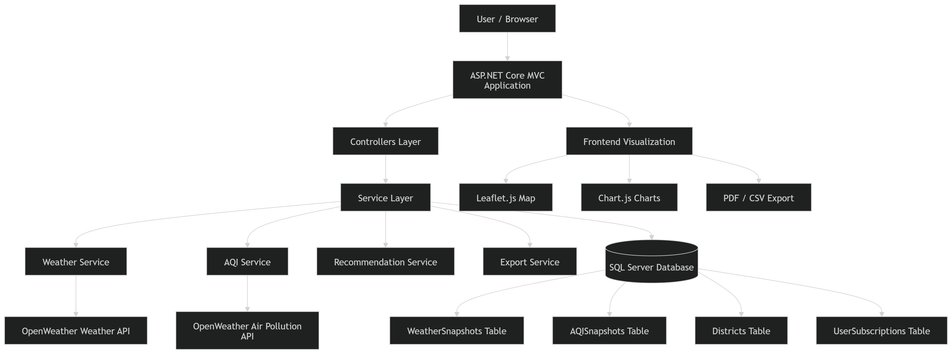
System Architecture Diagram

Slide 19
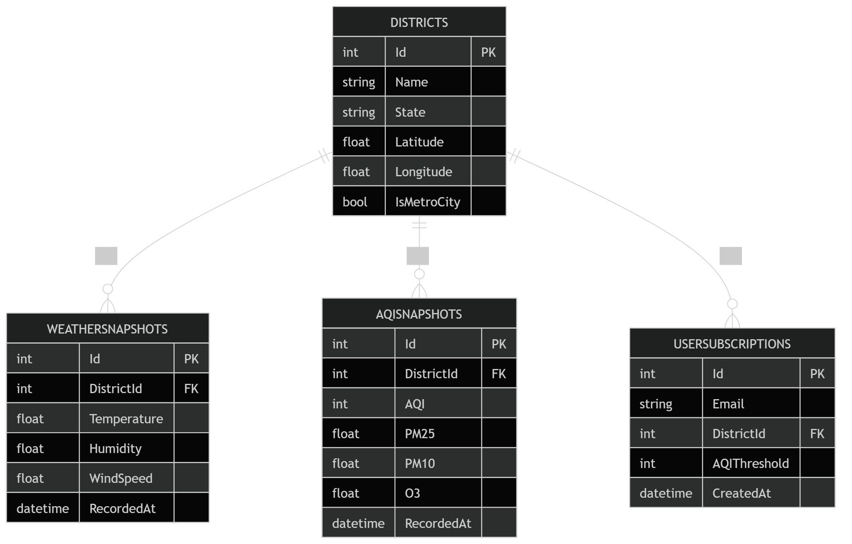
ER Diagram

Slide 20
Conclusion
EnviroWatch transforms raw environmental data into actionable intelligence — covering 780+ districts across India in real time.
⚡ What We Built
▸ Real-time AQI + Weather monitoring with Indian NAQI standards (CPCB breakpoints)
▸ Interactive Leaflet.js Map with color-coded district markers & live data popups
▸ Multi-Chart Analysis — 7-day & 30-day trend tracking with seasonal pattern detection
▸ Smart Health Engine — AQI + Heat Index → personalized health recommendations
▸ Export Suite — PDF reports (QuestPDF) + CSV downloads + Google OAuth
🛠️ Tech Stack
C# .NET 8 MVC • MS SQL Server • JavaScript/jQuery • Leaflet.js • Chart.js • OpenWeatherMap API
🎯 Impact & Future Scope
▸ Empowers citizens & policymakers with data-driven environmental decisions
▸ Scalable architecture ready for IoT sensors, predictive ML models & real-time alerts
▸ Bridges the gap between open government data and public health awareness
"Breathe Informed. Act Empowered."

Slide 21
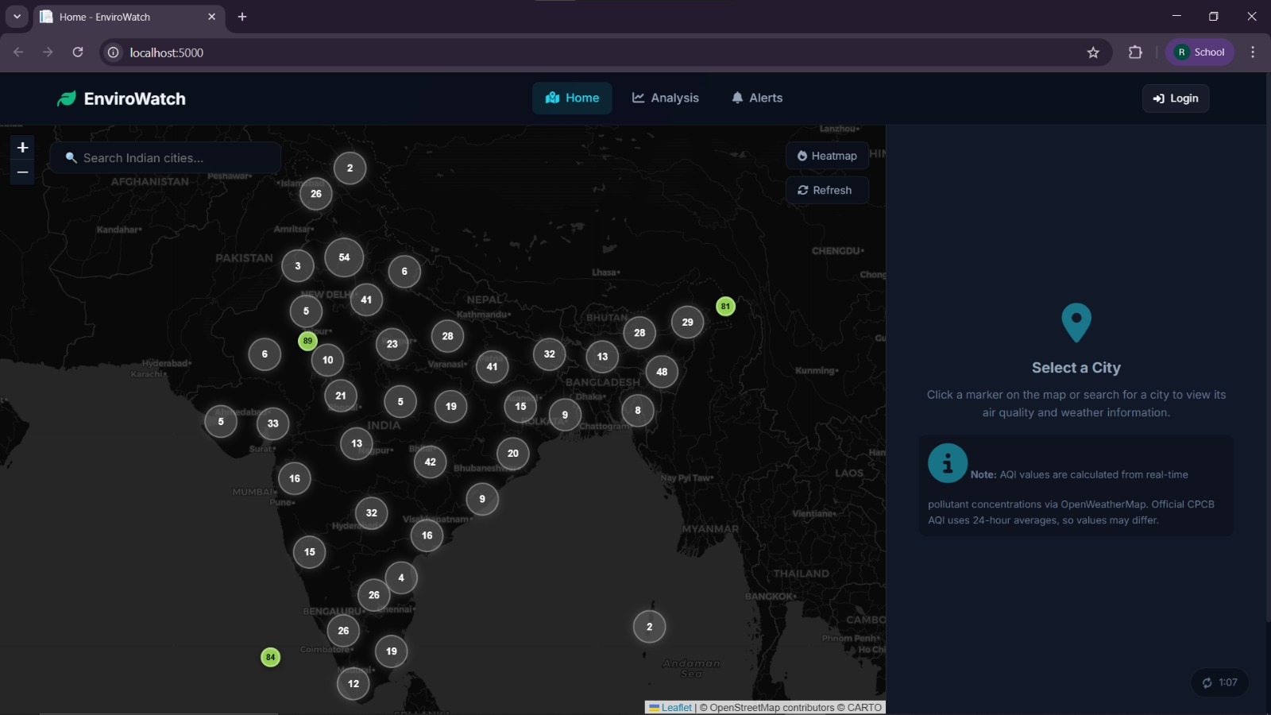
Our System

Slide 22
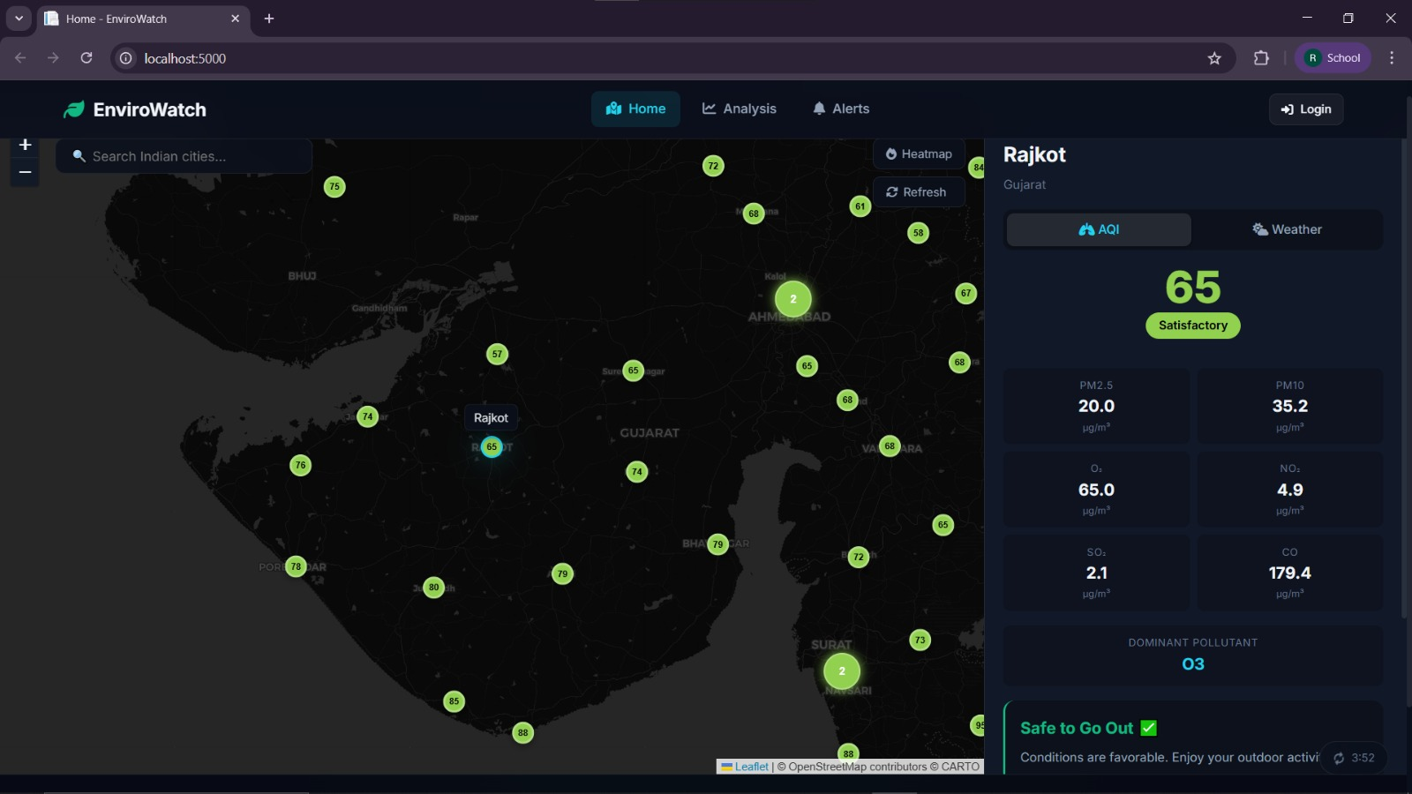
Our System

Slide 23
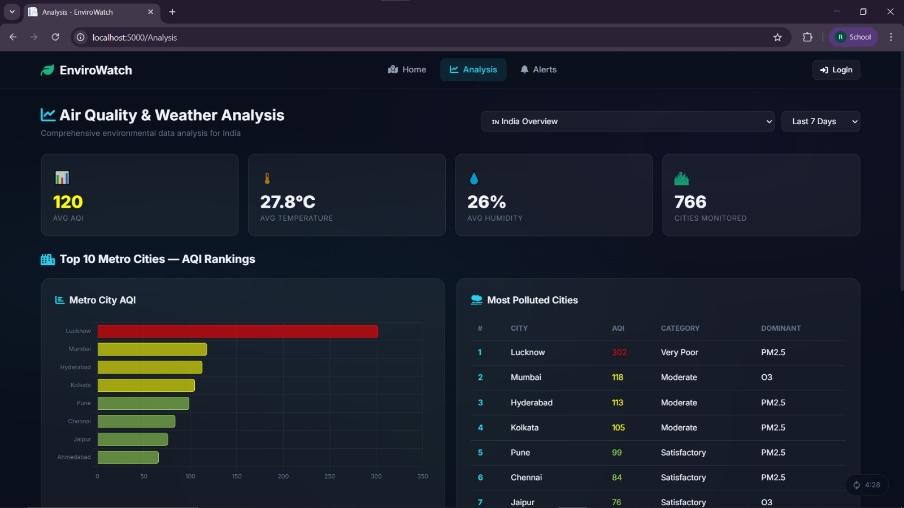
Our System

Slide 24
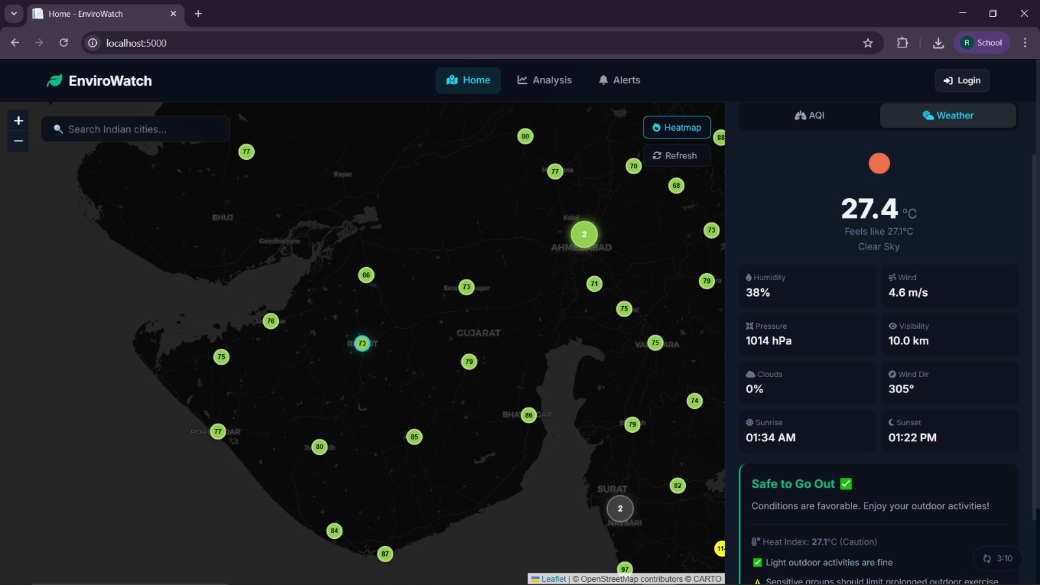
Our System

Slide 25
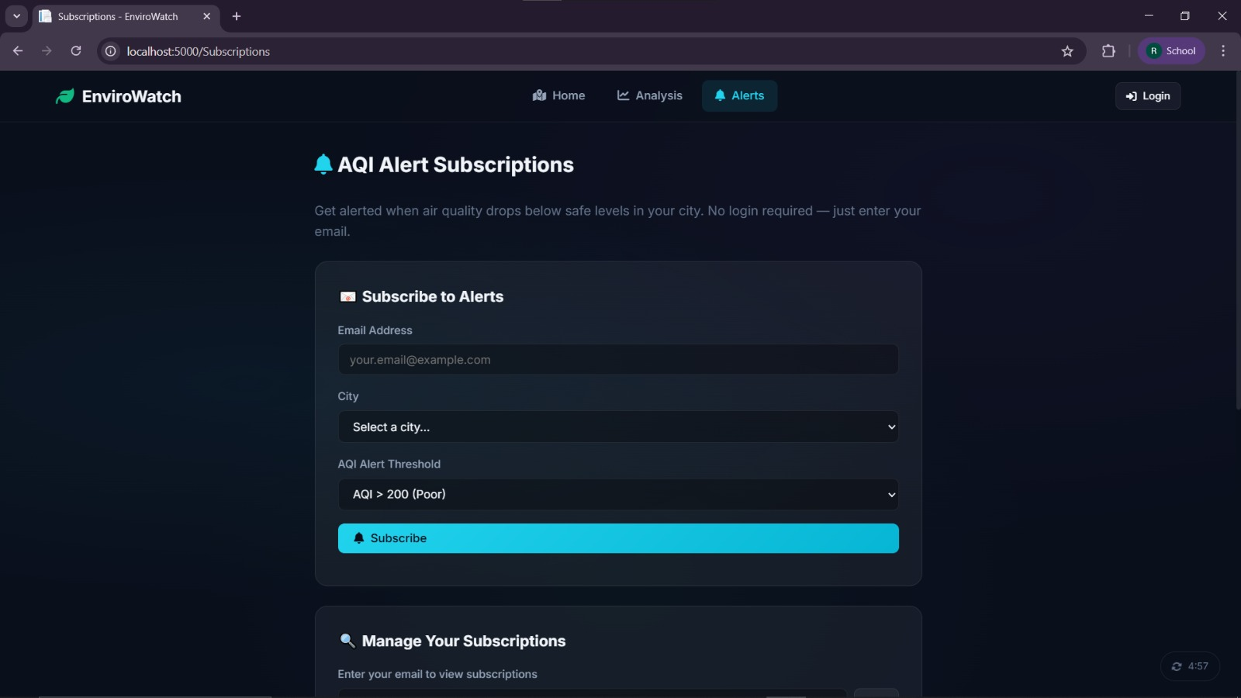
Our System

Slide 26
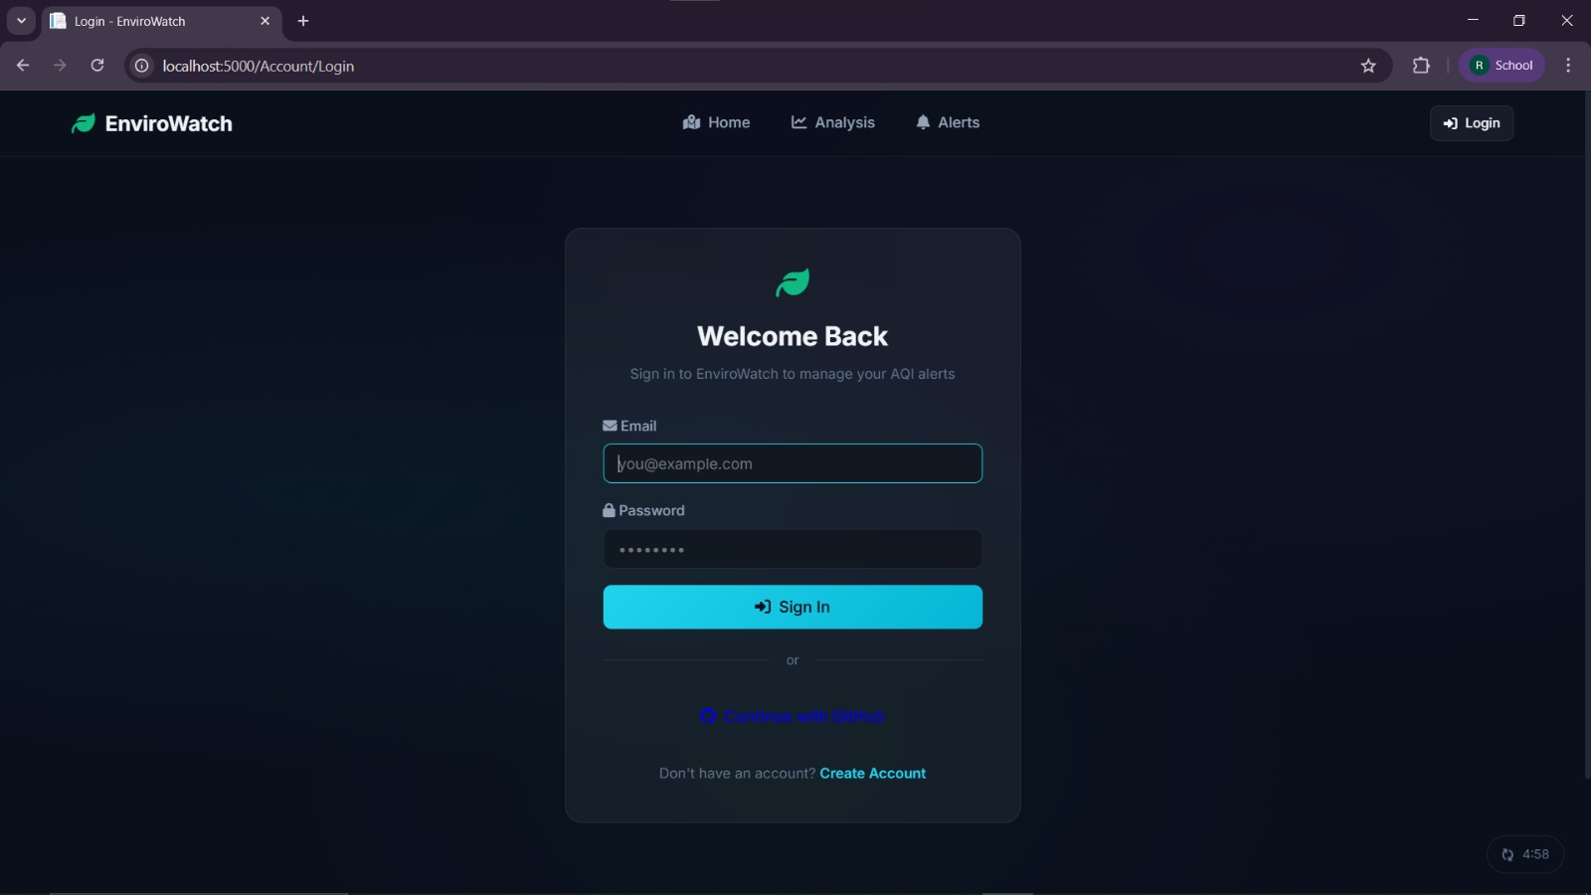
Our System

Slide 27
References
[1] Central Pollution Control Board (CPCB), "National Air Quality Index (NAQI)," Ministry of Environment, Forest and Climate Change, Government of India, 2014. [Online]. Available: https://cpcb.nic.in
[2] GBD 2019 Risk Factors Collaborators, "Global burden of 87 risk factors in 204 countries and territories, 1990–2019," The Lancet, vol. 396, no. 10258, pp. 1223–1249, Oct. 2020.
[3] IQAir, "2023 World Air Quality Report: Region & City PM2.5 Ranking," IQAir AG, Switzerland, 2024. [Online]. Available: https://www.iqair.com/world-air-quality-report
[4] OpenWeatherMap, "Air Pollution API Documentation," OpenWeather Ltd., 2024. [Online]. Available: https://openweathermap.org/api/air-pollution
[5] OpenWeatherMap, "Current Weather Data API Documentation," OpenWeather Ltd., 2024. [Online]. Available: https://openweathermap.org/current
[6] R. G. Steadman, "The assessment of sultriness. Part I: A temperature-humidity index based on human physiology and clothing science," J. Applied Meteorology, vol. 18, no. 7, pp. 861–873, 1979.
[7] L. P. Rothfusz, "The Heat Index Equation," National Weather Service (NWS), Technical Attachment SR 90-23, Fort Worth, TX, 1990.
[8] Microsoft, "ASP.NET Core MVC Documentation," Microsoft Learn, 2024. [Online]. Available: https://learn.microsoft.com/en-us/aspnet/core/mvc

Slide 28
References
[9] Microsoft, "Entity Framework Core Documentation," Microsoft Learn, 2024. [Online]. Available: https://learn.microsoft.com/en-us/ef/core
[10] Microsoft, "Background Tasks with Hosted Services in ASP.NET Core," Microsoft Learn, 2024. [Online]. Available: https://learn.microsoft.com/en-us/aspnet/core/fundamentals/host/hosted-services
[11] V. Agafonkin, "Leaflet — An Open-Source JavaScript Library for Interactive Maps," Leaflet, 2024. [Online]. Available: https://leafletjs.com
[12] Chart.js Contributors, "Chart.js — Simple yet Flexible JavaScript Charting," 2024. [Online]. Available: https://www.chartjs.org
[13] M. Stachowiak, "QuestPDF — Modern .NET Library for PDF Document Generation," QuestPDF, 2024. [Online]. Available: https://www.questpdf.com
[14] Google, "Google OAuth 2.0 for Server-side Web Apps," Google Identity Platform, 2024. [Online]. Available: https://developers.google.com/identity/protocols/oauth2
[15] W3C, "Web App Manifest Specification," World Wide Web Consortium, 2024. [Online]. Available: https://www.w3.org/TR/appmanifest

Slide 29
Q&A

Slide 30


