Slide 1
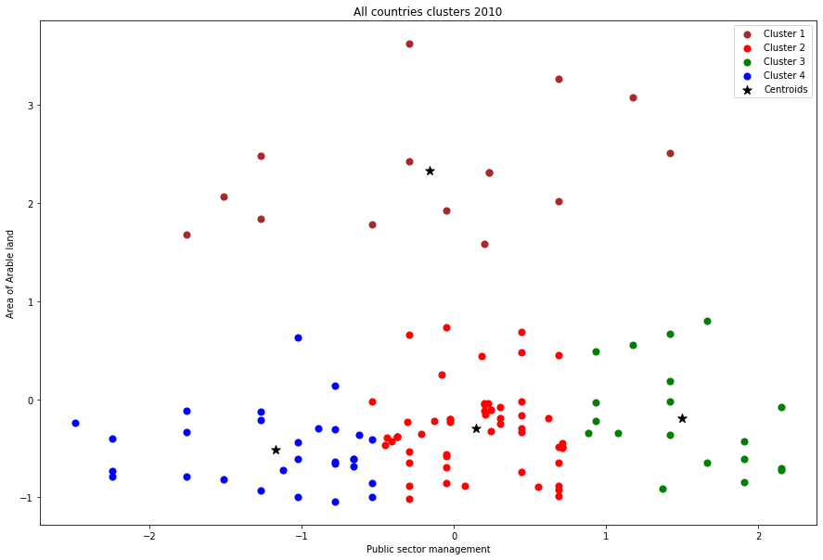
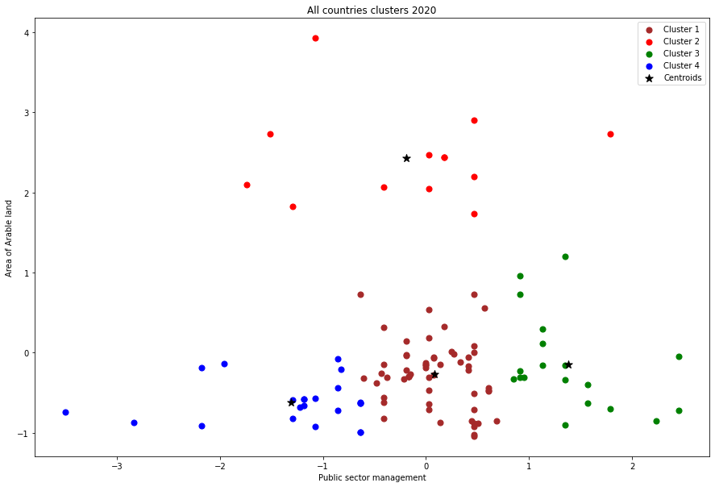
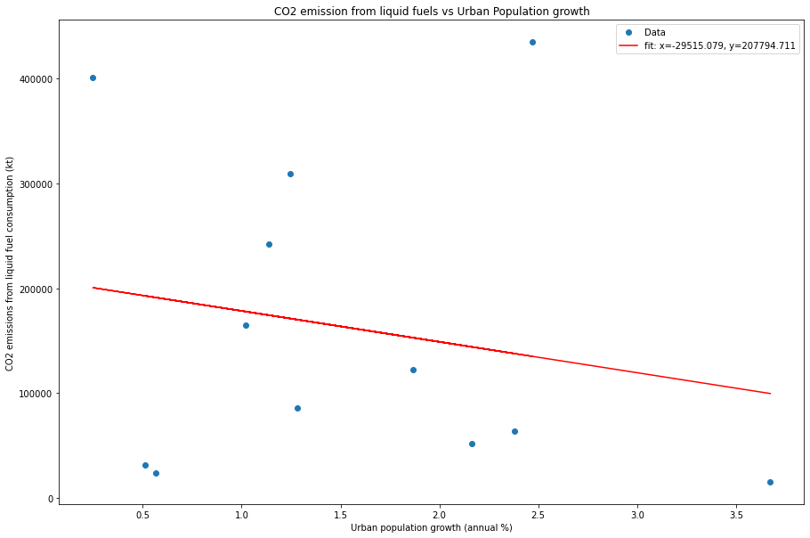
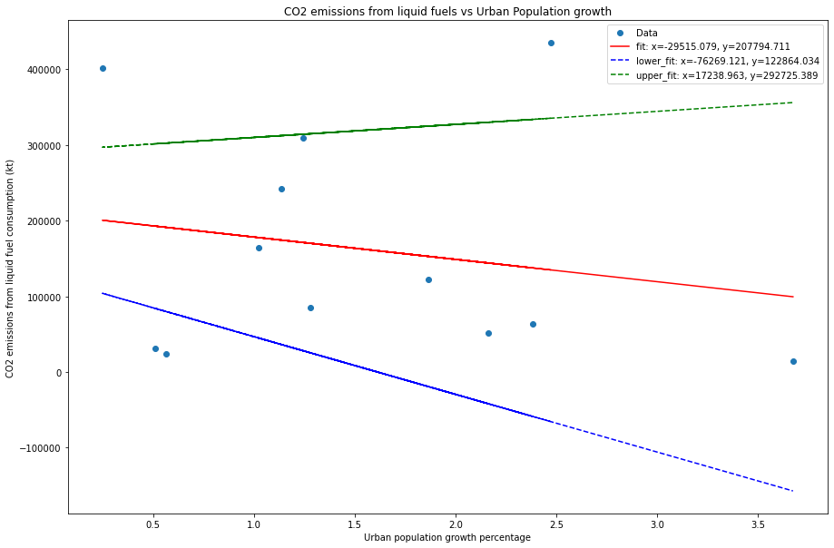
Applied Data Science
Clustering and Fitting
Kishan Rajan Ravi
21079867
INDRODUCTION
Climate change affects agriculture, public sector management, and urbanization. Rising temperatures may reduce arable land productivity and change precipitation patterns. CO2 emissions from liquid fuels also contribute to climate change, and managing them is crucial. Urbanization can lead to deforestation and higher energy consumption rates, adding to greenhouse gas emissions. Using clusters and fitting in Python comparison happens between the indicators.
In this scatter plot. Clusters can be visually shown in different colours.
Centroids is the centre of each clusters.
In this Public sector management and Area of Arabic land are compared.
In this relationship between both indicators are compared good if public sector management is running good the development of arable land will be more progressive. In other hand poor management will create poor arable infrastructure. Like education, buildings and environment.
The above plot is the list of 2010th year of all countries.
Compare the images from cluster 2010 and 2015.
In this plot Co2 emissions from liquid fuels VS Urban Population growth compared.
Fit is used to predict the one indicator data with another indicator.
In the above plot fit between is gradually going down. So the C02 emissions goes down urban population will increase.
On the other plot it is mentioned with lower fit and upper fit. Possibility of both fit is compared with the normal fit.
This is the plot compared for the years 1960 to 2020.
Conclusion:
The percentage rise in all countries from one year to the next is referred to as annual arable land growth. Public sector management is a measurement of the total value of goodness, developments produced in a
country over a given time period.
The Co2 emissions from liquid fuels VS Urban Population growth compared. For the respective years 1960 and 2020 has you can see the fit of the visualization it can predict for the upcoming years may 15 or 30 years or more than that.
CO2 emissions from liquid fuel consumption (kt) in 15 years: -234931.50195720082
CO2 emissions from liquid fuel consumption (kt) in 30 years: -677657.7188640031
These are measurements can be done for the future and past by the help fitting in python.
GitHub Link - https://github.com/Kishan2198/ADS-project3_21079867

