Slide 1
GA ASSIGMENT SW-PYT-001
Ardupilot SITL Mission Planner MAVProxy DroneKit Linux Ubuntu
Notes:
1

Slide 2
Over View
Setup SITL
Setup GCS (Ground Station Software) code using Pymavlink
Configure Python GCS code for mission control
Notes:
2

Slide 3
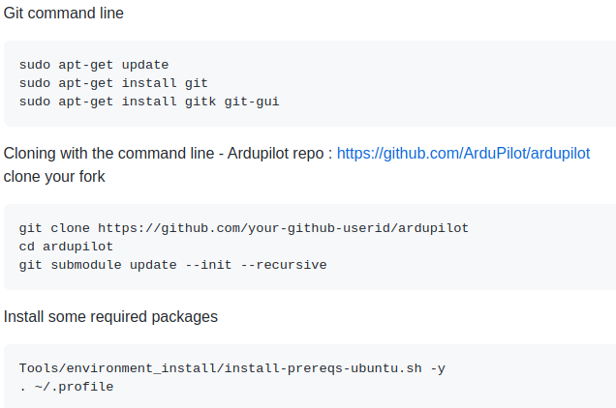
Setup SITL
Setting up the Build Environment (Linux/Ubuntu)
Source : https://ardupilot.org/dev/docs/building-setup-linux.html#building-setup-linux
Notes:
3

Slide 4
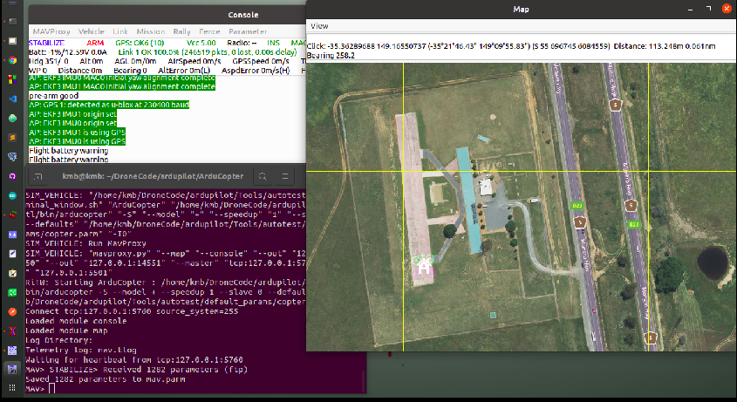
Setting up SITL on Linux Source
Source : https://ardupilot.org/dev/docs/setting-up-sitl-on-linux.html
Start SITL simulator
> cd ardupilot/ArduCopter
> sim_vehicle.py -w
> sim_vehicle.py --console –map
Notes:
4

Slide 5
Using SITL
Source : https://ardupilot.org/dev/docs/using-sitl-for-ardupilot-testing.html#using-sitl-for-ardupilot-testing
Using SITL for ArduPilot Testing
command : sim_vehicle.py -v ArduPlane -f quadplane --console --map
sim_vehicle.py → This is the simulation
-v ArduPlane → this selects the vehicle type
-f quadplane → this select the frame type for selected vehicle
--console → selects the ground station console window
--map → this enables the map
--osd → OSD emulation displays OSD panel items and locations
Testing mavproxy commands
Prepare for take off → qloiter
arm the throttle → arm throttle
help → will display mavproxy commands
Here the normal throttle is input on channel 3, we want to lift off and raise the throttle
command : rc 3 1700
set the wind speed for 4 meter per second : → param set SIM_WIND_SPD 4
take off and flying : → qhover
change the RTL mode → param set Q_RTL_MODE 1
command : → cruise
now turn cruiseing around channel 1 and 1300 left turn → rc 1 1300
and set up rc 1 1500 to stop turning
Notes:
5

Slide 6
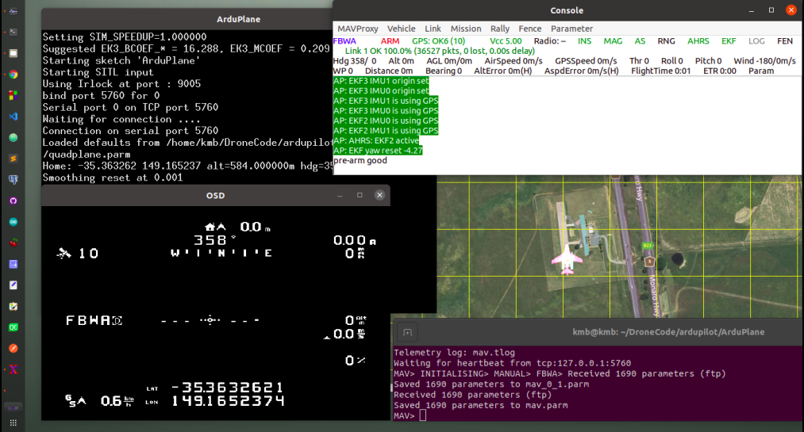
Notes:
6

Slide 7
Mission Planner on Linux
Download and install the latest version of MONO from [here]
(https://www.mono-project.com/download/stable/)
Download Mission Planner as a zip file from [here]
(https://firmware.ardupilot.org/Tools/MissionPlanner/MissionPlanner-latest.zip)
and unzip to a directory.
Change to that directory and execute:
mono MissionPlanner.exe
DroneKit
Installation
pip install dronekit
pip install dronekit-sitl
Get started
dronekit-sitl copter
mavproxy.py --master tcp:127.0.0.1:5760
--sitl 127.0.0.1:55001
--out 127.0.0.1:14550
--out 127.0.0.1:14551
Notes:
7

Slide 8
Setup GCS code using Pymavlink
Script : takeoff.py, move.py
SITL : sim_vehicle.py -v ArduCopter
GCS : mono MissionPlanner.exe
The MAVLink command protocol allows guaranteed delivery of MAVLink commands.
the GCS or program sends the message command_long to the drone
when the drone receives that message it tries to act upon the command
Here command_long is defined by message 76, every command has
target_system → that we are sending the command too
target_component → that we are sending the command too
command → enumeration of the command that we are sending
Confirmation → sending zero for the confirmation
7 param --> next 7 params are defined by command type
Notes:
8

Slide 9
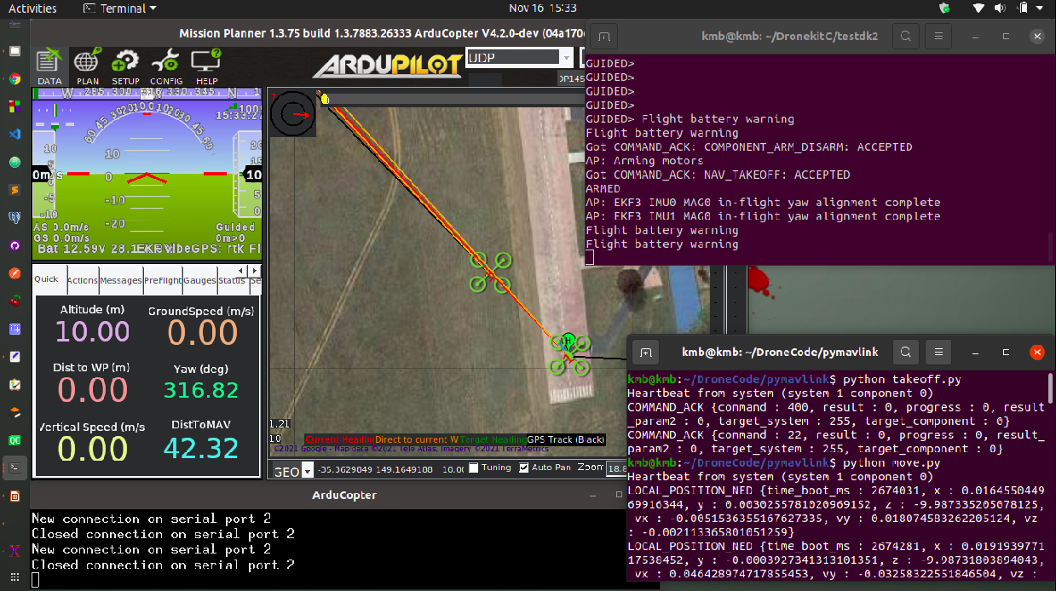
Notes:
9

Slide 10
Configure Python GCS code for mission control
Script : mission.py
SITL : sim_vehicle.py -v ArduCopter
GCS : mono MissionPlanner.exe
vehicle.mode -- This attribute is used to get and set the current flight mode.
vehicle.armed -- This attribute can be used to get and set the armed state of the vehicle (boolean).
simple_takeoff -- Take off and fly the vehicle to the specified altitude (in metres) and then wait for another command.
LocationGlobalRelative(lat, lon, alt=None) -- A global location object, with attitude relative to home location altitude.
simple_goto(location, airspeed=None, groundspeed=None) -- Go to a specified global location
Notes:
10

Slide 11
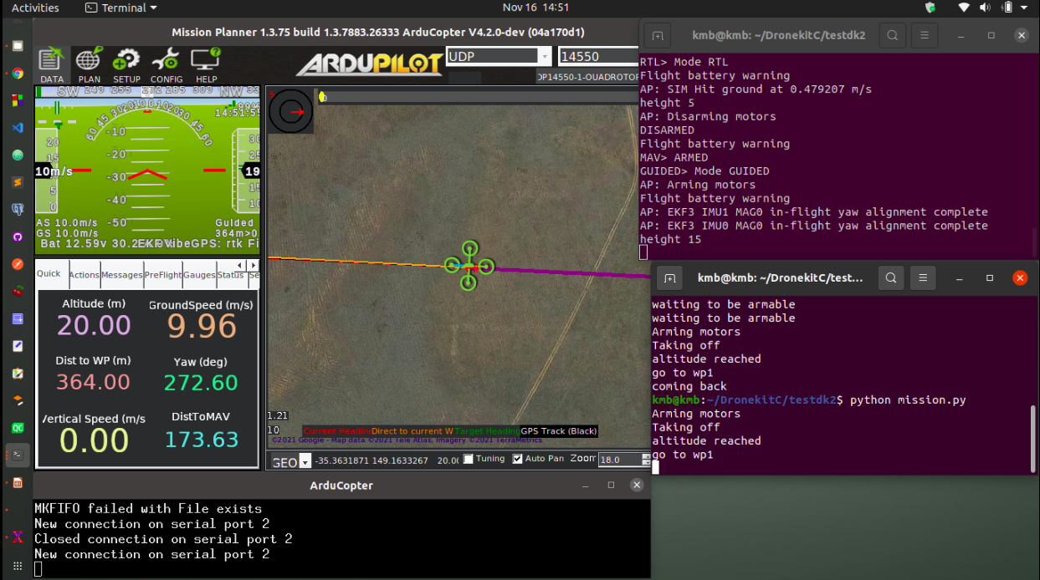
Notes:
11

Slide 12
Reference
https://ardupilot.org/ardupilot/
https://dronekit-python.readthedocs.io/en/latest/about/index.html
https://mavlink.io/en/mavgen_python/
https://www.youtube.com/user/prandtlmayer
https://www.youtube.com/c/IntelligentQuads
Thank you
Notes:
12

