Slide 1




Smart Hire Job Portal
(Web Application)

Slide 2

Group No:43
Presented By:- Kishan Mistry(681)
Monil Maisuriya(698)
Vishal Jariwala(886)
Meetkumar Vasava(394)
Guided By:- Prof.Jaimini Patel

Slide 3
Member’s Profile
Exam No | 7581
Name | Mistry Kishan Jayeshkumar
Roll no | 681
Division | G
Year | TYBCA
Exam No | 7545
Name | Maisuriya Monil Sharadkumar
Roll no | 698
Division | G
Year | TYBCA
Exam No | 7436
Name | Jariwala Vishalkumar Bipinkumar
Roll no | 886
Division | H
Year | TYBCA
Exam No | 7919
Name | Vasava Meetkumar Ravidasbhai
Roll no | 394
Division | D
Year | TYBCA

Slide 4
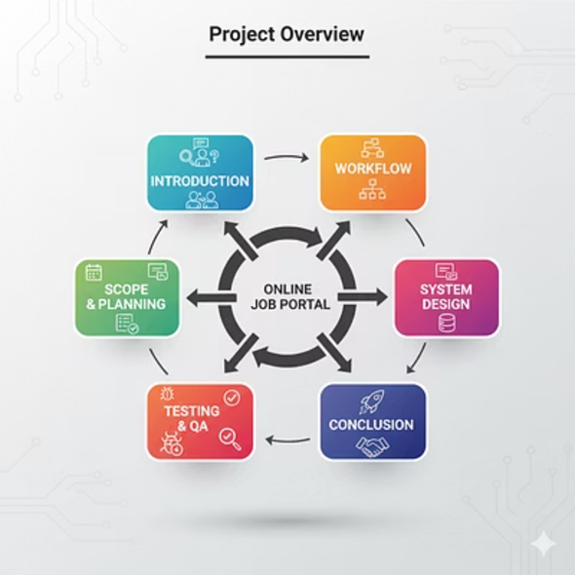
Project Overview

Slide 5
Introduction
Introduction
The Smart hire job portal System is designed to overcome these challenges by using technology to make the process easier and faster. It is a web-based platform where both employers and job seekers can interact. Job seekers can create an account, build their profile, upload their resume, and apply for jobs that match their skills. Employers can register, post job openings, review candidate applications, and shortlist suitable candidates directly through the system.

Slide 6

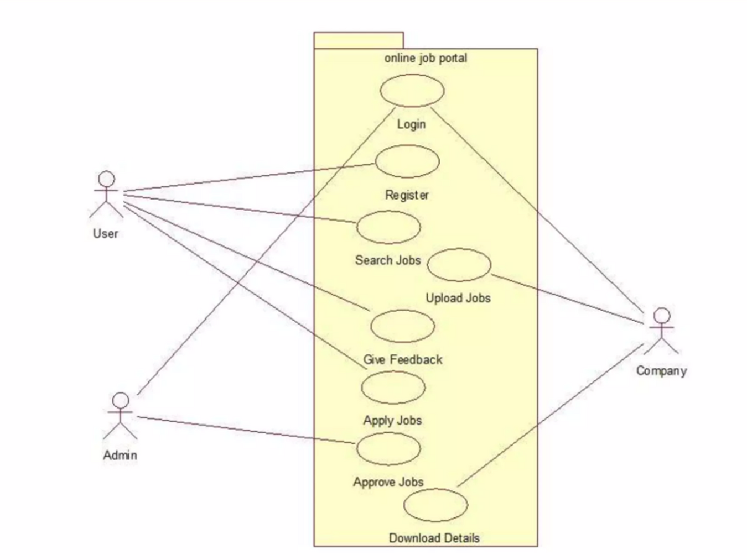
Work-Flow

Slide 7


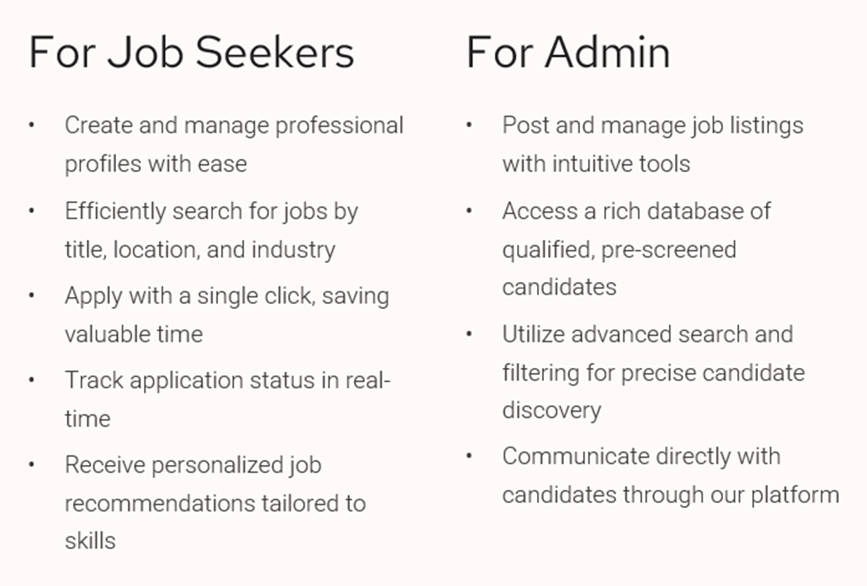
Features

Slide 8

Scope & Planning
Scope:-
Covers job posting, job searching, application tracking, and communication.
Can be extended with AI-driven job recommendations, resume scoring, and video interviews.
Useful for students, professionals, HR managers, and large companies.
Planning:-
Phase 1: Requirement gathering & analysis.
Phase 2: System design (database + front-end + back-end architecture).
Phase 3: Development (module-wise: login, job posting, search, dashboards).
Phase 4: Testing (unit testing, integration testing, usability testing).
Phase 5: Deployment & maintenance.

Slide 9
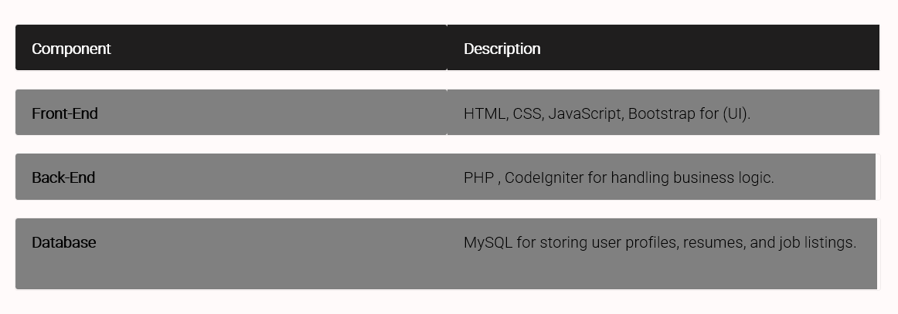
Design Technologies

Slide 10
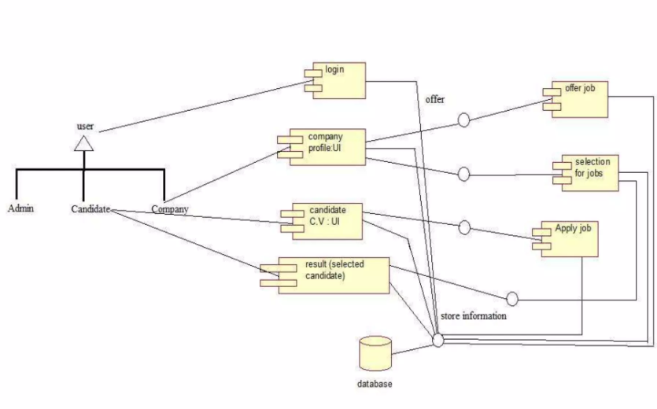
Database Diagram

Slide 11
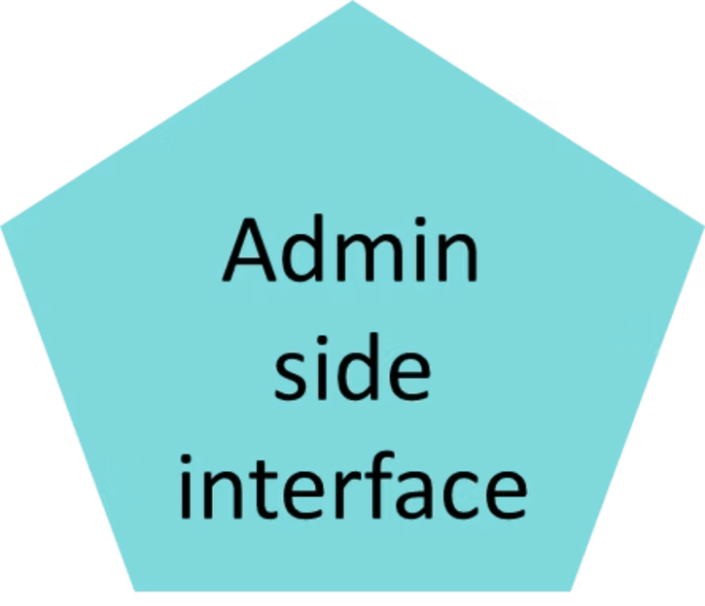
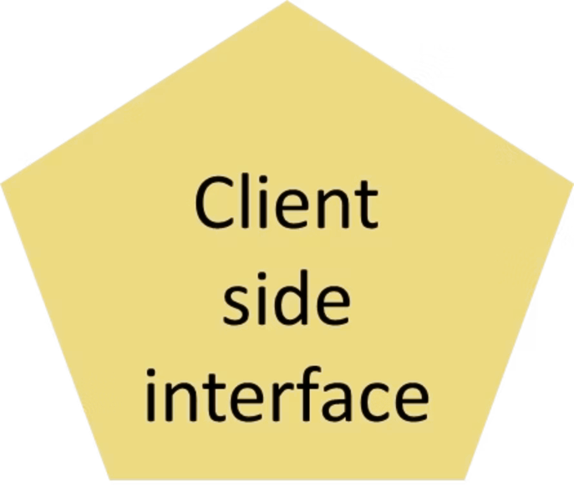
User Interface

Slide 12
Testing
Unit Testing: Each individual module, like the login feature, job application submission, or a user's profile creation, is tested in isolation to ensure it functions correctly on its own.
Integration Testing: This testing ensures that different modules work together smoothly.
Usability Testing: This focuses on the user experience. It checks how easy it is for both recruiters to post jobs and for job seekers to navigate the site and find relevant opportunities.
Performance Testing: This ensures the platform can handle heavy usage. It tests the system's stability when multiple users are searching for jobs or uploading resumes at the same time, especially during peak hours.
Security Testing: This is crucial for protecting sensitive data. It ensures that user data, such as resumes and personal information, is secure and that unauthorized users cannot access or alter it.

Slide 13
Conclution
The Online Job Portal Website is a platform that helps connect job seekers with recruiters in a fast and efficient way. It makes the hiring process quicker, more transparent, and easier for everyone to use. Job seekers can easily find and apply for jobs, while employers can quickly post openings and select the right candidates.
In the future, the system can be improved with smart features like AI-based job suggestions and automatic resume checking, making it even more useful and powerful for both job seekers and companies.

Slide 14


