Slide 1


GESVOC
Subject: CS357 SGP 4
Internal Mentor: Asst. Prof. Bela Shah
Group members:
20CS065 Kishan Prajapati
20CS068 Pruthvi Raj

Slide 2
Content
Introduction
Problem Statement
Project Scope
Objective
Intended users
Module
Flowchart/ System flow
Implementation Screenshots
Technology to be used

Slide 3
Introduction
GESVOC is an interface which makes human computer interaction simple by making use of Hand Gestures and Voice Commands.
GESVOC makes the interaction with PC with almost no direct contact.
All i/o operations can be virtually controlled by using static and dynamic hand gestures along with a voice assistant.

Slide 4
Problem statement
Difficulty while multitasking various operations.
All i/o operations can be virtually controlled by using static and dynamic hand gestures along with a voice assistant which solves problem when dealing with multitasking.

Slide 5
Project Scope
The scope of the above project is to develop a software system that integrates gesture recognition and voice commands to provide users with a more intuitive and natural way of interacting with their PCs. The system will require the use of advanced python libraries to interpret hand gestures and voice commands.
The project scope will include the following:
Development of the software system for gesture recognition and voice command integration.
Implementation of various hand gestures for performing different actions.
Implementation of a wide range of voice commands for performing various tasks.
User interface design and user experience optimization.

Slide 6
Objective
The project has the potential to improve the user experience of PC use, particularly for individuals who prefer a more intuitive and natural way of interacting with technology. The system can also have applications in various industries, including healthcare, education, and entertainment, where hands-free operation and interactive interfaces are increasingly in demand.
This project makes use advanced python libraries to recognize hand gestures and voice commands, which works smoothly without any additional hardware requirements

Slide 7
Intended users
Gamers who prefer a more immersive and interactive gaming experience.
Students and teachers who use computers for online learning and presentations.
Healthcare professionals who need to access patient records and medical software while maintaining a sterile environment.
Office workers who spend long hours on their computers and can benefit from a more ergonomic and natural way of interacting with their technology.

Slide 8
Modules
Gesture recognition:
This module is responsible for the action which will be performed based on the hand gestures of the user. Libraries used: MediaPipe(ML library for hand gestures), Pyautogui(Mouse control) , CV2(Camera access), Pycaw (image processing library).
Voice commands:
This module is responsible for the action which will be performed based on the voice commands given to system. Libraries used: Pyttsx3(text to speech), Speech Recognition(voice commands), OS(files), datetime, webbrowser.
Intergrating Gesture and Voice Commands:
This module is responsible for the intergration of both Gesture recognition and voice commands into one system.

Slide 9
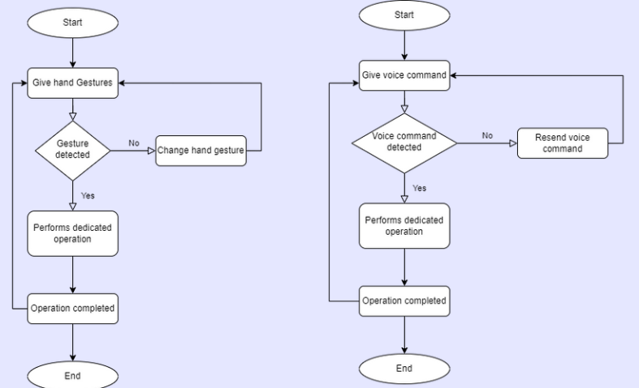
Flowchart

Slide 10
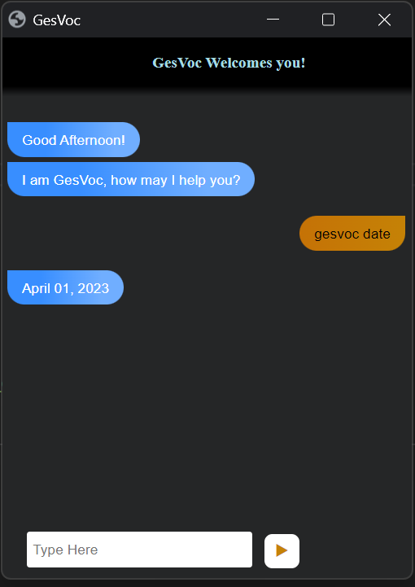
Voice Commands
Cyber wake up
Cyber bye
Cyber copy
Cyber paste
Cyber date
Cyber time
Cyber exit
Cyber find location
Cyber list files
Cyber launch gesture recognition
Cyber stop gesture recognition
Cyber search github

Slide 11
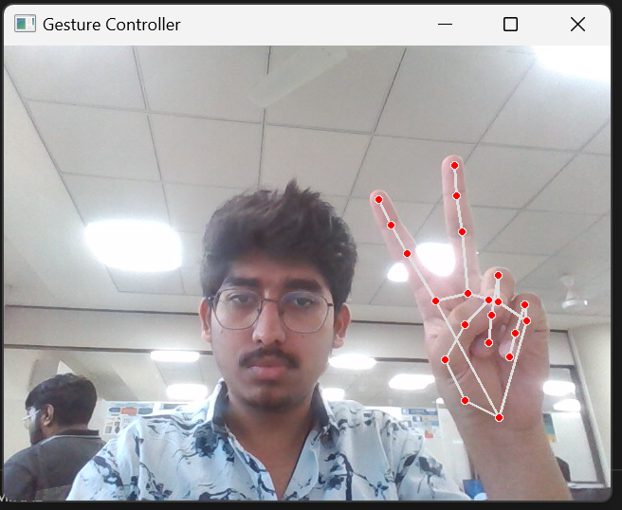
Implementation screenshots
Gesture Recognition operations
Control cursor
Brightness change (pinch)
Move file (grab from hand)
Mouse Right click (left finger)
Mouse Left click (right finger)
Close / open folders
select and drag (palm)

Slide 12
Tools and Technologies
The tools and technologies used for developing this project are given as follows :
Tools: VS code, Google APIs
Technology: Python and its libraries such as Speech Recognition, MediaPipe, NumPy, WebBrowser and HTML, CSS, JS for GUI .

Slide 13
Thank
You

