Slide 1

FlyReview AMCC │ Instructor: Dr. Arjan Durresi
Submitted By: Kishan Ramoliya & Ravikumar Shah

Slide 2
Abstract
FlyReview is designed to help air travelers who want to give feedback about their experience during the flight. This will let airline companies to gather customer reviews which will help them in improving their quality of service. Application will be developed for iPhone users which will use API’s of parse.com.

Slide 3
Application Background
Platform
iOS
Tools Used
Xcode
iOS SDK
iOS Simulator
Cloud Data Service
parse.com

Slide 4
Background Work
Studied the websites like airlinequality.com, tripadviser.com and airlineratings.com for gathering some information about what type of information that they gather and the way they gather.
Gathered data of around 75 airline companies.

Slide 5
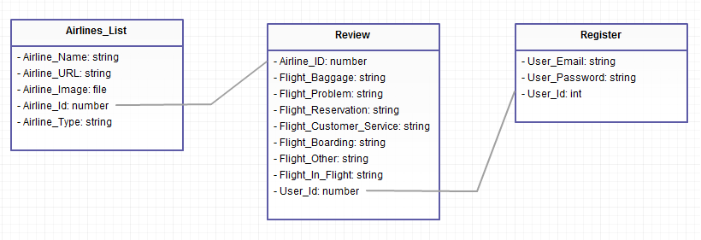
Database Design

Slide 6
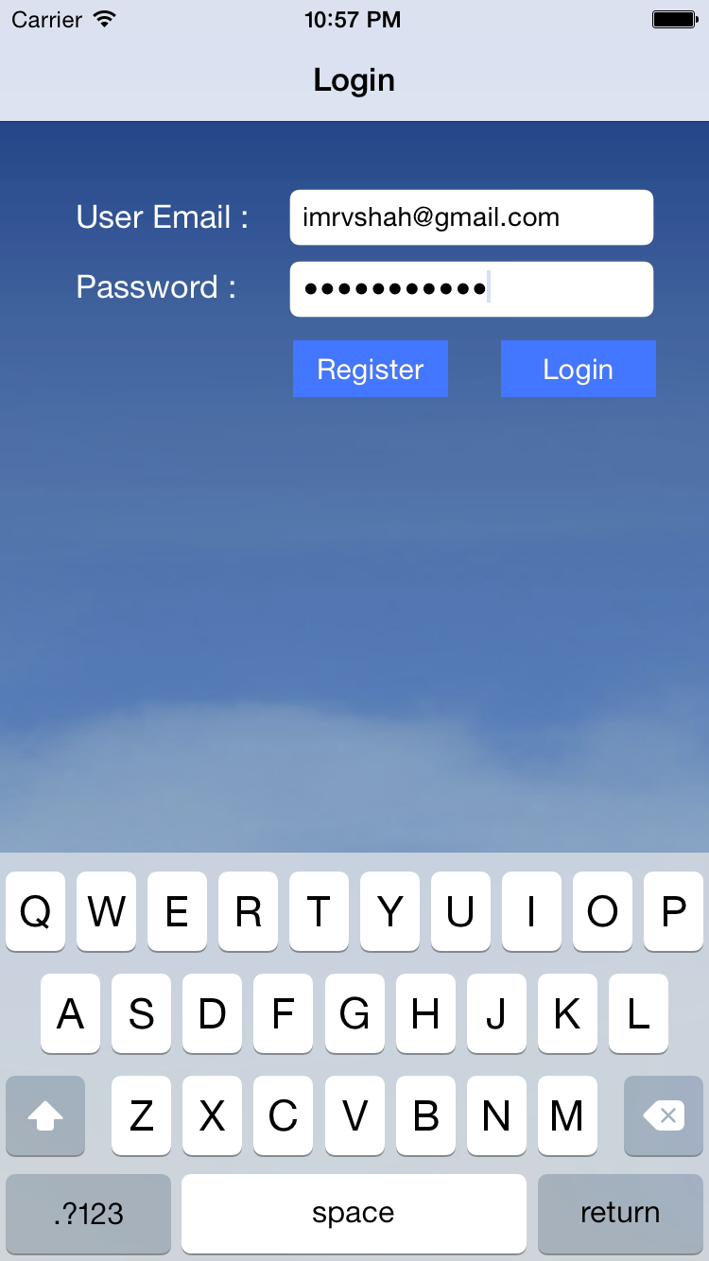
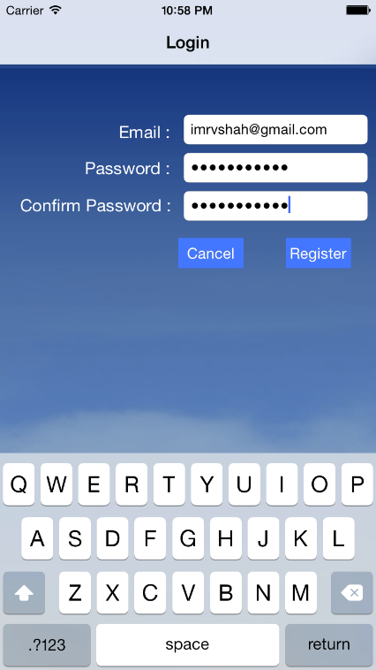
Application Design and Flow
Login and Register screen.

Slide 7
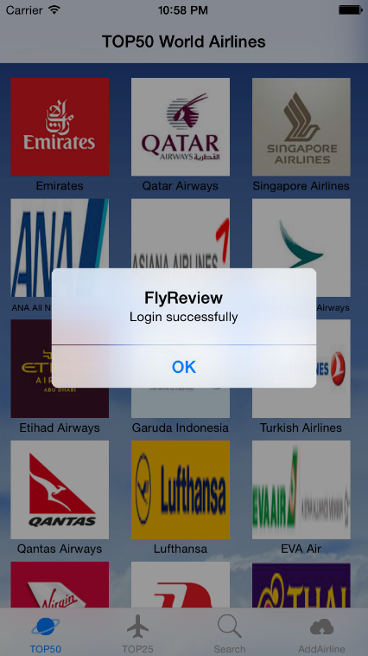
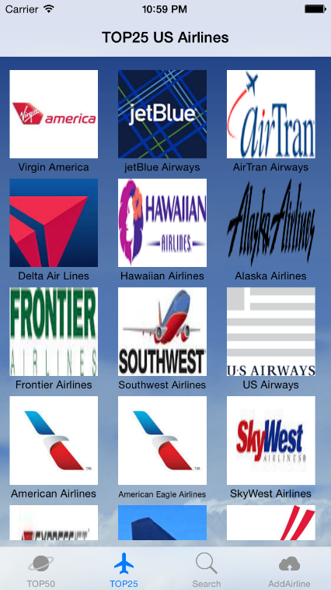
Application Design and Flow
Airline list.

Slide 8
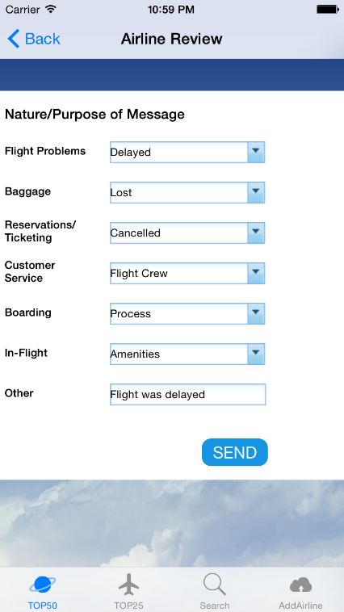
Application Design and Flow
Add Review.

Slide 9
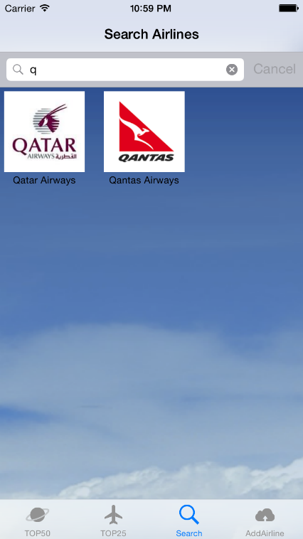
Application Design and Flow
Search airline.

Slide 10
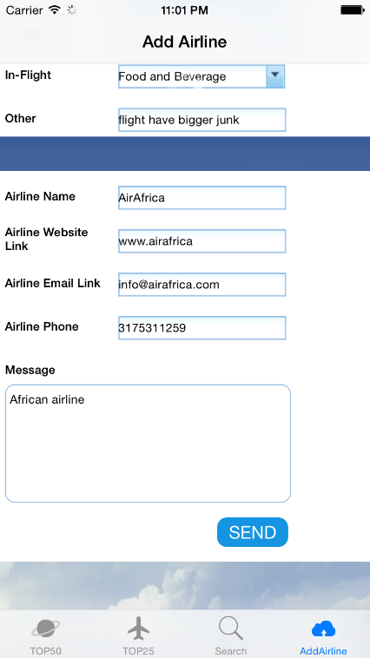
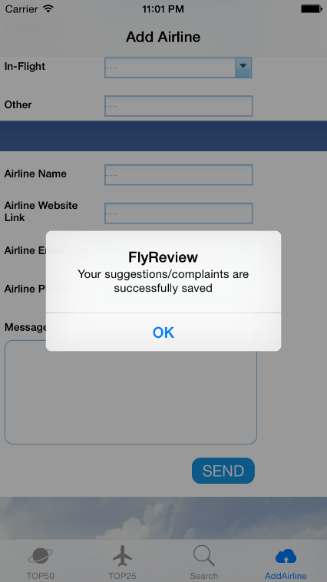
Application Design and Flow
Add new Airline and it’s Review.

Slide 11
Future Improvements
We have kept user interface of the application very simple so that it is easy for the user to use the application. It can be improved as much as we can.
Also we have to contact airline Company to discuss about the ideas.
We can add facility through which we can verify the identity of the user by email verification process.
Also we can make improvement in the performance of the application by improving the code.

Slide 12
Future Improvements (Cont.)
We can add new question in the review form that will collect more information from the user.
We can improve the application by providing more interactive interface.

Slide 13
Application Demo

Slide 14
Thank You!!

