Slide 1

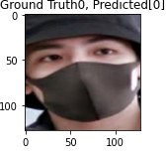
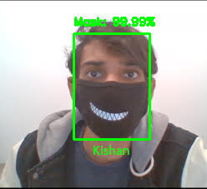
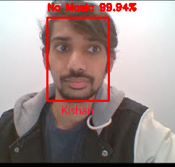
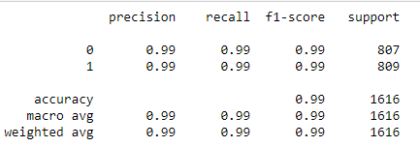
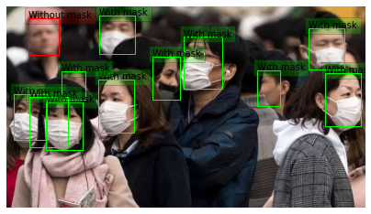
Face Recognition using Deep Learning
Kishan Teli | Raveena Mehta
Prof. Kevin Lu
Stevens Institute of Technology
ABSTRACT
INTRODUCTION
RESULTS
DISCUSSION
In today’s world, face recognition has become an integral part of our lives. We use face recognition feature for multi-purposes in our latest gadgets such as FaceID, etc. In this COVID-19 pandemic, people have to wear masks to protect themselves and to not spread the disease.
It is difficult for devices to even detect our faces when we have worn a mask. Thus, We have designed a unique model which recognizes our face even if we have worn a mask! This model can be implemented in any of our smart devices for them to have this feature.
We can use this feature in many other objects like survillence cameras in case of any theft, etc. for security purposes.
This model can be used for multi-purposes such as in medical field along with authentication purposes.
The need for advanced face recognition techniques was felt during COVID-19. The coming times in which wearing a mask will be the new norm, compels us to design something which solves our new emerging facial recognition problems.
We have thus, implemented a model/system which solves our problem of facial detection with masks. We have designed a Mask Detection Model which is a combination of RetinaNet model and Xception model. RetinaNet model is used for face detection, whereas, Xception model is used for classification. Classification is done to check two scenarios: faces with masks and faces without one.
In order to detect faces, we train these models by many datasets. Our high performance model is thus, able to recognize faces through our saved databases.
We analyzed our model in terms of performance metric such as precision, recall, f-1 score and accuracy. We compared the ground table and prediction values of our model.
Our model has 99% accuracy and loss value of 0.0182 only, due to RetinaNet model and recognizes faces with or without mask.
Our model could achieve this precision, recall and accuracy as, we implemented RetinaNet model which uses focal loss concept.
This enables our model to handle foreground-background class imbalances (an issue with one stage detectors which makes performance of single shot detectors inferior to two stage detectors for object detection).
Thus, RetinaNet model outperforms Single Shot Multibox Detectors, while attaining the accuracy of two stage detectors such as FPN Faster-RCNN with a ResNet-101 backbone.
Note:
F-1 score is the harmonic mean between precision and recall. It’s value ranges from 0 to 1. The model works at it’s best at f-1 score is 1. Our model has high f-1 score.
Figure 1. Comparison of ground truth and predicted values
METHODS AND MATERIALS
Figure 2. Face with mask o/p
Figure 3. Face w/o mask o/p
CONCLUSIONS
We implement our model by :
Training through datasets from Real World Masked Face Detection(RMFD), Kaggle API and Bing Search.
We use these datasets on RetinaNet model to detect even the small faces from an image input file which has many number of people.
These datasets are used for Xception model , so that it can categorize detected faces as face with mask or without mask.
We then, match the detected faces with that of our database, to recognize the person and display it on the same input file.
Our model was successful in achieving its objective of recognizing faces with masks due to great combination of two models (RetinaNet and Xception). Our model works better than face landmark estimation algorithm.
We would like to implement face prediction using these model in future.
Table 1. Performance metric of classification model
REFERENCES
[1] Tsung-Yi Lin, Priya Goyal, Ross Girshick, Kaiming He and Piotr Dollar, “ Focal Loss for Dense Object Detection”, Facebook AI Research (FAIR), Feb. 2018.
[2] Andrew Jason Shepley, “Deep Learning for face recognition: A critical analysis”, July 2019
[3] Zaeem Ahmad Varaich and Sidra Khalid, “Recognizing Actions of Distracted Drivers using Inception v3 and Xception Convolutional Neural Networks”, IEEE 2nd International Conference on Advancements in Computational Sciences (ICACS) 2019
CONTACT
Raveena Mehta:
rmehta19@stevens.edu
Kishan Teli:
kteli@stevens.edu
Figure 4. Detection of face with many people in image file

