Slide 1
Traffic speed Prediction using LSTM model
(Based on: Congestion prediction for smart sustainable cities using IoT and machine learning approaches, Majumdar et al.,2021)
Presented by:
Kishan Thakkar(21IM60R04) – Group 2

Slide 2
Index
Introduction
Literature review
Objectives
Dataset description
Data analysis
LSTM model
Results and discussions
References

Slide 3
Introduction
Sustainable Development Goal 11: Smart and sustainable cities
To develop Intelligent Transportation Systems (ITS) and Advanced Traffic Management Systems (ATMS), one of the critical needs for transportation community is to understand and forecast future traffic condition.
Route preplanning and rescheduling, congestion and improve traffic safety.

Slide 4
Literature Review
Reference | Summary of work
Gately et al., 2017 | Studied the effects of air pollution on regional scale and local scale due to traffic congestion in US and found that if speed reduction is more than 20mph leads to exponential increase in traffic emissions
Al-Turjman et al., 2020 | Many recent developments in traffic analysis also rely on connections to Internet of Things (IoT) devices. Such devices have considerable potential to support these systems, in particular when coupled with machine learning.
Jiang et al., 2016 | Compared different statistical and machine learning models for traffic speed prediction. This paper examined the multistep ahead prediction performance of eight different models using the 2-minute travel speed data collected from three Remote Traffic Microwave Sensors.
Ma et al., 2015 | Proposed the use of Long Short-Term Neural Network to capture nonlinear traffic dynamic in an effective manner.

Slide 5
Objectives
To understand the relation between traffic speed and vehicle flow
Integration of LSTM network models with data from IoT devices
Application of LSTM models for traffic speed prediction
Comparison between univariate and multivariate LSTM models

Slide 6
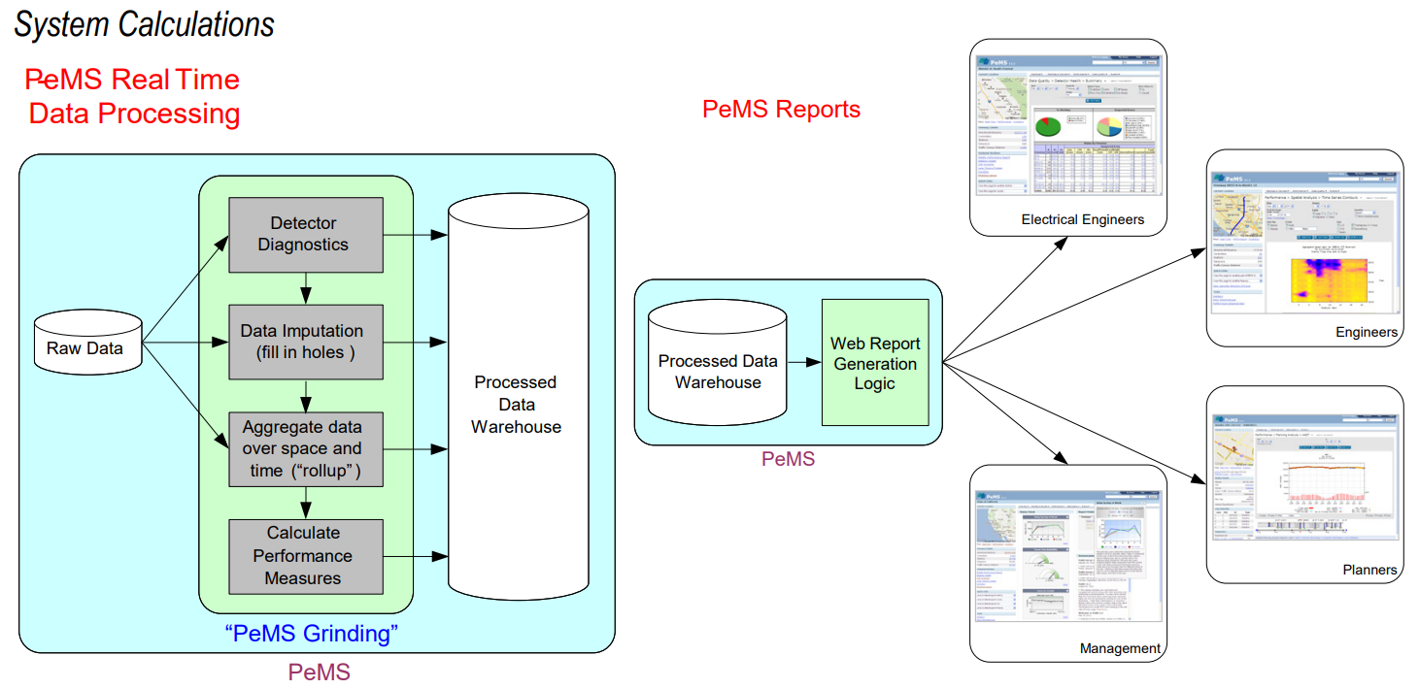
Data Collection & Processing
(Source: An introduction to California Department of Transportation Performance Measurement Systems(PeMS), 2020)

Slide 7
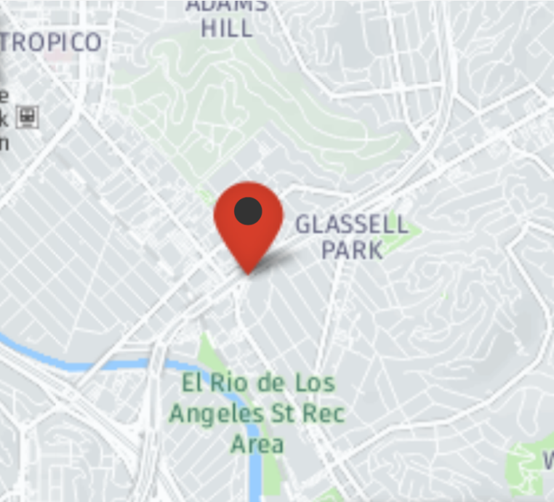
Dataset 1
Data set collected from California Department of Transportation(CALTRANS) Performance Measurement System(PeMS)
Roadway Information
Location | San Fernando road, Los Angeles
Detector used | Dual Loop sensors
Quantity | Speed, Flow
Data Quality | 97.4% Observed
Segment Type | VDS
Segment Name | Mainline VDS 767523
start date | 09/26/2021 00:00:00
end date | 10/02/2021 23:59:59
Time of Day Restriction | Hours=06:55-18:59
Day of Week | Su,Mo,Tu,We,Th,Fr,Sa
Granularity | 5min
Figure : Location for Dataset 1
Table 1: Dataset 1 information

Slide 8
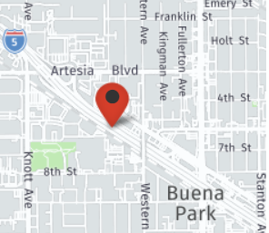
Dataset 2
Data set collected from California Department of Transportation(CALTRANS) Performance Measurement System(PeMS)
Roadway Information
Location | District 12, Orange County , City of Buena Park
Detector used | Dual Loop sensors
Quantity | Speed
Data Quality | 80% Observed
Segment Type | VDS
Segment Name | Mainline VDS 1216538 - Western
start date | 10/04/2021 00:00:00
end date | 10/10/2021 23:59:59
Time of Day Restriction | Hours=06:55-18:59
Day of Week | Su,Mo,Tu,We,Th,Fr,Sa
Granularity | 5min
Figure 2: Location for Dataset 2
Table 2: Dataset 2 information

Slide 9
Sample Data
5 Minutes | Lane 1 Speed (mph) | Lane 1 Flow (Veh/Minute)
26-09-2021 06:55 | 74.8 | 1
26-09-2021 07:00 | 74.9 | 1
26-09-2021 07:05 | 75 | 1
26-09-2021 07:10 | 74.7 | 1
26-09-2021 07:15 | 74.7 | 2
26-09-2021 07:20 | 74.7 | 1
26-09-2021 07:25 | 74.7 | 1
26-09-2021 07:30 | 74.7 | 1
26-09-2021 07:35 | 74.6 | 3
26-09-2021 07:40 | 74.3 | 3
 | Mean Speed = 72.17
5 Minutes | Lane 1 Speed (mph) | Lane 1 Flow (Veh/Minute)
10/4/2021 6:55 | 13.90 | 18.80
10/4/2021 7:00 | 15.30 | 20.80
10/4/2021 7:05 | 14.30 | 19.40
10/4/2021 7:10 | 13.60 | 17.00
10/4/2021 7:15 | 13.30 | 18.00
10/4/2021 7:20 | 13.00 | 18.60
10/4/2021 7:25 | 14.00 | 19.20
10/4/2021 7:30 | 17.10 | 21.80
10/4/2021 7:35 | 16.00 | 17.20
10/4/2021 7:40 | 17.00 | 19.60
 | Mean Speed = 24.22
Table 3: Dataset 1 – Los Angeles
Table 4: Dataset 2 - Buena Park

Slide 10
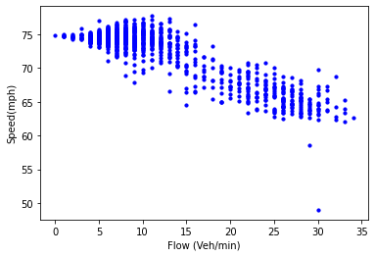
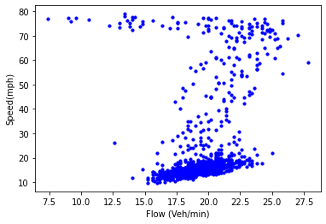
Speed vs Vehicle flow
(Pearson Correlation coefficient = -0.892)
(Pearson Correlation coefficient = 0.253)
Figure 3: Speed vs Vehicle flow scatter plot – Dataset 1
Figure 4: Speed vs Vehicle flow scatter plot – Dataset 2

Slide 11
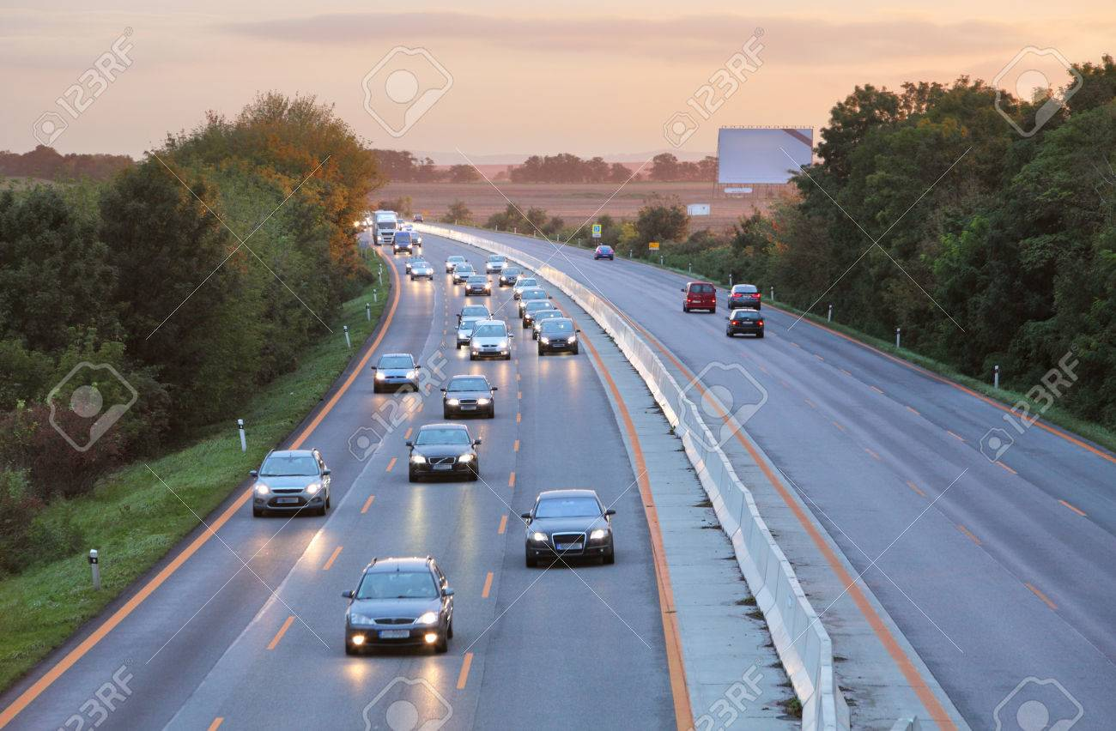
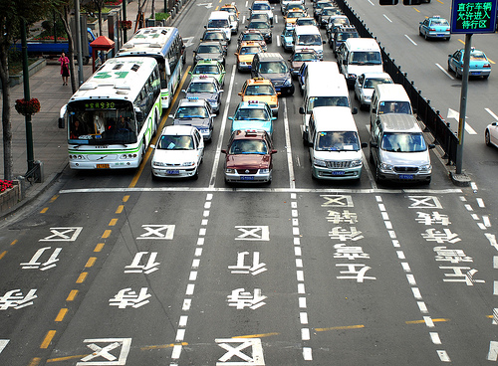
Speed vs Vehicle flow
Figure 5: Speed vs Vehicle flow condition similar to Dataset 1
Figure 6: Speed vs Vehicle flow condition similar to Dataset 2
(Source: https://www.123rf.com/photo_31822652_cars-on-highway-road-at-sunset.html)
(Source: https://www.greencarreports.com/news/1093560_1-2-billion-vehicles-on-worlds-roads-now-2-billion-by-2035-report)

Slide 12
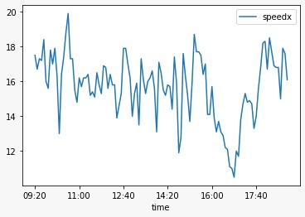
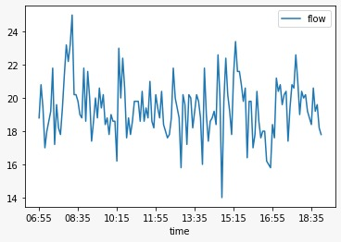
Speed and Vehicle flow vs Time
Figure 5: Average Speed vs Time – Dataset 2 on 04/10/2021
Figure 6: Average Vehicle flow vs Time – Dataset 2 on 04/10/2021

Slide 13
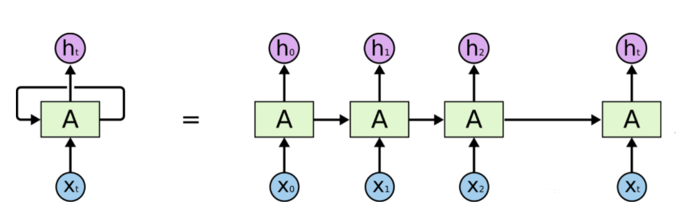
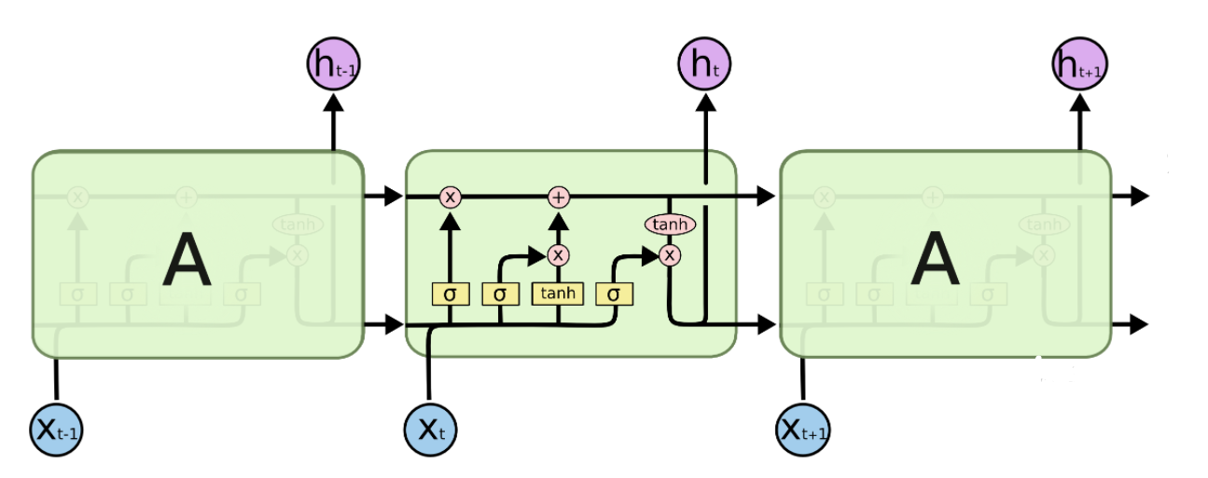
LSTM Model
Long Short Term Memory networks (LSTM)are a special kind of RNN.
Example of language recognition model:
“the clouds are in the sky”
“I grew up in France… I speak fluent French.”
Figure 7: RNN Model
Figure 8: LSTM Model

Slide 14
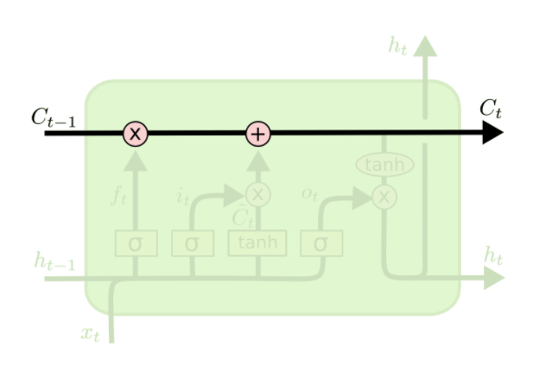
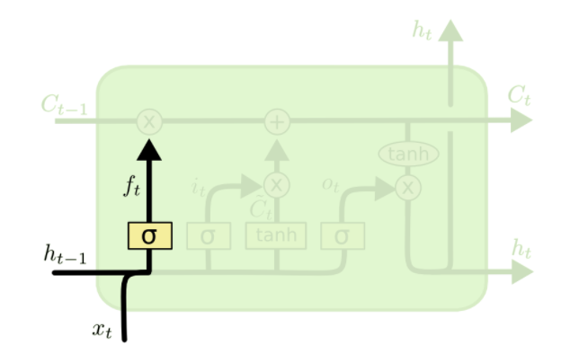
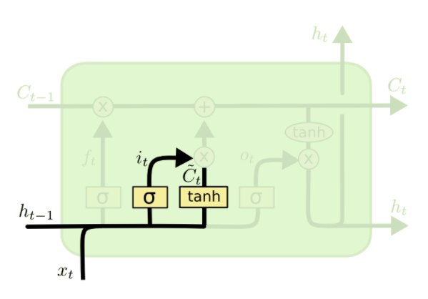
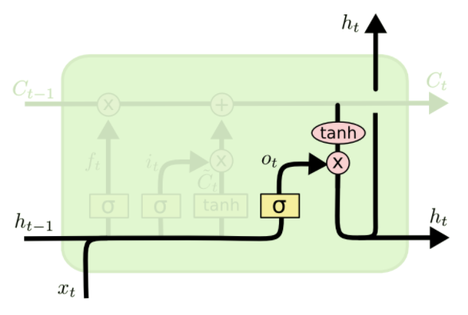
LSTM Model
Figure 9: Memory cell
Figure 10: Forget gate
Figure 11: Input gate
Figure 12: Output gate

Slide 15
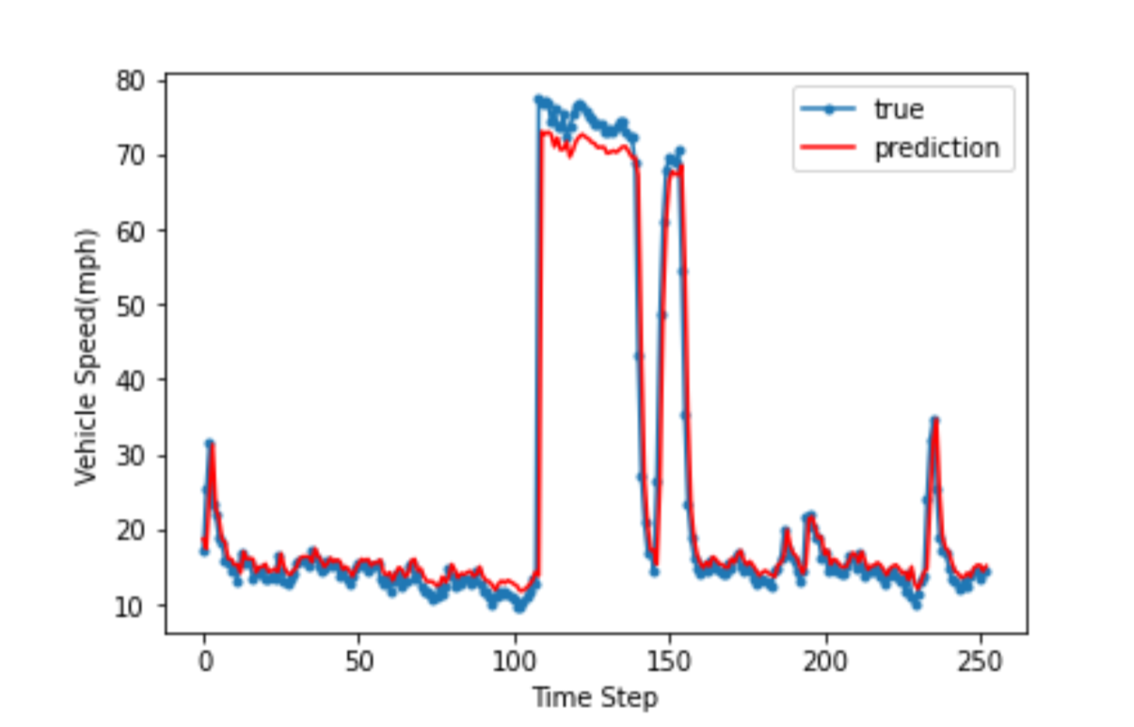
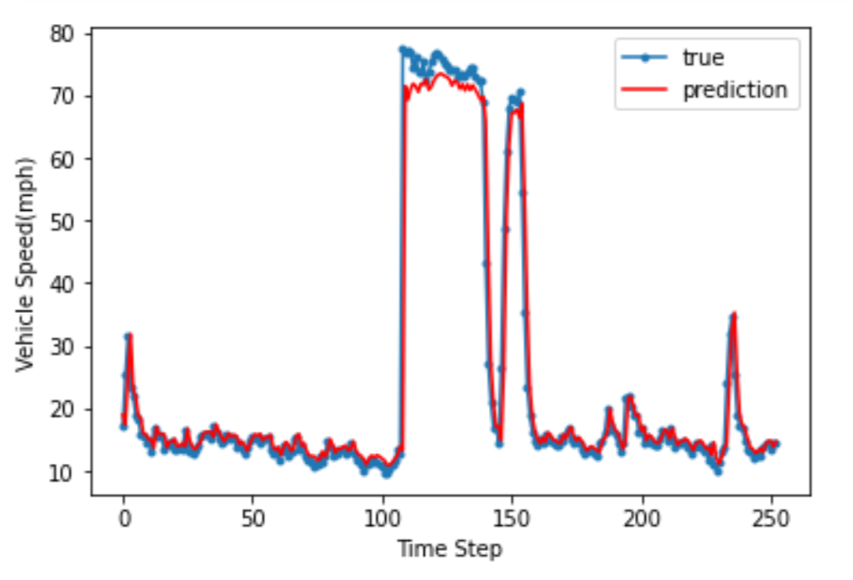
Results & Discussion
Figure 13: Univariate Model – Dataset 1
Figure 14: Multivariate Model – Dataset 1

Slide 16
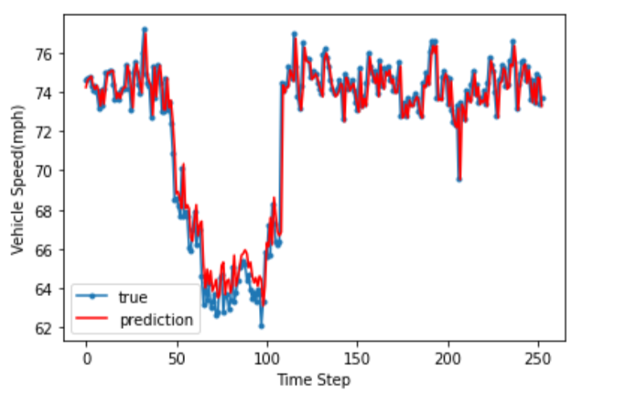
Results & Discussion
Figure 15: Univariate Model – Dataset 2
Figure 16: Multivariate Model – Dataset 2

Slide 17
Results & Discussion
Performance summary of LSTM model
Site | Mean speed(mph) | Univariate model accuracy (%) | Multivariate model accuracy (%)
Los Angeles(Dataset1) | 72.17 | 98.42 | 98.38
City of Buena Park(Dataset2) | 24.22 | 94.22 | 95.62
There is little correlation between flow rate and speed during incident of congestion
LSTM methods connected to IoT speed sensors provide a powerful and accurate method for traffic speed prediction in smart cities over short timescales.
Variation in accuracy depending on type of the road network.
Similar results seen between the univariate and multivariate models show that the multivariate model does not add any significant contribution to prediction accuracy

Slide 18
Limitations and Future Scope
To further improve model, increase length of time horizon for traffic speed prediction.
To inclusion of larger, more varied data sets and extend the work for congestion prediction.
Advanced model in this field could lead towards intelligent systems for congestion reduction through the suggestion of alternative routes, greatly aiding transport planning in future smart, sustainable cities.

Slide 19
References
[1] Majumdar, S., Subhani, M.M., Roullier, B., Anjum, A. and Zhu, R.,(2021). Congestion prediction for smart sustainable cities using IoT and machine learning approaches. Sustainable Cities and Society, 64, p.102500.
[2] Jiang, H., Zou, Y., Zhang, S., Tang, J. and Wang, Y., (2016). Short-term speed prediction using remote microwave sensor data: machine learning versus statistical model. Mathematical Problems in Engineering.
[3] Al-Turjman, F., Abujubbeh, M., Malekloo, A. and Mostarda, L., 2020. UAVs assessment in software-defined IoT networks: An overview. Computer Communications, 150, pp.519-536.
[4] Tian, Y., Zhang, K., Li, J., Lin, X. and Yang, B., (2018). LSTM-based traffic flow prediction with missing data. Neurocomputing, 318, pp.297-305.

Slide 20
References
[5] Ma, X., Tao, Z., Wang, Y., Yu, H. and Wang, Y.,(2015). Long short-term memory neural network for traffic speed prediction using remote microwave sensor data. Transportation Research Part C: Emerging Technologies, 54, pp.187-197.
[6] Qu, L., Li, W., Li, W., Ma, D. and Wang, Y., (2019). Daily long-term traffic flow forecasting based on a deep neural network. Expert Systems with applications, 121, pp.304-312.
[7] https://pems.dot.ca.gov/
[8] https://colah.github.io/posts/2015-08-Understanding-LSTMs/
[9] https://curiousily.com/posts/demand-prediction-with-lstms-using-tensorflow-2-and-keras-in-python/

