Slide 1
FPGA design and clock-domain-crossing
Gyula Istvan Nagy

Slide 2
FPGA internal elements (1)
I/O interface
  Voltage range per bank
  Supported input standards
  Supported output standards
  Required auxiliary voltages
  Required reference voltages
  Termination references
  Maximal SSO count
  Family failures. Check answer records and erratas
  I/O Block structure

Slide 3
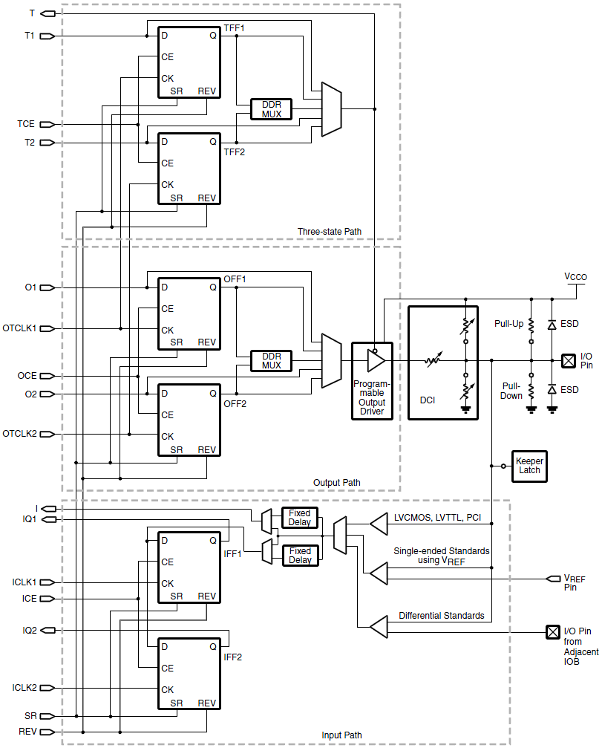
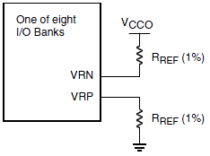
FPGA internal structure (2)

Slide 4
FPGA internal structure (3)
Clock generation
  Global clock input pins to PLLs
  PLL capabilities, VCO operation range, jitter figures
  Clock buffer count and connections
  Clock network
  Check recommendations for IP application

Slide 5
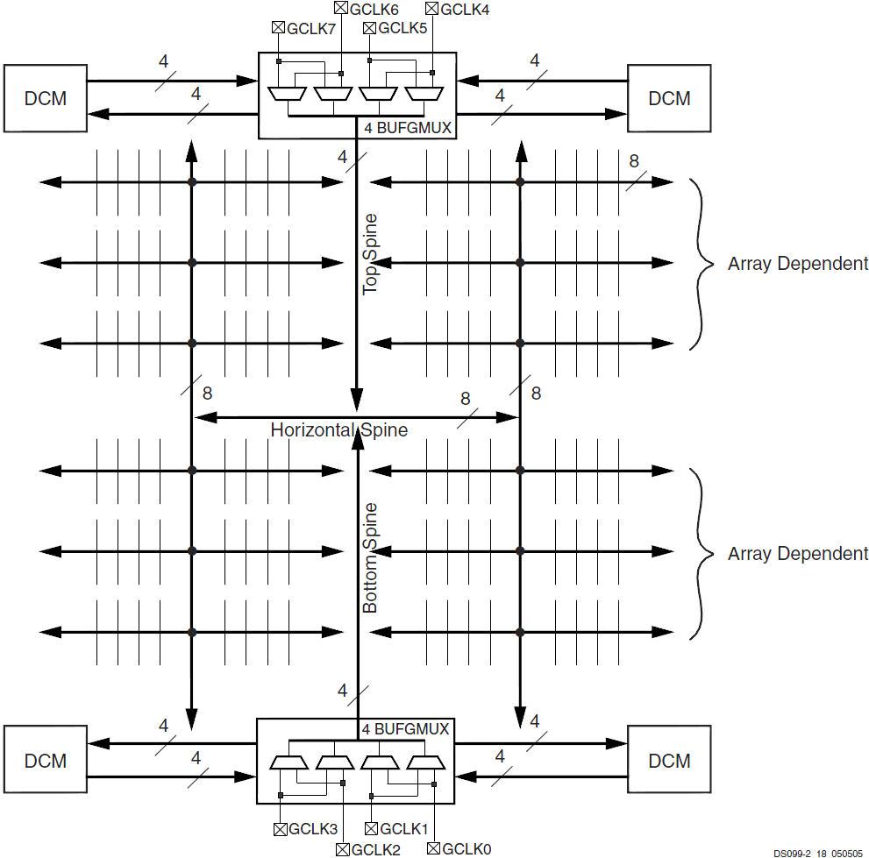
FPGA internal structure (4)

Slide 6
FPGA internal structure (5)
Logic resources
  Dedicated resources internal structure and operation
  Grouping
  Data network

Slide 7
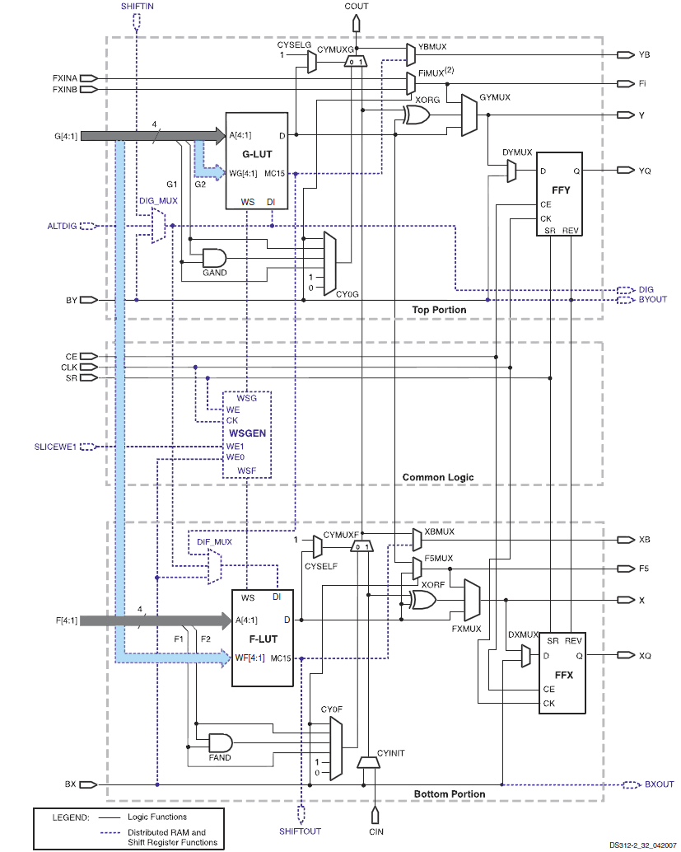
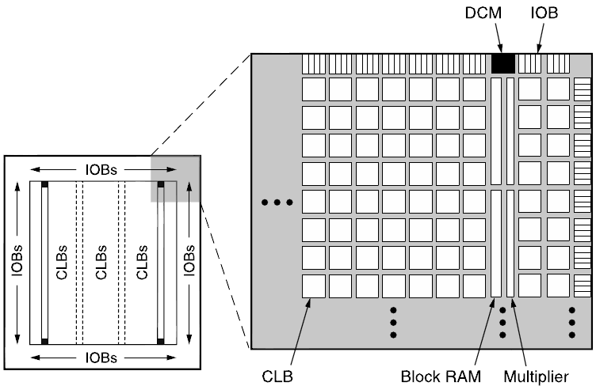
FPGA internal structure (6)

Slide 8
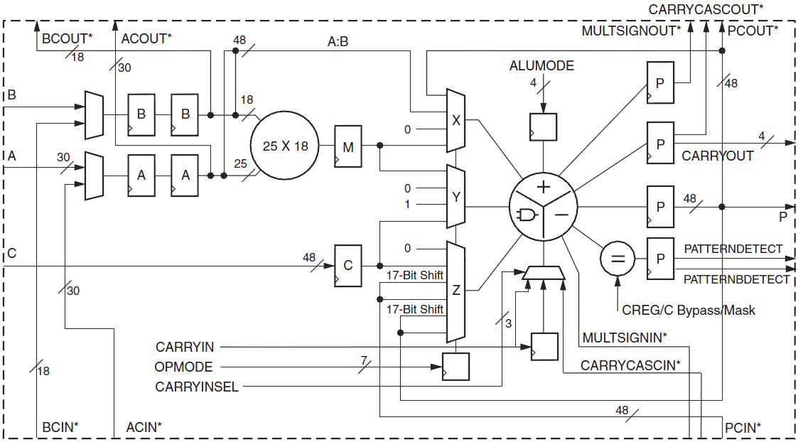
FPGA internal structure (7)

Slide 9
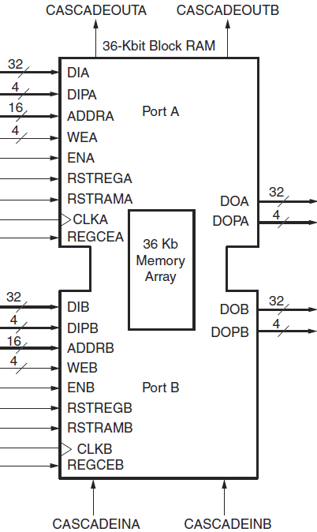
FPGA internal structure (8)

Slide 10
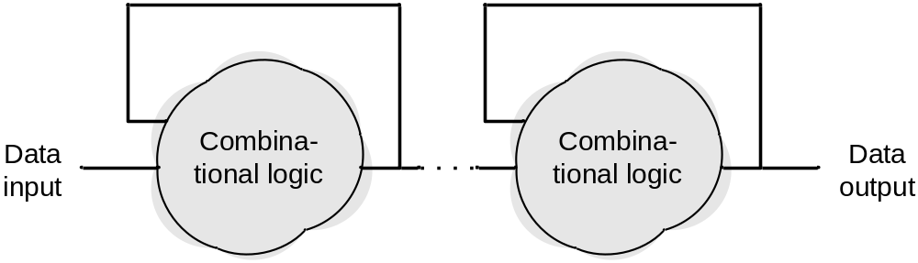
Asynchronous operation
Not for FPGA design
Optimal for overall propagation time

Slide 11
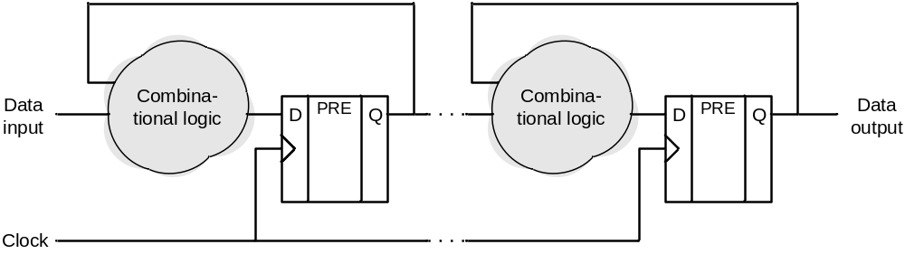
Synchronous operation
For FPGA design
Cycle-accurate operation

Slide 12
Required conditions for synchronous operation
Clock propagation is faster than data between each registers
Clock tree creates balanced distribution for minimal skew
Data and reset timings must be met at each Flip-Flop
Slack causes sub-optimal overall propagation time
Throughput can be increased by slicing combinational logic with pipelining

Slide 13
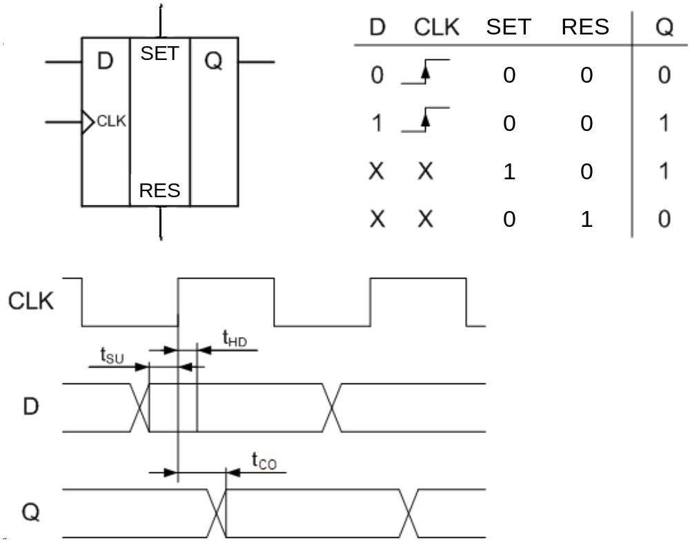
Flip-Flop data timing

Slide 14
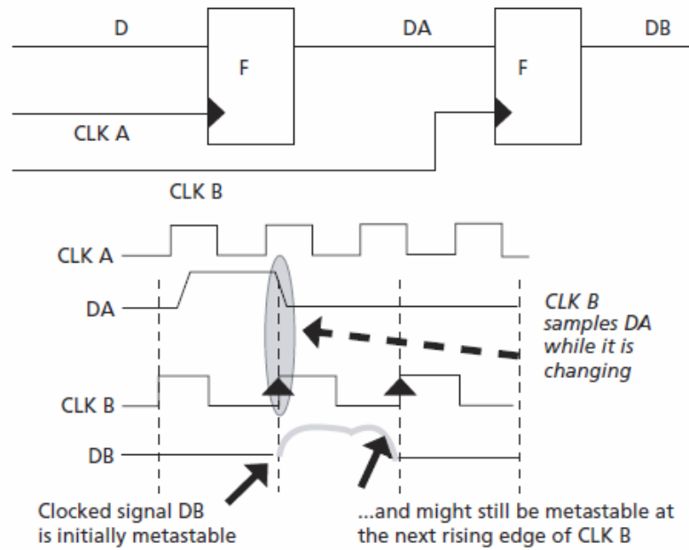
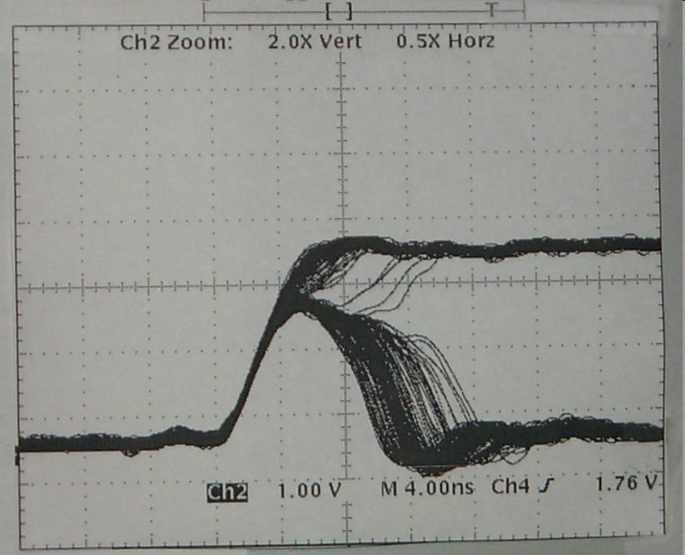
Asynchronous clocks in data path (1)
Affects data timing parameters
Leads to metastability
MTBF depends on clock frequency and fabric parameters

Slide 15
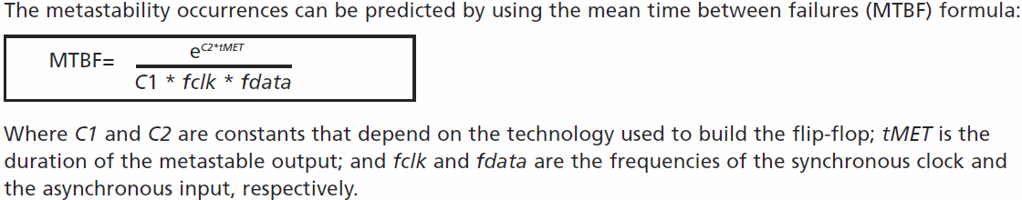
Asynchronous clock in data path (2)
Recovery duration and resulting logic state is a probability function
Metastability must be avoided during clock domain boundary data transfers
Clock-domain-crossing depends on throughput rate and signal dimensions

Slide 16
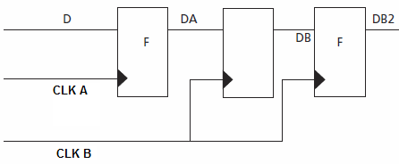
Single-signal clock-domain-crossing
At least two serially connected registers called double-stage synchronizer are required for affordable MTBF of synchronized signals
No combinational logic allowed between clock-domains and double-stage synchronizer registers
Combinational logic introduces hazard synchronization
Register retiming must be disabled in CDC units

Slide 17
Multi-signal clock-domain-crossing
Bit-wise double-stage synchronization doesn’t work because of individual propagation delays
Uses clock-domain-crossed flag signal to enable read in receiver domain
Applicable for low data rate
Signal propagation delay has to be constrained between the clock domains for flag and data
Optionally Gray-encoded incremental control signals can avoid false detection

Slide 18
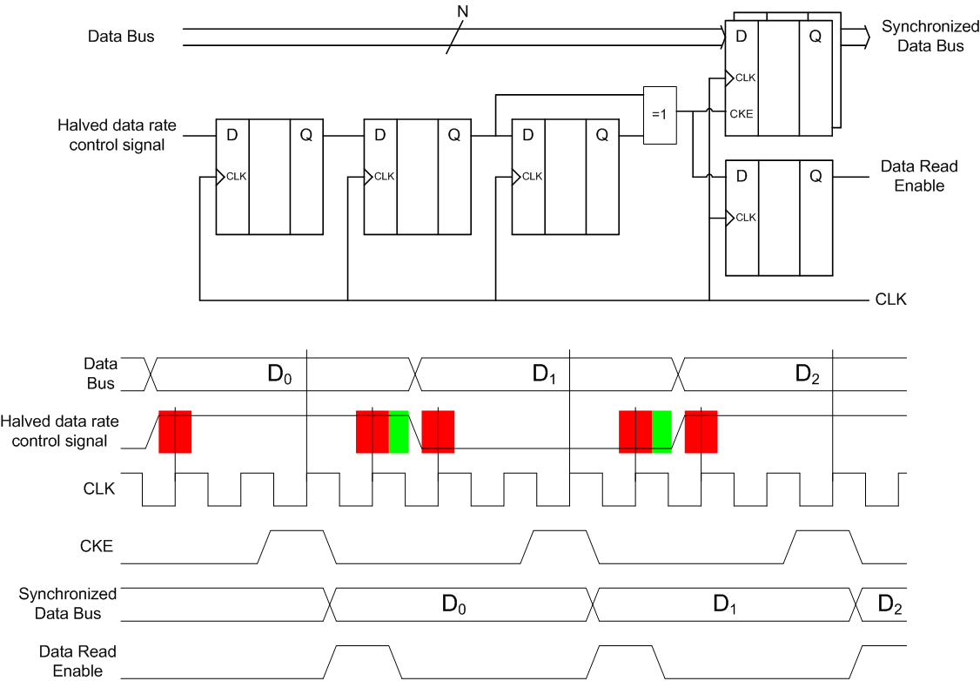
Multi-signal clock-domain-crossing

Slide 19
Multi-signal CDC for high data-rate
Parallel transfers between two domains for the same origin bus
Transmitter and receiver logics use the same data lane selection policy
Double buffer for the multiplexed transfers
Higher data rate ratio requires higher lane count per stage

Slide 20
Clock-domain-crossing with asynchronous FIFO (1)
Arbitrary clock relationship is possible
Clock-domain-crossing signals’ propagation must be constrained to the receiver clock period
Requires asynchronous SRAM

Slide 21
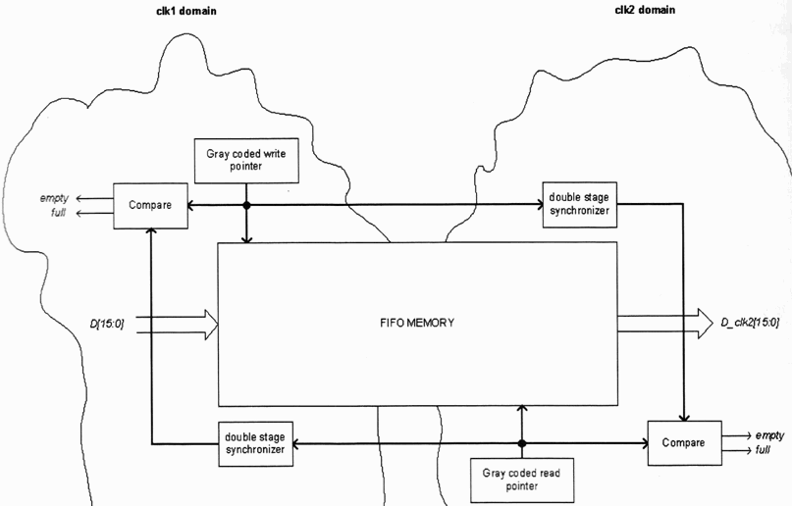
Clock-domain-crossing with asynchronous FIFO (2)

Slide 22
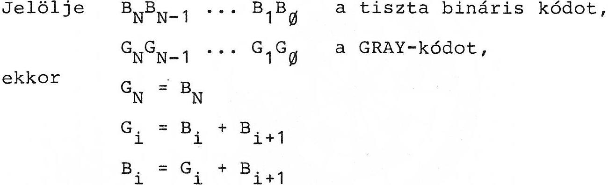
Clock-domain-crossing with asynchronous FIFO (3)
Gray-encoded write and read pointers ensure one-bit toggling between adjacent values for equivalency with single-signal CDC
Synchronization is possible with paralleled double-stage synchronizers
Rotary arbitration avoids data overwrite in SRAM

Slide 23
Flip-Flop reset timing
Timing parameters must meet for reset to avoid meta-stability during system start-up
Synchronous reset must meet setup and hold timing
Asynchronous reset must meet recovery and removal timing
Reset synchronization required for sources without clock relationship to the actual domain

Slide 24
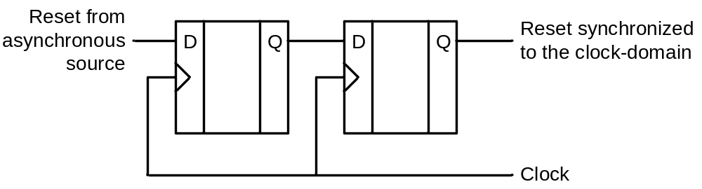
Synchronization for synchronous reset
Double-stage synchronizer for reset signal
Ensures setup and hold timing

Slide 25
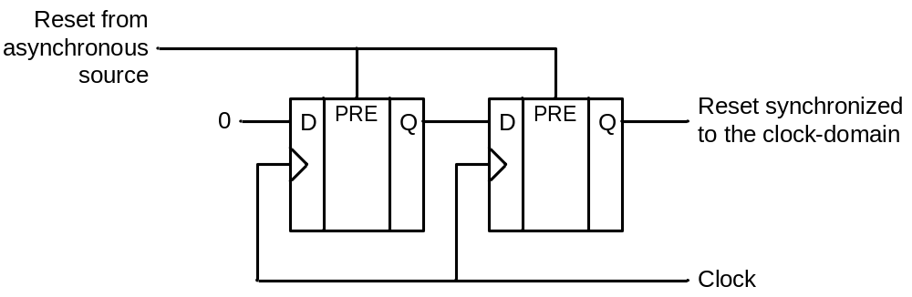
Synchronization for asynchronous reset (1)
Two serially connected flip-flops with asynchronous reset
Ensures removal timing
Minimal pulse width is required at input

Slide 26
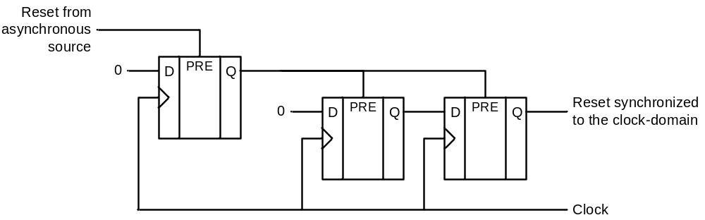
Synchronization for asynchronous reset (2)
If minimal pulse width is not known to be complied single input flip-flop is usable

Slide 27
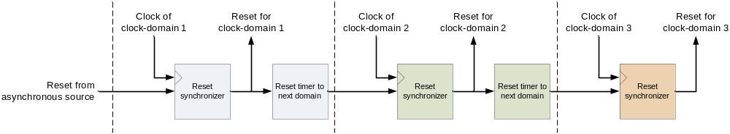
Reset sequencing
Reset sequence must be synchronized to each clock-domain

Slide 28


