Slide 1

Overview of System Verilog
-Kishan A V

Slide 2

Use of Verilog and VHDL
I have used Verilog and VHDL till date for development of design and its verification.
Developed basic test benches for verification.
Verification was done using
Simulation outputs
Waveforms

Slide 3
Introduction to System Verilog
System Verilog is a combined Hardware descriptive language and Hardware verification language based on extensions to Verilog.
SV helps us in quantitatively analysing the design with a very systematic Test bench.
With SV, we can analyze loopholes in the existing design easily and correct them as and when required.

Slide 4
Additions in System Verilog
Some of the new features in System Verilog are as listed below.
C type data types like int, typedef, struct, union, enum.
Dynamic data types : struct, classes, dynamic queues, dynamic arrays
New operators and built in methods
Enhanced flow control like, foreach, return, break, continue
Semaphores, mailboxes, event extensions
Classes for object oriented programming
Assertions
Coverage

Slide 5
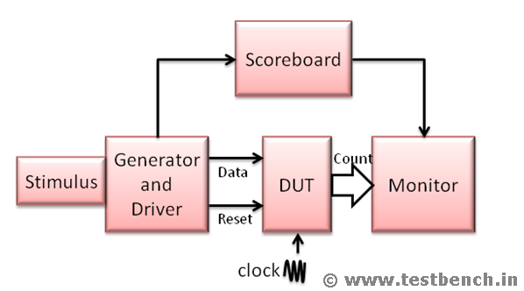
Basic Block Diagram of System Verilog Testbench

Slide 6
Counter Testbench Overview
Some of the Assertions and test coverage includes:
Reset pin setting the count to zero within stipulated number of clock cycles.
Rollover of the counter when it is full.
Covering all cross possibilities of reset and enable pins to verify the case.
Checking that the devices are clock sensitive and work in synchronous with the positive edge of the clock.

Slide 7
Counter Testbench Coverage Results
Some of the results include:
100% coverage to all the values of the counter
100% coverage to all the cross coverage features of the reset and enable pins
100% coverage to the coverpoint involving the rollover of the count variable
Verification of the Reset and an assertion in case of an error in the design.

Slide 8
FIFO Testbench Overview
Some of the test coverage cases includes:
All the read and write pointer addresses are covered i.e. from 0 to N
The read and write pointer addresses roll over after reaching N.
Read and write pointer addresses increment when the read and write enable is made high respectively.
All the states of Write enable are covered
All the states of Read enable are covered
All the states of Reset are covered
All the states of full and empty flags are covered
All the states of almost full and almost empty flags are covered
Cross Coverage for read enable, write enable and reset is covered with all possible combinations of the same.

Slide 9
FIFO Testbench Coverage Results
Some of the results include:
100% coverage to all the variables:
Write and read pointer
Write and read enable
Reset
Full and empty
Almost full and almost empty
100% coverage to all the cross coverage features of the reset and read and write enable pins
100% coverage to the cover point involving the rollover of the pointer variables
Verification of the Reset and an assertion in case of an error in the design.

Slide 10
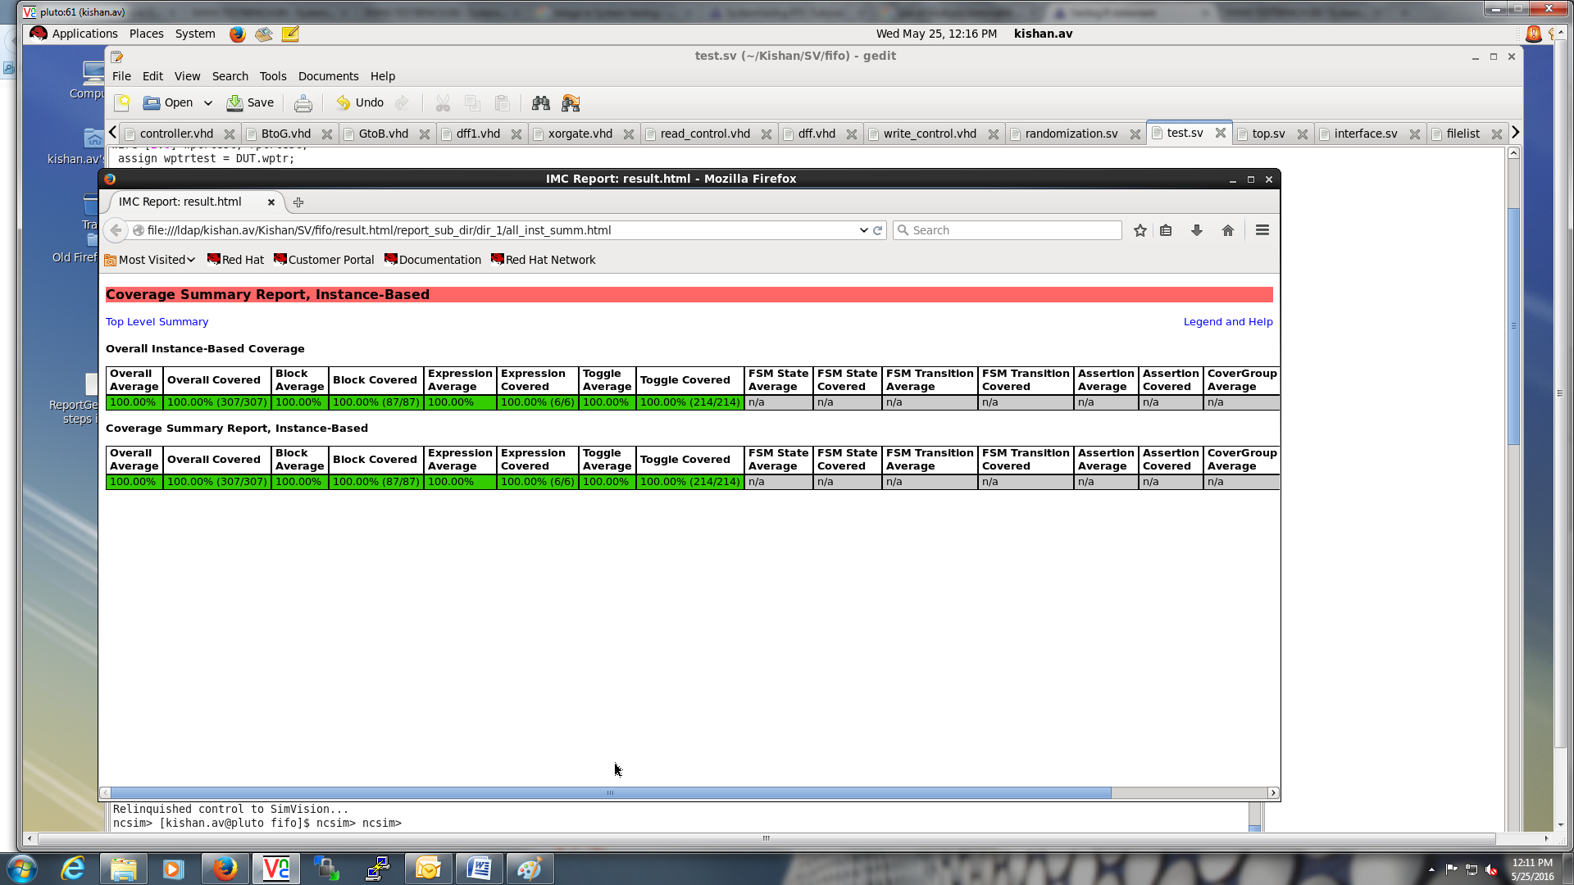
FIFO Testbench Coverage Results

Slide 11
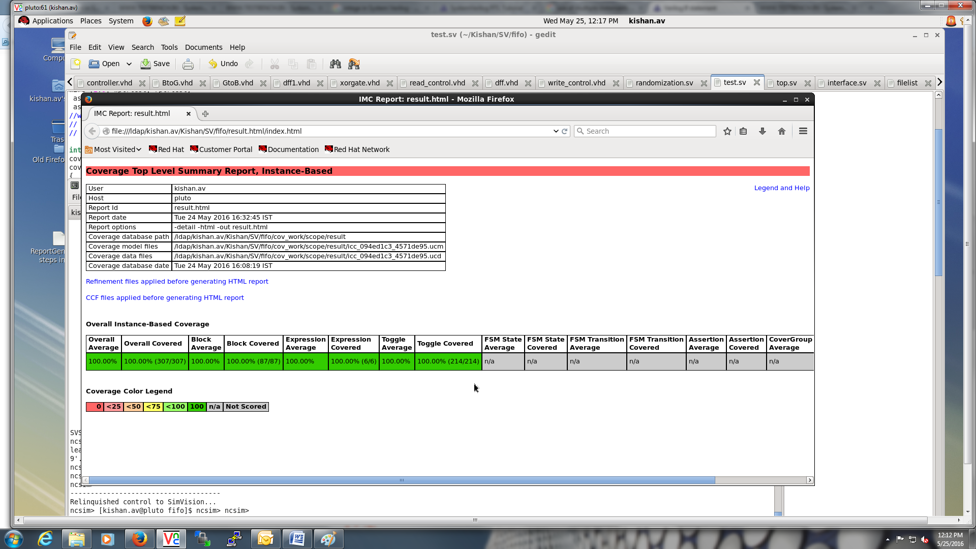
FIFO Testbench Coverage Results

Slide 12
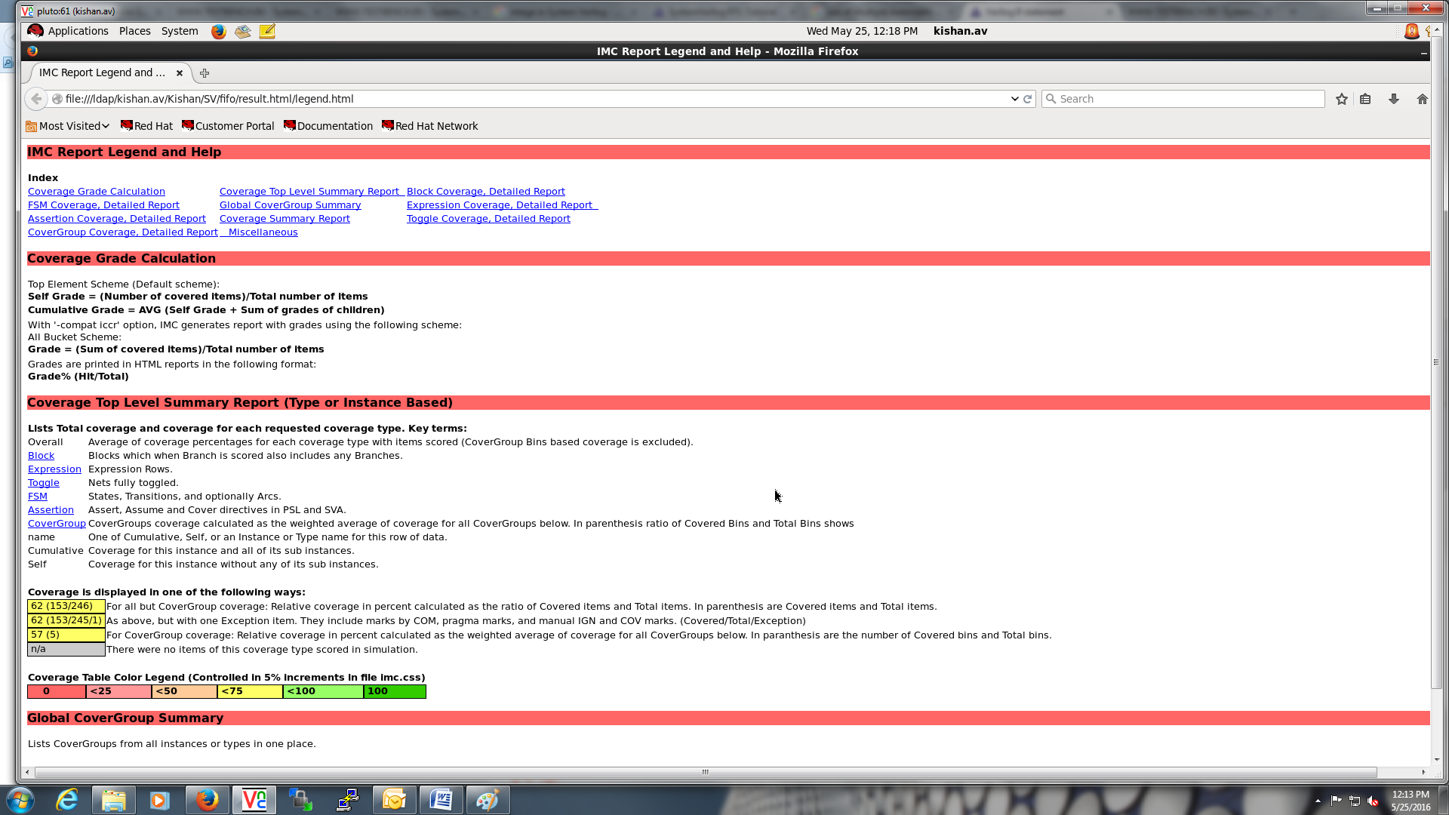
FIFO Testbench Coverage Results

Slide 13
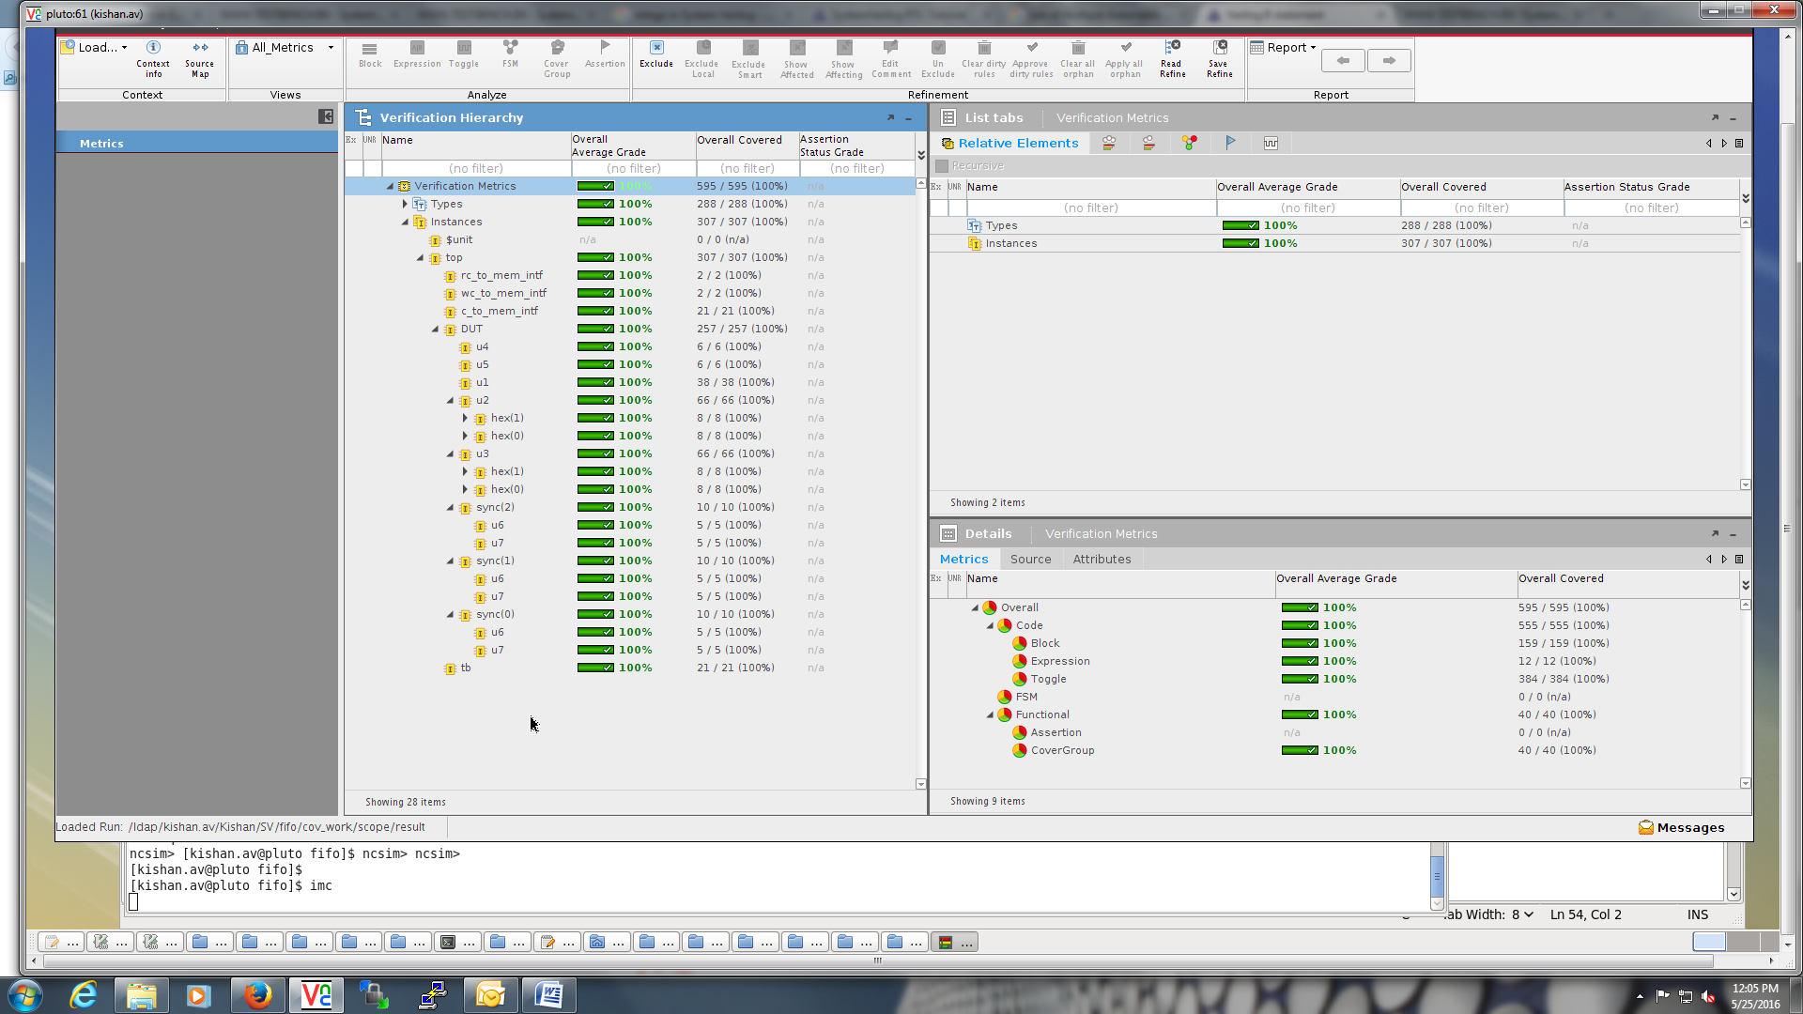
FIFO Testbench Coverage Results

Slide 14
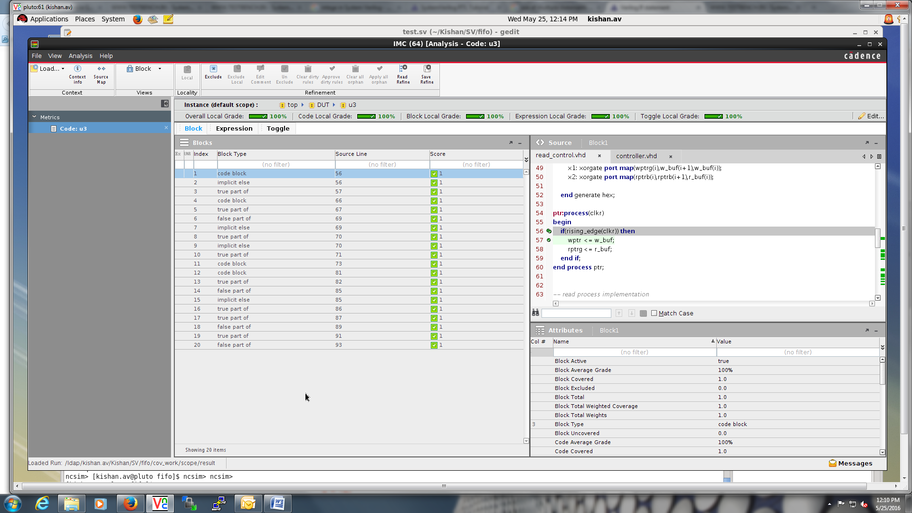
FIFO Testbench Coverage Results

Slide 15
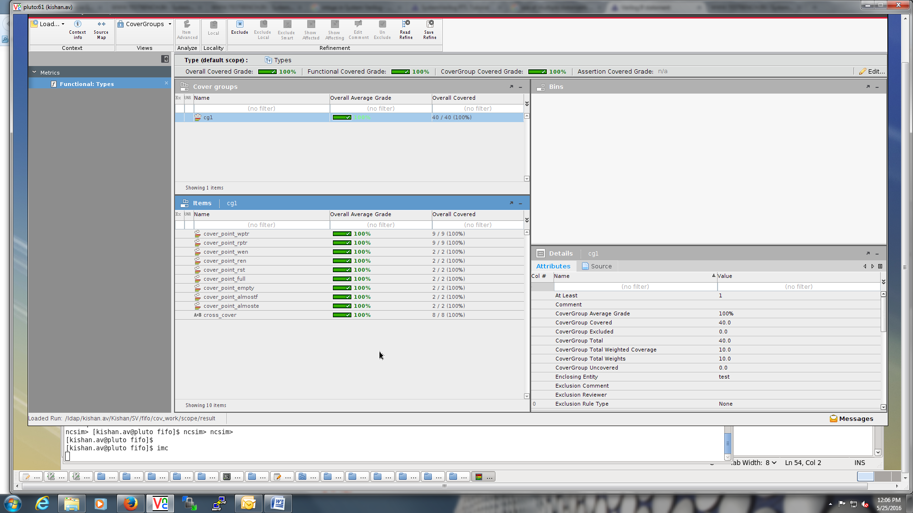
FIFO Testbench Coverage Results

