Slide 1
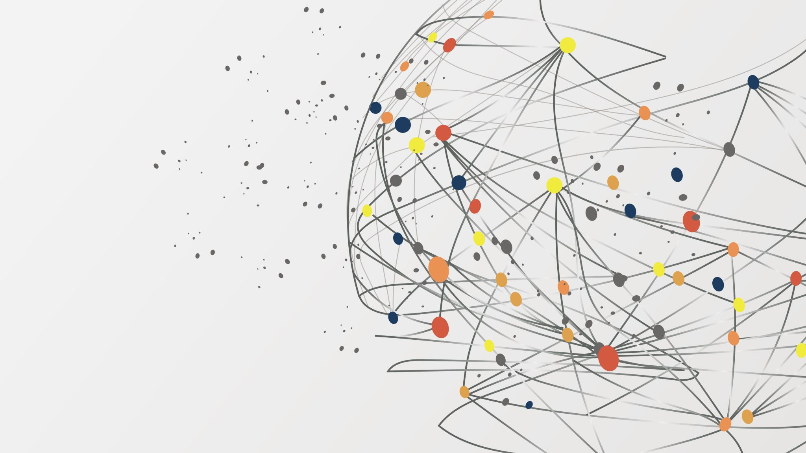
Gen AI
Tools and Collaborations

Slide 2
WHY GEN AI?
Generative AI is a rapidly evolving field with vast potential across various industries, offering innovative ways to create and interact with content. By understanding and leveraging these models, businesses and individuals can unlock new possibilities for creativity, efficiency, and user engagement.

Slide 3
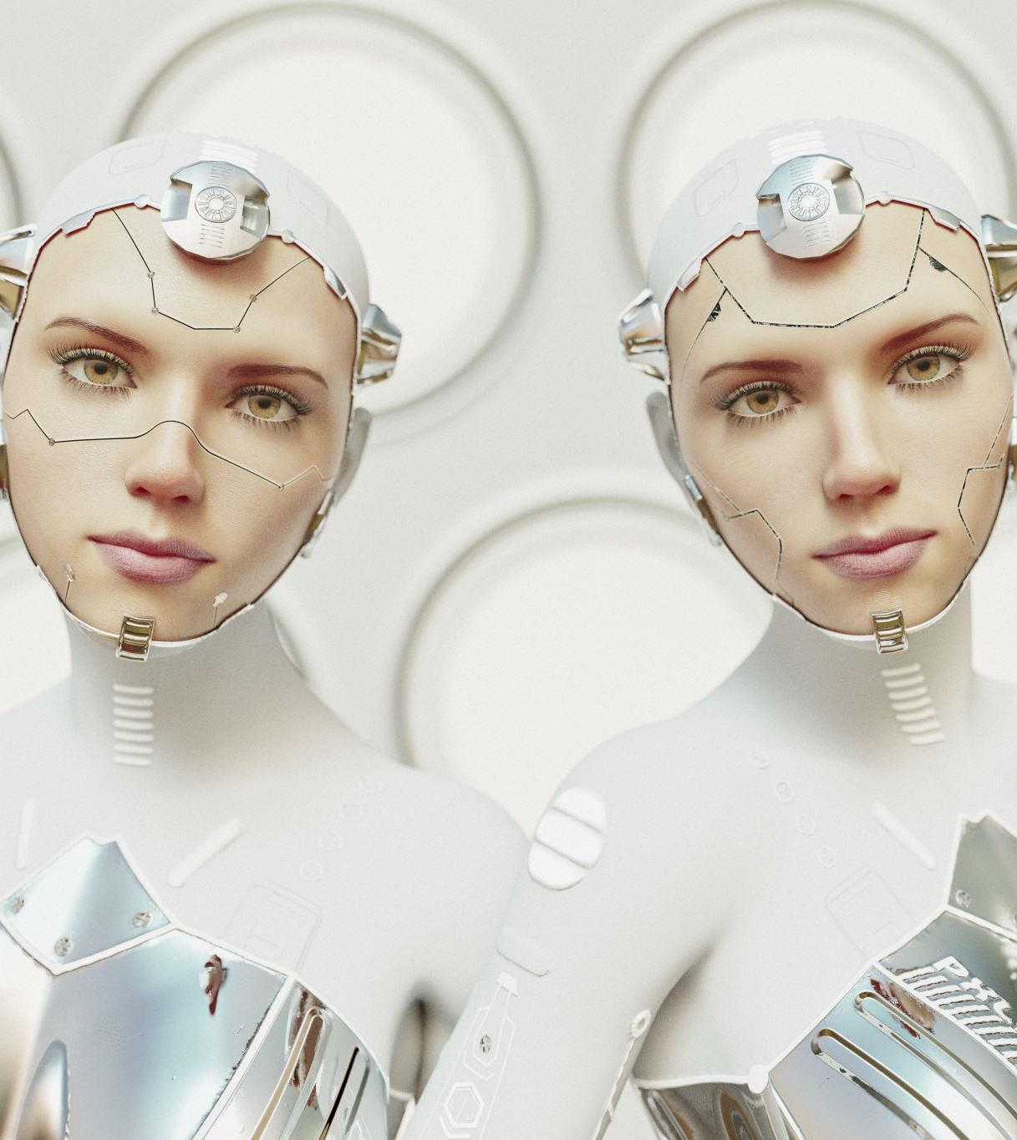
COMPONENTS OF GEN AI
Generative Models: These are the core of generative AI. They learn the distribution of the training data and can generate new data points that resemble the training set. Common generative models include:
Generative Adversarial Networks (GANs): highly realistic data.
Variational Autoencoders (VAEs): Encode input data into a latent space and then decode it back to generate new data. Transformers: (e.g., GPT-3) are designed to predict the next word in a sentence.

Slide 4
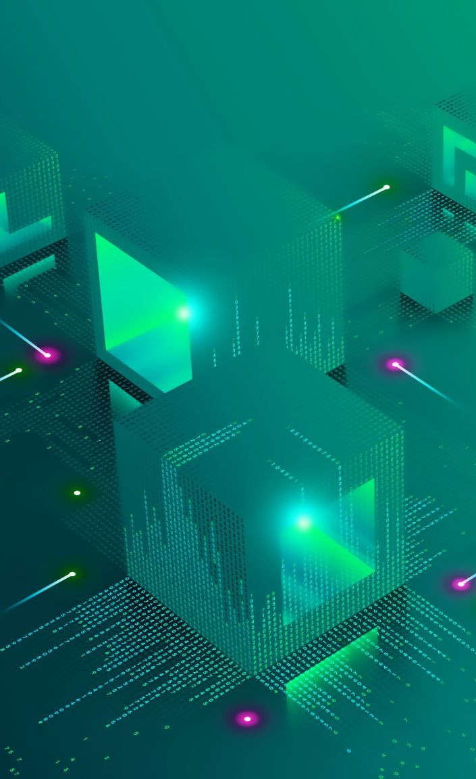
UNDERSTANDING GEN AI TOOLS
Generative AI refers to algorithms that can create new content, such as text, images, music, and even code, based on the data they have been trained on. These tools often use deep learning techniques, particularly generative adversarial networks (GANs) and transformers, to produce new data.
Generative Adversarial Networks (GANs):
Structure: Comprises two neural networks, a generator and a discriminator, that are trained simultaneously. The generator creates data, while the discriminator evaluates it.
Use Cases: Image generation, video creation, and data augmentation.
Transformers:
Structure: self-attention mechanisms - GPT (Generative Pre-trained Transformer) and BERT (Bidirectional Encoder Representations from Transformers).
Use Cases: Text generation, translation, summarization, and more.

Slide 5

LIFECYCLE
Building and deploying an application using Generative AI involves several stages, from conception to deployment and maintenance. Here's a detailed lifecycle, tailored for deploying on the cloud:
Defining The Project Scope And Requirements,
Researching And Selecting Models,
Collecting And Preparing Data,
Training And Developing The Model,
Optimizing The Model,
Integrating And Developing Apis,
Deploying On The Cloud,
And Monitoring And Maintaining The Application.

Slide 6

TOOLS AND SERVICES
Frameworks: TensorFlow, PyTorch, Hugging Face Transformers
Data Storage: AWS S3, Azure Blob Storage, Google Cloud Storage
Model Training: AWS Sagemaker, Azure Machine Learning, Google AI Platform
API Development: Flask, FastAPI
Containerization: Docker
Orchestration: Kubernetes
Deployment: AWS Lambda, Azure Functions, Google Cloud Run
CI/CD: Jenkins, GitHub Actions, AWS CodePipeline
Monitoring: AWS CloudWatch, Azure Monitor, Google Cloud Monitoring

