Slide 1
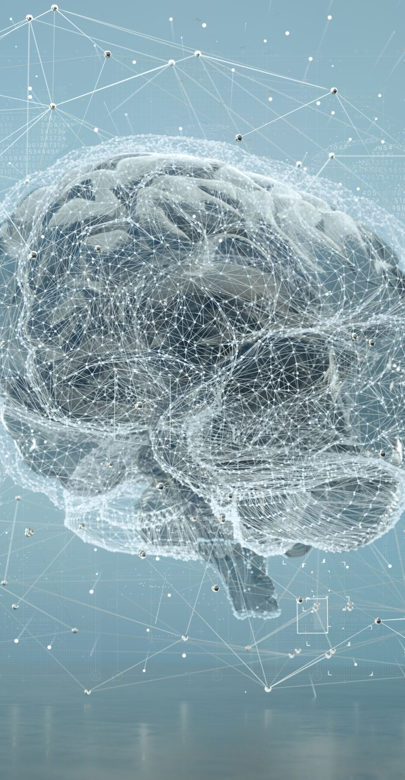
Generative AI & Agentic AI
Practical Guide to GANs, LLMs, Agentic AI & LangChain

Slide 2
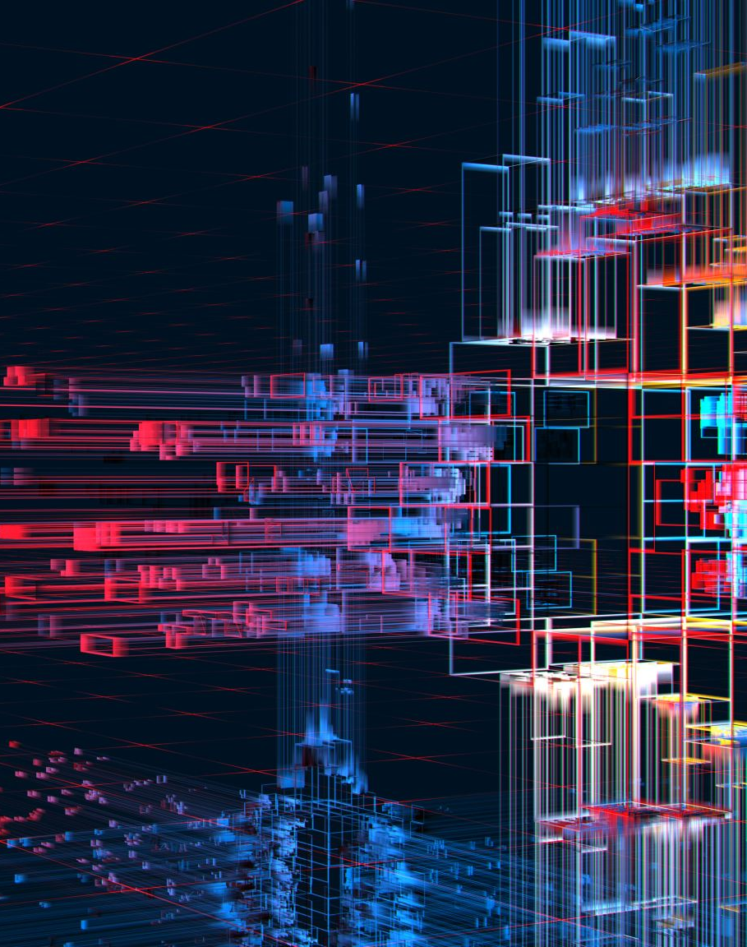
Definition
Generative AI refers to artificial intelligence models that can generate new data similar to the input they are trained on. Unlike traditional AI models that rely on explicit rules for tasks (e.g., classification, regression), generative AI can create realistic outputs such as images, text, music, and videos.
Key Concept: Generative models learn patterns and structures from existing data and use that knowledge to generate new, synthetic data.

Slide 3
Evolution of Generative AI
Generative AI has evolved significantly over the years:
• 2000s: Early statistical methods (e.g., Markov Chains, Hidden Markov Models)
• 2014: Generative Adversarial Networks (GANs) introduced by Ian Goodfellow
• 2017: Transformer architecture introduced (led to powerful LLMs like GPT, BERT)
• 2020s: AI systems like DALL·E, Stable Diffusion, and ChatGPT revolutionized text, image, and video generation
• 2023-Present: Rise of Agentic AI where AI can autonomously interact with tools and APIs to complete tasks

Slide 4
Applications of Generative AI
Text Generation: Chatbots (ChatGPT, Bard), AI-based writing tools (Copy.ai)
Image Synthesis: AI-generated art (DALL·E, Stable Diffusion, MidJourney)
Video Generation: Deepfake videos, AI-driven content creation (RunwayML)
Code Generation: AI-powered coding assistants (GitHub Copilot, CodeGeeX)
Healthcare: AI-assisted drug discovery, medical image enhancement
Music & Voice: AI-generated music, voice cloning (ElevenLabs, Murf AI)

Slide 5
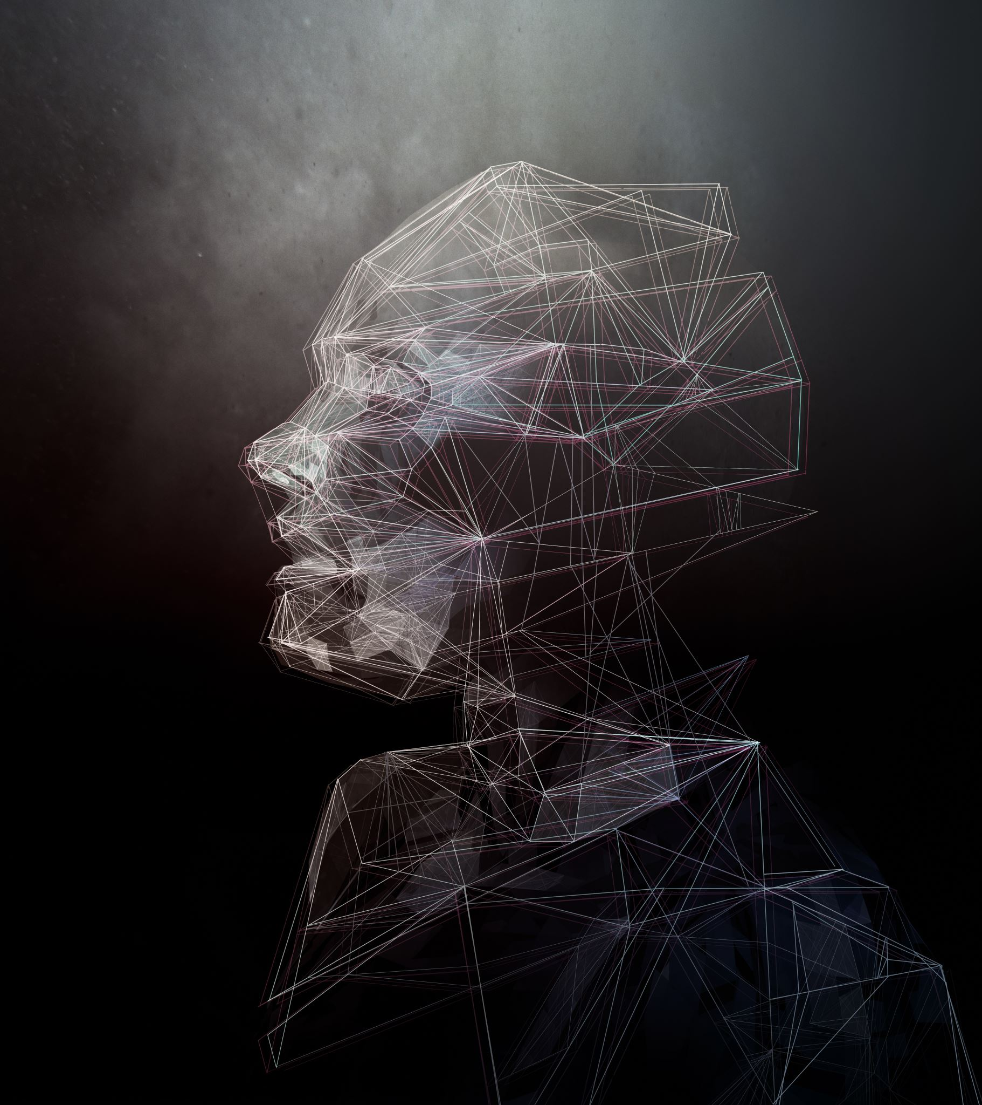
Tools Used for Generative AI
TensorFlow & PyTorch – Deep learning frameworks for training models
Hugging Face – Pre-trained generative models for text & vision
OpenAI API – Access to GPT models for text generation
DALL·E & Stable Diffusion – Image generation models
LangChain – Framework for AI-powered applications

Slide 6
GAN
Generative Adversarial Network (GAN)

Slide 7
GAN
A Generative Adversarial Network (GAN) is a deep learning model used to generate synthetic data that mimics real data. It was introduced by Ian Goodfellow in 2014. GANs consist of two neural networks that work against each other in a competitive setting (hence the name “adversarial”).

Slide 8
How Do GANs Work? (Generator vs. Discriminator)
GANs consist of two core components:
Generator (G)
• Takes random noise as input and generates synthetic data (e.g., fake images, text, audio).
• Goal: Fool the Discriminator into believing the generated data is real.
Discriminator (D)
• Takes real and fake data as input and classifies whether the input is real or generated.
• Goal: Correctly distinguish real from fake data.

Slide 9
Training Process:
Generator produces fake data
Discriminator evaluates data (real or fake)
Feedback is sent to Generator to improve its output
Over multiple iterations, Generator improves and creates more realistic data

Slide 10
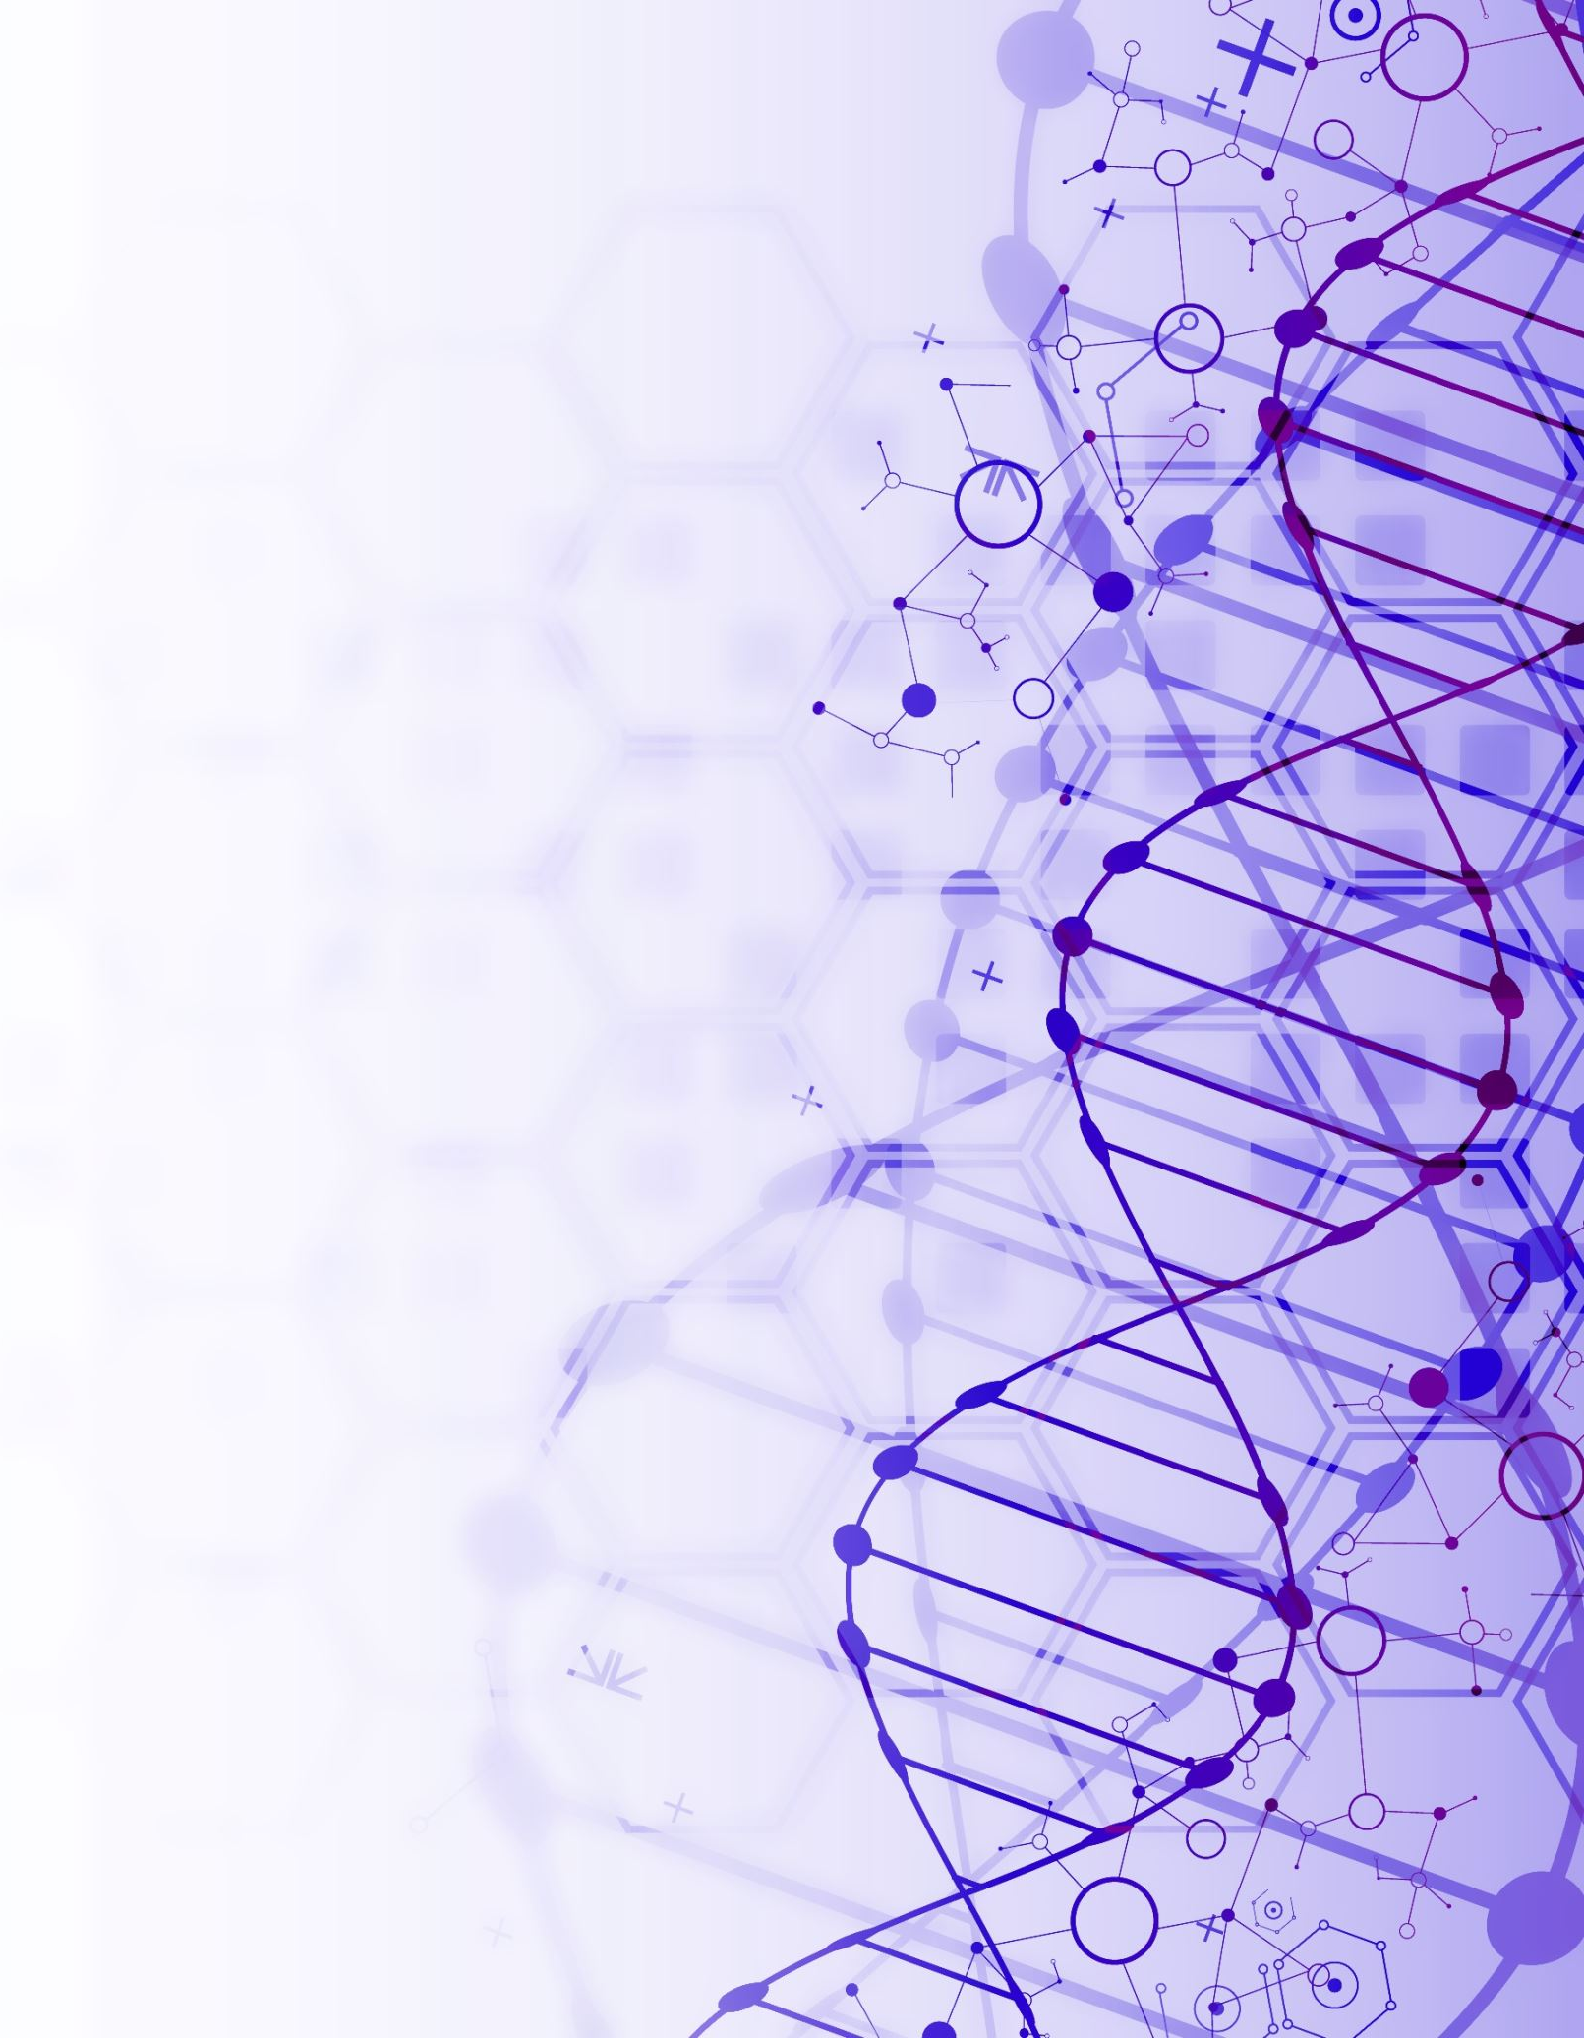
Applications of GANs
Image Generation: AI-generated faces (ThisPersonDoesNotExist.com)
Super-Resolution: Enhancing image quality (ESRGAN)
Style Transfer: Converting images into artistic styles (DeepArt)
Data Augmentation: Creating synthetic training data for machine learning
Deepfake Technology: AI-generated videos and voice cloning
Healthcare: Generating medical images for research

Slide 11
Types of GANs
Type | Purpose | Example Use Case
DCGAN (Deep Convolutional GAN) | Generates realistic images | AI-generated portraits
CycleGAN | Style transfer between domains | Turning horse images into zebras
Pix2Pix GAN | Converts images from one format to another | Sketch-to-photo conversion
StyleGAN | Generates high-quality images | Deepfake applications
BigGAN | Generates ultra-realistic images | Large-scale AI art

Slide 12
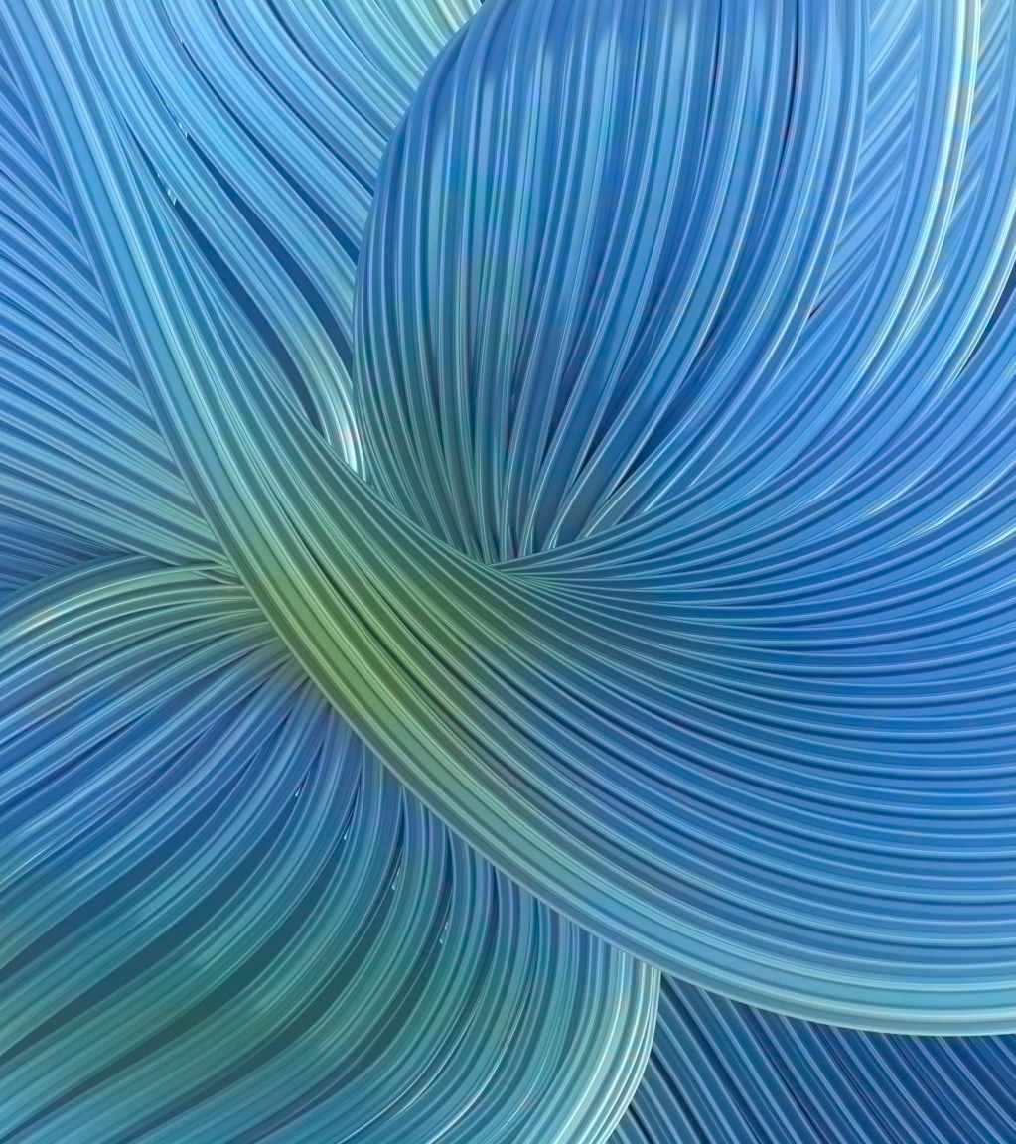
Tools Used for GANs
TensorFlow & PyTorch – Building and training GANs
FastGAN & StyleGAN – Pre-trained models for image generation
Google Colab & Jupyter Notebook – Running GAN models efficiently
OpenAI’s DALL·E – AI-powered image synthesis

Slide 13
Summary of GAN Hands-on Implementation
Step | Task | Description
1 | Import Libraries | Load necessary dependencies
2 | Load Dataset | Load MNIST dataset for training
3 | Define Generator | Create a model to generate fake images
4 | Define Discriminator | Create a model to classify real vs. fake images
5 | Set Up Training | Use loss function and optimizer for learning
6 | Train the GAN | Train both Generator and Discriminator
7 | Generate Images | Test Generator after training

Slide 14
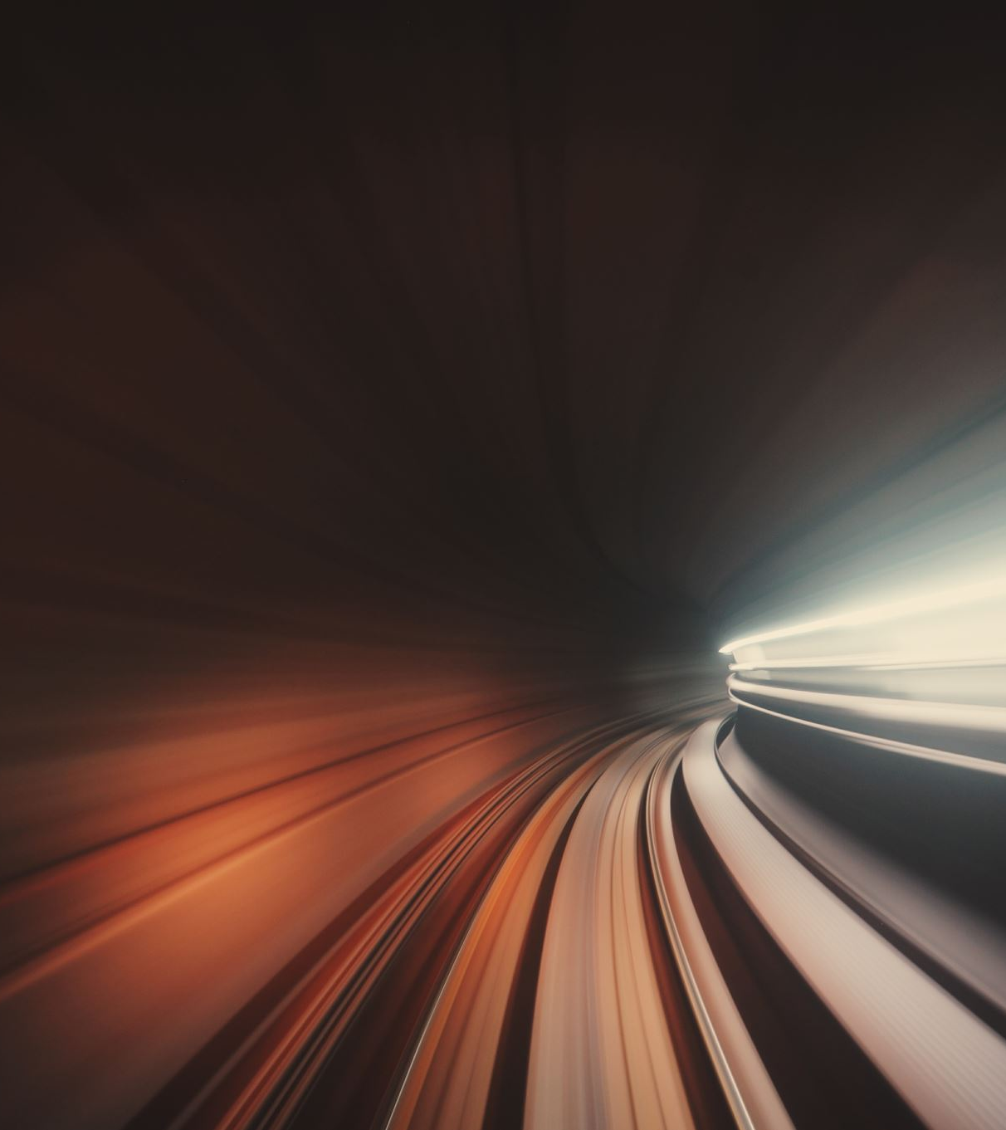
Improving GAN Performance
Train on more complex datasets like CIFAR-10 or CelebA (face images).
Use Advanced GAN Variants like DCGAN, StyleGAN, or CycleGAN.
Tune Hyperparameters (learning rate, optimizer settings, noise size).

Slide 15
Large language models
HuggingFace Transformers, PEFT, QLoRA

