Slide 1

Large Language Models (LLMs) & Prompt Engineering
fundamentals

Slide 2

What are LLMs?
Transformer-based models trained on massive text data
Examples: GPT-4, Claude, Gemini, LLaMA, Mistral
Used for understanding and generating human language
LLMs are advanced AI systems trained on diverse text data using Transformer architectures.
They enable natural language understanding, generation, summarization, classification, and more.
Core to many enterprise AI solutions across domains.

Slide 3
Key Features of LLMs
Billions to trillions of parameters
01
Trained on diverse datasets (web, books, code)
02
Capable of zero-shot, few-shot, and instruction-tuned tasks
03

Slide 4
Applications of LLMs
Chatbots and assistants
Summarization and translation
Code generation and debugging
Sentiment analysis
Legal and medical document analysis

Slide 5
Key Industry Models
GPT-4 / GPT-4o (OpenAI): High-performing in reasoning and multilingual tasks.
Claude (Anthropic): Known for safety and alignment.
Gemini (Google DeepMind): Integrated with search and multimodal capabilities.
Mistral, LLaMA (Meta): Open-source and lightweight industry alternatives.

Slide 6
Industrial Applications
Customer Service: Automating query handling, sentiment detection
Healthcare: Medical documentation, clinical assistant bots
Finance: KYC automation, risk analysis, report summarization
E-commerce: Product descriptions, personalized recommendations
Legal: Contract review, document comparison, summarization

Slide 7

Architecture of LLMs
Base Architecture: Transformer
Introduced in the paper “Attention is All You Need” (Vaswani et al., 2017), the Transformer is the foundation of LLMs like GPT, BERT, T5, LLaMA, and Gemini.

Slide 8
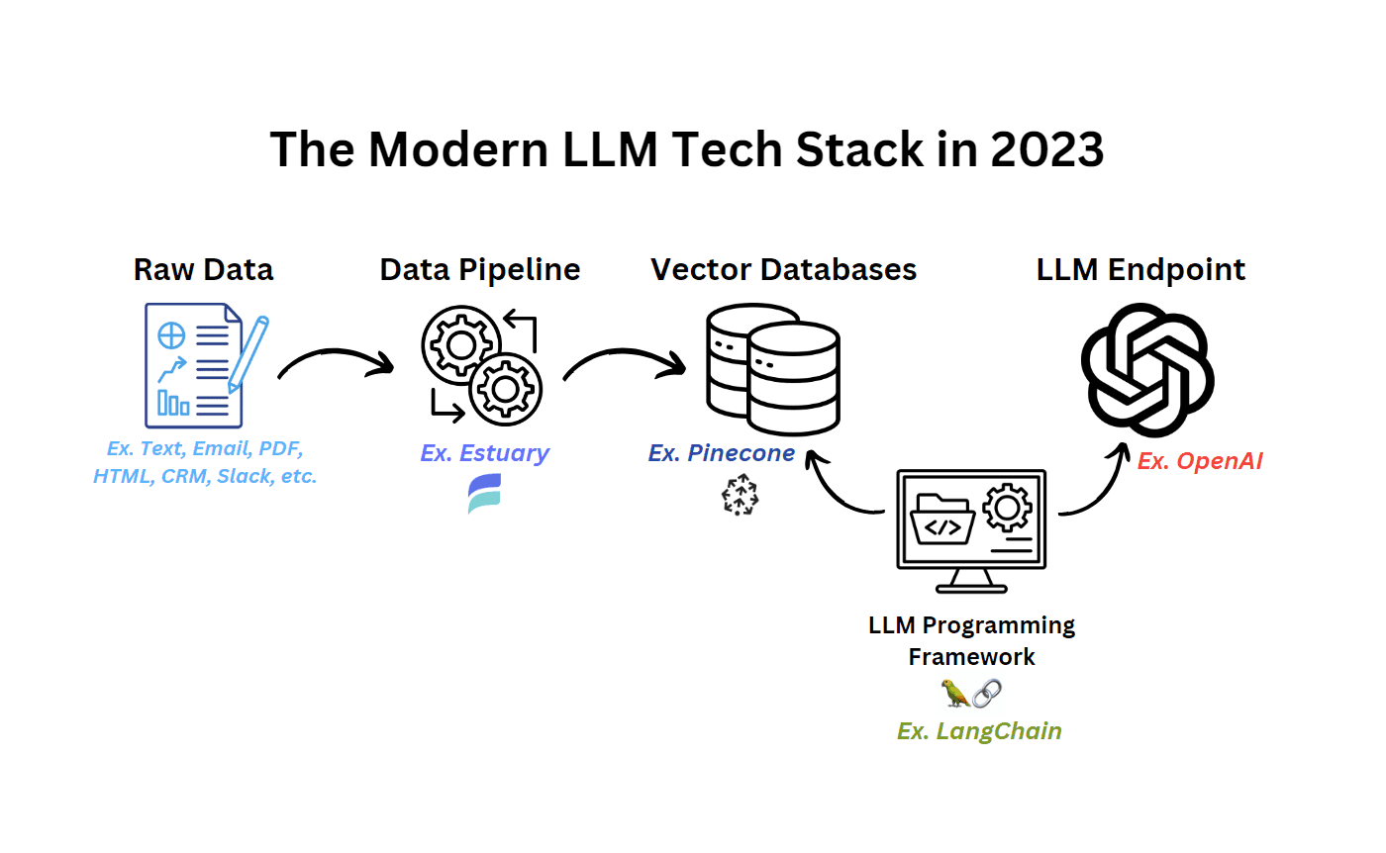

Slide 9
Transformer Components:
Input Embedding
Converts input tokens (words) into dense vectors (embeddings).
Adds positional encoding to preserve word order.
Multi-Head Self-Attention
Allows the model to “focus” on different parts of the input sentence simultaneously.
Feed Forward Neural Network
Fully connected layers applied after attention blocks.
Layer Normalization + Residual Connections
Helps in stabilizing training and enabling deeper models.

Slide 10
Types of Transformer-Based LLMs
Model Type | Example | Use Case
Encoder-only | BERT, RoBERTa | Classification, NER
Decoder-only | GPT, LLaMA | Text generation
Encoder-Decoder | T5, BART | Translation, Summarization

Slide 11
Training of LLMs
Pretraining
Objective: Predict the next word or fill in the blank (masked LM).
Data: Huge internet-scale corpora (Wikipedia, books, code, GitHub, etc.).
Loss function: Cross-entropy on token prediction.

Slide 12
Training of LLMs
Fine-tuning
Train on specific tasks (e.g., sentiment analysis, chatbot replies).
Smaller data + supervised labels.
Instruction Tuning (e.g., ChatGPT, Gemini)
Model is trained to follow natural language instructions.
Uses curated prompts and responses.
Reinforcement Learning from Human Feedback (RLHF)
Uses human rankings of responses to improve alignment.
Trains a reward model to rank outputs.

Slide 13
How an LLM Works – Step-by-Step
Example Prompt:
“Translate ‘How are you?’ to Spanish”
Step 1: Tokenization
Breaks input into smaller units (tokens): ["Translate", "How", "are", "you", "?"]
Step 2: Embedding
Each token is mapped to a dense vector (e.g., 768-dimensional).
Step 3: Self-Attention
Each token looks at other tokens to get context.
Step 4: Output Prediction
Model predicts the next token (autoregressively or masked).
Step 5: Decoding
Tokens are converted back to text → "¿Cómo estás?"

Slide 14
Parameters and Scaling
Model | Parameters
GPT-2 | 1.5 Billion
GPT-3 | 175 Billion
GPT-4 (est.) | >500 Billion
Gemini 1.5 Pro | ~1 Trillion (est.)

Slide 16
Limitations of LLMs
Hallucination: Generates believable but false info.
Bias: Inherited from training data.
Lack of reasoning (without prompt engineering or plugins).
Token Limitations (Gemini 1.5 supports up to 1M tokens in context).

Slide 17
Key Interview Questions (LLM-Focused)
What is the Transformer architecture and why is it used in LLMs?
How does self-attention work?
Difference between encoder-only and decoder-only models?
What is the role of positional encoding?
How do you reduce hallucination in LLMs?
What is prompt tuning vs fine-tuning vs RLHF?
Compare GPT vs BERT vs T5 vs Gemini.
Explain tokenization and how it affects performance.

Slide 18
Prompt Engineering Techniques
1. Zero-shot Prompting
Concept:
You provide the model a task directly — without giving it any examples.
Format:
“Translate this to Spanish: "Where is the bathroom?”
Use Case:
Simple tasks, direct questions, factual lookups.
Limitation:
Fails with complex or ambiguous instructions.

Slide 19
Prompt Engineering Techniques
2. Few-shot Prompting
Concept:
You provide a few input-output examples in the prompt to teach the model the pattern.
Format:
Translate these to Spanish:
English: Hello → Spanish: Hola
English: Good night → Spanish: Buenas noches
English: Where is the bathroom? →

Slide 20
Prompt Engineering Techniques
4. Chain-of-Thought Prompting (CoT)
Concept:
You guide the model to reason step by step before giving the final answer.
Format:
Q: A train leaves at 3:00 PM and takes 4 hours to reach its destination. What time will it arrive?
A: Let's think step by step.
Step 1: The train departs at 3:00 PM.
Step 2: It travels for 4 hours.
Step 3: 3:00 PM + 4 hours = 7:00 PM.
Answer: 7:00 PM

Slide 21
Prompt Engineering Techniques
5. Role Prompting
Concept:
Instruct the model to act as a specific persona or expert.
Format:
“You are a legal expert. Summarize this legal document in plain language.”
Use Case:
Chatbots, simulations, domain-specific assistance.

Slide 22
Prompt Engineering Techniques
Self-Consistency Prompting
Concept:
Generate multiple CoT outputs, then vote or choose the most common answer.
Format:
Ask model to solve same problem multiple times.
Choose the most frequent result.
Use Case:
Improves correctness on math/reasoning.

