Slide 1
E-Commerce Management System
DBMS Mini Project
Presented by: Kishan MC
BMS Institute of Technology
Date 14-05-2025

Slide 2
Project Overview
Objective:
To design a database system for managing an e-commerce platform with essential features like product management, user orders, and cart functionality.
Modules:
- User Registration/Login
- Product Catalog
- Shopping Cart
- Order Management
Tools Used:
- Frontend: HTML, CSS, JS
- Backend: Node.js, Express.js
- Database: MongoDB / MySQL

Slide 3
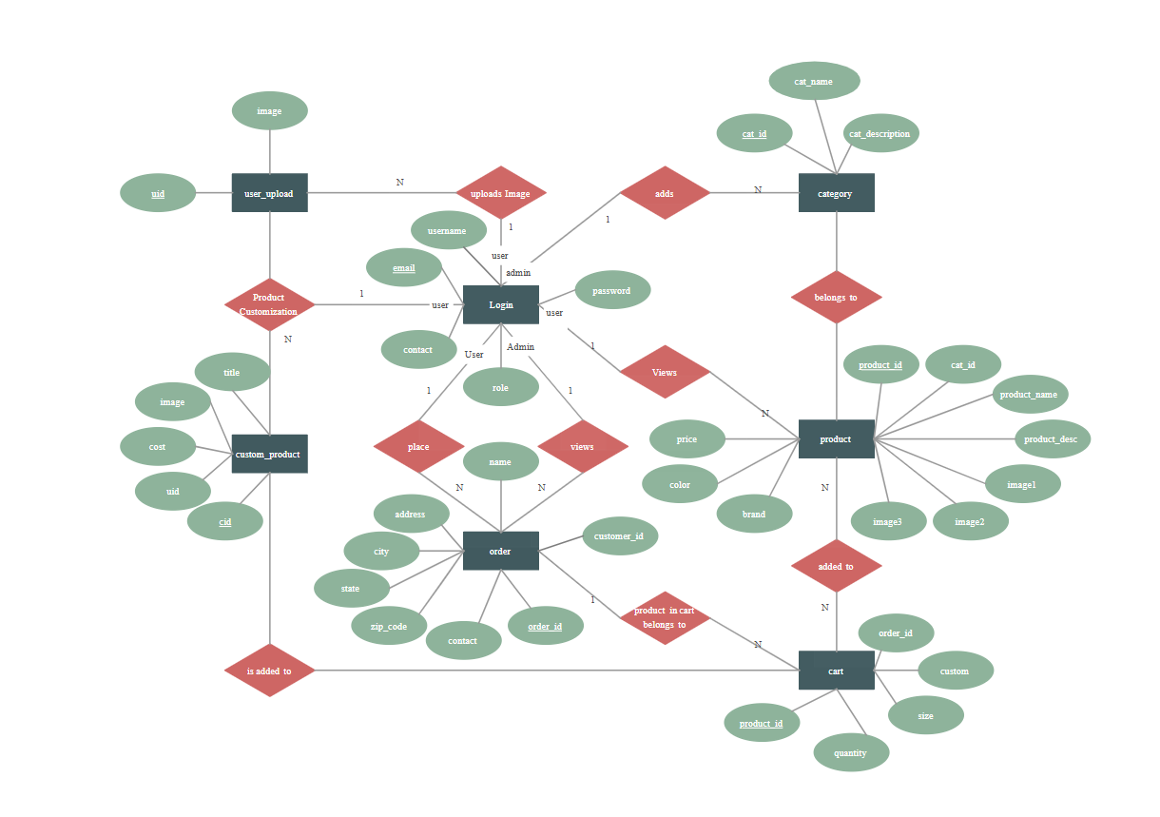
ER Diagram

Slide 4
Database Schema
Tables Overview:
USERS(user_id PK, name, email, password)
PRODUCTS(product_id PK, name, description, price, stock)
CART(cart_id PK, user_id FK, product_id FK, quantity)
ORDERS(order_id PK, user_id FK, order_date, total_amount)
ORDER_ITEMS(order_id FK, product_id FK, quantity)

Slide 5
Conclusion & Future Scope
Conclusion:
- Built a basic but functional DBMS-based e-commerce platform
- Implemented real-time product management and order tracking
Future Scope:
- Payment integration
- Product ratings & feedback
- Delivery tracking
Thank You!

