Slide 1
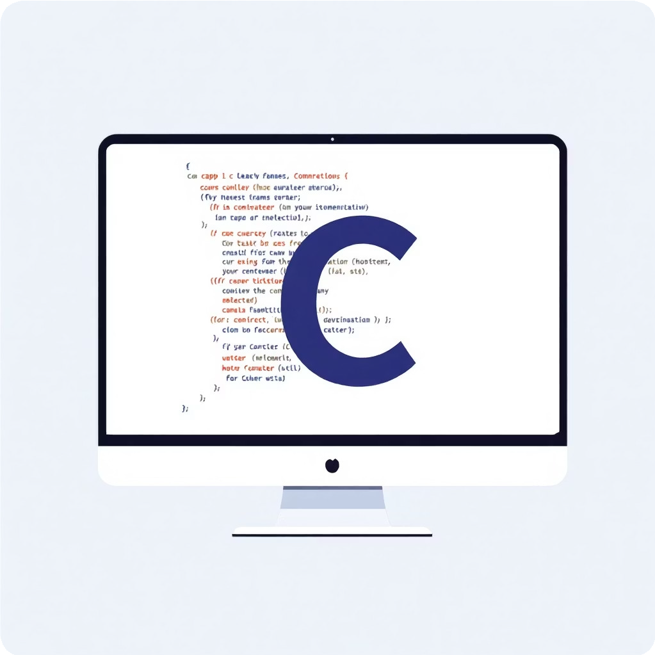
Restaurant Billing System Using C
Student Name: Kishan Rathore
ERP Number: RU-25-10687
Branch: AI/ML Subject: C Programming
College Name: Rungta International Skills University
Academic Year: 2025-29

Slide 2

Introduction: Automating the Culinary Experience
In today's fast-paced world, efficient restaurant operations are crucial. Our project focuses on streamlining the billing process, enhancing both customer service and managerial efficiency.
What is a Restaurant Billing System?
A software application designed to manage orders, calculate bills, and process payments in a restaurant setting. It replaces manual processes with digital efficiency.
Why Automation is Needed?
Automation reduces human error, speeds up service, manages inventory, and provides accurate financial records. It9s essential for modern business.
Purpose of this Project
To develop a robust, user-friendly billing system using C, demonstrating core programming concepts and practical application in a real-world scenario.

Slide 3
Core Objectives: Crafting a Seamless Billing Flow
Our system is meticulously designed to handle critical aspects of restaurant billing, ensuring accuracy and efficiency from order to payment.
1
Dynamic Menu Display
Present a clear and organised food menu with corresponding prices for easy customer selection.
2
Customer Information Capture
Securely record customer details, including name and phone number, for order tracking and future engagement.
3
Accurate Bill Calculation
Automatically compute the total amount based on selected items and quantities, minimizing manual errors.
4
GST and Discount Application
Incorporate Goods and Services Tax (GST) and apply discounts as per business rules, ensuring transparent pricing.
Final Bill Generation
Produce a comprehensive and readable final bill, ready for presentation to the customer.
5

Slide 4

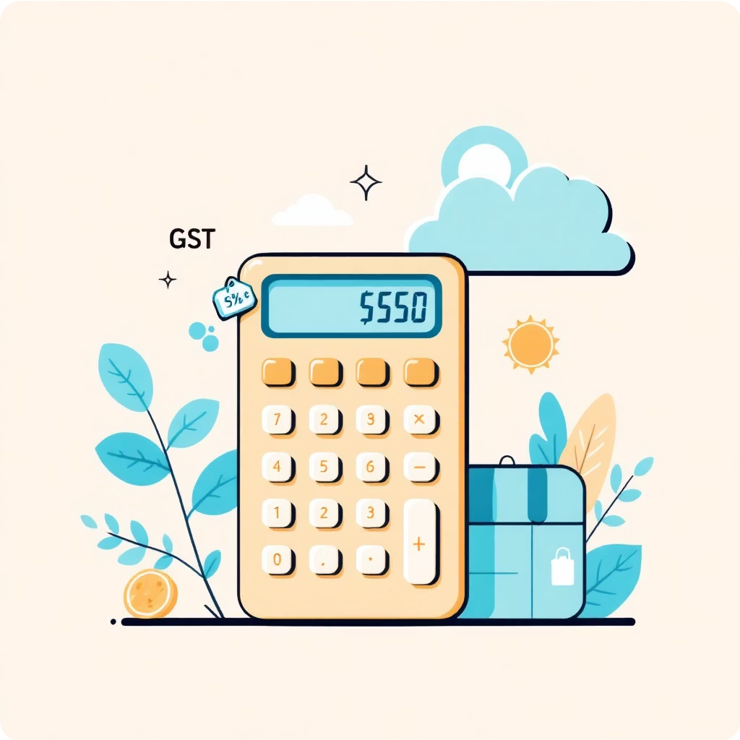
System Features: Enhancing the User Experience
Our billing system integrates key functionalities to ensure a practical and efficient solution for restaurant management.
Diverse Food Menu
Indian Cuisine Chinese Delicacies Italian Specialties
Automated Calculations
Quantity-based Billing Automatic 18% GST Application Discount for Bills Above Rs. 500
The user-friendly console interface ensures ease of use for restaurant staff, making billing a swift and straightforward process.

Slide 5




Technology & Tools Used: The Foundation of Our System
The project leverages industry-standard programming languages and development tools to build a robust and functional application.
Programming Language: C
Chosen for its efficiency, control over hardware, and foundational importance in computer science.
Compiler: GCC
The GNU Compiler Collection provides robust compilation for our C code, ensuring wide compatibility.
IDE: VS Code / CodeBlocks
Integrated Development Environments that offer powerful debugging and code editing features for streamlined development.
Platform: Windows
The primary operating system used for development and testing, ensuring broad accessibility.

Slide 6
Program Workflow: Step-by-Step Billing Process
Understanding the sequential flow of our program is key to appreciating its logical structure and efficiency.
Start Program
Initiates the billing application, preparing it for user interaction.
Take Customer Details
Prompts for and records the customer's name and contact number.
Display Menu
Presents the available food items and their prices to the user.
Select Items & Quantity
Allows the user to choose desired items and specify quantities for each.
Calculate Total, GST & Discount
Automatically computes the subtotal, adds GST, and applies any eligible discounts.
Display Final Bill
Generates and shows the complete bill with all charges and savings clearly itemised.

Slide 7

Conclusion: Project Summary & Learning Outcomes
This project served as an excellent practical application of C programming principles, delivering a functional restaurant billing system.
Project Summary
Successfully developed a C-based restaurant billing system that automates menu display, order processing, and final bill generation with GST and discounts.
Learning Outcomes
Gained proficiency in C programming, data structures, algorithm design, and user interface development for console applications.

Slide 8



Future Scope: Enhancing Functionality
While the current system is functional, there are numerous avenues for expansion and improvement, leveraging more advanced programming techniques.
File Handling Integration
Implement persistent storage for menus, customer data, and transaction history using file operations, ensuring data retention across sessions.
Item-wise Bill Generation
Provide a detailed breakdown of each item purchased on the bill, including quantity, price, and individual subtotal, for greater transparency.
GUI-based System
Transition from a console-based interface to a Graphical User Interface (GUI) for a more intuitive and visually appealing user experience.
Network Functionality
Explore integration with network protocols for multi-terminal support and remote order management.

Slide 9




Envisioning Growth: Future System Evolution
Imagine a future where our system evolves into a comprehensive restaurant management platform.
Customer Loyalty
Implement features like loyalty points and personalised offers.
Sales Analytics
Provide detailed reports on popular items and peak hours.
Inventory Management
Automate stock tracking and generate reorder alerts.
Online Order Integration
Seamlessly connect with online food delivery platforms.

Slide 10

Thank You!
We appreciate your attention and welcome any questions or feedback regarding the Restaurant Billing System Using C.
C PROGRAMMING
RESTAURANT MANAGEMENT
MINI PROJECT

