Slide 1
Final Project Evaluation
Stock Price Prediction Using Social Media and Historical Data
A Deep Learning Approach with GAT and HGAT
DEVANGAM KISHAN TEJA – 23B1061
KUNSOTH CHANDRASHEN – 23B1066
…
03-05-2025

Slide 2
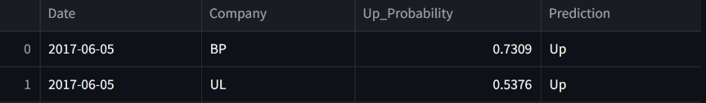
Problem Statement
Input: Output:
Historical stock prices (open, high, adjusted close) Classification: Predict if the stock price will go up (1) or down (0).
and tweets data. Regression: Predict the magnitude of price change (log-return).
Example:
Input:
prices:
tweets:
Output:
The project predicts stock price movement (up/down) using tweets. It uses BERT to understand tweet context and a hypergraph model to capture relationships between stocks in the same sector, improving prediction accuracy.
The model predicts stock price movements by combining historical prices, financial news, and structured knowledge from twitter data. It uses a graph neural network to capture relationships between entities for more informed and context-aware predictions.

Slide 3
Motivation
Stock market prediction has high practical and financial relevance. It combines multiple data types (text, numbers, graphs), making it a rich AI problem.
The market is influenced by both direct and indirect news/events, which are hard to capture. It requires integrating unstructured (news) and structured (knowledge graph) data. Real-time, accurate predictions can drive real financial decision-making.
Traditional models lack contextual understanding of entities and events. This model fills the gap by using twitter data to add real-world relationships. It can improve automated trading, risk analysis, and financial forecasting.

Slide 4
Literature Review
Background: Stock prediction often uses time-series models (ARIMA) or ML (SVM), but struggles with unstructured data like tweets.
Prior Work: MAN-SF model (Deep Attentive Learning for Stock Movement Prediction, 2020) uses GAT to model stock correlations and tweet sentiment
Inspiration: Extended MAN-SF by using 40 days of data for 88 company to capture long-term trends and improve F1/profit.

Slide 5
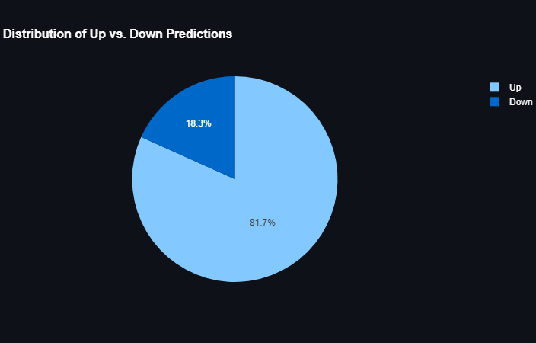
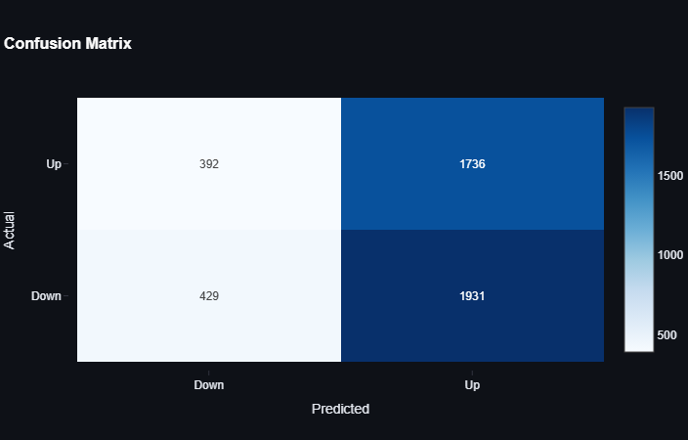
Dataset
Example Data Instance:
Input: output:
Statistics:
Samples: ~40(days) ; classes: up(1), down(0) ; features: prices(3) ,tweets(max 10/day)
~81.7% up, 18.3% down
Dataset source: https://github.com/yumoxu/stocknet-dataset
Distribution Graph:

Slide 6
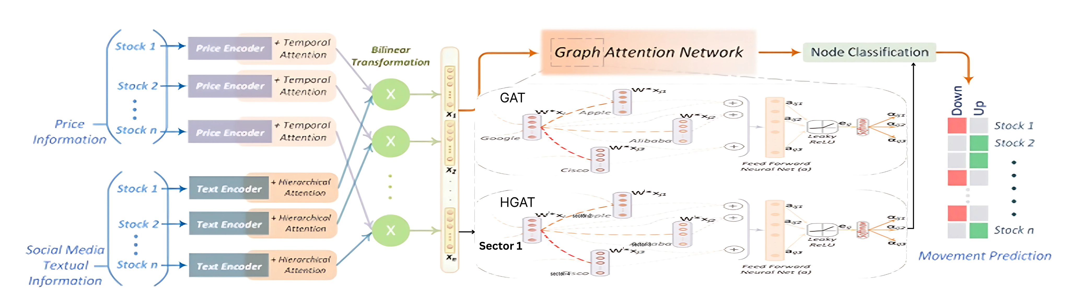
Method/Technique
Architecture: Tweet embedding (BERT) + Price GRU + GAT/HGAT for stock relationships.
Intuition: GAT captures pairwise stock correlations; HGAT models sector-based relationships; BERT extracts tweet sentiment.
Implementation: PyTorch, Streamlit; 200 epochs.

Slide 7
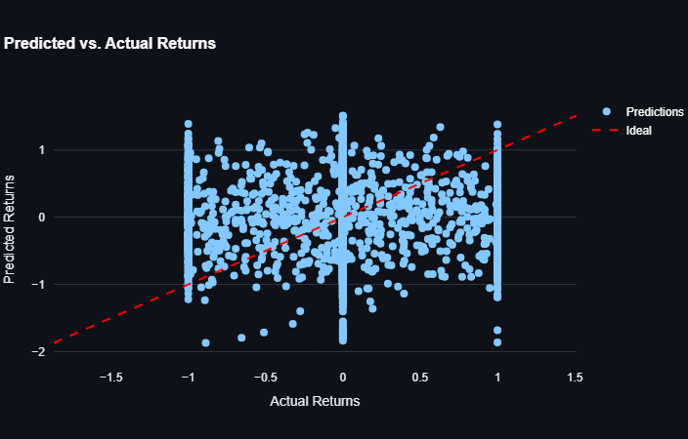
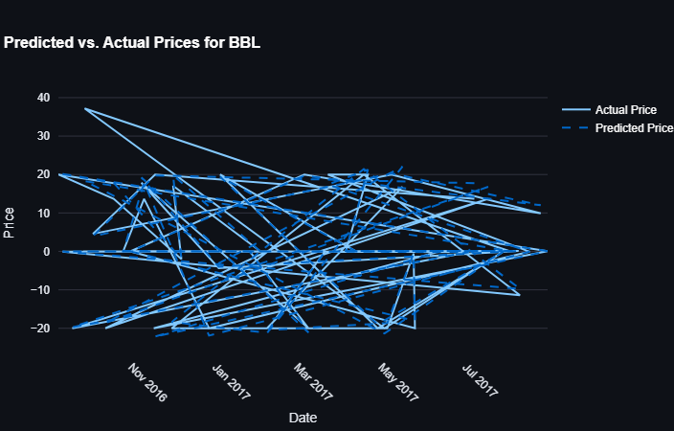
Results
Performance Metrics (40 Days):
F1: 0.5226 ; Profit: 1261.86 ; Accuracy: 0.52 ; MCC: 0.146 ; Sharpe: 0.0585

Slide 8
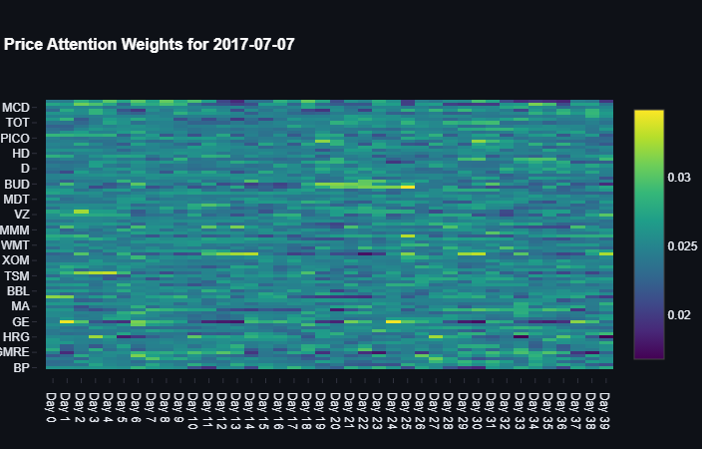
Analysis
Patterns: Model attends more to recent days’ prices (attention weights higher for last 5 days of the 40-day window).
Trends: Technology sector stocks (e.g., AAPL, GOOG) show stronger correlation with positive tweets due to frequent product news.
Insight: 40 days of data across 88 companies captures sector trends better than 5 days; GAT/HGAT effectively models inter-company relationships.

Slide 9
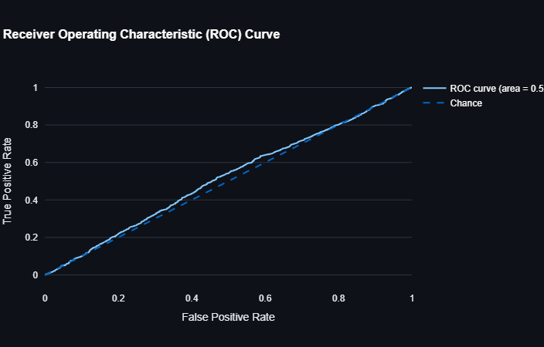
Error analysis
Example Incorrect Output: Input: 2016-02-12, GOOG, Tweet: "Google faces antitrust fine, stock under pressure."
Predicted: Up (0.55 probability)
Actual: Down
Reason: Model underestimates negative sentiment; inter-company correlations (via GAT) may overgeneralize trends from other tech stocks like AAPL.

Slide 10
Improvements over the paper
Integration of HGAT → Models group-based interactions via hyperedges (e.g., sectors) → Extends beyond pairwise modeling used in GAT → Allows higher-order reasoning on financial graph structures.
Dynamic Tweet Batching → Adaptively handles 0–20+ tweets/day instead of using fixed size → Improves efficiency (~70% less memory on sparse days) → More realistic simulation of market activity
Relative Price Normalization → Normalized using previous day's adjusted close → Captures relative rather than absolute price movement → Reduces volatility noise across different stock types
Interpretable Attention Mechanism → Added attention weight logging for post-hoc analysis → Enables visualization of tweet/stock influence using heatmaps

Slide 11
Learnings
Technical: Learned GAT/HGAT, BERT embeddings, and PyTorch for financial modeling.
Problem-Solving: Learned to handle noisy tweet data and class imbalance effectively.
Teamwork: Coordinated tasks (data processing, model training, UI development) efficiently.
Experimentation: Discovered the importance of long-term data for stock prediction.

Slide 12
Demo

Slide 13
Summary and Conclusion
Recap: Developed a stock prediction model for 88 companies using 40 days of data, achieved F1 (0.5226) and profit (1261).
Conclusion: Applied MAN-SF model to a larger scale, showing the value of multi-company modeling and extended historical data.
Future Work: Filter high-impact tweets, integrate real-time data, implementing time series models for better predictions, explore ensemble models for better accuracy.

