Slide 1

VOCATIONAL TRAINING PRESENTATION
CHHATTISGARH SWAMI VIVEKANAND TECHNICAL UNIVERSITY
On
TEXT TO SPEECH CONVERTER
At
Edunet Foundation
Presented By
Hitendra Mourya
Roll No-300012823023
CSE(Data Science) 5th Sem
Course:
Data Science, Machine Learning and AI using
Python

Slide 2
INDEX
Introduction
Technology Used
Machine Learning pipeline
Methodology
Data Preprocessing
Streamlit App Code
Output
Project Resources

Slide 3
INTRODUCTION
Converts written text into natural-sounding speech.
Built as a simple, interactive web app using Streamlit.
Useful in accessibility, voice assistants, audiobooks, and hands-free applications.
.

Slide 4


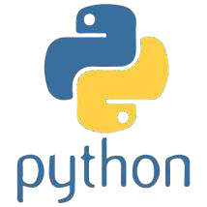
TECHNOLOGY USED
Python for implementation.
Natural Language Processing (NLP) & Speech Synthesis techniques.
Libraries:
gTTS (Google Text-to-Speech)
Streamlit for UI
Pydub for audio handling
Deployment: Streamlit web interface

Slide 5
MACHINE LEARNING PIPELINE
Input Layer – User enters text.
Preprocessing – Clean & prepare text.
Model Layer – gTTS converts text into speech.
Output Layer – Generated audio (MP3/WAV).
Frontend – Streamlit provides an easy-to-use interface.

Slide 6
METHODOLOGY
1.Accept user text input via Streamlit form.
2.Convert text into speech using gTTS API.
3.Save audio file locally.
4.Play/download audio directly in the app.

Slide 7
DATA PREPROCESSING
Convert input text to lowercase.
Remove special characters & extra spaces.
Ensure language compatibility (e.g., lang='en’).
Handle long text by splitting into smaller chunks before processing.

Slide 8
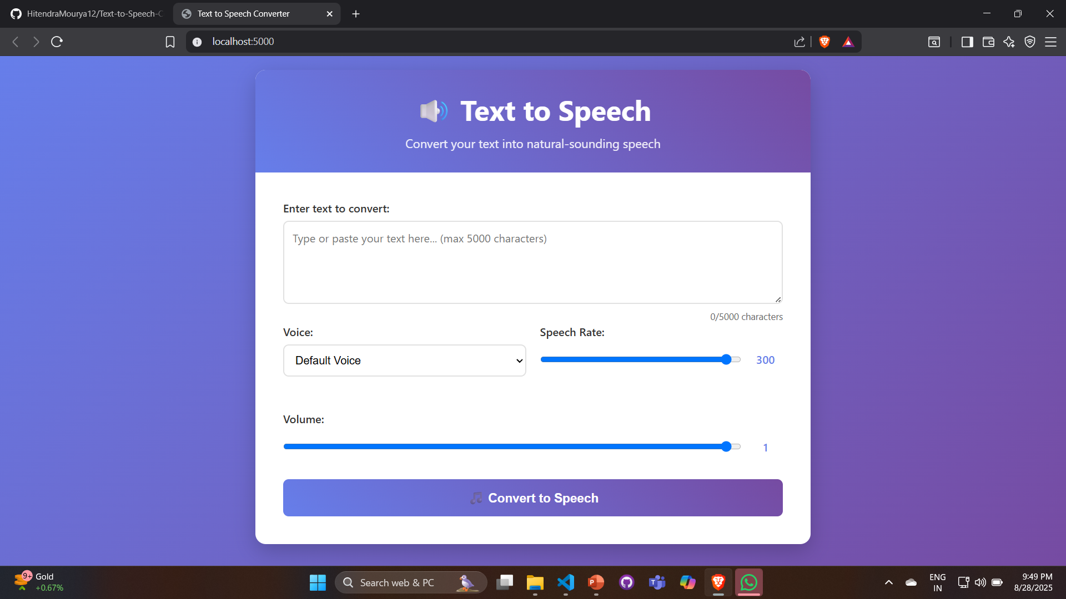
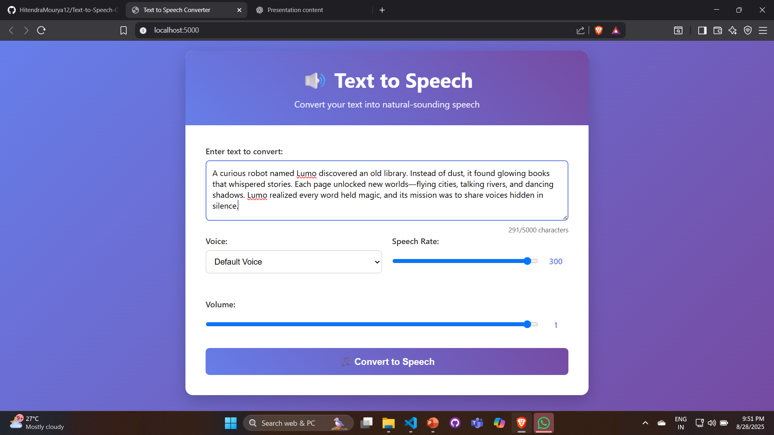
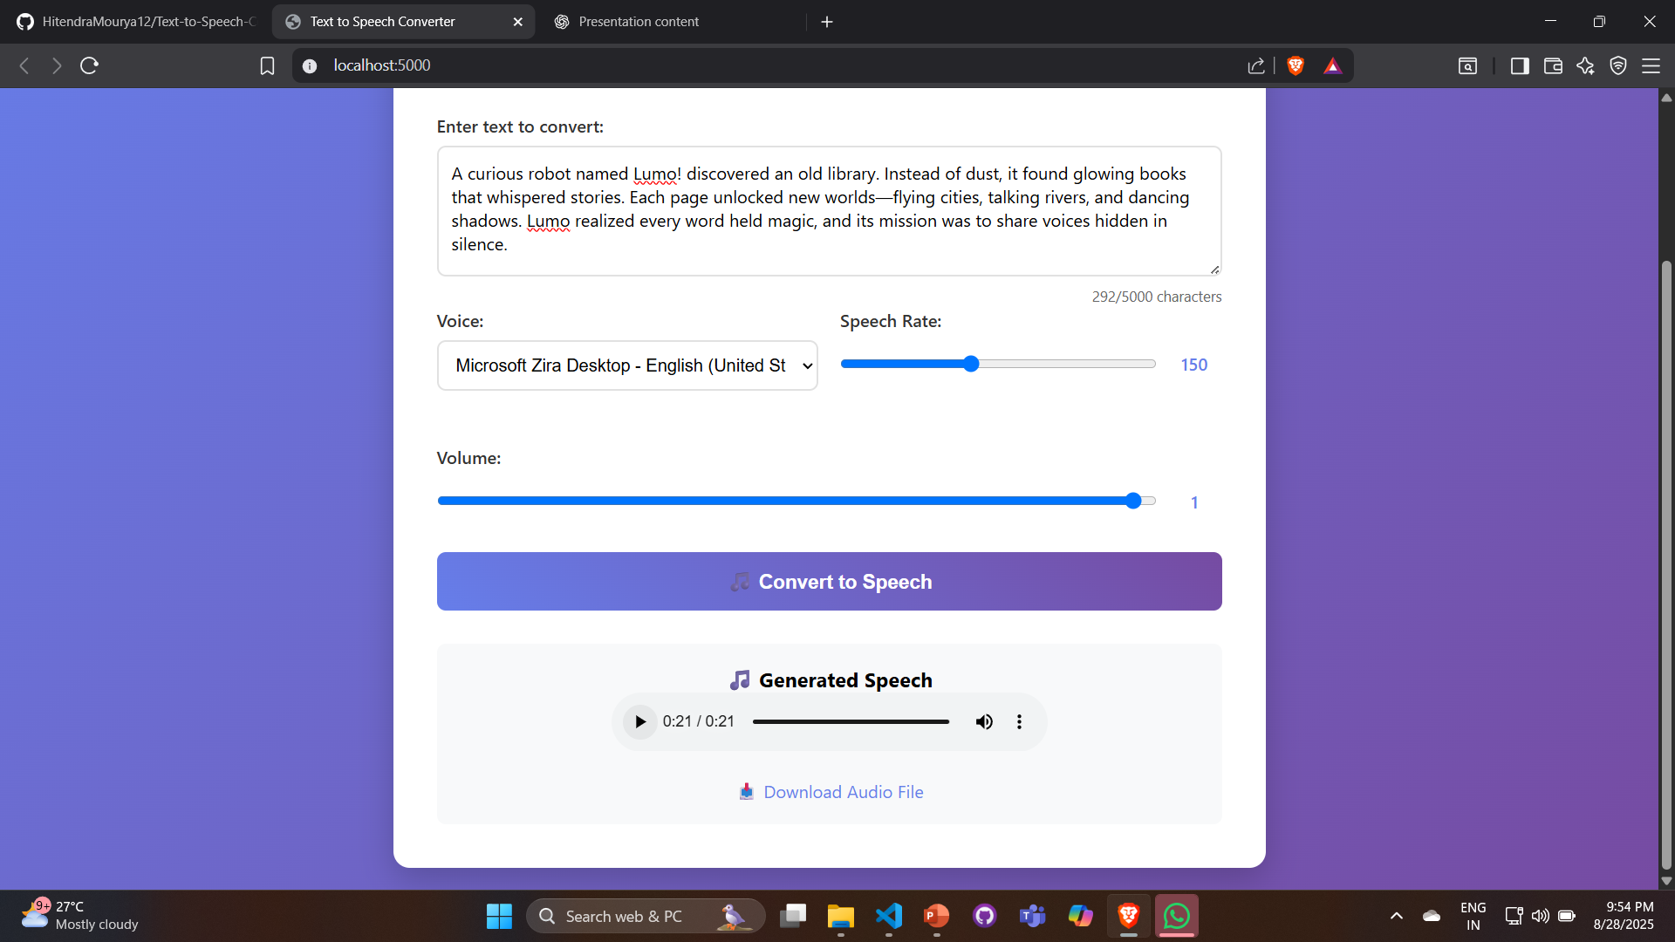
OUTPUT- DESIGN OF WEBSITE

Slide 9
PROJECT RESOURCES
Libraries & Docs:
Streamlit Documentation
Pydub Documentation
gTTS Documentation
Demo: https://github.com/HitendraMourya12/Text-to-Speech-Converter

Slide 10
Thank you!

