Slide 1

VOCATIONAL TRAINING PRESENTATION
CHHATTISGARH SWAMI VIVEKANAND TECHNICAL
UNIVERSITY, Bhilai
On
MULTIPLE DISEASE PREDICTION SYSTEM
At
Edunet Foundation
Presented By:-
Kishlay Kumar
Roll No- 300012723033
Branch- CSE(AI)
Sem.- 5th
Course: B.Tech(Hons.) in CSE(AI)

Slide 2
INDEX
Introduction
Objectives
Problem Statement
Technologies Used
Datasets & ML Models
System Architecture & Workflow
Results & Analysis
Conclusion & Future Enhancements

Slide 3
INTRODUCTION
AI-powered medical screening application
.
Predicts Diabetes, Heart Disease & Parkinson’s
Uses pre-trained ML models with medical datasets
Web application developed using Streamlit
Provides quick and accessible disease risk estimation

Slide 4
OBJECTIVES
To develop a unified platform for predicting 3 diseases
Achieve accuracy range of 75–87%
Provide easy user interface through Streamlit
Perform prediction in real-time
Maintain scalability and modular architecture

Slide 5
PROBLEM STATEMENTS
Existing medical diagnosis issues:
Costly laboratory tests
Long waiting time for reports
Limited accessibility in rural areas
No early screening facility
Solution: Fast, accurate and accessible ML-based risk prediction system

Slide 6



TECHNOLOGY USED
Programming Language: Python
Libraries: NumPy, Pandas, Scikit-Learn
GUI/Deployment Framework: Streamlit
Model Storage: Pickle
Tools: VS Code, Git, GitHub, Google Colab
GithubLink: https:https://github.com/Kishlay671/ Multiple_Disease_Prediction_System

Slide 7
DATASETS & ML MODELS
Datasets Used:(From Kaggle)
Diabetes: Pima Indians Dataset
Heart Disease: Cleveland Dataset
Parkinson’s: UCI Dataset
Machine Learning Models:
SVM (RBF kernel) → Diabetes & Parkinson’s
Logistic Regression → Heart Disease

Slide 8
SYSTEM ARCHITECTURE & WORKFLOW
Architecture:
UI Layer (Streamlit)
Processing Layer (Validation & ML Logic)
Data Layer (Saved Models)
Workflow:
User Inputs Data
Preprocessing & Validation
ML Model Prediction
Output Display with Interpretation

Slide 9
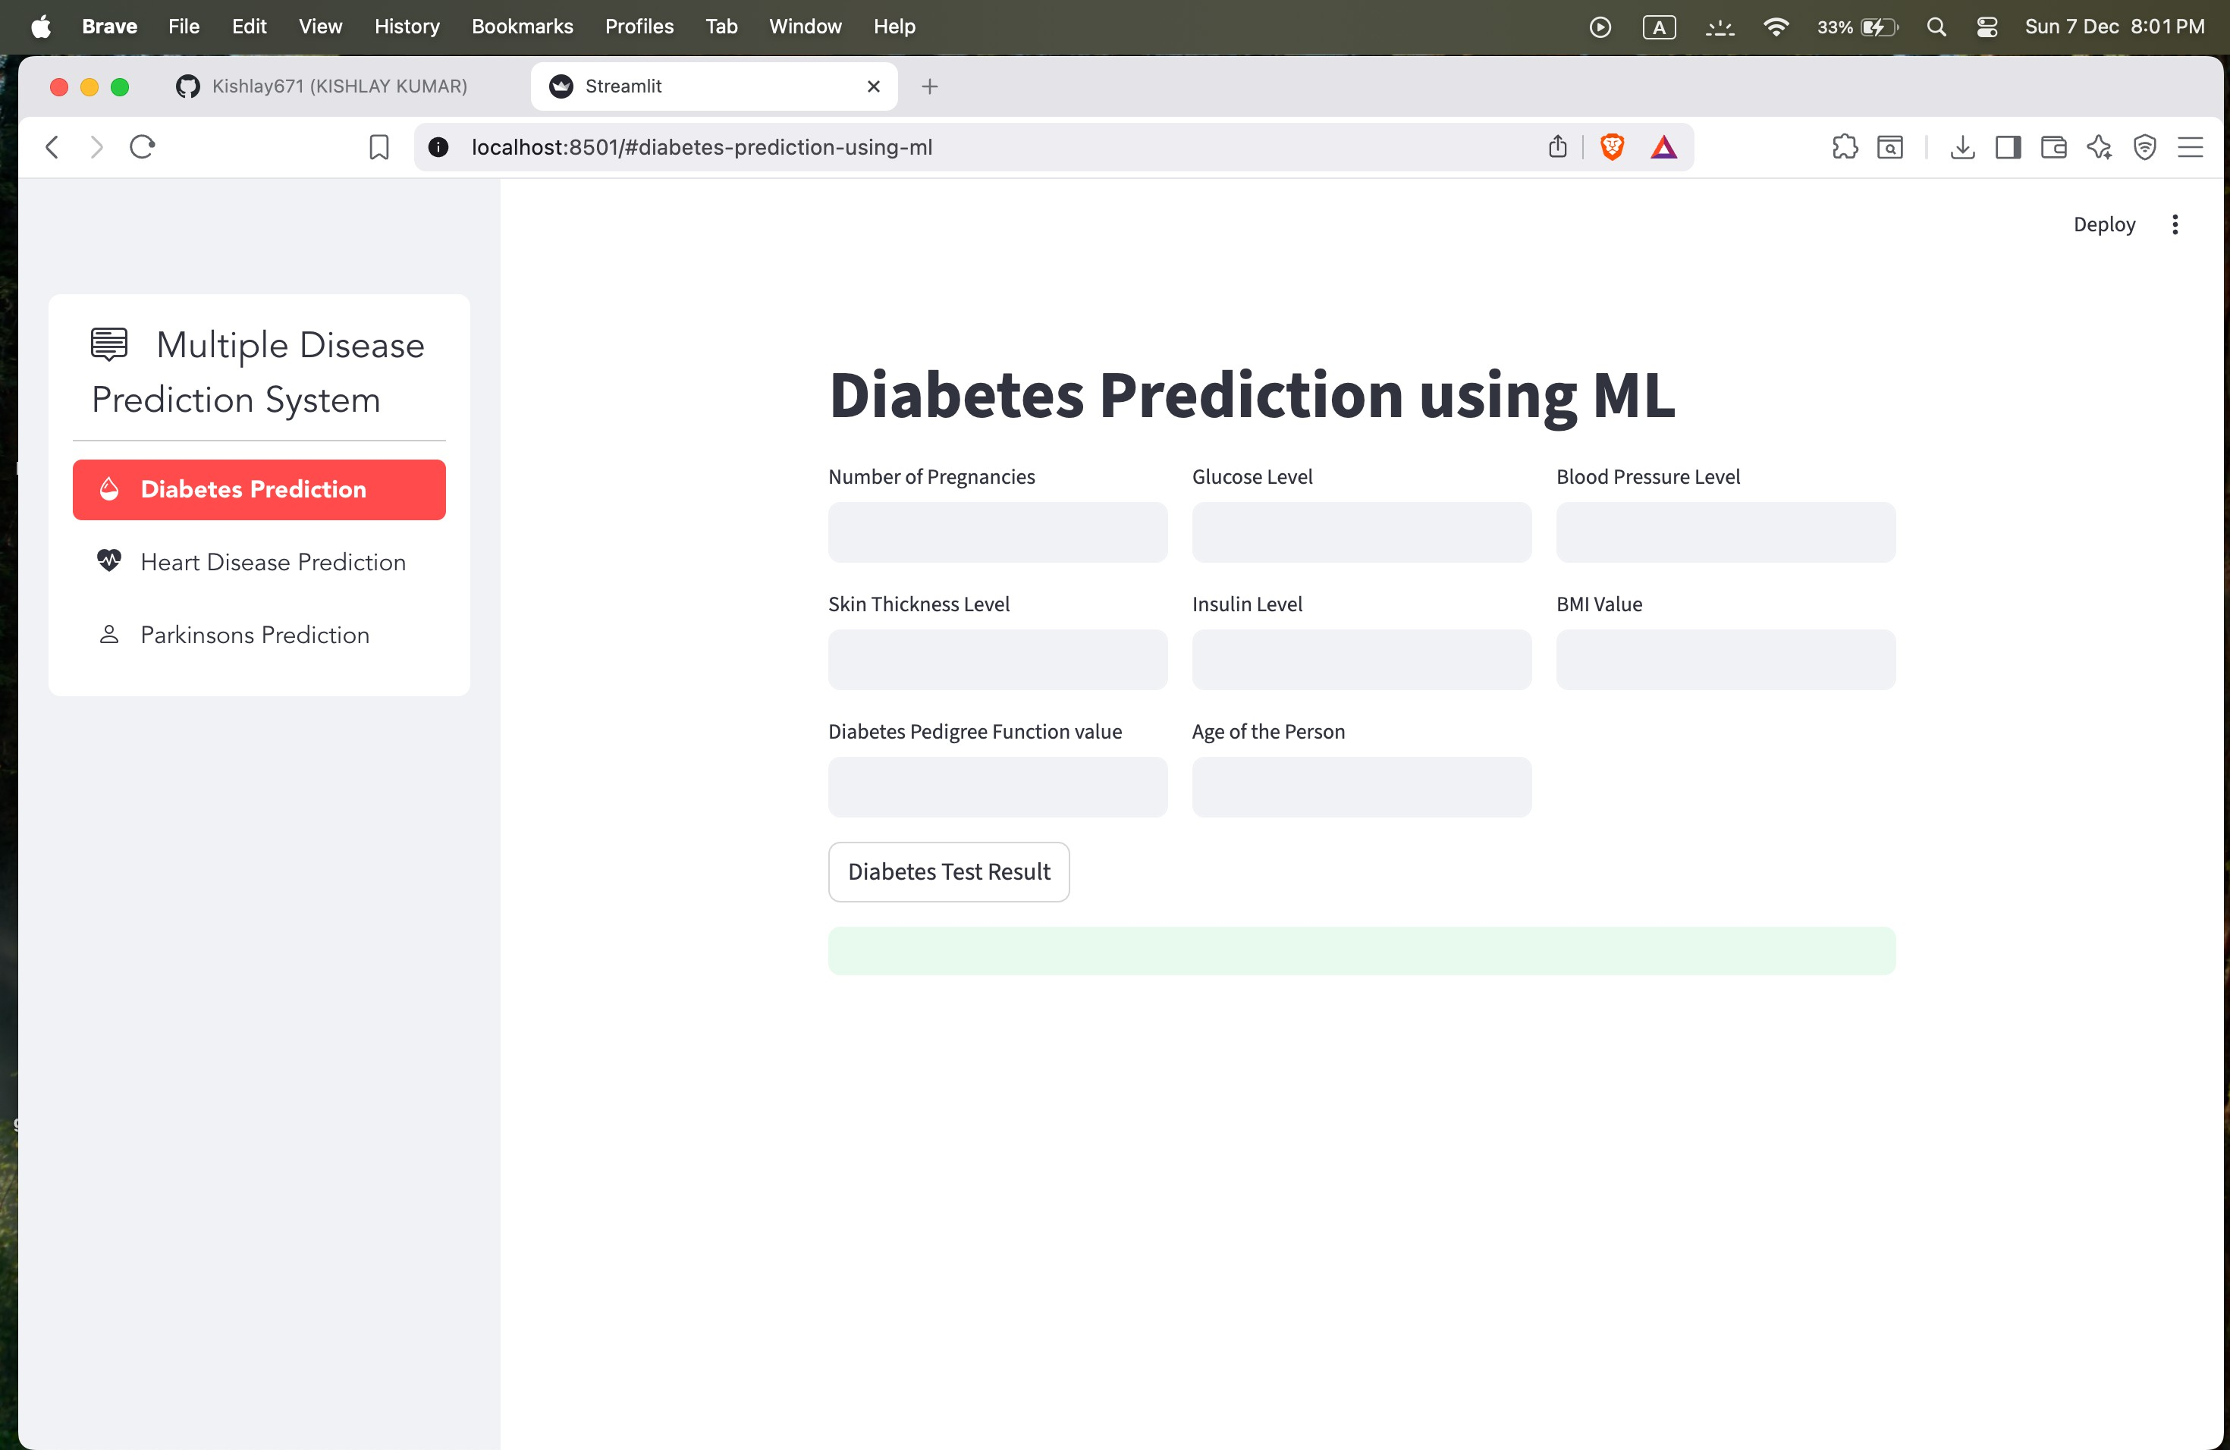
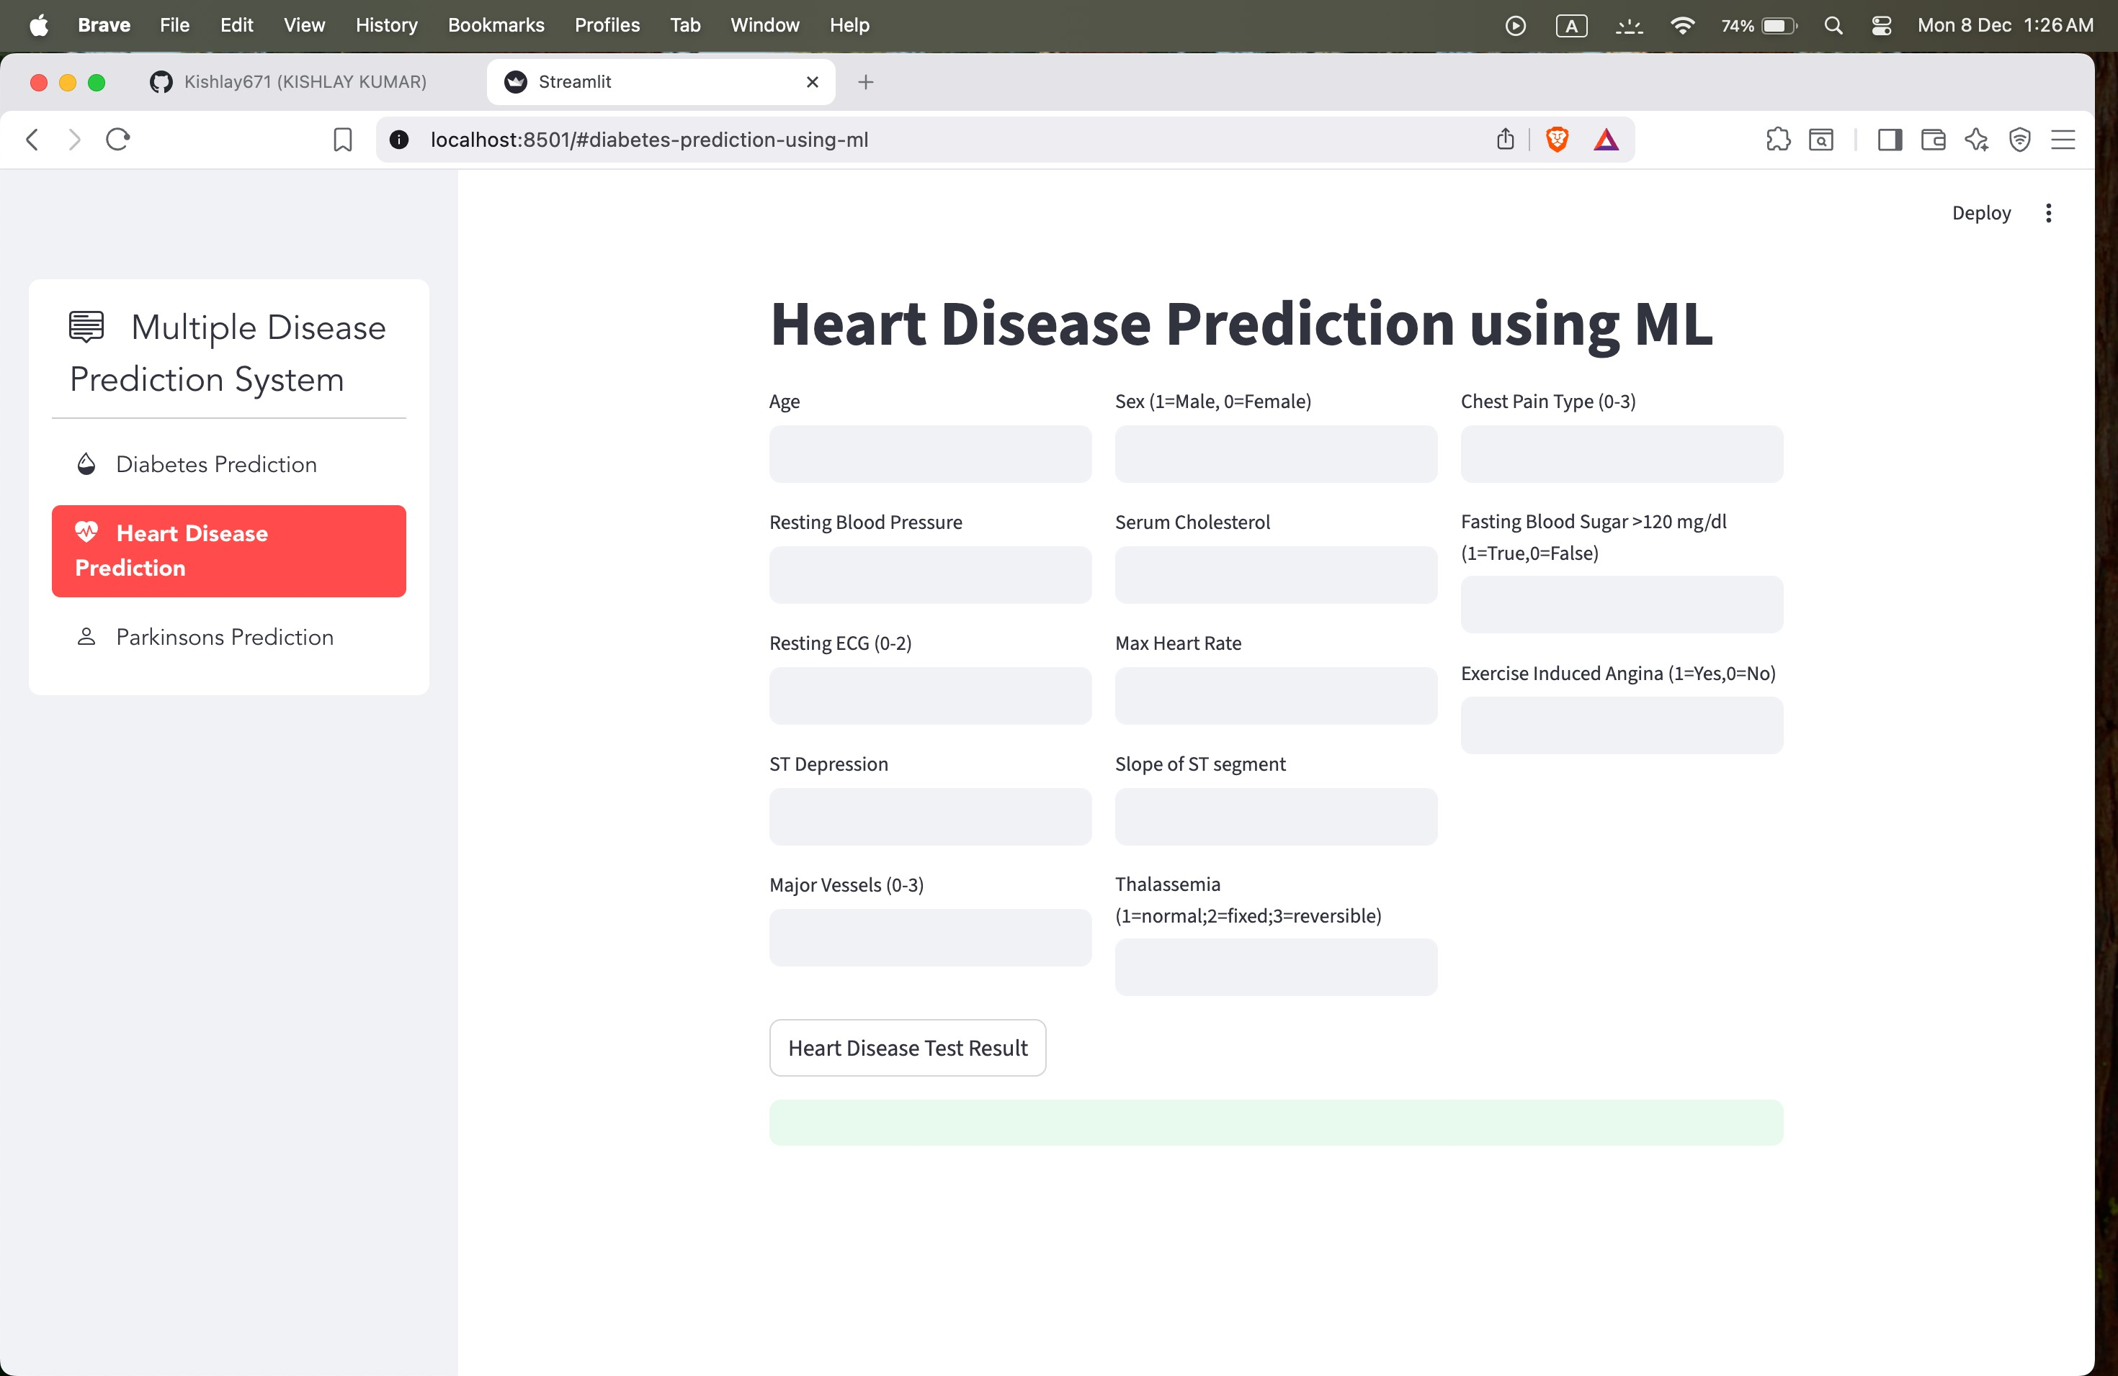
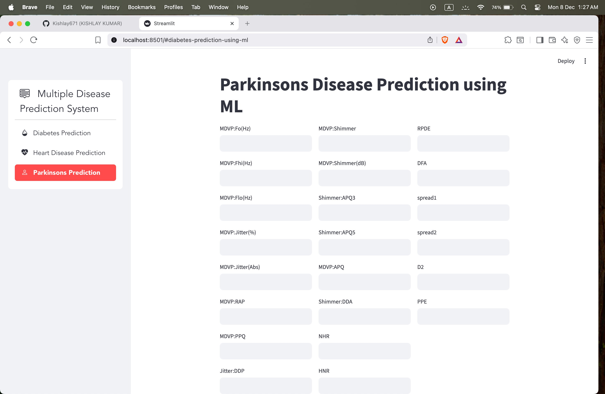
RESULT & ANALYSIS
Accuracy of Prediction Models:
Diabetes → 75.3%
Heart Disease → 81.8%
Parkinson’s → 87.2% Performance:
Real-time prediction (<0.1s)
Accurate and consistent results across multiple cases

Slide 10
CONCLUSION & FUTURE ENHANCEMENT
Conclusion:
Developed a functional multi-disease prediction web app
Highly accessible and fast health risk estimation tool
Reliable prediction with good accuracy
Future Enhancements:
Probability scores & risk visualization
Add more diseases (Kidney, Liver, Cancer)
Mobile App UI and cloud database integration

Slide 11
Thank you!

