Slide 1
Lab-2
Implement Linear and Multi-Linear Regression algorithm using appropriate dataset

Slide 2
Linear Regression
Linear regression is defined as an algorithm that provides a linear relationship between an independent variable and a dependent variable to predict the outcome of future events.
It is a statistical method used in data science and machine learning for predictive analysis.
Linear regression is a supervised learning algorithm that simulates a mathematical relationship between variables and makes predictions for continuous or numeric variables such as sales, salary, age, product price, etc.

Slide 3
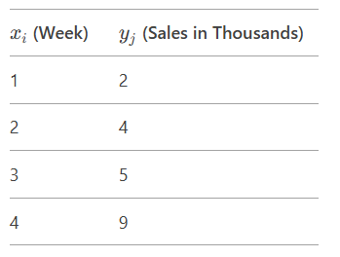
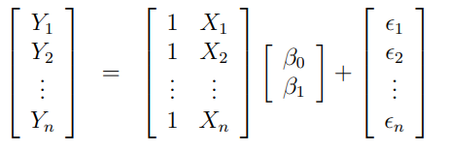

To write in Observation Book
Before switching on the Desktop systems in the lab, at the start of the lab, you should write following in your observation book.
Solving the following Linear Regression Problem using Matrix approach.
Find Linear Regression of the data of week and product sales.
β

Slide 4
Implementation
In your Google Co-lab account, execute following sample python program in the notebook.
linear_regression_housing_area_price.py
multiple_lr_homeprice.py

Slide 5
To Do: Implementation – Linear Regression
Write Python code to implement the following
Predict canada's per capita income in year 2020. Use the data file canada_per_capita_income.csv file. If required, apply the necessary data processing steps. Using this build a regression model and predict the per capita income for canadian citizens in year 2020
Predict Salary of the employee. Use the data file salary.csv file. If required, apply the necessary data processing steps. Using this build a regression model and predict the salary of the employee with 12 years of experience.
Notes:
canada_per_capita_income.csv , salary.csv, hiring.csv. 1000_companies.csv

Slide 6
Multiple Linear Regression
Multiple linear regression refers to a statistical technique that uses two or more independent variables to predict the outcome of a dependent variable.
Linear Regression with Multiple variables or Maltivariate Regression

Slide 7
To Do: Implementation – Multiple Linear Regression
Write Python code to implement the following
Considering the data file hiring.csv. The file contains hiring statics for a firm such as experience of candidate, his written test score and personal interview score. Based on these 3 factors, HR will decide the salary. Given this data, you need to build a Multiple Linear Regression model for HR department that can help them decide salaries for future candidates. Using this predict salaries for following candidates,
2 yr experience, 9 test score, 6 interview score
12 yr experience, 10 test score, 10 interview score
Considering the data file 1000_companies.csv. The file contains profit statics for a firm such as R&D Spend, Administration, Marketing Spend and State. Based on these four factors build a Multiple Linear Regression model to predict the profit. Using this predict profit for following,
91694.48 R&D Spend, 515841.3 Administration, 11931.24 Marketing Spend, Florida State
Note: If required, apply the necessary data processing steps to data files.

Slide 8
To Upload to Github
In your github account create folder “6thSem-ML-Lab” and upload your python notebook worked on Linear and Multi Linear regression modelss with file name as “yourUSN_Lab-2-Linear-Multiple-Regression. ipynb”

Slide 9
To write in the Observation Book
After building the regression models, write the answer for the following questions in your observation book
1. Considering the three data .csv files (canada_per_capita_income.csv , salary.csv, hiring.csv), Did you perform any data preprocessing steps (e.g., missing values, scaling, encoding)? If yes, why?
2. For canada_per_capita_income.csv, did you visualize the regression line along with the data points? What does the plot tell you about the relationship between year and per capita income?
3. For hiring.csv , What is the predicted salary for a candidate with 12 years of experience, 10 test score, and 10 interview score?
4. For 1000_companies.csv, Did you encode categorical variables (e.g., State)? If yes, how? Did you scale the features? If yes, why?

