Slide 1
Unit – 6.2
Regression
Estimation of regression coefficient by using least square estimation method

Slide 2
Regression and coefficient of regression :
Regression is a statistical method used in finance, investing, and other disciplines that attempts to determine the strength and character of the relationship between one dependent variable (usually denoted by Y) and a series of other variables (known as independent variables).Regression helps investment and financial managers to value assets and understand the relationships between variables, such as commodity prices and the stocks of businesses dealing in those commodities.
The two basic types of regression are simple linear regression and multiple linear regression, although there are non-linear regression methods for more complicated data and analysis. Simple linear regression uses one independent variable to explain or predict the outcome of the dependent variable Y, while multiple linear regression uses two or more independent variables to predict the outcome.

Slide 3
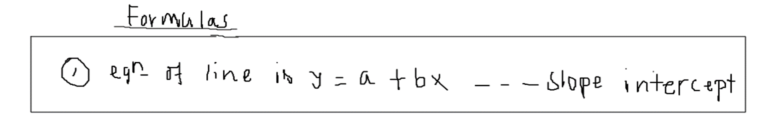
If the curve of Regression is a straight line then it is said to be line of Regression. And if the curve of Regression is not straight then the regression is known as curvilinear regression or non-linear regression.
There are two types of line of regression because the points(data) are interpolated and their deviation are not taken perpendicularly but taken horizontally and vertically.

Slide 4
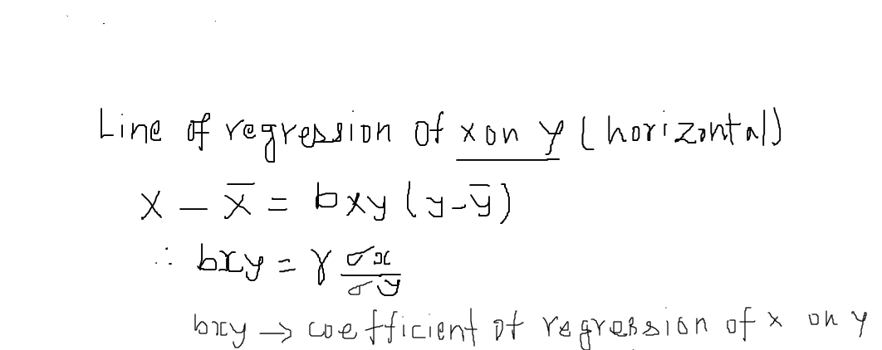
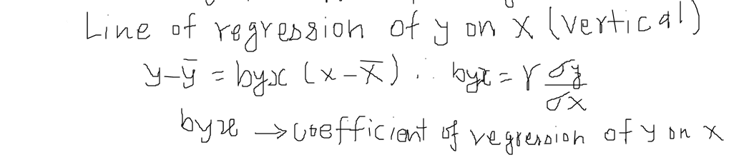

Slide 5
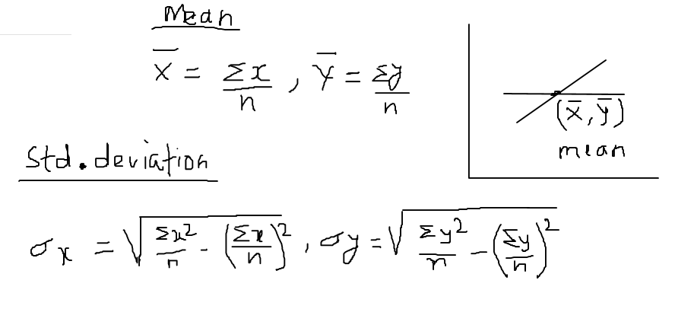

Slide 6
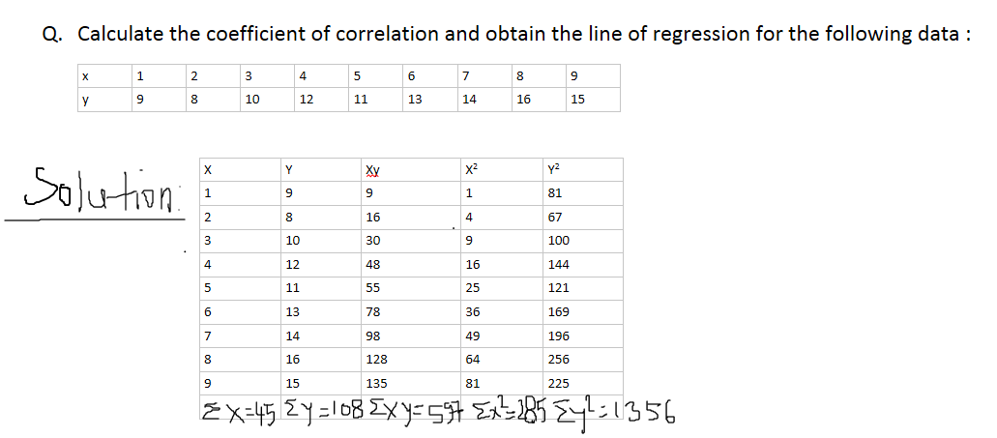

Slide 7
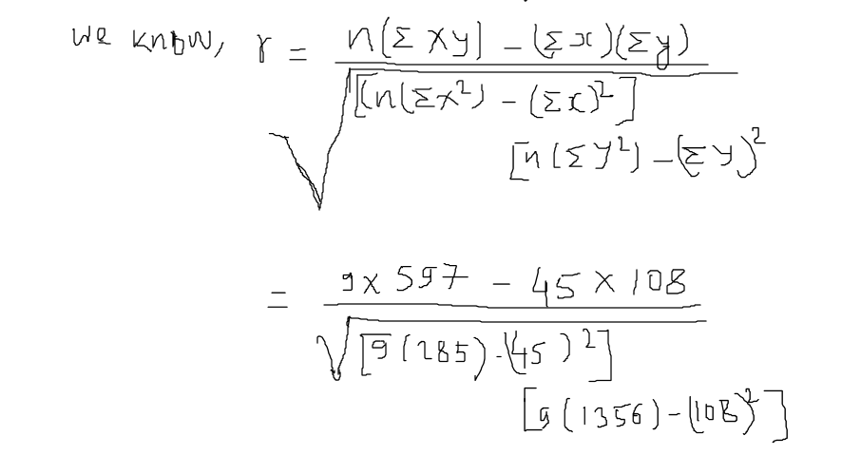
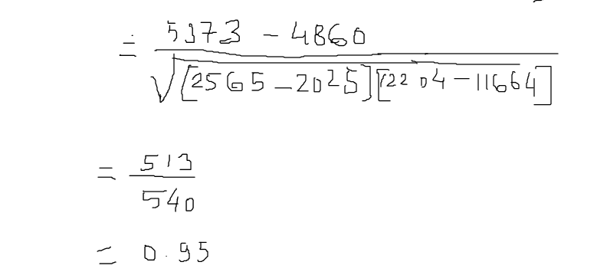

Slide 8
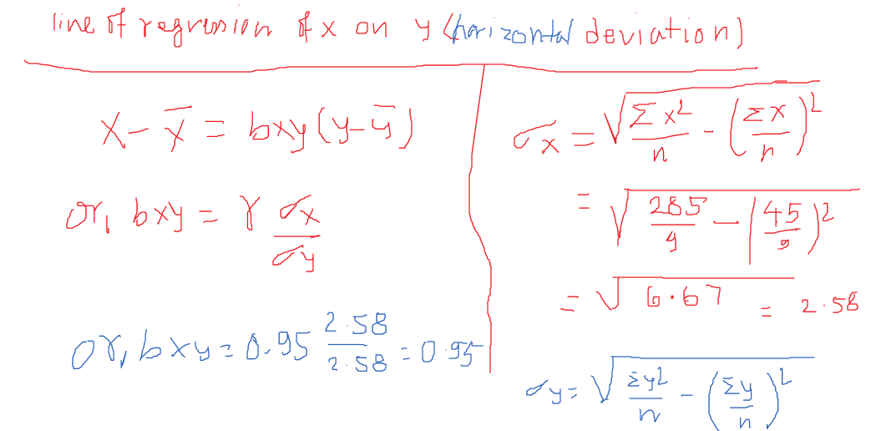
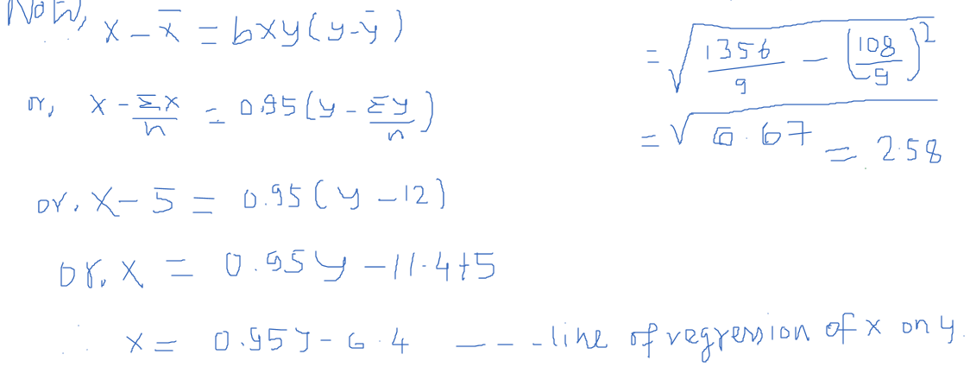

Slide 9
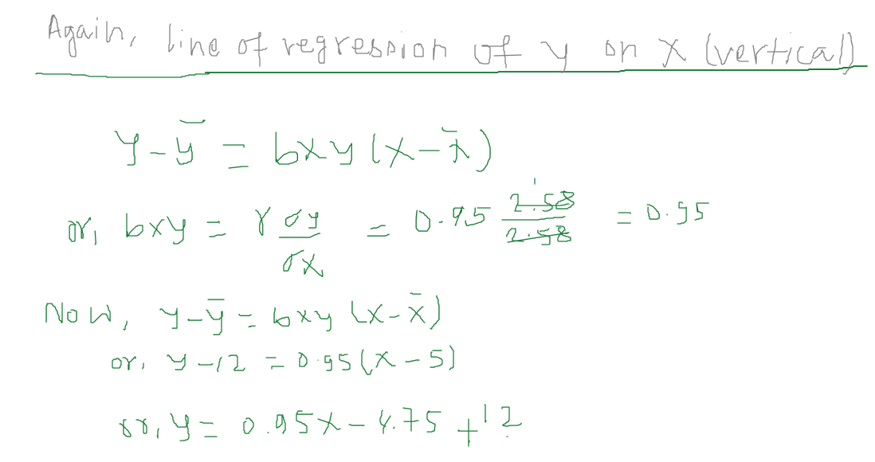
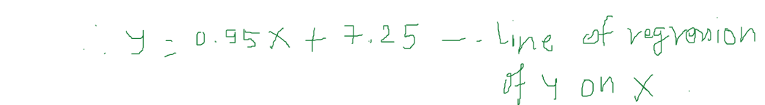

Slide 10
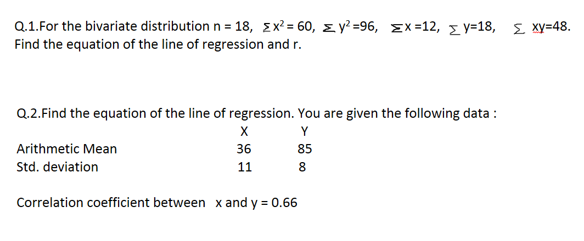
Classwork

Slide 11
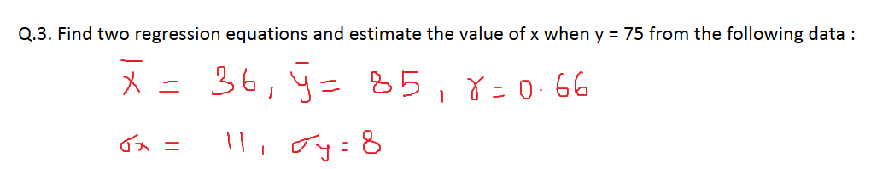

Slide 12
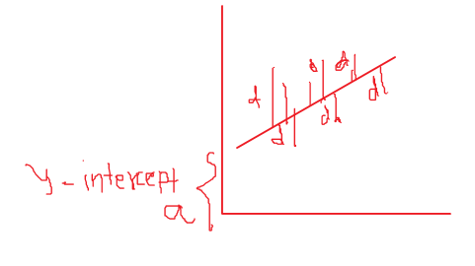
Regression is a method of estimating the value of one variable when that of the other is known and when the variables are correlated.
Applications of Regression:
a. It is used in machine learning.
b. It is used in experiments for interpolation of data.
Note; Deviations are not measured perpendicularly,
they are measured vertically and horizontally.
Line or regression of Y on X (vertical deviation) is given by y = a +bx ---slope intercept form equation. And it is used for estimating value of y for a given value of x.

Slide 13
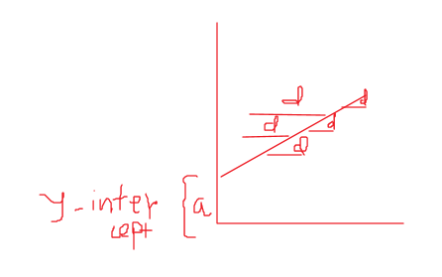
Line of regression of X on Y (Horizontal deviation) is given by x= a +by
And it is used for estimating the value of x for a given value of y.

Slide 14
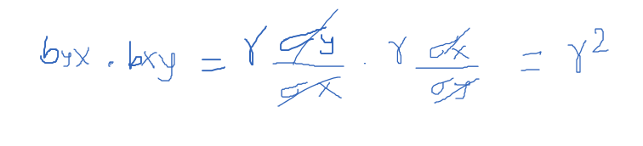
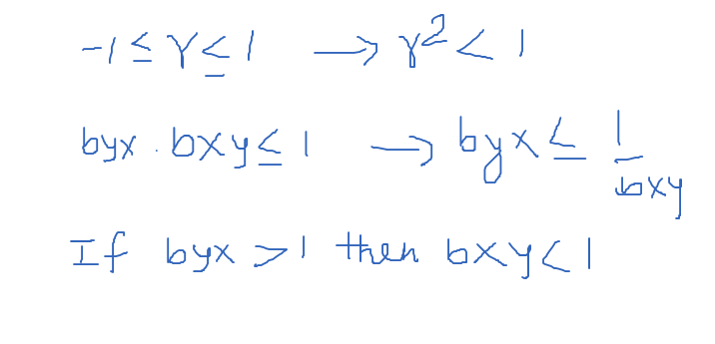
Properties of coefficient of regression :
Coefficient of correlation is the geometric mean between the coefficient of regression.
If one coefficient of regression is greater than 1,the other must be less than 1.

Slide 15
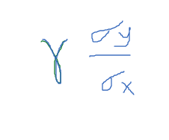
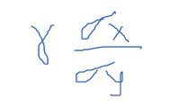
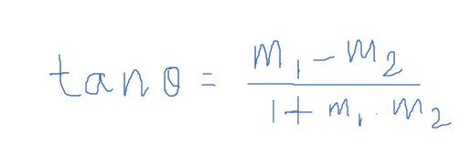
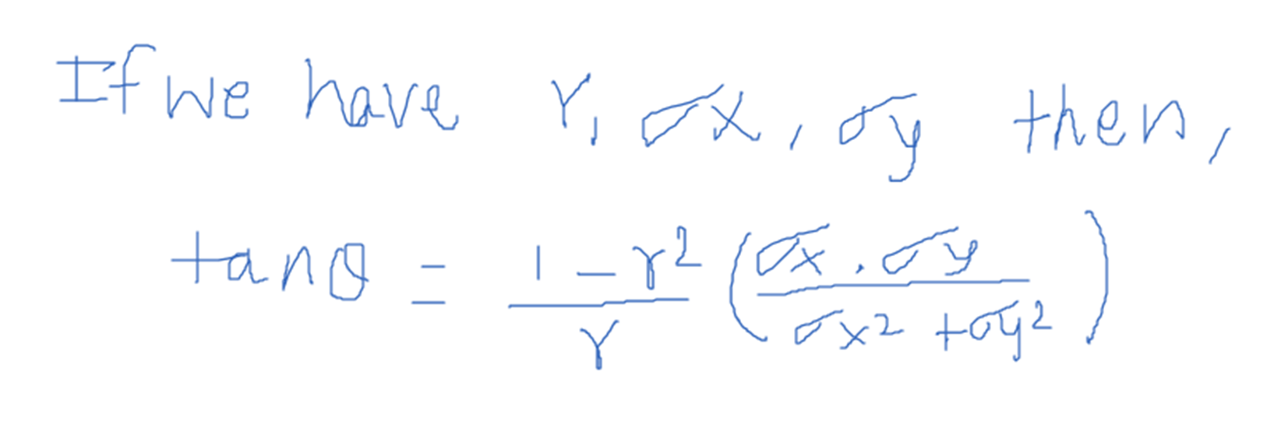

3.Coefficient of regression are independent of change of origin but not of change of scale .
u = ax +h v = by +k
buv = $\frac{a}{b}$ bxy ➔ buv = $\frac{coefficient of x}{coefficient of y }$. Bxy
4 Angle between lines of regression
m1=byx = m2= bxy =
Then ,

