Slide 1

Space-Grade Mechanical Fault Detector
An IEEE SSCS Chipathon 2026 Project — Team B22: Space Jam
Kishor R (Team Lead) · Rohit L · Rishadd Ranjith
National Institute of Technology Karnataka
Contact: nhskishor@gmail.com
GlobalFoundries 180nm · GF180MCU Process · 600×600 µm Die
1

Slide 2
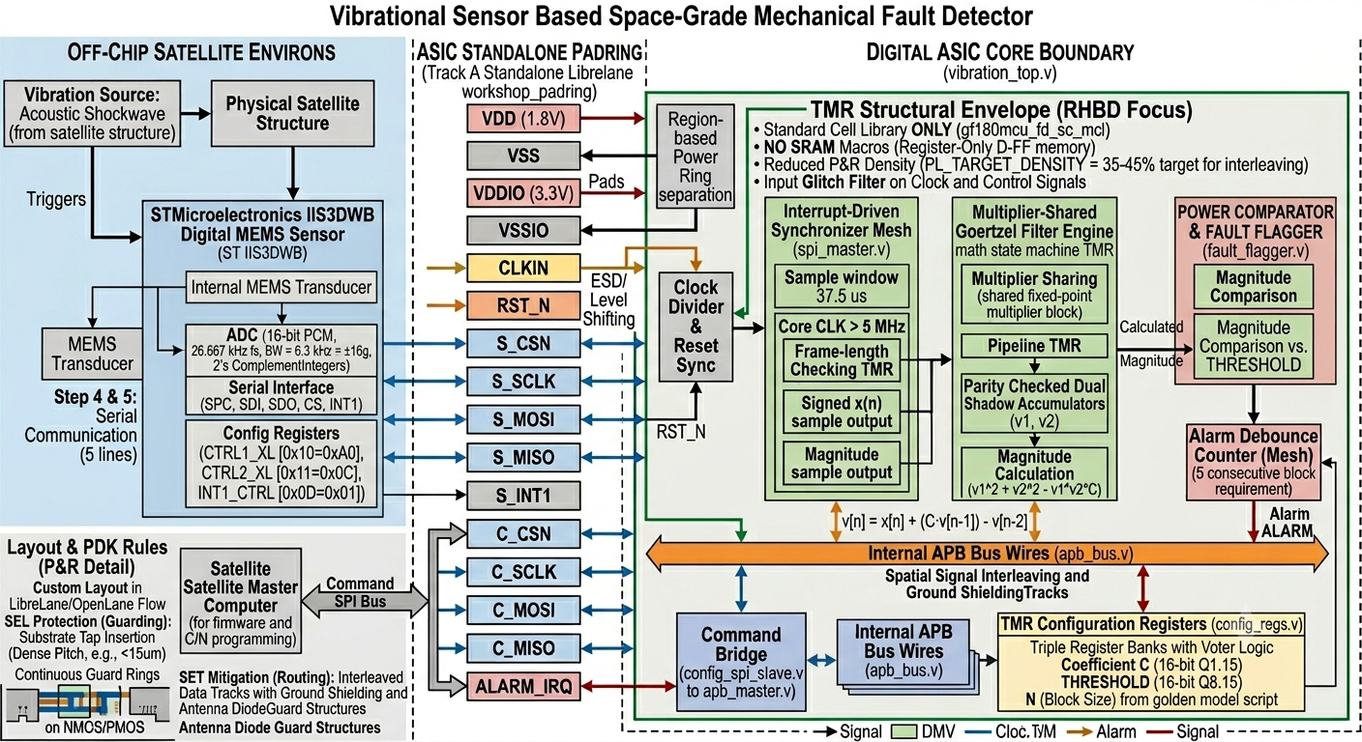
SPACE-GRADE MECHANICAL FAULT DETECTOR
System Architecture Overview
• Direct Digital MEMS Interface: 16-bit acceleration samples at 26.667 kHz natively via SPI.
• SPI-APB Interface: Buffers samples & decouples SPI and APB timing domains.
• TMR Register Bank: Radiation-hardened configuration storage for coefficients & thresholds.
• Axis Sequencer: Time-multiplexes X, Y, Z axis data to process them sequentially.
• Goertzel Core: Custom hardware DSP engine for targeted frequency bin filtering.
• Magnitude Compute: Converts recursive filter states into spectral energy snapshot.
• Fault Flagger: Compares spectral magnitude to thresholds and asserts interrupt.
• APB Master: Interfaces with system bus for register reads and configuration.
2

Slide 3
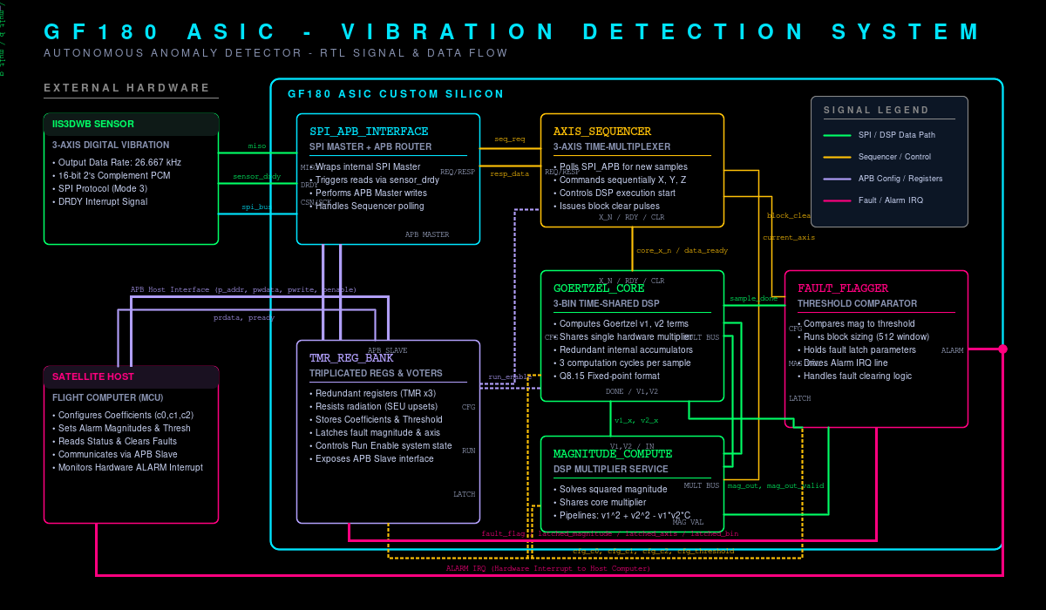
SPACE-GRADE MECHANICAL FAULT DETECTOR
Direct Digital Sensor Interface (SPI & APB Master)
SPI Master Interface (Module 1)
• Protocol: SPI Mode-3 (CPOL=1, CPHA=1)
• Acquisition: 48-bit XYZ burst reads minimize transaction overhead
• Clock Domain Crossing: 2FF synchronizers prevent metastability
• Triggering: Event-driven by sensor DRDY interrupt
• Shared FSM: Seamlessly handles boot configuration (4 regs) & acquisition
APB Master & Bus Interface (Modules 2 & 3)
• Protocol: Standard AMBA APB protocol
• FSM Control: Lightweight 3-state control (IDLE, SETUP, ACCESS)
• Wait States: Full PREADY support allows slow peripherals
• Efficiency: Request-driven transactions minimize switching power
3

Slide 4
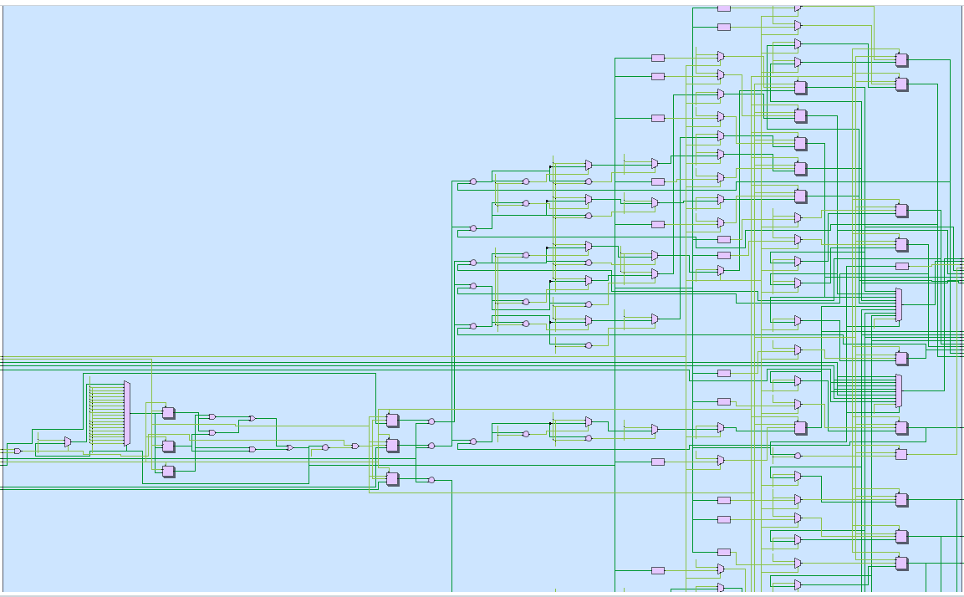
SPACE-GRADE MECHANICAL FAULT DETECTOR
Hardware-Optimized DSP Engine (Goertzel Core)
The Goertzel Algorithm (Second-Order IIR Filter)
v[n] = x[n] + C · v[n-1] - v[n-2]
Why Goertzel over FFT?
Computes energy at targeted frequency bins (1k, 5k, 10k Hz) only.
• Bins monitored: 3 programmable bins
• Execution speed: 6 clock cycles per sample
• Control: Triplicated (TMR) state machine for SEU resilience
DSP Hardware Features (Module 6)
• Shared Multiplier: Single multiplier shared across 3 bins
• Saturating Q8.15 Fixed-Point: Prevents overflow corruption
• Operand Isolation: Inputs gated when core is idle
• Power Savings: Active only 6 cycles out of 1875 cycles per sample
4

Slide 5
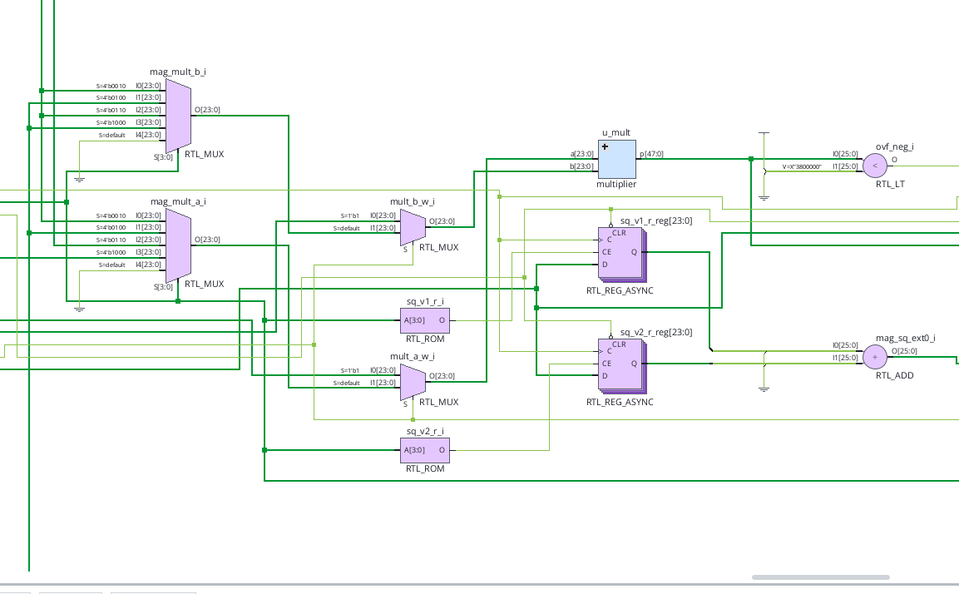
SPACE-GRADE MECHANICAL FAULT DETECTOR
Magnitude Compute Engine
Goertzel Magnitude Squared Formula
Magnitude² = v1² + v2² - C · v1 · v2
(v1 = v[N-1], v2 = v[N-2] at block boundary)
Snapshot Architecture (Module 7)
At block boundary (N=171), captures v1, v2, coefficient C, and axis index.
Resource Sharing (Zero-Area Multiplier)
• Multiplier Reuse: Magnitude engine reuses Goertzel core multiplier — 0 area cost!
• Sequential Magnitude FSM: Calculates 3 bins sequentially (8 cycles/bin, 24 cycles total)
• Triggering: Remains idle (near-zero power) until block boundary event
• Axis Attribution: Physical axis index snapshotted alongside Goertzel states
5

Slide 6
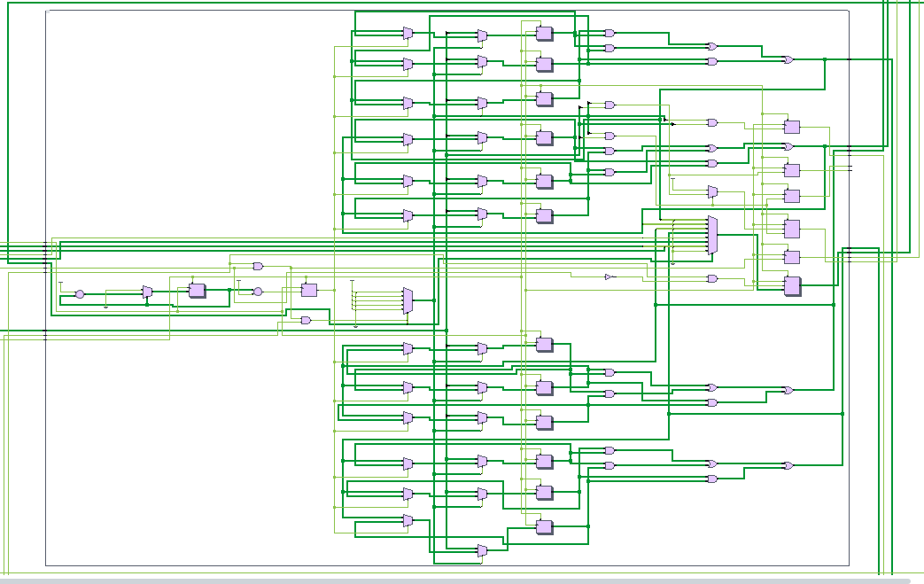
SPACE-GRADE MECHANICAL FAULT DETECTOR
Radiation Hardening by Design (RHBD) Strategy
Space Radiation Protection
High-energy space particles flip register bits (Single Event Upsets / SEUs).
Triple Modular Redundancy (TMR)
• Triplicated configuration registers, Goertzel coefficients, thresholds & FSMs.
• 1-cycle majority voting continuously resolves and masks bit flips.
Background Scrubbing (Module 4)
• Periodic scrubber checks register copies in background and restores corrupted copies.
SRAM-Free & Physical Hardening
• Hardened flip-flop arrays (no radiation-vulnerable SRAM).
• Dense substrate taps & guard rings enclose active logic.
6

Slide 7
SPACE-GRADE MECHANICAL FAULT DETECTOR
Critical Area Constraint & Trade-off Options
Engineering Challenge: IIS3DWB outputs 3 axes simultaneously, but Chipathon die area is strictly capped at 600×600 µm.
Option | Architecture Description | Die Area Cost | Fault Detection Latency
Option 1 | 3 Parallel Goertzel Cores (X, Y, Z) | Exceeds 600×600 µm limit ❌ | Fastest (19.2 ms)
Option 2 | Single-Axis Processing Only | Within Area Limit ✓ | No multi-axis coverage ❌
Option 3 | Axis Sequencer (BLOCK_SIZE=171) | Fits 600×600 µm Budget (0 Area Penalty) ✓ | 3× Latency Speedup (~6.4 ms) ✅
Selected Optimization: Option 3 (BLOCK_SIZE = 171) — Reduces block size from 512 to 171, achieving 3× faster per-axis latency detection with zero area penalty.
7

Slide 8
SPACE-GRADE MECHANICAL FAULT DETECTOR
Option 3 Implementation & Trade-off Analysis
Quantitative Performance Trade-offs
• BLOCK_SIZE reduced from 512 → 171 (3× improvement in per-axis detection latency)
• Threshold scaling: Magnitude ∝ N², so thresholds divided by (512/171)² ≈ 8.96
• Area: Zero additional area cost — achieved through sequencing, not added hardware
Accepted Limitations & Spacecraft Justification
1. Sequential Processing Data Loss: 2 of 3 axes discarded during any single block acquisition.
2. Intermittent Fault Coverage: Cannot detect simultaneous multi-axis faults during rotation.
3. Justification for Spacecraft Applications:
Mechanical failures (bearing wear, pump fatigue) degrade slowly over hours or days.
Per-axis latency of ~6.4 ms is far below the timescale of structural degradation.
This trade-off is fully acceptable for the mission profile.
8

Slide 9
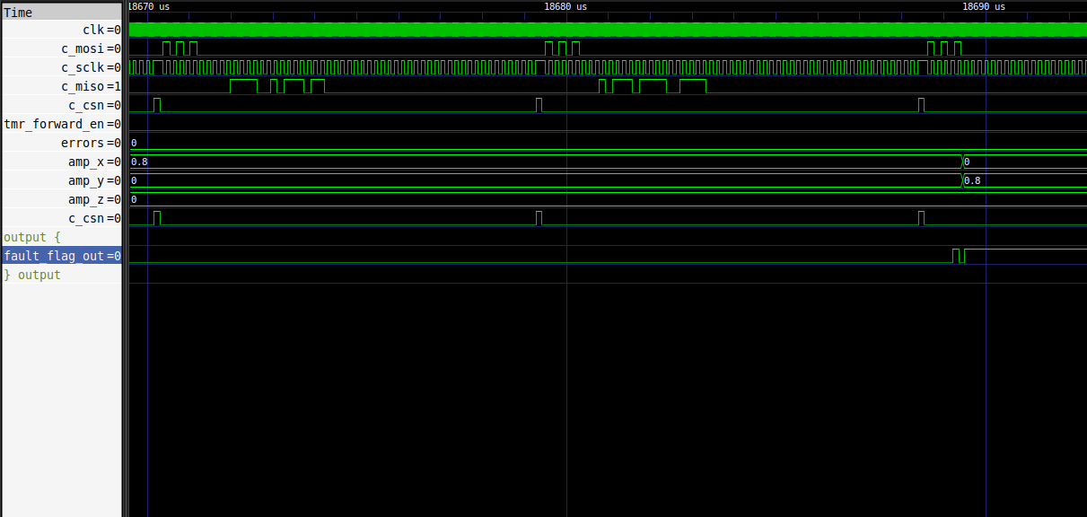
SPACE-GRADE MECHANICAL FAULT DETECTOR
Comprehensive Verification & Regression Testing
100% Assertion Success — All 79 Verification Checks Passed
Top Integration (tb_top.v) — 7 / 7 Passed ✅
• Case 1: Quiet normal operation (no false positives)
• Cases 2–4: X, Y, Z-axis fault detected & flagged
• Timing: Confirmed 6.4 ms per-axis rotation intervals
Goertzel Core (tb_goertzel_core.v) — Passed ✅
• Verified second-order recurrence filtering
• Q8.15 fixed-point arithmetic vs. Python model
SPI Master Interface — 71 / 71 Passed ✅
• Boot config, DRDY sync, Mode-3 timing
9

Slide 10
SPACE-GRADE MECHANICAL FAULT DETECTOR
Roadmap & Key Takeaways
Key Contributions
1. Direct Digital MEMS Interface: Eliminates analog radiation-vulnerable ADCs.
2. Pragmatic Optimization (Option 3): Fits 600×600 µm, 3× faster detection, zero area cost.
3. Radiation Hardening (RHBD): TMR, majority voting, background scrubbing.
4. Verified & Tapeout-Ready: 79/79 verification tests passed.
Project Roadmap
• week 28: Make Some Improvements in RTL
• week 29: Make some minute changes in rtl for ASIC readiness
• week 30: Initial ASIC runs
• week 31: Get to the AREA constraint and calculate power,solve timing issues
10

