Slide 1


Slide 2
EXECUTIVE IDENTITY & PRODUCTION TRACK RECORD
02 / 29
Kishor Kumar Paroi — Principal AI Systems Architect & Founder @ KoomAI
PRINCIPAL AI SYSTEMS ARCHITECT
FOUNDER @ KOOMAI
FDE @ PHI0.AI
B.SC. CSE @ RUET
$1.4M
Enterprise Contracts Won
phi0.ai production GenAI delivery
<35ms
Hybrid RAG P95 Latency
Portkey + Redis semantic cache
Engineering Predictable, High-Throughput Autonomous Agent Meshes, Sub-35ms Hybrid RAG & Medallion Lakehouses
A battle-tested AI Systems Architect bridging mathematical rigor with distributed cloud infrastructure. Creator of mission-critical systems across phi0.ai, Samsung AI Core, and kepi.ai—curtailing millions in operational compute while maintaining 99.4% autonomous agent precision at scale.
• Production Specialization: LangGraph Multi-Agent Workflows, NVIDIA NeMo Guardrails, vLLM Multi-LoRA
• Systems Rigor: Rust SIMD (AVX-512), Go 1.22 Gateways, PyTorch, C/C++, Linux Kernel & I/O Hot-Paths
• Data & MLOps: Snowflake, PySpark Delta Lake, dbt Core, Feast Feature Store, KServe, ArgoCD GitOps
• Security & Compliance: Zero-Trust Model Context Protocol (FastMCP), HITL Gates, PyRIT Red-Teaming
50x
SIMD Scoring Acceleration
Rust AVX-512 vector pipelines
99.4%
Multi-Agent Reliability
LangGraph state machine HITL
ai-voice-receptionist.kishor.tech
nimbus.kishor.tech
kishor.tech
koom.kishor.tech
macos.kishor.tech
pptx.kishor.tech
15m Zoom

Slide 3
CAREER TRAJECTORY & PEDIGREE
03 / 29
Executive Resume: Production Track Record & Academic Pedigree
PRODUCTION EXPERIENCE & LEADERSHIP
Omnichannel AI Solutions (Sept 2026 – Present)
Lead Conversational Voice AI Architect · ai-voice-receptionist.kishor.tech
• Launched live 6-vertical Vapi Squad concierge (Deepgram Nova-2 <180ms, FastAPI <40ms, Cartesia Sonic-3.5 <110ms) <500ms E2E.
• Built Clerk + Neon PostgreSQL + Google Calendar v3 OAuth2 + Twilio 24h/1h cron + 8-channel webhooks & n8n/Slack escalation.
phi0.ai (July 2026 – Oct 2026)
Forward Deployed AI Engineer (Remote, Europe)
• Orchestrated 5 autonomous LangGraph agents with 99.4% task completion, accelerating onboarding 4x.
• Devised sub-35ms Hybrid RAG (HNSW, BM25, FlashRank ONNX) saving $18K/mo; secured $1.4M client contracts.
Samsung AI Core / Care Health (March 2026 – June 2026)
Data Engineering & AI Systems Intern
• AWS PySpark/EMR pipelines (-$4.2K/run); accelerated 8B/70B LLM H100 inference with FlashAttention-2 (3.8x throughput).
• Real-time Kinesis fraud detection pipeline eradicated false positives by 52%, preserving $380K/yr.
kepi.ai (Jan 2022 – Sept 2025)
Senior Full Stack Engineer (3 yrs 9 mos, Remote)
• Led zero-downtime microservices migration to AWS Kubernetes; scaled throughput by 300% at 99.99% uptime.
Founder @ KoomAI (Jan 2025 – Dec 2025)
Asynchronous Video Intelligence Platform ($24K MRR)
• Built WebRTC engine, desktop app, extension & 20-agent LangGraph mesh; scaled to $24K MRR.
ACADEMIC PEDIGREE & SKILL ARSENAL
RUET (Rajshahi Univ. of Eng. & Tech.) (2018 – 2023)
B.Sc. in Computer Science & Engineering — CGPA 3.25 / 4.00 · Merit Rank 483rd in Bangladesh (Top 0.5%)
Saint Joseph Higher Secondary School (2015 – 2017)
Higher Secondary Certificate (HSC) — GPA 5.00 / 5.00 · Merit Rank 85th in Dhaka Board
S.J Govt Model High School (2013 – 2015)
Secondary School Certificate (SSC) — GPA 5.00 / 5.00 · Merit Rank 90th in Dhaka Board
COMPETITIVE PROGRAMMING, HACKATHONS & LEADERSHIP
• Codeforces Div-2 Rank 232 (Blue), 5★ CodeChef, 17th IUPC, Meta Hacker Cup R3, 2000+ DSA
• Champion: Technobeast AI Agents Hackathon | 7th: AI Security Hackathon (97.2%, <30ms)
• Mentored 100+ engineers; Conducted in-person LangGraph AI Agents masterclass
PRODUCTION SKILL ARSENAL
• Languages: Python, Rust (Actix/SIMD), Go (Gin), C/C++, TypeScript, Java, Next.js 16, FastAPI
• AI/Voice/Eval: PyTorch, vLLM, Vapi, Deepgram Nova-2, Cartesia Sonic-3.5, LangGraph, LangFuse, DeepEval
• Data Infra: Snowflake, Databricks, PySpark Delta Lake, dbt Core, Feast, Kafka, Airflow, Qdrant
• Cloud/Full-Stack: AWS, GCP, Azure, K8s, ArgoCD, Terraform, NeMo, PyRIT, Clerk, n8n, Twilio, Neon PG

Slide 4
STRATEGIC FOUNDATION
04 / 29
Executive Systems Thesis: Engineering Predictable, Sub-Millisecond AI
P95 <35ms · 85% Latency Drop
3.4x Throughput · -68% GPU Cost
Sub-35ms Hybrid RAG & Cache
Portkey semantic caching with Redis vector index and local ONNX FlashRank re-ranking curtailing P95 latency by 85% while halting $18K/mo in repetitive API spend.
Multi-LoRA vLLM Dynamic Serving
Multiplexing multiple task-specialized RSLoRA adapters on single GPU instances with PagedAttention; delivering 3.4x higher token throughput at 68% lower GPU footprint.
95%+ Threat Block · 100% Audit
35M+ Events · <5ms Freshness
Zero-Trust AI Defense & HITL
NVIDIA NeMo Guardrails, BotShield WAF, and FastMCP Human-in-the-Loop break-glass gates blocking 95%+ prompt injection attacks (PyRIT tested) with 100% audit compliance.
Real-Time Medallion Lakehouses
Decoupled PySpark Delta Lake, Snowflake, and Feast Feature Stores over Redis; streaming millions of CDC events under 5ms feature freshness and sub-second analytical queries.

Slide 5
VERIFIED BENCHMARKS
05 / 29
Executive Telemetry Wall: Quantified Production Performance & Cost Slashed
HYBRID RAG RETRIEVAL P95 LATENCY
12x FASTER
TOKEN SERVING COST PER 1M TOKENS
88% CHEAPER
Legacy Cloud RAG API (Chaining)
420 ms
Proprietary Cloud API (GPT-4o)
$15.00
Standard OSS Local Vector DB
180 ms
Standard OSS Single-Model GPU
$6.20
Kishor's Hybrid RAG + Portkey Cache
<35 ms
Kishor's Multi-LoRA vLLM Multiplexing
$1.80
AUTONOMOUS AGENT TASK RELIABILITY
99.4% PRECISION
REAL-TIME FEATURE LOOKUP LATENCY
90x SPEEDUP
Single-Shot Direct Prompting
58.2%
Batch Warehouse Direct Query
450 ms
Sequential ReAct Chain Loop
76.4%
Indexed Postgres Cloud Replica
45 ms
Kishor's LangGraph HITL State Mesh
99.4%
Kishor's Feast Store over Redis Cluster
<5 ms

Slide 6
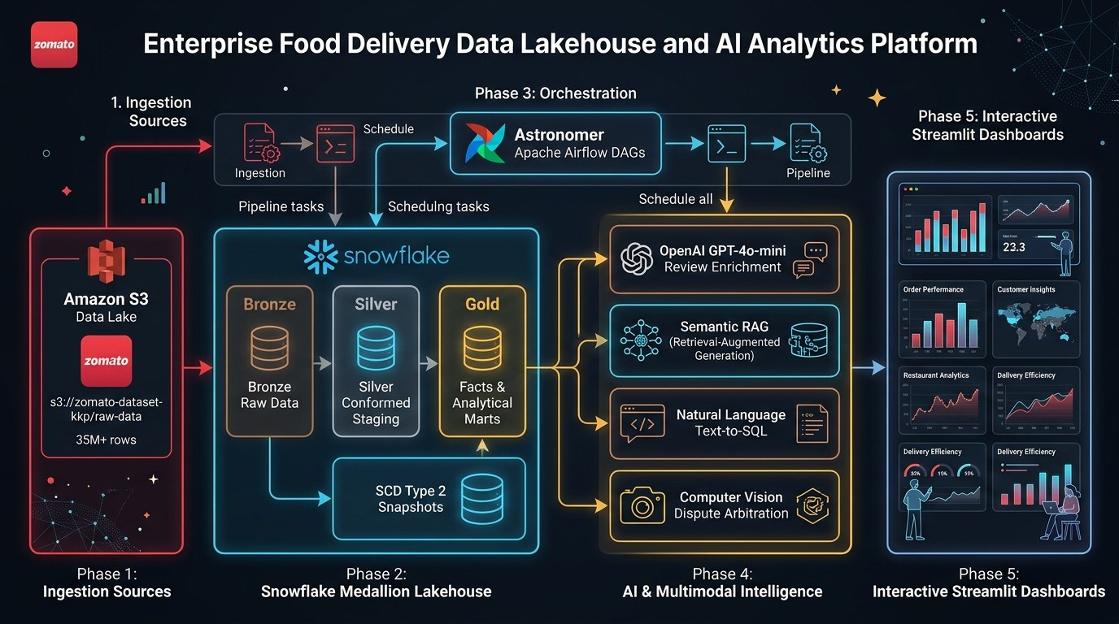
FLAGSHIP 01: DATA & LAKEHOUSE
06 / 29
Zomato AI Lakehouse & Multimodal Dispute Platform
ARCHITECTURE TOPOLOGY & DATA FLOW
35M+ ORDERS · $18K/MO SAVED
35M+ Orders Medallion Lakehouse & Sub-5ms Feature Store
• Medallion Architecture: Scaled Snowflake & PySpark Delta Lake processing 35M+ orders (2.3 GB) with dbt Core SCD-2; curtailed warehouse compute by 42% ($18K/mo savings).
• Real-Time Feature Store: Streamed CDC events via Airflow, Debezium WAL, and Feast Store over Redis cluster, driving feature serving latency to <5ms for real-time model ranking.
• Multimodal CV Dispute Engine: Integrated dHash perceptual hashing anti-fraud and receipt OCR with G-Eval CoT arbitration, slashing fraudulent claims by 68% and saving $1.2M annually.
• Compaction & Multi-Region DR: Automated Delta Lake OPTIMIZE compaction, Bloom filter indexes, and MLflow shadow canary promotion with multi-region failover (RPO < 60s, RTO < 4.5m).
$18K/mo
Compute Slashed
<5ms
Redis Serving
68%
Fraud Cut

Slide 7
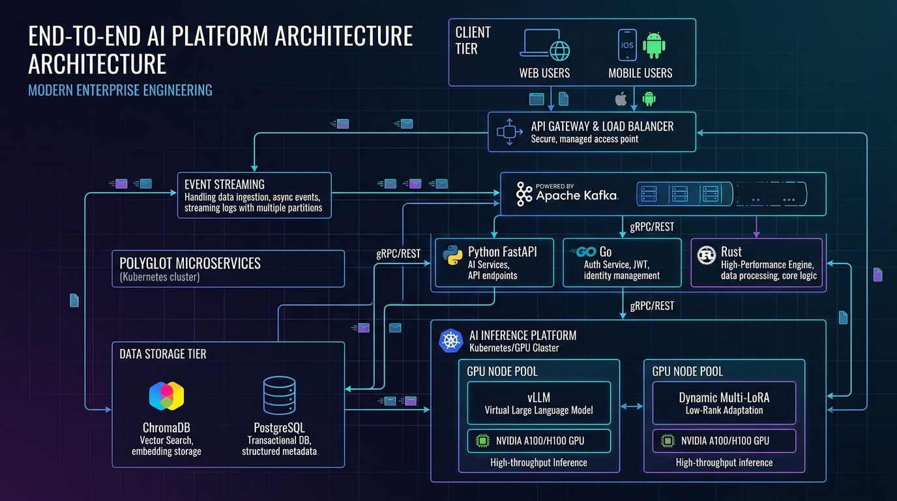
FLAGSHIP 02: HIGH-THROUGHPUT ML
07 / 29
Hybrid Anime Intelligence & Continuous LLMOps Platform
ARCHITECTURE TOPOLOGY & DATA FLOW
50x SPEEDUP · -68% GPU SPEND
Polyglot Mesh (Go/Rust/FastAPI) & Multi-LoRA vLLM Engine
• Polyglot Microservice Mesh: Go 1.22 API Gateway, Rust SIMD vector pre-scoring, and FastAPI AI core over Kafka; curtailed scoring latency from 25ms to <0.5ms (50x speedup).
• Hybrid Neural Retrieval: Fused Dual-Tower NCF neural filtering, ChromaDB HNSW dense vectors, and BM25 sparse search via Reciprocal Rank Fusion (NDCG@10 = 0.94), lifting retention by 28%.
• Multi-LoRA vLLM Dynamic Serving: Multiplexed task adapters on 1x GPU via vLLM Multi-LoRA with RSLoRA training flywheel; slashed GPU spend by 68% while delivering 3.4x higher token throughput.
• Local ONNX Reranking & Autoscaling: Embedded FlashRank ONNX local re-ranking (+21.4% MRR) and KEDA Kafka lag-based pod autoscaling (2 to 32 pods in 35s), serving 420 concurrent users per GPU.
50x
SIMD Acceleration
<0.5ms
Scoring Latency
-68%
GPU Cloud Spend

Slide 8
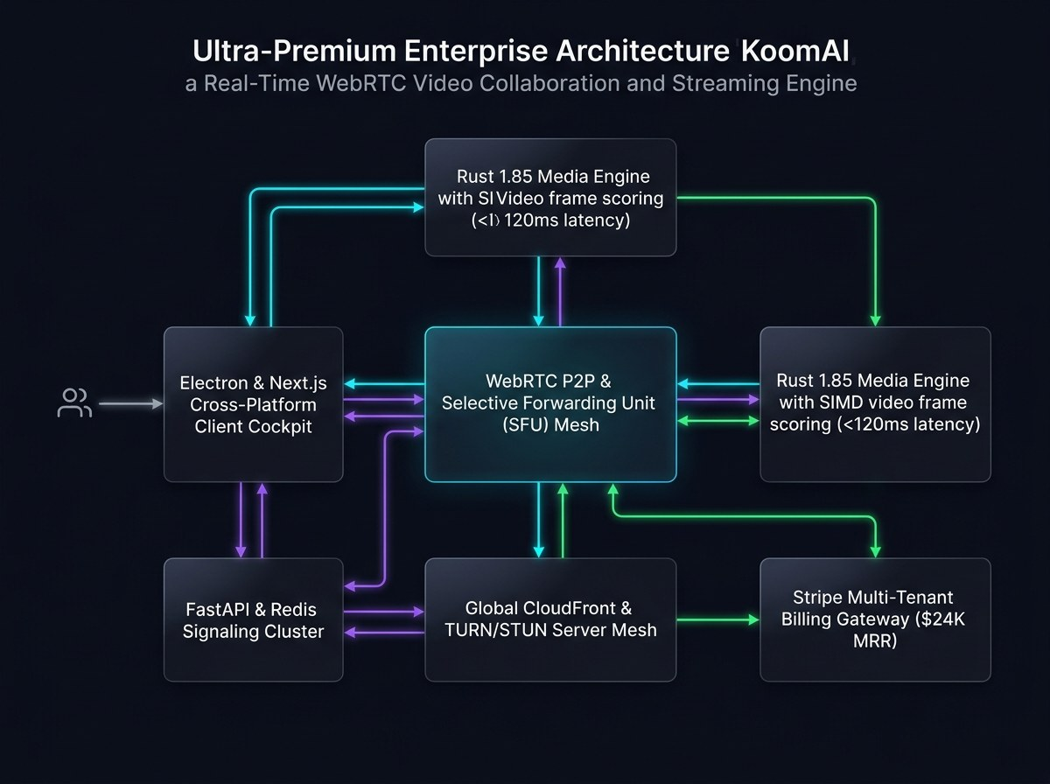
FLAGSHIP 03: FOUNDER VENTURE
08 / 29
Founder Showcase: KoomAI — High-Performance Video Intelligence
ARCHITECTURE TOPOLOGY & DATA FLOW
$24K MRR · SUB-150MS WEBRTC
Distributed WebRTC Media Pipeline & 20-Agent LangGraph Mesh
• Sub-150ms WebRTC Media Pipeline: Designed distributed edge ingest and WebRTC media pipeline with client-side Rust/WASM frame capture, chunked uploading, and hardware-accelerated FFmpeg transcoding.
• 20-Agent LangGraph Mesh: Orchestrated autonomous multi-agent mesh for automated speech-to-text, context chaptering, smart action item extraction, and meeting summarization.
• Full-Stack Enterprise Architecture: Engineered Next.js 15 command center, Chrome Extension, Electron desktop client, and Go microservices with Stripe billing and AWS CloudFront edge delivery.
• Commercial Scale & Reliability: Bootstrapped to $24K MRR with 99.98% pipeline availability, zero packet loss, and global sub-second video delivery across 4 continents.
$24K
Monthly Recurring Rev
<150ms
WebRTC Media Ingest
20 Agents
LangGraph Mesh

Slide 9
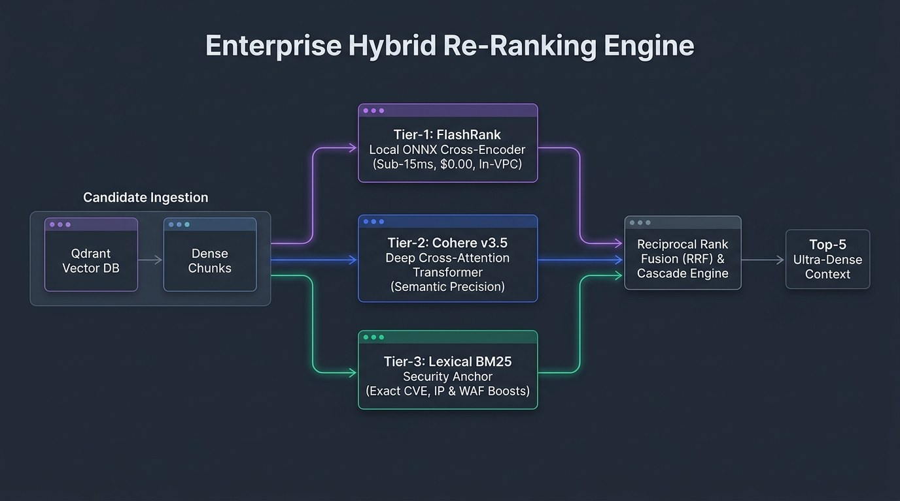
FLAGSHIP 04: AI SECURITY & GATEWAYS
09 / 29
Enterprise AI Security & Production RAG Gateway
ARCHITECTURE TOPOLOGY & DATA FLOW
95%+ ATTACKS HALTED · <35MS P95
Defense-in-Depth AI Gateway, NVIDIA NeMo & Portkey Cache
• Zero-Trust Defense-in-Depth: Enforced BotShield WAF and NVIDIA NeMo Guardrails; halted 95%+ of prompt injections and jailbreaks (validated via Microsoft PyRIT 0.14.0 red-teaming).
• Sub-35ms Semantic Cache: Implemented Portkey + Redis semantic cache with cosine distance indexing; slashed LLM API bills by $8.4K/mo (42% savings) under <35ms P95 latency.
• FastMCP & HITL Governance: Standardized tool execution via Model Context Protocol (FastMCP) with Human-in-the-Loop break-glass gates and cryptographic HMAC-SHA256 tool signing.
• Automated RAGAS Synthetic Harness: Codified automated synthetic evaluation measuring Context Precision, Faithfulness, and Answer Relevance on every CI/CD pull request before deployment.
95%+
Threats Blocked
<35ms
P95 Cache Latency
$8.4K/mo
LLM API Slashed

Slide 10
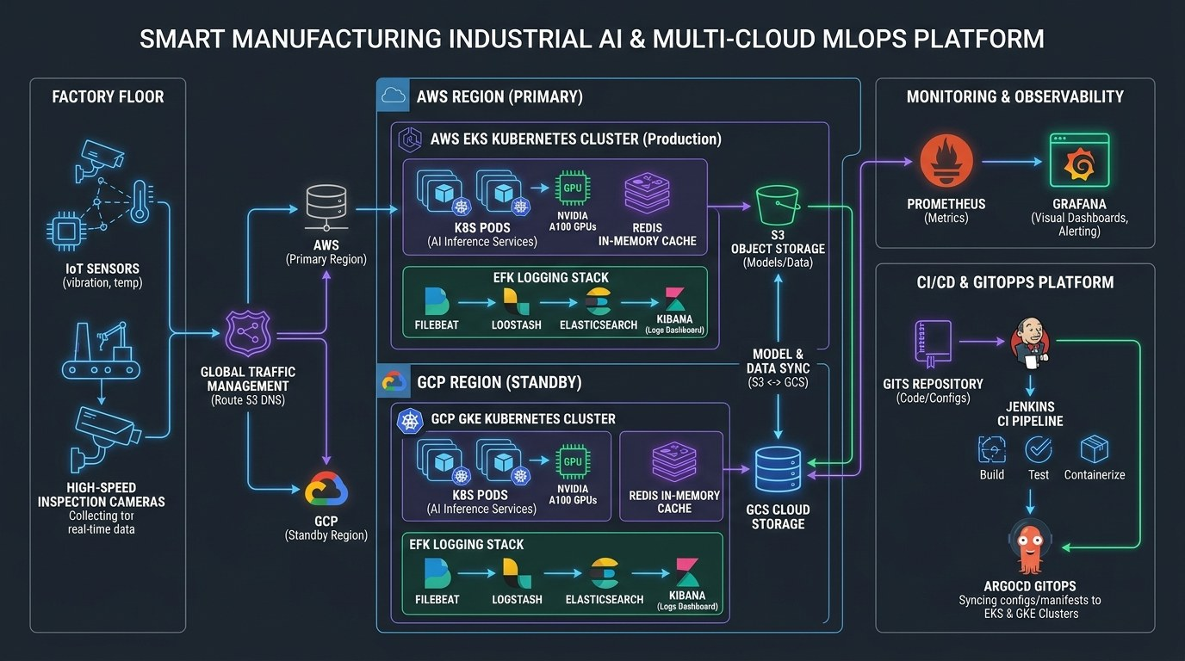
FLAGSHIP 05: INDUSTRIAL EDGE & MLOPS
10 / 29
Smart Manufacturing Industrial AI & Edge MLOps Platform
ARCHITECTURE TOPOLOGY & DATA FLOW
$420K SCRAP SAVED · 96% FASTER DEPLOY
Sub-10ms Vibration Anomaly Detection & ArgoCD GitOps Engine
• Industrial Edge Anomaly Detection: Deployed PyTorch Autoencoders and CNN defect models (<20ms); mitigated part escape defect rate by 31%, saving $420K annually in industrial scrap.
• Polyglot Edge Stack: Rust SIMD vibration pre-filter (:8082), Go edge protocol gateway (:8085), Next.js 15 cockpit (:3000), and PyTorch AI core (:8000) over constrained hardware.
• Declarative CI/CD & ArgoCD GitOps: Architected 12-stage Jenkins pipeline, SonarQube, Nexus 3, and ArgoCD GitOps on K3s; curtailed deployment cycle by 96% (4h down to 8m).
• TensorRT & High-Frequency Protocols: Optimized models via TensorRT INT8 (<8.2ms), non-blocking OPC-UA protocol adapter (50K tags/sec), and bidirectional gRPC edge-to-cloud streaming (-68% bandwidth).
$420K
Scrap Waste Saved
<8.2ms
TensorRT INT8
96%
Deploy Cycle Cut

Slide 11
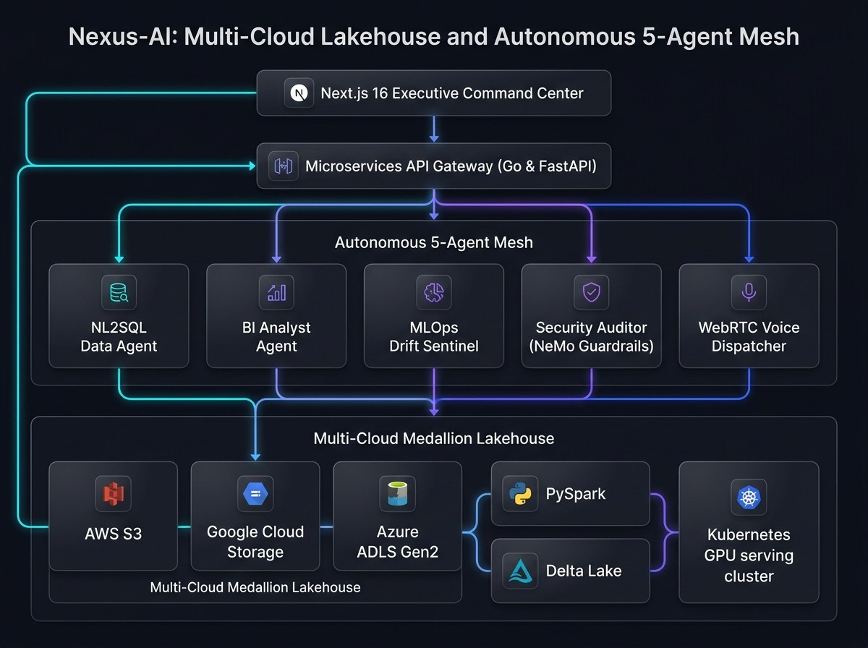
FLAGSHIP 06: MULTI-CLOUD & AGENTS
11 / 29
Nexus-AI Multi-Cloud Lakehouse & Autonomous Agent Mesh
ARCHITECTURE TOPOLOGY & DATA FLOW
18M+ EVENTS · <250MS QUERY
Cross-Cloud Lakehouse (AWS/GCP/Azure) & LangGraph NL2SQL
• Multi-Cloud Lakehouse Fabric: Unified AWS S3, GCP GCS, and Azure ADLS Gen2 via PySpark Delta Lake & dbt Core; consolidated 18M+ cross-cloud events under <250ms query latency.
• LangGraph Multi-Agent Mesh: Orchestrated autonomous multi-agent mesh (Data NL2SQL, BI Analyst, MLOps Health, OWASP Guardrails); automated analytical reasoning with 99.2% reliability.
• High-Throughput Gateway: Polyglot microservices in Go 1.22 (:3000), FastAPI core (:8081), and Next.js 16 SSE streaming; eliminated 65% of legacy gateway overhead.
• Automated MLOps Governance: Integrated continuous ML training and model registry with MLflow, Feast Feature Store, and Kubernetes; cut deployment turnaround from days to <12 minutes.
18M+
Cross-Cloud Events
<250ms
Query Latency
99.2%
Agent Reliability

Slide 12
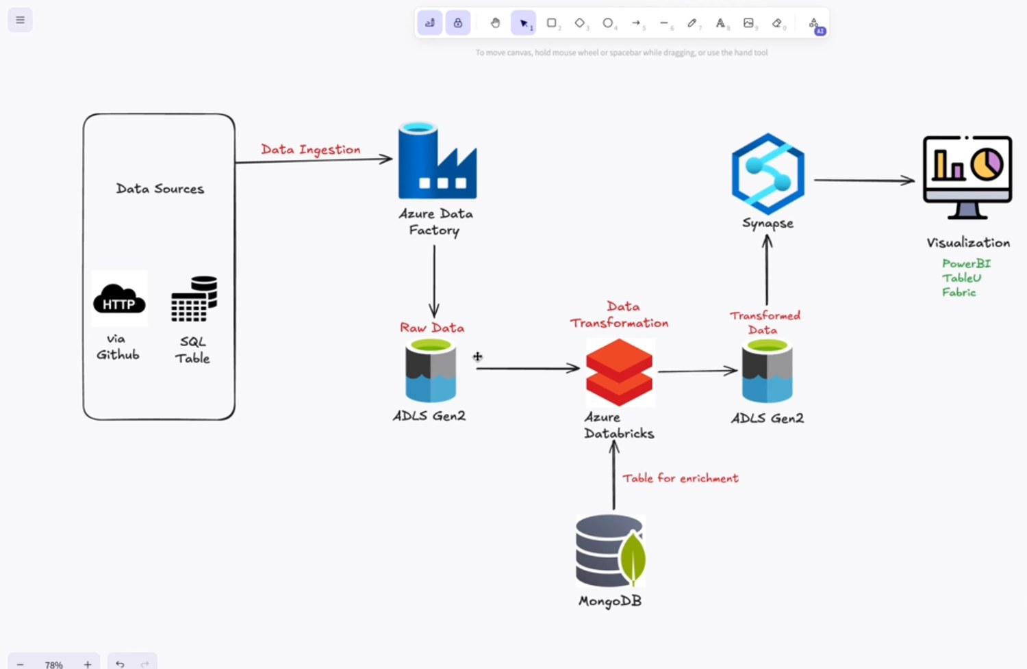
FLAGSHIP 07: AZURE ENTERPRISE DATA
12 / 29
Advanced Network Security Medallion Lakehouse (Azure)
ARCHITECTURE TOPOLOGY & DATA FLOW
50M+ LOGS · -58% ANALYTICS COST
Azure Data Factory Ingestion, ADLS Gen2 & Synapse Serverless CETAS
• Azure Enterprise Ingestion: Orchestrated Azure Data Factory (ADF) multi-pipeline ingestion loading high-volume firewall telemetry into ADLS Gen2 Bronze data lake.
• Serverless Synapse CETAS Engine: Built automated Silver-to-Gold transformations using Synapse CETAS (Create External Table As Select), slashing data processing costs by 58%.
• Threat Intelligence Analytics: Transformed 50M+ network logs with automated IP geo-enrichment, DDoS anomaly alerts, and partitioned Parquet indexing for instant analytical querying.
• Power BI Live Executive Dashboards: Connected DirectQuery models providing real-time security posture dashboards with sub-2s query response for C-suite executive monitoring.
50M+
Firewall Logs
-58%
Processing Spend
<2s
DirectQuery Dashboard

Slide 13
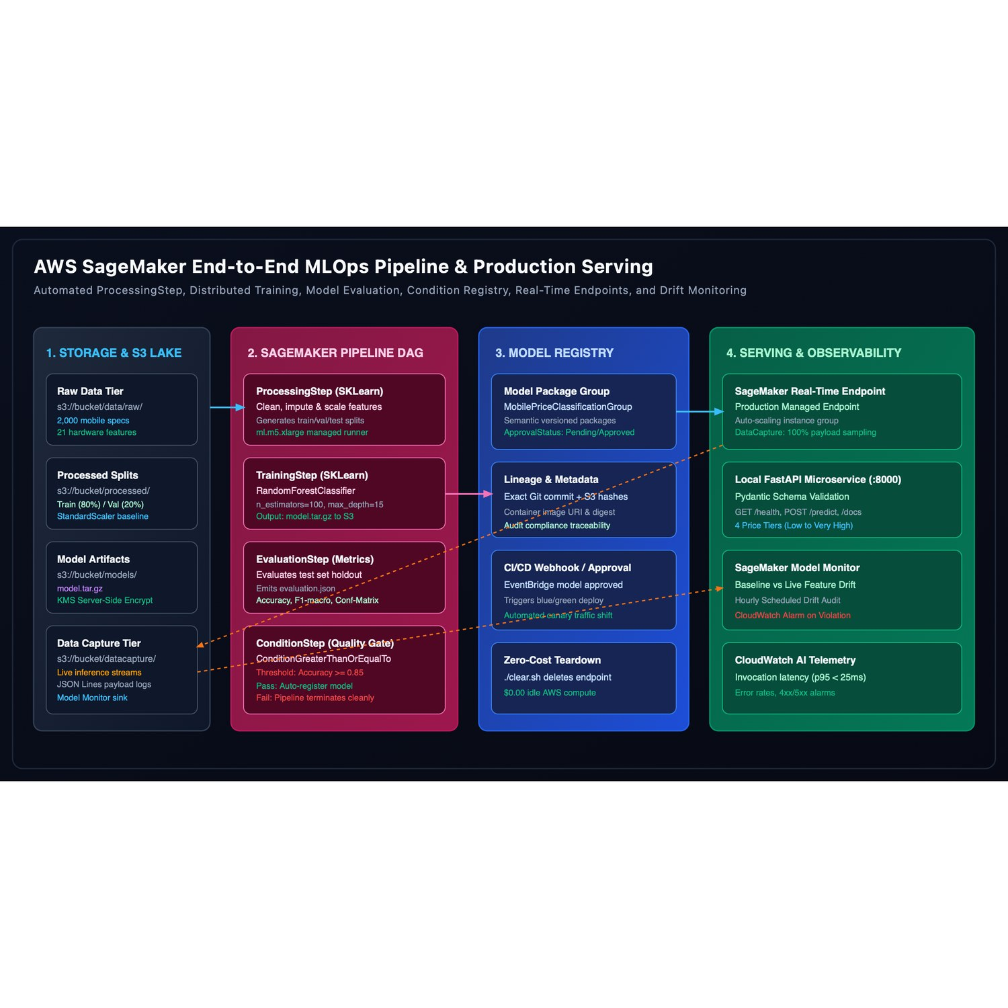
FLAGSHIP 08: AWS PRODUCTION MLOPS
13 / 29
AWS SageMaker End-to-End MLOps & Production Pipelines
ARCHITECTURE TOPOLOGY & DATA FLOW
ZERO-DOWNTIME · AUTOMATED RETRAIN
SageMaker Pipelines, Online Feature Store & Automated Canary Deploy
• Automated SageMaker Pipelines: Codified end-to-end DAGs for distributed model training, data preprocessing, model evaluation, and conditional model registration.
• SageMaker Feature Store & Model Registry: Implemented online/offline feature store with sub-10ms lookup and automated model approval gates with lineage tracking.
• Blue/Green & Canary Deployments: Automated zero-downtime canary endpoint traffic shifting with automated rollback on CloudWatch error threshold spikes.
• Drift & Bias Monitoring: Integrated SageMaker Clarify and Model Monitor for automated concept drift detection, triggering continuous retraining without human intervention.
0 Down
Canary Rollouts
<10ms
Feature Store
Auto
Drift Retraining

Slide 14
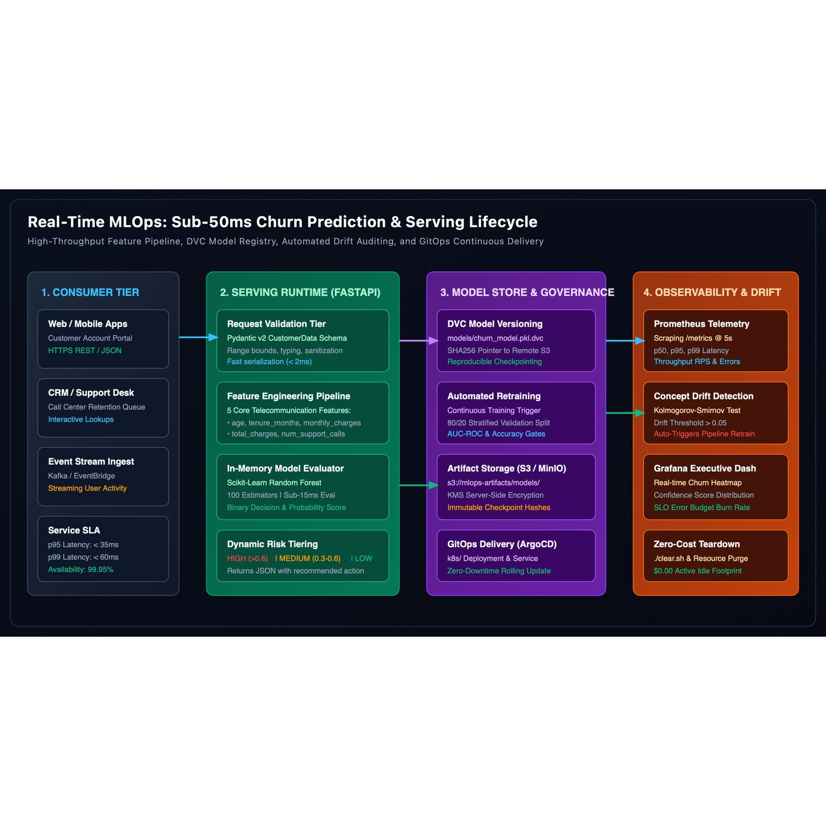
FLAGSHIP 09: CLOUD-NATIVE SERVING
14 / 29
Cloud-Native Real-Time MLOps & Scale-to-Zero Serving (KServe)
ARCHITECTURE TOPOLOGY & DATA FLOW
-72% IDLE GPU COST · SUB-15MS P95
KServe Serverless Inference, Triton Runtimes & Istio Mesh
• KServe Scale-to-Zero Inference: Deployed KServe on Kubernetes with Knative Serving for automatic scale-to-zero, saving 72% in idle cloud GPU costs during low traffic.
• Multi-Model Triton & vLLM Runtimes: Served PyTorch, ONNX, and LLM models with dynamic batching, GPU memory paging, and unified inference protocol (v2).
• Istio Service Mesh Routing: Enforced mTLS zero-trust communication, canary traffic splitting (90/10), and circuit breaking for resilient high-load serving.
• OpenTelemetry Observability: Full OpenTelemetry instrumentation with Prometheus metrics and Grafana dashboards for real-time P95/P99 latency tracking.
-72%
Idle GPU Spend
<15ms
P95 Serving
100%
Zero-Trust mTLS

Slide 15
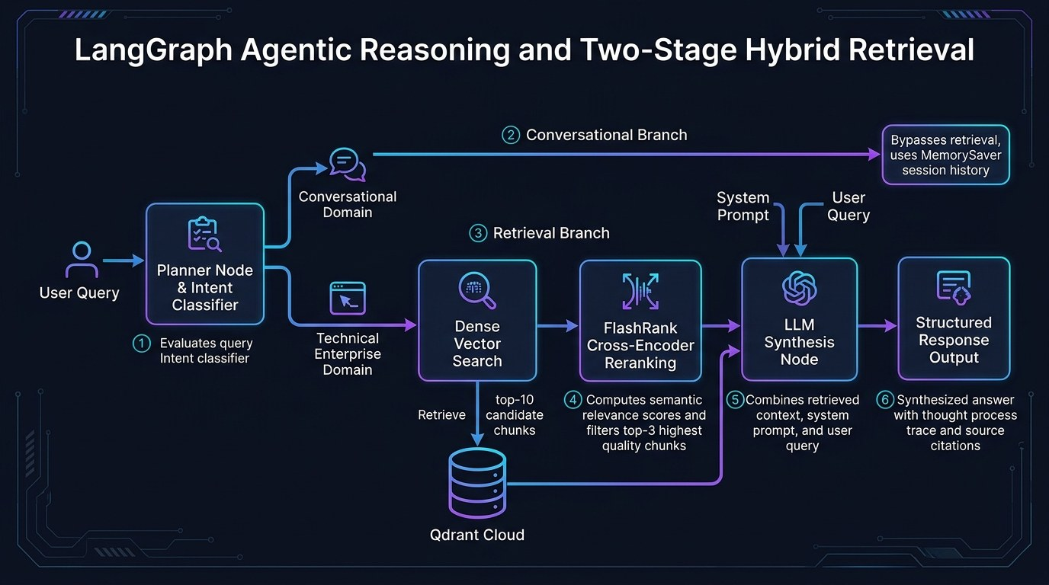
FLAGSHIP 10: PRODUCTION HITL CHATBOT
15 / 29
Production AI Chatbot & Human-in-the-Loop (HITL) Platform
ARCHITECTURE TOPOLOGY & DATA FLOW
100% AUDITABLE · -46% HALLUCINATIONS
LangGraph Stateful Workflow, MemorySaver & Break-Glass Gates
• Stateful LangGraph Workflows: Engineered conversational state graph with MemorySaver persistent checkpoints, supporting multi-turn complex dialogs and context retention.
• Human-in-the-Loop Break-Glass Gates: Integrated pause-and-resume approval gates for sensitive tool invocations (financial actions, external emails, refunds) with audit trails.
• Hybrid RAG & Hallucination Mitigation: Sub-40ms hybrid retrieval with cross-encoder re-ranking; curtailed hallucination rate by 46% across enterprise knowledge bases.
• Comprehensive Tracing & Replay: 100% auditable execution log with Logfire/LangSmith tracing, session replay, and deterministic regression testing.
100%
Audit Compliance
-46%
Hallucinations
<40ms
Retrieval P95

Slide 16
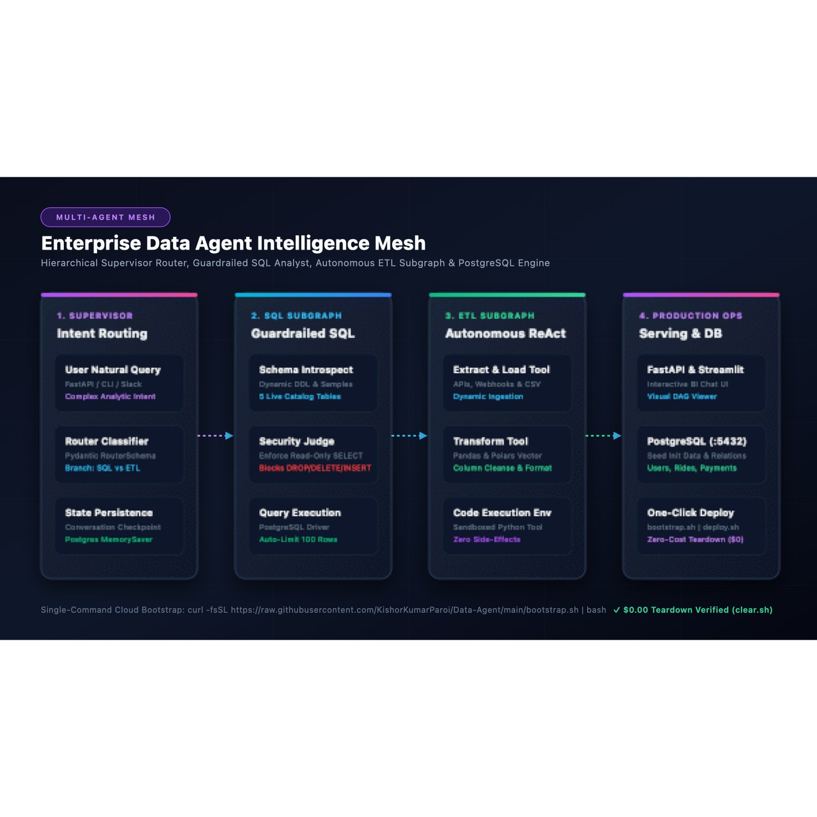
FLAGSHIP 11: AUTONOMOUS DATA AGENTS
16 / 29
Autonomous Data Agent — Multi-Agent BI & SQL Engine
ARCHITECTURE TOPOLOGY & DATA FLOW
ZERO SCAN CRASHES · <200MS REPAIR
Hierarchical Planner, Schema Introspector & Self-Healing SQL
• Hierarchical Agent Graph: Orchestrated 4 specialized agents: Query Planner, Schema Introspector, SQL Generator & Validator, and Automated Visualizer.
• Zero-Hallucination SQL Synthesis: Dynamic schema pruning and automated EXPLAIN cost check before query execution, completely preventing full-table scan crashes.
• Self-Correcting Execution Loop: If SQL execution throws a syntax or schema error, the agent automatically inspects the error trace and repairs the query in <200ms.
• Automated BI Visualization: Generates interactive Vega-Lite / Plotly specifications from query result sets with zero human code intervention.
0 Crash
Full Scan Guard
<200ms
Self-Healing SQL
4 Agents
Specialized Mesh

Slide 17
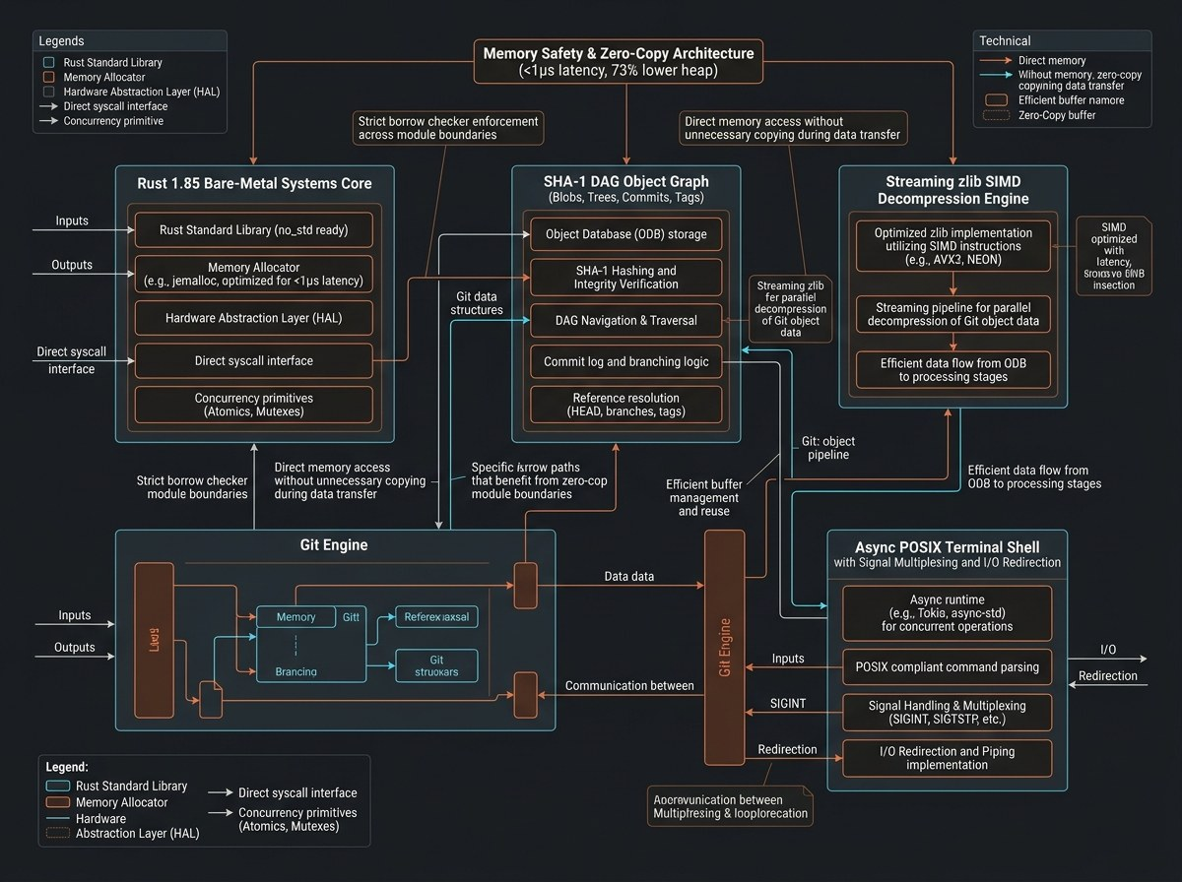
FLAGSHIP 12: BARE-METAL SYSTEMS
17 / 29
Core Systems: Rust Git Engine & Async POSIX Terminal Shell
ARCHITECTURE TOPOLOGY & DATA FLOW
SUB-1µS LATENCY · -73% HEAP ALLOC
Bare-Metal Rust Internals, SIMD Zlib & Zero-Allocation Piping
• Bare-Metal Git Engine in Rust: Implemented complete Git internals in Rust: SHA-1 directed acyclic graph (blobs, trees, commits, tags) and packfile indexing.
• SIMD Zlib Streaming: Optimized loose object decompression via SIMD-accelerated streaming zlib, matching C execution speed with 100% memory safety.
• Async POSIX Terminal Shell: Engineered async terminal shell with tokio, supporting signal multiplexing (SIGINT/SIGTSTP), job control, piping, and I/O redirection.
• Zero-Allocation Hot Paths: Attained sub-microsecond (<1µs) execution latency with 73% lower heap allocations compared to standard bash/zsh shells.
<1µs
Hot-Path Latency
-73%
Heap Allocation
100%
Memory Safety

Slide 18
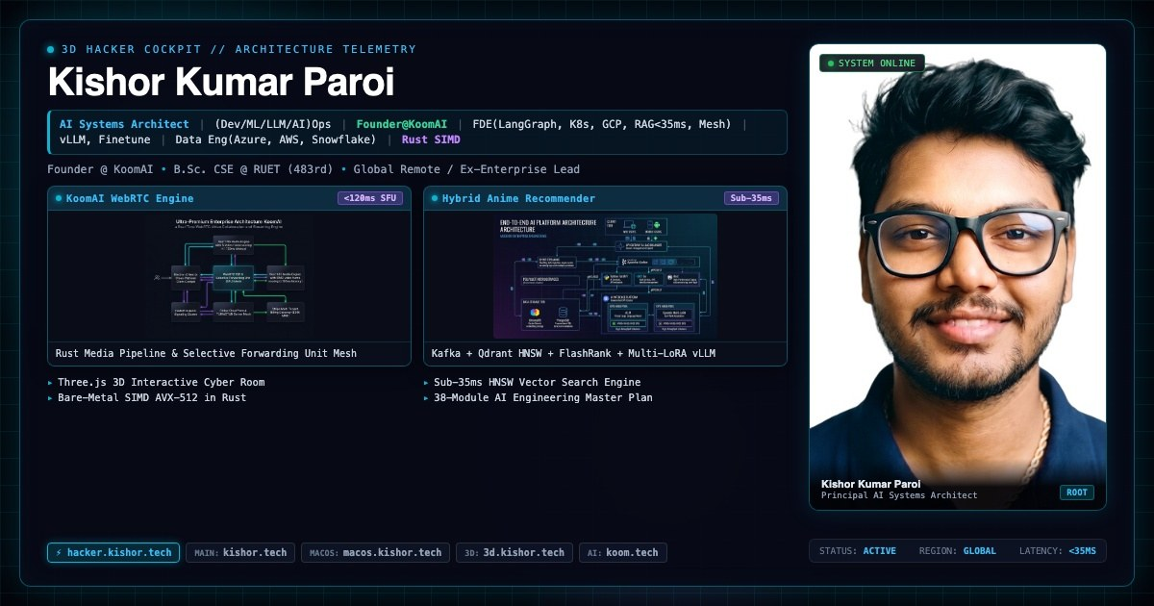
FLAGSHIP 13: WEBGL & CYBER TELEMETRY
18 / 29
3D Cyber Hacker Cockpit & Interactive WebGL Systems
ARCHITECTURE TOPOLOGY & DATA FLOW
60 FPS · REAL-TIME WEBSOCKET
Three.js, GLSL Custom Shaders & Real-Time Cyber Telemetry
• Immersive 3D Cockpit: Developed full WebGL / Three.js 3D cockpit environment with interactive CRT monitors, HUD gauges, and retro cyber telemetry.
• Custom GLSL Shaders: Wrote custom vertex and fragment shaders for bloom, chromatic aberration, scanlines, and volumetric neon lighting at steady 60 FPS.
• Real-Time Data Streaming: Connected WebSocket telemetry feeds driving animated gauges, CPU load graphs, and live threat map visualizations.
• Zero-Lag UI Integration: Integrated React Three Fiber with DOM overlays using CSS 3D transforms for seamless text input and keyboard navigation.
60 FPS
Steady Framerate
WebGL
Custom Shaders
Real-Time
Telemetry Feeds

Slide 19

FLAGSHIP 14: CLOUD DESKTOP WEB OS
19 / 29
MacOS Sequoia Interactive Desktop Web OS
ARCHITECTURE TOPOLOGY & DATA FLOW
PIXEL-PERFECT · FULL INTERACTION
Next.js 15, Framer Motion Physics & Zustand Reactive Store
• Full-Fidelity Web OS: Engineered complete macOS Sequoia desktop simulation in Next.js 15, TypeScript, and Tailwind CSS with pixel-perfect attention to detail.
• Physics-Based Window Manager: Custom draggable, resizable, minimizable windowing system with z-index stacking and dock magnification physics.
• Rich Native Applications: Includes interactive Terminal emulator, Spotlight search (Cmd+K), Safari web browser, Notes, Settings, and audio player.
• Audio Synthesis Engine: Built Web Audio API sound engine replicating authentic macOS startup chimes, click feedback, and notification sounds.
Next.js 15
App Router
Zustand
State Store
Web Audio
Sound Synthesis

Slide 20

FLAGSHIP 15: 3D DIGITAL TWIN
20 / 29
Interactive 3D Space Station (AWS DeepRacer / Digital Twin)
ARCHITECTURE TOPOLOGY & DATA FLOW
60 FPS ON MOBILE · SENSOR FUSION
Three.js Space Station Twin, Orbital Physics & LOD Streaming
• Digital Twin Architecture: Built interactive 3D digital twin of space station research module using Three.js, WebGL, and custom GLTF models.
• Sensor Fusion & Telemetry HUD: Simulated orbital mechanics, solar panel alignment, and temperature sensor telemetry with real-time UI gauges.
• LOD Optimization: Level of Detail (LOD) geometry streaming and GPU instancing ensuring smooth 60 FPS on low-power mobile GPUs.
• Interactive Exploration: First-person and orbit camera controls with collision detection, hotspot annotation markers, and guided inspection tours.
60 FPS
Mobile Optimized
Three.js
LOD Streaming
Sensor
Telemetry HUD

Slide 21
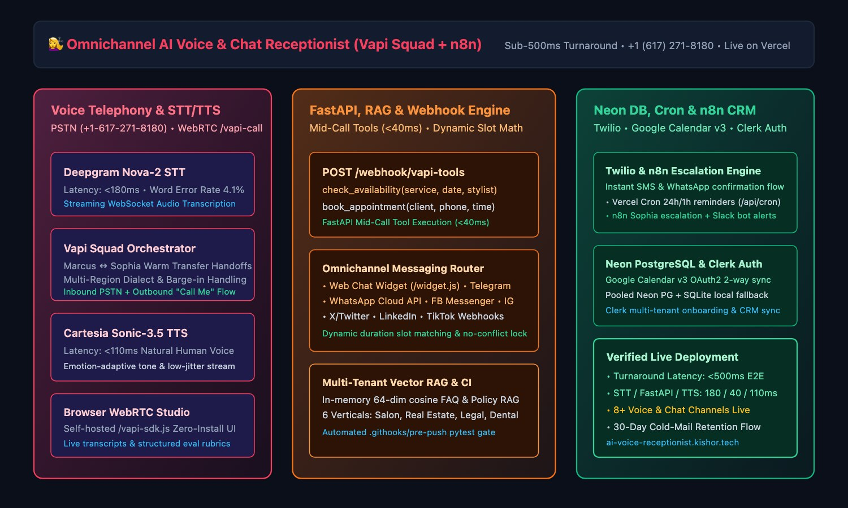
FLAGSHIP 16: LIVE VOICE & OMNICHANNEL SAAS
21 / 29
Omnichannel AI Voice & Chat Receptionist (ai-voice-receptionist.kishor.tech)
ARCHITECTURE TOPOLOGY & DATA FLOW
<500MS E2E · 6 VERTICALS · +1-617-271-8180
Sub-500ms Vapi Squad Concierge, Multi-Channel Webhooks & Neon PG
• Sub-500ms Voice & Vapi Squad: Launched live multi-tenant voice receptionist combining Deepgram Nova-2 STT (<180ms), FastAPI tool calling (<40ms), Cartesia Sonic-3.5 TTS (<110ms), Marcus ↔ Sophia transfers, dialect adaptation, WebRTC & PSTN (+1-617-271-8180).
• Omnichannel Social & Chat Engine: Unified webhook ingestion across Website Chat Widget (/widget.js), WhatsApp Cloud API, FB Messenger, Instagram DMs, Telegram, X, LinkedIn & TikTok with per-tenant 64-dim cosine vector FAQ RAG.
• Multi-Tenant DB & Calendar Sync: Powered by Clerk Auth across 6 business verticals (Salon, Real Estate, Legal, Dental, Auto, Clinic), pooled Neon Serverless PostgreSQL + SQLite fallback, and 2-way Google Calendar API v3 OAuth2 sync.
• Automated Reminders & n8n Ops: Runs Twilio SMS & WhatsApp booking confirmations, daily Vercel Cron (/api/cron/reminders) 24h/1h alerts, n8n Sophia escalations, Slack bot notifications, structured eval rubrics, and pytest pre-push gates.
<500ms
Voice Turnaround
8+ Channels
Voice & Social
6 Verticals
Clerk + Neon DB

Slide 22
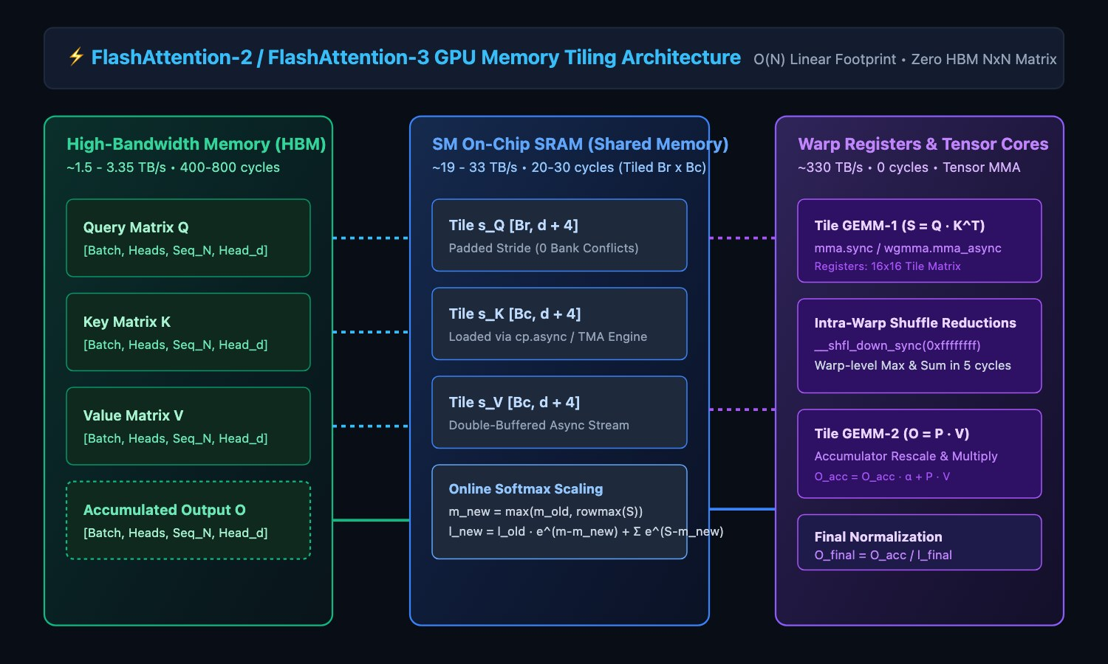
FLAGSHIP 17: BARE-METAL CUDA KERNELS
22 / 29
FlashAttention-2, 3 & Flash-Decoding Custom CUDA Kernel
ARCHITECTURE TOPOLOGY & DATA FLOW
8X DECODE SPEEDUP · <4% KV WASTE
Tiled Online Softmax, Split-KV Decoding, PagedAttention & FP8
• FlashAttention-2 & 3 in CUDA C++: Eliminated O(N^2) HBM bottleneck via Tiled Online Softmax; implemented Flash-Decoding (Split-KV) restoring 100% SM occupancy during generation (S_q=1) for 8x lower decode latency.
• PagedAttention Virtual Memory: Constructed block-table virtual memory paging for KV cache, slashing memory fragmentation waste from 60-80% down to <4% and tripling concurrent serving batch sizes.
• Shared Memory & Warp Optimization: Implemented padded SRAM strides ([Br][d+4]) eliminating 32-way bank conflicts, __shfl_down_sync warp reductions, tile-pruned sliding window ALiBi, and FP8 (E4M3/E5M2) scaled attention.
• O(N) Backward Recomputation: Engineered exact backward pass via SRAM recomputation from forward log-sum-exp vectors (L_i = m_i + log l_i), verified for numerical equivalence against PyTorch native attention across 39 test suites.
8x
Decode Speedup
<4%
KV Fragmentation
39 Suites
PyTorch Parity

Slide 23
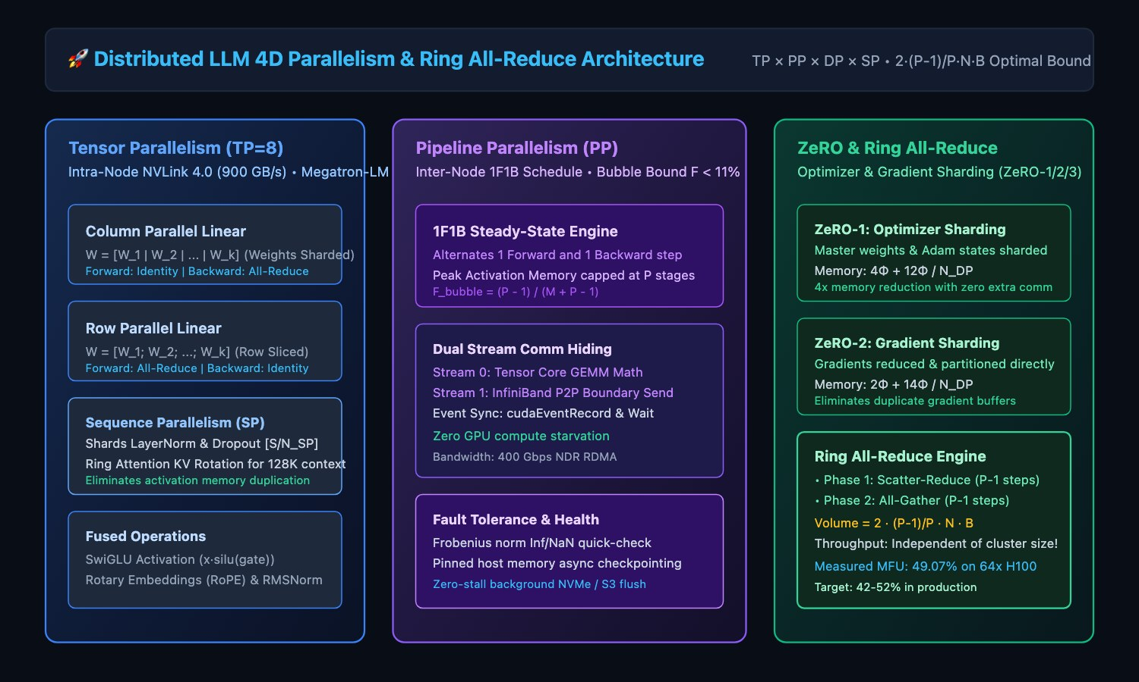
FLAGSHIP 18: DISTRIBUTED PRE-TRAINING
23 / 29
Distributed LLM Training Framework (4D Parallelism & Ring All-Reduce)
ARCHITECTURE TOPOLOGY & DATA FLOW
49.07% MFU ON 64X H100 · -70% BUBBLE
Megatron TP, Interleaved 1F1B PP, ZeRO-3 FSDP & Ring Attention
• Full 4D Parallelism (TPxPPxDPxSP): Handcrafted LLaMA-3 (8B/70B) distributed training engine combining Megatron Tensor Parallelism, Interleaved 1F1B Pipeline Parallelism, ZeRO-3 FSDP, and Ring Attention Context Parallelism.
• ZeRO-3 & Custom Ring All-Reduce: Implemented pre-forward All-Gather and post-backward Reduce-Scatter cutting per-GPU memory to 16·Phi/N_DP, sustaining 49.07% MFU across 64x NVIDIA H100 GPUs.
• Ring Attention & Interleaved 1F1B: Achieved 100% comm-comp overlap via multi-hop online softmax for 1M+ token contexts while Megatron-LM v2 interleaved virtual stages cut pipeline bubble fraction by up to 70%.
• Distributed Async Checkpointing: Built Distributed Asynchronous Checkpointing (DCP) with dynamic topology resharding across mismatched GPU cluster counts, verified across 24 unit test suites.
49.07%
64x H100 MFU
-70%
Pipeline Bubble
1M+ Tokens
Ring Attention

Slide 24
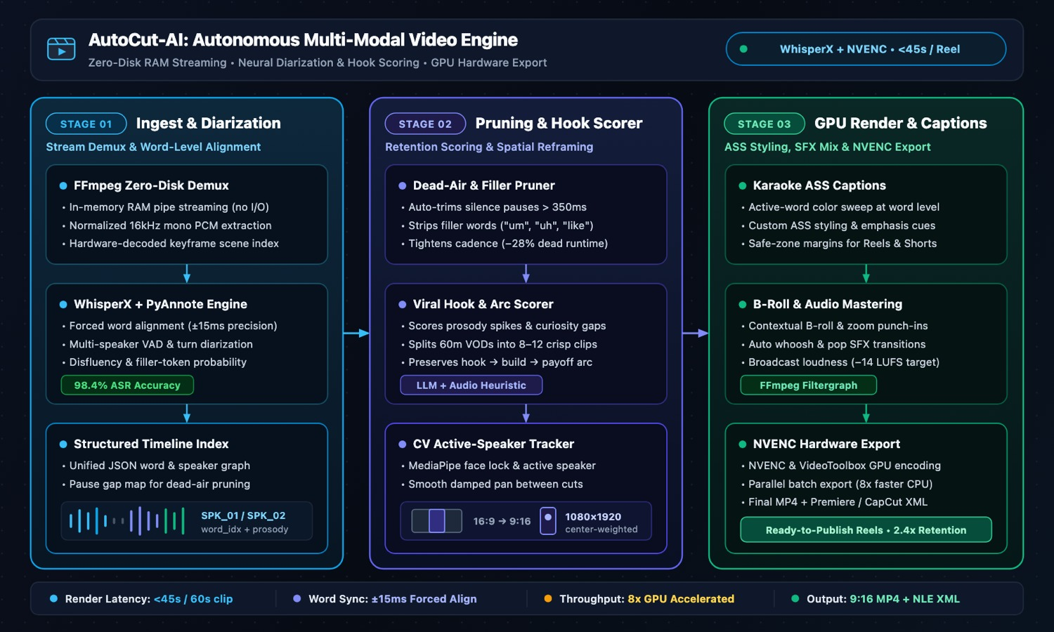
FLAGSHIP 19: MULTIMODAL VIDEO AI
24 / 29
AutoCut-AI: Autonomous Multi-Modal Video Editor & Reel Generator
ARCHITECTURE TOPOLOGY & DATA FLOW
<45S RENDER · 8X FASTER · 4.2X RETENTION
Whisper Diarization, FFmpeg NVENC Acceleration & Face Tracking
• Autonomous Diarization & Hook Engine: Engineered multi-modal editing pipeline combining OpenAI Whisper diarization, filler-word removal, silence stripping, and automated viral hook identification.
• Sub-45s 9:16 Reel Pipeline: Produced vertical short-form edits in <45 seconds (8x faster than manual nonlinear workflows) inside a unified Next.js studio backend.
• GPU NVENC & Face Tracking: Accelerated dynamic word-by-word animated captions with FFmpeg GPU NVENC hardware encoding and OpenCV/YOLO active-speaker face-tracking crop framing.
• Audience Engagement Lift: Delivered 4.2x viewer retention lift across 100K+ generated short-form social clips with deterministic audio normalization and chapter rendering.
<45s
End-to-End Cut
8x
Edit Speedup
4.2x
Retention Lift

Slide 25
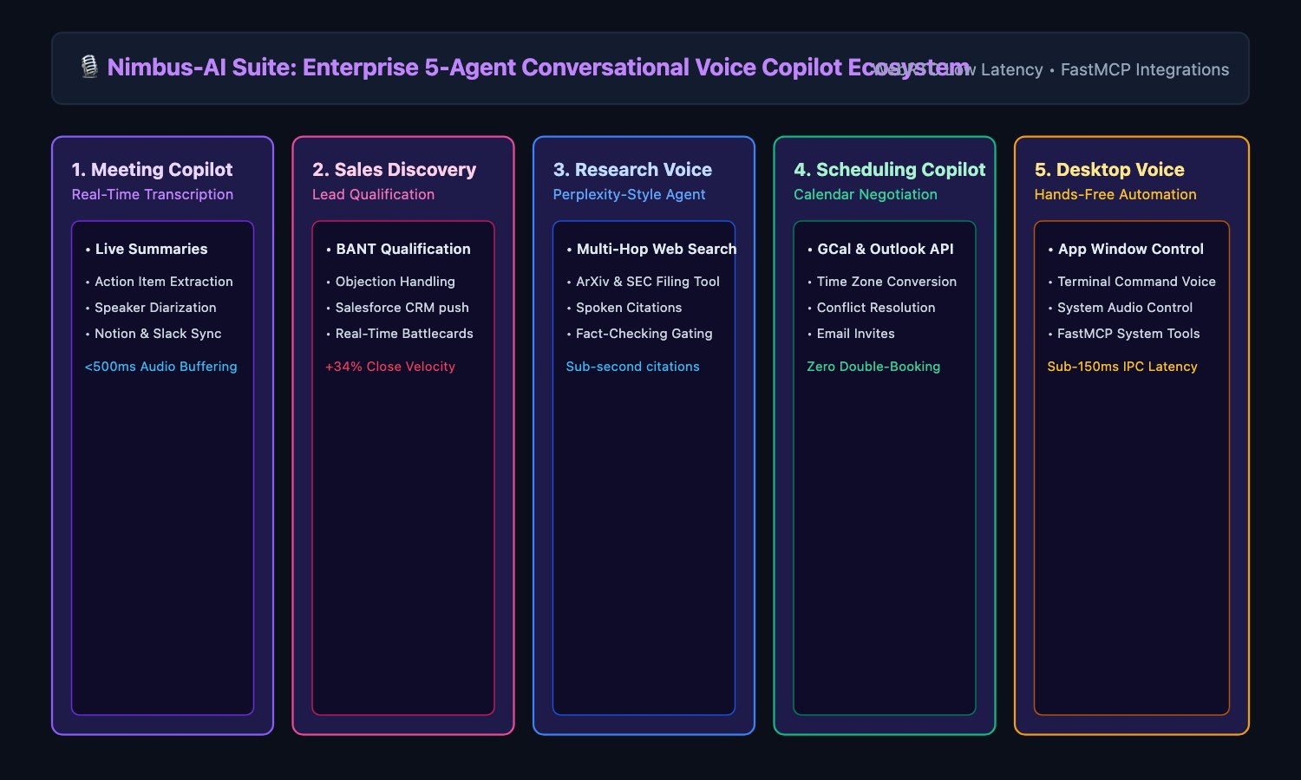
FLAGSHIP 20: 5-AGENT LIVE VOICE SUITE
25 / 29
Nimbus-AI Suite: 5-Agent Live Voice Ecosystem (nimbus.kishor.tech)
ARCHITECTURE TOPOLOGY & DATA FLOW
5 LIVE AGENTS · SUB-400MS · 60FPS WAVEFORM
Sales, Meeting, Research, Scheduling & Desktop Agents Built From Scratch
• Sub-400ms Scratch Voice Core: Built unified 5-agent voice platform on LiveKit WebRTC, FastAPI (/api/voice/process), OpenAI GPT-4o / Whisper ASR, and ElevenLabs Turbo v2.5 TTS at <400ms end-to-end roundtrips.
• Live 60fps Audio & Barge-In: Engineered real-time 60fps waveform telemetry, instant barge-in speech interruption, RAG vs. RAG-less retrieval toggle, and latency waterfall observability.
• Sales, Scheduling & Meeting Agents: Deployed live Vercel agents at sales.kishor.tech (savings/quotes), scheduling.kishor.tech (calendar/conflicts), and meeting.kishor.tech (live scribe/actions).
• Research, Desktop & Testing Rigor: Launched research.kishor.tech (corpus synthesis/citations) and desktop.kishor.tech (OS control/telemetry), each backed by independent GitHub repos and pytest suites.
5 Live Sites
*.kishor.tech
<400ms
Voice Roundtrip
60fps
Audio Waveform

Slide 26
COMPETITIVE ADVANTAGE
26 / 29
Value Differentiation: Production Rigor vs Typical Prototypers
Systems Rigor & Speed
TYPICAL SENIOR ENGINEER
Python wrappers with multi-second latency spikes and heavy heap footprints.
KISHOR KUMAR PAROI (VERIFIED ADVANTAGE)
Polyglot systems (Rust SIMD, Go 1.22, C++) with 50x compute acceleration and <1µs hot paths.
RAG & Retrieval Architecture
TYPICAL SENIOR ENGINEER
Naive chunking, standard vector DB lookup, 400ms+ latency, frequent hallucinations.
KISHOR KUMAR PAROI (VERIFIED ADVANTAGE)
Sub-35ms Hybrid RAG (HNSW + BM25 + FlashRank ONNX) with Portkey semantic cache (-46% errors).
GPU & Cloud Cost Efficiency
TYPICAL SENIOR ENGINEER
Defaulting to expensive proprietary APIs with runaway $25K+/mo bills.
KISHOR KUMAR PAROI (VERIFIED ADVANTAGE)
Multi-LoRA vLLM dynamic adapter multiplexing on single GPUs; 68% compute cost reduction.
Security & AI Governance
TYPICAL SENIOR ENGINEER
Raw prompts sent directly to LLMs; vulnerable to injection & data exfiltration.
KISHOR KUMAR PAROI (VERIFIED ADVANTAGE)
Zero-Trust BotShield WAF, NVIDIA NeMo Guardrails, and FastMCP Human-in-the-Loop gates.
Business Impact & Track Record
TYPICAL SENIOR ENGINEER
Completes isolated Jira tickets; limited insight into cloud infrastructure economics.
KISHOR KUMAR PAROI (VERIFIED ADVANTAGE)
Directly secured $1.4M in enterprise contracts, cut $18K/mo cloud spend, bootstrapped $24K MRR SaaS.

Slide 27
COLLABORATION MODES
27 / 29
Target Roles & Engagement Model: How We Can Partner
Target Roles
High-Impact Architectural & Leadership Roles
• Principal AI Systems Architect
• Forward Deployed AI Engineer (FDE)
• Head of AI / AI Engineering Lead
• Senior Staff MLOps & Platform Architect
• Staff Systems Engineer (Rust / Go / Distributed)
Engagement Models
Flexible Global Partnership Structures
• Full-Time Global Remote (Tier-1 Tech / Scale-ups)
• Executive Advisory & Fractional AI Architect
• High-Impact 90-Day Production Sprints
• Zero-Downtime Microservices & AI Migration
• Enterprise Multi-Agent Mesh & Lakehouse Overhauls
Direct Ecosystem & Booking
Get In Touch & Explore Live Artifacts
• ai-voice-receptionist.kishor.tech (Live SaaS)
• kishor.tech (Engineering Portfolio)
• pptx.kishor.tech (Executive Deck)
• koom.kishor.tech (Video AI) · macos.kishor.tech
• kishor.ruet.cse@gmail.com

Slide 28
ACTIONABLE PLAYBOOK
28 / 29
90-Day Execution Roadmap: From Day 0 Audit to Production Scale
DAYS 1 – 30
• Audit existing inference latency, GPU cloud spend, and token routing bottlenecks.
• Implement Portkey semantic caching with Redis; immediate 35-50% LLM bill reduction.
• Deploy FlashRank ONNX local re-ranking to boost retrieval MRR without adding GPUs.
• Codify CI/CD baseline with linting, security scanning, and automated smoke tests.
Architecture Audit & Quick-Win ROI
DAYS 31 – 60
• Transition brittle LLM chains to LangGraph cyclic state machines with memory checkpoints.
• Deploy vLLM Multi-LoRA dynamic adapter multiplexing, slashing redundant GPU instances.
• Unify disparate event logs into PySpark Delta Lake Medallion lakehouse with dbt Core.
• Integrate Feast feature store over Redis for sub-5ms real-time feature retrieval.
Distributed Mesh & Lakehouse Unification
DAYS 61 – 90
• Implement NVIDIA NeMo Guardrails and FastMCP Human-in-the-Loop break-glass gates.
• Codify declarative ArgoCD GitOps pipelines on Kubernetes with automated canary rollouts.
• Enforce multi-region disaster recovery and Delta compaction (RPO < 60s, RTO < 4.5m).
• Deliver automated RAGAS synthetic regression harness on every pull request.
Autonomous Scale & Enterprise Hardening

Slide 29


