Slide 1
Advanced Gold Price Forecasting System
By Guided by
Kishore A (312422205002) Dr. Mahalakshmi G
Joseph Sundar Marshal F V (312423205092) Assistant Professor
Date:15/05/2026

Slide 2
Abstract
Gold is a reliable investment asset, but forecasting its price is challenging due to market volatility and complex time-series patterns.
This project proposes an advanced gold price forecasting system using an ensemble of Chronos-T5 and N-HiTS models to improve prediction accuracy and stability across multiple horizons, including next-day, next-week, and next-month forecasts.
The system integrates data ingestion, preprocessing, feature engineering, model evaluation, and visualization into a complete end-to-end pipeline.
SQLite is used for cost-effective local storage, and a Streamlit dashboard provides interactive forecasting and analysis for investors.

Slide 3
Objective
The objective of this project is to develop an investor-focused gold price forecasting system capable of predicting gold prices across multiple future horizons such as next day, next week, and next month with improved accuracy and stability.
The project uses advanced time-series forecasting models, namely Chronos-T5 and N-HiTS, combined through an ensemble approach to overcome the limitations of traditional machine learning models.
It also aims to provide an interactive and production-ready dashboard for visualization, analysis, and decision-making using automated data pipelines and real-time forecasting techniques.

Slide 4
Problem Statement
Volatile, multi-driver market: Gold prices react to currency moves, geopolitics, inflation, and demand–supply shifts, making simple heuristics unreliable.
Retail access gap: Advanced, data-driven forecasting is mostly institutional; individual investors lack affordable, user-friendly tools.
Weak traditional models: ARIMA and standalone LSTM often overfit, struggle with regime changes, and need heavy manual feature engineering.
Single-horizon focus: Most tools target short-term only, leaving medium/long-term (weeks to years) planning unsupported.
Not investor-ready: Outputs are statistical, not actionable (e.g., no custom weight-based cost estimates or USD→INR conversions).
High deployment cost: Reliable, continuously updating systems usually require expensive cloud infrastructure, blocking small-scale users.

Slide 5
Literature Survey
S.NO | Title, Author, Year | Technique used | Description | Remarks
1 | Chronos: Learning the Language of Time Series — M. Ansari et al., 2024 | Chronos-T5 Foundation Model | Introduced a pretrained transformer-based foundation model for accurate multi-horizon time-series forecasting. | Highly scalable and inspired the forecasting architecture used in this project.
2 | N-HiTS: Neural Hierarchical Interpolation for Time Series Forecasting — C. Challu et al., 2022 | N-HiTS Deep Learning Model | Proposed a hierarchical interpolation-based deep forecasting architecture for long-term time-series prediction. | Provides strong performance for trend and seasonality forecasting.

Slide 6
S.NO | Title, Author, Year | Technique used | Description | Remarks
3 | Forecasting: Principles and Practice — R. J. Hyndman & G. Athanasopoulos, 2021 | Statistical Forecasting | Explained core forecasting principles, evaluation metrics, and forecasting methodologies. | Widely used foundational reference for time-series analysis.
4 | Forecasting with Artificial Neural Networks: The State of the Art — G. Zhang et al., 2003 | Artificial Neural Networks (ANN) | Reviewed the application of ANN models in forecasting and compared them with statistical approaches. | Demonstrated the potential of neural networks in prediction tasks.

Slide 7
S.NO | Title, Author, Year | Technique used | Description | Remarks
5 | Long Short-Term Memory — S. Hochreiter & J. Schmidhuber, 1997 | LSTM Neural Network | Introduced LSTM architecture to solve long-term dependency issues in sequential data. | Became a foundational model for deep time-series forecasting.
6 | Conditional Time Series Forecasting with Convolutional Neural Networks — A. Borovykh et al., 2017 | CNN-based Forecasting | Applied convolutional neural networks for conditional time-series forecasting tasks. | Showed CNN effectiveness in financial and sequential forecasting.

Slide 8
S.NO | Title, Author, Year | Technique used | Description | Remarks
7 | Horses for Courses in Demand Forecasting — F. Petropoulos et al., 2014 | Comparative Forecasting Methods | Compared multiple forecasting methods across different forecasting scenarios. | Highlighted that no single model performs best in all situations.
8 | Statistical and Machine Learning Forecasting Methods: Concerns and Ways Forward — S. Makridakis et al., 2018 | Statistical & ML Forecasting | Discussed challenges and limitations of machine learning forecasting methods. | Motivated the use of advanced hybrid and ensemble approaches.

Slide 9
S.NO | Title, Author, Year | Technique used | Description | Remarks
9 | Deep Learning with Long Short-Term Memory Networks for Financial Market Predictions — T. Fischer & C. Krauss, 2018 | LSTM for Financial Forecasting | Applied LSTM models for stock and financial market prediction tasks. | Demonstrated deep learning effectiveness in financial forecasting.
10 | Deep Learning-Based Financial Time Series Forecasting: A Survey — Y. Zhang et al., 2021 | Deep Learning Survey | Surveyed deep learning techniques for financial time-series forecasting applications. | Provided insights into modern forecasting architectures and trends.

Slide 10
Existing System
Current gold price prediction primarily uses traditional statistical methods and elementary machine learning models, such as moving averages and ARIMA, which assume linear and stationary market behavior due to their simplicity and interpretability.
These legacy approaches suffer from significant limitations, including manual and repetitive data gathering, non-automated model retraining, and a high risk of human error, consuming valuable time and resources.
Furthermore, these methods are generally limited to short-term forecasts, perform poorly in volatile markets, lack robustness against unexpected events, and are unsuitable for handling increasing data volumes or providing meaningful visualization and decision support.

Slide 11
Drawbacks
Traditional methods suffer from significant accuracy drops during volatile periods and are incapable of detecting intricate, non-linear, or long-range dependencies in market data.
Their forecast horizons are typically limited, offering little value for medium- or long-term planning.
These approaches require frequent manual intervention for updates and retraining, making them labor-intensive, costly to maintain, and lacking in automation, with rudimentary or non-existent visualization and decision-making tools.

Slide 12
Proposed System
This proposed system is a cutting-edge solution that harnesses the power of deep learning ensemble models for gold price prediction, fundamentally rethinking the forecasting workflow to surpass legacy approaches.
It employs a hybrid ensemble of Chronos-T5 and N-HiTS, state-of-the-art models designed for time-series analysis, combining their strengths to produce accurate and robust forecasts across various market conditions.
Automation is central to the system, autonomously retrieving data, performing feature engineering, storing processed data in SQLite, and presenting seamlessly integrated forecasts via an interactive Streamlit dashboard for visualization and customization.

Slide 13
Algorithms Used
Chronos-T5: A transformer-based foundation model for time-series forecasting, it learns complex temporal patterns from sequential data, capturing short-term market movements and supporting multi-horizon forecasting with minimal feature engineering.
N-HiTS (Neural Hierarchical Interpolation for Time Series Forecasting): A deep learning architecture designed for long-term time-series prediction, it uses hierarchical interpolation to model trends, seasonality, and temporal dependencies efficiently, providing stable and accurate forecasts for medium- and long-term horizons.
Ensemble Forecasting: This method combines predictions from Chronos-T5 and N-HiTS using weighted averaging, which reduces prediction variance, improves overall forecasting

Slide 14
Working mechanism
INPUT:
Historical gold price dataset
Exchange rate data
Financial indicators
OUTPUT:
Forecasted gold prices
BEGIN
1. LOAD dataset
2. PREPROCESS dataset
HANDLE missing values
SORT by date
SCALE numerical features
3. PERFORM feature engineering
COMPUTE SMA
COMPUTE EMA
COMPUTE RSI
COMPUTE MACD
4. SPLIT data into train and test sets
5. TRAIN Chronos-T5 model
FIT model on training sequence
6. TRAIN N-HiTS model
FIT model on training sequence
7. GENERATE forecasts
P1 ← Chronos prediction
P2 ← N-HiTS prediction
8. COMPUTE ensemble prediction
Final_Prediction =
(W1 × P1) + (W2 × P2)
9. EVALUATE performance
CALCULATE MAE
CALCULATE RMSE
CALCULATE MAPE
10. STORE predictions in SQLite
11. VISUALIZE predictions using Streamlit dashboard
END

Slide 15
Advantages
Significantly improved forecast accuracy, especially during volatile and unpredictable market periods, due to the synergistic power of ensemble deep learning.
Ability to generate reliable predictions across both short-term and long-term horizons, meeting the diverse needs of different investor profiles.
Automation permeates the entire workflow, from data acquisition to model retraining and prediction generation, freeing users from time-consuming manual tasks.
The platform is built entirely on open-source technologies, resulting in zero licensing or operational costs and fostering community-driven enhancements.
The use of SQLite ensures that the underlying database remains lightweight, fast, and capable of scaling with growing datasets without compromising performance, complemented by an intuitive and visually engaging dashboard for easy interpretation and informed actions.

Slide 16
System Requirements
Hardware Requirement
Computational Resources: Requires an Intel i5 processor or higher, a minimum of 8 GB RAM for model training and data processing, and at least 10 GB of free disk space for historical data and model artifacts.
Internet Connectivity: An internet connection is necessary for automated retrieval of up-to-date gold price data and potential model updates.
Software Requirement
Operating Environment: The system is compatible with Windows and Linux, developed in Python 3.10 or later, and utilizes SQLite for efficient data storage.
Key Libraries: It leverages NumPy and Pandas for data manipulation, PyTorch for deep learning models, and Streamlit with Plotly for interactive dashboards and visualizations.

Slide 17
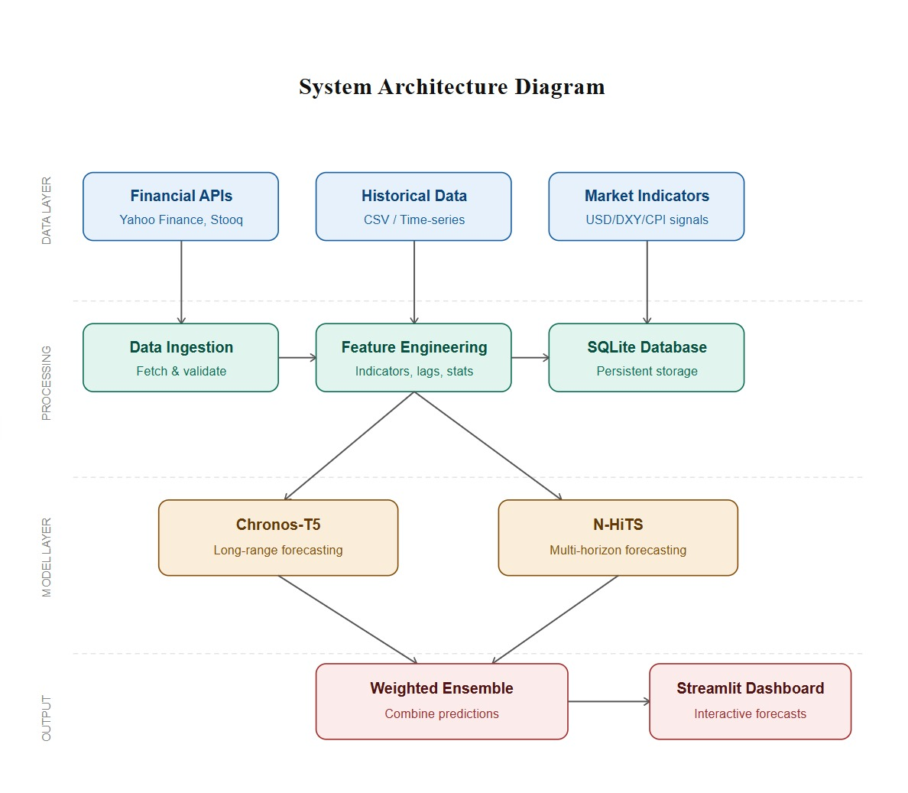
System Architecture
Data Collection & Processing: Historical gold prices and financial indicators are collected from various sources, then cleaned, transformed, and enhanced with technical indicators using Pandas.
Database Management: Processed data and forecasts are stored in SQLite, providing a lightweight and cost-effective local storage solution.
Forecasting Layer: Chronos-T5 and N-HiTS generate independent forecasts, capturing short-term patterns and long-term trends respectively.
Ensemble Prediction: Predictions from Chronos-T5 and N-HiTS are combined using a weighted ensemble approach to enhance forecasting stability and accuracy.
Visualization & Automation: A Streamlit dashboard visualizes forecasts and trends, backed by a Python pipeline automating daily data updates and refreshes.

Slide 18
Modules
Financial Data Acquisition Module
Feature Engineering & Data Processing Module
Chronos-T5 & N-HiTS Forecasting Module
Weighted Ensemble Prediction Module
Streamlit Visualization & Deployment Module

Slide 19
Module Description
1. Data Collection & Ingestion Module:
Collects historical gold price data from financial sources such as Yahoo Finance and LBMA.
Fetches supporting financial indicators like USD Index and exchange rates.
Stores raw data in SQLite database for further processing.
Ensures updated and continuous data availability for forecasting.
Forms the foundation of the entire forecasting pipeline.

Slide 20
Module Description
2. Data Preprocessing & Feature Engineering Module:
Cleans and formats collected time-series data.
Handles missing values and date alignment issues.
Generates technical indicators such as SMA, EMA, RSI, and MACD.
Converts raw market data into model-ready features.
Improves forecasting quality and model performance.

Slide 21
Module Description
3. Forecasting Model Development Module:
Uses Chronos-T5 for short-term pattern forecasting.
Uses N-HiTS for long-term trend and seasonality learning.
Trains and evaluates deep learning forecasting models.
Supports multi-horizon forecasting for day, week, and month predictions.
Produces future gold price forecasts using historical trends.

Slide 22
Module Description
4.Ensemble Prediction System Module:
Combines Chronos-T5 and N-HiTS predictions using weighted averaging.
Reduces prediction variance and improves stability.
Balances short-term and long-term forecasting strengths.
Enhances overall forecasting accuracy compared to individual models.
Generates final investor-focused ensemble predictions.

Slide 23
Module Description
5. Visualization & Dashboard Deployment Module:
Displays historical and forecasted gold prices interactively.
Provides next-day, next-week, and next-month forecast visualization.
Shows forecast statistics such as average price and price range.
Allows CSV export for analysis and reporting purposes.
Deploys the complete system using Streamlit for user interaction.

Slide 24
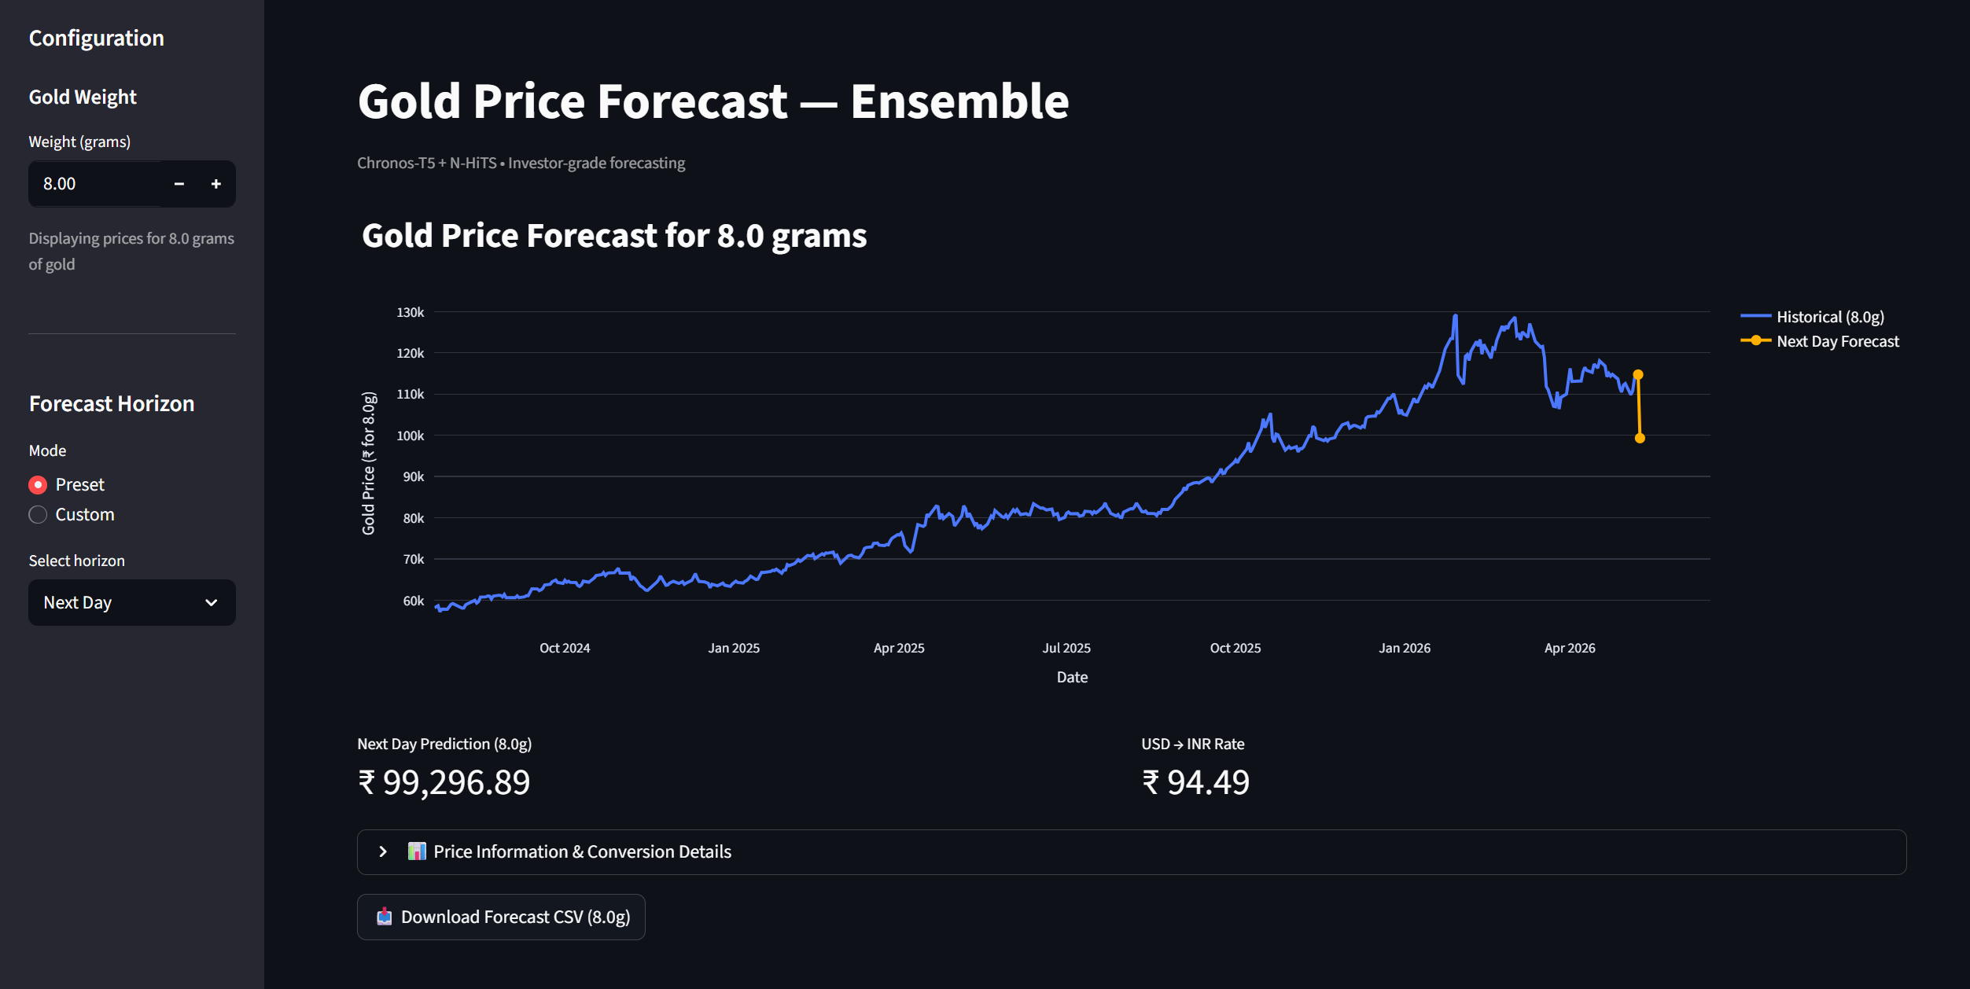
Output Screenshot

Slide 25
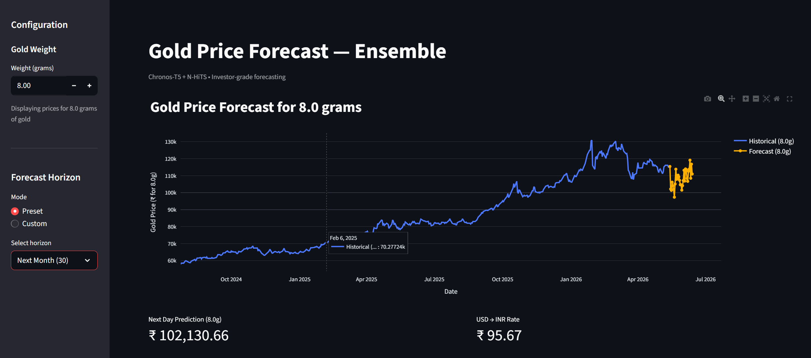
Output Screenshot

Slide 26
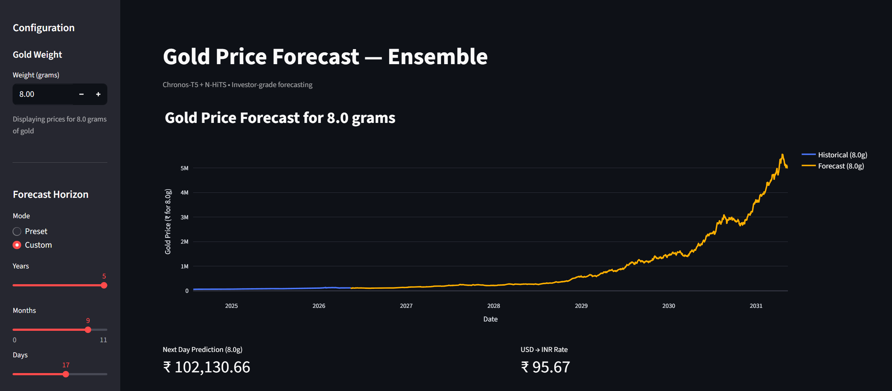
Output Screenshot

Slide 27
Conclusion
Traditional statistical and basic deep learning models struggle to handle the complexity and volatility of financial time-series data effectively.
Modern deep learning models such as Chronos-T5 and N-HiTS provide better forecasting accuracy, scalability, and adaptability for multi-horizon prediction tasks.
Ensemble forecasting approaches improve robustness by reducing individual model bias and handling unpredictable market fluctuations more effectively.
The proposed system combines Chronos-T5 and N-HiTS to leverage both transfer learning capabilities and long-range forecasting performance.
This integrated ensemble framework aims to deliver more accurate, stable, and reliable gold price predictions for investor-focused decision making.

Slide 28
Future Enhancement
Integrate News Sentiment Analysis using NLP/LLMs for market-aware forecasting.
Add Confidence Intervals for uncertainty-aware predictions.
Implement Real-Time Data Streaming for live gold price updates.
Improve Long-Term Forecasting Accuracy using advanced ensemble optimization.
Develop Mobile-Friendly Deployment with alert and notification features.

Slide 29
References
[1] M. Ansari, A. Bansal, K. Dhingra, and S. Singh, “Chronos: Learning the Language of Time Series,” arXiv preprint arXiv:2403.07815, 2024.
[2] C. Challu, K. Olivares, M. T. Januschowski, L. Salinas, and A. Flunkert, “N-HiTS: Neural Hierarchical Interpolation for Time Series Forecasting,” Proceedings of the AAAI Conference on Artificial Intelligence, vol. 36, no. 6, pp. 6989–6997, 2022.
[3] R. J. Hyndman and G. Athanasopoulos, “Forecasting: Principles and Practice,” OTexts, 3rd ed., 2021.
[4] G. Zhang, B. Eddy Patuwo, and M. Y. Hu, “Forecasting with Artificial Neural Networks: The State of the Art,” IEEE Transactions on Neural Networks, vol. 14, no. 1, pp. 35–62, Jan. 2003.
[5] S. Hochreiter and J. Schmidhuber, “Long Short-Term Memory,” Neural Computation, vol. 9, no. 8, pp. 1735–1780, 1997
[6] A. Borovykh, S. Bohte, and C. W. Oosterlee, “Conditional Time Series Forecasting with Convolutional Neural Networks,” IEEE International Conference on Data Mining Workshops (ICDMW), pp. 115–121, 2017.
[7] F. Petropoulos, S. Makridakis, V. Assimakopoulos, and N. Nikolopoulos, “Horses for Courses in Demand Forecasting,” European Journal of Operational Research, vol. 237, no. 1, pp. 152–163, 2014.
[8] S. Makridakis, E. Spiliotis, and V. Assimakopoulos, “Statistical and Machine Learning Forecasting Methods: Concerns and Ways Forward,” PLOS ONE, vol. 13, no. 3, 2018.
[9] T. Fischer and C. Krauss, “Deep Learning with Long Short-Term Memory Networks for Financial Market Predictions,” European Journal of Operational Research, vol. 270, no. 2, pp. 654–669, 2018.
[10] Y. Zhang, Q. Song, and J. Zhang, “Deep Learning-Based Financial Time Series Forecasting: A Survey,” IEEE Access, vol. 9, pp. 59312–59336, 2021.

Slide 30
References
[11] B. N. Oreshkin, D. Carpov, N. Chapados, and Y. Bengio, "N-BEATS: Neural Basis Expansion Analysis for Interpretable Time Series Forecasting," in Proceedings of the 8th International Conference on Learning Representations (ICLR), 2020.
[12] H. Zhou, S. Zhang, J. Peng, S. Zhang, J. Li, H. Xiong, and W. Zhang, "Informer: Beyond Efficient Transformer for Long Sequence Time-Series Forecasting," in Proceedings of the 35th AAAI Conference on Artificial Intelligence (AAAI), vol. 35, pp. 11106–11115, 2021.
[13] H. Wu, J. Xu, J. Wang, and M. Long, "Autoformer: Decomposition Transformers with Auto-Correlation for Long-Term Series Forecasting," in Advances in Neural Information Processing Systems (NeurIPS), vol. 34, 2021.
[14] T. Zhou, Z. Ma, Q. Wen, X. Wang, L. Sun, and R. Jin, "FEDformer: Frequency Enhanced Decomposed Transformer for Long-Term Series Forecasting," in Proceedings of the 39th International Conference on Machine Learning (ICML), 2022.
[15] Y. Nie, N. H. Nguyen, P. Sinthong, and J. Kalagnanam, "A Time Series is Worth 64 Words: Long-term Forecasting with Transformers," in Proceedings of the 11th International Conference on Learning Representations (ICLR), 2023.
[16] A. Zeng, M. Chen, L. Zhang, and Q. Xu, "Are Transformers Effective for Time Series Forecasting?" in Proceedings of the 37th AAAI Conference on Artificial Intelligence (AAAI), vol. 37, no. 9, 2023.
[17] Y. Liu, T. Hu, H. Zhang, H. Wu, S. Wang, L. Ma, and M. Long, "iTransformer: Inverted Transformers Are Effective for Time Series Forecasting," in Proceedings of the 12th International Conference on Learning Representations (ICLR), 2024.
[18] H. Wu, T. Hu, Y. Liu, H. Zhou, J. Wang, and M. Long, "TimesNet: Temporal 2D-Variation Modeling for General Time Series Analysis," in Proceedings of the 11th International Conference on Learning Representations (ICLR), 2023.
[19] D. Salinas, V. Flunkert, J. Gasthaus, and T. Januschowski, "DeepAR: Probabilistic Forecasting with Autoregressive Recurrent Networks," International Journal of Forecasting, vol. 36, no. 3, pp. 1181–1191, 2020.
[20] B. Lim and S. Zohren, "Time-Series Forecasting with Deep Learning: A Survey," Philosophical Transactions of the Royal Society A, vol. 379, no. 2194, 2021.

Slide 31
Thank You!

