Slide 1

CODE MENTOR
INTERACTIVE PROGRAMMING LANGUAGE LEARNER
Malarvannan M (2022503011)
Kalaidharun K (2022503009)

Slide 2

Introduction
IN TODAY’S DIGITAL AGE, CODING HAS BECOME AN INDISPENSABLE SKILL, YET TRADITIONAL LEARNING METHODS OFTEN MAKE THE JOURNEY, CHALLENGING ESPECIALLY FOR BEGINNERS. THE COMPLEXITIES OF SYNTAX, THE DRYNESS OF THEORETICAL LESSONS, AND THE LACK OF IMMEDIATE FEEDBACK CAN BE DISCOURAGING. RECOGNIZING THESE CHALLENGES, WE INTRODUCE THE INTERACTIVE PROGRAMMING LANGUAGE LEARNER (IPLL)

Slide 3


Problem Statement
In the rapidly evolving tech landscape ,learning programming languages effectively and engagingly remains a significant challenge.
Traditional education methods often fall short in providing interactive and practical learning experiences.
The ”Interactive Programming Language Learner” project aims to bridge the gap by creating a dynamic platform that revolutionizes how individuals learn programming languages.

Slide 4


The IPLL platform aims to track and manage various types of user data, such as progress on learning modules, quiz results, badges earned, and daily question engagement. The platform also needs to store a diverse set of programming challenges and associated metadata, including difficulty level, language type, and user interaction records (e.g., attempts, feedback). Traditional SQL-based databases, while effective, may face challenges in scalability and flexibility as the amount and variety of data increase.
Solution for Problem Statement

Slide 5

Requirements
Functional Requirements
Providing Choosing the programming language.
To conduct small quiz
.
Provide daily question
Physical learning materials and equipment
like paper, pens and chalkboard
Provide a interactive session.
To check overall progress
Teach user from basic to advance concept.
To provide Badges

Slide 6

Requirements
Non Functional Requirements
Usability (user friendly interface)
Performance (Fast loading times)
Reliability
Portability.

Slide 7

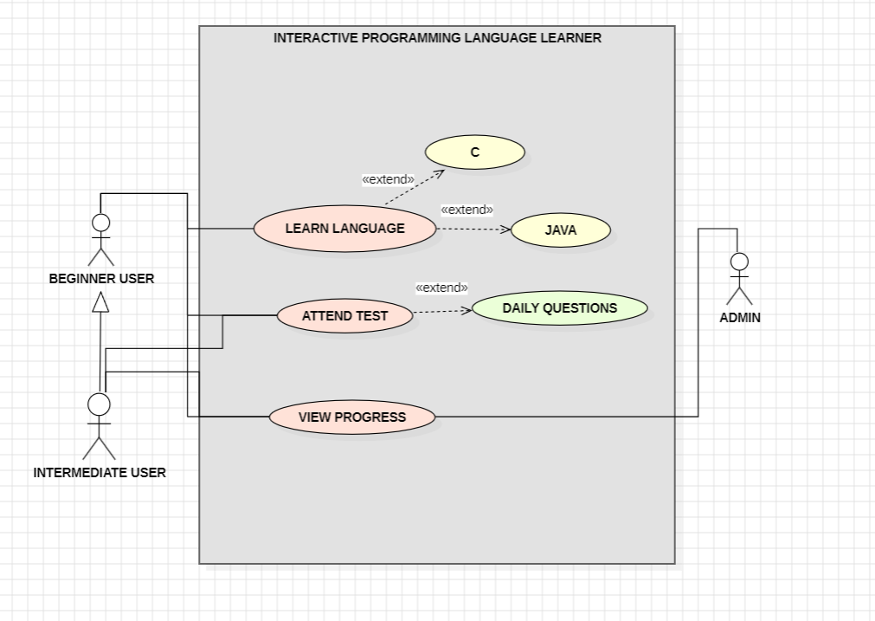
Use Case Diagram

Slide 8
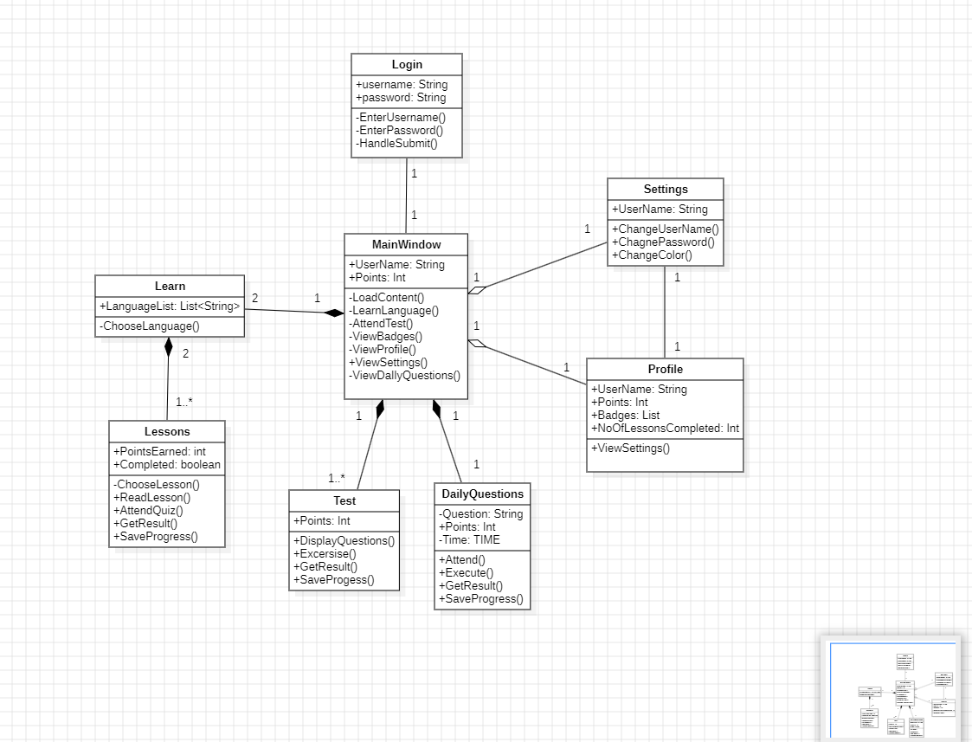
Class Diagram

Slide 9
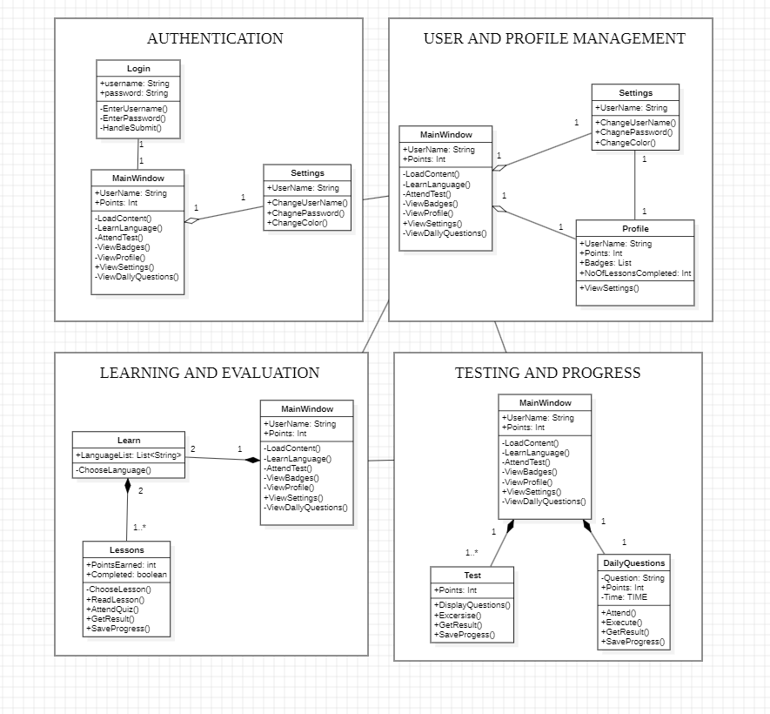
Module Diagram

Slide 10
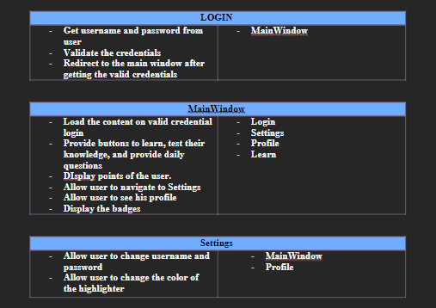
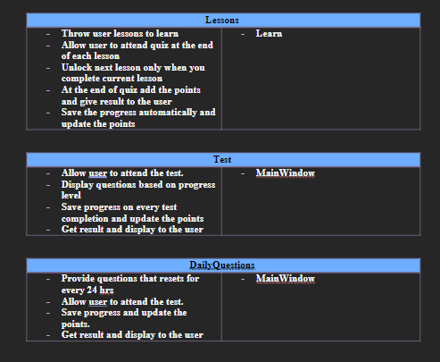
Class Responsibility Collaboration Cards

Slide 11
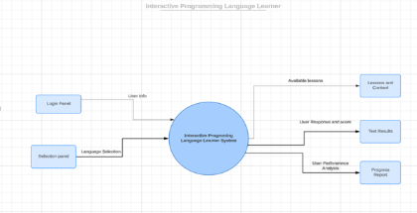
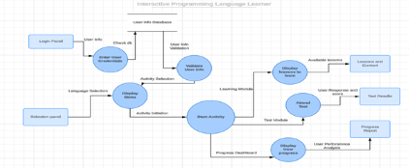
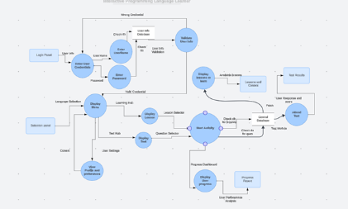
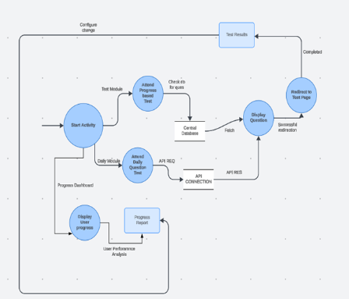
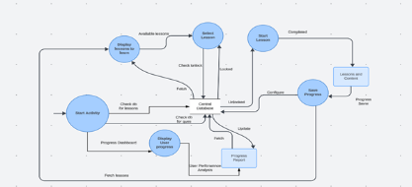
Data Flow Diagram
Level 0
Level 1
Level 2
Level 3
Level 4

Slide 12
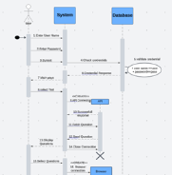
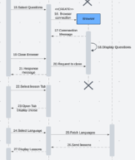
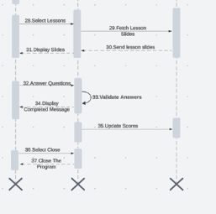
Sequence Diagarm
A
B
C

Slide 13
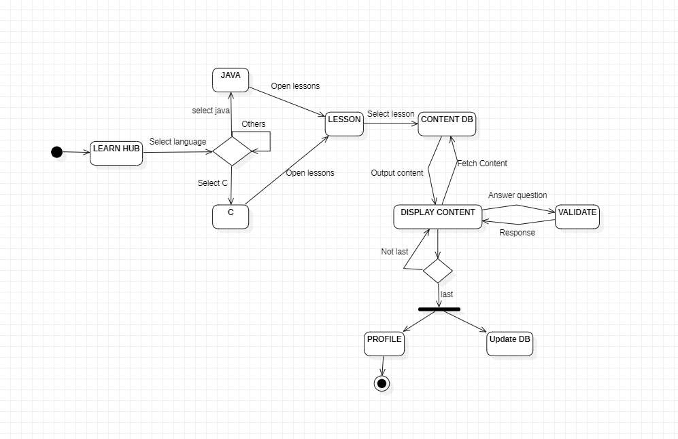
State Machine Diagram

Slide 14



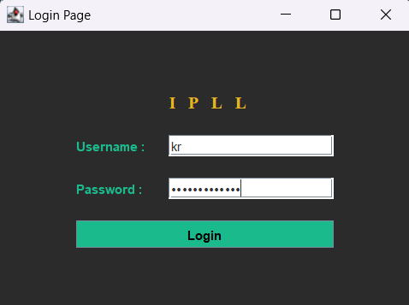
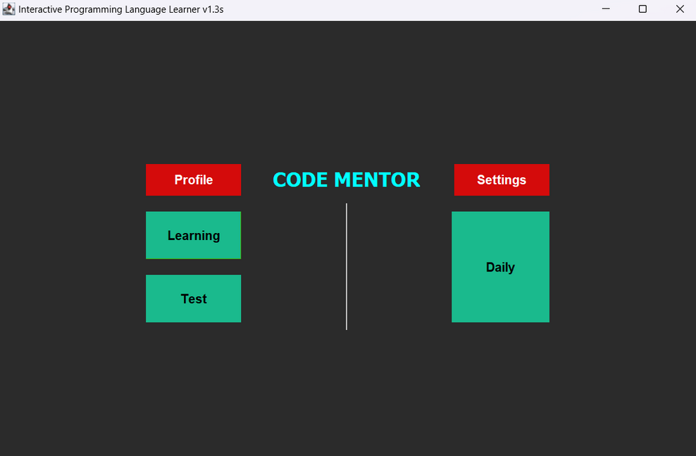
Demonstration
LOGIN PAGE
HOME PAGE

Slide 15


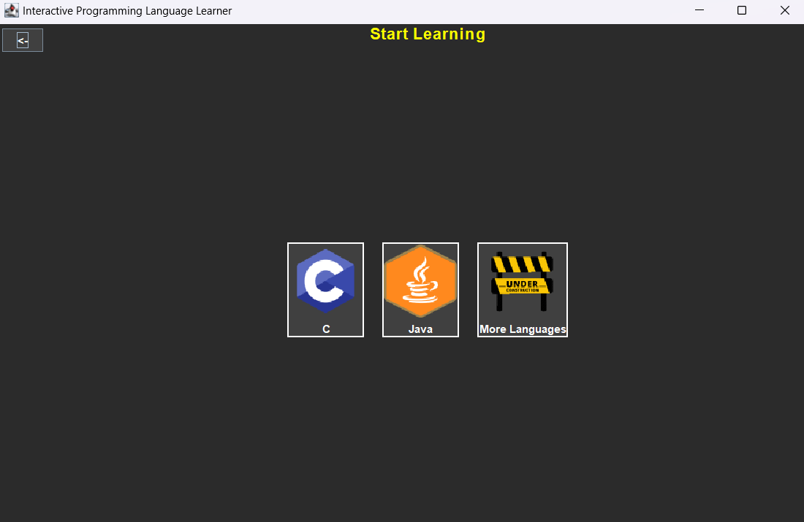
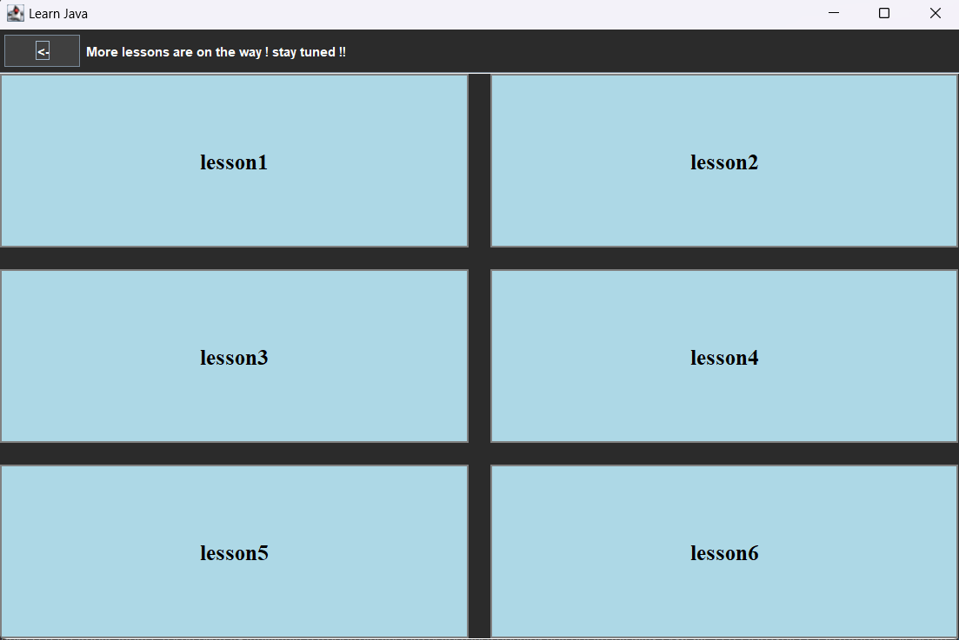
Demonstration
LEARN HUB
LESSONS PAGE

Slide 16


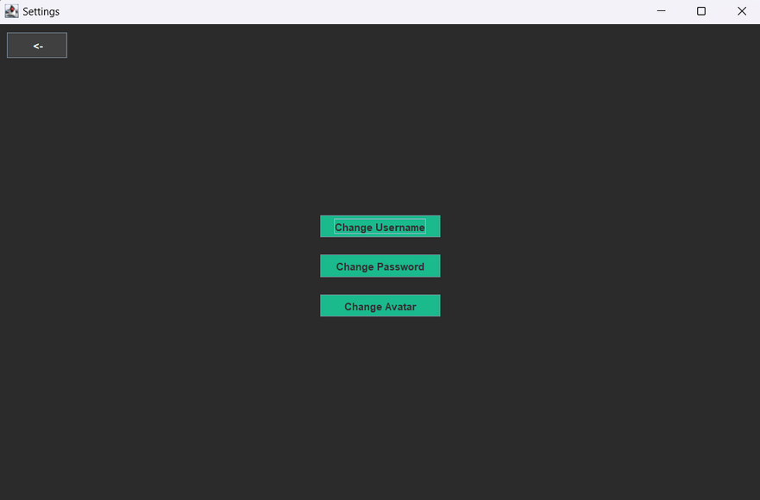
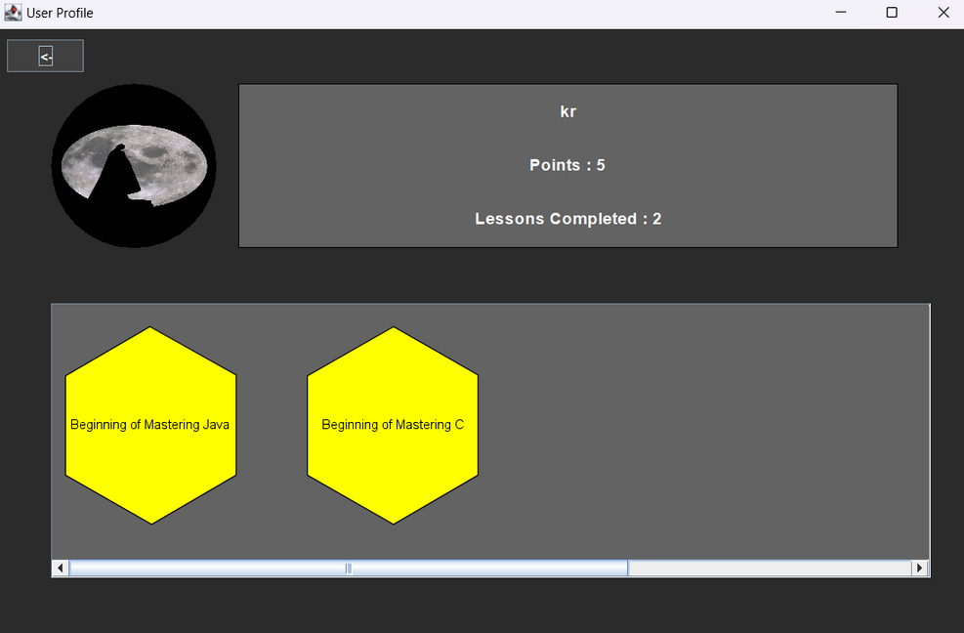
Demonstration
SETTINGS
PROFILE

Slide 17


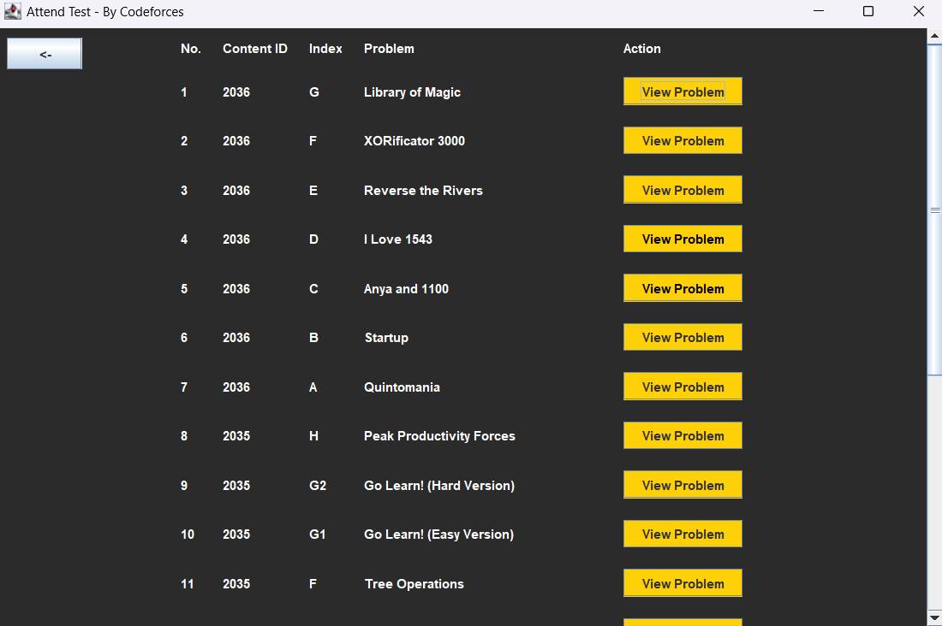
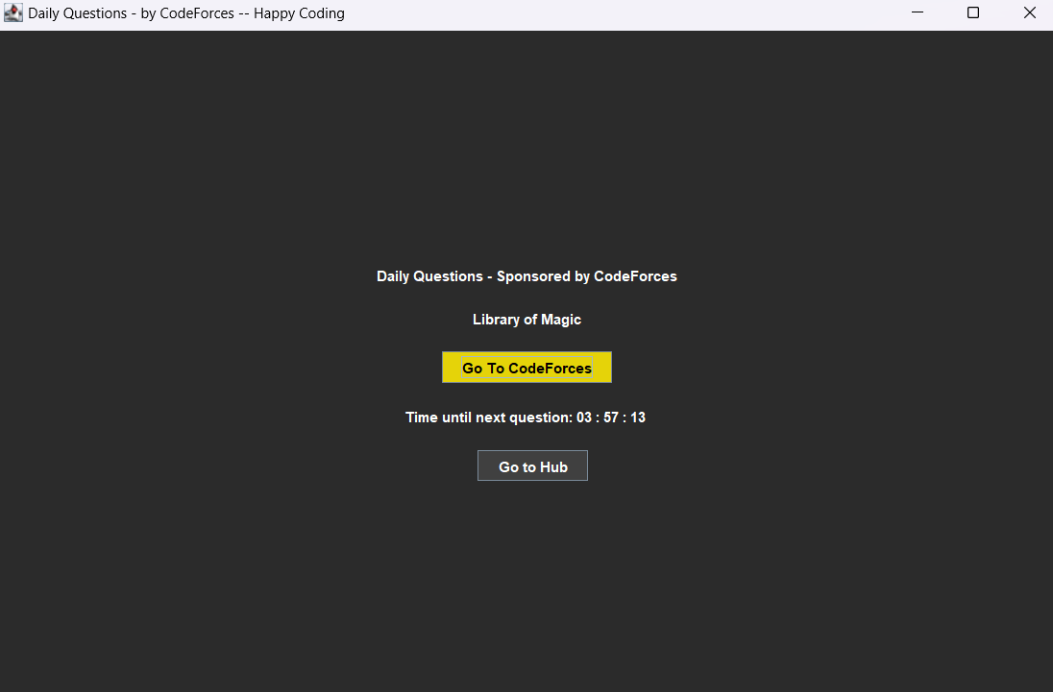
Demonstration
TEST PAGE
DAILY PAGE

Slide 18


Technology Stack Used
JAVA
MONGO
CODE FORCE

Slide 19

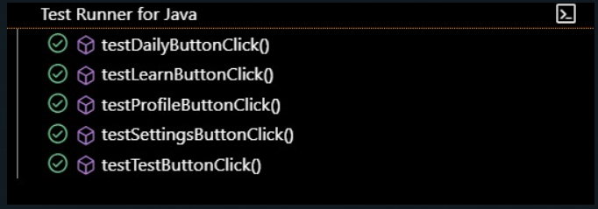
Testing with JUnit

Slide 20
The Interactive Programming Language Learner (IPLL) platform addresses the limitations of traditional programming education by creating an immersive, engaging learning environment.
Conclusion
IPLL transforms coding into an enjoyable and productive experience.
IPLL not only supports beginners in grasping foundational concepts but also provides continuous challenges to maintain their learning trajectory.

