Slide 1




ANNA UNIVERSITY
MADRAS INSTITUTE OF TECHNOLOGY CAMPUS
CHENNAI – 600 044
Creative Inovative Project - Review 1
Sub Code: CS6611
Secure Image Key Generation for Medical image security using WGAN-GP
Presented by
Guided by
Malarvannan M (2022503011)
Dr.R.Kathiroli
Assistant Professor
Dept of Computer Technology
Anna University, MIT campus
Maanasa Prathap Chander (2022503065)
Kalaidharun R (2022503009)
1

Slide 2

OutLine
01
Problem Statement
07
Algorithm
02
Abstract
08
Metrics
03
Objectives
09
Test case
04
Literature Survey
10
Implementation plan
05
Architecture Diagram
11
Tools and libraries
06
Module wise Architecture Diagram
12
References
2

Slide 3
Problem Statment
Traditional cryptographic key generation depends on deterministic algorithms which can be suspectible to attacks if the entropy is very less.
Machine Learning based key generation approaches are currently booming to generate high entropy keys but they suffer from training instability and mode collapse.
This highlights the need for the use of a more stable model for the training process to overcome training instability, mode collapse and to generate a strong quality key.
3

Slide 4
Abstract
The need for medical image encryption is increasingly pronounced to safeguard the privacy of the patient’s medical imaging data.
Generative Adversial Network (GAN) have shown promising result in generating a strong high entropy key and encypting the medical image.
However, they suffer from training instability and mode collapse reducing the effectiveness of generated key.
Thus we have come with Wasserstien GAN - Gradient Penality to overcome this issue by enforcing Lipshitz continuity for better genralization
4

Slide 5
Objective
To develop a secure one time pad key generation framework using WGAN-GP.
To enhance training stability.
To evaluate the quality of the generated key and check its effectiveness with respect to GAN
5

Slide 6
Literature Survey
S.NO | Title | Name of the Journal and Published Year | Proposed Methodology | Limitations
1 | DeepKeyGen: A Deep Learning-Based Stream Cipher Generator for Medical Image Encryption and Decryption | IEEE Transactions on Neural Networks and Learning Systems / 2022 | DeepKeyGen presented a deep learning-based stream cipher generator that utilized Generative Adversarial Networks (GANs) for the encryption and decryption of medical images. | The process relies heavily on the randomness of deep learning models, which can cause inconsistencies in key generation even under identical conditions and the training process is unstable.
2 | DeepEDN: A Deep-Learning-Based Image Encryption and Decryption Network for Internet of Medical Things | IEEE Internet of Things Journal / 2021 | DeepEDN is an end-to-end encryption-decryption framework for IoMT. It uses Cycle-GANs to encrypt medical images and an inverse mapping network for loss-minimized decryption. An ROI mining network enables selective retrieval of critical data without full decryption. | The computational complexity is very high as Cycle-GANs and ROI mining require significant processing power
6

Slide 7
Literature Survey
S.NO | Title | Name of the Journal and Published Year | Proposed Methodology | Limitations
3 | DeepENC: Deep Learning-Based ROI Selection for Encryption of Medical Images Through Key Generation with Multimodal Information Fusion | IEEE Transactions /2024 | DeepENC securely encrypts the Region of Interest (ROI) in medical images using a 2D hybrid chaotic key. It leverages UNet3+ for ROI segmentation and biometric features for key generation, ensuring high security with low computational cost. | There are some potential vulnerabilities in this such as, while selective ROI encryption improves efficiency, the unencrypted background could still leak contextual information about the medical image.
7

Slide 8
Literature Survey
S.NO | Title | Name of the Journal and Published Year | Proposed Methodology | Limitations
4 | Chaotic Medical Image Encryption Method Using Attention Mechanism Fused with ResNet Model | Frontiers in Neuroscience / 2023 | AT-ResNet-CM enhances medical image encryption by integrating an attention mechanism with ResNet for high-dimensional feature extraction. The attention module focuses on critical regions, improving encryption quality, while a chaotic system ensures randomness and security. | It requires careful tuning of its attention mechanism and chaotic system. If not configured properly, the encryption quality may drop, potentially affecting security and performance.
8

Slide 9
Literature Survey
S.NO | Title | Name of the Journal and Published Year | Proposed Methodology | Limitations
5 | Deep Learning-Based Encryption Scheme for Medical Images Using Deep Convolutional Generative Adversarial Networks | Nature Scientific Reports / 2024 | Utilizes Deep Convolutional Generative Adversarial Networks (DCGANs) for encrypting medical images. Implements Virtual Adversarial Training (VAT) to enhance robustness against adversarial attacks. | Mode collapse is a well-known issue in DCGANs where instead of exploring the full distribution of possible transformations, the model starts producing similar outputs for different inputs. This happens because the generator finds a "shortcut" to fool the discriminator without learning a complete mapping from the original image space to the encrypted space.
9

Slide 10
Literature Survey
S.NO | Title | Name of the Journal and Published Year | Proposed Methodology | Limitations
6 | EiMOL: A Secure Medical Image Encryption Algorithm based on Optimization and the Lorenz System | ACM Transaction / 2023 | EiMOL uses the Lorenz chaotic system combined with optimization techniques to generate a random sequence, transforming medical images into encrypted data. | EiMOL uses a chaotic system (Lorenz), which could be reverse-engineered by attackers to break the encryption.
7 | A Faster Privacy-Preserving Medical Image Diagnosis Scheme with Machine Learning | Springer / 2024 | Uses CKKS Homomorphic Encryption for encrypting both medical images and diagnostic parameters. | Homomorphic encryption is computationally expensive and requires high processing power.
10

Slide 11
Literature Survey
S.NO | Title | Name of the Journal and Published Year | Proposed Methodology | Limitations
8 | MedBlindTuner: Towards Privacy-preserving Fine-tuning on Biomedical Images with Transformers and Fully Homomorphic Encryption | Springer/ 2024 | Encrypts medical images before training, allowing ML models to learn without decrypting sensitive data and utilizes DEiT (Data-Efficient Image Transformer) for efficient image classification. | FHE operates on encrypted data using techniques like ciphertext addition and multiplication, which are computationally expensive and not natively supported by GPUs/TPUs.
11

Slide 12
Literature Survey
S.NO | Title | Name of the Journal and Published Year | Proposed Methodology | Limitations
9 | CaRENets: Compact and Resource-Efficient CNN for Homomorphic Inference on Encrypted Medical Images | Springer / 2024 | CaRENets presents a significant advancement in performing CNN-based inference on encrypted medical images by introducing a compact and resource-efficient approach. | Despite the optimizations, homomorphic encryption inherently introduces substantial computational overhead and processing time is very high for high resolution image
10 | RISE: Rubik’s Cube and Image Segmentation-Based Secure Medical Image Encryption | Springer / 2024 | The medical image is divided into multiple segments for enhanced security. Each segment undergoes a scrambling process based on the Rubik’s Cube principle to create randomness. | The security of the encryption heavily depends on the initial key and transformation steps, making it vulnerable to brute-force or differential attack
12

Slide 13
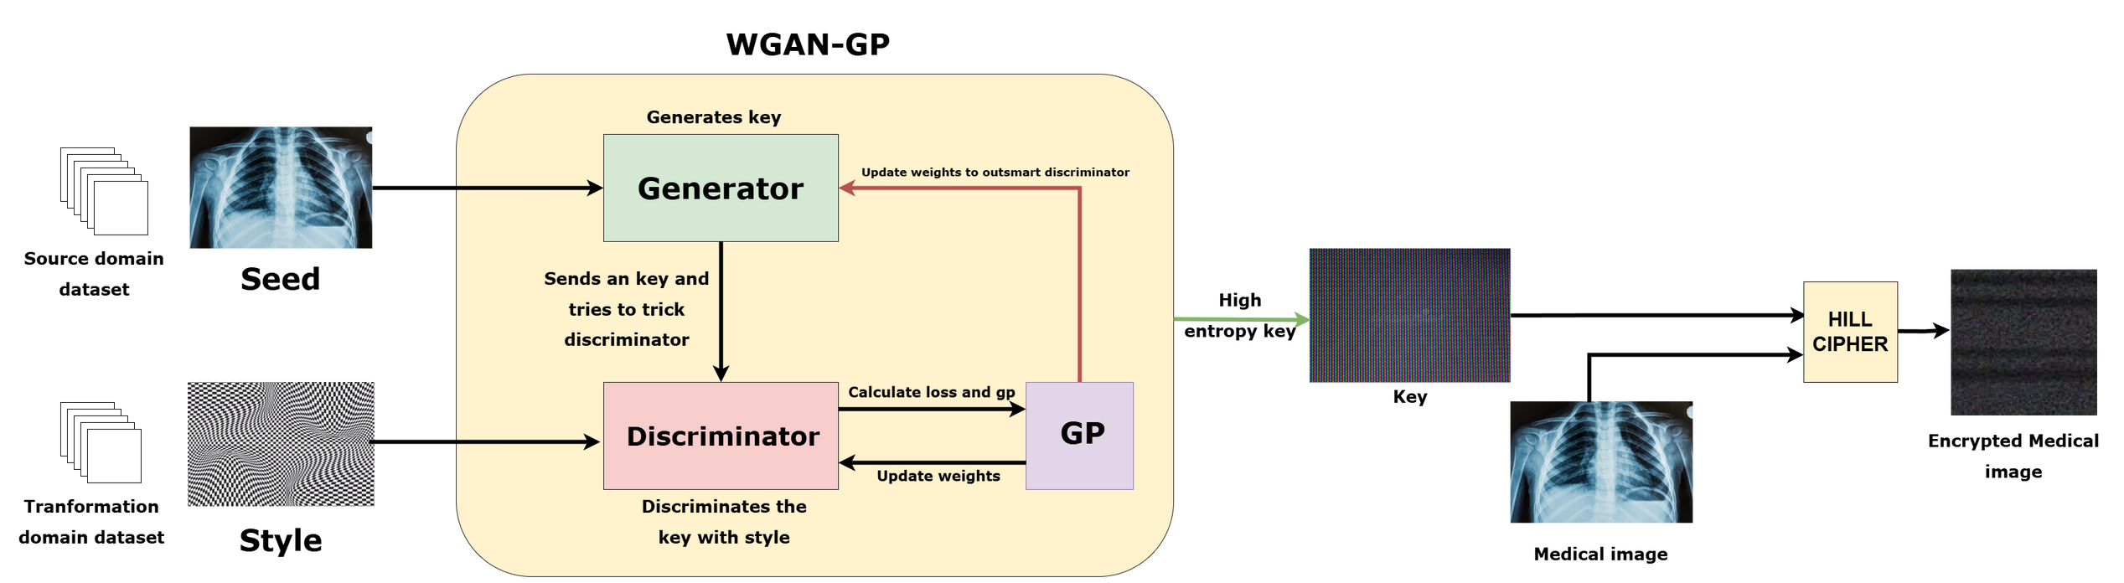
Architecture Diagram
Fig a) How the proposed model works
13

Slide 14
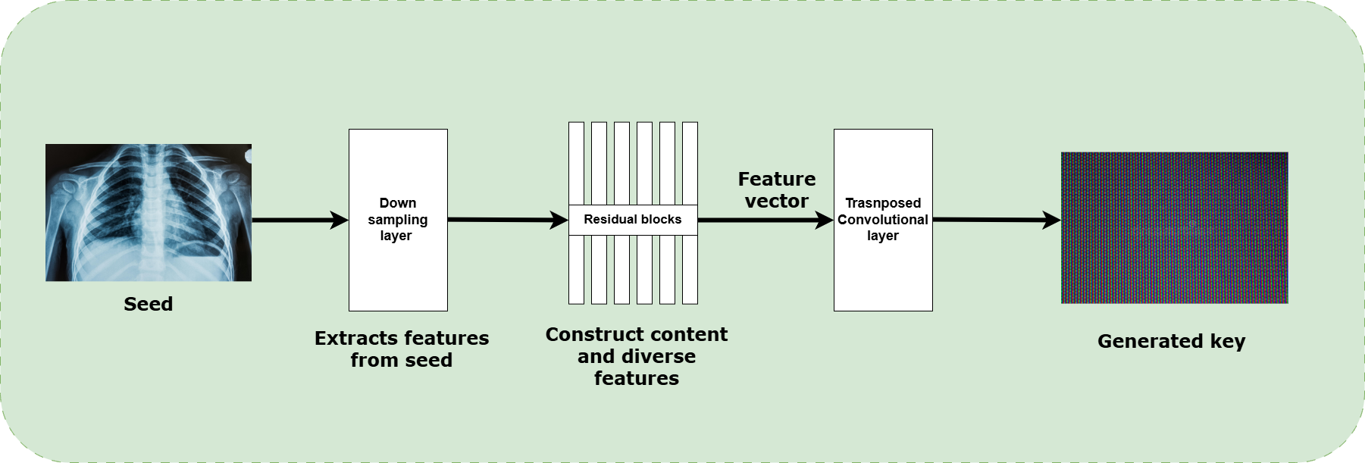
Architecture Diagram
Generator
Fig b) How the generator generates a key
14

Slide 15
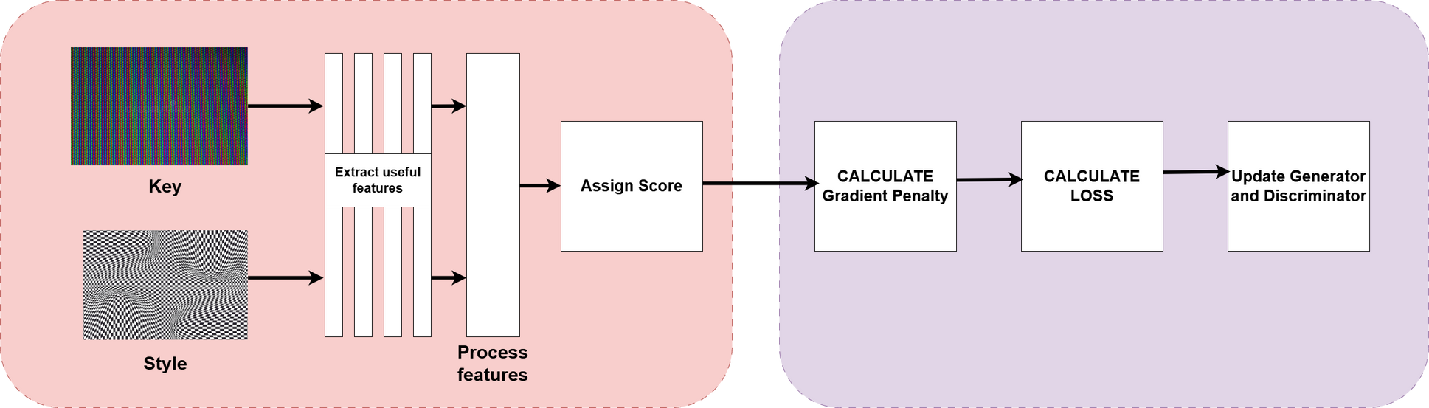
Architecture Diagram
Discriminator
GP and loss updation
Fig c) How the discriminator assigns score for the key and how the gradient penalty is
15

Slide 16
Modules
Key Generation Module :
Here the strong high entropy key is generated using WGAN-GP
The WGAN-GP consists of Generator, Discriminator and uses Gradient penalty and the loss is calculated and propagated.
This fight will continue till the model stabilizes and finally generates a strong key.
Input: Seed image and Style image
Expected output: High Entropy Key
Encryption Module:
The high entropy key generated is then used to encrypt the medical image.
Here, Hill cipher is used to encrypt the image.
Input: Medical image and key
Expected output: Encrypted Medical image
16

Slide 17

Algorithm for Key generation Module
Initialization: Randomly initialize the parameters W of the DeepKeyGen, Wn = random [Wn,1,Wn,2, ... ,Wn,i]. Define the dimension of KEY as 256 x 256 x 3.
while Epoch < Epoch_target do
x = Convert(IMAGE_sourcedomain);
y = Convert(IMAGE_transformationdomain) // Convert training images into 256 x 256 x 3 matrices.
KEY = G(x) // Forward propagation of generator network G. At the last layer of G, the KEY is generated.
Result = D(y) // Forward propagation of discriminator network D. Output the judgment result whether the input is from transformation domain.
L = LG + LD / / Calculate the total loss L.
Backward(L) // Backward propagation.
Wj= Wj-1 - A J(W) // Calculate the gradient that pass back to each layer, and then update the network parameters.
end while
17

Slide 18

Metrics
a) NPCR (Sensitivity)
NPCR denotes the pixel change rate, which is used to indicate the ratio of different pixel values at the same location of two images.
where,
W , H -> Width and Height of the image
D(i, j) -> Pixel Change Indicator Function , where i and j are pixel positions.
D(i,j) is 1 if both pixels are same else it is 0 .
18

Slide 19

Metrics
b) UACI (Sensitivity)
Measures how much the pixel values change in intensity.Ensures that the differences between the two private keys are not just binary changes but are also spread over a wide range of values.
where,
T1(i,j) and T2(i,j) are the pixel values at position (i, j) in the two generated private keys
19

Slide 20

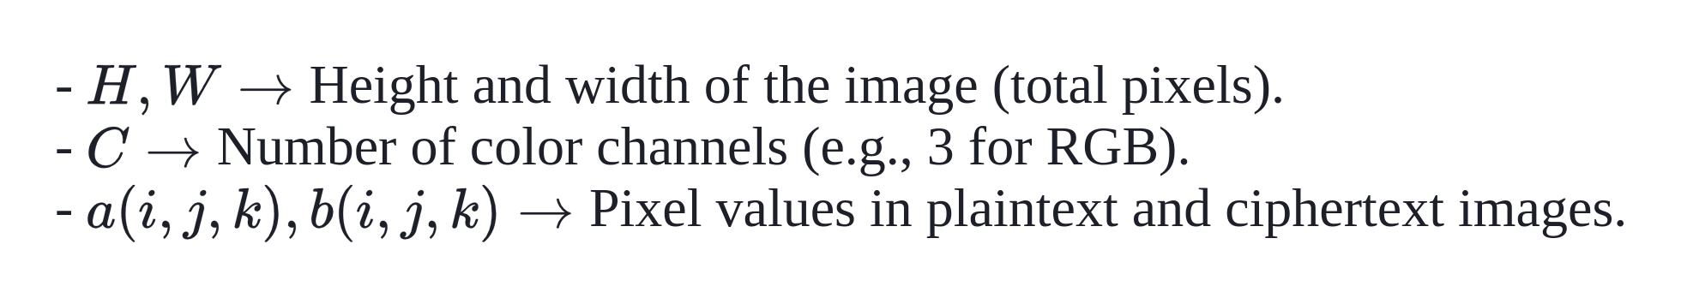
Metrics
C) Mean Square Error (MSE)
Used to measure the average squared difference between corresponding pixel values of two images. It evaluates how much the encrypted image (ciphertext) deviates from the original image (plaintext)
where,
20

Slide 21
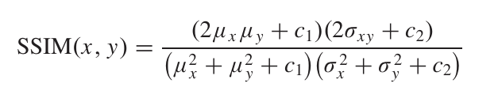
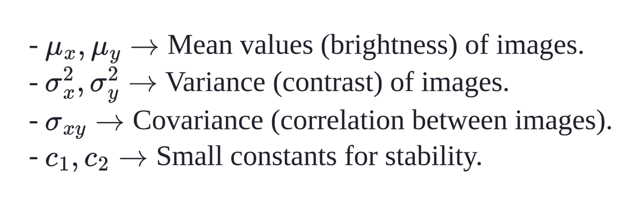
Metrics
D) Structural Similarity Index (SSIM)
Metric that measures the similarity between two images by considering structural information, luminance, and contrast. Used for evaluating structural similarity.
where,
21

Slide 22
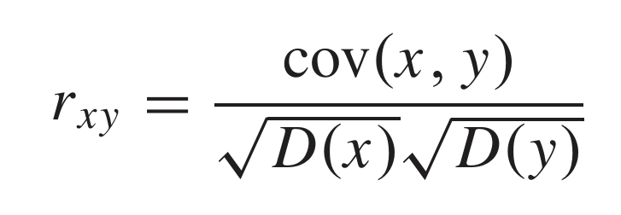
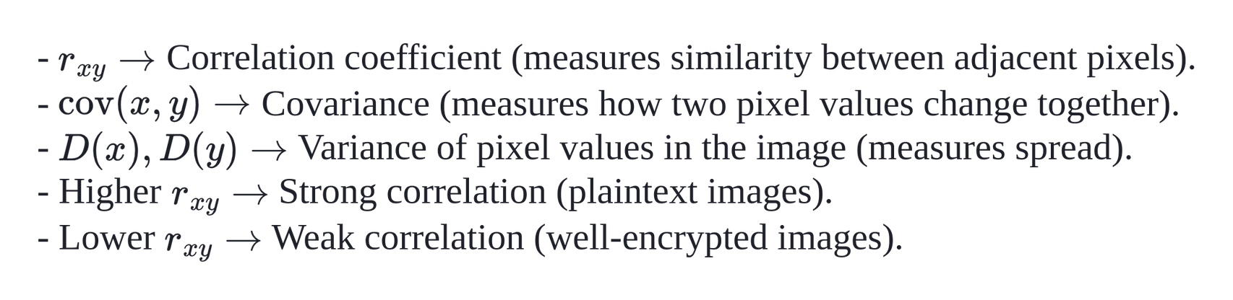
Metrics
E) Correlation Analysis
Correlation analysis measures the relationship between adjacent pixels in an image. A strong correlation in plaintext images makes them vulnerable to attacks, so encryption aims to reduce this correlation in ciphertext images for higher security.
where,
22

Slide 23
Test cases
TC1: Ascertain that a high entropy key is conjured.
TC2: Does the Hill cipher enchantingly encrypt the medical image with the high entropy key?
TC3: Can the encrypted image be restored with the same clarity?
TC4: Is the key forged uniquely with each invocation?
23

Slide 24
Implementation plan
Phase 1 : Implement the WGAN-GP module.
Phase 2 : Test the quality of the key generated from WGAN-GP module
Phase 3 : Implement Hill cipher for image encryption.
Phase 4 : Test the quality of the encrypted image
24

Slide 25
Tools and libraries
PyTorch : A machine learning library that includes algorithms like neural networks, support vector machines,
TorchVision : It is a package within Torch that provides image and video processing capabilities
SciPy and Numpy : For mathematical computations and optimizations
Medical Image Dataset : https://www.kaggle.com/datasets/raddar/tuberculosis-chest-xrays-montgomery
Transformation domain Dataset: https://www.kaggle.com/datasets/vishalbakshi/hms-hbac-training-spectrogram-images
25

Slide 26
References
[1] P. Tang, X. Wang, B. Shi, X. Bai, W. Liu, and Z. Tu, “Deep FisherNet for imageclassification,” IEEE Trans. Neural Netw. Learn. Syst., vol. 30, no. 7, pp. 2244–2250, Jul. 2019.
[2] G. Li and Y. Yu, “Contrast-oriented deep neural networks for salient object detection,” IEEE Trans. Neural Netw. Learn. Syst., vol. 29, no. 12, pp. 6038–6051, Dec. 2018.
[3] Y. Ding, C. Luo, C. Li, T. Lian, and Z. G. Qin, “High-order correlation detecting in features for diagnosis of Alzheimer’s disease and mild cog- nitive impairment,” Biomed. Signal Process. Control, vol. 53, Aug. 2019, Art. no. 101564.
[4] H. Chen, Z. Qin, Y. Ding, L. Tian, and Z. Qin, “Brain tumor seg- mentation with deep convolutional symmetric neural network,” Neuro- computing, vol. 392, pp. 305–313, Jun. 2020, doi: 10.1016/j.neucom. 2019.01.111.
[5] S. Jaeger, S. Candemir, S. Antani, Y. X. Wang, P. X. Lu, and G. Thoma, “Two public chest X-ray datasets for computer-aided screening of pulmonary diseases,” Quant. Imag. Med. Surg., vol. 4, p. 475, Dec. 2014. algorithm with NW algorithm for key generation,” J. Med. Syst., vol. 42, no. 1, p. 17, Jan. 2018.
26

Slide 27
References
[6] Ultrasound Nerve Segmentation. Accessed: Jan. 9. [Online]. Available: https://www.kaggle.com/c/ultrasound-nerve-segmentation/data/
[7] B. H. Menze et al., “The multimodal brain tumor image segmentation benchmark (BRATS),” IEEE Trans. Med. Imag., vol. 34, no. 10, pp. 1993–2024, Oct. 2015.
[8] S. Bakas et al., “Advancing the cancer genome atlas glioma MRI collections with expert segmentation labels and radiomic features,” Sci. Data, vol. 4, no. 1, Dec. 2017, Art. no. 170117.
[9] S. R. Moosavi, E. Nigussie, M. Levorato, S. Virtanen, and J. Isoaho, “Low-latency approach for secure ECG feature based cryptographic key generation,” IEEE Access, vol. 6, pp. 428–442, 2018.
[10] T. Liu, J. Tian, Y. Gui, Y. Liu, and P. Liu, “SEDEA: State estimation- based dynamic encryption and authentication in smart grid,” IEEE Access, vol. 5, pp. 15682–15693, 2017.
27

Slide 28
References
[11] S. Kalsi, H. Kaur, and V. Chang, “DNA cryptography and deep learning using genetic algorithm with NW algorithm for key generation,” J. Med. Syst., vol. 42, no. 1, p. 17, Jan. 2018.
[12] Y. Ding, C. Luo, C. Li, T. Lian, and Z. G. Qin, “High-order correlation detecting in features for diagnosis of Alzheimer’s disease and mild cog nitive impairment,” Biomed. Signal Process. Control, vol. 53, Aug. 2019, Art. no. 101564.
[13] H. Chen, Z. Qin, Y. Ding, L. Tian, and Z. Qin, “Brain tumor seg mentation with deep convolutional symmetric neural network,” Neuro computing, vol. 392, pp. 305–313, Jun. 2020, doi: 10.1016/j.neucom. 2019.01.111.
[14] S. Jaeger, S. Candemir, S. Antani, Y. X. Wang, P. X. Lu, and G. Thoma, “Two public chest X-ray datasets for computer-aided screening of pulmonary diseases,” Quant. Imag. Med. Surg., vol. 4, p. 475, Dec. 2014.
[15] Ultrasound Nerve Segmentation. Accessed: Jan. 9. [Online]. Available: https://www.kaggle.com/c/ultrasound-nerve-segmentation/data/
28

Slide 29
Thank
You
29

