Slide 1

Training Continuum
- Kishore Thirunagari

Slide 2

Before Training
Eager to learn Git to better collaborate with team.
Interested in learning to design classes for automate tasks.
Interested in Learn more about Re-Sampling Techniques for Imbalance Datasets.
Interested in learn about MLOps and how to create a pipeline.
Interested in segment the customers for more effective marketing.

Slide 3

Training Tasks
Git Operations and Commands
Regression Problem for Restaurant Revenue.
Classification Problem for Ecommerce Customers Churn.
Customer Segmentation on Sales dataset.
Imbalance data Handling with Manufacturing Defect.
Time Series Analysis on Whare House Inventory.

Slide 4

Flow Chart of Implementation
Modeling
and
Cross Validation
Data_loader()
Handlign_null_values()
EDA
data_encoding()
data_scaling()
get_predictions()
univariate_plot()
bi-variate_plot()
multi-variate_plot()
model_training()
model_scores()
best_model()
Data Preprocessing
Feature
Engineering
Prediction

Slide 5
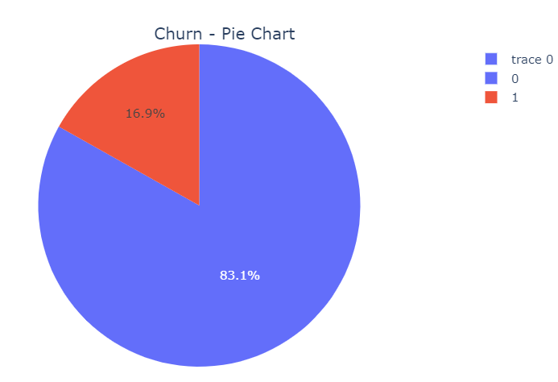
Ecommerce Customer Churn
Worked on Ecommerce-Customer Churn Prediction.
The goal of this project is to develop a predictive model that can accurately forecast customer churn based on various customer behavior and demographic data.
In Data, 83.1% Customers are Non-Churned, 16.9% Customers are Churned.

Slide 6
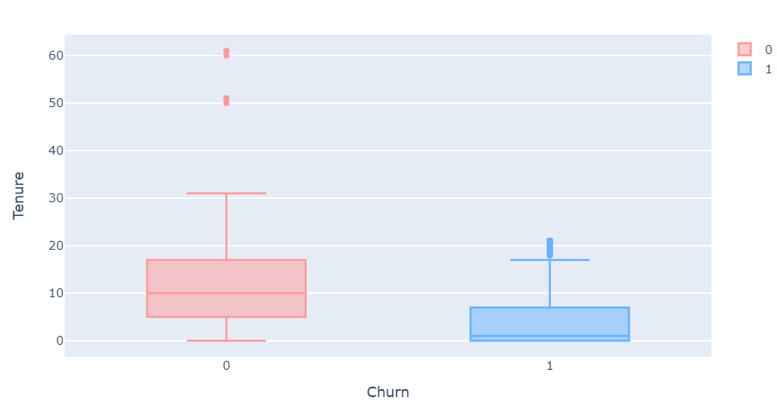
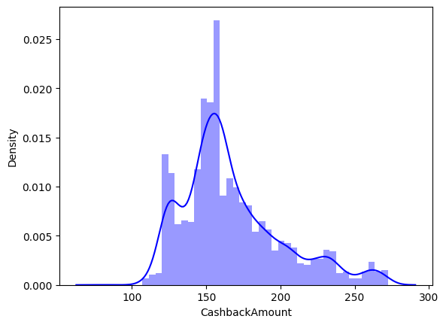
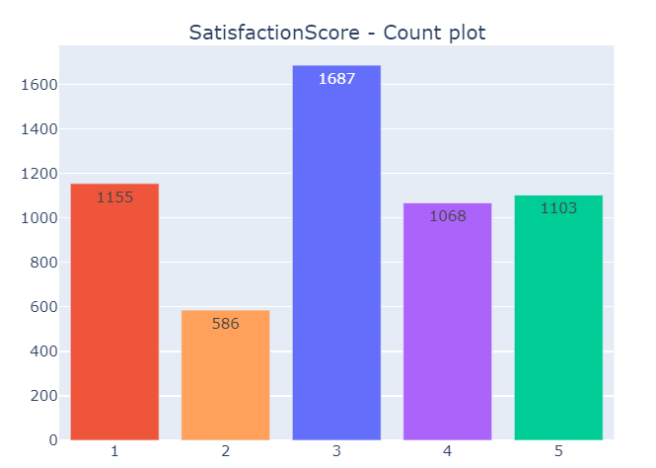
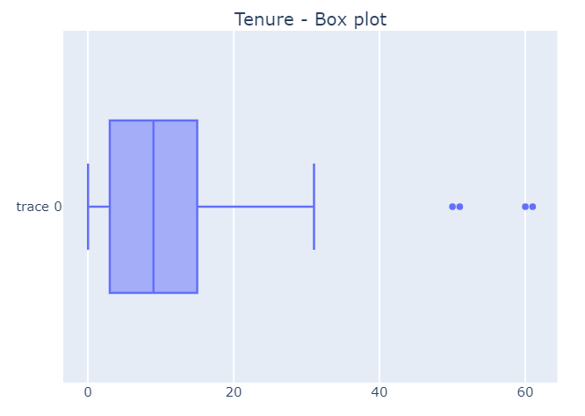
EDA - Customer Churn
Satisfaction score was 3 for most customers.
Order amount hike from last year percent is 13-18%.
churned Customers tenure <7, Cashback Amount<150.
Customers averagely spending 3 hours on Ecommerce site.

Slide 7
Modeling Before Re-Sampling
Mainly focused on Recall score.
Random Forest classifier achieved highest Recall score of 92%.
After Hyper tuning, Recall Score increased to 92% for Random Forest.
Tried with Re-Sapling techniques.
Models/Metrics | Train Accuracy | Test Accuracy | Recall Score | Precision Score | F1 Score
Logistic Regression | 0.87 | 0.85 | 0.72 | 0.31 | 0.43
Bernoulli NB | 0.85 | 0.84 | 0.64 | 0.22 | 0.33
KNN | 0.93 | 0.88 | 0.76 | 0.63 | 0.53
SVM | 0.89 | 0.87 | 0.82 | 0.35 | 0.50
Decision Tree | 1.00 | 0.92 | 0.76 | 0.78 | 0.77
Bagging Classifier | 1.00 | 0.94 | 0.89 | 0.77 | 0.82
Ada Boost | 1.00 | 0.92 | 0.77 | 0.78 | 0.78
Random Forest | 1.00 | 0.93 | 0.92 | 0.70 | 0.80
Random Forest (Hyper Tuning) | 1.00 | 0.96 | 0.94 | 0.82 | 0.88

Slide 8
Modeling After Re-Sampling
Up sampling will be good option for balancing the data.
Ensemble Method- Balanced Random Forest achieved Recall Score of 94%.
Random Forest Classifier without re-Sampling for prediction Pipeline.
Models/Metrics | Train Accuracy | Test Accuracy | Recall Score | Precision Score | F1 Score
Neighborhood Cleaning (under) | 1.00 | 0.93 | 0.79 | 0.84 | 0.82
Tomek Links Under sampling | 1.00 | 0.95 | 0.92 | 0.80 | 0.86
SMOTE (over) | 1.00 | 0.93 | 0.86 | 0.71 | 0.78
SVMSMOTE(over) | 1.00 | 0.94 | 0.90 | 0.78 | 0.83
RUS Boost | 0.88 | 0.87 | 0.74 | 0.40 | 0.52
Balanced Random Forest | 1.00 | 0.93 | 0.90 | 0.76 | 0.67
Balanced Random Forest (Hyper Tuning) | 1.00 | 0.96 | 0.94 | 0.80 | 0.87

Slide 9

Customer Segmentation
Worked on Transactional Sales Data.
The objective is to identify distinct customer segments and tailor marketing strategies to maximize sales and customer satisfaction.
Data is from 2003 and 2004.
No of Unique Customers 92 and unique Orders 307.

Slide 10
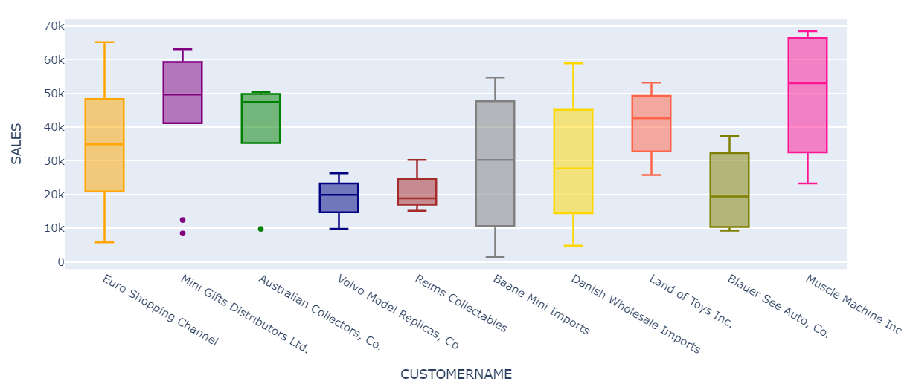
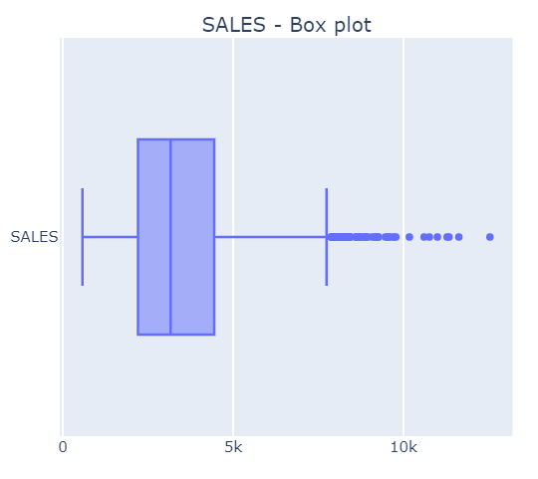
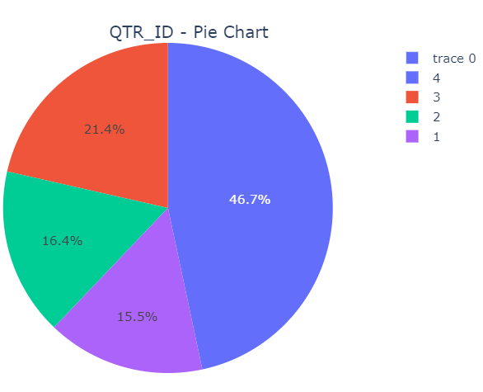
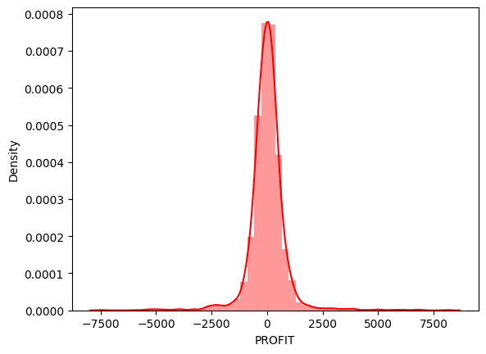
EDA-Customer Segmentation
Average sale amount per order is 3K.
Maximum sale amount is 15K and minimum is 0.5K.
More Orders in 4th Quarter of every year.
Maximum Loss amount is -7.5K and Maximum Profit is 8K

Slide 11
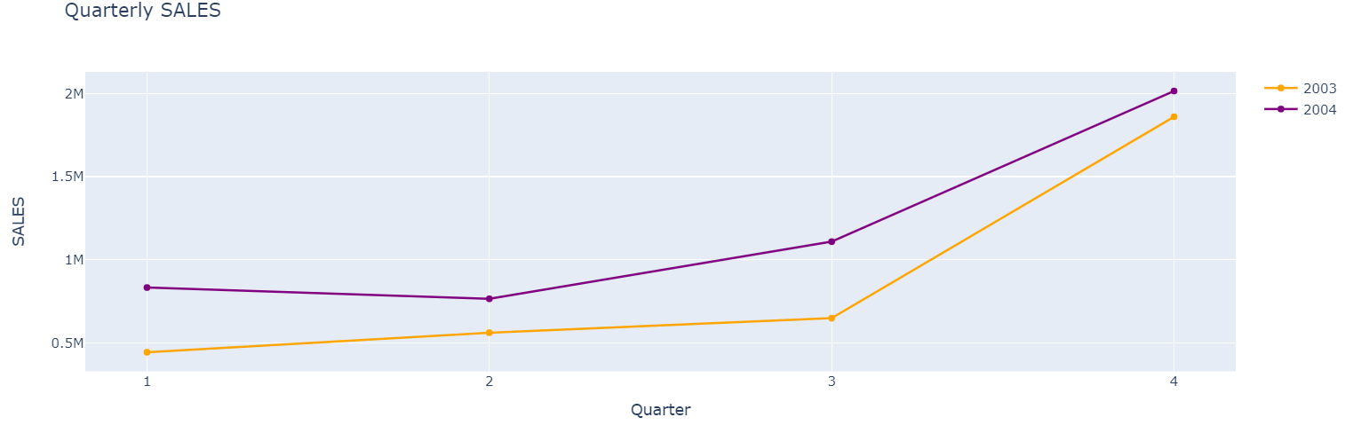
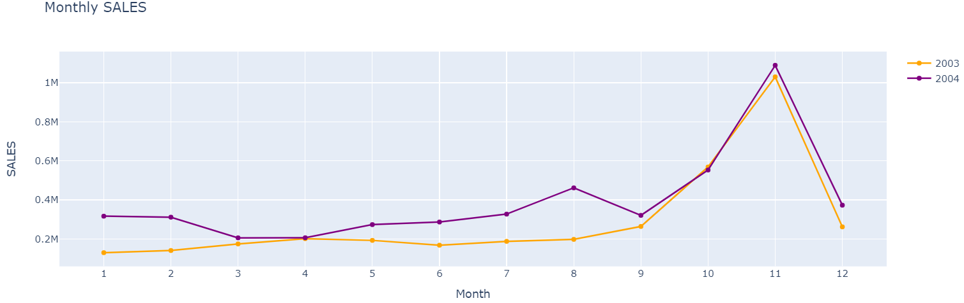
Sales Analysis
Average sale amount is 3K per order.
More Sales are in November Month.
Total Sales in 2004 more than the sales in 2003.
Muscle Machine Inc Customer has the highest Average sale amount 53K.

Slide 12
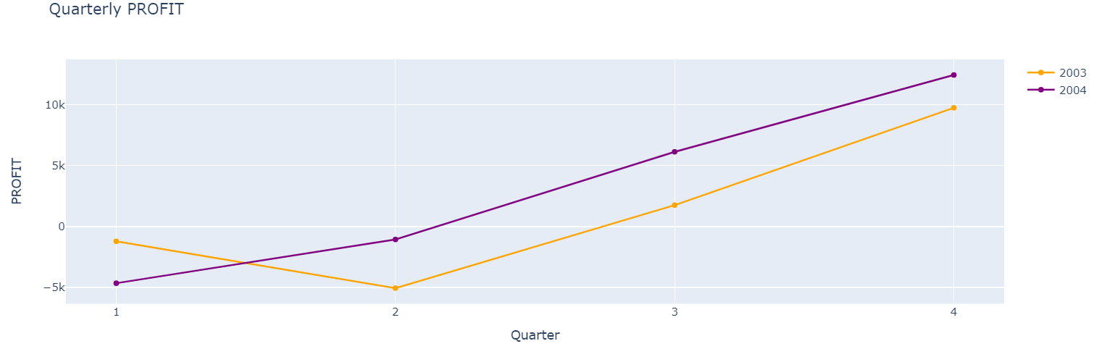
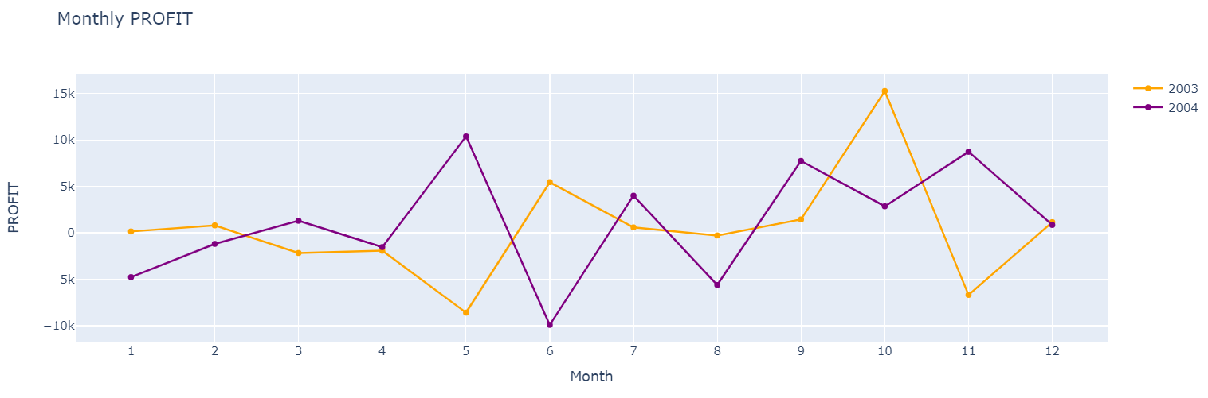
Profit Analysis
Average profit 13$ per order.
Highest profit earned 15K in October 2003.
Having Loss of 10K in June 2004.
Overall profit of 2004 is greater than 2003.

Slide 13
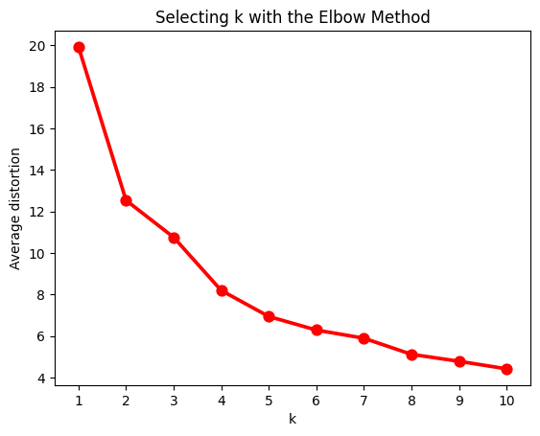
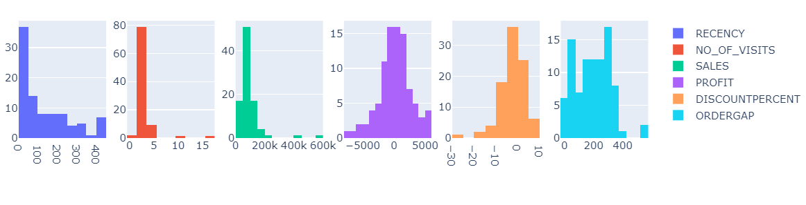
Clustering
Segment the customers using K-means Clustering.
with Elbow method 4 clusters are good.
Categorized as Top-level, High-Level, Medium Level, Low level Customers.

Slide 14
Conclusion
Created the Automated Functions.
Worked on Classification and Regression problems.
Complete pipeline for Machine Learning Models.
Visualized the Different kinds of plots.
Worked on Different Re-Sampling Techniques.
Analyzed the Customer data for Segmentation.

Slide 15

After Training
I can use Git Operations and commands.
I can Create a Classes for Automate the tasks:
Read any type of file.
Handling Null values, and Outliers.
Plotting the data irrespective of Feature type.
Statistical tests with any kind of data.
Prediction Pipeline.
I can work with Imbalance data.
I can work with Customer Segmentation problem.

Slide 16
Thank You

