Slide 1
Neural Networks

Slide 2
Neural Networks
What are Neural Networks
Biological Neural Networks
ANN - Basic

Slide 3
Neural Network (NN)
Neural Networks were inspired by the neural architecture of a human brain.
Massively parallel, distributed system, made up of simple processing units (neurons).
It provided an output by applying the function on the inputs provided.
NN composed of neurons, contains activation functions that makes it possible to predict non-linear outputs

Slide 4
History
late-1800's - Neural Networks appear as an analogy to biological systems
1960's and 70's – Simple neural networks appear
Fall out of favor because the perceptron is not effective by itself, and there were no good algorithms for multilayer nets
1986 – Backpropagation algorithm appears
Neural Networks have a resurgence in popularity
More computationally expensive

Slide 5
Perceptron and Neural Nets
Biological neuron to artificial neuron

Slide 6
Neural Network Architecture
# of hidden layers (depth)
# of units per hidden layer (width)
Type of activation function (nonlinearity)
Form of objective function

Slide 7
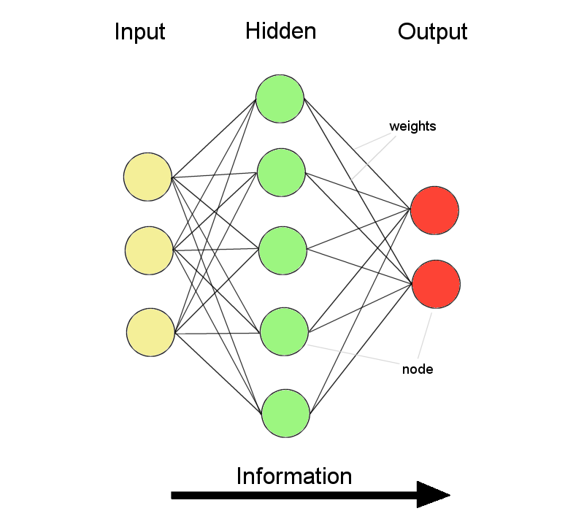
Feed-forward Neural Nets
Information flow is unidirectional
Data is presented to Input layer
Passed on to Hidden Layer
Passed on to Output layer
Information is distributed
Information processing is parallel
Neurones (nodes)
Synapses (weights)

Slide 8
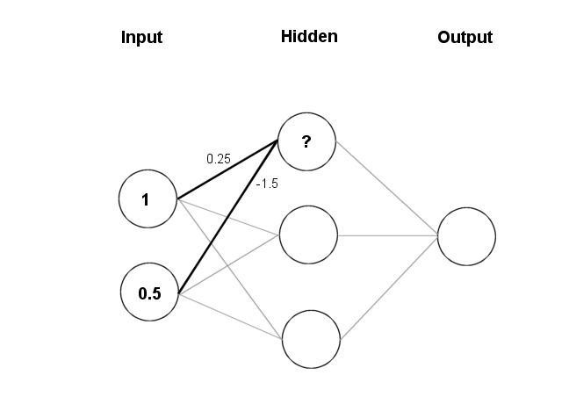
Feeding data through the net
(1 × 0.25) + (0.5 × (-1.5)) = 0.25 + (-0.75) = - 0.5
Squashing:

Slide 9
Different Network Topologies
Single layer feed-forward network
Input layer projecting into the output layer
Single layer
network
Input Output
layer layer

Slide 10
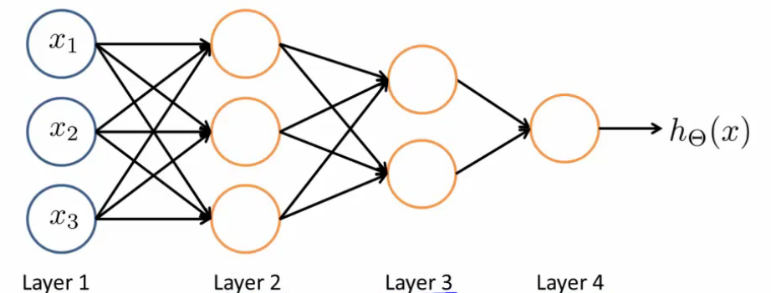
Different Network Topologies
Multi-layer feed-forward networks
Input Hidden Output
layer layers layer

Slide 11
Neural Network Model

Slide 12
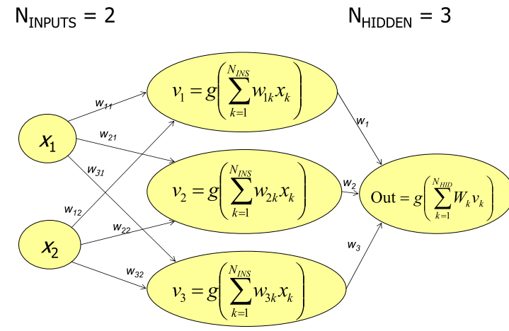
Hidden Layer Net

Slide 13
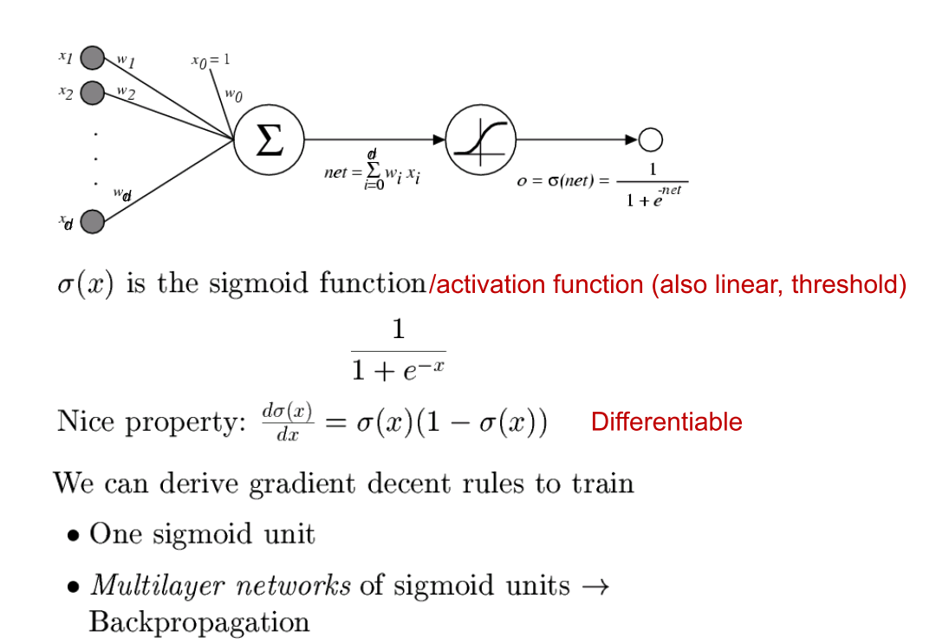
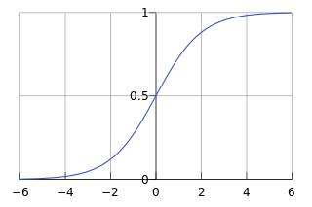
Sigmoid unit
Sigmoid / Logistic Function

Slide 14
Artificial Neural Networks (ANN)

Slide 15
ANN Structure
Training ANN means learning the weights of the neurons

Slide 16
Activation Functions
Neural Network with sigmoid activation functions
Neural Network with arbitrary nonlinear activation functions

Slide 17
Summary
Neural Networks…
provide a way of learning features
are highly nonlinear prediction functions
(can be) a highly parallel network of logistic regression classifiers
discover useful hidden representations of the input
Back propagation…
provides an efficient way to compute gradients
is a special case of reverse-mode automatic differentiation

