Slide 1
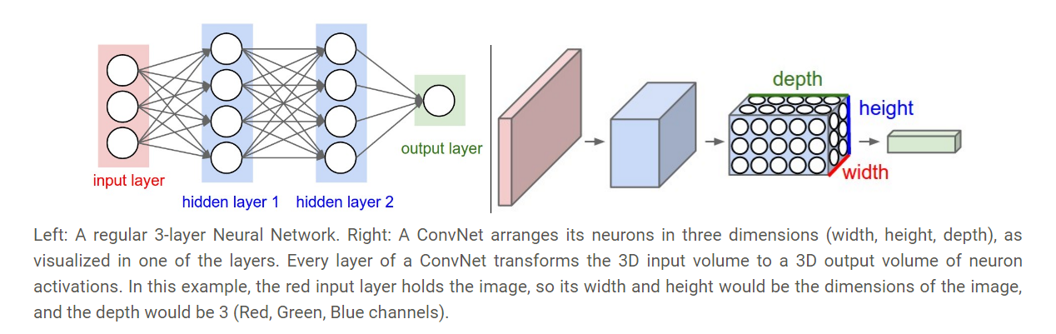
Convolution Neural Network
Dense neural network and Convolutional neural network

Slide 2
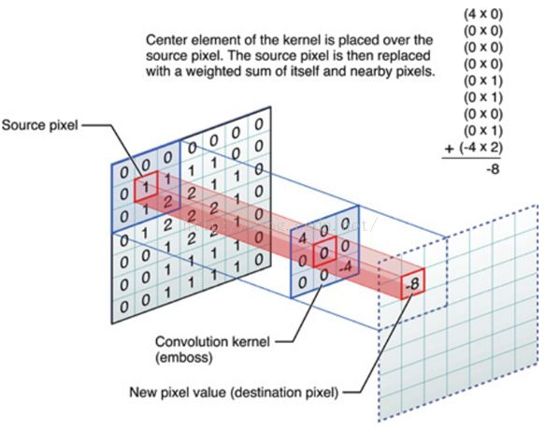
Convolutional kernel

Slide 3
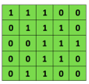

Convolutional Neural Network (CNN) work flow

Slide 4
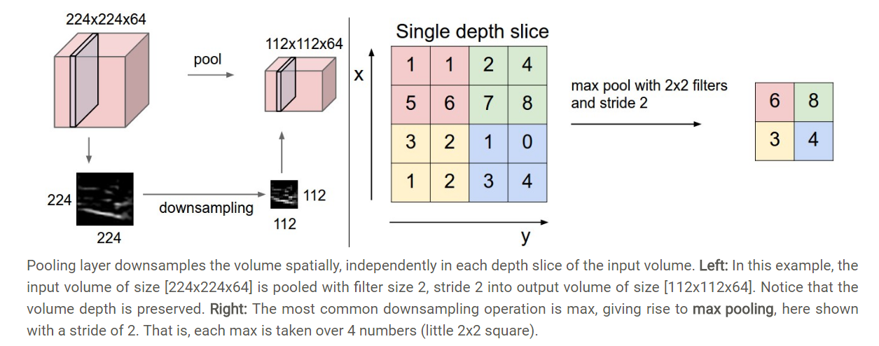
Pooling layer

Slide 5
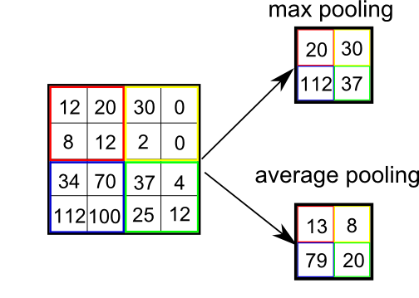
Pooling Methods

Slide 6
Convolutional Neural Networks (CNNs)
Compute vectors for n-grams and group them afterwards
https://shafeentejani.github.io/assets/images/pooling.gif

