Slide 1


WAYANAMC EDUCATION TRUST®
DON BOSCO INSTITUTE OF TECHNOLOGY
Kumbalagodu, Bengaluru – 560 074
Department of Electrical and Electronics Engineering
Presented on
ALCOHOL DETECTION SYSTEM USING ARDUINO UNO

Slide 2
ALCOHOL DETECTION SYSTEM USING ARDUINO UNO
Team members:
1DB21EE014 - Kishore C
1DB21EE019 - Omkar Jain
1DB22EE410 - Jeevan M
1DB22EE416 - Sinchana M R
1DB22EE419 - Venugopalareddy G S
Guided By
Mrs. AKSHATHA R HEGDE
Assistant Professor
Department of EEE, DBIT
BENGALURU

Slide 3
Table of contents
Introduction
Block Diagram
Components
Circuit diagram
Working
Advantage
conclusion

Slide 4
Introduction
Today we are creating a simple Alcohol detection system.
We can use it in various application fields.
So this is a small demonstration of a simple Alcohol detector using Arduino and MQ3 sensor.
Many advanced alcohol sensors are available in the market for a reasonable price, but we are here to make this project using some basic microcontroller like Arduino, LED, Buzzer and MQ3 alcohol sensors.

Slide 5
Block Diagram
POWER SUPPLY
ALCOHOL SENSOR
ARDUINO UNO
LED
C PROGRAMING
BUZZER

Slide 6
Components
MQ-3 Alcohol Sensor
Arduino UNO
Buzzer
LED
Resistor
Connecting wires

Slide 7
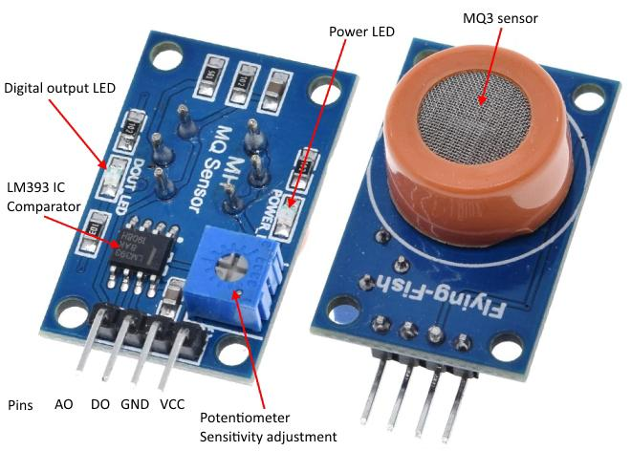
MQ-3 Alcohol Sensor
VCC - Supplies power for the module. You can connect it to 5V output from your Arduino
GND - It is the Ground Pin and needs to be connected to GND pin on the Arduino
D0 - Provides a digital representation of the presence of alcohol
A0 - Provides analog output voltage in proportional to the concentration of alcohol
MQ3 alcohol sensor is suitable for detecting alcohol concentration on your breath, just like your common breathalyzer.

Slide 8
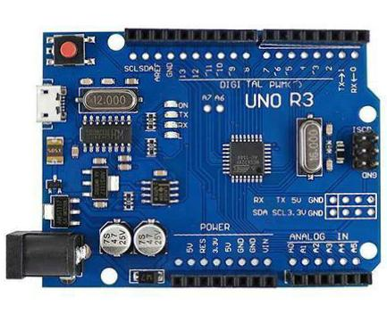
Arduino UNO
Arduino UNO is a low-cost and flexible.
It is easy-to-use programmable open-source microcontroller board.
This board can be interfaced with other Arduino boards, Arduino shields, Raspberry Pi boards.
It can control relays, LEDs, servos, and motors as an output.
Arduino UNO is a microcontroller board based on the ATmega328P.

Slide 9
Buzzer is a device that converts electrical signals into audio signal.
LED (light-emitting diode) is a semiconductor device that emits light when an electric current passes through it.
Connecting wires are allow electricity to flow from one electrical component to another
Resistor is a either limiting or regulating the flow of electric current in electrical circuits

Slide 10
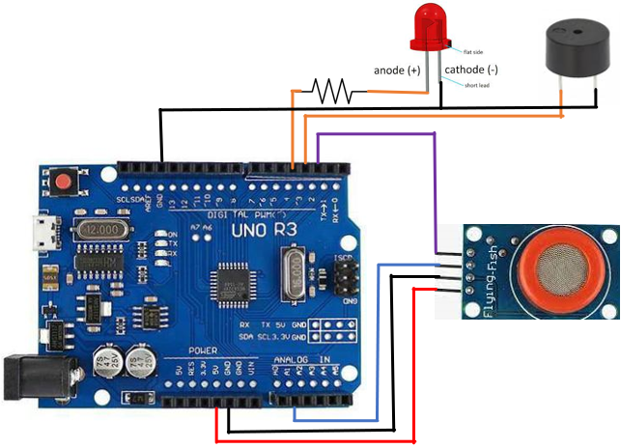
Working and Circuit diagram
Sensor: The MQ3 sensor detects the presence of alcohol. The sensor’s resistance changes when it comes into contact with alcohol.
Arduino: The Arduino Uno board is a microcontroller that receives signals from the sensor.
Digital pin: The sensor’s output is connected to a digital pin on the Arduino. If the Arduino reads a high pulse, alcohol is present.
Indicator: LED and Buzzer will activate.

Slide 11
Advantages
Safety: They can prevent drunk driving and reduce traffic accidents.
Simple to use: They have a simple drive circuit and are easy to interface with microcontrollers.
Easy to implement: They are small in volume and easy to implement.

Slide 12
Conclusion
By leveraging the Arduino platform and the MQ-3 sensor’s capabilities, this system can effectively detect alcohol presence.
It offers potential applications in areas such as vehicle safety or personal use, contributing to efforts in preventing alcohol-related incidents

Slide 13


