Slide 1



Don Bosco Institute of Technology
Department of Electrical and Electronics Engineering
TEMPERATURE BASED fan SPEED CONTROLLER using ARDUINO
TEAM MEMBERS
KISHORE C - 1DB21EE014
LUCKY ALI - 1DB21EE016
SHASHANK R - 1DB21EE023
SRIKANTH S - 1DB21EE027
`
Guided By
Mrs. AKSHATHA R HEGDE
Assistant Professor
Dept. of EEE, DBIT

Slide 2
PROBLEM STATEMENT: TEMPERATURE BASED FAN SPEED CONTROLLER USING ARDUINO.
OBJECTIVES
To reduce the power consumption.
To assist people with disabilities who are unable to control the speed of fan.
In near future, it can also be used in different industries and electronic devices.

Slide 3
CONTENTS
INTRODUCTION
LITERATURE SURVEY
BLOCK DIAGRAM
CIRCUIT DIAGRAM
COMPONENTS REQUIRED
RESULT
ADVANTAGES
APPLICATIONS
LIMITATIONS
FUTURE SCOPE
CONCLUSION
REFERENCE

Slide 4
INTRODUCTION
Temperature-based fan speed controller is an intelligent system that adjusts motor speed based on the temperature readings.
This project showcases the potential of Arduino in creating scalable and adaptable solutions for various applications.
This project has far-reaching implications for industries such as HVAC, Robotics and automotive where precise temperature is crucial

Slide 5
LITERATURE SURVEY
Sl. No | Author , Title, Publication Year | Highlights | Limitations
1. | K Sai Kumar, Sirolla Rajasekhar, Shaik Haseeb Tanveer,S Venkata Prasad Reddy, Valthati Allababu, Automatic temperature based fan controller,2023 | In this work they have designed the temperature based speed controlled fan. The surrounding temperature is sensed by LM35 sensor the sensed signal is sent as voltage pulses to microcontroller ATMEGA 328P and converts into an electrical signal which is applied to micro controller. The micro controller on arduino drives the motor driver to control the fan. ESP8266 Wi-Fi module is interfaced with arduino by using UBIDOTS free cloud storage website it is possible to switch the fan using mobile phone or laptop. | Due to temperature variation, after sometimes its efficiency decrease.
2. | Shivshankar Adsule , Shivani Mohite , Rahul Patil , Namrata R. Dhawas, Automatic Temperature Based Fan Speed Controller Using Arduino,2020 | Temperature Based Fan Speed Control & Monitoring With Arduino and LM35 Temperature Sensor. The microcontroller controls the speed of an electric fan according to the requirement & allows dynamic and faster control and the LCD makes the system user-friendly. Sensed temperature in Celsius Scale and fan speed in percentage are simultaneously displayed on the LCD panel. | The model is expensive, complex in design and not flexible

Slide 6
Sl. No | Author, Title, Publication Year | Highlights | Limitations
3. | Srinivas P , Kavinkumar B, Arun Venkat A , Dr.R.Senthil Kumar, Temperature based Fan Speed Controller,2020 | In the proposed system itself said that it is designed to detect the temperature of the room and send that information to the Arduino UNO board. Then the Arduino UNO board carries out the contrast of current temperature and set temperature based on the inbuilt program of the Arduino that feed through us. The output obtained from the operation is given through the o/p port of an Arduino UNO board to the LCD display that connected with the board. | Less efficiency , expensive and complex in design
4. | B.L.Tanmai,K.Rishitha,M.Padma, SK.Khamurunnisa, Temperature controlled fan using ,2020 | This paper presents the design and simulation of the fan speed control system using PWM technique based on the room temperature. A temperature sensor has been used to measure the temperature of the room and the speed of the fan is varied according to the room temperature using PWM technique | No monitoring of speed by LCD Not flexible and reliable

Slide 7
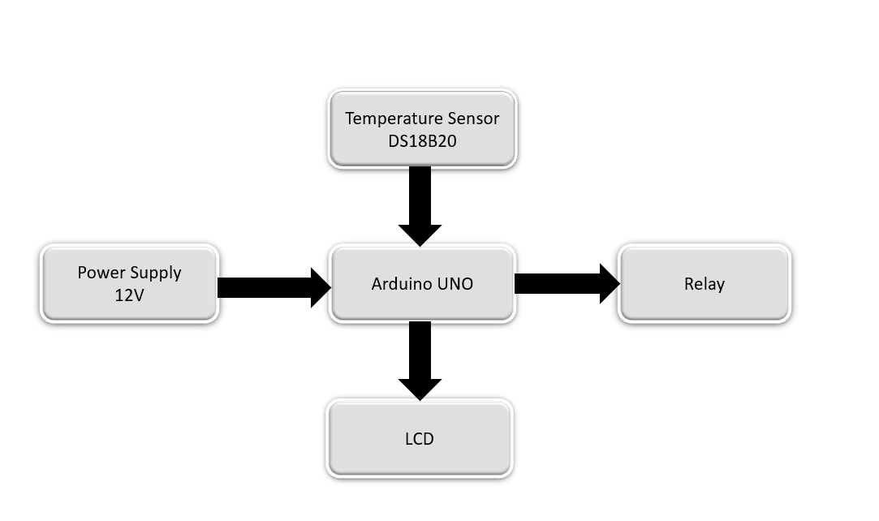
BLOCK DIAGRAM
WORKING:
The system uses a DS18B20 temperature sensor to measure the current temperature.
The Arduino UNO reads this temperature data. Based on the temperature, the Arduino controls a relay that adjusts the speed of a DC fan powered by a 12V power supply.
When the temperature rises, the Arduino tells the relay to speed up the fan to cool things down.
If the temperature drops, the relay slows down or stops the fan to save energy.
The current temperature is also displayed on an LCD screen so you can monitor it in real-time.

Slide 8
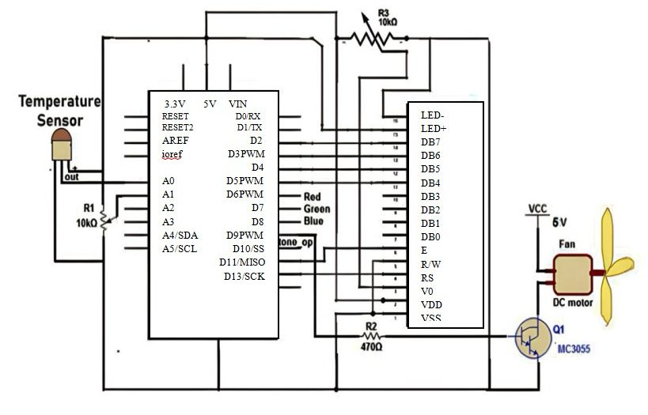
CIRCUIT DIAGRAM:

Slide 9
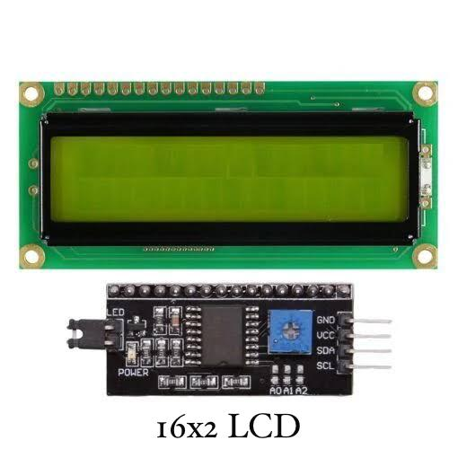
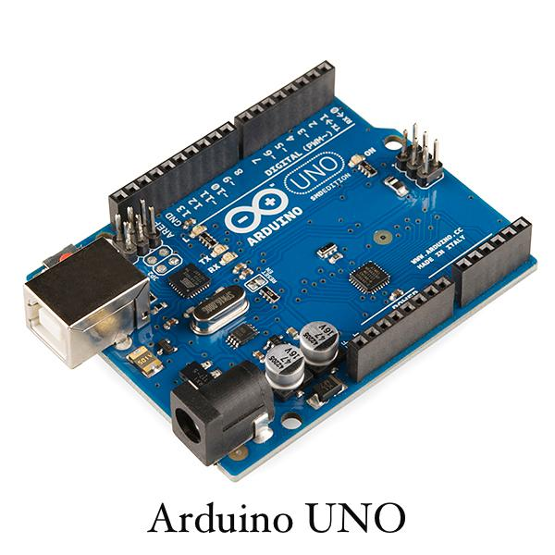
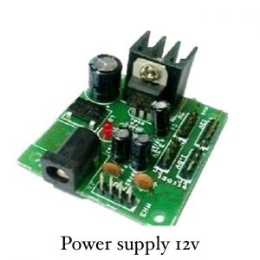
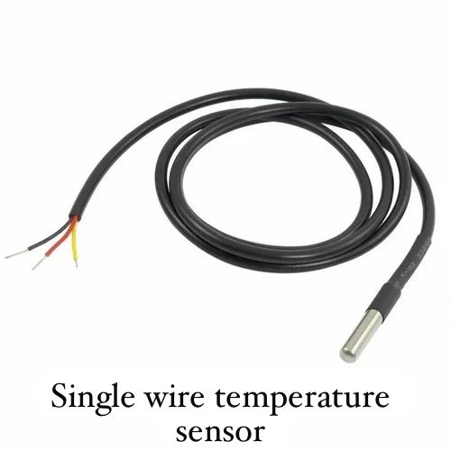
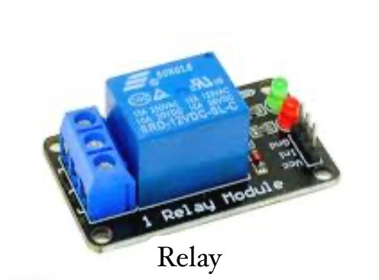
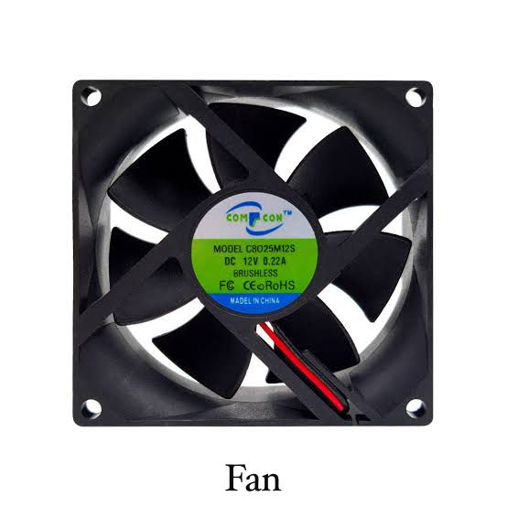
COMPONENTS:

Slide 10
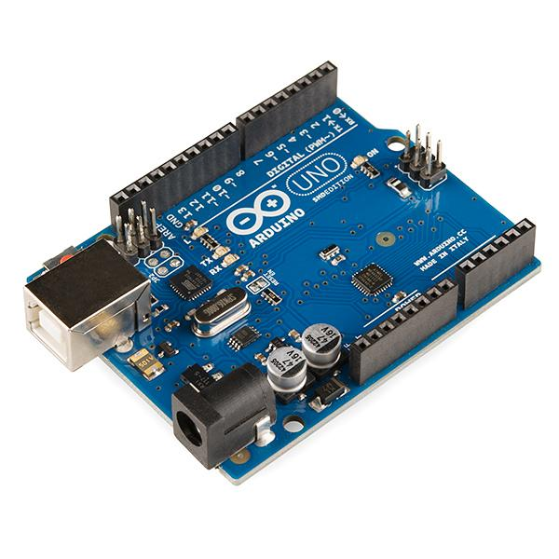
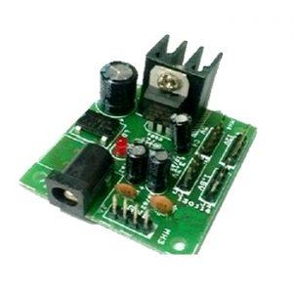
1.Arduino UNO:
Arduino UNO is a microcontroller board based on ATmega328P and it consist of 32 pins.
Arduino UNO is a low-cost, flexible, and easy-to-use programmable open-source microcontroller board that can be integrated into a variety of electronic projects.
This board can be interfaced with other Arduino boards, Arduino shields, Raspberry Pi boards and can control relays, LEDs, servos, and motors as an output.
2.Power Supply 12V:
A power supply is an electronic device that provides a constant and stable output voltage regardless of variations in input voltage or load conditions.
It is designed to maintain a steady voltage level, ensuring that electronic components and systems operate reliably and within their specified parameters.

Slide 11
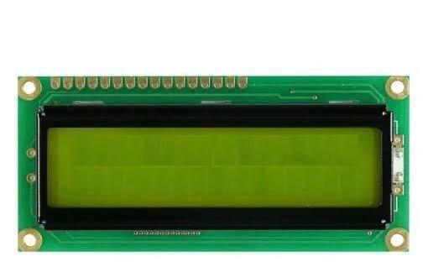
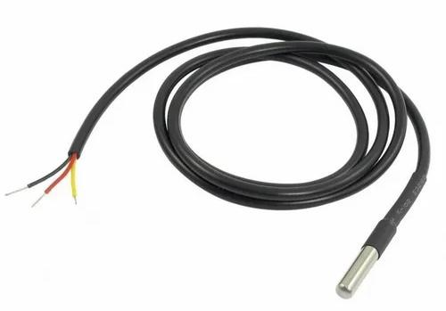
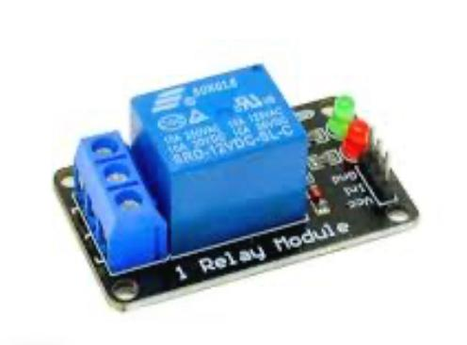
3.16x2 LCD:
A 16x2 LCD (Liquid Crystal Display) is a popular display module commonly used in embedded systems for displaying alphanumeric characters.
It comprises two lines, each capable of displaying 16 characters.
4.DS18B20(Single wire
temperature sensor):
The 1-Wire DS18B20 Digital Temperature Sensor is a widely used device for precise temperature measurement.
This sensor communicates over a single data line, simplifying wiring and reducing the number of pins needed on microcontrollers.
The DS18B20 offers a temperature range from -55°C to +125°C .
5.Relay:
A 12V relay is an electromechanical switch used to control a high-power circuit with a low-power signal.

Slide 12
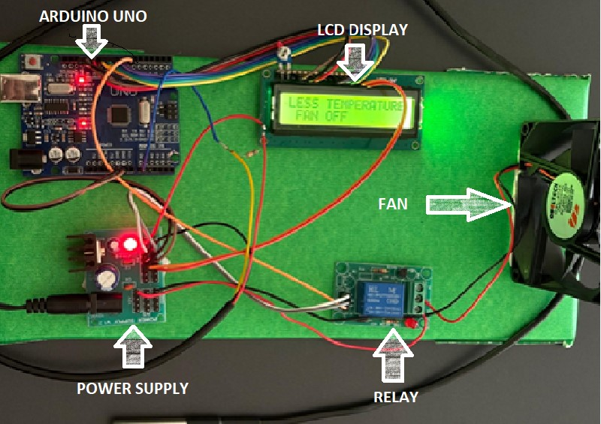
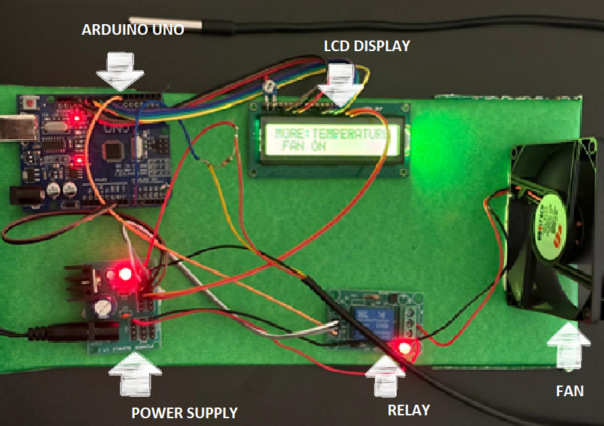
RESULT:
Temperature <30
Temperature >30

Slide 13
ADVANTAGES:
Energy Efficiency: By dynamically adjusting the fan speed based on temperature, this system conserves energy and electricity.
User-Friendly: The LCD display provides real-time temperature and fan speed information, making it easy for users to monitor and control.
Cost-Effective: The components required (such as Arduino, relay, temperature sensor, and fan) are affordable and readily available.

Slide 14
APPLICATIONS:
Personal computers.
Exhaust fans in large hotels.
Washing machines.
The circuit can be used for Car Engine to reduce the heat.
This project can be used in Home & Industry.
This will help in saving the energy / electricity.

Slide 15
Limitations:
Real-time Response: The system's response time may not be fast enough for applications requiring instant adjustments.
Cost: While the system is cost-effective, high-volume production may increase costs.
Environmental Factors: Extreme temperatures may affect the system's performance.

Slide 16
FUTURE SCOPE:
We can monitor more parameters like humidity, light and at the same time control them.
We can send this data to a remote location using mobile or internet.
We can draw graphs of variations in these parameters using computer.
When temperature exceeds the limit, a call will be dialed to the respective given number by an automatic Dialer system.

Slide 17
CONCLUSION:
Basic idea of this project is to run the DC motor fan when temperature sensed by the temperature sensor is greater than threshold value. In this project we have used Arduino board for the programming of microcontroller through the USB. The microcontroller uses the hexadecimal file to execute the program. The temperature sensor output is connected to the microcontroller and it gives the output to the relay which runs the motor. In this way our main objective of the project is achieved.

Slide 18
REFERENCE
https://www.electronicsforu.com/electronics-projects/fan-speed-control-monitoring-arduino
https://how2electronics.com/temperature-based-fan-speed-controller-using-arduino/
https://robu.in/temperature-controlled-fan-using-arduino-step-by-step-guide-with-code/
https://www.bing.com/search?q=temperature+based+fan+speed+controlling+and+monitoring+using+arduino+advantages+%2Capplications+and+future+scope&qs=n&form=QBRE&sp=-1&lq=1&pq=temperature+based+fan+speed

Slide 19

THANK YOU…

