Slide 1

STEAM MARKET ANALYSIS
Name: Boddupally Kishore
Batch: 543

Slide 2
About me
Boddupally Kishore
B-Tech in Mahaveer Institute of Science and Technology
I’ve choosen Data Analytics because I like using data to answer business questions and help teams make better, faster decisions.
Linkedin : www.linkedin.com/in/boddupally-kishore-27825a3b5
Github : Kishore1Boddupalli (Kishore Boddupalli) · GitHub

Slide 3
Agenda
Business Problem
Business Statement
Introduction
Dataset Overview
Analysis and Insights
Testing
Recommendations
Future Enhancements
Conclusion
Q&A Slide

Slide 4
BUSINESS PROBLEM
The Steam marketplace has thousands of games with no clear visibility on pricing patterns and discount trends.
There is lack of clarity on platform dominance and availability - which platform is most supported.
Raw price and discount data makes it difficult to compare value-for-money games.
Absence of structured analysis on correlation between Original Price, Final Price and Discount %.
No statistical estimation of average game pricing for the entire population.

Slide 5
BUSINESS STATEMENT
This project analyzes Steam game listings to understand how Original Price, Discount, Final Price and Platform influence market positioning.
The analysis converts scattered game data into a structured market view, enabling comparison across platforms and pricing models.
It aims to turn raw Steam data into actionable insights for better pricing and decision-making.

Slide 6
INTRODUCTION
Steam is the largest PC gaming platform with games ranging from free-to-play to premium AAA titles.
Each listing contains price, discount %, final price, platform support (Windows/Mac/Linux) and release date.
The global gaming market is growing rapidly, with pricing and discounts playing a key role in purchase decisions.
Understanding platform availability is crucial as gamers use different operating systems.
This project uses those attributes to examine pricing, discount behavior and platform strategy to reveal market trends.

Slide 7
DATASET OVERVIEW
Title - Name of the game
Original_Price - Initial price before discount
Discount - Discount % offered (0-90%)
Final_Price / Price - Price after discount
Platform - Windows / Mac / Linux support
Released_On - Game release year

Slide 8
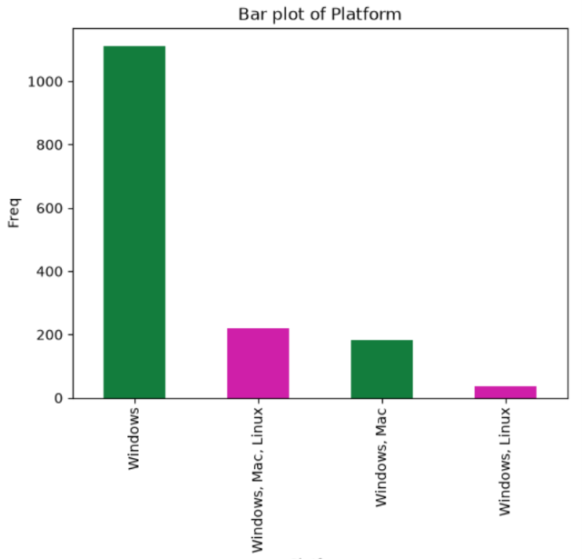
UNI-VARIATE ANALYSIS
Which platform is most supported by Steam games?
INSIGHT:
Windows - 100%,
Mac – 25.82%,
Linux – 16.53%.
So Windows is the universal platform.

Slide 9
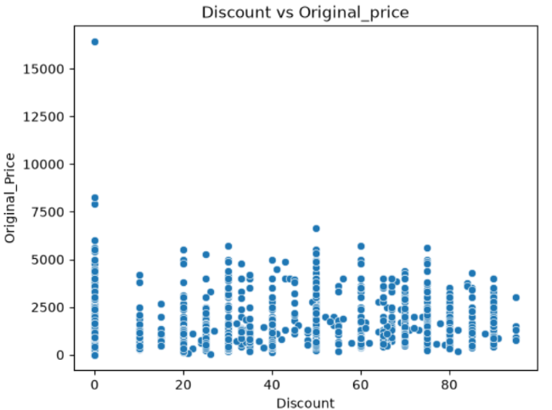
BI-VARIATE ANALYSIS
What is the relationship between Discount and Original Price?
INSIGHT:
Presence of Major Outlier: One product at 0% Discount has Original_Price of ∼16,500, with 2 more at ∼7,500-8,000, indicating a global outlier that will skew analysis
No Correlation: Discount and Original_Price show no relationship - products from 500 to 6,000 are given random discounts from 10% to 90%, showing discount is independent of price.

Slide 10
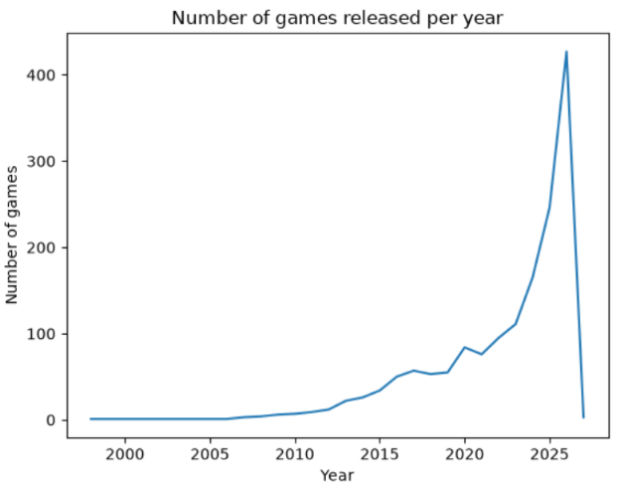
BI-VARIATE ANALYSIS
What is trend analysis of games released over the years?
INSIGHTS:
Continuous Growth: From 1 game in 1998 to 427 games in 2026, showing massive growth of Steam platform
Fastest Growth Phase: After 2020, count has approximately tripled - from 84 in 2020 to 246 in 2025
Highest Release Year is 2026: With 427 games, indicating a huge upcoming lineup / pre-registered games

Slide 11
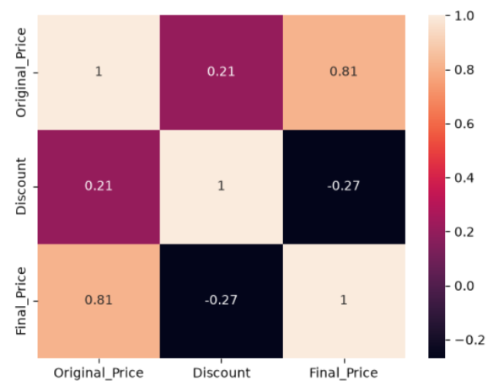
MULTI-VARIATE ANALYSIS
What is the correlation among numeric columns?
INSIGHT:
Original vs Final = 0.81 (Strong) - Final price is highly dependent on Original price
Discount vs Final = -0.27 (Negative) - As discount increases, final price decreases
Discount vs Original = 0.21 (Weak) - No strong relation

Slide 12
TESTING
OBJECTIVE: To test how games are distributed across platforms.
Hypothesis Framed:
H0 (Null): Games are equally distributed across all platforms.
H1 (Alternate): Games are NOT equally distributed, one platform dominates.
TEST PERFORMED: Chi-Square
INTERPRETATION: The distribution is NOT uniform. There is a statistically significant difference between platforms. Windows has a significantly higher number of games compared to Linux and Mac. This proves Windows is the dominant platform in the Steam dataset and the difference is not due to random chance.
CONCLUSION: Since P-Value < 0.05, we Reject H0 and we can conclude that games are not equally distributed.

Slide 13
TESTING
OBJECTIVE: To check whether game price depends on platform support.
Hypothesis Framed:
H0: Average price is same for all 3 platform groups.
H1: Average price is different for at least one platform group.
TEST PERFORMED: Anova
INTERPRETATION: There is a statistically significant difference in pricing based on platform support. Games that support Windows, Mac, Linux (all three) are priced differently than games that support only Windows. This suggests that development cost for multi-platform support affects the final price. Windows-only games have more low-cost/free titles, while multi-platform games are priced higher.
CONCLUSION: Since P < 0.05, we Reject H0. We can conclude that the price does not depend upon the platform support

Slide 14
RECOMMENDATIONS
Focus on Low-Price Segment: 90% games are sold in 0-500 range, so pricing new games in this range will get more buyers.
Smart Discount Strategy: Give discounts on mid-range games (<3000) to boost sales, avoid high discounts on premium AAA titles.
Protect Premium Value: Most expensive games (∼16k) are kept at 0% discount to maintain brand value - follow same strategy.

Slide 15
FUTURE ENHANCEMENTS
Price Prediction Model: Build a Machine Learning regression model (Random Forest, XGBoost) to predict the final_price of a game based on features like genre, platform, ratings, and discount.
Game Recommendation System: Develop a content-based recommendation system that suggests similar games to users based on their played history, just like Netflix or Spotify.
Sales and Demand Forecasting: Incorporate release date, seasonality, and discount trends to forecast future sales and identify the best time to launch a game.
Cross-Platform Strategy: Analyze the ROI of developing for multiple platforms. By combining development cost estimation with sales data, we can determine if porting a Windows game to Mac/Linux is financially profitable or if focusing on Windows-only yields higher returns. This will help indie developers make data-driven decisions on cross-platform launches

Slide 16
CONCLUSION
This project analyzes Steam games pricing data to understand price distribution, discount strategy, and correlation between pricing factors.
The platform is dominated by low-cost games, making gaming affordable for a large audience.
Discounts are strategically used to increase sales of mid-range games, not for premium titles.
This analysis can help developers to set competitive pricing and Steam to optimize discount campaigns for higher revenue.

Slide 17
QUERIES..??

Slide 18

THANK YOU

