Slide 1
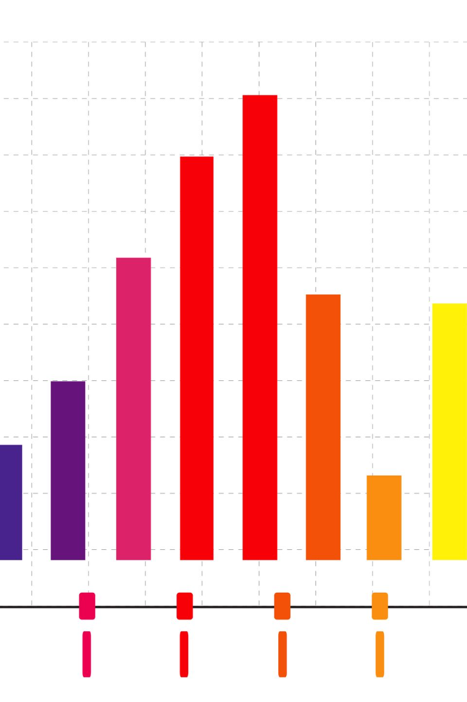
Data Exploration and Visualization for Product Sales Analysis
Data exploration involves getting familiar with your dataset to understand its structure and characteristics. You can start by examining summary statistics, such as mean, median, and standard deviation, to gain an overview of the data. Explore the distribution of data using histograms, box plots, or density plots to identify patterns and outliers.
Data visualization is the process of representing data visually using charts, graphs, and plots to make patterns and insights more accessible. Common visualization types include bar charts, line charts, scatter plots, histograms, pie charts, and heatmaps. Choose the appropriate visualization type based on the nature of the data and the insights you want to convey.
JS

Slide 2

Data Cleaning and Pre-processing
1
Data Validation
2
Normalization
3
Feature Engineering
Identify and fix inconsistencies, missing values, and outliers to ensure data quality.
Transform data into a consistent format to facilitate meaningful analysis and comparisons.
Create new variables or modify existing ones to extract valuable insights from the data.

Slide 3
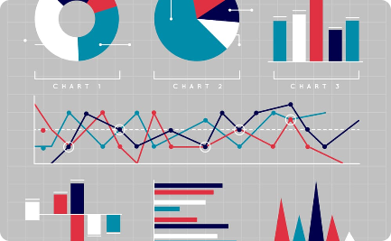
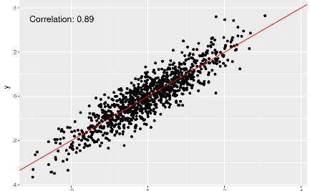
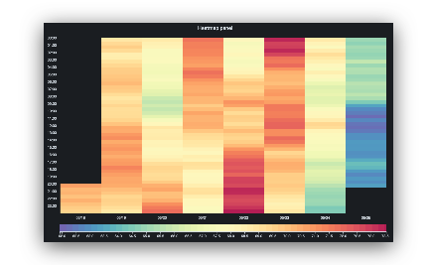
Exploratory Data Analysis
Descriptive Statistics
Data Distribution
Categorical Analysis
Summarize and analyze the main characteristics of the data, such as mean, median, and standard deviation.
Visualize the distribution of data points to identify patterns, outliers, and potential correlations.
Examine the relationship between categorical variables to gain insights into customer preferences and behavior.

Slide 4
Visualizing Data for Insights
1
Bar Charts
Compare sales across different products, regions, or time periods using the power of visual representation.
2
Line Graphs
Track sales trends over time and identify growth opportunities or seasonal fluctuations.
3
Heatmaps
Uncover patterns and correlations in sales data using color-coded grids.

Slide 5
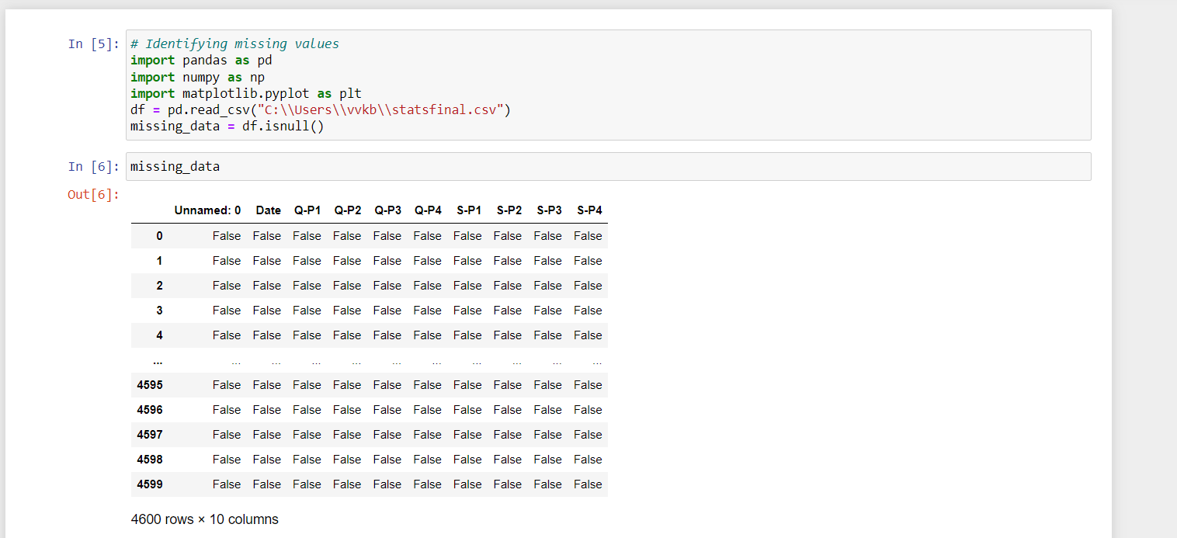
DATA EXPLORATORY
Missing data
Missing Data can occur when no information is provided for one or more items or for a whole unit. Missing Data is a very big problem in a real-life scenarios. Missing Data can also refer to as NA(Not Available) values in pandas. In DataFrame sometimes many datasets simply arrive with missing data, either because it exists and was not collected or it never existed.

Slide 6
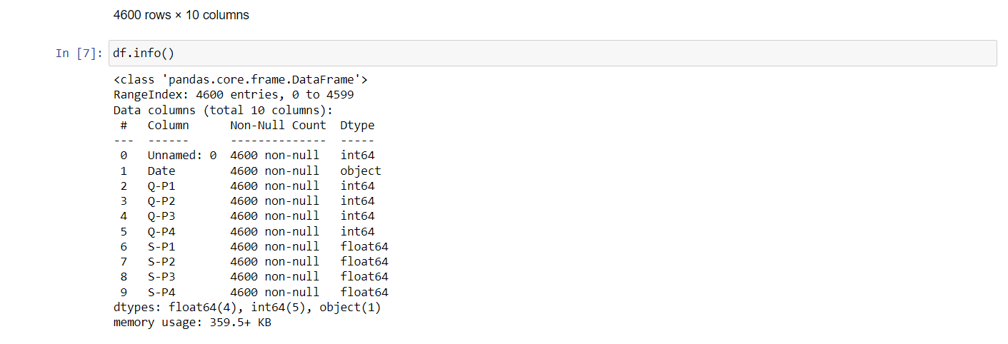
df.info()
df.info() is a commonly used method in data exploration and visualization with Pandas, a popular Python library for data manipulation and analysis. It provides valuable information about a DataFrame, which is a primary data structure in Pandas. When you call df.info(), it typically displays the following:The number of non-null (non-missing) values in each column.The data type of each column (e.g., integer, float, object, etc.).The memory usage of the DataFrame.

Slide 7
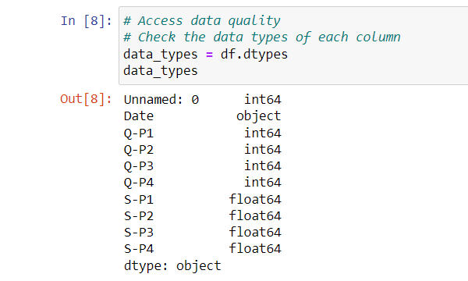
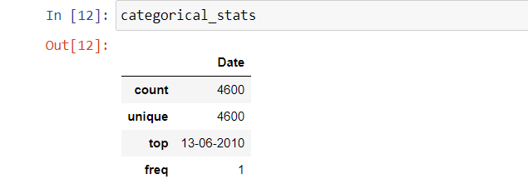
df.dtypes
In Python, particularly when using the Pandas library, you can use the df.dtypes attribute to check the data types of each column (or Series) in a DataFrame. This is useful for understanding the data structure of your dataset. Pandas DataFrame is a two-dimensional size-mutable, potentially heterogeneous tabular data structure with labeled axes (rows and columns). Arithmetic operations align on both row and column labels.
Categorical stats
Categoricals are a pandas data type corresponding to categorical variables in statistics. A categorical variable takes on a limited, and usually fixed, number of possible values (categories; levels in R). While the latter two variables may also be considered in a numerical manner by using exact values for age and highest grade completed, it is often more informative to categorize such variables into a relatively small number of groups.

Slide 8
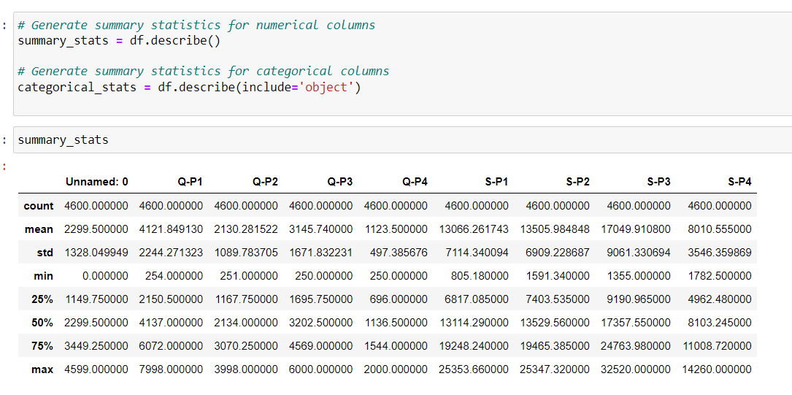
Summary_stats
Descriptive or summary statistics in python – pandas, can be obtained by using the describe() function. The describe() function gives us the count , mean , standard deviation(std) , minimum , Q1(25%) , median(50%) , Q3(75%) , IQR(Q3 - Q1) and maximum values.

Slide 9
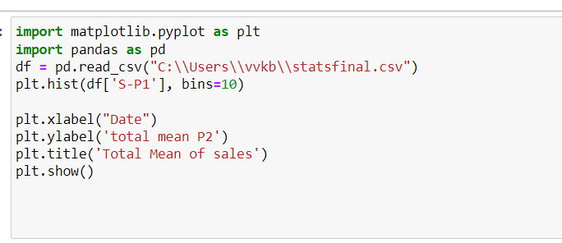
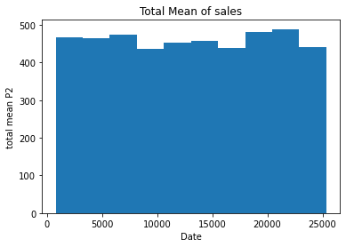
Visualization
Visualization (graphics), the physical or imagining creation of images, diagrams, or animations to communicate a message. Data and information visualization, the practice of creating visual representations of complex data and information.
The graphic depiction of data and information is known as data visualization. Converting unstructured data into visual representations like maps, charts, graphs, and infographics helps users comprehend the data's patterns, trends, and relationships
The total mean of product 2 is represented in histogram
The mean is the average or the most common value in a collection of numbers. In statistics, it is a measure of central tendency of a probability distribution along median and mode. It is also referred to as an expected value. It is a statistical concept that carries a major significance in finance.

Slide 10
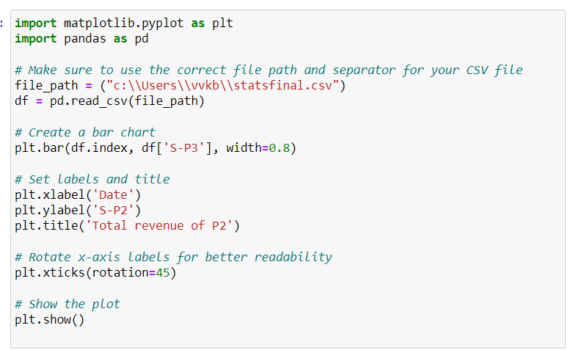
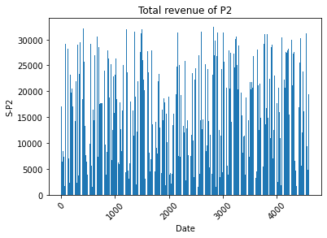
Data visualization is the representation of information and data using charts, graphs, maps, and other visual tools. These visualizations allow us to easily understand any patterns, trends, or outliers in a data set.
Data visualization also presents data to the general public or specific audiences without technical knowledge in an accessible manner. For example, the health agency in a government might provide a map of vaccinated regions.
The purpose of data visualization is to help drive informed decision-making and to add colorful meaning to an otherwise bland database.
The total mean of product 2 is represented in line graph
Revenue meaning is the money that is produced by carrying out normal business operations and is calculated by multiplying the average sales price by the number of items sold. It is the total sum of money from which other costs and expenses are subtracted to calculate net income.

Slide 11
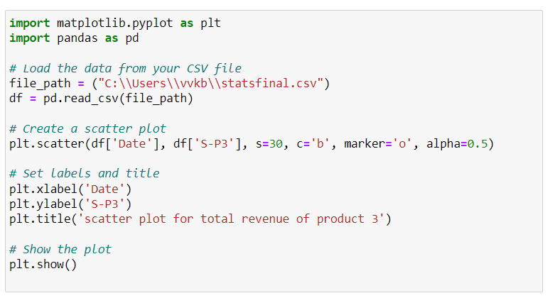
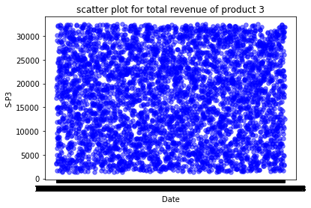
Data visualization is the practice of translating information into a visual context, such as a map or graph, to make data easier for the human brain to understand and pull insights from. The main goal of data visualization is to make it easier to identify patterns, trends and outliers in large data sets. The term is often used interchangeably with others, including information graphics, information visualization and statistical graphics.
Data visualization is one of the steps of the data science process, which states that after data has been collected, processed and modeled, it must be visualized for conclusions to be made. Data visualization is also an element of the broader data presentation architecture (DPA) discipline, which aims to identify, locate, manipulate, format and deliver data in the most efficient way possible
Scatter plots are the graphs that present the relationship between two variables in a data-set. It represents data points on a two-dimensional plane or on a Cartesian system. The independent variable or attribute is plotted on the X-axis, while the dependent variable is plotted on the Y-axis. These plots are often called scatter graphs or scatter diagrams.

Slide 12
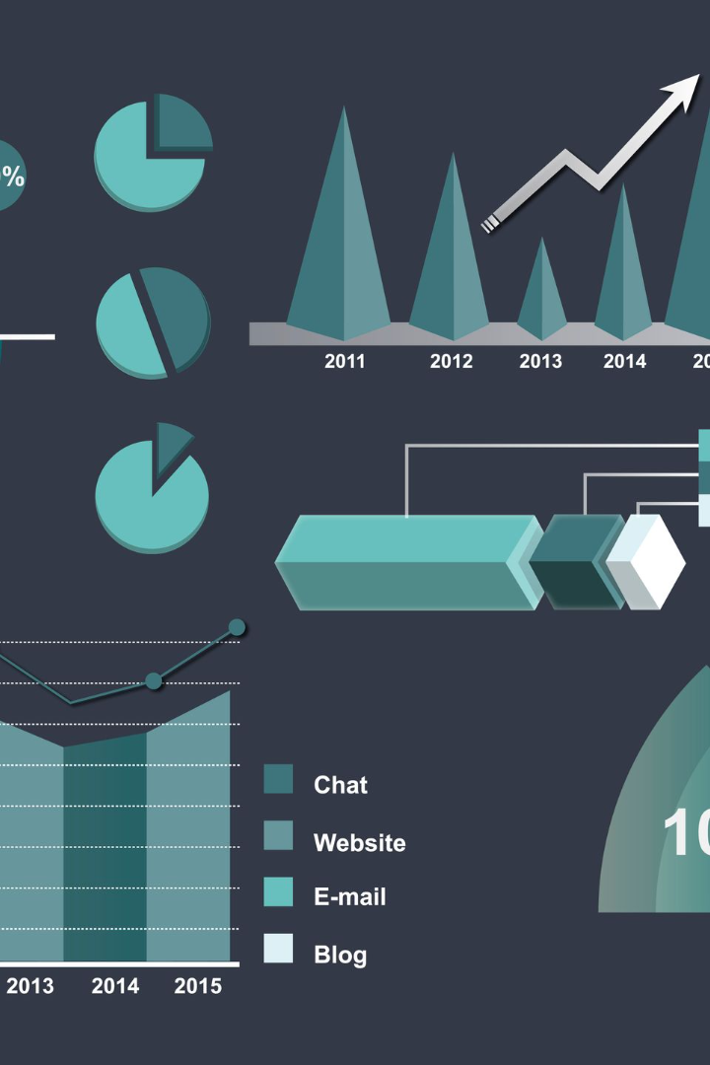

Supervised Learning-Regression for Product Sales Analysis
Discover how supervised learning regression can revolutionize your product sales analysis. Explore key concepts, data preparation, model building, and real-world applications.
JS

Slide 13

Why is it Relevant for Product Sales Analysis?
Supervised learning regression provides valuable insights into sales trends, patterns, and factors affecting product sales. With accurate sales predictions, businesses can make informed decisions, optimize pricing strategies, and improve demand forecasting.

Slide 14

Applications of Supervised Learning Regression in Product Sales Analysis
1
Demand Forecasting
2
Pricing Optimization
3
Customer Segmentation
Predict future product demand to optimize inventory management and production planning.
Utilize regression models to determine the optimal pricing strategy for maximizing profit while meeting customer demand.
Segment customers based on purchasing behavior to target marketing efforts, personalize offers, and enhance customer satisfaction.

Slide 15
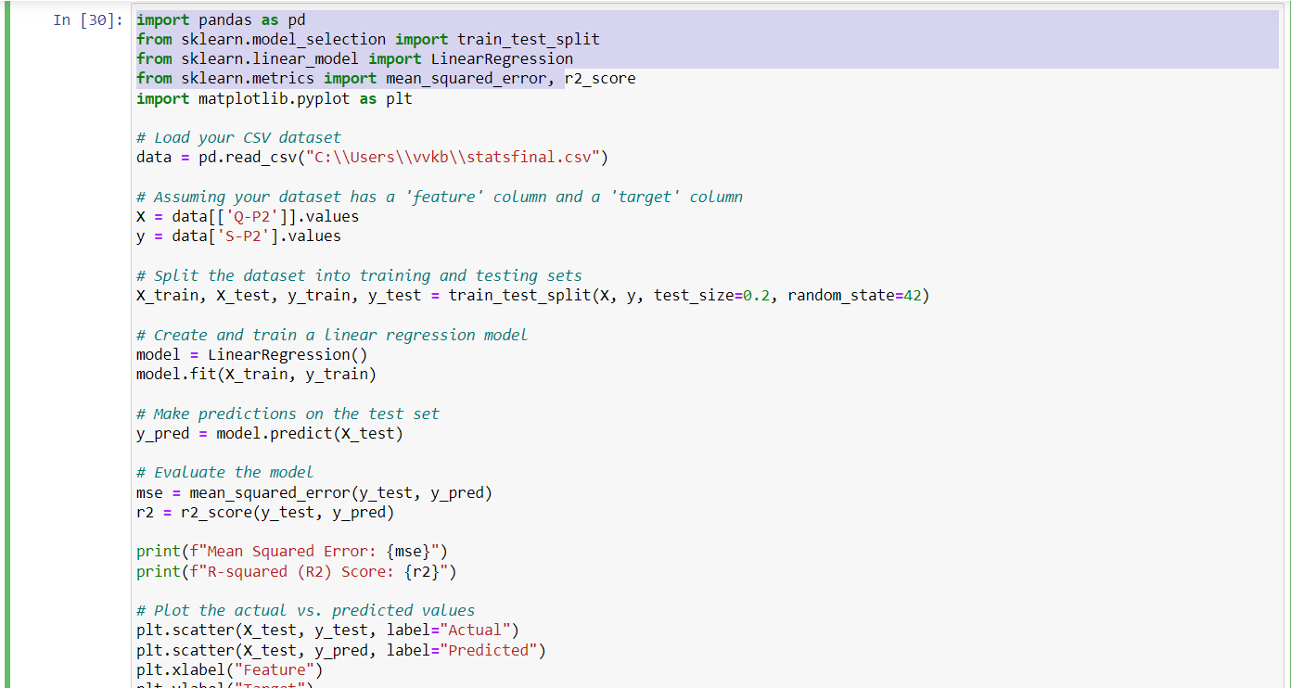
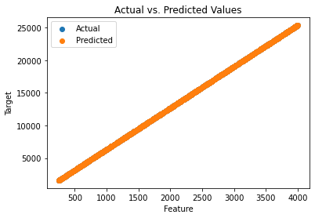
Supervised Learning Regression
Formulating a regression analysis helps you predict the effects of the independent variable on the dependent one. Example: we can say that age and height can be described using a linear regression model. Since a person's height increases as age increases, they have a linear relationship
Regression is a statistical method used in finance, investing, and other disciplines that attempts to determine the strength and character of the relationship between one dependent variable (usually denoted by Y) and a series of other variables (known as independent variables).

Slide 16

CONCLUSION
Conclusions. Regression analysis is a powerful and useful statistical procedure with many implications for nursing research. It enables researchers to describe, predict and estimate the relationships and draw plausible conclusions about the interrelated variables in relation to any studied phenomena.

