Slide 1

Product Sales Analysis

Slide 2
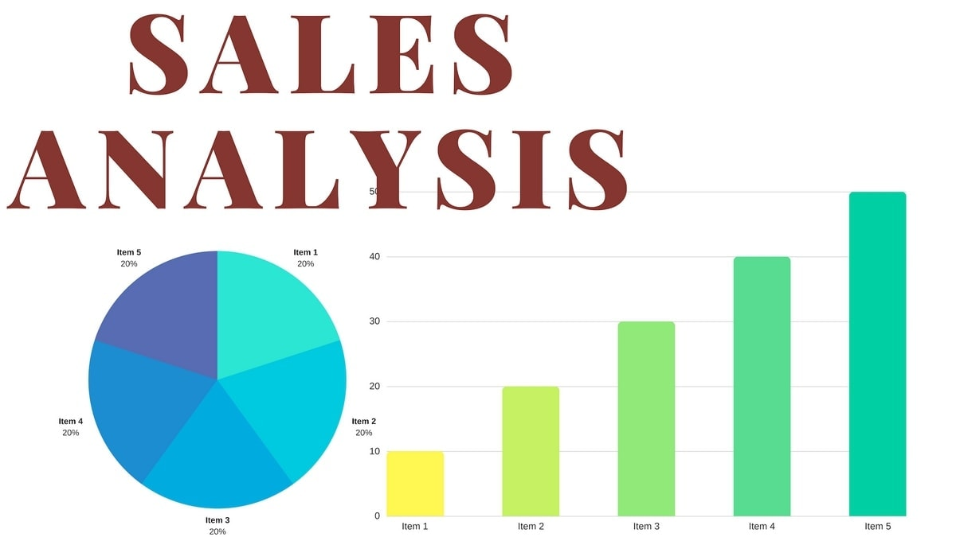
PRODUCT SALES ANALYSIS
Product sales analysis is a method of evaluating and interpreting data related to the sales of a product or group of products.
It involves examining factors such as sales trends, customer demographics, pricing strategies, and profitability to gain insights into how well a product is performing in the market.
This analysis helps businesses make informed decisions to optimize their sales and marketing strategies, manage inventory effectively, and maximize revenue and profit.

Slide 3
BENEFITS OF PRODUCT SALES ANALYSIS
BENEFITS OF SALES ANALYSIS
Product sales analysis offers several benefits to businesses, helping them make informed decisions and improve their overall performance. Here are some of the key advantages:
1.Improved Decision-Making: Sales analysis provides data-driven insights, enabling businesses to make informed decisions about pricing, marketing, and inventory management.
2.Identifying Trends: It helps identify sales trends over time, allowing companies to adjust strategies based on seasonal variations or changing customer preferences.
3.Customer Insights: Analysis reveals customer demographics and buying behaviors, aiding in targeted marketing and product development.
4.Competitor Benchmarking: Comparing sales performance with competitors helps companies understand their market position and make competitive adjustments.

Slide 4
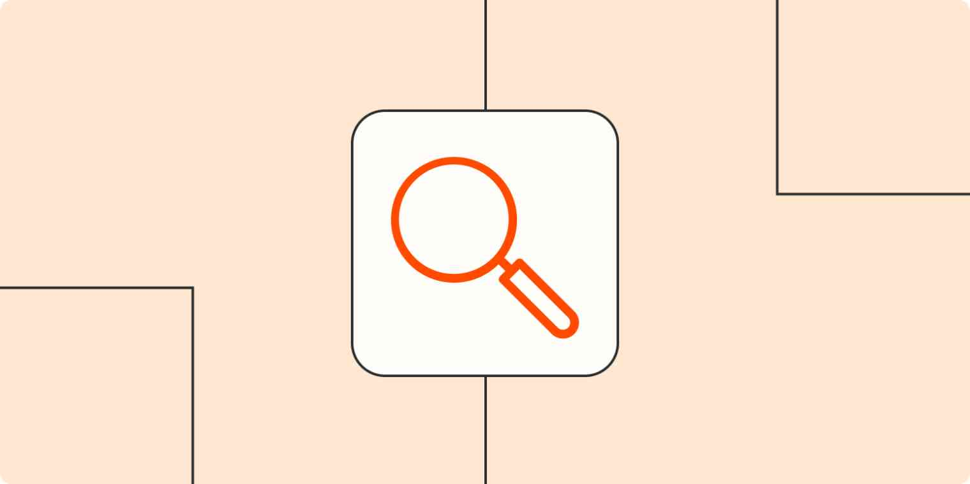
Importance of Product Sales Analysis
1
Understanding Customer Demand
2
Identifying Best-Selling Products
3
Analyzing Sales Trends
By analyzing product sales, we can gain insights into customer preferences, helping us tailor our offerings to meet their needs.
Analyzing sales data allows us to identify the products that are driving our success and prioritize their promotion.
By studying sales patterns over time, we can spot trends and make data-driven decisions to optimize our strategies.

Slide 5
ANALYSING SALES TRENDS
ANALYZING SALES TRENDS
1.Time Period Analysis:Examining sales patterns and trends over different time periods allows for informed decision-making and helps identify opportunities for improvement.
2.Seasonal Trends:Uncover the impact of seasons on purchasing behavior and leverage this knowledge to optimize marketing strategies and inventory management.
3.Geographic Analysis:Analyze sales data by region or location to identify geographical strengths and weaknesses, revealing untapped markets and potential challenges.

Slide 6
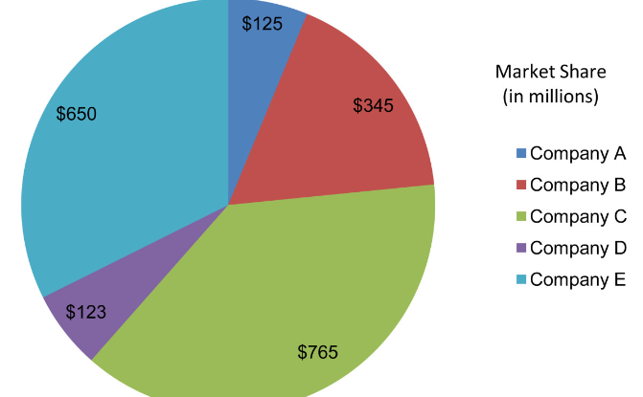
IDENTIFYING TOP SELLING PRODUCTS
Product Performance Metrics
Market Share Analysis
Utilize product performance metrics to identify your top-selling products, empowering you to focus on what drives revenue and customer satisfaction
Gain insights into your market share and compare it to competitors. Understanding your position in the market helps you refine your strategies and stay ahead of the competition.

Slide 7
SD
Methods of Analyzing Product Sales
1
Sales Data Collection
Collecting accurate and comprehensive sales data is the foundation of effective analysis. Implement robust data collection systems and automate data capture wherever possible.
2
Data Analysis Techniques
Utilize statistical analysis, data mining, and machine learning techniques to extract valuable insights from raw sales data, enabling us to make informed decisions.
3
Visualization of Sales Data
Presenting sales data in visually appealing formats such as charts and graphs improves understanding and facilitates better communication of insights to stakeholders.

Slide 8

Key Metrics for Product Sales Analysis
Total Sales Revenue
Sales by Product Category
Sales by Region
Measure the overall financial performance of our products and evaluate our growth trajectory.
Analyze sales performance in different geographic regions to identify opportunities for expansion or optimize distribution channels.
Understand which product categories are the most profitable and allocate resources strategically.

Slide 9

Steps Involved in Data Analysis
Step 1: Data Collection and Preparation
Define your data sources and collect the data. Check for missing values and remove duplicate records before proceeding.
Step 2: Data Cleaning and Transformation
Remove noisy data, perform data normalization, and categorize data. Develop data preprocessing techniques that are relevant to your analysis goals.
Step 3: Data Exploration and Visualization
Visualize data to reveal patterns, trends, and correlations. Use numerous data exploration tools to gain insights and transform data into a format conducive to analysis.
Step 4: Data Modeling and Analysis
Choose an appropriate model, develop predictive models, and conduct statistical analysis, identify relationships between variables, and run models to forecast trends.
Step 5: Communication of Findings and Insights.
Create a report of your findings and communicate them effectively to the audience using useful visualizations. Draw meaningful conclusions and propose recommendations.

Slide 10

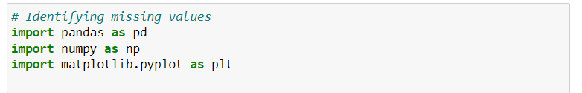

Step 1: Import Libraries
In this step, you import the necessary libraries. pandas is a powerful library for data analysis in Python.
Step 2: Load the Data
This code reads the data from the CSV file into a pandas DataFrame, which is a two-dimensional labeled data structure
The dataset is downloaded from Kaggle website.
Kaggle is one of the largest communities of data scientists and machine learning practitioners in the world, and its platform hosts thousands of datasets covering a wide range of topics and industries.

Slide 11
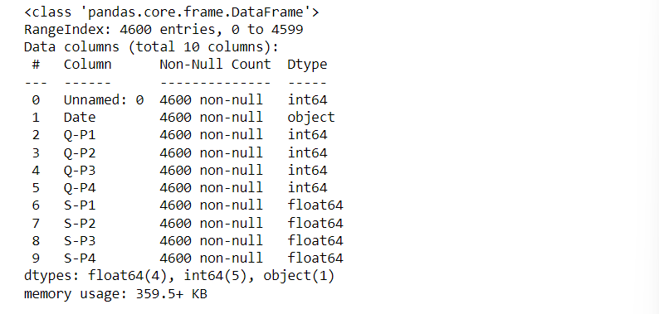
Step 3: Explore the data
The info() method prints information about the DataFrame. The information contains the number of columns, column labels, column data types, memory usage, range index, and the number of cells in each column (non-null values). Note: the info() method actually prints the info.

Slide 12
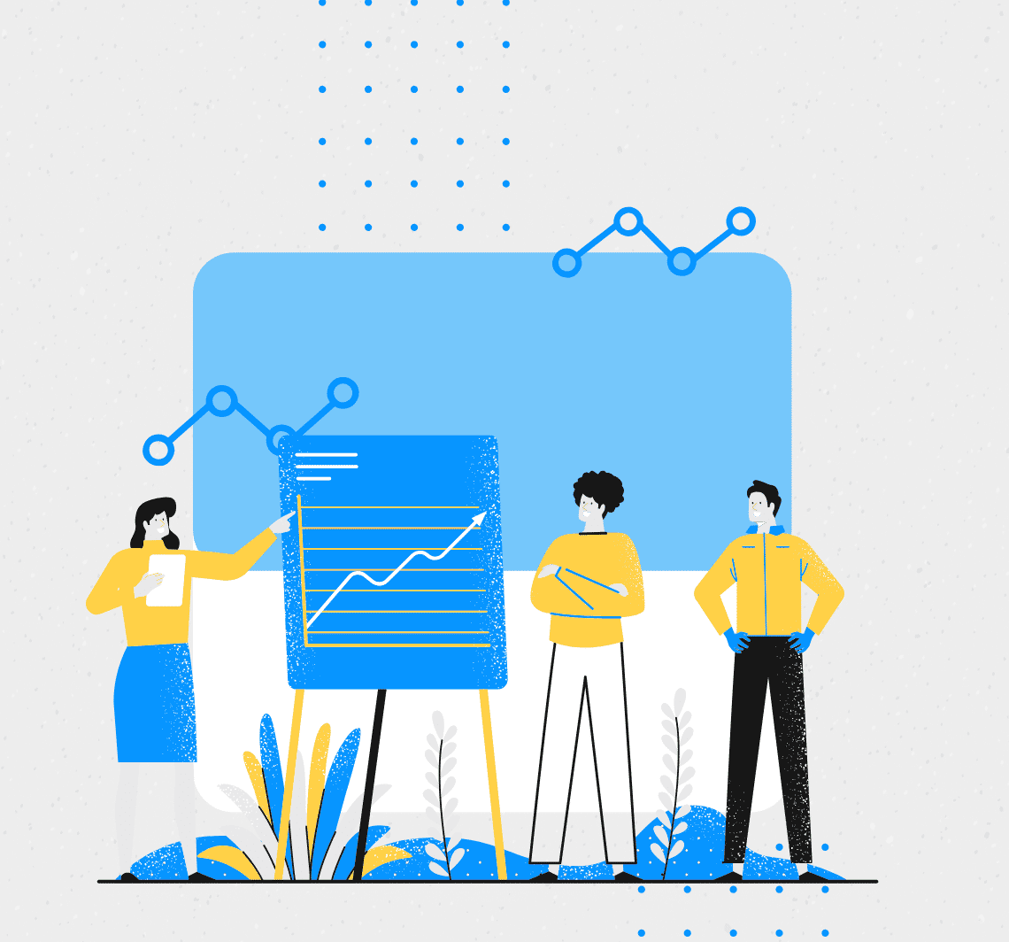
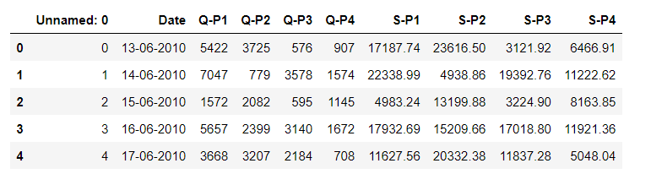
Definition and Usage. The head() method returns a specified number of rows, string from the top. The head() method returns the first 5 rows if a number is not specified. Note: The column names will also be returned, in addition to the specified rows.

Slide 13
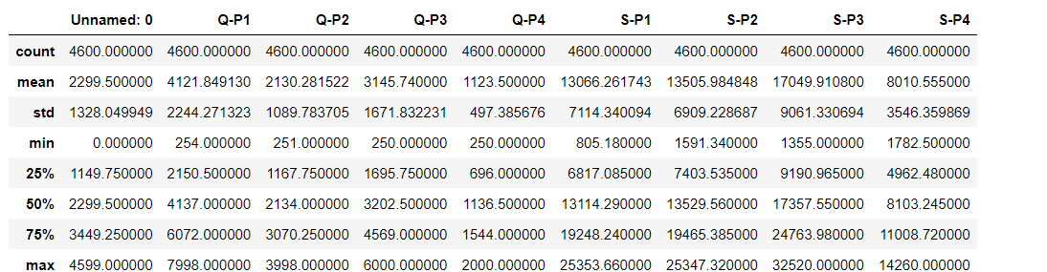

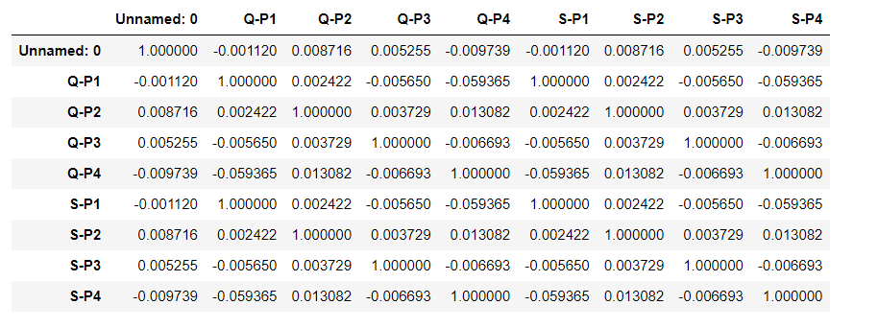
The describe() method returns description of the data in the DataFrame. If the DataFrame contains numerical data, the description contains these information for each column: count - The number of not-empty values. mean - The average (mean) value.
The corr() method calculates the relationship between each column in your data set.

Slide 14
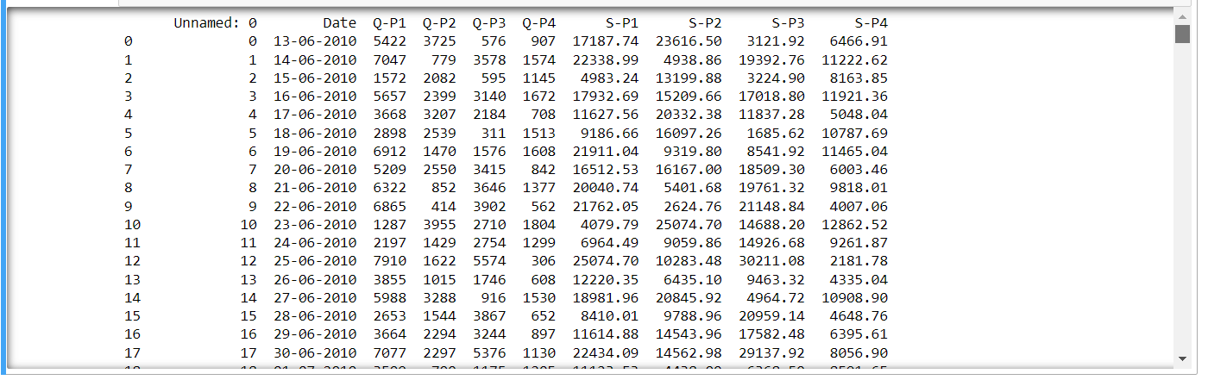
Step 4: Data Cleaning
Data cleansing, also referred to as data cleaning or data scrubbing, is the process of fixing incorrect, incomplete, duplicate or otherwise erroneous data in a data set. It involves identifying data errors and then changing, updating or removing data to correct them.

Slide 15
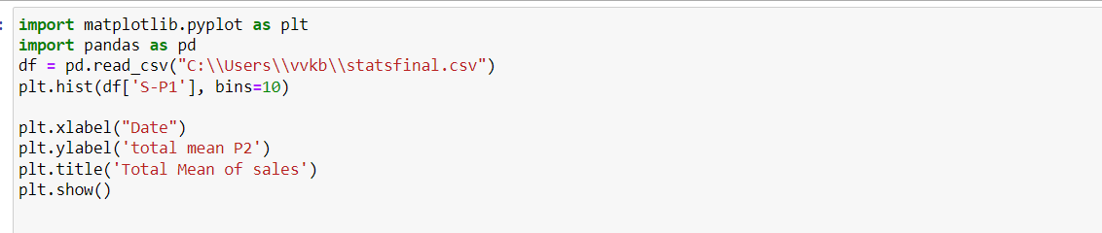
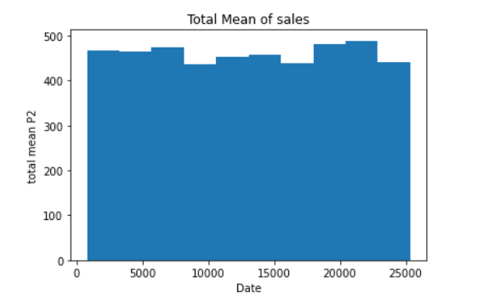
Step 5: Data Visualization
The process of finding trends and correlations in our data by representing it pictorially is called Data Visualization. To perform data visualization in python, we can use various python data visualization modules such as Matplotlib, Seaborn, Plotly, etc

Slide 16
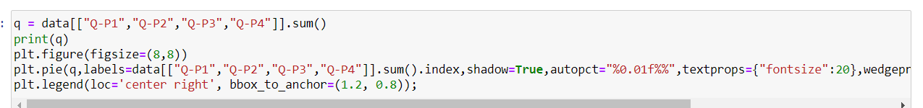
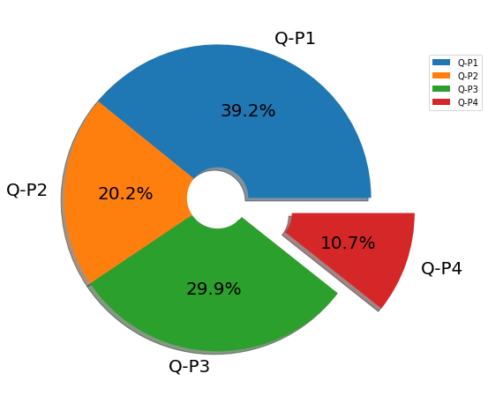
Step 6: Data Analysis and Manipulation
Python can quickly create and manage data structures, allowing you to analyze and manipulate complex data sets. Python also has a massive ecosystem of libraries and tools that can assist in processing data quickly and efficiently. It features simple syntax, making Python easier to learn and understand.

Slide 17
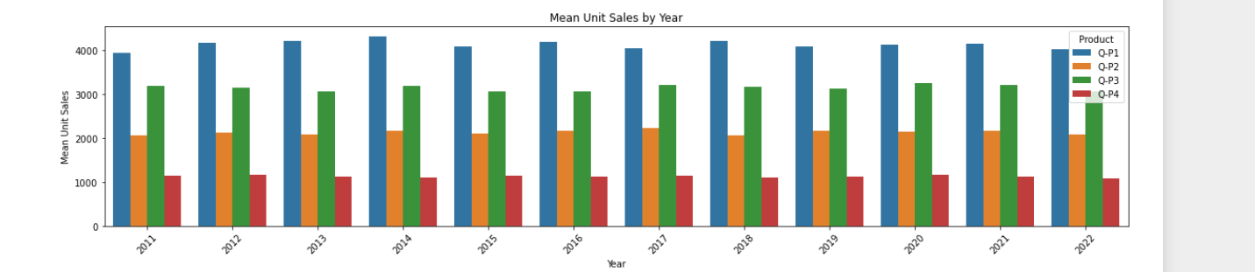
Analysing the data of the dataset the mean value of four products has been manipulated using bargraph
The bar chart displays data using a number of bars, each representing a particular category. The height of each bar is proportional to a specific aggregation (for example the sum of the values in the category it represents). The categories could be something like an age group or a geographical location.
Mean unit sales of year by product 1, product 2, product 3 and product 4 in histogram representation.

Slide 18

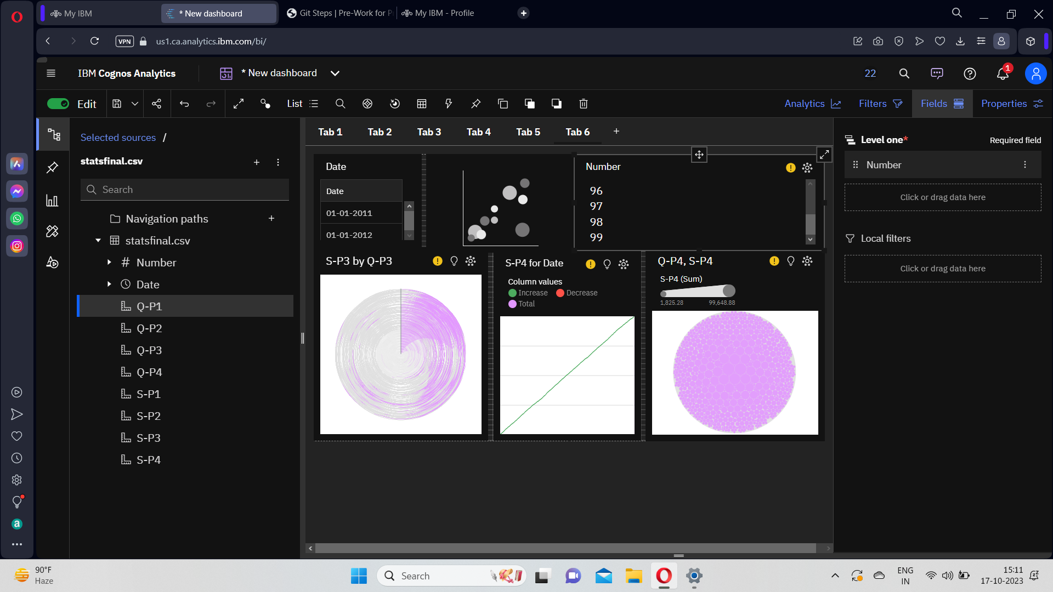
IBM COGNOS ANALYTICS IBM Cognos Analytics integrates reporting, modeling, analysis, dashboards, stories, and event management so that you can understand your organization's data, and make effective business decisions.
the act of studying or examining something in detail, in order to discover or understand more about it, or your opinion and judgment after doing this: Our financial experts conducted an independent analysis of the investment plan's performance. I was interested in Clare's analysis of the situation.

Slide 19
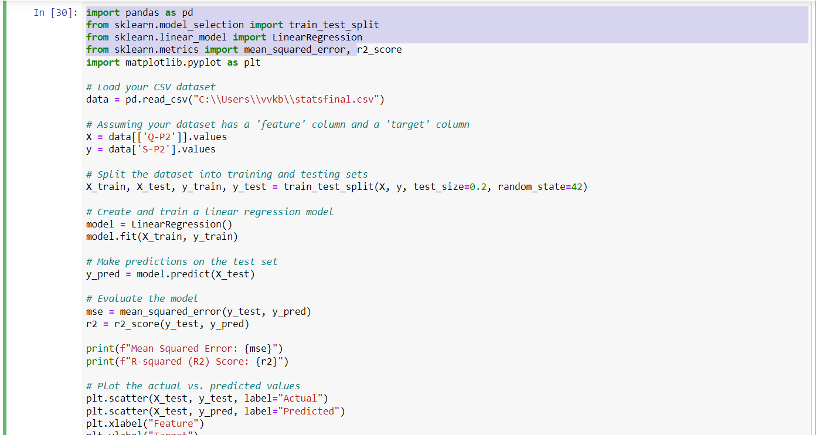
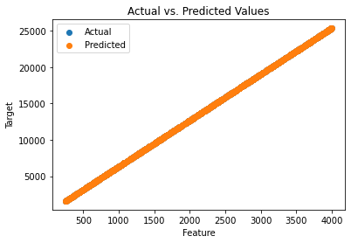
Supervised Learning Regression
Formulating a regression analysis helps you predict the effects of the independent variable on the dependent one. Example: we can say that age and height can be described using a linear regression model. Since a person's height increases as age increases, they have a linear relationship
Regression is a statistical method used in finance, investing, and other disciplines that attempts to determine the strength and character of the relationship between one dependent variable (usually denoted by Y) and a series of other variables (known as independent variables).

Slide 20

CONCLUSION
Conclusions. Regression analysis is a powerful and useful statistical procedure with many implications for nursing research. It enables researchers to describe, predict and estimate the relationships and draw plausible conclusions about the interrelated variables in relation to any studied phenomena.

