Slide 1
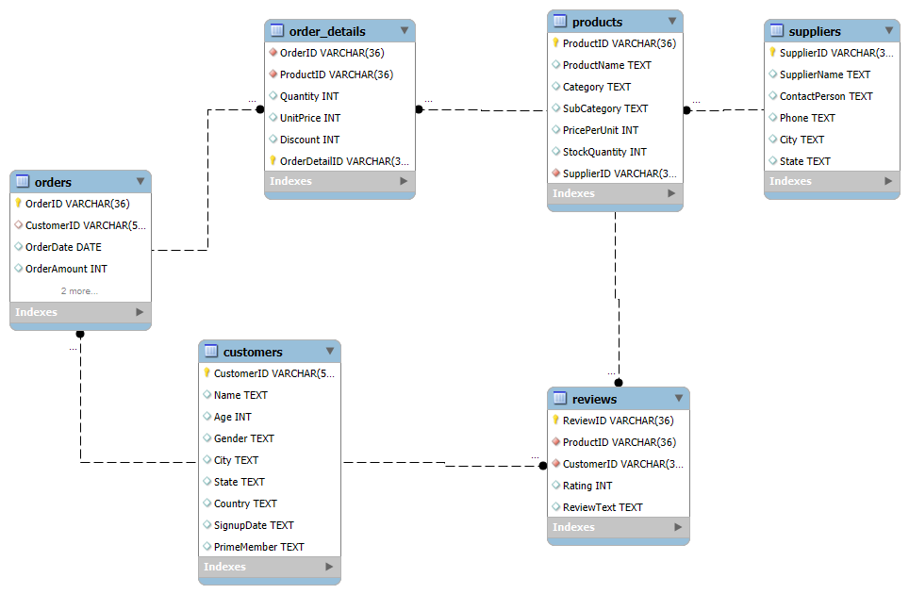
Task 1: Designing the ER Diagram for the Database

Slide 2
Task 2: Defining Primary and Foreign Key Relationships
Customers Table:
Primary Key: CustomerID (This uniquely identifies each customer).
No Foreign Key in this table.
Products Table:
Primary Key: ProductID (This uniquely identifies each product).
Foreign Key: SupplierID references Suppliers(SupplierID).
Orders Table:
Primary Key: OrderID (This uniquely identifies each order).
Foreign Key: CustomerID references Customers(CustomerID).
Order_Details Table:
Primary Key: Composite of OrderID and ProductID (Together, they uniquely identify each order detail).
Foreign Keys:
OrderID references Orders(OrderID).
ProductID references Products(ProductID).
Reviews Table:
Primary Key: ReviewID (This uniquely identifies each review).
Foreign Keys:
ProductID references Products(ProductID).
CustomerID references Customers(CustomerID).

Slide 3
Task 3: Retrieving Customer and Product Information
Retrieved customers from a specific city – Created a query to filter customers based on their city.
b10b93c8-d812-4bc0-8016-7a637bab554d | Thomas Moore | 53 | Female | Lake Jeffreyfurt | Massachusetts | India | 2022-05-13 | No

Slide 4
Task 4 — DDL Statements & Data Constraints
.
Used ALTER TABLE to add constraints without dropping existing data.
Set CustomerID as the PRIMARY KEY to uniquely identify each customer.
Enforced data validation with CHECK (Age ≥ 19) and NOT NULL on Age.
Added UNIQUE constraint to Name after cleaning duplicate entries.

Slide 5
Task 5: Inserting New Product Entries into the Database
In this task, we inserted 3 new products into the Products table with unique ProductIDs, categories, and prices.
ProductID | ProductName | Category | SubCategory | PricePerUnit | StockQuantity | SupplierID
bdbd2e3d-b99b-4c9d-8234-fbd9e50e3c30 | Fresh Apple | Fruits | Sub-Fruits-1 | 150 | 300 | 0658c953-98c4-4d00-bf29-4fbfe4aca4cd
c0ef7386-5067-4776-b60a-0ac75f3a96a8 | Healthy Snack Bar | Snacks | Sub-Snacks-2 | 200 | 250 | cb890936-8142-4fa3-ac60-2ecba78f8aa8
0a8d3b8f-44b5-4cbf-bf22-44f3fae7b8f2 | Organic Milk | Dairy | Sub-Dairy-1 | 90 | 500 | 16c44a77-d01f-4154-a7b7-1f5b5dee4255

Slide 6
Task 6: Updating Product Stock Quantity
ProductID | ProductName | Category | SubCategory | PricePerUnit | StockQuantity (Updated) | SupplierID
bdbd2e3d-b99b-4c9d-8234-fbd9e50e3c30 | Fresh Apple | Fruits | Sub-Fruits-1 | 150 | 350 | 0658c953-98c4-4d00-bf29-4fbfe4aca4cd

Slide 7
Task 7: Removing Supplier Data from the Database
SupplierID | SupplierName | City | ContactNumber
0658c953-98c4-4d00-bf29-4fbfe4aca4cd | Fresh Supplies Ltd | Maine | +1 800 555 1234
Input:
DELETE FROM Suppliers
WHERE City = 'Maine’;
Output:
We delete a supplier from the Suppliers table where the city is Maine
No suppliers from 'Maine' remain.

Slide 8
Task 8: Implementing SQL Constraints for Data Integrity
Input:
ALTER TABLE Reviews
ADD CONSTRAINT chk_rating CHECK (Rating BETWEEN 1 AND 5);
ALTER TABLE Customers
MODIFY PrimeMember VARCHAR(3) DEFAULT 'No';
Output:
12:26:39 ALTER TABLE Reviews ADD CONSTRAINT chk_rating CHECK (Rating BETWEEN 1 AND 5) 2000 row(s) affected Records: 2000 Duplicates: 0 Warnings: 0 0.078 sec
12:28:15 ALTER TABLE Customers MODIFY PrimeMember VARCHAR(3) DEFAULT 'No' 0 row(s) affected Records: 0 Duplicates: 0 Warnings: 0 0.047 sec

Slide 9
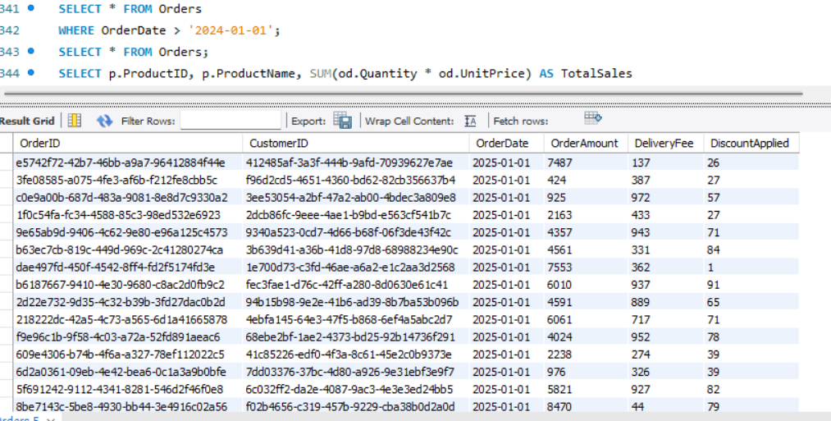
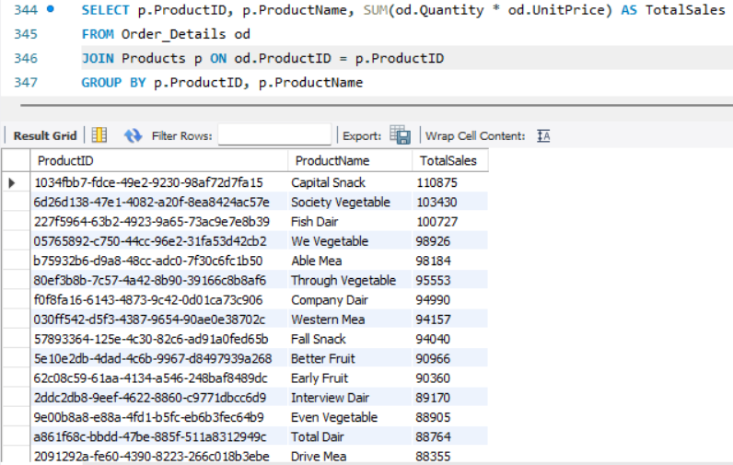
Task 9: Filtering and Aggregating Data with SQL Clauses
Filtering Orders by Date:
Aggregating Product Sales:

Slide 10
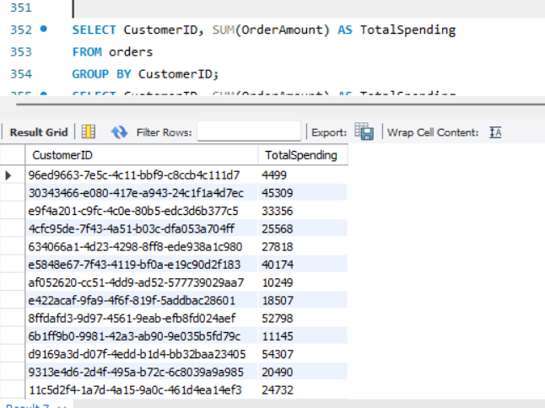
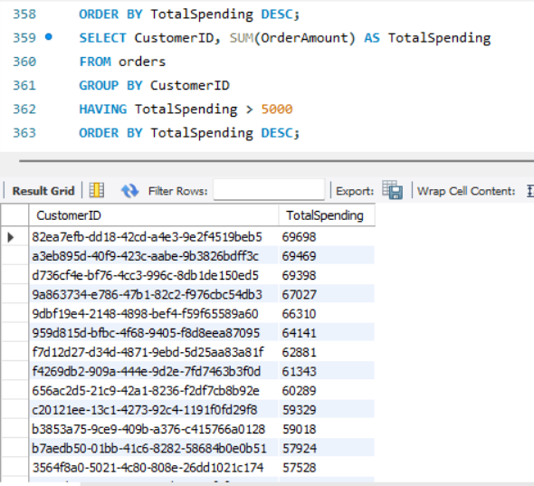
Task 10: Identifying High-Value Customers Based on Spending
Calculating Total Spending for Each Customer:
Identifying Customers Who Spent Over ₹5,000:

Slide 11
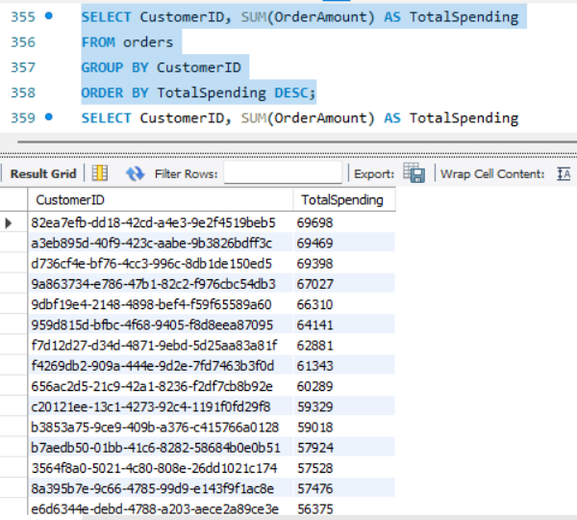
Ranking Customers Based on Their Total Spending:

Slide 12
Task 11: Analyzing Orders and Identifying Key Customers
1. Total Revenue Per Order
Calculated the total revenue for each order by multiplying Quantity and UnitPrice from the Order_Details table.
Example: OrderID 000037f7-142c-4349-a419-51a985c4921b generated a total revenue of ₹14,717.
2. Identifying Top Customers Based on Number of Orders
CustomerID c9666602-3b31-45a3-a19b-61365fe80936 placed the most orders — 12 orders in total.
These customers represent high engagement and can be prioritized for special offers or loyalty programs.
3. Supplier with the Most Products in Stock
SupplierID 5f23af2b-90e2-45a7-b4d6-f02d3fbf2ab0 has the highest stock quantity of 498 units.
This supplier is a key player in fulfilling high-demand products.

Slide 13
Task 12: Normalizing the Products Table to 3NF
Step 1: Creation of ProductCategories Table
Created a new ProductCategories table with two columns: CategoryID (unique identifier) and CategoryName.
Step 2: Populating the New Table
Inserted distinct category names from the original Products table into the ProductCategories table.
Step 3: Updating the Products Table
Added a new CategoryID column to the Products table to link each product to its corresponding category.
Step 4: Finalizing the Normalization
Removed the redundant Category column from the Products table.
Added a foreign key constraint to ensure CategoryID in the Products table corresponds to an existing CategoryID in the ProductCategories table.

Slide 14
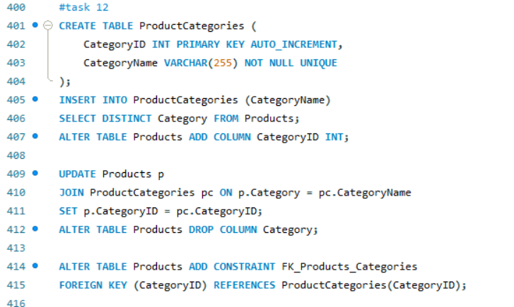

Slide 15
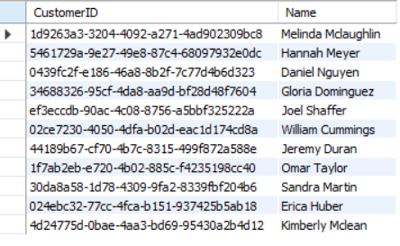
Task 13: Using Subqueries for Product and Customer Analysis
1. Identifying the Top 3 Products Based on Sales Revenue:
2. Finding Customers Who Haven’t Placed Any Orders:

Slide 16
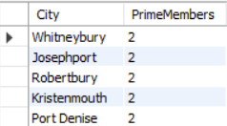

Task 14: Generating Actionable Insights for Business Strategy
1. Which cities have the highest concentration of Prime members?
2. What are the top 3 most frequently ordered categories?

