Slide 1
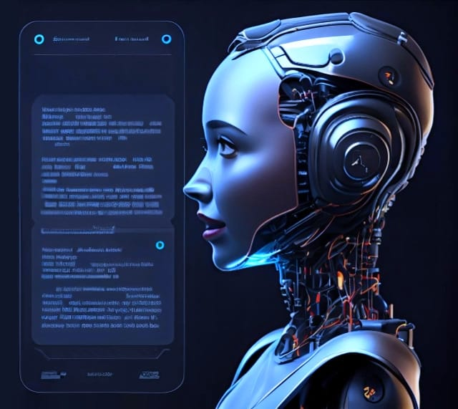
Chatbot for Simple Questions
BANDARU KISHORE KUMAR
21JR1A1238

Slide 2
Introduction to Chatbot
Define what a chatbot is
Explain its purpose
Showcase its benefits
A chatbot is a computer program designed to simulate conversation with human users, especially over the internet. It is powered by artificial intelligence and natural language processing to understand and respond to user queries.
The main purpose of a chatbot is to automate customer support and provide instant responses to frequently asked questions. It streamlines interactions, saves time for users and businesses, and enhances user experience.
Chatbots offer 24/7 availability, consistent responses, scalability, and cost-effectiveness. They can handle simple queries efficiently, free up human agents for more complex tasks, and improve overall customer satisfaction.

Slide 3

Building a Chatbot
Discuss the steps involved
Highlight key considerations
Building a chatbot involves defining objectives, selecting a platform, designing conversation flows, integrating AI capabilities, testing, and deploying. Each step is crucial for creating an effective chatbot.
Consider factors like target audience, tone of voice, language support, security measures, and continuous improvement. Understanding user needs and feedback is essential for refining the chatbot over time.

Slide 4
Chatbot Features
Feature | Description
Natural Language Processing | Ability to understand user inputs in normal language.
FAQ Integration | Database of frequently asked questions for quick responses.
Multi-Platform Support | Availability on various messaging platforms.
Personalization | Tailoring responses based on user preferences.
Analytics | Tracking usage data for insights and improvements.
Human Handover | Seamless transfer to human agents for complex issues.

Slide 5
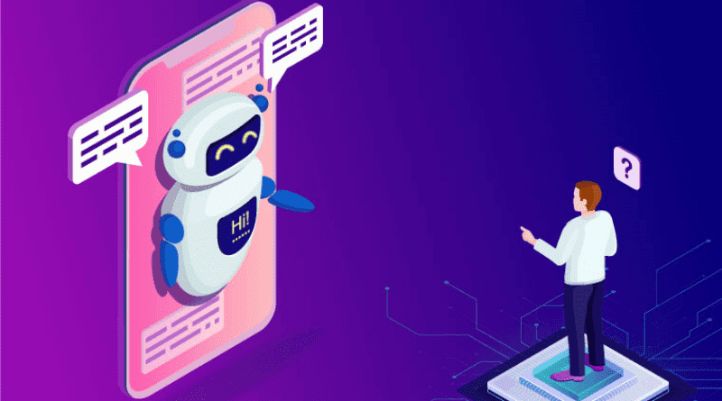
User Interaction with Chatbot
Explain how users can interact
Users interact with a chatbot by typing or speaking questions, receiving automated responses, and engaging in a conversation flow. Chatbots can offer buttons, menus, and suggestions to guide user interactions.

Slide 6
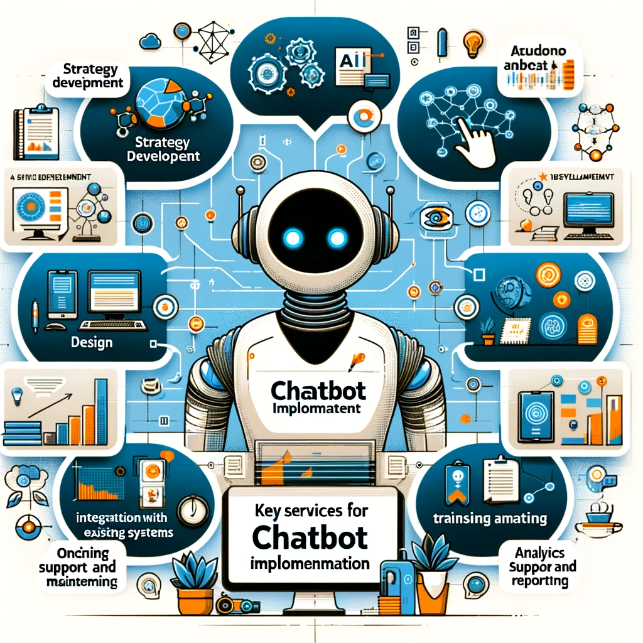
Chatbot Implementation
60%
15%
Efficiency
Scalability
Chatbots have shown an efficiency rate of 60% in handling simple questions, reducing response times and enhancing customer satisfaction.
The implementation of chatbots offers a scalable solution, capable of handling a growing number of simple questions without the need for additional resources.

Slide 7
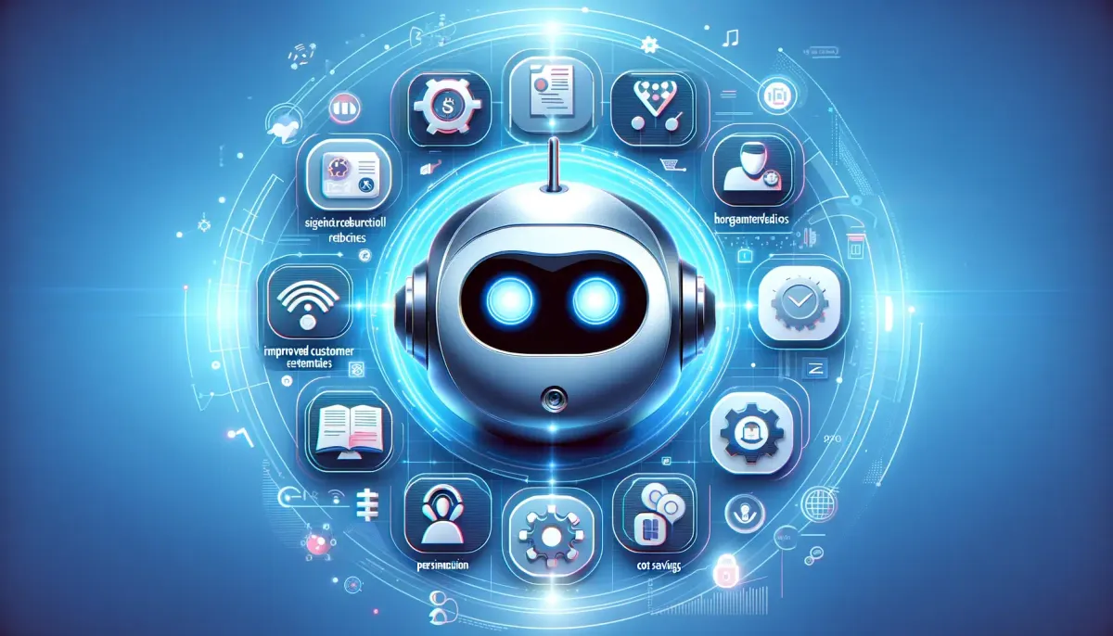
Chatbot Benefits
Advantages of implementing
Impact on customer experience
Efficiency in query resolution
Implementing a chatbot for handling simple queries streamlines customer support, reduces response times, and increases operational efficiency. It leads to cost savings and improved customer satisfaction.
Chatbots enhance customer experience by offering instant responses, personalized interactions, and round-the-clock support. They contribute to higher engagement levels and build brand loyalty.
Chatbots provide quick and accurate answers to simple questions, freeing up human agents for more complex tasks. This results in faster query resolution and a more streamlined support process.

