Slide 1

UNDERSTANDING THE BELL CURVE: EXPLORING NORMAL DISTRIBUTION IN STATISTICS AND DATA ANALYSIS

Slide 2

INTRODUCTION
The Bell Curve is a fundamental concept in statistics, representing a normal distribution of data. It is characterized by its symmetrical, bell-shaped curve, with the mean, median, and mode all at the center.
Understanding the Bell Curve is essential for
analyzing and interpreting data in various ﬁelds.

Slide 3

CHARACTERISTICS OF NORMAL DISTRIBUTION
The normal distribution is deﬁned by its mean and standard deviation, with approximately 68% of the data falling within one standard deviation from the mean, and 95% within two standard deviations. It is symmetric and unimodal, with a bell-shaped curve.

Slide 4

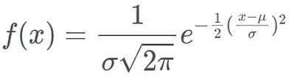

Slide 5

APPLICATIONS IN DATA ANALYSIS
The Bell Curve is widely used in data analysis, from quality control in manufacturing to educational assessment.
It helps in understanding the probability of events and making predictions based on the distribution of data. Moreover, it is essential in hypothesis testing and setting performance standards.

Slide 6
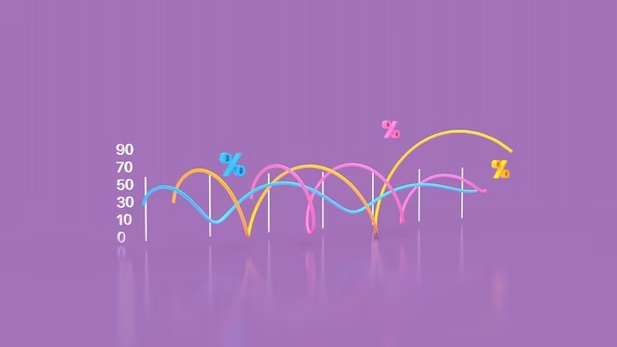
Z-SCORE AND STANDARDIZATION
The Z-score is a measure of how many standard deviations a data point is from the mean. It allows for comparison of different data sets and standardization of scores. Understanding the Z- score is crucial in interpreting data and identifying outliers in a dataset.

Slide 7

REAL-WORLD EXAMPLES
The Bell Curve is evident in various real- world phenomena, such as human traits like height and intelligence, as well as in natural processes like rainfall distribution.
Understanding normal distribution helps in analyzing and making predictions about these phenomena.

Slide 8
CONCLUSION
Understanding the Bell Curve and normal distribution is essential for interpreting and analyzing data in diverse ﬁelds. It provides valuable insights into the probability of events, helps in making predictions, and is fundamental in statistical inference and decision-making.

