Slide 1

UNRAVELING THE MYSTERIES OF LOG- NORMAL DISTRIBUTION: INSIGHTS INTO STATISTICS AND DATA ANALYSIS

Slide 2

INTRODUCTION
The log-normal distribution is a key concept in statistics and data analysis, offering insights into the distribution of positive real values. Understanding its properties and applications is crucial for various ﬁelds such as ﬁnance, biology, and engineering.

Slide 3

PROPERTIES OF LOG-NORMAL DISTRIBUTION
The log-normal distribution is characterized by its skewness and fat tails, making it suitable for modeling phenomena with positive skewness and large variability. Its parameters, mean, and variance play a crucial role in its application.

Slide 4
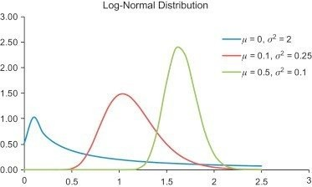

Slide 6

APPLICATIONS IN FINANCE
In ﬁnance, the log-normal distribution is widely used to model asset prices and investment returns. Understanding its properties is essential for risk management, option pricing, and portfolio optimization.

Slide 7

DATA ANALYSIS TECHNIQUES
When dealing with positively skewed data, understanding the log-normal distribution is crucial for accurate data analysis.
Techniques such as log transformation and model ﬁtting are commonly applied to handle such data.

Slide 8

CHALLENGES AND LIMITATIONS
While the log-normal distribution offers valuable insights, it also presents challenges such as interpretation dificulties and sensitivity to outliers. Understanding its limitations is essential for robust statistical analysis.

Slide 9
CONCLUSION
The log-normal distribution is a powerful tool for understanding the distribution of positive real values, with diverse applications in various ﬁelds. By unraveling its mysteries, we gain valuable insights into statistics and data analysis, enabling more accurate modeling and interpretation of real-world phenomena.

