Slide 1



CS 3811 - Project Work
WILDLIFE SANCTUARY IN VIRTUAL REALITY
Final Review
24.04.2025
Batch No :17
Presented by
Supervisor
Ashwanth Kumar K
Kishore Kumar S Gokul GJ Nitheshkumar S
- 311021104017
- 311021104062 - 311021104040 - 311021104078
Ms.Divya A
2024-2025

Slide 2
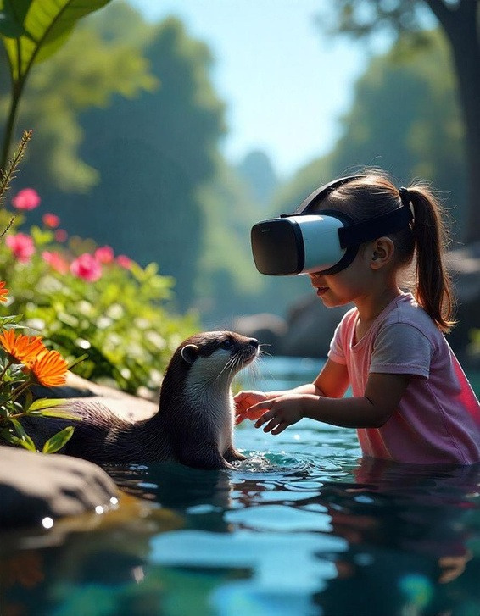
Objective
To design and develop a Wildlife Sanctuary in Virtual Reality that simulates existing and extinct species in their natural habitats, aiming to enhance educational engagement and promote conservation awareness.

Slide 3
Project Description
This project provides features such as the realistic simulation of animal behaviors, interaction with virtual environments, and exploration of natural habitats for existing and extinct species
The system integrates techniques such as 3D modeling in Blender, VR
interaction via XR Toolkit, and scripting in C# for seamless functionality.
The system ensures high immersion and accuracy through detailed visual
elements, optimized assets, and realistic environmental responses using Unity
and Oculus Quest 2.

Slide 4
Problem Definition
Existing Wildlife Sanctuary in Virtual Reality systems oversimplify animal behavior and environmental interactions, leading to a lack of realism and immersion in simulations. Current VR-based habitat simulations fail to capture the dynamic
Unpredictable nature of animal behavior, limiting their effectiveness for education and research. Many systems do not fully utilize the potential of extinct and endangered species, reducing their value for interdisciplinary studies like bio-inspired robotics and ethical research.

Slide 5
Proposed Solution
Create an interactive Wildlife Sanctuary in Virtual Reality with realistic animal behaviors using AI models and real-time environmental interactions. Utilize Blender for high-quality 3D modeling and XR Toolkit in Unity for seamless VR integration,
Optimized for Oculus Quest 2. Simulate dynamic animal behaviors using reinforcement learning to enhance realism and unpredictability. Enable interactive user feedback to trigger specific animal behaviors and provide educational data for interdisciplinary research.

Slide 6
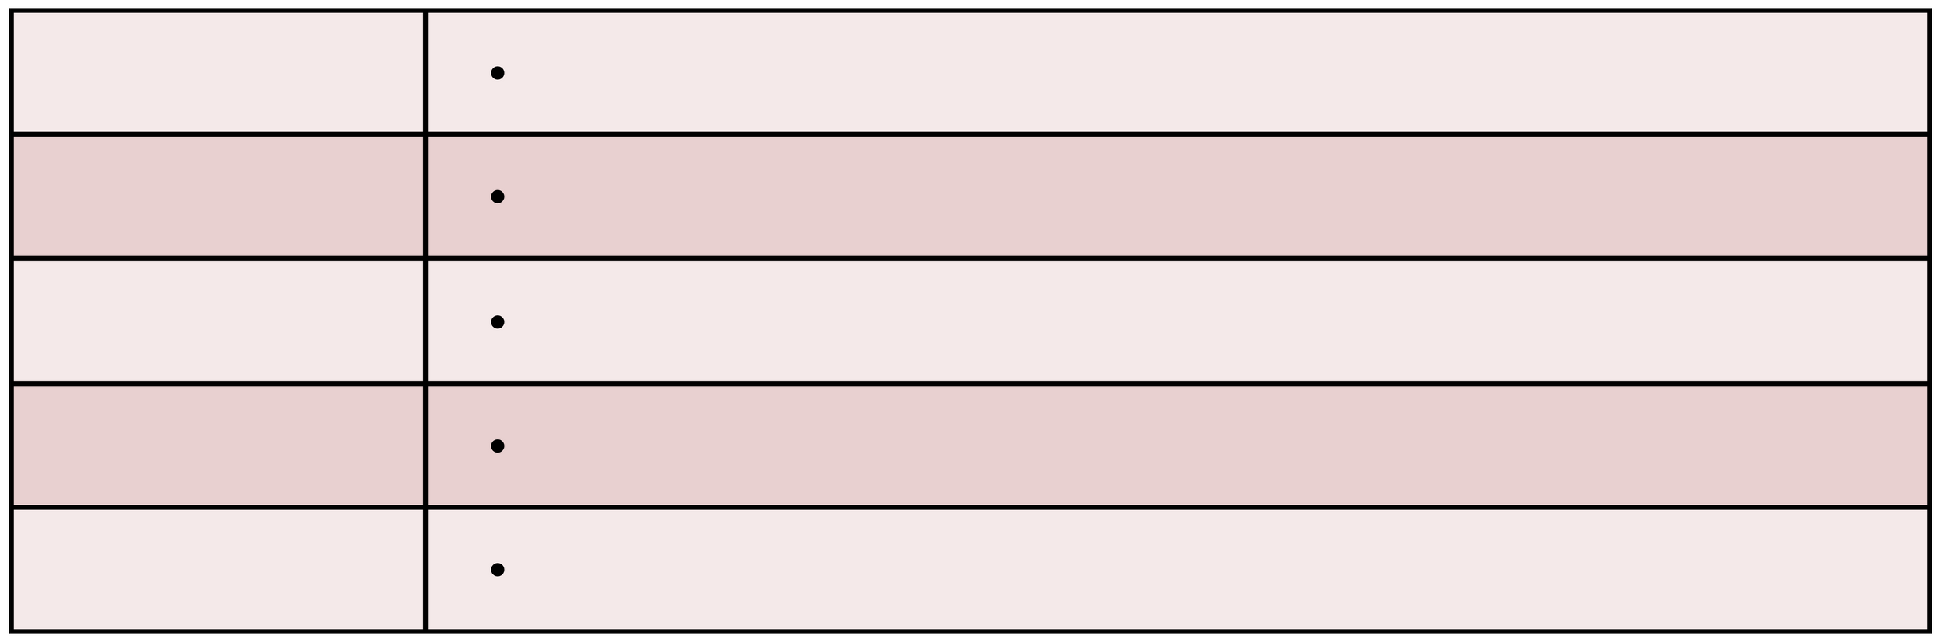
Requirement Specification
Software
Blender
For 3D asset creation and animation.
Unity (XR Toolkit)
For VR environment integration and interactivity.
C#
For scripting animal behaviors and VR interactions.
Oculus Software
For Oculus Quest 2 integration and optimization.
Git
For version control and collaboration.

Slide 7
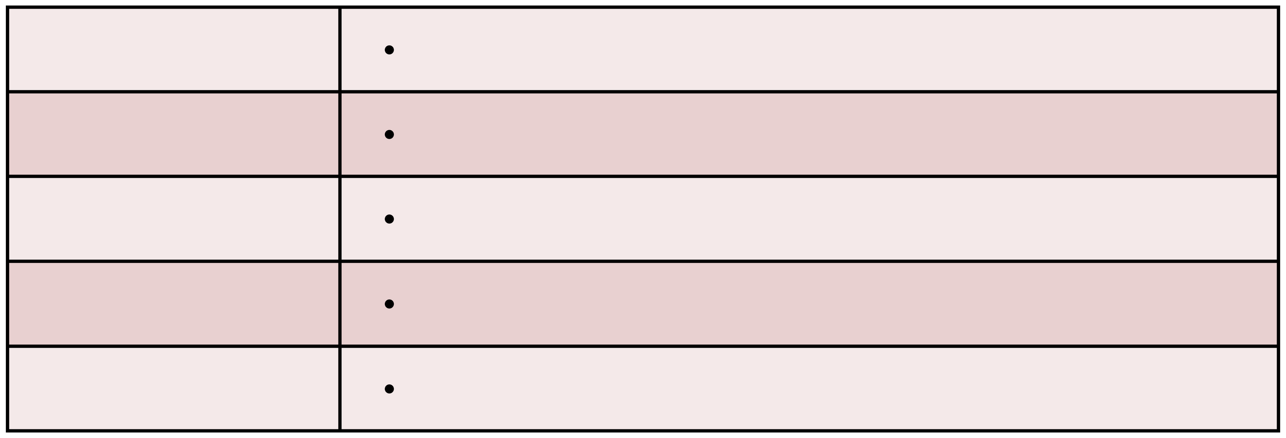
Requirement Specification
Hardware
Oculus Quest 2
For immersive VR experience.
CPU
Intel Core i7 or equivalent
RAM
16GB or more
GPU
NVIDIA GTX 1660 or higher (VR-capable)
Storage
500GB SSD or more

Slide 8
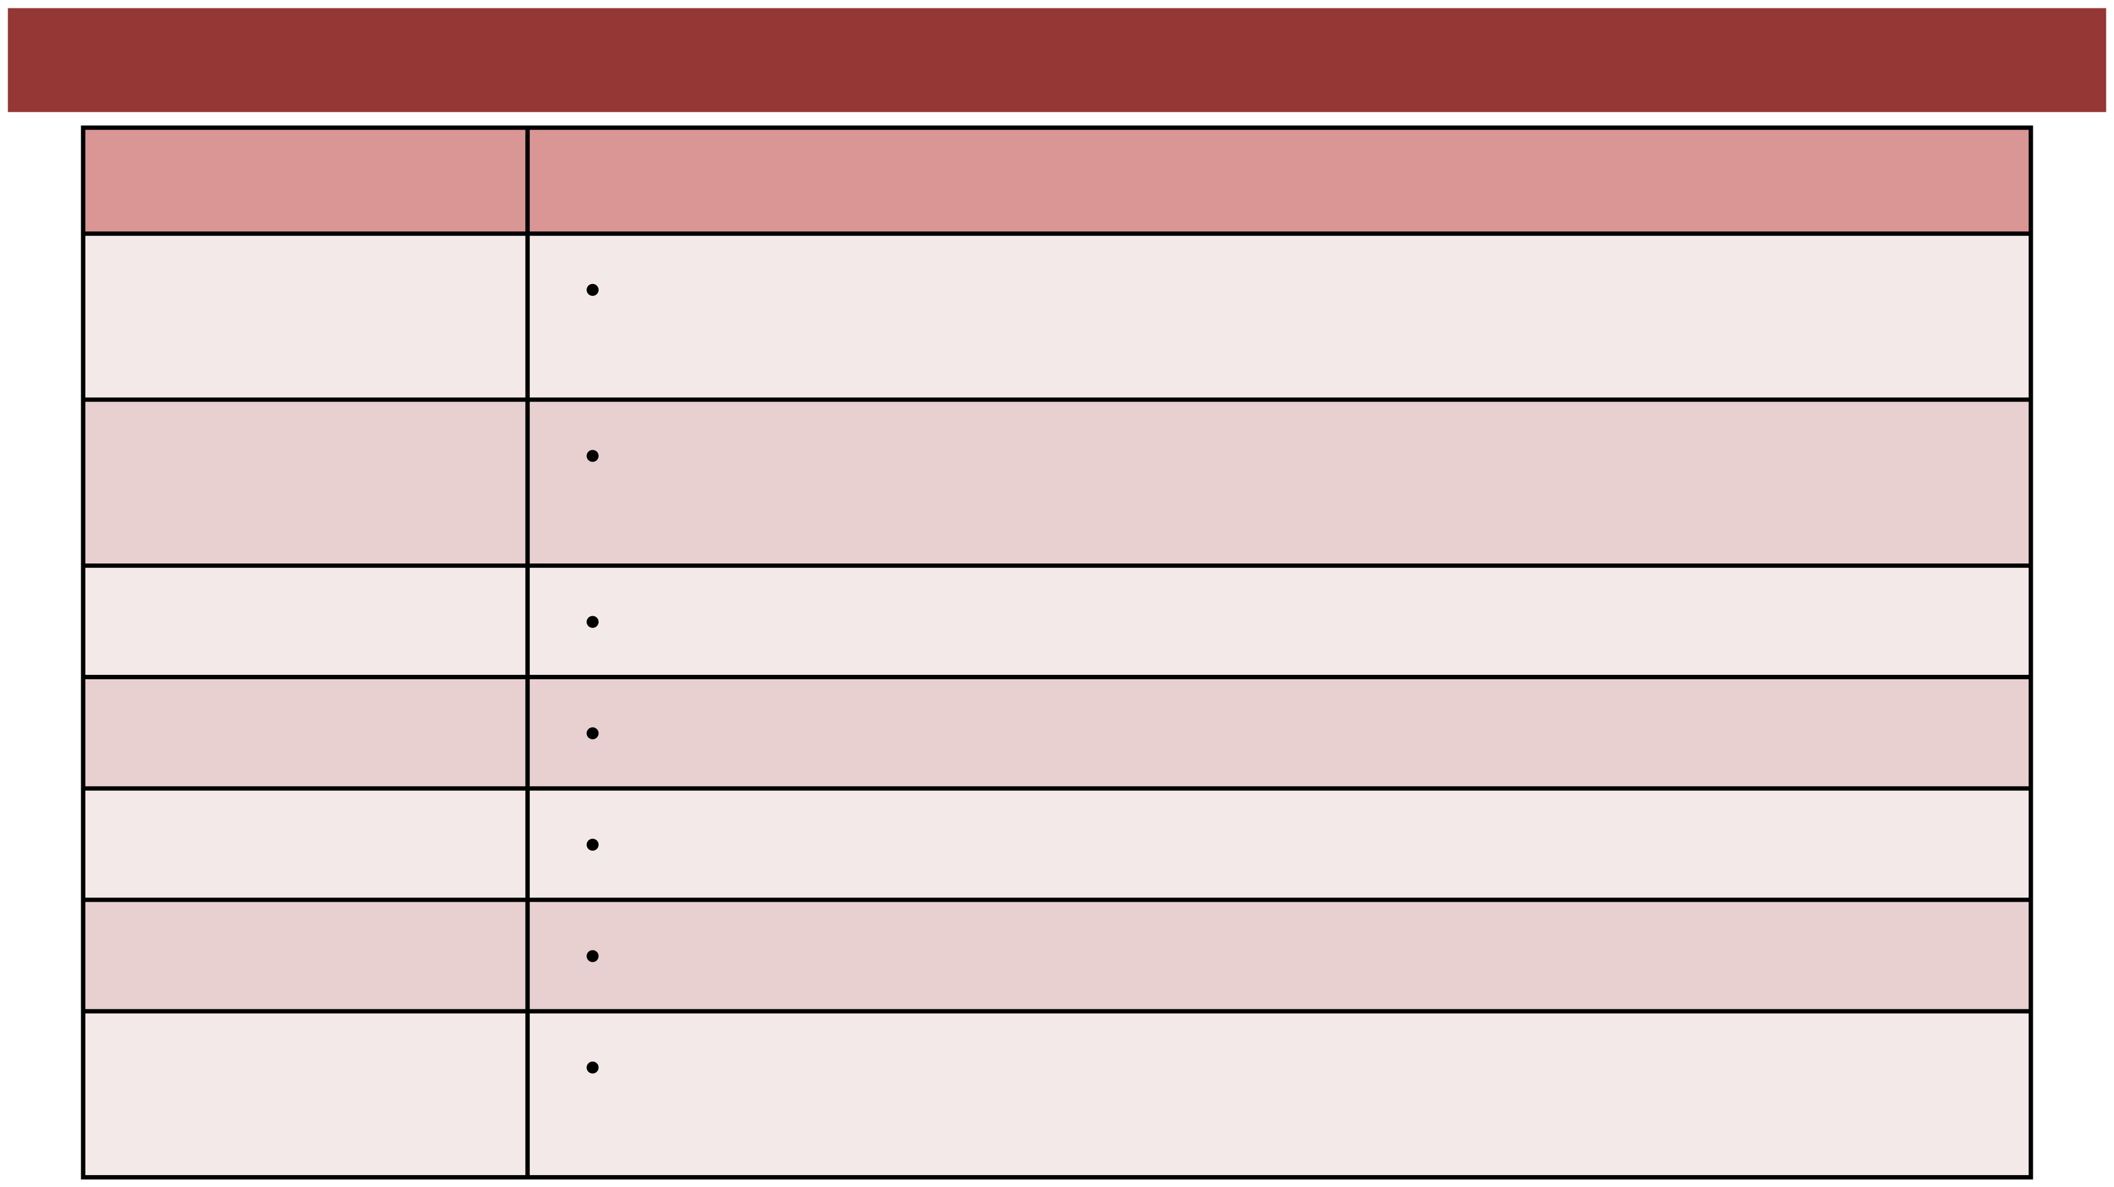
Requirement Specification - Justification
Component
Purpose/Justification
Blender
3D asset creation, texturing, and animation for detailed models and environments.
VR environment development and seamless integration of assets and
interactions.
Unity (XR Toolkit)
C#
Scripting for animal behaviors, interactions, and VR logic.
Oculus Software
Optimizes performance and ensures compatibility with Oculus Quest 2.
Git
Version control for code and asset management, supporting collaboration.
Oculus Quest 2
Provides immersive VR experience for real-time interactions in the virtual zoo.
Runs Unity, Blender, and VR testing efficiently with a powerful CPU, GPU, and
High-Performance PC
storage.

Slide 9
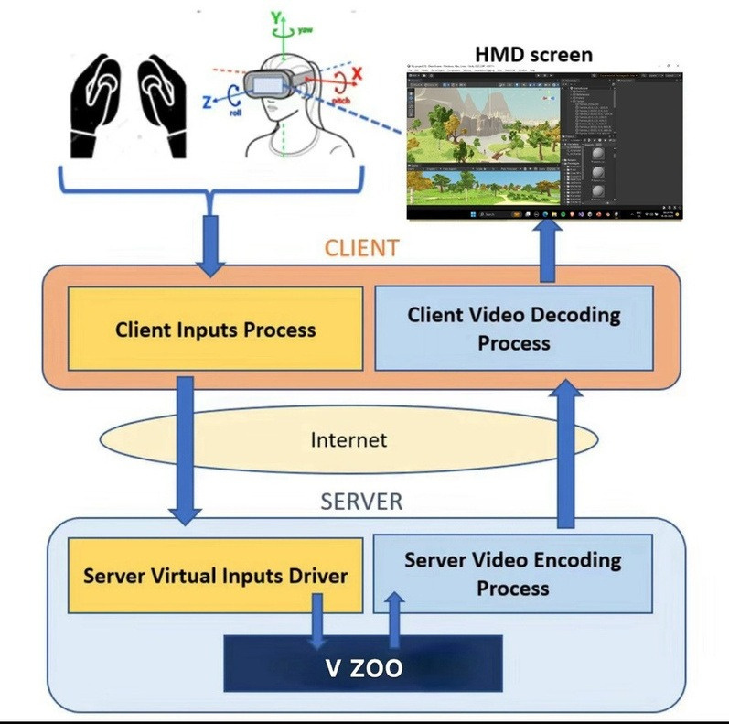
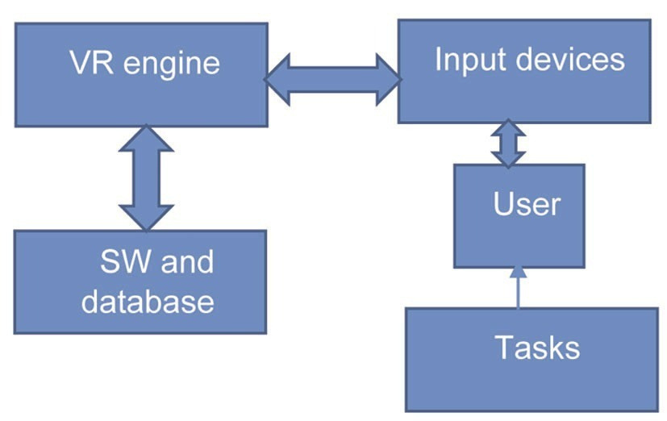
Architecture Diagram

Slide 10
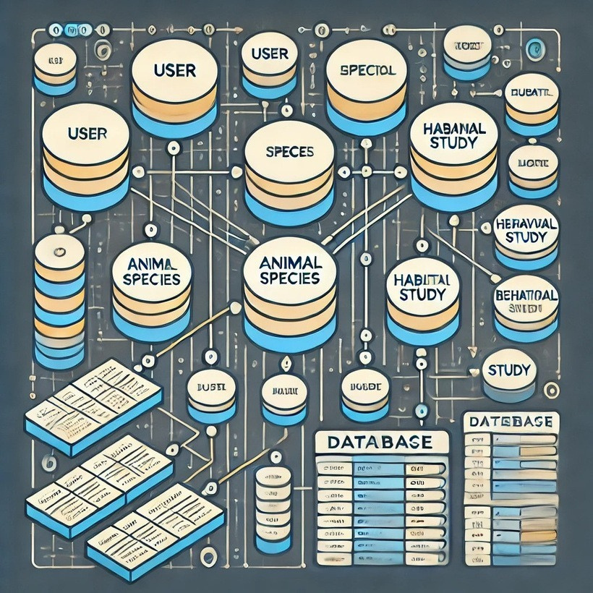
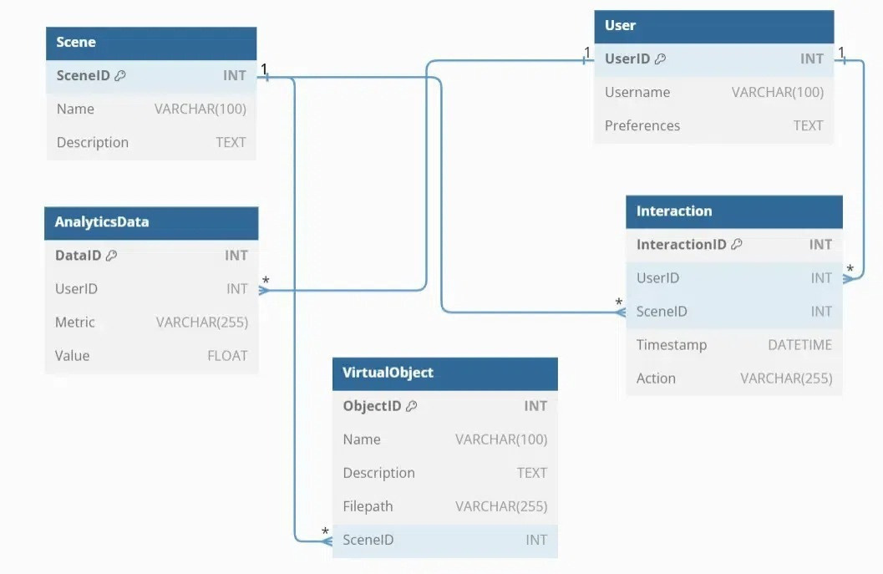
Database Design

Slide 11
Algorithm Explanation
Introduction to the Project Logic
Algorithm:
Input:
User decides to explore the virtual zoo.
Process:
Initialize the VR environment, load necessary assets (animals,
terrain), and enable VR interaction settings.
Output:
User is ready to interact with the environment in a VR setting.

Slide 12
Algorithm Explanation
Setting up the Environment (Initialization)
Algorithm:
Start:
Initialize the XR settings for VR interaction.
Load Scene:
Load the default virtual zoo scene (terrain, animals).
Activate VR Mode: Enable Oculus Quest 2 and VR controls.
Display:
Show the initial view of the zoo scene for the user.
Wait for User Interaction:
Await input from the user to interact with animals or objects

Slide 13
Algorithm Explanation
Animal Behavior Simulation
Algorithm: Start:
Assign an initial state to the animal (e.g., idle).
Monitor Environment:
Check for stimuli (e.g., food nearby or user interaction).
State Transition:
If food is nearby, transition to Eating state.
If user presses a button, transition to Walking state.
Behavior Execution:
Based on the current state, execute appropriate behavior (e.g., walk, eat).
Repeat:
Continuously monitor and update the animal’s state.

Slide 14
Algorithm Explanation
Interaction with Virtual Environment
Algorithm: Start:
Wait for input from the Oculus controller (e.g., button press).
Detect Input:
If the user presses a specific button (e.g., select), trigger an interaction.
Interaction:
If interacting with an animal, call animal behavior methods (e.g., change state to eating).
If interacting with an object, modify or animate the object.
Provide Feedback:
Provide haptic feedback or visual cue (e.g., animal reacts).
Repeat:
Continuously check for input and trigger interactions.

Slide 15
Algorithm Explanation
Optimizing Performance and Rendering
Algorithm: Start:
Check asset quality (models, textures).
Optimize Models:
Reduce polygon count for 3D models.
Optimize Textures:
Reduce texture resolution for efficiency.
Optimize Shaders:
Use efficient shaders to improve rendering performance.
Test Performance:
Ensure smooth performance on Oculus Quest 2.
Repeat:
Continue monitoring performance in real-time.

Slide 16
IMPLEMENTATION
XR Interaction System:
Uses XR Toolkit Supports to handle VR/AR interactions.
hand-tracking, controller input, and gesture recognition.
Animal AI Behavior (FSM-Based):
Implements an FSM model with states such as idle, move, react, eat, and sleep.
Uses NavMesh AI for pathfinding.
Rendering Optimization:
Implements LOD techniques to reduce rendering overhead.
Uses baked lighting and shader optimization.
User Experience Enhancements:
Includes voice-over narration for each animal.
Adds haptic feedback support for a more immersive experience.

Slide 17
IMPLEMENTATION
public class AnimalFSM : MonoBehaviour { enum AnimalState { Idle, Walk, Eat, Sleep, React } AnimalState currentState; void Start() { currentState = AnimalState.Idle; InvokeRepeating("ChangeState", 5f, 10f); } void ChangeState() { currentState = (AnimalState)Random.Range(0, 5); Debug.Log("Animal is now: " + currentState); }
void Update()
{ switch (currentState)
{ case AnimalState.Walk: transform.Translate(Vector3.forward *
Time.deltaTime);
break;
case AnimalState.React:
Debug.Log("Animal is reacting to user!");
break;
}
}
}

Slide 18
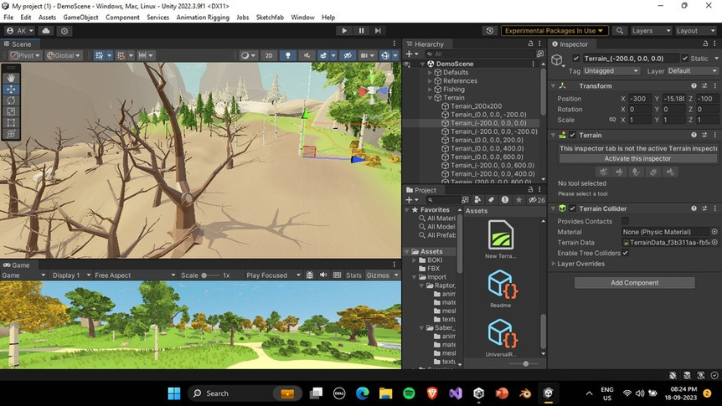
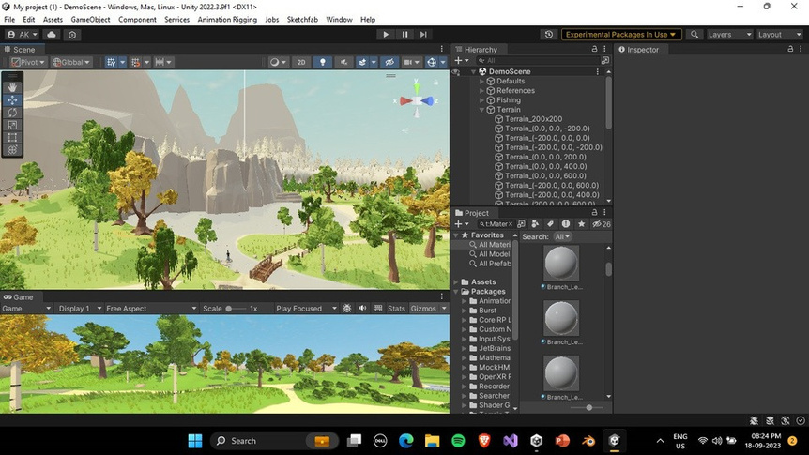
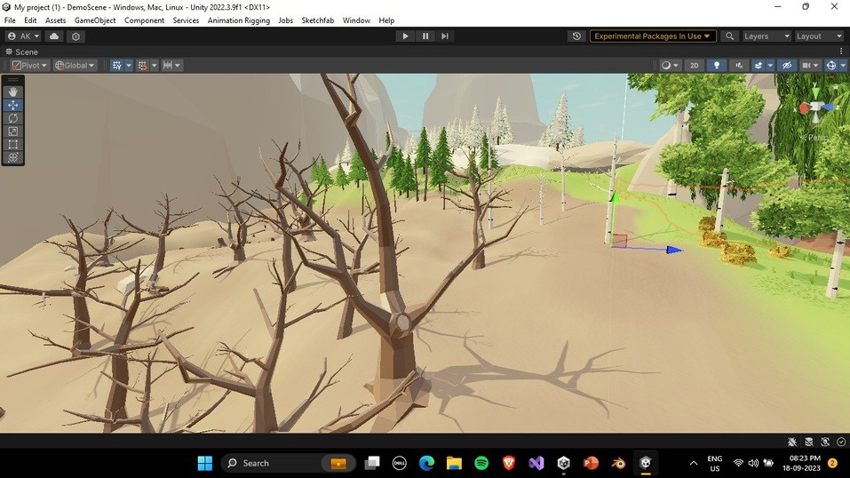
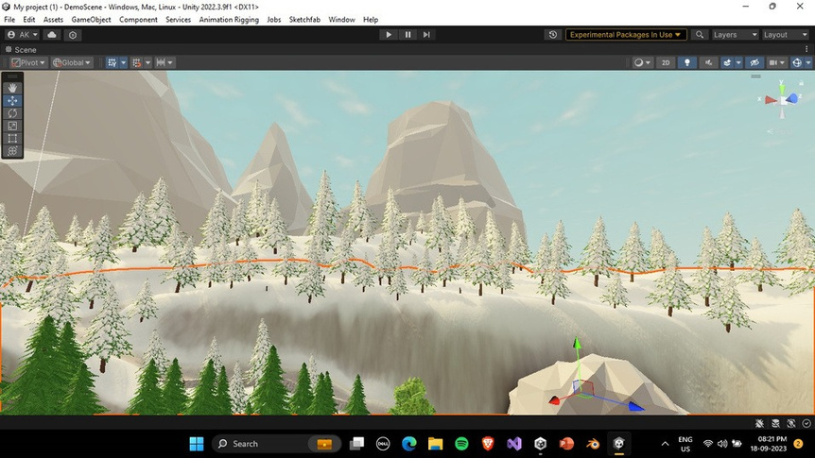
SCREENSHOTS

Slide 19
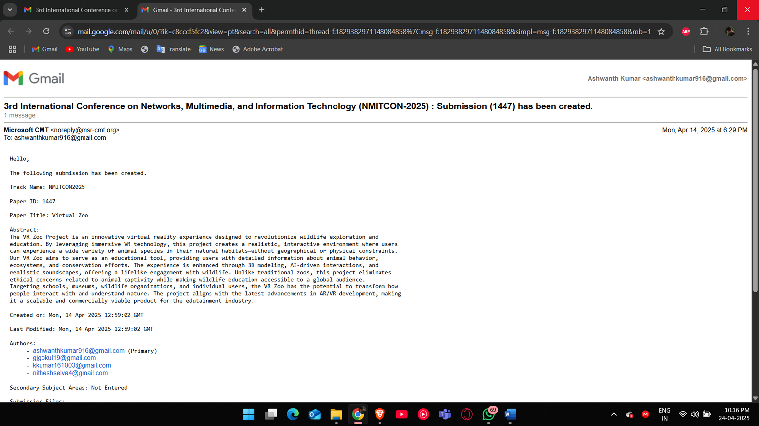
Details of Technical Paper Presentation / Publication
This paper titled Virtual Zoo using Virtual Zoo is communicated to 3rd International Conference on Networks, Multimedia, and Information Technology (NMITCON-2025) : Submission (1447) has been created.

Slide 20
Conclusion
The "Wildlife Sanctuary in Virtual Reality " project integrates VR and animal behavior simulation, providing an engaging educational tool. Using Unity 3D and Oculus Quest 2, it allows users to explore realistic animal behaviors in a virtual environment. Future improvements could include enhanced behaviors, multiplayer features, and optimization for different VR platforms.
19

Slide 21
References
Wiederhold, B. K., and Rizzo, A. S. (2019), “Virtual Reality and Its Role in Behavioral Medicine,” in American Journal of Lifestyle Medicine, vol. 13, no.
3, pp. 211-221. Rothbaum, B. O., et al. (2014), “Virtual Reality Exposure Therapy for Post-Traumatic Stress Disorder,” in Journal of Clinical
Psychology, vol. 70, no. 9, pp. 944-957. Liu, X., et al. (2020), “Simulation of Animal Behavior in Virtual Reality Environments for Education and Training,” in Journal of Virtual Reality and Broadcasting, vol. 17, no. 6, pp.
35-42. Fletcher, K. D., and Leung, H. L. (2021), “Enhancing Interactivity and Immersion in Virtual Reality-based Educational Applications,” in Computers & Education, vol. 160, pp. 104031.
20

Slide 22
THANK YOU

