Slide 1


22MAT220 MATHEMATICS FOR COMPUTING 3
Optimizing House Price Prediction Using Lasso and Ridge Regression with ADMM-Based Regularization
AIE – C Team – 7
G Prajwal Priyadarshan – CB.SC.U4AIE24214
Kabilan K – CB.SC.U4AIE24224
Kishore B – CB.SC.U4AIE24227
Rahul LS – CB.SC.U4AIE24248

Slide 2

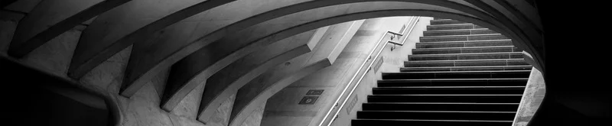
INDEX
INTRODUCTION | 3
PROBLEM STATEMENT | 5
OPTIMIZATION PROBLEM | 6
LAGRANGIAN | 6
UPDATE EQUATIONS | 7
DATASET DESCRIPTION | 21
COMPUTATIONAL DETAILS | 24
RESULTS | 25
REFERENCE | 27

Slide 3

INTRODUCTION
Convex optimization has several applications, including communication networks, data analytics, economics, and statistics. This technique emerged as the most efficient method of optimization
It can be performed using a variety of algorithms like gradient descent, penalties, augmented Lagrangians, etc.
Predicting house sale prices using supervised regression.
Linear regression is a method used to find the best-fit line that predicts a target variable based on input features, but it can overfit when there are too many features or when they are highly correlated.

Slide 4
INTRODUCTION
Ridge and Lasso Regression are two popular techniques in machine learning used for regularizing linear models to avoid overfitting and improve predictive performance.
Ridge Regression, also known as L2 regularization, adds the squared magnitude of the coefficients as a penalty.
Lasso Regression, or L1 regularization, introduces a penalty based on the absolute value of the coefficients.
ADMM splits the problem into smaller subproblems that are easier to solve individually, especially when the objective has separable components
Methods compared: Lasso (L1) and Ridge (L2) regression solved with ADMM.

Slide 5
PROBLEM STATEMENT
To build models that predict Melbourne house prices from features with minimized error and controlled model complexity.
Regularization methods are used to cope with overfitting and huge datasets. We know that there are two types of regularization techniques: Ridge and Lasso, which penalize the regression function.
We compare problems based on the ADMM technique

Slide 6
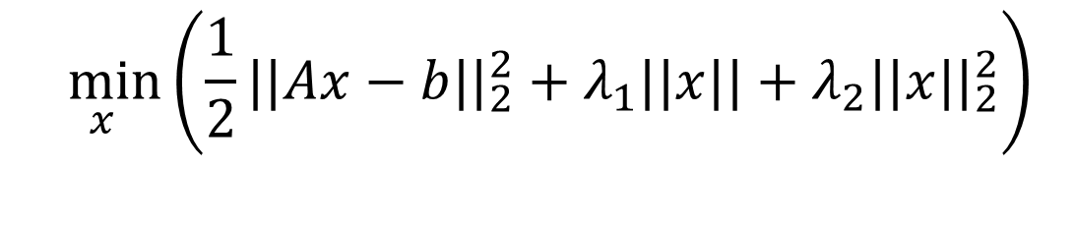
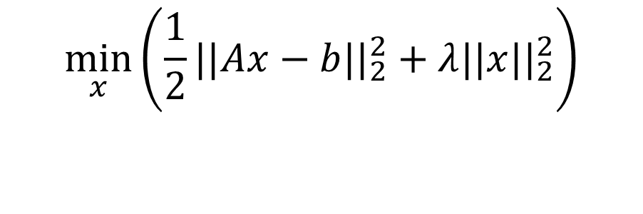
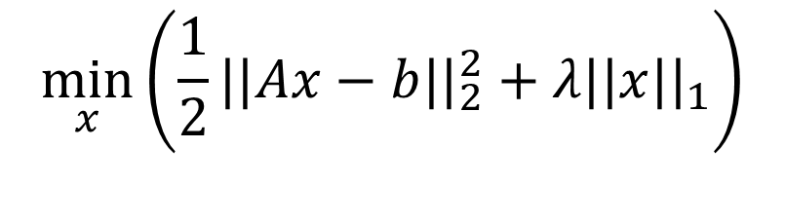
OPTIMIZTION PROBLEM
LASSO :
$$\min_{x}\left(\frac{1}{2}||Ax−b||_{2}^{2}+λ||x{||}_{1}\right)$$
RIDGE :
$$\min_{x}\left(\frac{1}{2}||Ax−b||_{2}^{2}+λ||x||_{2}^{2}\right)$$
ELASTIC NET :
$$\min_{x}\left(\frac{1}{2}||Ax−b||_{2}^{2}+λ_{1}||x||+λ_{2}||x||_{2}^{2}\right)$$
(A) is the feature matrix,
(x) is the coefficient vector,
(b) is the output vector,
(λ) is the regularization parameter controlling sparsity.
Both Lasso and Ridge are unconstrained optimization problems in their basic form. However, to apply ADMM, these problems are reformulated with equality constraints by introducing auxiliary variables [z] , subject to the condition x – z = 0

Slide 7
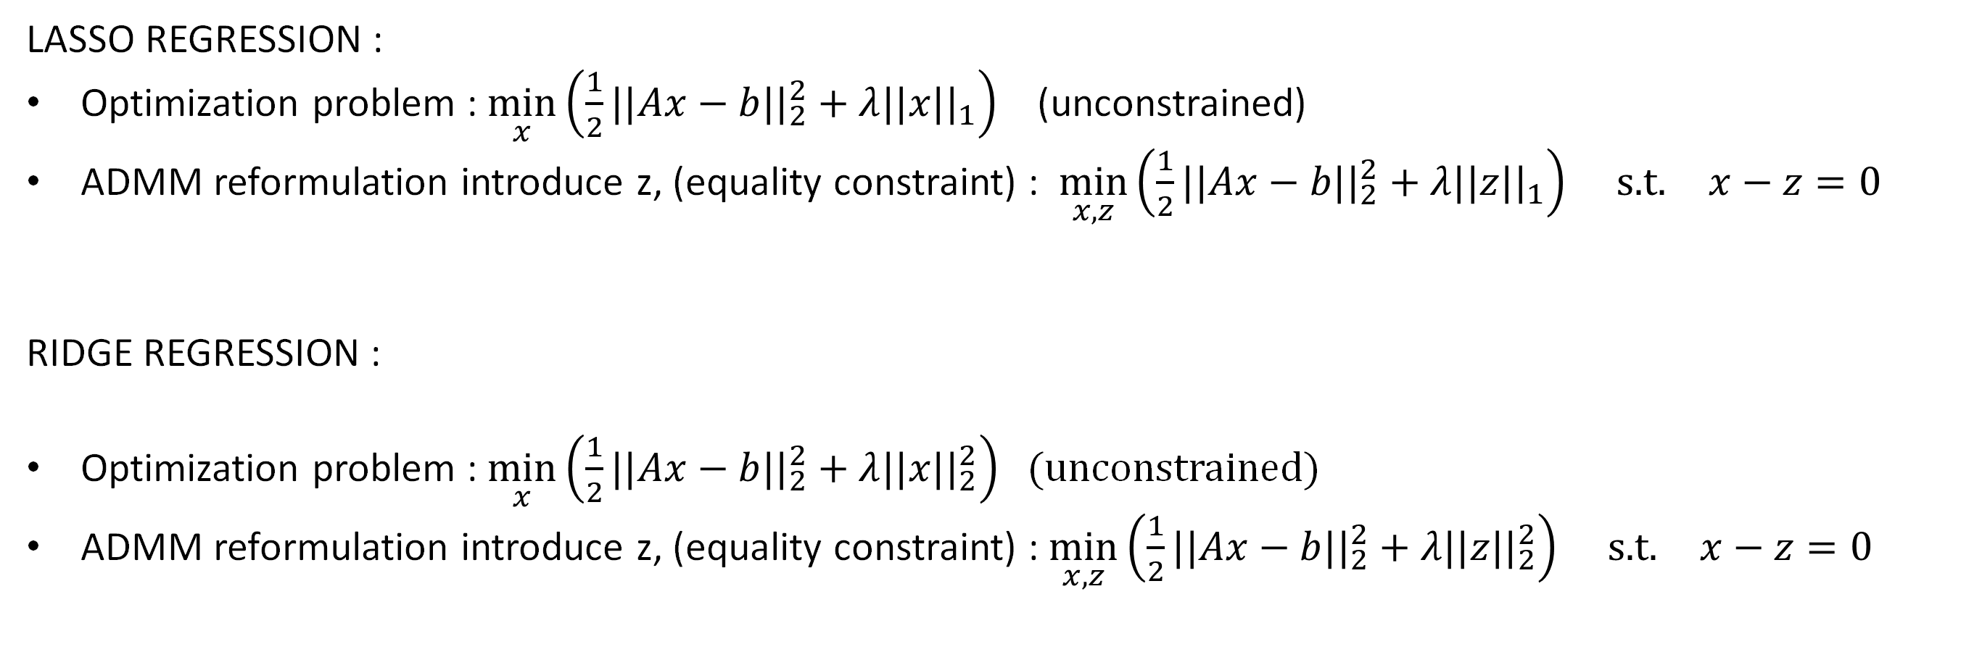
OPTIMIZTION PROBLEM
LASSO REGRESSION :
Optimization problem : $\min_{x}\left(\frac{1}{2}||Ax−b||_{2}^{2}+λ||x||_{1}\right)$ (unconstrained)
ADMM reformulation introduce z, (equality constraint) : $\min_{x,z}\left(\frac{1}{2}||Ax−b||_{2}^{2}+λ||z||_{1}\right) \text{s}\text{.}\text{t}\text{.} x−z=0$
RIDGE REGRESSION :
Optimization problem : $\min_{x}\left(\frac{1}{2}||Ax−b||_{2}^{2}+λ||x{||}_{2}^{2}\right)$ (unconstrained)
ADMM reformulation introduce z, (equality constraint) : $\min_{x,z}\left(\frac{1}{2}||Ax−b||_{2}^{2}+λ||z{||}_{2}^{2}\right) \text{s}\text{.}\text{t}\text{.} x−z=0$

Slide 8
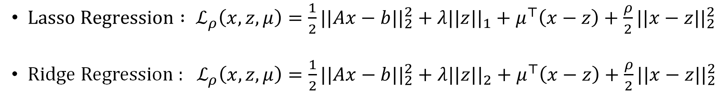
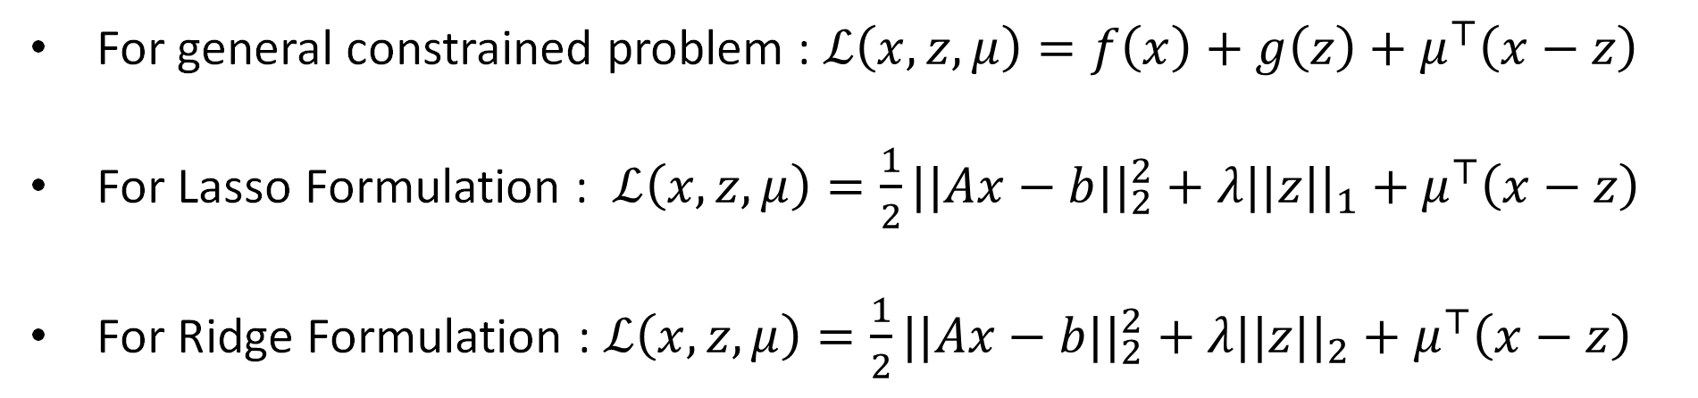
LAGRANGIAN / AUGMENTED LAGRANGIAN
LAGRANGIAN (Equality Constraints):
For general constrained problem : $ℒ\left(x,z,μ\right)=f\left(x\right)+g\left(z\right)+μ^{⊤}\left(x−z\right)$
For Lasso Formulation : $ℒ\left(x,z,μ\right)=\frac{1}{2}||Ax−b||_{2}^{2}+λ||z{||}_{1}+μ^{⊤}\left(x−z\right)$
For Ridge Formulation : $ℒ\left(x,z,μ\right)=\frac{1}{2}||Ax−b||_{2}^{2}+λ||z||_{2}+μ^{⊤}\left(x−z\right)$
AUGMENTED LAGRANGIAN :
${Lasso Regression : ℒ}_{ρ}\left(x,z,μ\right)=\frac{1}{2}||Ax−b||_{2}^{2}+λ||z{||}_{1}+μ^{⊤}\left(x−z\right)+\frac{ρ}{2}||x−z||_{2}^{2}$
Ridge Regression : $ℒ_{ρ}\left(x,z,μ\right)=\frac{1}{2}||Ax−b||_{2}^{2}+λ||z||_{2}+μ^{⊤}\left(x−z\right)+\frac{ρ}{2}||x−z{||}_{2}^{2}$

Slide 9
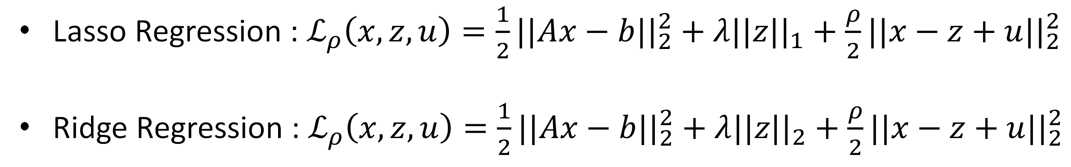
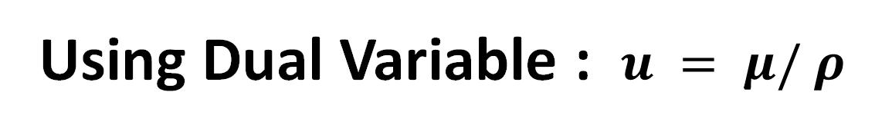
LAGRANGIAN / AUGMENTED LAGRANGIAN
Using Dual Variable : $u = μ/ ρ$
Lasso Regression : $ℒ_{ρ}\left(x,z,u\right)=\frac{1}{2}||Ax−b||_{2}^{2}+λ||z{||}_{1}+\frac{ρ}{2}||x−z+u{||}_{2}^{2}$
Ridge Regression : $ℒ_{ρ}\left(x,z,u\right)=\frac{1}{2}||Ax−b{||}_{2}^{2}+λ||z||_{2}+\frac{ρ}{2}||x−z+u||_{2}^{2}$

Slide 10
NOTATIONS
ρ: ADMM penalty parameter (positive)
z: auxiliary variable introduced to split objective.
μ: lagrangian coefficient.
u: dual variable or scaled dual variable.
‖·‖₂: Euclidean norm
‖·‖₁: L1 norm.
[m,n]: number of samples and features respectively

Slide 11
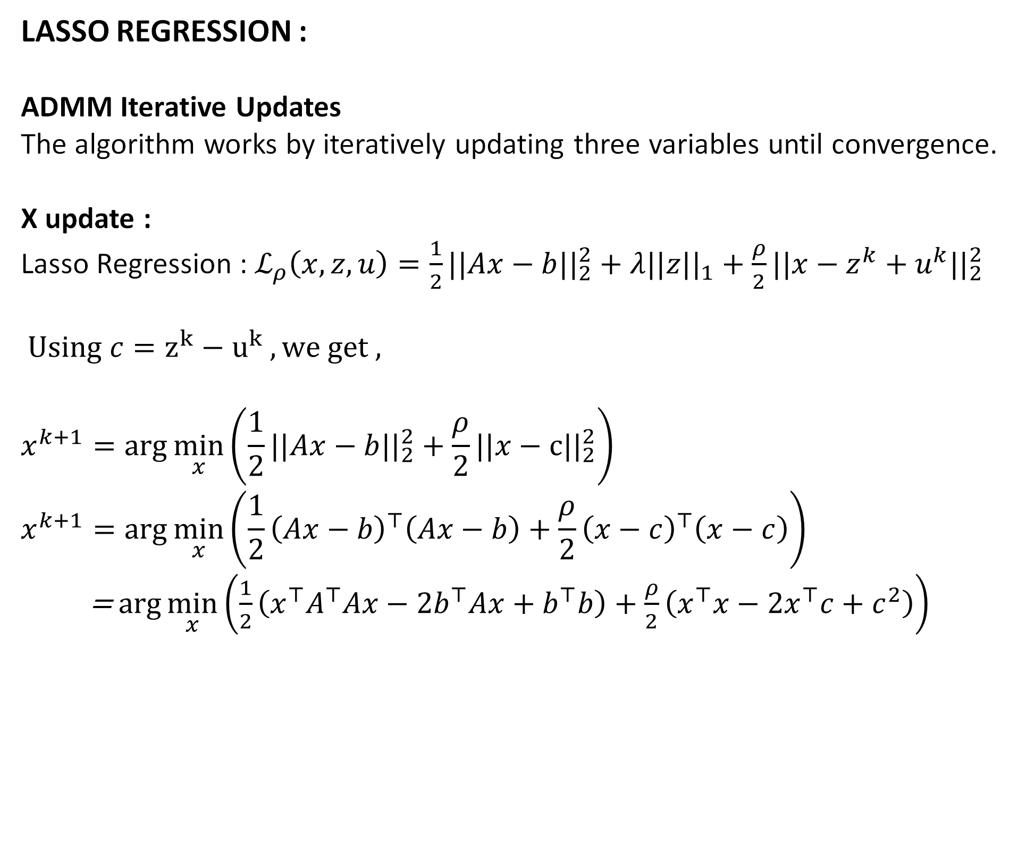
UPDATE EQUATIONS
LASSO REGRESSION : ADMM Iterative Updates
The algorithm works by iteratively updating three variables until convergence.
X update :
Lasso Regression : $ℒ_{ρ}\left(x,z,u\right)=\frac{1}{2}||Ax−b||_{2}^{2}+λ||z{||}_{1}+\frac{ρ}{2}||x−z^{k}+u^{k}{||}_{2}^{2}$
$Using c=z^{k}−u^{k} , we get ,$
$$x^{k+1}=\arg{\min_{x}\left(\frac{1}{2}||Ax−b{||}_{2}^{2}+\frac{ρ}{2}||x−c||_{2}^{2}\right)}$$
$$x^{k+1}=\arg{\min_{x}\left(\frac{1}{2}{\left(Ax−b\right)}^{⊤}\left(Ax−b\right)+\frac{ρ}{2}{\left(x−c\right)}^{⊤}\left(x−c\right)\right)}$$
= $\arg{\min_{x}\left(\frac{1}{2}\left(x^{⊤}A^{⊤}Ax−2b^{⊤}Ax+b^{⊤}b\right)+\frac{ρ}{2}\left(x^{⊤}x−2x^{⊤}c+c^{2}\right)\right)}$

Slide 12
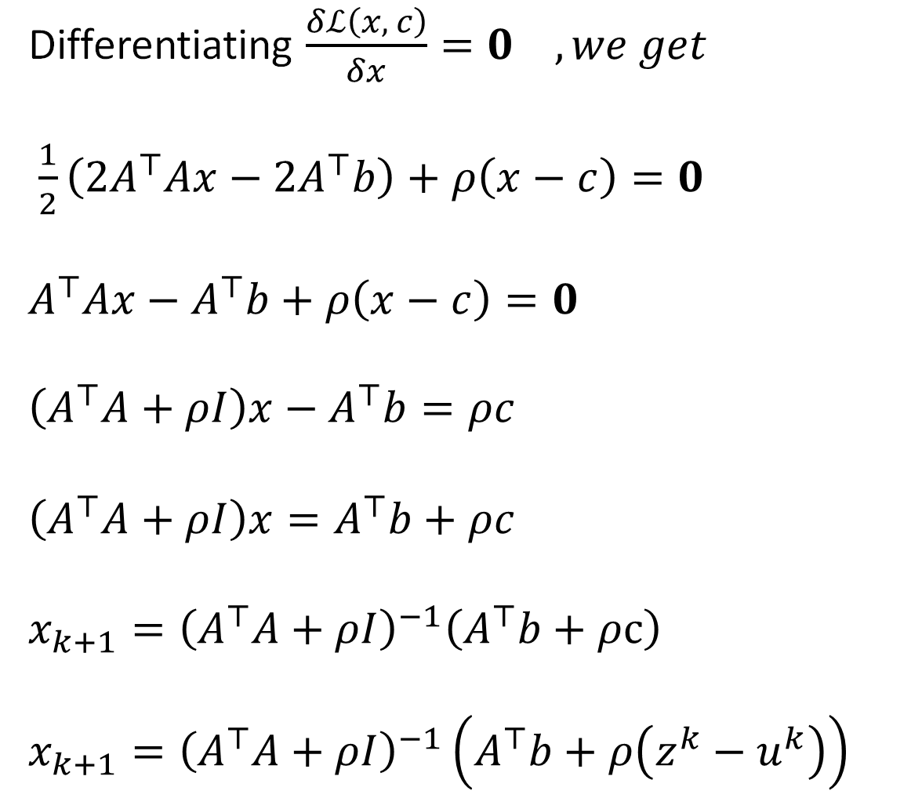
UPDATE EQUATIONS
X update
Differentiating $\frac{δℒ\left(x, c\right)}{δx}=0 , we get$
$\frac{1}{2}\left(2A^{⊤}Ax−2A^{⊤}b\right)+ρ\left(x−c\right)=0$
$$A^{⊤}Ax−A^{⊤}b+ρ\left(x−c\right)=0$$
$$\left(A^{⊤}A+ρI\right)x−A^{⊤}b=ρc$$
$$\left(A^{⊤}A+ρI\right)x=A^{⊤}b+ρc$$
$$x_{k+1}={\left(A^{⊤}A+ρI\right)}^{−1}\left(A^{⊤}b+ρc\right)$$
$$x_{k+1}={\left(A^{⊤}A+ρI\right)}^{−1}\left(A^{⊤}b+ρ\left(z^{k}−u^{k}\right)\right)$$

Slide 13
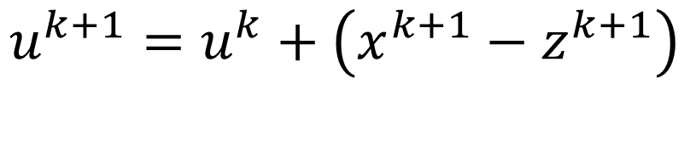
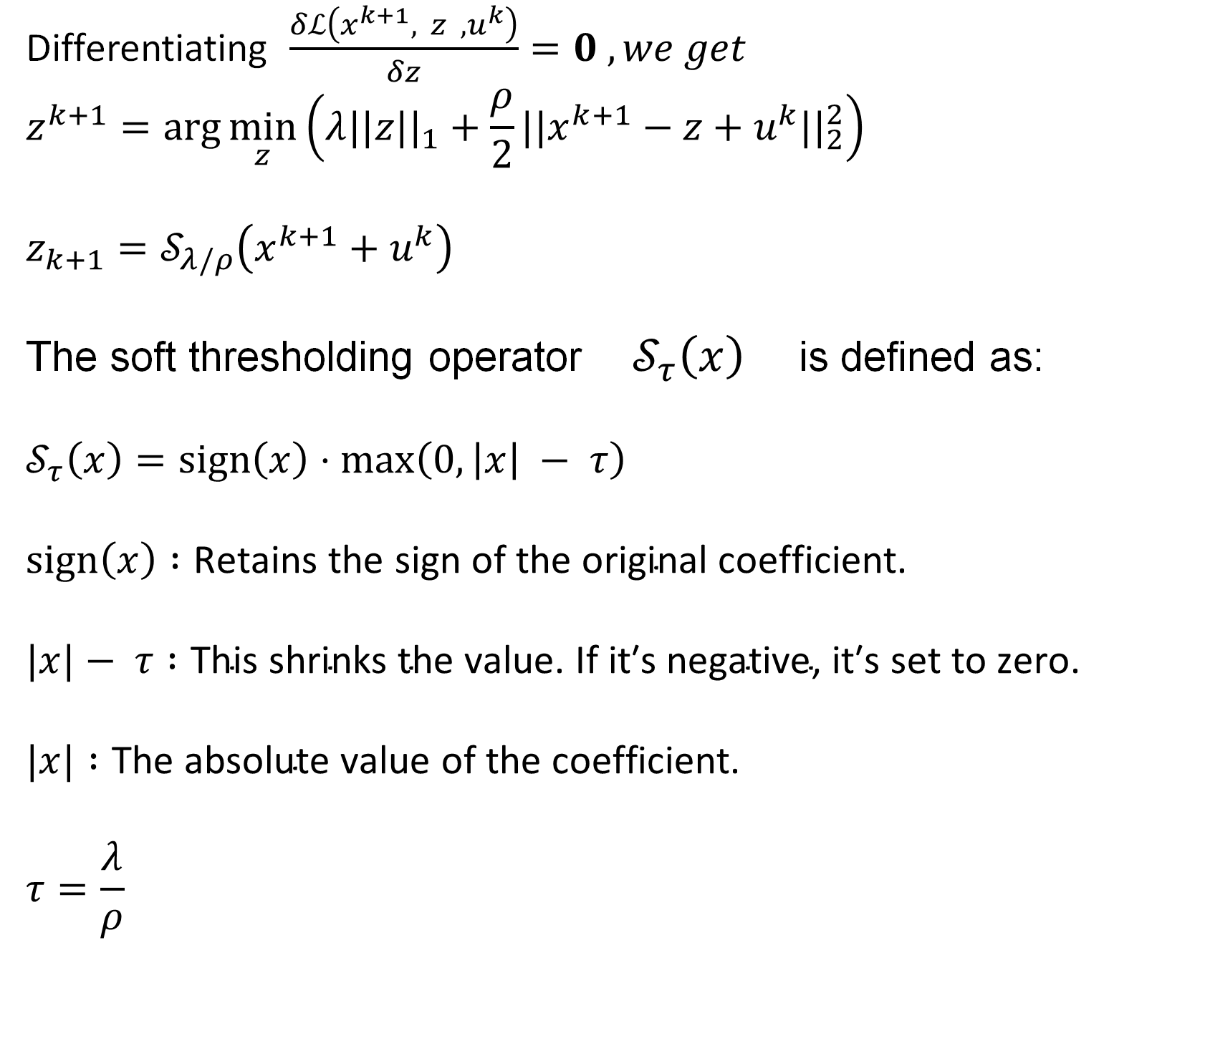
UPDATE EQUATIONS
Z Update
Differentiating $\frac{δℒ\left(x^{k+1}, z ,u^{k}\right)}{δz}=0 , we get$
$$z^{k+1}=\arg{\min_{z}\left(λ||z||_{1}+\frac{ρ}{2}|{|x}^{k+1}−z+u^{k}||_{2}^{2}\right)}$$
$$z_{k+1}=𝒮_{λ/ρ}\left(x^{k+1}+u^{k}\right)$$
The soft thresholding operator $𝒮_{τ}\left(x\right)$ is defined as:
$$𝒮_{τ}\left(x\right)=\text{sign}\left(x\right)⋅\max\left(0, \left|x\right| − τ\right)$$
$$\text{sign}\left(x\right) :\text{Retains} \text{the} \text{sign} \text{of} \text{the} \text{original} \text{coefficient}\text{.}$$
$$|x|− τ :\text{This} \text{shrinks} \text{the} \text{value}\text{. }\text{If} \text{it}\text{′}\text{s} \text{negative}\text{, }\text{it}\text{′}\text{s} \text{set} \text{to} \text{zero}\text{.}$$
$$|x| :\text{The} \text{absolute} \text{value} \text{of} \text{the} \text{coefficient}\text{.}$$
$$τ=\frac{λ}{ρ}$$
U Update
$$u^{k+1}=u^{k}+\left(x^{k+1}−z^{k+1}\right)$$

Slide 14
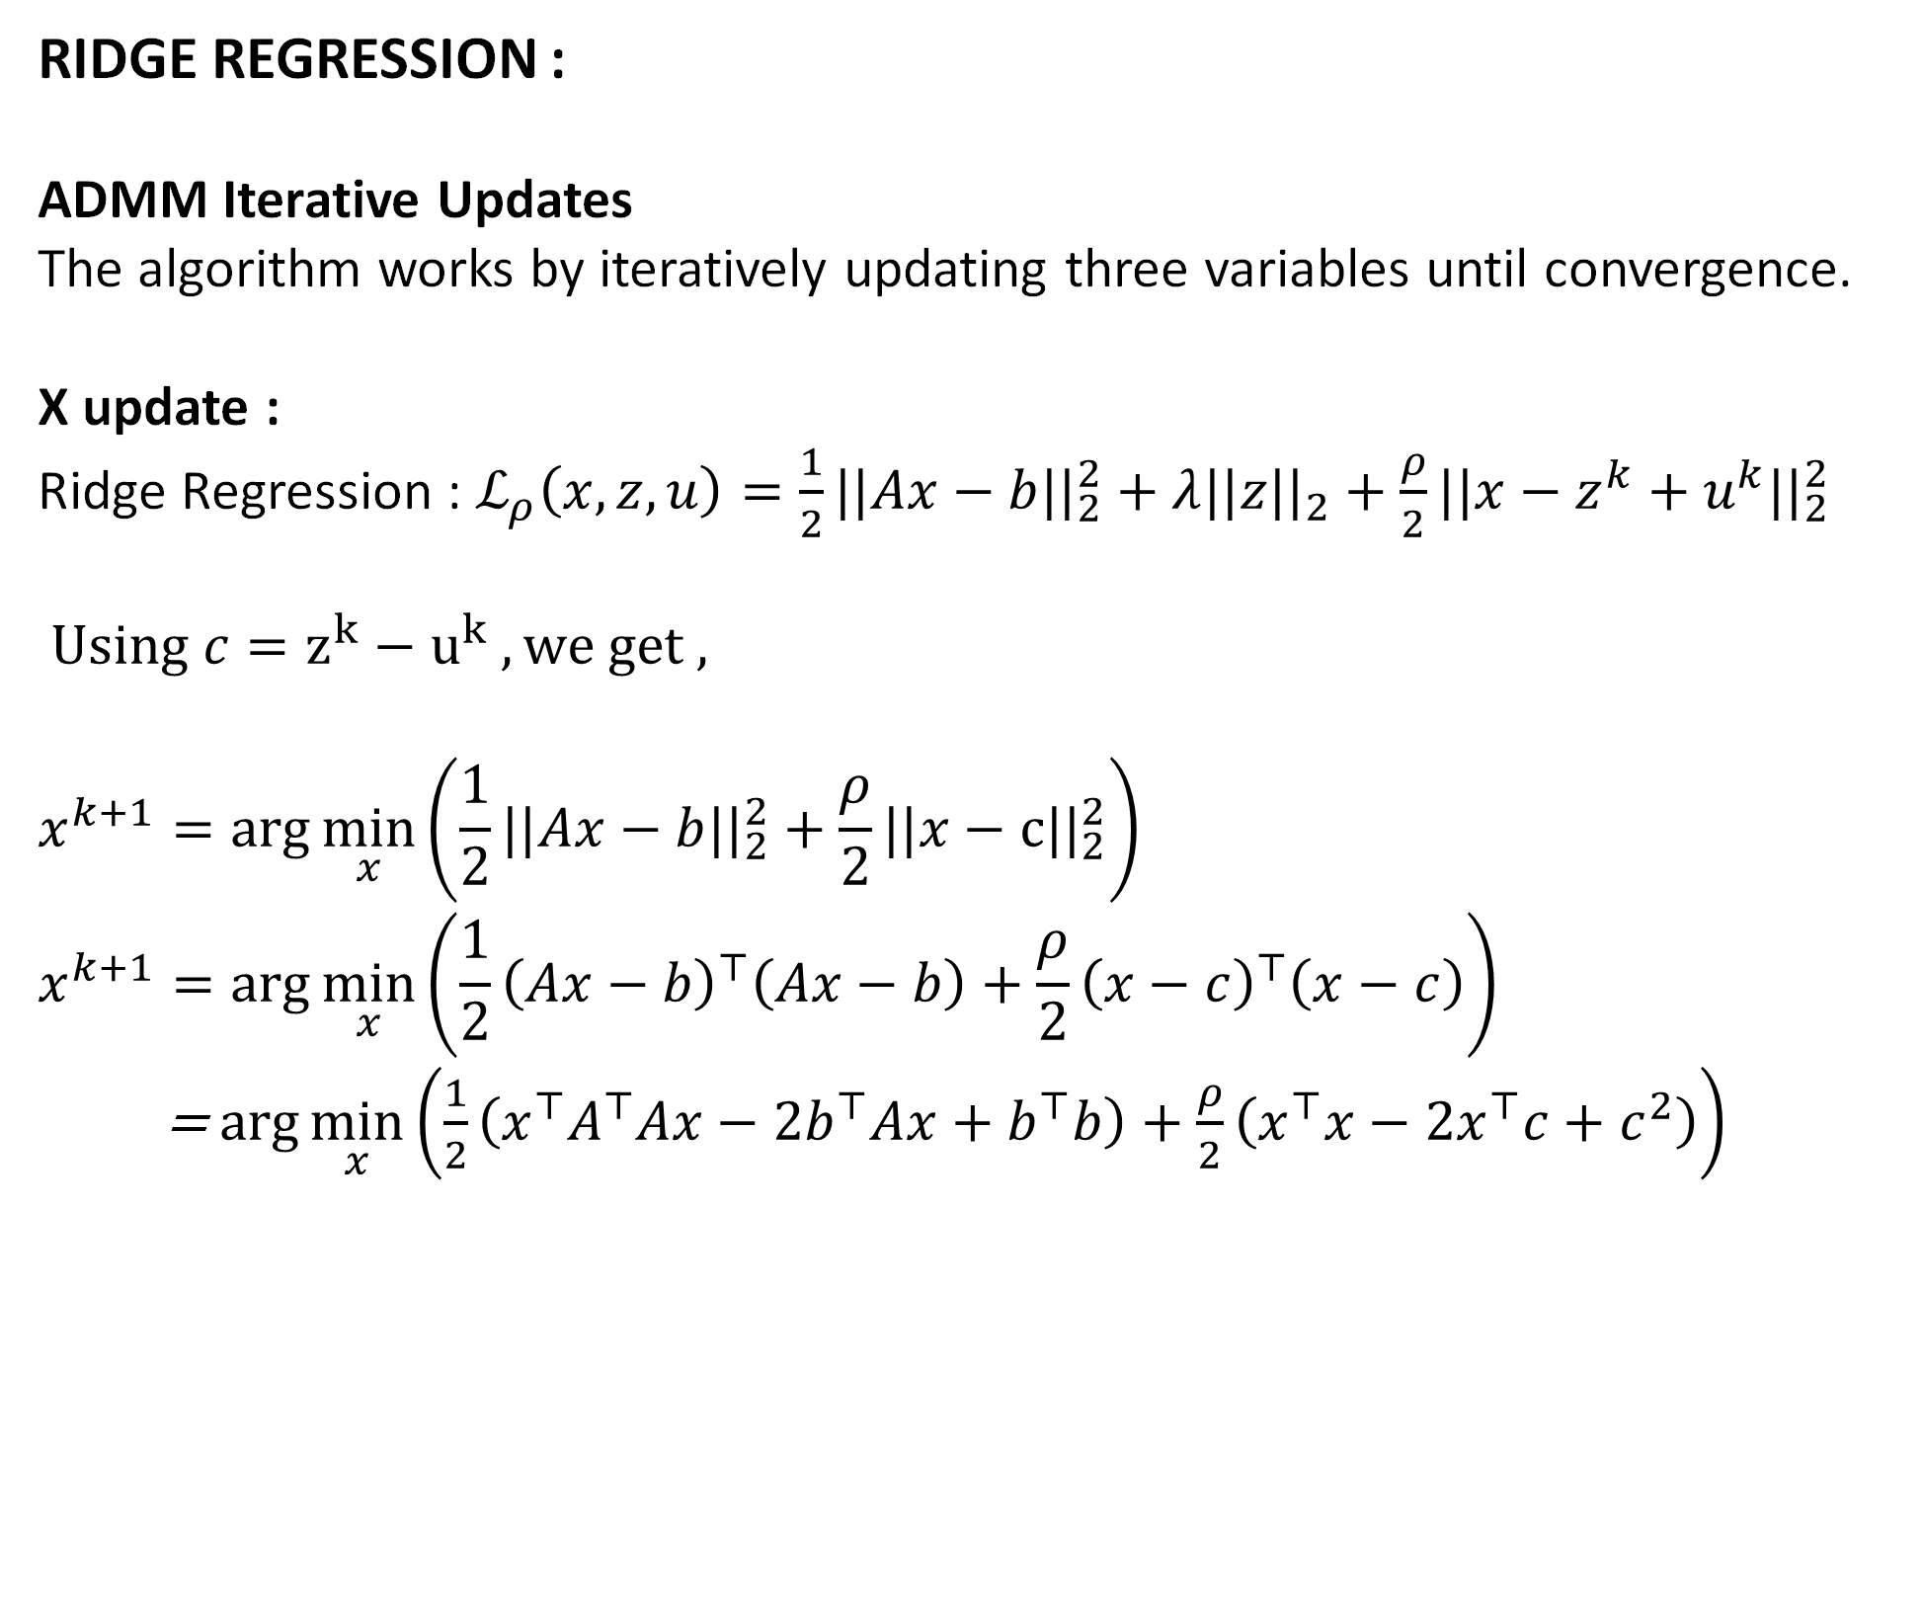
UPDATE EQUATIONS
RIDGE REGRESSION : ADMM Iterative Updates
The algorithm works by iteratively updating three variables until convergence.
X update :
Ridge Regression : $ℒ_{ρ}\left(x,z,u\right)=\frac{1}{2}||Ax−b||_{2}^{2}+λ||z{||}_{2}+\frac{ρ}{2}||x−z^{k}+u^{k}{||}_{2}^{2}$
$Using c=z^{k}−u^{k} , we get ,$
$$x^{k+1}=\arg{\min_{x}\left(\frac{1}{2}||Ax−b{||}_{2}^{2}+\frac{ρ}{2}||x−c||_{2}^{2}\right)}$$
$$x^{k+1}=\arg{\min_{x}\left(\frac{1}{2}{\left(Ax−b\right)}^{⊤}\left(Ax−b\right)+\frac{ρ}{2}{\left(x−c\right)}^{⊤}\left(x−c\right)\right)}$$
= $\arg{\min_{x}\left(\frac{1}{2}\left(x^{⊤}A^{⊤}Ax−2b^{⊤}Ax+b^{⊤}b\right)+\frac{ρ}{2}\left(x^{⊤}x−2x^{⊤}c+c^{2}\right)\right)}$

Slide 15
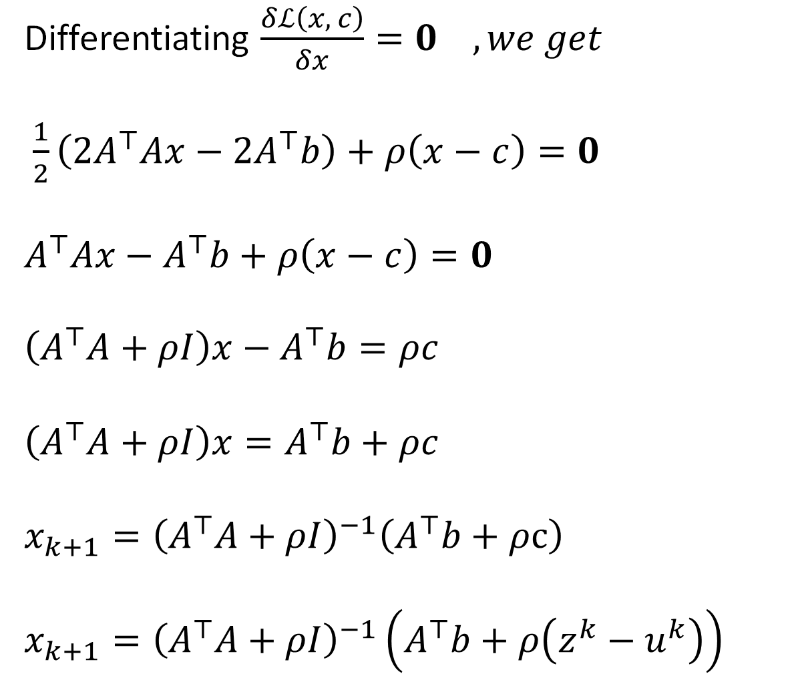
UPDATE EQUATIONS
X Update
Differentiating $\frac{δℒ\left(x, c\right)}{δx}=0 , we get$
$\frac{1}{2}\left(2A^{⊤}Ax−2A^{⊤}b\right)+ρ\left(x−c\right)=0$
$$A^{⊤}Ax−A^{⊤}b+ρ\left(x−c\right)=0$$
$$\left(A^{⊤}A+ρI\right)x−A^{⊤}b=ρc$$
$$\left(A^{⊤}A+ρI\right)x=A^{⊤}b+ρc$$
$$x_{k+1}={\left(A^{⊤}A+ρI\right)}^{−1}\left(A^{⊤}b+ρc\right)$$
$$x_{k+1}={\left(A^{⊤}A+ρI\right)}^{−1}\left(A^{⊤}b+ρ\left(z^{k}−u^{k}\right)\right)$$

Slide 16
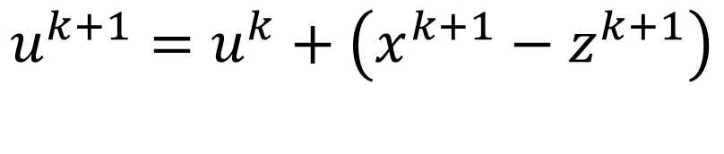
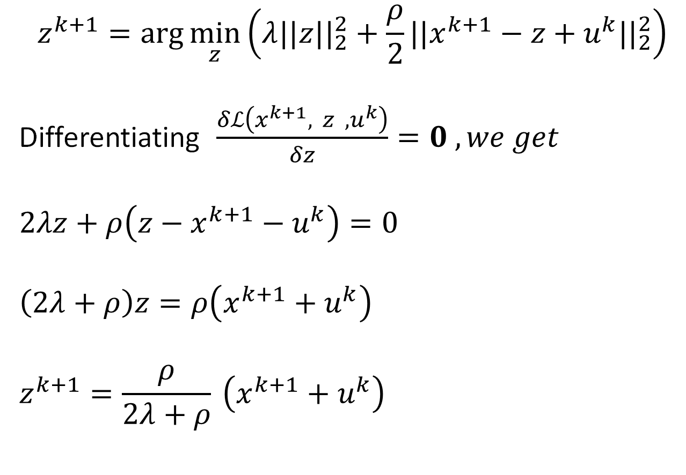
UPDATE EQUATIONS
Z Update
U Update
$$z^{k+1}=\arg{\min_{z}\left(λ||z||_{2}^{2}+\frac{ρ}{2}|{|x}^{k+1}−z+u^{k}||_{2}^{2}\right)}$$
Differentiating $\frac{δℒ\left(x^{k+1}, z ,u^{k}\right)}{δz}=0 , we get$
$$2λz+ρ\left(z−x^{k+1}−u^{k}\right)=0$$
$$\left(2λ+ρ\right)z=ρ\left(x^{k+1}+u^{k}\right)$$
$$z^{k+1}=\frac{ρ}{2λ+ρ} \left(x^{k+1}+u^{k}\right)$$
$$u^{k+1}=u^{k}+\left(x^{k+1}−z^{k+1}\right)$$

Slide 17
Why do we need Elastic Regression
Each method alone has limits :
Lasso can fail when features are highly correlated (it randomly picks one).
Ridge keeps all features but doesn’t zero out any (no feature selection).
Elastic Net fixes both :
Keeps the stability of Ridge,
Keeps the sparsity (feature selection) of Lasso.
Elastic Net combines both pushes — a little smooth pull (Ridge) + a little snapping (Lasso) → Result: a balanced, powerful model
Elastic Net = Lasso + Ridge combo.
It keeps important features (like Lasso) and stays stable (like Ridge)

Slide 18
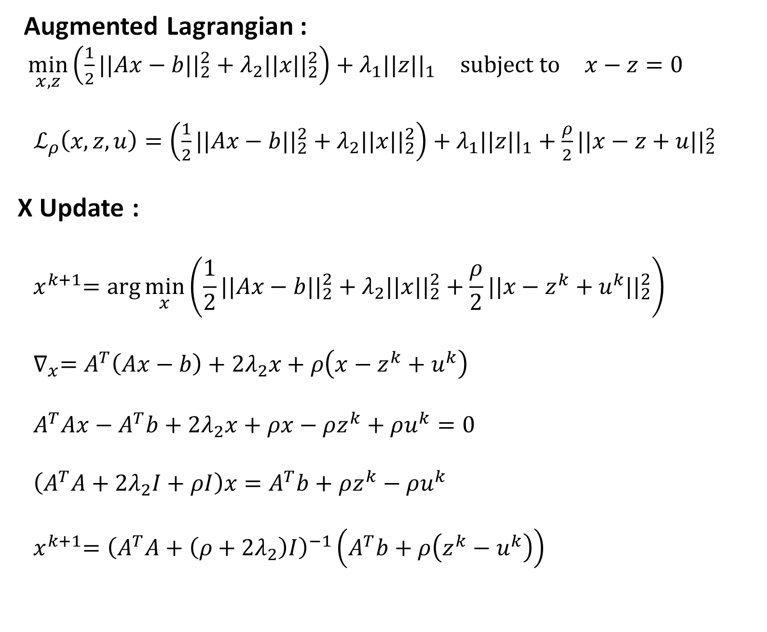
UPDATE EQUATIONS
Augmented Lagrangian :
$\min_{x,z}\left(\frac{1}{2}||Ax−b||_{2}^{2}+λ_{2}||x||_{2}^{2}\right)+λ_{1}||z||_{1} \text{subject} \text{to} x−z=0$
$ℒ_{ρ}\left(x,z,u\right)=\left(\frac{1}{2}||Ax−b||_{2}^{2}+λ_{2}||x{||}_{2}^{2}\right)+λ_{1}||z||_{1}+\frac{ρ}{2}||x−z+u||_{2}^{2}$
X Update :
$${ x}^{k+1}=\arg{\min_{x}\left(\frac{1}{2}||Ax−b||_{2}^{2}+λ_{2}||x||_{2}^{2}+\frac{ρ}{2}||x−z^{k}+u^{k}{||}_{2}^{2}\right)}$$
$${ ∇}_{x}=A^{T}\left(Ax−b\right)+2λ_{2}x+ρ\left(x−z^{k}+u^{k}\right)$$
$${ A}^{T}Ax−A^{T}b+2λ_{2}x+ρx−ρz^{k}+ρu^{k}=0$$
$$\left(A^{T}A+2λ_{2}I+ρI\right)x=A^{T}b+ρz^{k}−ρu^{k}$$
$${ x}^{k+1}={\left(A^{T}A+\left(ρ+2λ_{2}\right)I\right)}^{−1}\left(A^{T}b+ρ\left(z^{k}−u^{k}\right)\right)$$
ELASTIC NET REGRESSION :
Which is combination of both Lasso & Ridge Regression ADMM Iterative Updates
The algorithm works by iteratively updating three variables until convergence.

Slide 19
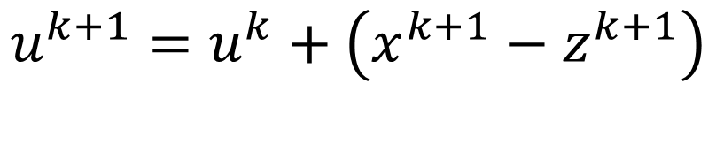

UPDATE EQUATIONS
Z Update :
$$z^{k+1}=\arg{\min_{z}\left(λ_{1}||z||_{1}+\frac{ρ}{2}||x^{k+1}−z+u^{k}||_{2}^{2}\right)}$$
$$\text{Let} v^{k}=x^{k+1}+u^{k}$$
$$z^{k+1}=S_{κ}\left(x^{k+1}+u^{k}\right)$$
$$z_{i}^{k+1}= sign\left(v_{i}^{k}\right)⋅\max\left(0,\left|v_{i}^{k}\right|−\frac{λ_{1}}{ρ}\right)$$
$where S_{κ}\left(v\right)$ is the Soft Thresholding operator where $κ=\frac{λ_{1}}{ρ}$
$z_{i}^{k+1}= sign\left(v_{i}^{k}\right)⋅\max\left(0,\left|v_{i}^{k}\right|−κ\right)$
U Update
$$u^{k+1}=u^{k}+\left(x^{k+1}−z^{k+1}\right)$$

Slide 20

RESIDUALS
Residual Equations
$$r^{k}=x^{k}−z^{k}$$
$$s^{k}=ρ\left(z^{k}−z^{k−1}\right)$$
We will get to know about the convergence by checking both the residual norm and dual norm are less than tolerance value.

Slide 21
Dataset Description
Dataset Description
General Info
Dataset Source: Melbourne Housing Market
Dataset Link: Kaggle - Melbourne Housing Dataset
Use Case: House price prediction using Lasso & Ridge Regression (with ADMM) Dataset Features:
Features :21
Instances : 13579
Typical features available: Suburb, Address, Rooms, Type, Price, Method, SellerG, Date, Distance, Postcode, Bedroom2, Bathroom, Car, Landsize, BuildingArea, YearBuilt, CouncilArea, Lattitude, Longtitude, Regionname, etc.

Slide 22
Feature Name | Datatype | Description
Suburb | String | Tells us the locality of house , like Abbotsford, Airport West, Albert Park, Alphington..
Address | String | Address of each house (unique to each house)
Rooms | Integer | No of room ( Min: 1, Max: 10,)
Type | String | Type of House : h (house), u (unit/duplex), t (townhouse)
Price (Target) | Integer | Price in Australian Dollars Min: 85,000 → Max: 9,000,000, Mean ≈ 1,075,684
Method | String | Sales Method: S (sold), SP (sold prior), PI (passed in), PN → Sold Prior, Price Not Disclosed SN → Sold, Price Not Disclosed NB → No Bid VB → Vendor Bid (bid made by seller at auction, not genuine) W → Withdrawn prior to auction SA → Sold After Auction SS → Sold After Auction, Price Not Disclosed N/A → Price or highest bid not available
SellerG | String | Examples: Biggin, Nelson, Jellis, Ray, Hocking, … (many agents)
Date | date/Time | Range: 2016 – 2018 (format: dd/mm/yyyy)
Distance | Integer | Min: 0, Max: ~50 km from CBD(Melbourne’s Central Business District)

Slide 23
FEATURE | Datatype | Description
Postcode | Integer | Range: ~3000–3999 (Melbourne postcodes)
Bedroom2 | Integer | No of Bedrooms : Min: 0, Max: 20
Bathroom | Integer | Min: 0, Max: 8
Car | Integer | Min: 0, Max: 10 (car spots)
Landsize | Integer | Min: 0, Max: 43,650 m² (large land parcels)
BuildingArea | Integer | Min: 0, Max: ~44515 m²
Council Area | String | Examples: Yarra, Darebin, Boroondara, Moreland
YearBuilt | Integer | Range: 1196 – 2018 (mostly 1800s–2000s)
Latitude | Integer | Range: -38.18 to -37.40
Longitude | Integer | Range: 144.40 to 145.53
RegionName | String | Examples: Northern Metropolitan, Western Metropolitan, Southern Metropolitan, …
Property Count | Integer | Min: 83, Max: 21650 (properties in a suburb)

Slide 24
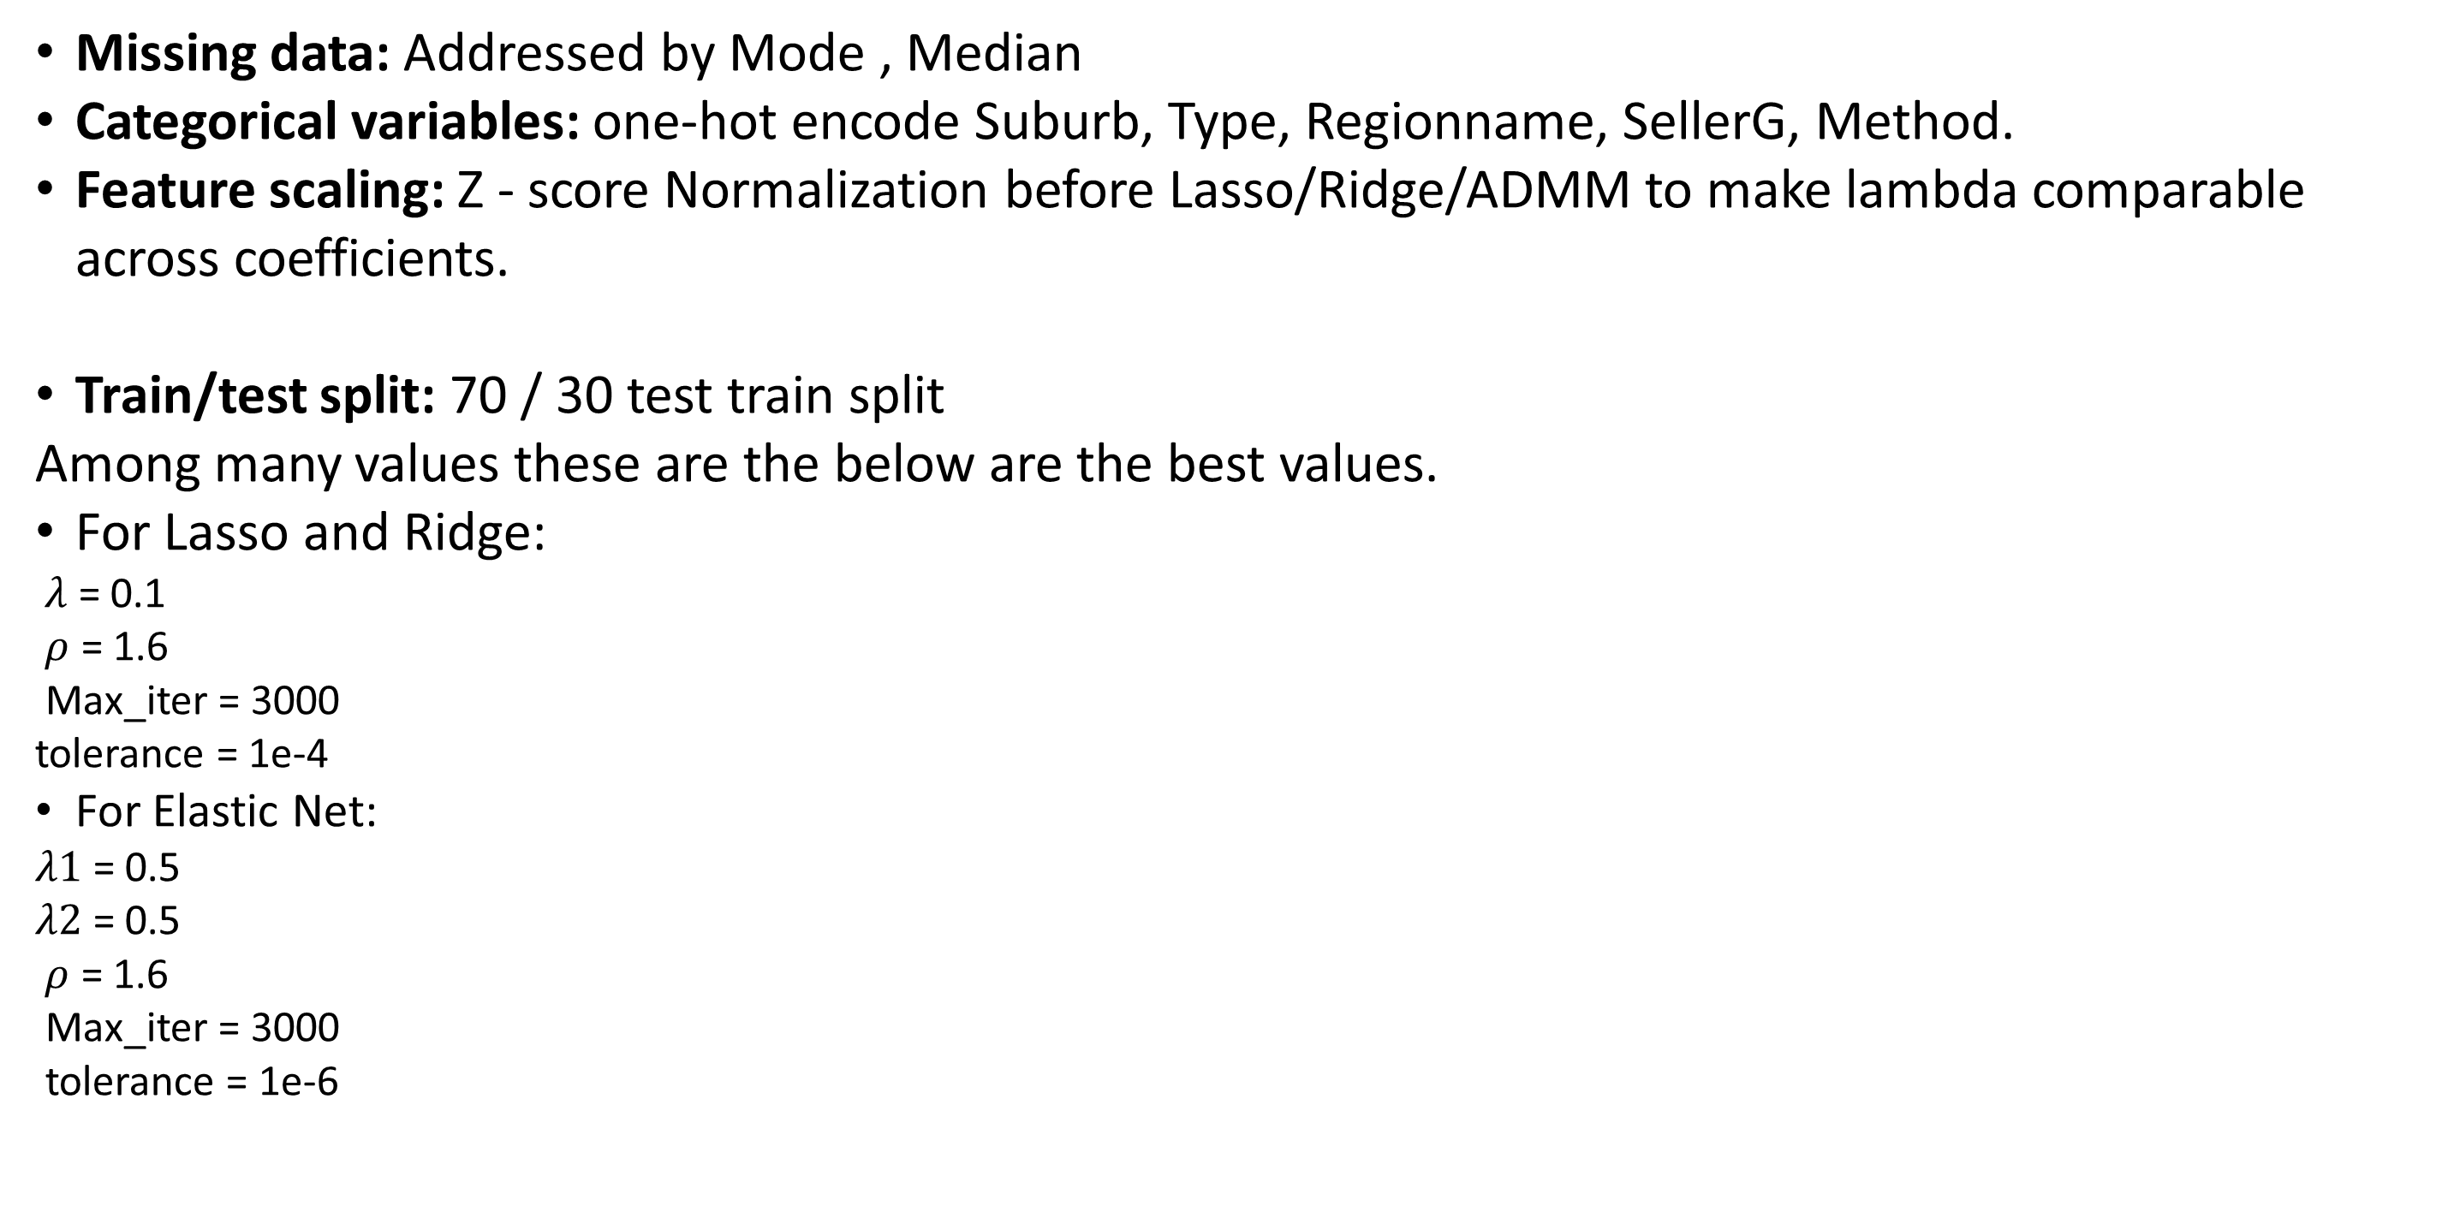
COMPUTATIONAL DETAILS
Missing data: Addressed by Mode , Median
Categorical variables: one-hot encode Suburb, Type, Regionname, SellerG, Method.
Feature scaling: Z - score Normalization before Lasso/Ridge/ADMM to make lambda comparable across coefficients.
Train/test split: 70 / 30 test train split
Among many values these are the below are the best values.
For Lasso and Ridge:
$λ$ = 0.1​
$ρ$ = 1.6​
Max_iter = 3000 ​
tolerance = 1e-4
For Elastic Net:
$λ1$ = 0.5
$λ2$ = 0.5
$ρ$ = 1.6​
Max_iter = 3000 ​
tolerance = 1e-6
​
​

Slide 25
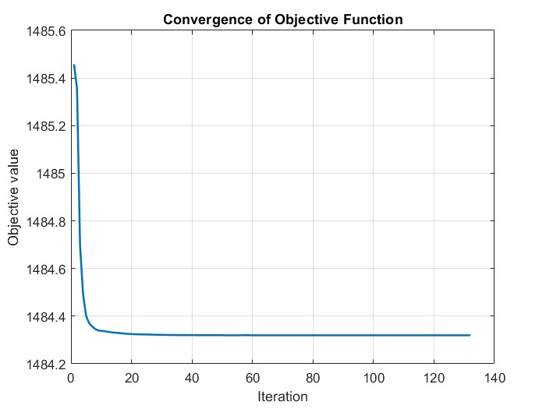
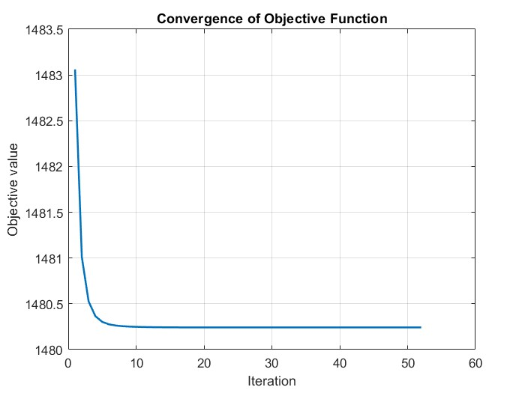
RESULTS
Lasso Regression
Ridge Regression​

Slide 26
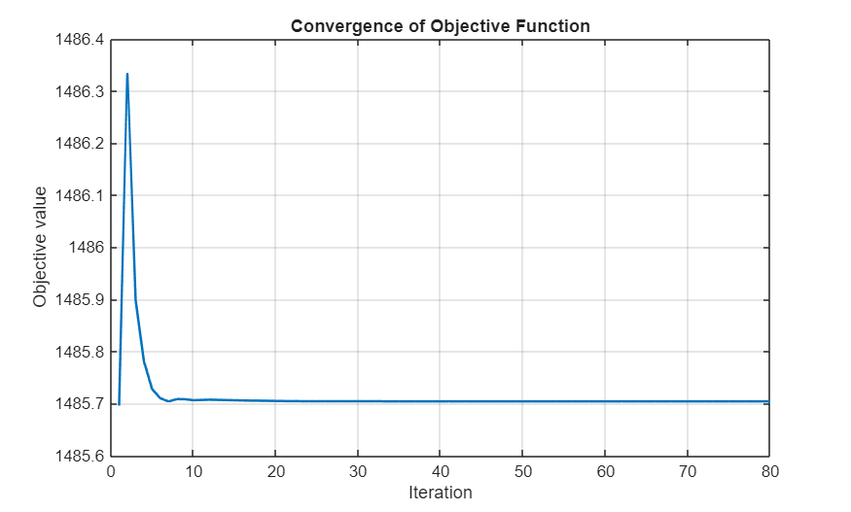
RESULTS
Elastic Net Regression

Slide 27
Results comparision of ADMM & Scikit-Learn
Model | RMSE | MAE
LASSO Regression using Scikit-Learn | 0.7589 | 0.5249
Ridge Regression using Scikit-Learn | 0.7226 | 0.3916
Elastic Net Regression using Scikit-Learn | 0.6763 | 0.4422
LASSO Regression using ADMM | 0.72265 | 0.39014
Ridge Regression using ADMM | 0.72156 | 0.38964
Elastic Net Regression using ADMM | 0.72167 | 0.38981

Slide 28
REFERENCES
[1] Shingne, H., Sountharrajan, S., Karthiga, M. and Rajan, C., 2020. Lasso and Ridge Regression for Optimized Resource Allocation In Cloud Computing. Journal of Advanced Research in Dynamical and Control Systems, 12, pp.1740-1747.
[2]. M. Hong and Z.-Q. Luo, “On the linear convergence of the alternating direction method of multipliers,” Mathematical Programming, vol. 162, no. 1, pp. 165–199, 2017.
[3] P. Sulc, S. Backhaus, and M. Chertkov, “Optimal distributed control of ˇ reactive power via the alternating direction method of multipliers,” IEEE Transactions on Energy Conversion, vol. 29, no. 4, pp. 968–977, 2014
[4] V. S. Swarna, M. and K. P. Soman., “Effect of dimensionality reduction on sparsity based hyperspectral unmixing. international conference on soft computing and pattern recognition. springer, cham, 2016.”
[5] https://www.kaggle.com/datasets/dansbecker/melbourne-housing-snapshot

Slide 29

THANK YOU

