Slide 1

A Web-Based Keylogger
A Web-Based Keylogger
Under the Guidance of Mrs.MOUNIKA
Presented By
Kishore D , Manoj kumar M, Nithin kumar R

Slide 2
Abstract
A web-based keylogger designed to capture a user keystrokes on websites. when Victim Visits a Attacker's Malicious Site and Enter any Juicy Informations such as Passwords , Pin, Credit Card Numbers , Debit Card Numbers , etc.. In a Keylogger a PHP and JavaScript Code for covertly transmitting the intercepted keystrokes to an attacker-controlled server(NGROK) via POST requests. Additionally, the system saves a log of captured keystrokes in a local text file on the attacker's system.

Slide 3
Existing System
The existing model of the current problem statement is the traditional style of
transferring data using keylogger is very costly and not for the small purpose However ,
we have keylogger which is basically used for monitoring payments and, PINs, and
passwords as a result. Without drawing the user's attention. A hardware keylogger
is a device that connects your keyboard to your computer. Keyloggers can be connected directly to the keyboard and the computer through manually using one of two approaches.
PS/2 and the USP keylogger are two examples

Slide 4
Proposed System
We can construct software keyloggers instead of physical keyloggers to solve the above-mentioned problem. The proposed model offers a technique that alleviates the challenges of installing the keylogger in the target system. Because software keyloggers can be deployed remotely and do not require physical access to the target system, they are very popular. The proposed software is capable of installing itself in a targeted system when the user, for example, clicks on a malicious link sent to him via email or social media, and then captures all of the user's keystrokes while logged into the system, saves the logs in a folder, or sends

Slide 5
Modules
Capturing Keystrokes
Sending Captured Keystrokes
Storing Data in Attacker’s Machine
Admin Panel
Getting User’s current Location
Sending Captured Loaction Data
Firebase Authentication

Slide 6
Modules Description
1. Capturing Keystrokes
A keylog.js file typically refers to a JavaScript file that is designed to log keystrokes made by users on a webpage. This type of file can be used for various purposes, including user behavior analytics, debugging, or even malicious activities like capturing sensitive information such as passwords or credit card details without the user’s knowledge.

Slide 7
2.Sending Captured Keystrokes:
The script can handle various types of HTTP requests (e.g., GET, POST) sent from client-side applications or web browsers. It might extract data from these requests, validate it, and then use it to perform specific actions, such as updating a database, retrieving information, or sending a response back to the client.

Slide 8
3.Storing Keystrokes in Attacker’s Machine:
The PHP script may receive file uploads from users through HTTP requests, and then perform actions such as saving the files to a server directory, processing them in some way, or storing file metadata in a database.
4.Admin Module:
A website admin page module is a tool for administrators to manage users, content, settings, security, analytics, backups, updates, and communication from a centralized dashboard.

Slide 9
5. Getting User’s current Location:
The "getmylocation.js" JavaScript code module is designed to surreptitiously monitor the location of victims accessing a webpage. By leveraging browser geolocation APIs, this module retrieves the precise geographic coordinates of the user's device without their knowledge or consent. Through unobtrusive integration within the webpage, the module initiates a request to obtain the user's current location silently in the background, without alerting them to the monitoring activity. Once the coordinates are acquired, the module can transmit this sensitive information to a predefined endpoint controlled by the attacker. This data transmission occurs seamlessly via HTTP GET requests, enabling the attacker to remotely access and track the victim's movements in real-time.

Slide 10
7.Storing Captured Location data:
The module responsible for sending location data via POST request plays a crucial role in facilitating the covert transmission of victim location information to the attacker's server. Upon successfully retrieving the geographic coordinates of the victim's device using JavaScript, the module securely packages this sensitive data into an HTTP POST request payload. Through the use of encryption and secure communication protocols, such as HTTPS, the module ensures the confidentiality and integrity of the transmitted location information. The POST request is then directed to a predefined endpoint hosted on the attacker's server, where a PHP handler awaits to receive and process the incoming data. The PHP handler validates and sanitizes the received location data, preventing any potential tampering or unauthorized access.

Slide 11
7.Firebase Authentication
The Firebase Authentication module for your website will enable users to securely sign up, sign in, and manage their accounts. This module will leverage Firebase's robust authentication system, providing various sign-in methods such as email/password, phone number, and social media platforms like Google, Facebook, and Twitter. Users will have the ability to register new accounts, reset passwords, and update their profile information.

Slide 12
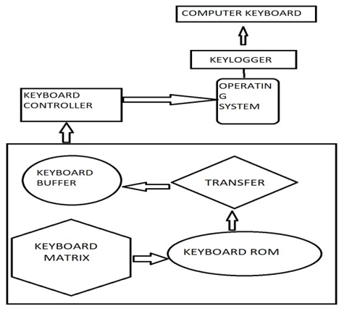





Overall Diagram:
User
Computer
Website
Keylogger
Hacker

Slide 13
SYSTEM SPECIFICATIONS
HARDWARE CONFIGURATIONS
• Processor - i3
• RAM - 4 GB
• Hard Disk - 500GB
SOFTWARE CONFIGURATIONS
• Operating System - Windows
• Server - Apache2
• Front End - HTML,CSS
• Back End - JS,PHP, Firebase( cloud-based NoSQL database)

Slide 14
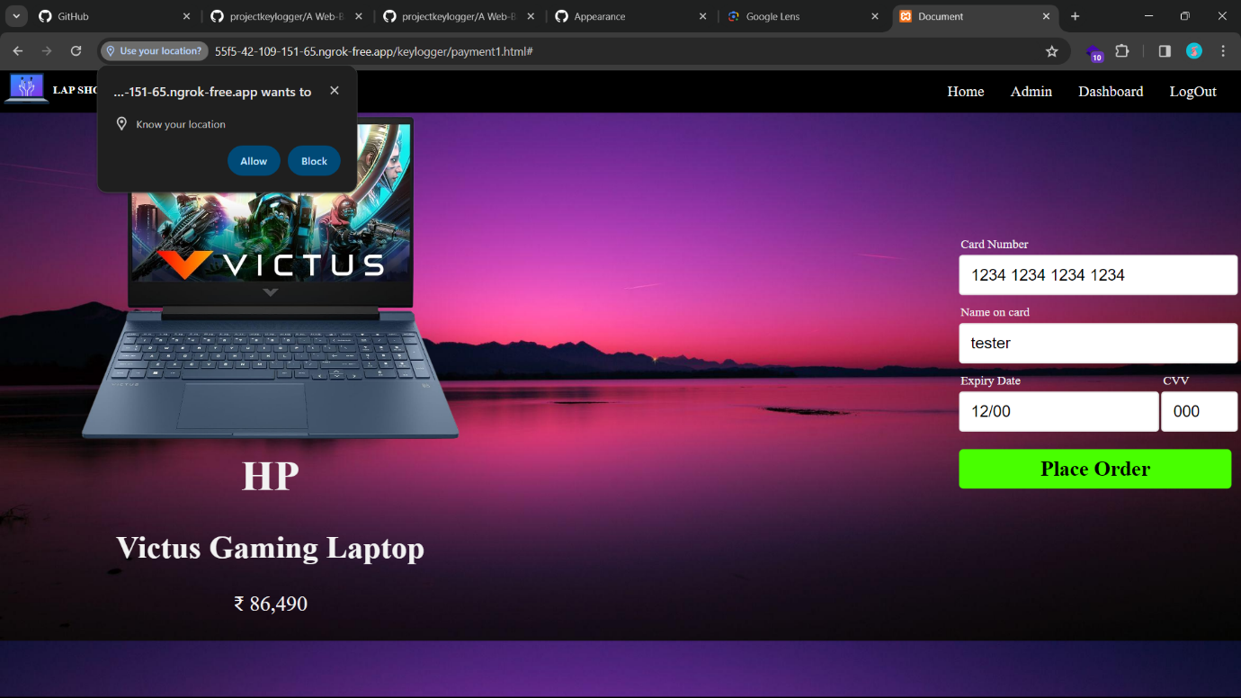
Sample Output:

Slide 15
Future Enhancement:
"In the continuous development of the web-based keylogger project, several avenues for enhancement emerge, spanning functionality, security, and user experience. One significant direction involves implementing advanced encryption protocols to ensure the secure transmission and storage of captured keystrokes, safeguarding sensitive user data from unauthorized access. Additionally, integrating machine learning algorithms could enable the system to intelligently analyze keystroke patterns, distinguishing between normal user input and potentially malicious activities, thereby enhancing detection accuracy and minimizing false positives.

Slide 16
Conclusion:
In conclusion, the culmination of our final year project, centered around the creation of a web-based keylogger, epitomizes the intricate fusion of HTML, CSS, JavaScript, PHP, Ngrok, and XAMPP technologies. Our endeavor traversed the expansive landscape of web development, unraveling the complexities of frontend design, backend functionality, and the integration of diverse frameworks. Through meticulous coding and relentless debugging, we engineered a sophisticated system capable of discreetly logging user keystrokes with precision and efficiency.

Slide 17
ThankingYou…

