Slide 1

A Web-Based Keylogger
A Web-Based Keylogger
Under the Guidance of Mrs.MOUNIKA
Presented By
Kishore , Manoj kumar, Nithin kumar

Slide 2
Abstract
A web-based keylogger designed to capture a user keystrokes on websites. when Victim Visits a Attacker's Malicious Site and Enter any Juicy Informations such as Passwords , Pin, Credit Card Numbers , Debit Card Numbers , etc.. In a Keylogger a PHP and JavaScript Code for covertly transmitting the intercepted keystrokes to an attacker-controlled server(NGROK) via POST requests.
Additionally, the system saves a log of captured keystrokes in a local text file on the attacker's system.

Slide 3
SYSTEM SPECIFICATIONS
HARDWARE CONFIGURATIONS
• Processor - i3
• RAM - 4 GB
• Hard Disk - 500GB
SOFTWARE CONFIGURATIONS
• Operating System - Windows
• Server - Apache2
• Front End - HTML,CSS
• Back End - JS,PHP, Firebase( cloud-based NoSQL database)

Slide 4
Front End
HTML
CSS
Back End
Firebase(cloud-based NoSQL database)
JavaScript
Web Server
NGROK(http)
Apache2

Slide 5
Existing System
The existing model of the current problem statement is the traditional style of
transferring data using keylogger is very costly and not for the small purposeHowever ,
we have keylogger which is basically used for monitoring payments and, PINs, and
passwords as a result. Without drawing the user's attention. A hardware keylogger
is a device that connects your keyboard to your computer. Keyloggers can be connected directly
to the keyboard and the computer through manually using one of two approaches.
PS/2 and the USP keylogger are two examples

Slide 6
Disadvantages of Existing System
Detectability- Physical keyloggers can be detected by users who are
vigilant about checking their hardware for any irregularities.
Physical access required - Installing a physical keylogger requires
physical access to the target device, which may not always be feasible or
practical.
Maintenance - Physical keyloggers may require periodic maintenance
or retrieval of data, which can pose logistical challenges for the attacker.

Slide 7
Proposed System
We can construct software keyloggers instead of physical keyloggers to solve the above-mentioned problem. The proposed model offers a technique that alleviates the challenges of installing the keylogger in the target system. Because software keyloggers can be deployed remotely and do not require physical access to the target system, they are very popular. The proposed software is capable of installing itself in a targeted system when the user, for example, clicks on a malicious link sent to him via email or social media, and then captures all of the user's keystrokes while logged into the system, saves the logs in a folder, or sends

Slide 8
Advantages of Proposed System
Remote Access - Since they operate through a web interface users can
remotely access the keylogger from anywhere with an internet connection.
This allows monitoring of activities on the target device without physical access.
Stealth - Web-based keyloggers can be designed to run silently in the
background without being detected by the user of the target device,
making them effective for covert monitoring.
Real-Time Monitoring - Some web-based keyloggers provide real-time monitoring,
allowing users to view keystrokes and other activities as they occur, providing
instant access to information.

Slide 9
Modules
Capturing Keystrokes
Sending Captured Keystrokes
Storing Data in Attacker’s Machine
Admin Panel
Dashboard
Firebase Authentication

Slide 10
Modules Description
1. Capturing Keystrokes
A keylog.js file typically refers to a JavaScript file that is designed to log keystrokes made by users on a webpage. This type of file can be used for various purposes, including user behavior analytics, debugging, or even malicious activities like capturing sensitive information such as passwords or credit card details without the user’s knowledge.

Slide 11
2.Sending Captured Keystrokes
The script can handle various types of HTTP requests (e.g., GET, POST) sent from client-side applications or web browsers. It might extract data from these requests, validate it, and then use it to perform specific actions, such as updating a database, retrieving information, or sending a response back to the client.

Slide 12
3.Storing Keystrokes in Attacker’s Machine
The PHP script may receive file uploads from users through HTTP requests, and then perform actions such as saving the files to a server directory, processing them in some way, or storing file metadata in a database.

Slide 13
4.Admin Module
A website admin page module is a tool for administrators to manage users, content, settings, security, analytics, backups, updates, and communication from a centralized dashboard.
5.Dashboard
The Dashboard module for the Lap Shopz website serves as the central hub for both administrators and users, providing an intuitive interface for managing orders, products, and user accounts. This module offers comprehensive functionalities tailored to streamline the e-commerce operations of the Lap Shops platform.

Slide 14
6.Firebase Authentication
The Firebase Authentication module for your website will enable users to securely sign up, sign in, and manage their accounts. This module will leverage Firebase's robust authentication system, providing various sign-in methods such as email/password, phone number, and social media platforms like Google, Facebook, and Twitter. Users will have the ability to register new accounts, reset passwords, and update their profile information.

Slide 15
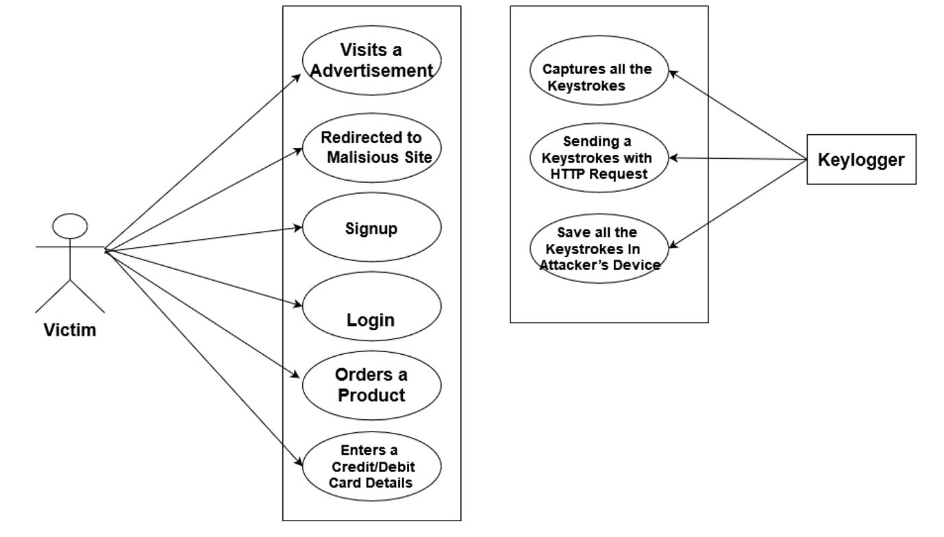
Use Case Diagram For A Web-Based KeyLogger

Slide 16





Overall Design
User
Computer
Website
Keylogger
Hacker

Slide 17
ThankingYou…

