Slide 1
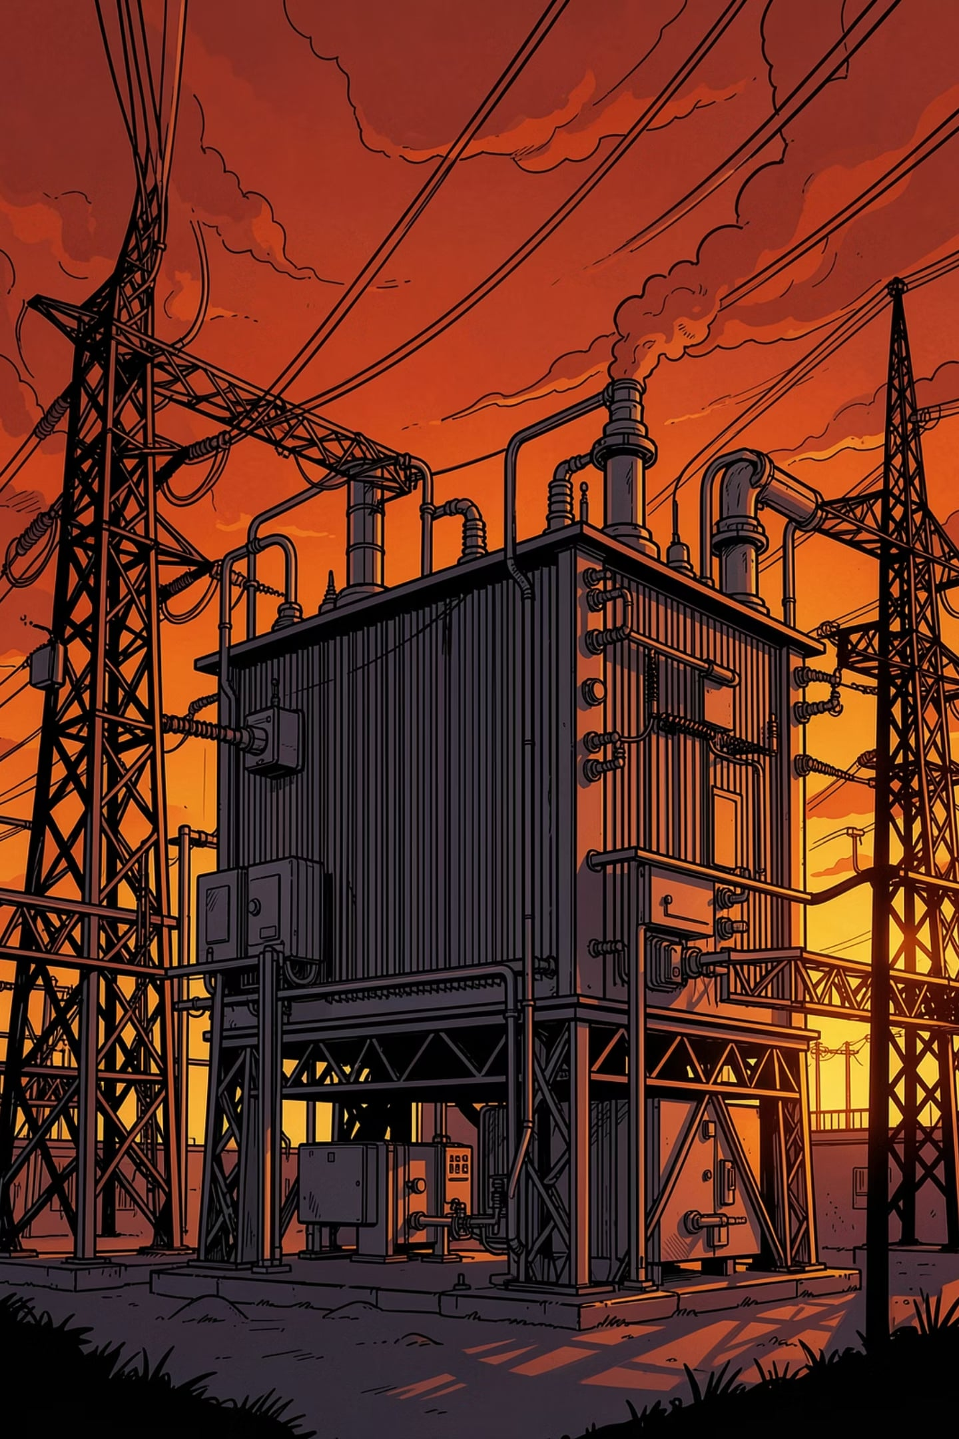
TATA TECHNOLOGIES INNOVENT-27
TRACK 3.2.2.2 — EDGE AI
Edge-Guardian
Autonomous, Physics-Aware Edge AI for Industrial Transformer and Feeder Protection
Co-sponsored by Tata Technologies · AWS · Emerson NI

Slide 2
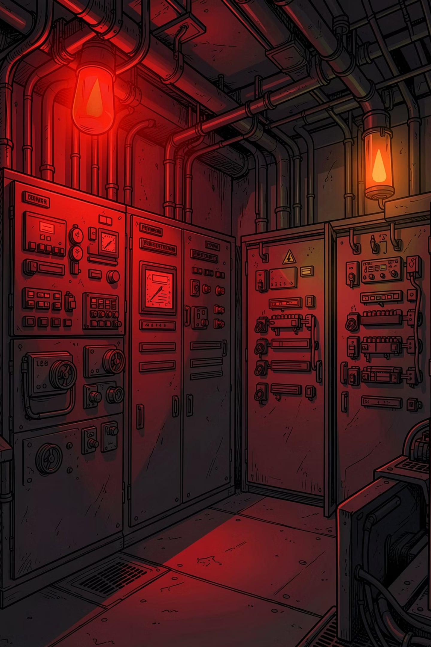

Industrial Power Infrastructure is Flying Blind
India operates 13 million distribution transformers with a 10% annual failure rate — 1.3 million failures every year. Each failure costs industrial facilities 5–10% of monthly revenue. Root causes are detectable weeks in advance — but go undetected because affordable, asset-level monitoring doesn't exist.
Utility-Grade SCADA
Plant Incomer Only
₹2–5 lakh per node — inaccessible to most
Monitoring at plant level, not individual transformers
Cloud Rejected
63M MSMEs Unserved
Air-gapped industrial OT networks reject cloud solutions
Zero transformer monitoring infrastructure

Slide 3
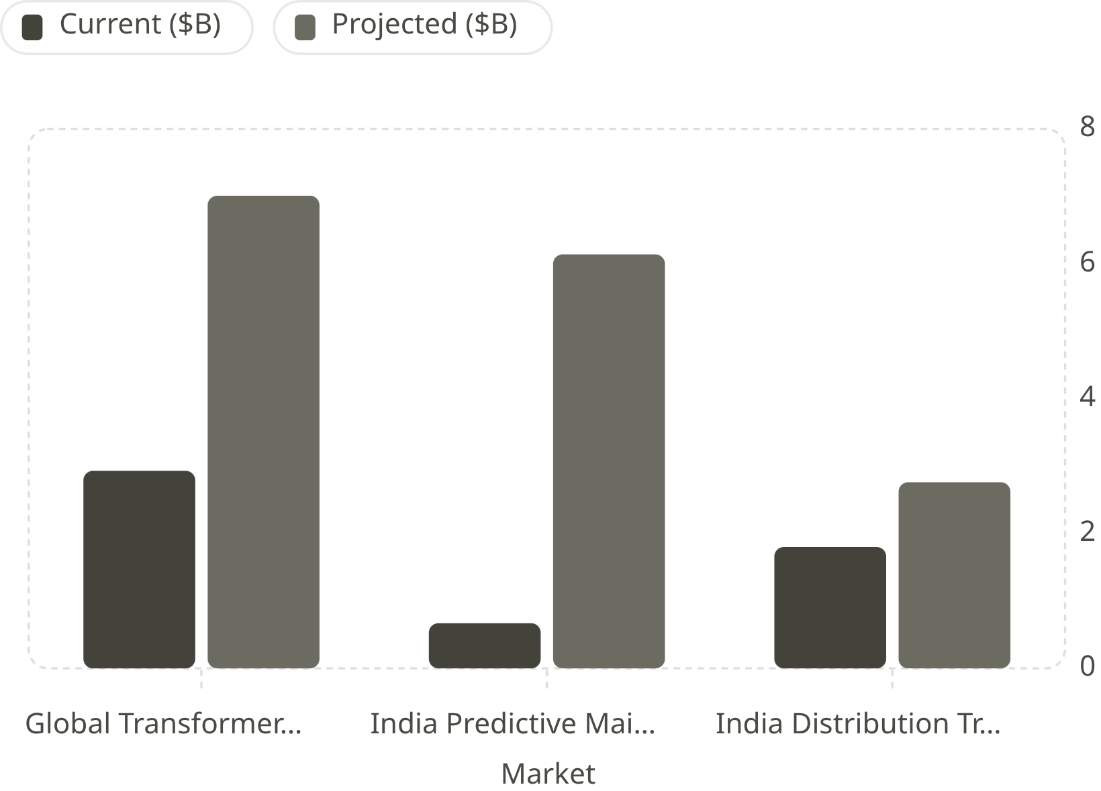
Market Opportunity & Tailwinds
Government Tailwind
RDSS scheme — ₹12,585 crore in FY25. 5 million transformers sanctioned for metering. Peak demand growing 243 GW → 400 GW by 2030.
Sustainability Impact
One unhealthy transformer wastes 71 tonnes CO₂ annually. At 1% market penetration — 923,000 tonnes CO₂ avoided per year.

Slide 4
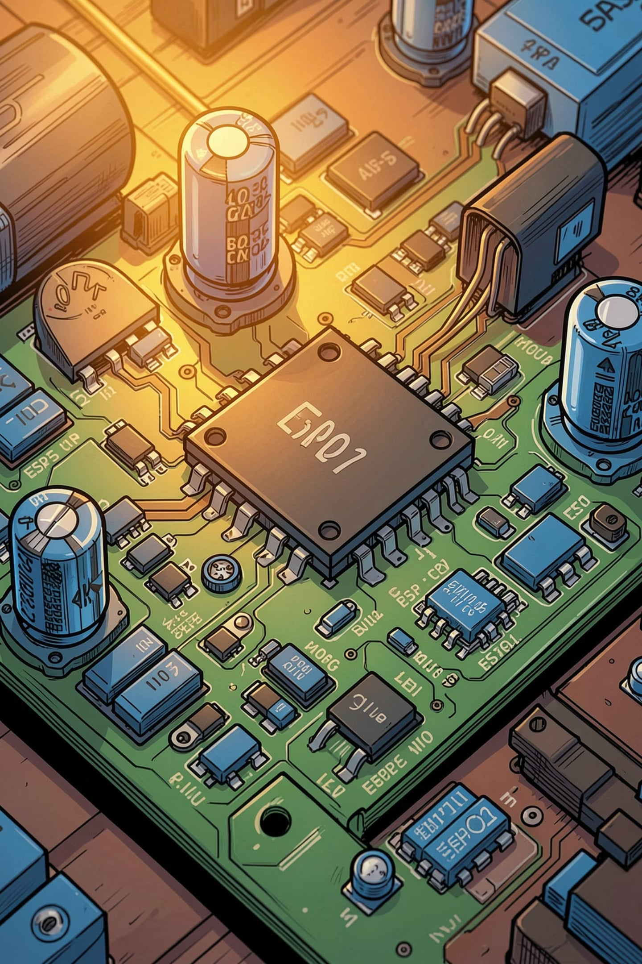
From Reactive Repair to Autonomous Prevention
Build an edge-native, AI-powered transformer health monitoring system that predicts failures weeks in advance, operates without cloud dependency, and costs under ₹2,000 per node.
01
Physics-First Sensing
Dual CT+VT sensors on feeder and secondary compute differential power loss — enabling fault classification, not just alerting.
02
Three-Tier Edge State Machine
Deterministic safety in under 50µs. Physics extraction in milliseconds. TFLite inference every 500ms. AI never touches safety-critical decisions.
03
Physics-Informed ML
Autoencoder trained on synthetic data derived from the same physics equations running in firmware. Fine-tuned on real circuit data after deployment.
04
Agentic Maintenance Loop
LLM agent monitors telemetry continuously, generates work orders autonomously on fault detection, dispatches in under 60 seconds.

Slide 5
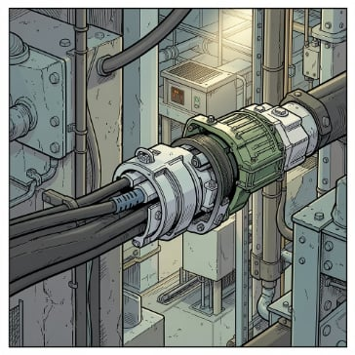
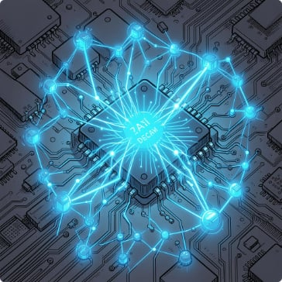
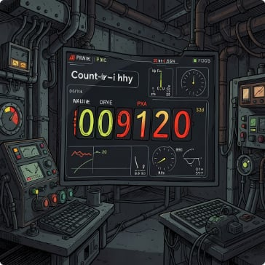
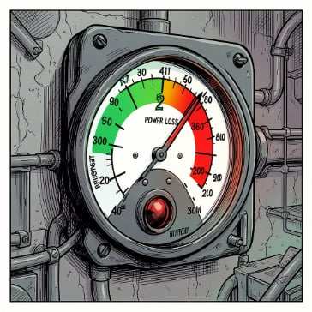
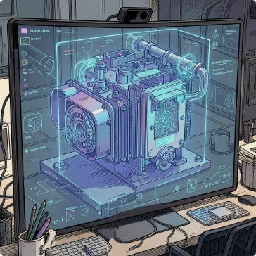

Six Layers of Industrial Intelligence
Edge Monitoring
TinyML Fault Detection
Remaining Useful Life
Energy Loss Analytics
Dual CT+VT sensors, 16-bit ADC, ESP32-S3. Non-invasive clip-on — no rewiring, no shutdown.
TFLite Micro autoencoder on ESP32-S3. Inference under 2ms. Classifies winding degradation, overload, feeder loss, or energy theft.
Thermal regression model estimates hours to critical failure. Live countdown on dashboard. Weeks of advance warning instead of zero.
Real-time differential efficiency reports per node. Displays kWh wasted, ₹ lost, CO₂ emitted — turning invisible waste into a quantified cost line.
Asset Digital Shadow
Agentic Maintenance Assistant
Live virtual representation updated every 500ms. Current state, 7-day health trend, 24-hour predictive projection, full anomaly history.
LLM-powered agent detects fault → reasons about type and urgency → generates work order → dispatches via WhatsApp or email. No human trigger required.

Slide 6
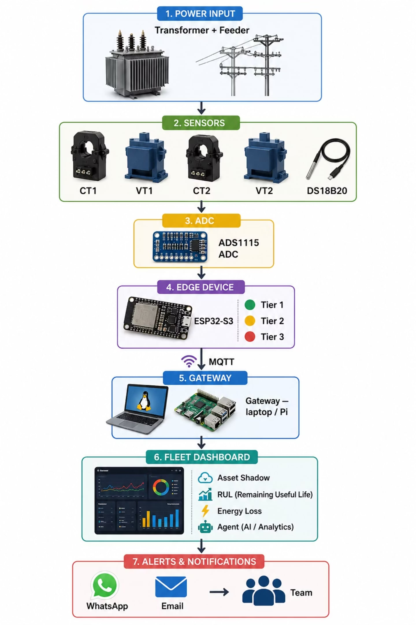


What Makes Edge-Guardian Different
1
2
3
Dual Differential Sensing
Physics-Gated TinyML
Deterministic-AI Hybrid
₹1.5 lakh industrial differential protection relay logic on a ₹400 microcontroller. Sensors at both feeder and secondary classify fault type and location.
Raw data never reaches ML. Deterministic physics engine computes RMS, PF, power, thermal regression first. Model receives a clean 7-value feature vector.
AI architecturally prevented from safety-critical decisions. FreeRTOS mutex enforces core isolation. Mirrors aviation and nuclear safety architecture.
4
5
Agentic Maintenance Loop
Cost Democratisation
LLM agent reasons about fault type, severity, urgency — generates work order — dispatches in under 60 seconds. Fully autonomous.
₹2,000 per node vs ₹2–5 lakh SCADA. 100x cost reduction. First solution priced for India's 63 million MSMEs.

Slide 7

How Edge-Guardian Works
Transformer & Feeder
Fleet Dashboard
Asset shadow, RUL & energy loss
Primary sources of line signals
MQTT to Gateway
Edge-Guardian Data Path
CT & VT Sensors
Publish telemetry securely
Current and voltage sensing
ESP32-S3 (3 Tiers)
ADS1115 ADC
High-resolution digitization
Tier1 rules, Tier2 features, Tier3 TFLite
Three-tier state machine: Tier 1 runs hard physics rules in under 50µs. Tier 2 extracts RMS, power factor, efficiency features in milliseconds. Tier 3 runs TFLite Micro inference every 500ms on Core 1. FreeRTOS mutex enforces core isolation between safety-critical and AI layers.
Component
Role
SCT-013-030 ×2
CT1 feeder / CT2 secondary current
ZMPT101B ×2
VT1 feeder / VT2 secondary voltage
ADS1115
16-bit ADC, I2C 400kHz, 860 SPS
ESP32-S3
Dual-core 240MHz, WiFi, TFLite Micro

Slide 8
Honest Engineering — Challenges & Solutions
ESP32 ADC Non-Linearity
Replaced onboard ADC with external ADS1115 16-bit module for precision measurement.
230V Primary Safety
Open-frame transformer enclosed in sealed project box, RCD adapter on mains input.
Low Sample Rate (200 SPS)
Cross-correlation for power factor instead of zero-crossing detection.
Cross-Core Data Race
FreeRTOS mutex protecting shared FeatureVector struct between cores.
TFLite Model Size on ESP32
INT8 quantisation reducing model to under 50KB for on-device inference.
No Real Fault Data for Training
Physics-informed synthetic data generation from firmware equations.

Slide 9
Edge-Guardian in Action
Hardware BOM finalised, firmware architecture complete, circuit design validated, ML pipeline ready, dashboard architecture defined.
1
Normal Operation
All 3 nodes publishing healthy telemetry. Dashboard shows green health scores 85–95.
2
Fault Injection
Series resistor added to Node 2 secondary — simulates feeder cable resistance increase.
3
Detection
Tier 2 computes rising Eff_Delta. Autoencoder reconstruction error crosses threshold. Anomaly flag = true.
4
Dashboard Response
Node 2 turns red. Health score drops 87 → 43. RUL countdown accelerates. Energy loss spikes.
Agentic Response
5
Agent generates work order in 60 seconds. WhatsApp message received on judge's phone — live.

Slide 10
From One Factory to National Infrastructure
₹2,000
923K
63M
₹1,000Cr
Cost Per Node
Tonnes CO₂ Avoided
MSMEs Unserved
Revenue Potential
100x reduction vs ₹2–5 lakh SCADA alternatives
Annually at just 1% market penetration
Primary market with zero existing monitoring
At RDSS mandate scale of 5 million nodes
"India loses 1.3 million transformers every year to failures that were entirely predictable. Edge-Guardian gives every industrial facility — from a small textile mill in Tirupur to a steel plant in Jamshedpur — the intelligence to see failure coming and act before it arrives. At ₹2,000 per node, this is not a research prototype. It is a deployable solution waiting for scale."

