Slide 1
Fitness buddy- ai agent
CAPSTONE PROJECT
Presented By: Kishore
Student name : Kishorekumar S
College Name : SRM Institute of Science and Technology
Department:Computer Science Engineering

Slide 2
OUTLINE
Problem Statement
Technology used
Wow factor
End users
Result
Conclusion
Git-hub Link
Future scope
IBM Certifications

Slide 3
Problem Statement
Many individuals struggle to maintain a healthy lifestyle due to lack of personalized guidance, time, and credible information. Generic fitness apps often fail to address unique goals, dietary needs, or motivation levels. Fitness Buddy was created to offer AI-driven, personalized fitness and nutrition support that's accessible, adaptable, and easy to use.

Slide 4
Technology used
IBM cloud lite services
Natural Language Processing (NLP)
Retrieval Augmented Generation (RAG)
IBM Granite model

Slide 5
IBM cloud services used
IBM Cloud Watsonx AI Studio
IBM Cloud Watsonx AI runtime
IBM Cloud Agent Lab
IBM Granite foundation model

Slide 6
Wow factors
Powered by advanced AI technologies: IBM Watsonx.ai and Granite Large Language Models
Understands natural language queries for seamless, human-like conversations
Generates personalized workout plans and diet charts tailored to individual goals and preferences
Uses Retrieval-Augmented Generation (RAG) to provide accurate, up-to-date, and trustworthy fitness advice
Adapts to various fitness levels—from beginners to advanced users
Friendly, motivating, and easy-to-understand communication style
Accessible 24/7 for instant guidance and ongoing support
Helps users stay accountable and engaged throughout their wellness journey

Slide 7
End users
Fitness Beginners
Personal Trainers and Coaches
Individuals with Specific Health Goals
Athletes and Fitness Enthusiasts

Slide 8
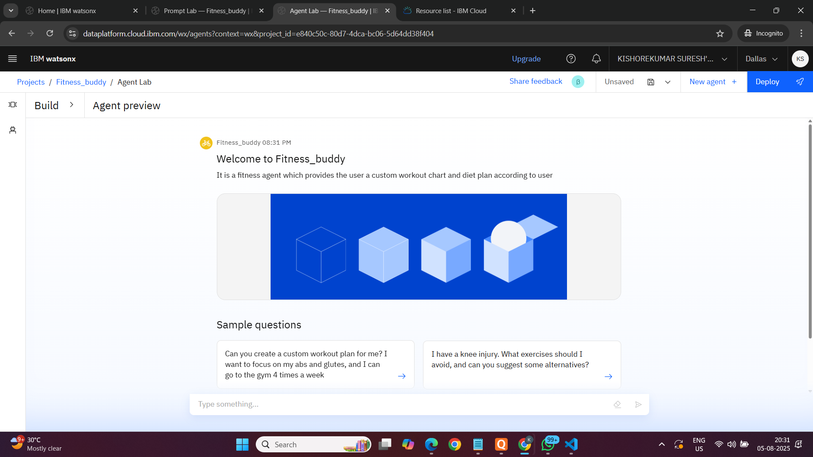
Results

Slide 9
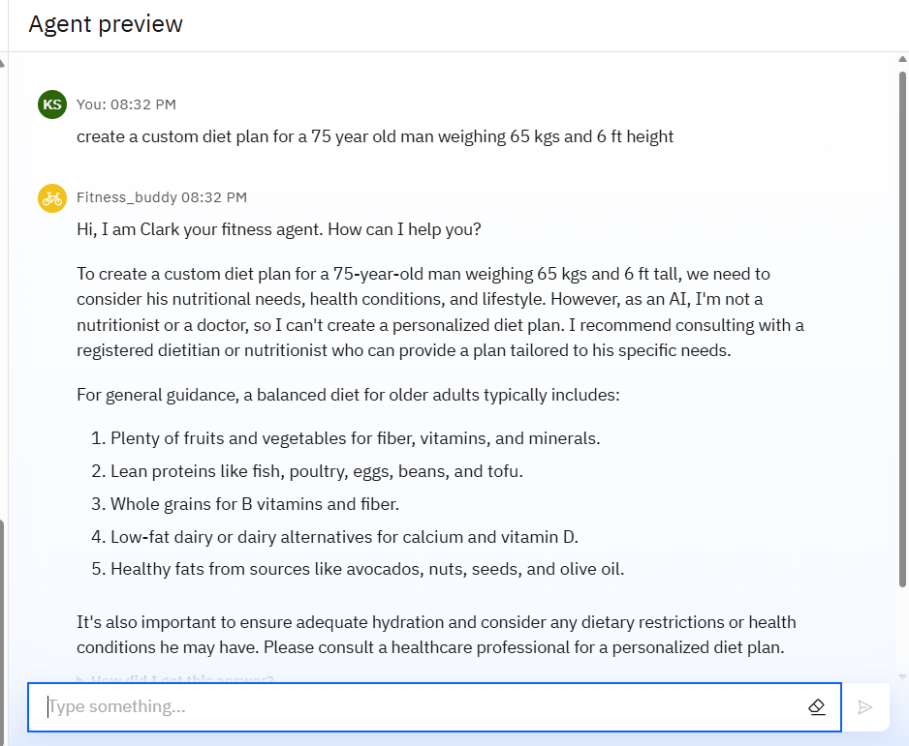
Results

Slide 10
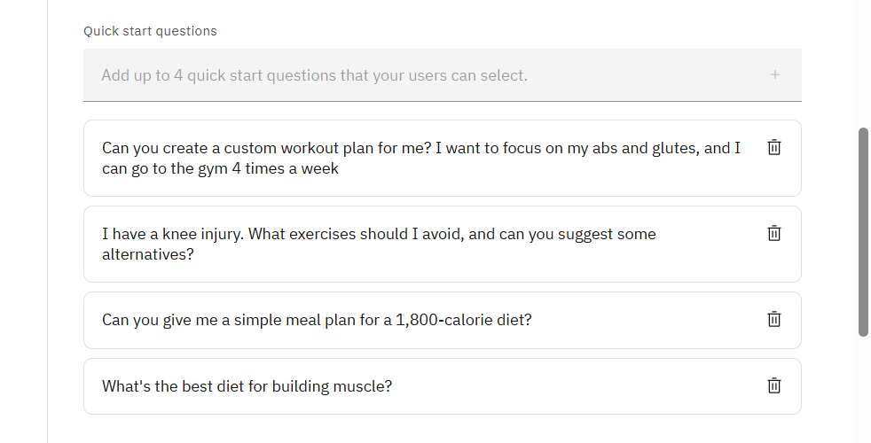
Results

Slide 11
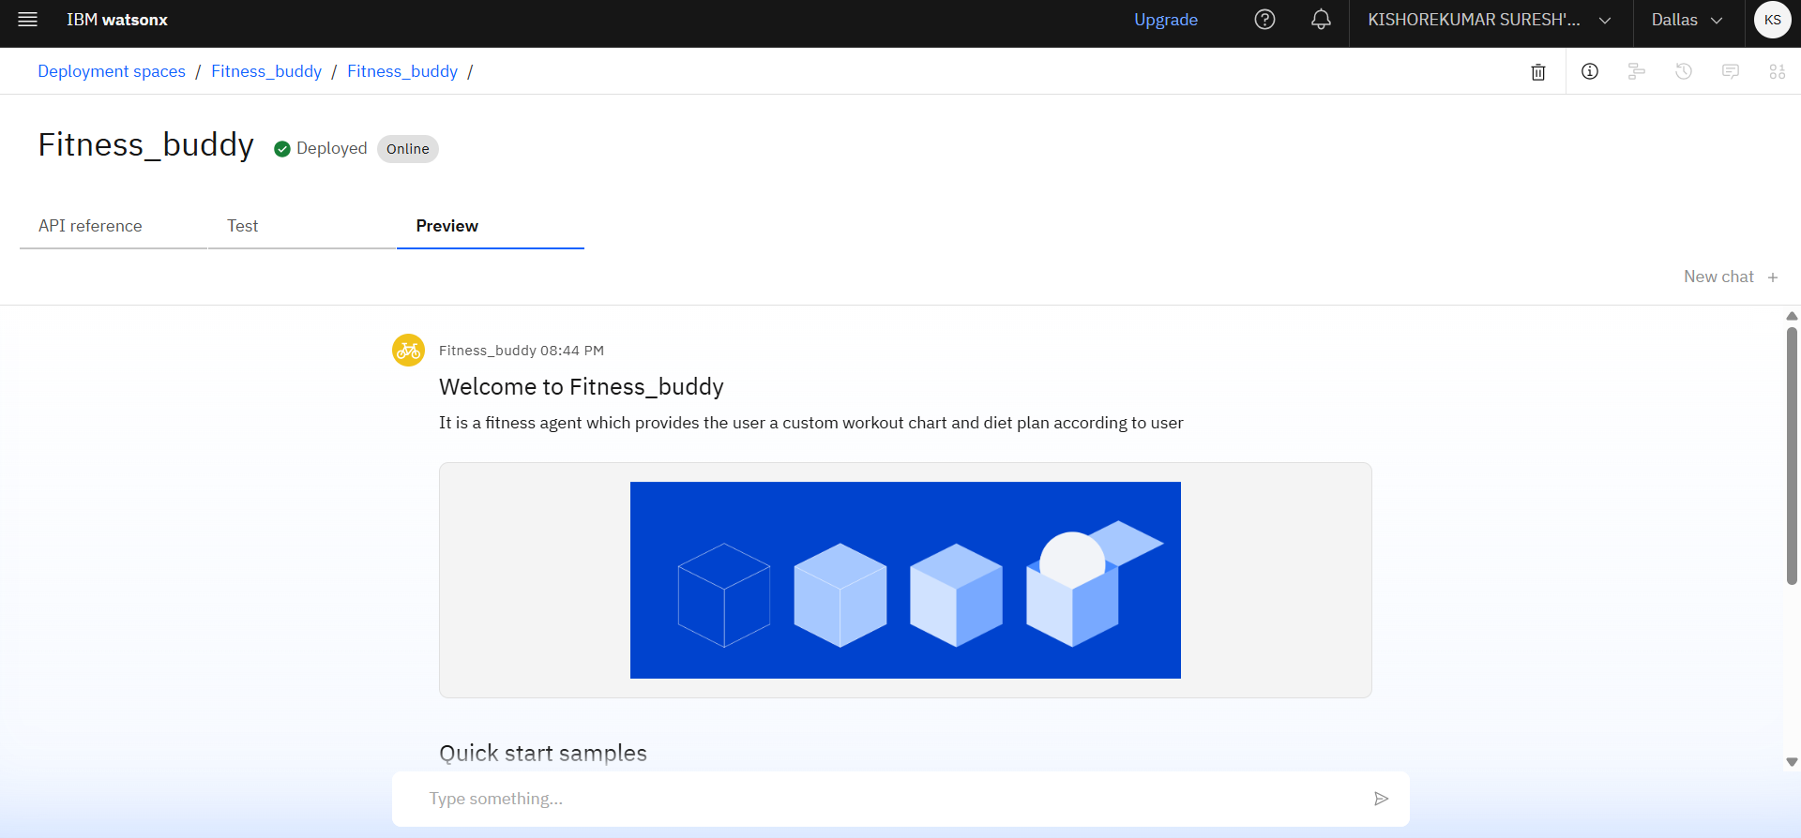
Results
Deployed AI Agent

Slide 12
Conclusion
Empowers users with personalized, AI-driven fitness and nutrition guidance.
Makes healthy living accessible, flexible, and easy for all fitness levels.
Helps build sustainable habits for long-term health and well-being.

Slide 13
Future scope
Multilingual Support Enable interactions in regional and international languages (e.g., Hindi, Spanish, etc.)
Mobile & Web App Integration Launch cross-platform apps with real-time chat and voice support for a smoother user experience.
Progress Tracking & Analytics Introduce weekly/monthly health reports, activity charts, and goal tracking dashboards.
Integration with Wearables Sync with smartwatches and fitness trackers (Fitbit, Apple Watch, etc.) for real-time data input.
Mental Wellness Module Add guided meditation, stress management tips, and sleep tracking features.

Slide 14
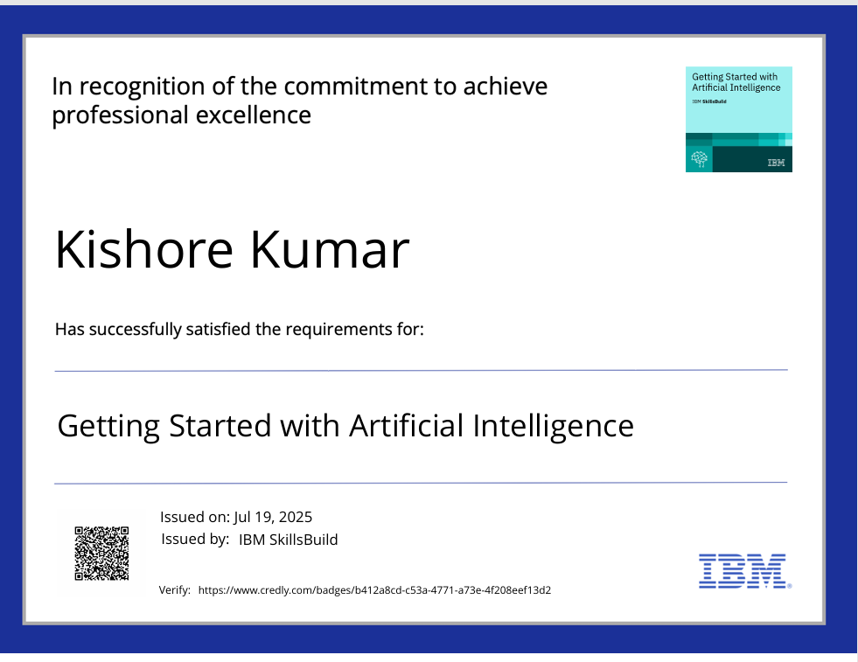
IBM Certifications

Slide 15
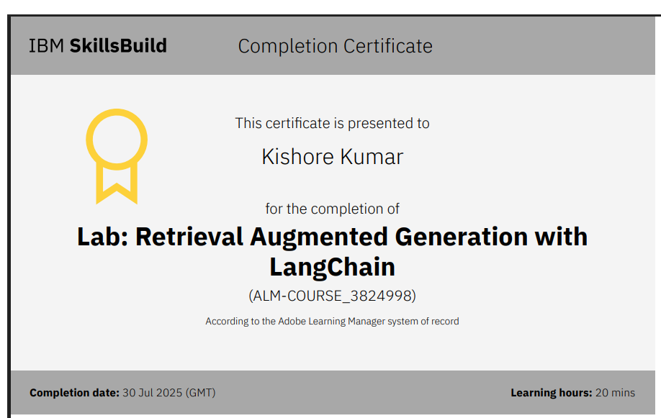

Slide 16
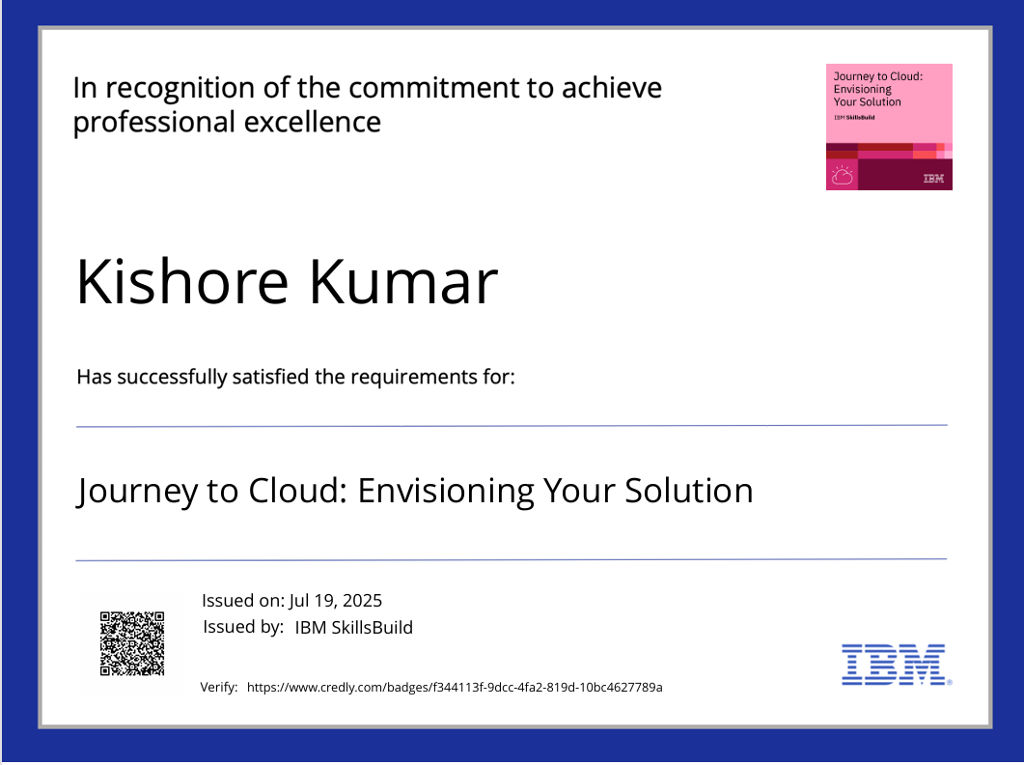

Slide 17
GitHub Link
GITHUB LINK : https://github.com/KishoreKumar1208/fitness_AI_agent

Slide 18
THANK YOU

